Slide 1

Tee Ball Workshop

Slide 2
Topics
Basic Rules
Throwing Mechanics
Catching
Hitting
Positional Play
Practice Plan
Parent Meeting
Key Dates

Slide 3
Basic Rules
Run the correct direction after hitting
Running past first base
Runners must touch all the bases
Scoring a run
How to record outs
1. Catch the ball in the air
2. Force outs
3. Tag the runner
Three outs constitutes an inning

Slide 4
Basic Rules Drills
Swing, drop, and run
Ball transfer
Tag the runner
Relay race
1. Runner says base name
2. If they miss the base they return to it
3. Teams can’t pass each other

Slide 5
Throwing Mechanics
Turn the body so shoulder points toward target
Point glove at target
Step and point toe towards target
Keep elbow above the shoulder
Throw and Release the ball
Proper throwing needs repetitions

Slide 6
Throwing Drills
Hit the target
1. Helmet as target
2. Bucket on top of bucket as target
3. Fishing net tee as target
4. Target
One knee
Front foot forward
Bare hand pick up

Slide 7
Catching/Fielding
Track the ball to the glove
Use two hands to catch and field
Glove up versus glove down
Try to catch the ball out in front of the body
Catching needs lots of repetition

Slide 8
Catching/Fielding Drills
Ball drop (bleachers)
Alligator chomp
Coach to Kid toss
Coach VS Kids Games
Soccer goalie
Throwing Relay Race (Team)
Pickup Race (4 players)

Slide 9
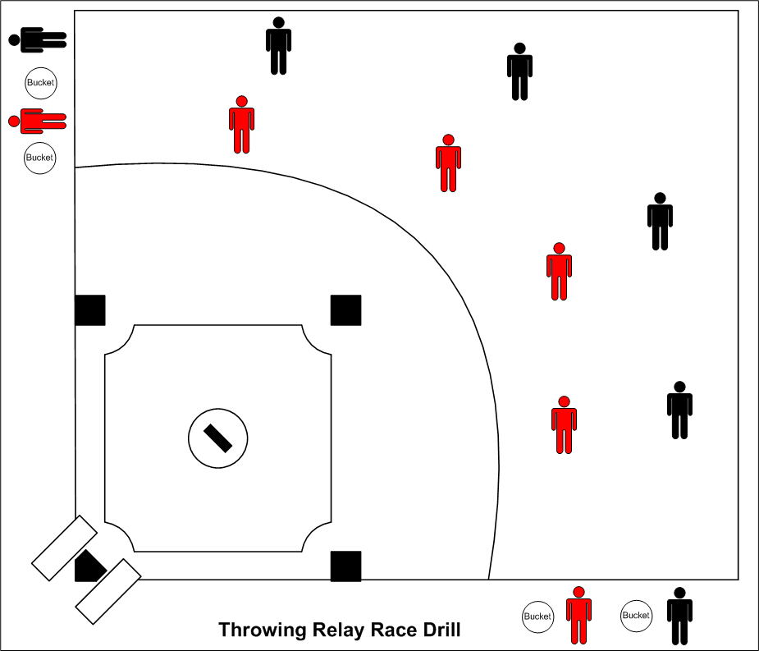
Throwing Relay Race

Slide 10
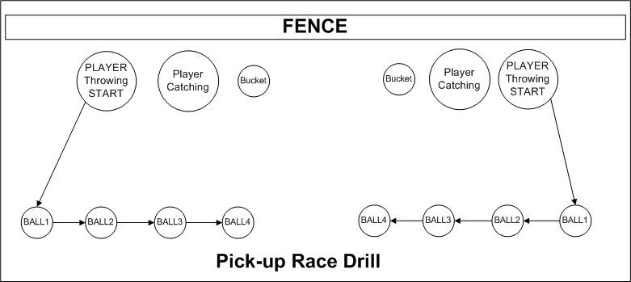
Pickup Race

Slide 11
Hitting
Batting safety
1. Wearing helmets
2. When not to swing the bat
How to grip the bat
Proper batting stance
How to swing the bat
Hitting off a tee
Hitting softly tossed pitches
Hitting needs lots of repetition

Slide 12
Hitting Drills
Hitting off tee
Soft toss
Hit stick
Throw the knob
Bat behind back tee drill

Slide 13
Positional Play
Only 10 players on the field
Share the ball
Covering bases
Throwing VS Running for Outs

Slide 14
Positional Drills
I got it
2 position (P to 1st, P to 3rd, P to C)
4 position (1st, 2nd, SS, and 3rd)
3 position (1st, 2nd, and RF)
2 groups, 3 positions
1. 1st, 2nd, and RF
2. SS, 3rd, and LF
4 Position Infield and Outfield (2nd, SS, LC, and RC)

Slide 15
Practice Plan
Create a practice plan
Assign drills to assistant coaches
Explain the drill to assistant before practice
“Divide and Conquer”
Have lots of drills to keep the kids moving
Have good time management

Slide 16
Parent Meeting
Introduce yourself
Have the kids introduce themselves to each other and the parents
Go over the team rules
    Only Players, Team Parent, and Coaches are allowed in the dugout.
    Physical or verbal assaults will not be tolerated. This includes hitting, kicking, biting, spitting, and name calling. They will be asked to go sit on the bench for a cooling off period then they must apologize.
    During games the on deck batter does not leave the dugout until the ball is thrown to the catcher
If you have an assistant ask them to start practice with the kids
Go over the statistics of making it to the pros

Slide 17
Probability of Competing in Athletics Beyond High School
 | Men's Basketball | Women's Basketball | Football | Baseball | Men's Ice Hockey | Men's Soccer
High School | 535,289 | 435,885 | 1,095,993 | 474,219 | 35,732 | 411,757
High School - Senior | 152,940 | 124,539 | 313,141 | 135,491 | 10,209 | 117,645
NCAA | 17,890 | 16,134 | 69,643 | 31,999 | 3,891 | 22,987
NCAA - Freshman | 5,111 | 4,610 | 19,898 | 9,143 | 1,112 | 6,568
NCAA - Senior | 3,976 | 3,585 | 15,476 | 7,111 | 865 | 5,108
NCAA - Drafted | 51 | 31 | 253 | 693 | 10 | 37
High School to NCAA | 3.30% | 3.70% | 6.40% | 6.70% 5 in 75 | 10.90% | 5.60%
NCAA to Pro | 1.30% | 0.90% | 1.60% | 9.70% 10 in 100 | 1.20% | 0.70%
High School to Pro | 0.03% | 0.02% | 0.08% | 0.51% 1 in 200 | 0.10% | 0.03%
http://www.ncaa.org/wps/wcm/connect/public/NCAA/Resources/Research/Probability+of+Going+Pro

Slide 18
Parent Meeting Cont.
Let the parents know what they can expect from you
Let the parents know what is expected of them
Parents refrain from coaching from the bleachers
Practice must continue at home (Handout)
Educate the parents on good mechanics
    Throwing
    Fielding
    Hitting
Go over league information

