Slide 1

Women’s Golf Association of Western PA
Spring Meeting
April 20, 2016
South Hills Country Club

Slide 2
WGAWP Spring Meeting 2016
Agenda
President’s Welcome – Corinne Lacich
Roll Call – Lisa Popovich
Treasurer’s Report – Kathy Campbell
Tournament Chairman’s Report – Christine Haythorn
Assistant Tournament Chairman’s Rpt – Joanne McHolme
Handicap Chairman’s Report – Maria Jarrett
Open Day Chairman’s Report – Betty Minnotte
Junior Chairman’s Report – Susie Perrin
Team Chairman’s Report – Beth Szymczak

Slide 3
2016 Membership Status
Individual Memberships
At end of 2015 – 581 Members
As of April 15 - 524 Members
Includes 4 New Members, 11 Reinstatements
Member Clubs – 38
Loss of Rolling Hills, Lone Pine, Shadow Lakes
Addition of Southpointe Golf Club

Slide 4
2016 Focus – Pace-of-Play
Policy & Procedural Changes
Hopeful Impacts
Shortening Play Times
Freeing Course to Host Club
Separate Session to Present Changes
After Regular Meeting – Before Break Out Meetings
Q&A
See Yearbook & “What’s New” Document

Slide 5
WPGA Collaboration
West Penn has been trusted Partner.
Expanded relationship in 2013 with Online Registration and Tournament Preparations.
Another extension of relationship begins in 2016:
Letter of Understanding in Place
Permanent Office facilities and Mailing Address
Future extensions
Leveraging WPGA Scholarship Program
Leveraging WPGA Investment Program

Slide 6
WGAWP Tournament Registration
Opens tomorrow, April 21
Register for all Tournaments
Register for “A” Open Days

Slide 7
WGAWP Spring Meeting 2016
Agenda
President’s Welcome – Corinne Lacich
Roll Call – Lisa Popovich
Treasurer’s Report – Kathy Campbell
Tournament Chairman’s Report – Christine Haythorn
Assistant Tournament Chairman’s Rpt – Joanne McHolme
Handicap Chairman’s Report – Maria Jarrett
Open Day Chairman’s Report – Betty Minnotte
Junior Chairman’s Report – Susie Perrin
Team Chairman’s Report – Beth Szymczak

Slide 8
WGAWP Spring Meeting 2016
Agenda
President’s Welcome – Corinne Lacich
Roll Call – Lisa Popovich
Treasurer’s Report – Kathy Campbell
Tournament Chairman’s Report – Christine Haythorn
Assistant Tournament Chairman’s Rpt – Joanne McHolme
Handicap Chairman’s Report – Maria Jarrett
Open Day Chairman’s Report – Betty Minnotte
Junior Chairman’s Report – Susie Perrin
Team Chairman’s Report – Beth Szymczak

Slide 9
WGAWP Spring Meeting 2016
Agenda
President’s Welcome – Corinne Lacich
Roll Call – Lisa Popovich
Treasurer’s Report – Kathy Campbell
Tournament Chairman’s Report – Christine Haythorn
Assistant Tournament Chairman’s Rpt – Joanne McHolme
Handicap Chairman’s Report – Maria Jarrett
Open Day Chairman’s Report – Betty Minnotte
Junior Chairman’s Report – Susie Perrin
Team Chairman’s Report – Beth Szymczak

Slide 10
Tournament Chairman’s Report
Policy / Procedural Changes for 2016 – To be covered in more detail in “Rules General Session”
Tournament Changes for 2016
Championship at South Hills

Slide 11
Policy Changes for 2016
Slow Play Policy – Times to be monitored for individual stroke play tournaments. Anyone violating pace of play to be issued “Slow Play Warning” Letter. Multiple Slow Play letters will result in playing restrictions.
Withdrawal Policy – Competitors now permitted to withdraw as a courtesy to fellow competitors when a high score(s) may create a slow play situation.

Slide 12
Policy Changes for 2016
Field Limitation – Field size limited to 100 in selected shotgun events so that course can be returned to host club for member usage.
Cell Phone Usage (as permitted by host club)
No voice usage (incoming or outgoing)
Limited Internet usage (USGA rules, GPS, Weather)
Text (WGAWP Communications, emergencies)

Slide 13
Tournament Changes for 2016
Senior’s / Super Senior’s
Buck Cup
Curley / Semple
Super Seniors now set at 65 (previously 60)
Partners no longer need to belong to the same club.
Alternate Shot format changed to Chapman.
No longer medallion events

Slide 14

Spotlight Events for 2016
WGAWP Championship
July 25th – July 29th
Hosted by South Hills Country Club
Championship Flight selection based on qualifying round score.
Ties for all positions in Championship Flight settled by Playoff.

Slide 15
Spotlight Events for 2016
WGAWP Championship
All other flights based on handicap and seeded by qualifying round score.
Ties for all positions in other flights settled by random draw.
Matches days 1-3, low flights scheduled early. Matches last day, reverse order.
Live scoring for Championship round

Slide 16
WGAWP Spring Meeting 2016
Agenda
President’s Welcome – Corinne Lacich
Roll Call – Lisa Popovich
Treasurer’s Report – Kathy Campbell
Tournament Chairman’s Report – Christine Haythorn
Assistant Tournament Chairman’s Rpt – Joanne McHolme
Handicap Chairman’s Report – Maria Jarrett
Open Day Chairman’s Report – Betty Minnotte
Junior Chairman’s Report – Susie Perrin
Team Chairman’s Report – Beth Szymczak

Slide 17
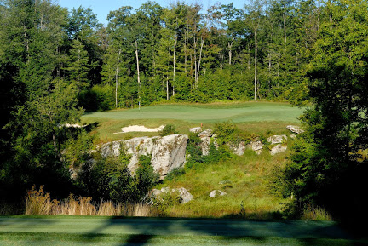
Assistant Tournament Chairman’s Report
Spring 2-Day
WISP Resort – Lodestone Course
Monday / Tuesday, June 27 - 28
First Day, 12:00 pm Shotgun & Dinner
Second Day, 9:00 am Shotgun
followed by Lunch & Awards
Medallion for Low Gross
10 lowest handicapped registrants included in field
Cost per person $308.00

Slide 18

Assistant Tournament Chairman’s Report
VIP Tournament
Hosted at Chartiers Country Club
Tuesday, July 12, 8:30 am Shotgun
18 Hole Stroke Play with full handicap
Two Medallions Awarded
Low Gross
Low Net

Slide 19


Assistant Tournament Chairman’s Report
First President’s
First Day, Wednesday, August 3 at Pittsburgh Field Club
Second Day, Thursday, August 4 at Fox Chapel Golf Club

Slide 20

Assistant Tournament Chairman’s Report
Fall 2-Day
Avalon Golf & Country Club
Monday / Tuesday, Sept. 19 - 20
First Day, 12:00 pm Shotgun/Avalon Lakes, followed by Dinner
Second Day, 8:30 am Shotgun/Squaw Creek, followed by Lunch & Awards
Cost per person $312.00

Slide 21
WGAWP Spring Meeting 2016
Agenda
President’s Welcome – Corinne Lacich
Roll Call – Lisa Popovich
Treasurer’s Report – Kathy Campbell
Tournament Chairman’s Report – Christine Haythorn
Assistant Tournament Chairman’s Rpt – Joanne McHolme
Handicap Chairman’s Report – Maria Jarrett
Open Day Chairman’s Report – Betty Minnotte
Junior Chairman’s Report – Susie Perrin
Team Chairman’s Report – Beth Szymczak

Slide 22
Handicap Chairman’s Report
Post It after you Play It
No changes to New Member Qualification
Allow 10 working days for processing of applications.
Handicap Indexes are updated on the 1st and 15th of the month

Slide 23
WGAWP Spring Meeting 2016
Agenda
President’s Welcome – Corinne Lacich
Roll Call – Lisa Popovich
Treasurer’s Report – Kathy Campbell
Tournament Chairman’s Report – Christine Haythorn
Assistant Tournament Chairman’s Rpt – Joanne McHolme
Handicap Chairman’s Report – Maria Jarrett
Open Day Chairman’s Report – Betty Minnotte
Junior Chairman’s Report – Susie Perrin
Team Chairman’s Report – Beth Szymczak

Slide 24
Open Day Chairman’s Report
Established Designation of “A” and “B”
Recommendation of Open Day Chair and Approval of Board
Based on Participation over 2 Year Period
Threshold – 10 Foursomes

Slide 25
Open Day Chairman’s Report
38 Open Days Available
8 “A” Days
33 “B” Days
“A” Open Day Registration
Use Online TPP – Same as last year
Registration Opens April 21
“B” Open Days
Check the WGAWP Calendar & Mark Yours
Don’t forget to call the Club
Reminder – Need a Partner Page on Website

Slide 26
WGAWP Spring Meeting 2016
Agenda
President’s Welcome – Corinne Lacich
Roll Call – Lisa Popovich
Treasurer’s Report – Kathy Campbell
Tournament Chairman’s Report – Christine Haythorn
Assistant Tournament Chairman’s Rpt – Joanne McHolme
Handicap Chairman’s Report – Maria Jarrett
Open Day Chairman’s Report – Betty Minnotte
Junior Chairman’s Report – Susie Perrin
Team Chairman’s Report – Beth Szymczak

Slide 27
Junior Chairman’s Report
Junior Clinic
Wednesday, May 4, 5:00 PM at Oakmont
Co-sponsored with PA State WGA
See Website for flyer and registration
Junior Events
Pat Hinkle @ Pittsburgh Field Club on July 6
Junior / Member @ Westmoreland on July 11
Junior Championship @ Connoquenessing on August 2
See Website for flyer and registration
Reminder – Junior Scholarship available

Slide 28
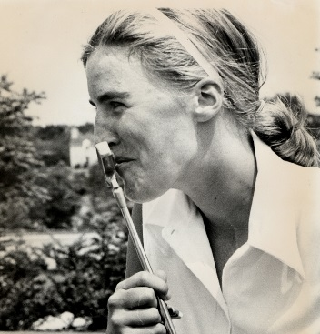
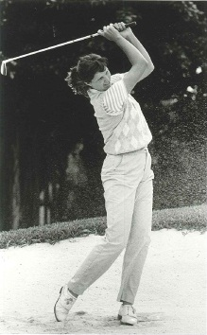
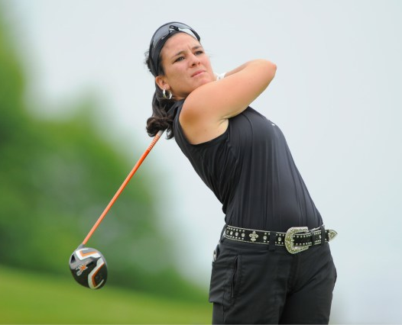
Return on your investments! Something to be proud of!
1967 WGAWP Junior Champion
Carol Semple Thompson
~ World Golf Hall of Fame Member
~ 2005 PGA “First Lady of Golf Award”
1980 WGAWP Junior Champion
Michelle “Missie” Berteotti
~ LPGA Tour - player 14 years
~ Current member of The Legends Tour
2005 WGAWP Junior Champion
Rachel Rohanna
~ Current LPGA Tour Member

Slide 29
WGAWP Spring Meeting 2016
Agenda
President’s Welcome – Corinne Lacich
Roll Call – Lisa Popovich
Treasurer’s Report – Kathy Campbell
Tournament Chairman’s Report – Christine Haythorn
Assistant Tournament Chairman’s Rpt – Joanne McHolme
Handicap Chairman’s Report – Maria Jarrett
Open Day Chairman’s Report – Betty Minnotte
Junior Chairman’s Report – Susie Perrin
Team Chairman’s Report – Beth Szymczak

Slide 30

Team Chairman’s Report Recognize 2015 Winners
Championship – Sewickley Heights
Division II – Treesdale I
Division III – Ligonier
Division IV – Diamond Run II
Division V – Edgewood

Slide 31
Team Chairman’s Report 2016 Season
Five divisions competing this year
Loss of Rolling Hills Team in Division IV
Modified Schedule for five teams
No loser in the Division
Connoquenessing to be added to Team Schedule in 2017
Tie Breaker match scheduled @ Westwood on June 2nd

Slide 32
Women’s Golf Association of Western PA
Spring Meeting
April 20, 2016
South Hills Country Club

Slide 33

What’s Happening at PSWGA
PA Championship (Amateur, Seniors, and Super Seniors)
Saucon Valley Country Club in Bethlehem, PA
Wednesday, August 10 – Saturday, August 13

Slide 34
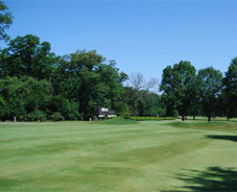
What’s Happening at PSWGA
Western Four Ball
Butler Country Club
Thursday, September 22

Slide 35
Women’s Golf Association of Western PA
Spring Meeting
April 20, 2016
What’s New for 2016

Slide 36
Slow Play Policy / Procedures
Why Change?
Feedback from Member Clubs with Play Times much longer than planned.
Member participation affected by slow play.
Existing previous policy very hard to administer and was not effective.
Needed a practical approach that would be fair and consistent.

Slide 37
Slow Play Policy / Procedures
New Approach:
Only applies to Stroke Play Tournaments with Tee Times.
Tag Hill
Barnes Murphy
Seniors / Super Seniors
Bobby Cruickshank
First Day of 1st Presidents
Pace-of-Play to be Posted on Registration Table.
Score Cards to indicate times for each hole.
T&R Official records finishing time for group (when flag placed back in hole on #18).

Slide 38
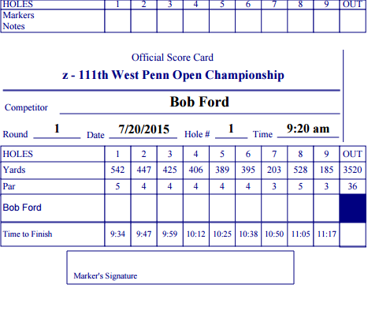
Sample Scorecard with Times

Slide 39
Slow Play Policy / Procedures
New Approach:
Violation occurs when the group exceeds Pace-of-Play by more than 15 minutes and finishes more than 15 minutes behind the group in front of them.
Entire group is issued “Slow Play Warning” Letter.
Penalty: Anyone who receives two “SPW” Letters in 24 months is placed on the Slow Play Restriction List.
Disqualified from “A” Open Days
Back of Field for Tee Time Tournaments
Lifted after 24 months w/o SPW

Slide 40
Slow Play Policy / Procedures
Summary:
YOU Don’t want to earn a SPW.
Reference your score card to monitor pace.
Keep up with the Group in front of you.
Hopeful 2016 Results:
No SPW’s issued.
Faster completion of tournaments.
Happier Host Clubs
Increased Participation in Tournaments

Slide 41
Withdrawal Policy
As has been our policy, competitors are strongly encouraged to complete their round of golf unless unable to do so due to illness or injury.
Competitor having a tough round may have an impact on Pace-of-Play for their group and remainder of field (searching for lost balls, rules clarification, etc.).
Competitor, as a courtesy to their playing partners and the field, may elect to withdraw from the tournament when she determines that she is not having a competitive round and potentially affecting pace-of-play.

Slide 42
Withdrawal Policy
Withdrawal Procedure:
Announce to your fellow competitors in your group.
Unless you are needed as a marker, stop play immediately and leave the course, if practical.
At end of round, report to the Tournament Administrator at what hole you withdrew.
Follow Up:
WGAWP to monitor Withdrawals.
Excessive W/D’s could result in ineligibility.

Slide 43
Cell Phone Policy: Why Change
Technology advances with Smart Phones.
Tool that can be of assistance during round w/o interfering with play.
Ability to communicate with field, if needed.
Weather related stoppages.
Course conditions

Slide 44
Cell Phone Policy:
Predicated on Local Rules at the Hosting Club (See Course Information Document).
No voice communications allowed during play. Phone to be on silent. No phone calls to be made or answered.
Limited Internet Usage Permitted:
Course GPS.
Weather
USGA Rules
Texting Permitted:
Communications from Tournament Officials
Emergencies.

Slide 45
Cell Phone Policy: Remember
Limited use of smart phone is permitted.
Not an invitation to surf the net while golfing.
Not appropriate to respond to casual texts while golfing.
Be considerate of fellow competitors, as use of phone can be a distraction.

Slide 46
Website Enhancements:
New Tab on Home Page for “Clubs” includes:
Club Roster with Links
Club Contact Info
Club Course Ratings for Women
Course Information Forms
Roster 2016
New feature to select Club
Select details for more information on member
About Us
Committees
Handbooks

Slide 47
Women’s Golf Association of Western PA
What’s New for 2016
Q & A

