Slide 1
Task Force 2018
Round Table Discussion

Slide 2
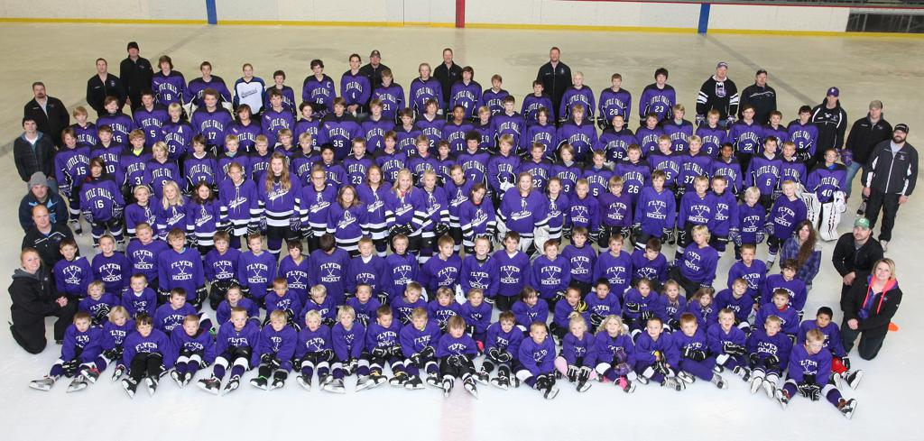
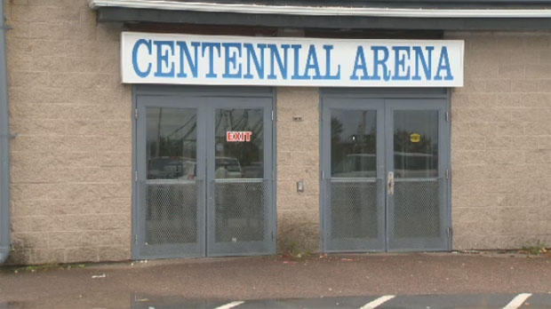
Michigan Hockey
Circa Early 2000’s
Circa 2009 - 2016

Slide 3
Definition of Insanity
Doing the same thing over and over again and expecting different results."
- Albert Einstein

Slide 4
Why Task Force 2018
Support Growth
  Retain Players You Bring Into the Game
  More Flexibility in Introductory Programs
  Flexibility in Building Your Teams
  More Association Flexibility to Grow Their Local Program
Reduce Cost / Rules
  More Low-Cost Recreational Options
  More Flexibility in Ice Utilization
  Eliminate Outdated Rules and Rule That Hinder Growth

Slide 5
Why Task Force 2018
Proper Development
  Structure to Provide Appropriate Level of Play for ALL Players
  Provide Players & Parents a Level of Hockey They Can be Proud of Playing
Strengthen Association
  Help Retain Players
  Help Retain Coaches
  Simplify Existing Rules
  Protect Big & Small Associations

Slide 6
Proper Development
Elite
Performance
Participation
Foundation

Slide 7
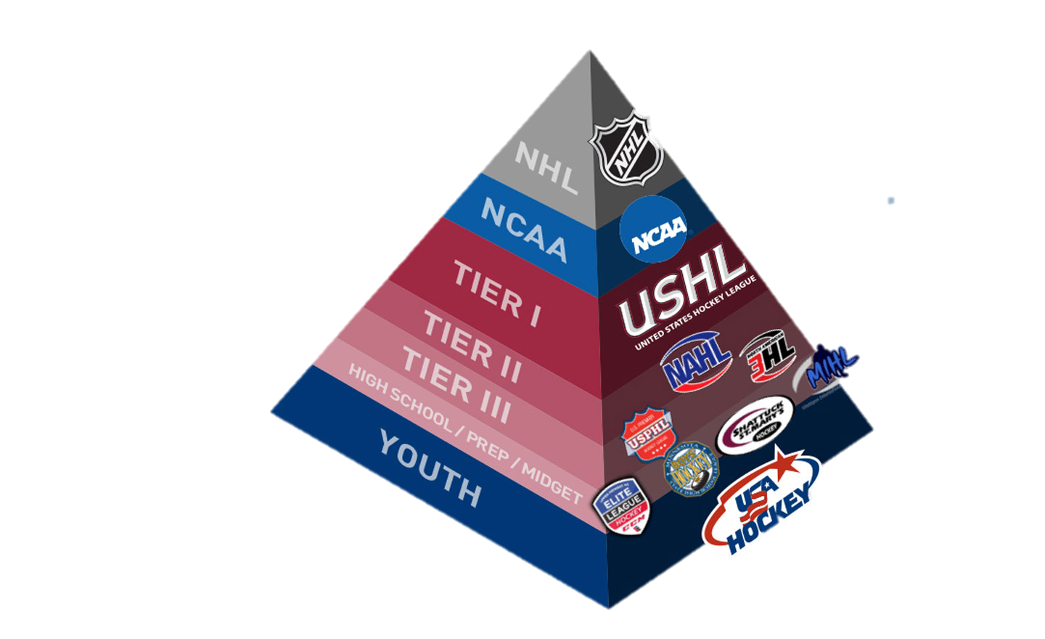

Slide 8
Proper Development
Rebranding & Reorganizing of Tier Levels
  Restores Proper Development Pyramid
  Allows Association More Flexibility in Team Selection & Player Development
  Provides More Equal and Competitive League Play = More Fun for Players
  Provides Easier Utilization of ADM Guidelines in Practices

Slide 9
Strengthen Associations
Help You Develop & Keep Your Own Players & Coaches
  Looked at Several Different Option Used by Other States
  Recommending Restrictions on a Coach Moving to a New Association for the First Season
Association Requirement no Longer Require a Certain # of Teams
  Associations Still Need to Focus on Building the Base of Their Association
  All Association Have Responsibility to Build Player Pool
  Association Requirement Will be Based on 10U Player Numbers
  Eliminates the incentive to recruit “B” Teams
  Requirement Works to Sustain Both Big & Small Associations
  Eliminates The Needs for Most Exceptions

Slide 10
Strengthen Associations
Provide More Attractive Programs
  Rebranding and Restructuring of Tier II & House Rec
  Provides Recognition that “B” Hockey is More Than House Hockey in Michigan
  Easier to Market and For Parents to Understand Levels
Adds Additional Levels of Play
  Provides More Ability Levels For Association to Choose From
  More Equal Competition in League Play
  Bigger League Division - Reduce Travel
  Additional State Championships

Slide 11
Strengthen Associations
Eliminates Draft
  Associations Responsible to Build Teams at Proper Levels
  Additional Levels Helps Keep Teams Balanced
  Allows More Friends to Play Together

Slide 12
Support Growth
Keep More of the Players Your Bring Into the Game
  Allow Players to Participate at the Closest Rink to Their Home Regardless of District
New Category Called Flex Hockey
  Tailor Programs to Your Local Needs
  From Small Area Games to Full-Ice
  Checking Optional at 14U and Up
  No Out Of District Player Limits
  Team Can Be Built on Skill Not Age
  Dual Rostering Allowed on Other Teams
  Minimal Coaching Requirements

Slide 13
Task Force #1
Associations must be self-supporting. A minimum of 30% of their youth membership shall be ages 10 or under. Non-compliance requires review of the Association by the respective District Council in which the Association must submit an action plan to meet the 30% of membership at 10 or under and may subject the Association to disciplinary action.

Slide 14
Task Force #1
  Replaces requirement for three “B” teams
  Provides the foundation base for essential growth to build an Association and it's programs.
  Requires all Associations to put the time, work and effort into developing and bringing younger players to the game; supports teams at the upper age classifications

Slide 15
Task Force #2
Michigan resident players of any age classification are permitted to play for an Association/Club that has the rink closest to their residence, based on Google Maps point-to-point distance, and will not be counted as an out of District player if it is beyond District Boundaries. Player residence documentation must be provided at the time of team registration with MAHA/USA Hockey.

Slide 16
Task Force #2
Allows players and their families the convenience of playing at their neighborhood rink or the one that is closest to their home.
Current rules penalize border associations that do the work at 8U. Inconveniences families and disrupts associations when OD player limits kick in at Squirts.
This rule would help Associations that start young players in their learn to skate programs to retain them.

Slide 17
Task Force #3
Coaches or mangers from all Tiers, who change Associations or Clubs, can only coach their son(s)/daughter(s) from that previous Association or Club the following season at the new Association or Club. If an Association/Club severs relationship with a coach, then this rule shall be null and void for that coach. An exception may be requested by a coach moving from Tier 2 or Tier 3 to Tier 1. The State Playoff Committee shall render a decision on that request within (14) days of the request.

Slide 18
Task Force #3
Prevents mass player and coach movements that otherwise has detrimental effects to their respective Association/Club, but still provides freedom of choice.
Encourages any issues to be addressed and worked out as opposed to leaving.
Helps to strengthen community based hockey.

Slide 19
Task Force #4 – ReTiering
Current Classification | Task Force 2018 Recommendation
Tier 1 AAA (1 Team Per Age Classification) | No Change
Tier II A & AA (Many Have Multiple Teams) | One Team Per Classification, Per Age (Additional Teams May Be Allowed per Recommendation)
House/Rec B, BB, C (Many Association Have No Teams at Some Levels) | Tier III A & AA (Unlimited Travel or Non-Travel Teams.
 | Flex Hockey

Slide 20
Advantages of ReTiering
Players / Parents
  Creates More Opportunities to Play With Friends
  Creates More Opportunity to Stay Within the Same Association
  Players and Parents Can Choose Skill and Commitment Level
  Allows Opportunity to Just Play for Fun
Associations
  Competitive Alignment Eliminates Need for Draft & Draft Rules
  Allows You to Properly Place Players for Skill
  More Flexibility in Team Formation
  Creates Environment for Growth

Slide 21
Advantages of ReTiering
Statewide
  Leagues Will Be Supportive of ReTiering
  Creates Levels of Play That Today’s Parents Want for Their Player
  Creates the Proper Development Pyramid
  Creates More Uniformity of Competition

Slide 22
Task Force #4 - Tier II A, AA
Associations can have one team per age classification. In order to have an additional Tier II Team in the same age classification the Association must have had three Tier III teams the previous winter season to support having any additional teams in the same age classification at the Tier II level.
If an association has more than 50 players that registered and played at the Tier II or Tier III level within that association the previous regular season, they must roster at least one team at the Tier II level.
To be eligible for District & State Playoffs, a team may not play more than 30% of their games against teams of a higher Division Classification during the regular season

Slide 23
Task Force #4 – Tier III AA
Associations can have an unlimited number of teams in this classification.
Any team which plays in a declared Tier III AA league, and any team playing an independent schedule, registered as a Tier III team.
Has no more than three (3) players who reside outside the District in which the team is registered. In the 18U classification teams will be allowed six (6) players who reside outside the district in which the team is registered. The State Playoff Committee has no authority to consider or grant an exception to this rule.
To be eligible for District & State Playoffs, a team may not play more than 30% of their games against teams of a higher Division Classification during the regular season

Slide 24
Task Force #4 – Tier III A
Associations can have an unlimited number of teams in this classification.
Any team which plays in a declared Tier III A league, and any team playing an independent schedule, registered as a Tier III team.
If no Tier III A league is available, teams may apply to the District Council and State Playoff Committee for authorization to participate in a Tier III AA league without losing their A status for District/State Playoffs.
Has no more than three (3) players who reside outside the District in which the team is registered. In the 16U classification teams will be allowed six (6) players who reside outside the district in which the team is registered. The State Playoff Committee has no authority to consider or grant an exception to this rule.

Slide 25
Task Force #4 – Tier III A
A 14 and under, 12 and under and a 10 and under team in this classification shall not have players who are in their last year of eligibility. In the 15/16 classification, no players from the 17/18 classification are
To be eligible for District & State Playoffs, a team may not play more than 30% of their games against teams of a higher Division Classification during the regular season

Slide 26
Task Force #4 – Flex Hockey
Associations can have an unlimited number of teams in this classification.
Associations can form teams of varying ages to obtain balanced levels of team play.
Checking is optional at 14U and older divisions.
No out of district player limit.
Teams are not eligible for District or State Playoffs
Players can dual roster on any Tier III team without affecting their player game count

Slide 27
Task Force #4 – Tier II A, AA (Ver. 2)
Associations can have one team per age classification. In order to have an additional Tier II Team in the same age classification the Association must have had three Tier III teams the previous winter season the ability to support having any additional three teams in the same age classification at the Tier III level.
In each age classification the number of players in the appropriate birth years shall be counted for those players that registered and played at the Tier II or Tier III level within that association the previous regular season. For the purposes of this calculation, each team will be presumed to have 15 players. The total of all players shall be counted, the previous regular seasons Tier II teams subtracted and the remainder divided by 15 to determine the number of Tier III teams an association can support. Note: You cannot round up.

Slide 28
Task Force #4 – Version 2 Example
Example
Association A has 80 players at the 2002 & 2003 birth year for the 15-16 regular season. They had both a Bantam A & a PeeWee AA team at the Tier II level
They could Have the following in 16-17:
Subtract (2) two Tier II teams = 30 Players
Divide remainder (50) by 15 = 3.33 Teams
Note: Anything less than 45 would not allow them an additional team

