Slide 1
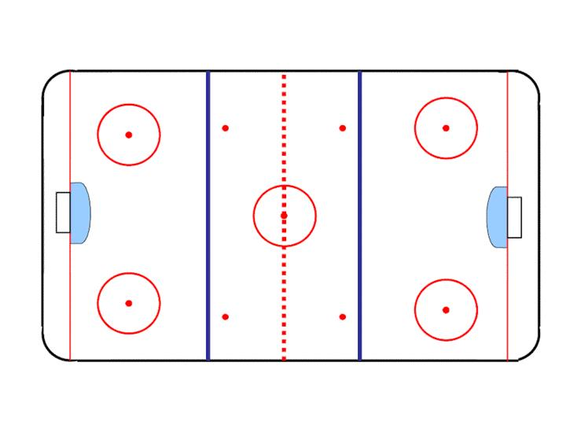
End Zone Positioning

Slide 2
End Zone Positioning
Proper end zone positioning:
  Gives a better overall view of the play
  Gives an improved view of the goal and goal line
  Lessens the chance of a referee being caught behind the play on a fast break
  Keeps the official safe from deflections on a shot on goal
  Keeps the referee in a predictable spot for players,
There are 3 positions and 2 maneuvers for the Referee in the end zone and together are referred to as the “Piston”

Slide 3
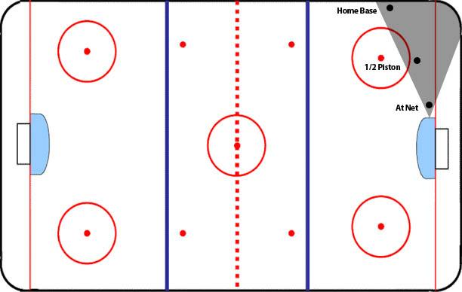
End Zone Positioning
The preferred end zone positioning for the Referee or end-zone Official in the 2 Official system is anywhere in the cone (shaded area) in the illustration below.
Although the cone area is
below the goal line at certain points, the Referee
is encouraged to stay at or above the goal line as much
as possible. The Referee isallowed to move away from
the shaded area when absolutely necessary but should always try to return.

Slide 4
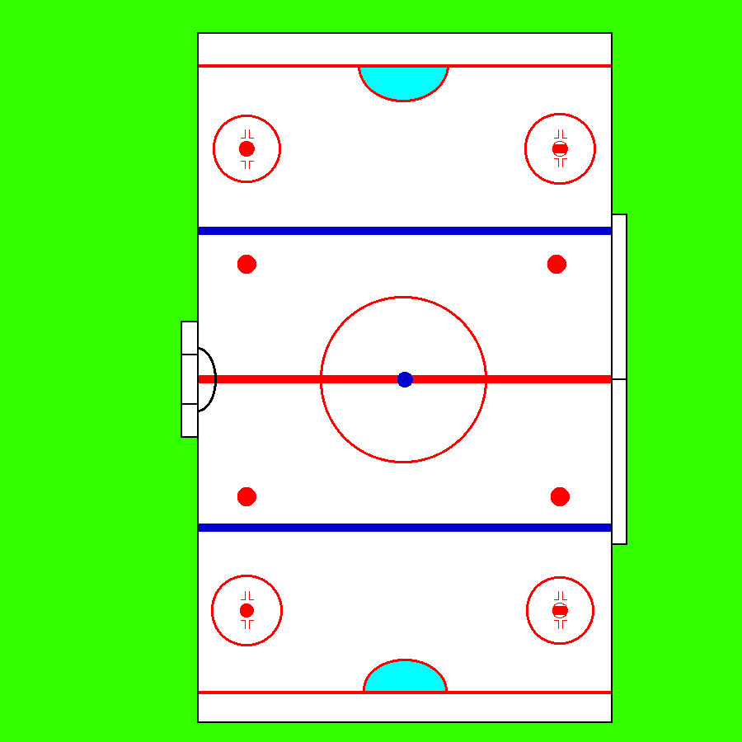
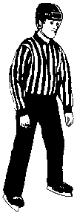
End Zone Positioning
Home Base
  15-20 cm (6-8in) off the boards
  1/2 way between the hash marks and the goal line
  Used when the play is on the same side of the ice as the official
Home Base

Slide 5
End Zone Positioning
Half Piston
  Between Home Base and nearest goal post, usually in line with face-off dots
  Used when play is on the far side of the ice from the Referee
Half Piston

Slide 6
End Zone Positioning
At The Net
  The position anywhere around the net that gives the referee the best view to see if the puck has crossed the line
  Ideally, at the corner of the net, 0.6-1m (2-3ft) from the goal line
At The Net

Slide 7
End Zone Positioning
As the puck moves during the game, you will be required to move back and forth from position to position (within the cone), thus creating a piston action
Home Base
Half Piston
At The Net

Slide 8
The 2 Maneuvers
Bump
  Used when play comes around the boards in the direction of the Referee standing at Home Base
  The Referee “bumps” up or down from his/her position, until they reach the the hash marks or goal line.

Slide 9
The “Bump”
Bump

Slide 10
The 2 Maneuvers
Pivot
  When you have bumped to the goal line or hash marks and the play continues toward you, you must perform the pivot
  Take a stride out from the boards
  Then cross under, and skate backwards to Home Base

Slide 11
The “Pivot”
The Pivot

Slide 12
Faults and Tips
Try to stay above the goal line as much as possible
Do not cross behind the net
Anticipation is key
  Relax, anticipate the play, and move only when you need to.

