Slide 1
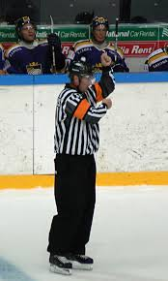
Penalty Calling Procedure
Notes:
We have intentionally removed the answers or the suggested answers to avoid the discussion on the particular check in question
What the instructor needs to focus on is the knowledge of the rule, the fact that there was a “danger zone” trigger and a consequence and that the officials know how to handle the situations when they occur.

Slide 2
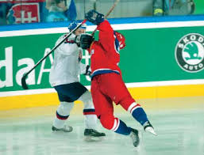
Procedures
Mentally record offending player’s number
Raise non-whistle arm (straight up, hand open, fingers together)
Whistle not in mouth
Blow whistle (WITH AUTHORITY) when offending team has possession and control of puck
Come to complete stop as whistle blown with arm extended

Slide 3


Procedures
Pause to allow everyone to focus on referee
Lower signal arm and point toward offending player; do not use one finger point
Call out player’s #, team, colour and infraction – clear, calm, assertive voice
Give signal for infraction and report penalty at penalty box; remain clear of penalized player

Slide 4
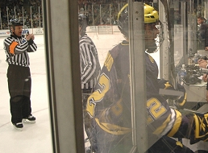
Procedures
Report #, team colour, infraction and duration to timekeeper
Keep all players in view
Signal infraction at penalty box area
Leave penalty box area remaining clear of penalized player(s)

Slide 5
Verbal Communication
Use calm, clear voice with neutral tone
Do not include unnecessary words
Do not get personal or engage in “reverse abuse”

Slide 6
Penalty Calling Tips
Know procedure well
Be professional, not emotional
Come to complete stop and make distinct pause after whistle
Treat disrespect with respect
Adjust route to penalty box to avoid confrontations
Make eye contact with timekeeper
Not mandatory to stop if timekeeper well qualified and simple situation

Slide 7
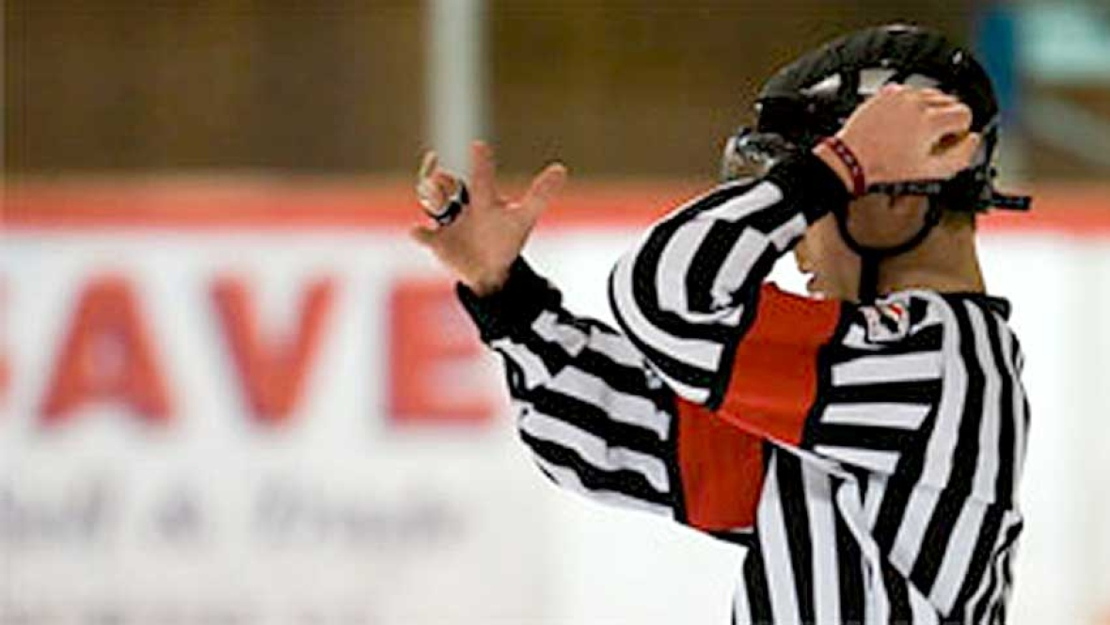
Signals
Delayed penalty signal – arm straight up, hand open, fingers together
Rotate raised arm down to point to penalized player(s)
Point with open hand (fingers together)
Do not point if player is too close (3metres)
Signal each infraction
Signal clearly and deliberately

Slide 8
QUIZ
1. When assessing penalties to multiple players you must signal each penalty.
TRUE
2. Identify the player by pointing with one finger.
FALSE
3. The Referee always gives the number, team and infraction
TRUE
4. The Referee should avoid crowding the penalized player on the way to the penalty box.
TRUE
5. The Referee should use the penalty procedure for every penalty assessed.
TRUE

