Slide 1
RYHA Mite coaches meeting
Robb Wiedrich – Mite Hockey Coordinator
Jeff Phillips – Boys Unit Coordinator
Doug Zmolek – Ryha hockey advisor

Slide 2

Topics
Coaching requirements
Schedules
Volunteers
Practice plans
Practice formats

Slide 3
Coaching requirements
Requirements Due Prior to Season Start: (all online)
  USA Hockey Registration
  Background Screening
  Safe Sport Training
  Concussion Module
  Age Specific Module
Requirements Due Prior to December 31st, 2017: (in person)
  Coaching Clinic
Coaching Requirements document can be found here:
  http://ryha.pucksystems2.com/page/show/1625-coaches-corner

Slide 4
Reimbursement
Register with USA hockey and receive a 9 digit confirmation number. (Please note that this is not your CEP number).
E-mail that number to ktheight@msn.com and tell her what team you are coaching this year. This MUST be done to be put on a roster. This is a $41.00 fee that will be reimbursed by RYHA it if is completed on time.

Slide 5
Mite Schedules
Termites
  OMC – Monday’s (once a month)
  Saturday – Practice (Every week)
  Sunday – Cross ice games (once a month)
SuperMites
  OMC – Wednesday’s and Friday’s (twice a month)
  Saturday – Practice (every week)
  Sunday – Practice (every week) & Cross ice games (twice a month)
  Monthly Games
    End of month (last Sunday) – Game with your current practice partner/team
    Special All Star Game – working on a 1 time event where all star jersey’s are used/music/announcements
Mite Calendar: https://drive.google.com/open?id=0BwZ_RuJCVqEeVmM3cVF6MWpJQWM

Slide 6
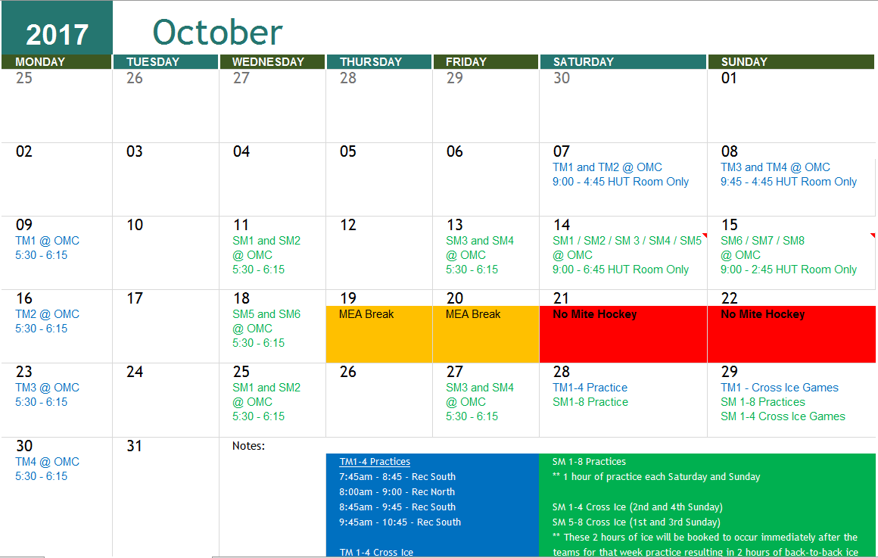

Slide 7
volunteers
Volunteers
  Volunteer description document (link)
  Tracking document (link)
    Key Volunteers:
      Pizza parent
      Picture Parent
      Added this year: Off-Ice Assistant

Slide 8
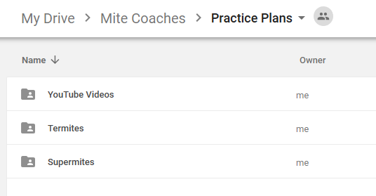
Practice plans
All mite coaches have been added to
  Practice Plans
    Google Drive folder
  Zmolek’s Mite handout
    google drive folder

Slide 9

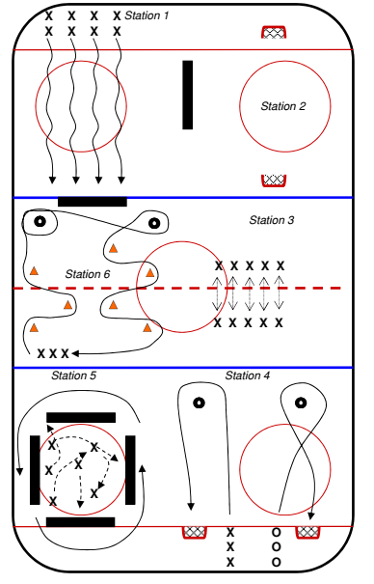
Termite Practice format

Slide 10
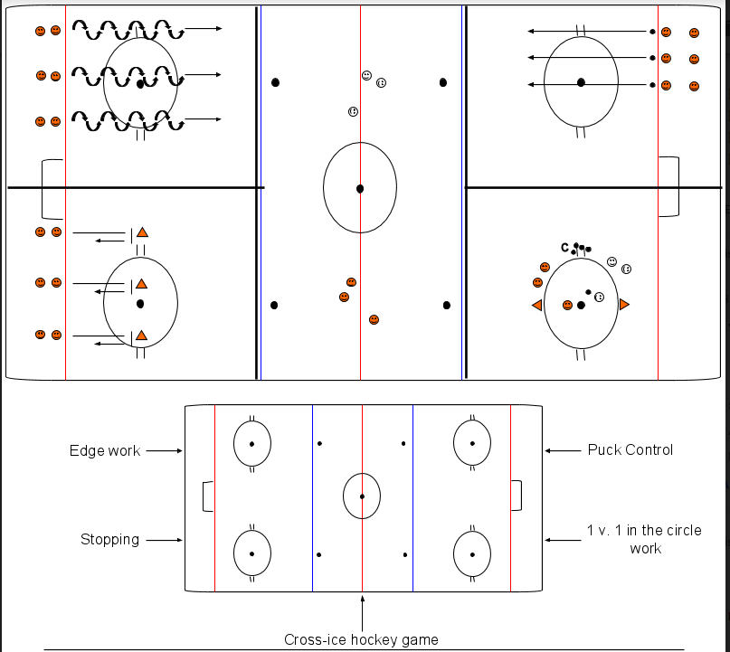
SuperMite practice Format
Small Area Games
Cross-Ice Hockey
Cross-Ice Survival
2 v. 2 Cross-Ice
3 v. 3 Cross-Ice
1 v. 1 in the Circle
1 v. 1 in the Corner

Slide 11
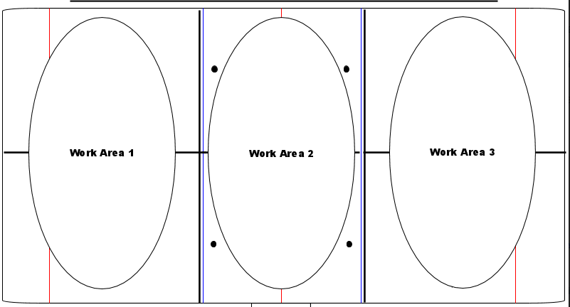
Cross Ice Game Format
Work area 1
  Cross Ice Game
Work area 2
  Skating Fundamentals
  Stickhandling fundamentals
Work area 3
  Cross Ice Game
Divide into 2 groups by skill
Rotate every 90 – 120 seconds
  1 -> 2 & 2 –> 1
  3 -> 2 & 2 -> 3

Slide 12
Equipment
Rec Center
Storage room behind/under players bench
Attack Triangles
Cones (may be on benches or in coaches locker room)
Ringette (ordering)
Noodles (ordering)
Soft borders (on benches)
Graham
Looking for storage room
Cones (on benches)
Ringette (ordering)
Noodles (ordering)
Attack Triangles (use chairs in penalty boxes) – may order some for Graham
Goalie Equipment (SuperMite Coaches) : Grab 2 bags per team before leaving

Slide 13
Thank you!
Have FUN
Good Luck
Ask Questions!
Link to charts: https://drive.google.com/open?id=0BwZ_RuJCVqEeV25FTk9YZEtHMk0

