Slide 1

FUELING the Athlete
Lindsey Remmers
MS, RD, CSSD, LMNT
Director of Performance Nutrition, University of Nebraska
EliteFueling Sports Nutrition

Slide 2
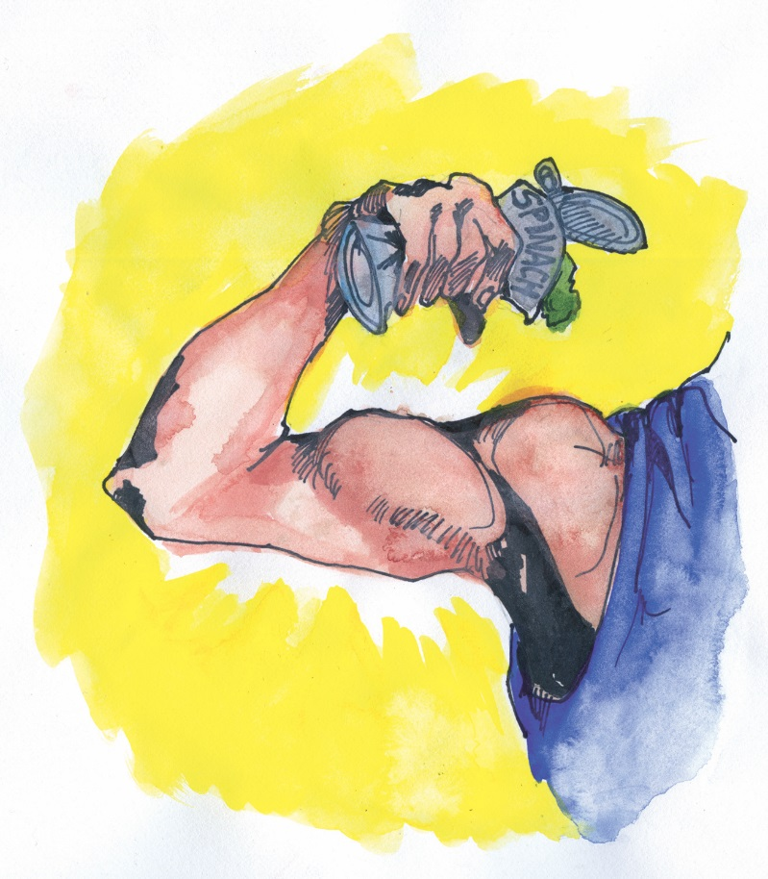
What is PERFORMANCE Nutrition?
More than just “eating healthy”…
Proper FUELING will:
Improve performance
Reduce fatigue
Optimize recovery
Increase Power & Speed
Improve focus
Heal and repair injuries
Prevent heat cramps

Slide 3
“Young athletes may fail to reach their genetic potential if energy demands from sports and training are not met with adequate energy intake”
~ Oded Bar-Or, M.D.
Sports Science Exchange Roundtable. Youth In sport: Nutritional Needs. GSSI. 8:4 (1997).

Slide 4
THE BASICS
MEET ENERGY NEEDS
  Adolescent athlete energy needs are higher than normal recommendations
Focus on:
  FUEL!
  Calcium & Vitamin D – bone growth & development
    Get 3 to 4 servings of dairy each day
    Need 5000IU Vitamin D during winter months
  Iron – oxygen transport to working muscles
    consume lean red meat 3x/wk
  Magnesium, Zinc, Vitamin B6 – protein synthesis, growth
    Whole grains, dairy, beans, nuts, leafy greens….SPINACH!!

Slide 5
WRESTLING
GOAL: 5-8% of weight class HYDRATED
The MORE hydrated you are, the MORE you sweat

Slide 6
  How much?

Slide 7
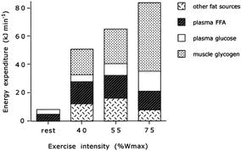
ENERGY USE
Types of energy sources used during different intensities of training

Slide 8


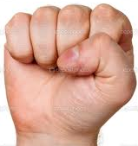
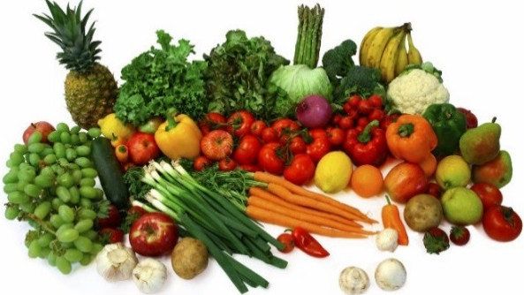
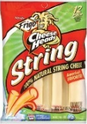
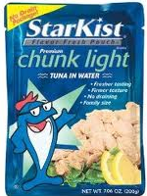
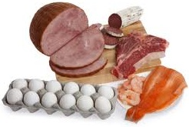
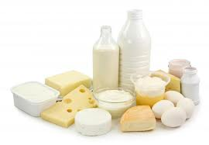
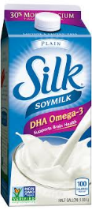
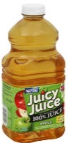

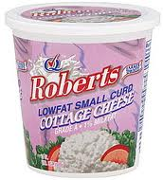

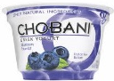
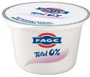
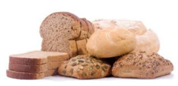
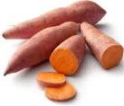

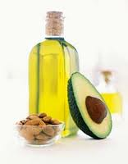
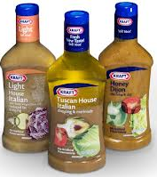
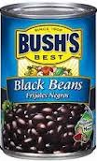
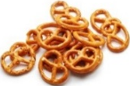
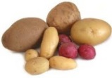
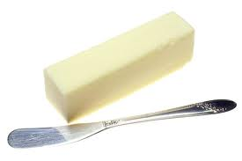


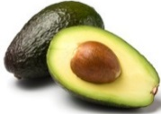
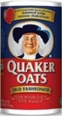
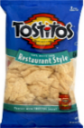
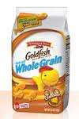



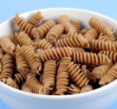
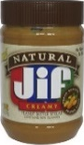
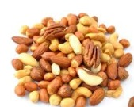
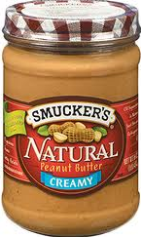
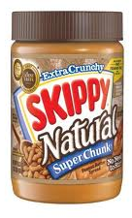
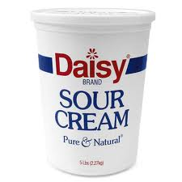
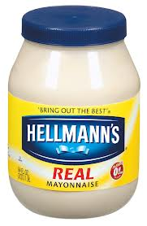
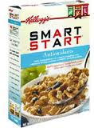

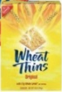
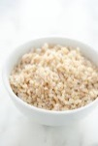





THE FOOD GROUPS
Include all food groups at each meal.
At Snacks: Combine 1 group from left side with 1 group from right side
FRUIT & VEG =
BOOST IMMUNE SYSTEM
LEAN PROTEIN =
MUSCLE BUILDING
Fights Inflammation, improves recovery
Helps muscles repair, recover, and rebuild.
= 1 svg fruit
= 2 svg veg
= 3-4-oz. meat
CARBOHYDRATE = FUEL
FATS
Energy for training.
Healthy sources provide energy, help body absorb vitamins & minerals, provides satisfaction from meals.
= 2 svg.
= 2 slc. bread
= 2-3 fat svg or
1 Tbsp.

Slide 9

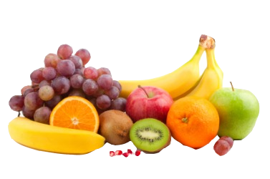
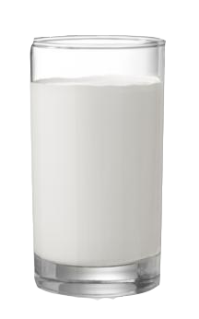



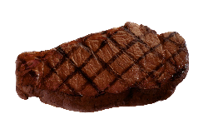
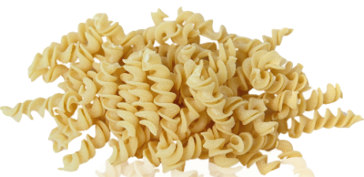
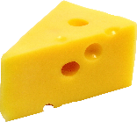
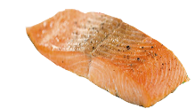
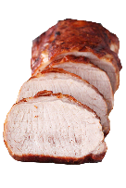

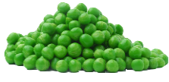
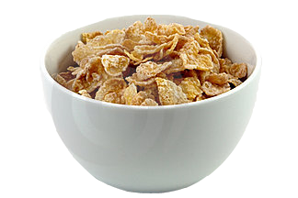
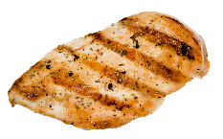

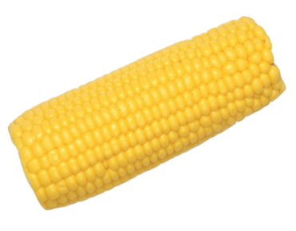
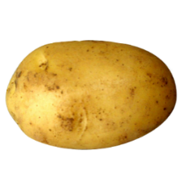
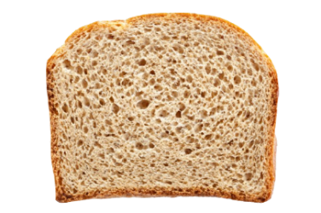
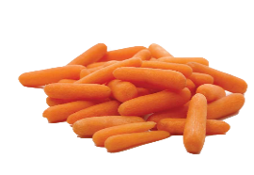
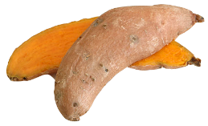













ACTIVE DAY PLATE
FRUIT
DAIRY
Water
Unsweet Tea
Coffee/ Decaf
Dilute Juice
Grains
16-oz.
Lean
8-oz.
100% Juice
Carbs/
Protein
=
=
=
tables
Vege
FATS
For Weight Gain
Drink 100% juice, 2% milk, or chocolate milk
Add cheese to vegetables
Add Nuts & Dried Fruit
Add Guacamole, Dressings
Choose bagels or hoagies instead of sliced bread
x1

Slide 11

How FULL is Your Tank?
There is nothing more fundamental or foundational to nutrition as meeting calorie needs.
SIGNS CALORIES ARE LOW
  Feeling Tired or no energy
  Heavy Legs
  Loss of speed/power/strength
  Weight loss
  Missed Periods
  Moody
EFFECTS of CHRONIC LOW-CALORIES
  metabolic rate
  Protein synthesis (muscle)
  Induced immune suppression, decreased vigor, increased fatigue
  Hormonal imbalances
  Poor Cognitive function
  susceptibility to heat illness
  Compromised nutritional status

Slide 12

THE BASICS
Meet energy needs
QUALITY COUNTS – what should I eat?

Slide 13



Slide 14


QUALITY COUNT
How do you know if it’s a quality food?
A
Water, High Fructose Corn Syrup, 2% or Less of Each of the Following: Concentrated Juices (Orange, Tangerine, Apple, Lime, Grapefruit), Citric Acid, Ascorbic Acid (Vitamin C), Beta-Carotene, Thiamin Hydrochloride (Vitamin B1), Natural Flavors, Food Starch-Modified, Canola Oil, Cellulose Gum, Xanthan Gum, Sodium Hexametaphosphate, Sodium Benzoate (to protect flavor), Yellow 5, Yellow 6
B
Pure Filtered Water, Premium Concentrated Orange Juice, Orange Pulp

Slide 15


Flour Enriched ( Wheat Flour , Niacin Vitamin B3 , Ferrous Sulfate , Thiamine Mononitrate Vitamin B1 , Riboflavin Vitamin B2 [ Vitamin B12 ] , Folic Acid Vitamin B9 ) , Water, Tomatoes ( Water , Tomatoes Paste ) , Cheese Mozzarella Substitute ( Water , Soybeans Oil Partially Hydrogenated , Casein , Potatoes Starch , Wheat Gluten Vital , Sodium Aluminum Phosphate , Salt , Potassium Chloride , Citric Acid , Potassium Sorbate , Preservative , Sodium Citrate , Sodium Phosphate , Titanium Dioxide [ Colors Artificial ] ) , Maltodextrin , Magnesium Oxide , Zinc Oxide , Vitamin A Palmitate , Riboflavin Vitamin B2 ( Vitamin B12 ) , Pepperoni ( Pork , Beef , Salt , Water , Dextrose , Lactic Acid Starter Culture , Oleoresin of Paprika , Sodium Nitrate Nitrite , BHA , Beef Stock , BHT , Citric Acid , Garlic Powder , Flavors Natural Smoke , Spices , Flavors Natural ) , Soybeans Oil Partially Hydrogenated , Cheese Mozzarella Non fat Rehydrated Pasteurized Process ( Water , Milk Non Fat , Cheese Cultures , Salt , Enzymes , Citric Acid , Vitamin A Palmitate , Pyridoxine Vitamin B6 , Sodium Aluminum Phosphate , Sodium Citrate , Sodium Phosphate ) , Sugar , Corn Starch Modified , Salt , Yeast Dry , Soy Flour , Cheese Modified Rehydrated Enzyme ( Water , Milk , Cheese Cultures , Salt , Enzymes ) , Flavors Natural , Dextrose , Monocalcium Phosphate , Spices , Baking Soda , Beets Powder , Xanthan Gum , Peppers Red , Sorbitan Monostearate
QUALITY COUNTS
WHOLE PIZZA
720 cal, 24g pro, 66g carb, 6g fiber, 40g fat
176 ingredients!

Slide 16
What’s the BIG DEAL with Ingredients?

Slide 17



INFLAMMATION

Slide 19


  QUALITY IS KEY
3 Finger Combo (no drink)
970 cal, 29g pro, 108g carb, 1g fiber, 53g fat
6 slc roast beef
2 scoop peas
4 c snap peas
2 cup grapes
950 cal, 80g pro, 110g carb, 13g fiber, 15g fat

Slide 20
Does it REALLY matter what I eat?
AFFECTS:
Muscle recovery & gains
Concentration levels
Overall energy levels
Nutrient needs
Weight of food does NOT contribute to bodyweight

Slide 21
THE BASICS
Meet energy needs
Quality
CONSISTENCY / FREQUENCY
  Aka don’t skip meals
  Frequency is important for muscle building and maintenance…
    PROTEIN THROUGHOUT THE DAY

Slide 22



CONSISTENCY is
Meal: Consistent Eaters
+Bkfst
Meal: Inconsistent Eaters
*REFUEL*
Body Fat
Energy
Muscle
PREFUEL
Body Fat
Energy
Muscle
Wake up
Sleep

Slide 23
BULK of calories need to be consumed by mid-afternoon
TYPICAL WRESTLER DIET
B-FAST: nothing or granola bar
LUNCH: sandwich…maybe
AFTERNOON: nothing
DINNER: 3 plates of food (easily 1500-2000 calories)
IDEAL WRESTLER DIET
B-FAST: bowl of cereal (no kid cereals) + greek yogurt
LUNCH: sandwich, apple, milk, whole-grain goldfish
AFTERNOON: PB&J or trail mix bar before practice
AFTER PRACTICE: choco milk
DINNER: 1 plate of food – mostly veggies & protein

Slide 24
BREAKFAST: 500-900 calories
1 bagel with 2 Tbsp cream cheese plus 1 Greek yogurt
Peanut butter & banana wrap plus fruit and milk
2 bowls ADULT cereal (mix granola or grapenuts into cereal for extra calories)
  ADULT CEREAL: 1-2g fiber per serving, less than 10g sugar/serving
Oatmeal with brown sugar, big handful trail mix, glass of juice
Oatmeal, greek yogurt, banana, juice
Roll up a tortilla with scrambled eggs and salsa
1-2 clif bars, banana, milk or juice box
2 eggs, avocado, 2 slices toast, milk or yogurt, juice
Eating more during the morning & day will lead to higher energy at practice, stronger bodies, and leaning out.
*Bonus* – better able to concentrate in class and improved sleep

Slide 25
THE BASICS
Meet energy needs
Quality
Consistency & TIMING
  Fuel body around training

Slide 26









PRE WORKOUT FUELING
Timeline: Within 15-60 minutes before training
Protein
  8-15g of Protein
  Greek yogurt, string cheese
Carbohydrate
  15-45g
  Top off energy stores
  Granola bars, PB&J, fruit cup/applesauce
Fluids
Electrolytes
  Easy to pack snack:
  PB&J, applesauce cups, fruit snacks, Clif bars, Whole-grain goldfish & raisins, pudding cup & banana, cereal w/ nuts & craisins mix, nutrigrain bar(s)

Slide 27

RECOVERY
“Consuming carbohydrate and protein during the early phases of recovery has been shown to positively affect subsequent exercise performance and could be of specific benefit for athletes involved in multiple training or competition sessions on the same or consecutive days.” 2010.Burke et al. Nutritional Strategies to Promote Post-Exercise Recovery.
Basically, EAT WITHIN 20-45 MINUTES of finishing training.
RESEARCH SHOWS….
Muscle tissue best recovers with small amounts of protein spread throughout the day. For best muscle recovery, have up to 30g (~4 oz.) lean protein with each meal, 10-20g with each snack (1-3oz.), and 15-20g (16-oz skim or chocolate milk) right after running/strength training.

Slide 28






POST WORKOUT FUELING
Timeline: Within 20-45 minutes after training!
Protein
  15-20g of Protein
  Chocolate Milk, Milk
  EAT ALL THRU DAY
Carbohydrate
  30-60g
  Delayed feeding can reduce glycogen restoration by 47%
Fluids
Maximize muscle recovery or protein synthesis
Maximize restoration of glycogen stores (carbohydrate stores)
Restore immune suppression
Tipton et al., 2006
Willoughby et al., 2006
Tipton et al., 2004

Slide 29

fueling BEFORE, DURING AFTER, is KEY for training gains

Slide 30
THE BASICS
Meet energy needs
Quality
Timing & Consistency
HYDRATION

Slide 31




HYDRATION
SWEAT SCIENCE
Athletes lose up to 9x more SODIUM than potassium in sweat
Gatorade or Water??
>90 min practice OR heavy sweater
60-90 min or shorter practice

Slide 32
HYDRATION
SWEAT SCIENCE
Gatorade is good for during training…NOT to drink casually with meals or snacks or otherwise

Slide 33

HYDRATION
Dehydration WILL ALWAYS hinder your performance
Fatigue
Dry/cotton mouth’
Training feels harder than it should
Dizziness
Nauseous
Shaking
Inability to focus
No appetite
Overall decrease in performance and skills
Muscle cramps
Research shows that good hydrators will practice at higher intensities, be more focused, and have improved performance compared to non-hydrators.

Slide 34

#checkyourpee
If urine is a 4 or higher 1.5-hours before activity (color below), you are dehydrated.
Drink enough ½ BDWT in oz daily.
urine is a light lemonade color.
After Training: drink 20-oz. fluid for every 1-lb lost during training

Slide 35
THE BASICS
Meet energy needs
Quality
Timing & Consistency
Hydration
SUPPLEMENTS
  Food first

Slide 36

Below is a list of supplements based on peer-reviewed, clinical research, and their effectiveness. Great resource for supplement research:
http://www.ausport.gov.au/ais/nutrition/supplements
SUPPLEMENTS
*STRONGLY SUPPORTED
Fish Oil
Vitamin D
Caffeine
Creatine
Whey Protein
Beta-alanine
BCAA’s
FOOD is always the FOUNDATION
SUPPLEMENTS compliment a SOLID foundation
Not regulated by FDA
Companies can make claims without any scientific proof
DON’T BE FOOLED by MLM companies
SOMEWHAT SUPPORTED
MCT’s
Glucosamine Chondroitin
LIMITED OR NO SUPPORT
HMB
Glutamine
Arginine
CLA
ZMA
Ginseng
Gingko Biloba
Carnitine
Chromium Picolinate
Oxygenated Waters
Super Juices (Mona Vie, Euro)
Weight Loss:
Appetite Suppressors
Stimulants (excluding caffeine)
Malabsorptive supplements
Look for this logo on products signifying testing by NSF.
POTENTIALLY DANGEROUS
**This list is NOT all-inclusive**
Androstenedione
19-norandrostenediol
Ephedra
Strychnine
Methylhexaneamine (Jack3d)
Tribulus Terrestris or other herbal testosterone boosters

Slide 37
WRESTLING specifics
WEIGHT LOSS
  Avoid extremes
    Too much too fast =
Cosgrove, Alwyn. Art & Science of Making Weight. 2008

Slide 38

Inability to maintain or develop lean tissue
Reduced Metabolic Rate
Compromised Immune Function
Cosgrove, Alwyn. Art & Science of Making Weight. 2008

Slide 39
WRESTLING
GOAL: 5-8% of weight class HYDRATED
The MORE hydrated you are, the MORE you sweat

Slide 40
  Inside Bodyweight
Fast weight loss =
  fast regain….why?
    Initially only lost water & glycogen
    slowed metabolism
  regain muscle or fat?
Your weight plateaus, you decrease calories, you don’t lose weight…why?

Slide 41
  Inside Bodyweight
“Athletes who aggressively diet for a competitive season and rapidly regain weight may find it more challenging to achieve optimal body composition in following seasons.” J of Int Soc of Sport Nutr.
“post-starvation obesity” – because metabolism hasn’t caught back up to your normal eating.

Slide 42

  FACT
A USOC Retrospective Study Revealed:
of all USA medals - judo, tai-kwon-do, & wrestling at the last Olympics…
Anyone who won a medal maintained bodyweight control over the long-term
Always within 1-2 lbs day before or they were underweight at weigh-in
Most only cut 1-2 lbs

Slide 43
  Inside Bodyweight
Instead of crash dieting, what should you do?
If you have/are trying to lose and doing it rapidly, instead start slowly feeding your body to recover metabolism.

Slide 44
WRESTLING NUTRITION
GOAL: 5-8% of weight class HYDRATED

Slide 45
WEIGHT GAIN
No more than 1% of your bodyweight per week gained
Why??
HOW
Focus on calorie dense foods
  whole milk, trail mix, bagels, cheese, 100% juice, chocolate milk, guacamole, PB&J before bed with milk
Eat often
Eat breakfast – not just cereal
Have a snack before bed

Slide 46
WEIGHT LOSS
No more than 1% of your bodyweight per week lost
Why??
HOW
Recognize if eating for boredom or hunger
Skip the junk
  No concession stand trips
Eat more fruits & veggies
Eat no later than 1 hour before bed OR “fast” for 12+ hours at night

Slide 47
  IN-SEASON WEIGHT MAKING
WATER/HYDRATION
DO NOT START CUTTING WATER TOO EARLY!!!
If you do…
Body will upregulate anti-diuretic hormone due to dehydration…. If dehydrate too early in the week, your body will hang on to water instead of lose it

Slide 48
  IN-SEASON WEIGHT MAKING
Week of:
Stay Super-hydrated until 1-2 days before your final workout
  Helps minimize release of anti-diuretic hormone (it causes water retention)
  Will help your body maintain metabolism, get nutrients to muscles, clear toxins, improve energy, improve your workouts, improve muscle resiliency and make your weight cut easier!
2 days out:
Decrease added salt to avoid water retention.
  High salt foods: cured meats (ham), crackers, processed foods, fast food, fried food, soup, pretzels, sauces, ketchup & mustard, American & cheddar cheese, canned vegetables, deli meat, frozen pizza, frozen dinners, popcorn, chips
Can begin to focus on low-residue (lower fiber) foods to minimize bulk in gut (see chart)
Day Before:
Enter final day 2% of BW overweight & hydrated (adjust based on ability to sweat)
Finish workout 0-2 pounds overweight. If over this weight, return for another workout to cut water in order to be 0-2 pounds overweight
Eat & drink lower-carb foods up to 2-3 pounds overweight.
  Well-cooked Vegetables, fruit (apple, pear, kiwi, cherries, banana, grapefruit, grapes, peach, mango, pum), cottage cheese, lean meat, fish, chicken & turkey, milk, cheese, eggs, greek yogurt, nuts, beans, brown rice, whole potatoes)
If final workout is early enough that you will float before bed, eat enough or snack so that bedtime weight is +2-3 pounds
Go to sleep 2-3 pounds overweight, depending upon ability to float. Note: the more you are over, the more your body will allow you to float
Day of:
Wake up ~1lb overweight
If competing at night, can focus on liquid calories during day (shakes, milk, applesauce, smoothie)
Drill to lose remaining weight
Make Weight
Refuel—post weigh-in fuel

Slide 50
Example Real-Life Plan
Wt Class: 149. Current weight: 159. Goal walk-around weight: 154-155.

Slide 51
Example Real-Life Plan
Wt Class: 149. Current weight: 159. Goal walk-around weight: 154-155.

Slide 52
Example Real-Life Plan
Wt Class: 149. Current weight: 159. Goal walk-around weight: 154-155.

Slide 53
  IN-SEASON WEIGHT MAKING
AFTER WEIGH-IN
Eat foods easy on the gut to avoid diarrhea or vomiting
White bread w/small amount pbutter & jelly
Nutrigrain bars
Gels
Gatorade Chews or Fruit Snacks
Bananas, raisins, craisins, applesauce packs
Ensure shakes
Pudding Cups

Slide 55
  WEEKENDS OR END OF WEEK
Hungrier than during the week?
Come back Heavier on Monday?
Eat consistently during the week – don’t skip meals to try to lose weight. WILL BACKFIRE
Get recovery drink in after practice

Slide 56
QUESTIONS

