Slide 1

2016 NHSACA Annual Meeting MHSCA Award Functions

Slide 2
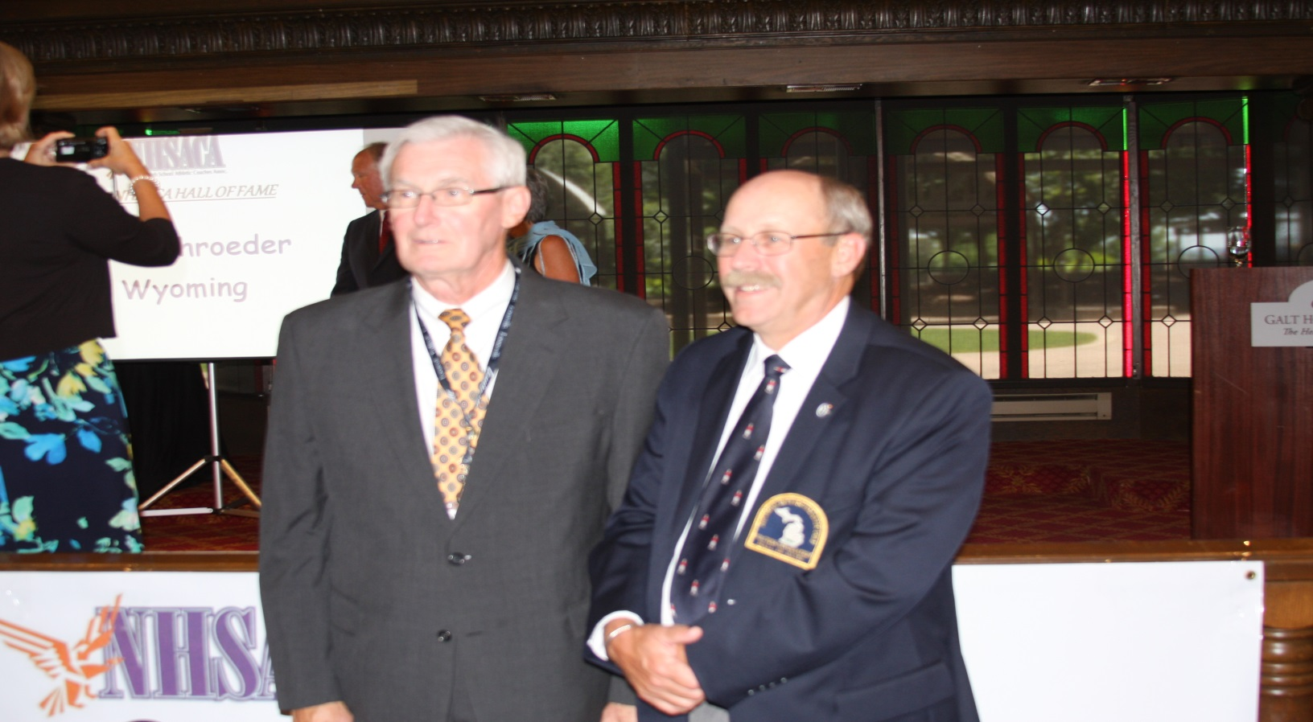
2016 NHSACA Hall of Fame
Jerry Lasceski & Jim Bennett

Slide 3
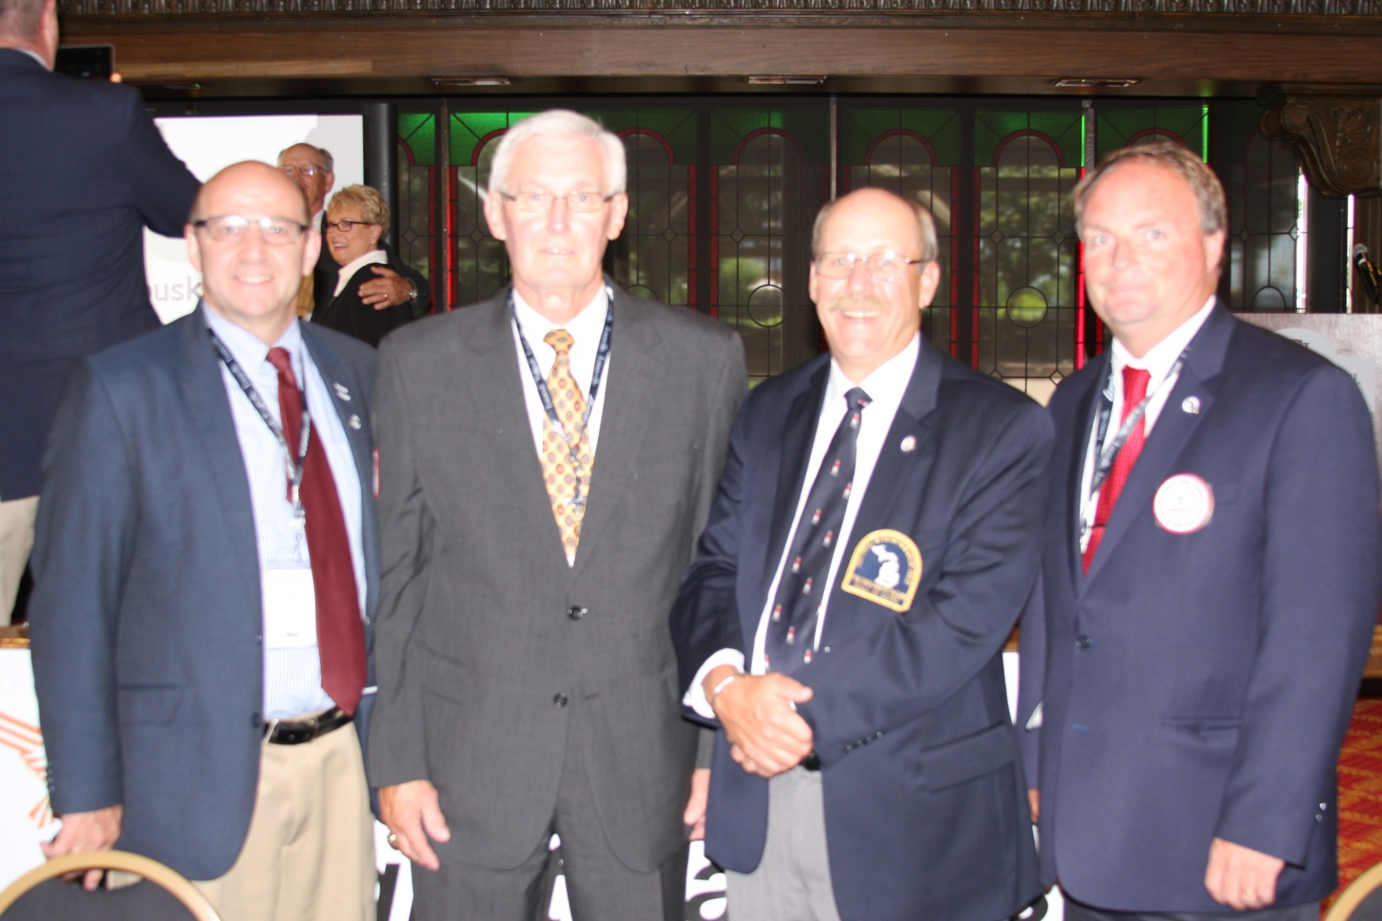
2016 NHSACA Hall of Fame

Slide 4
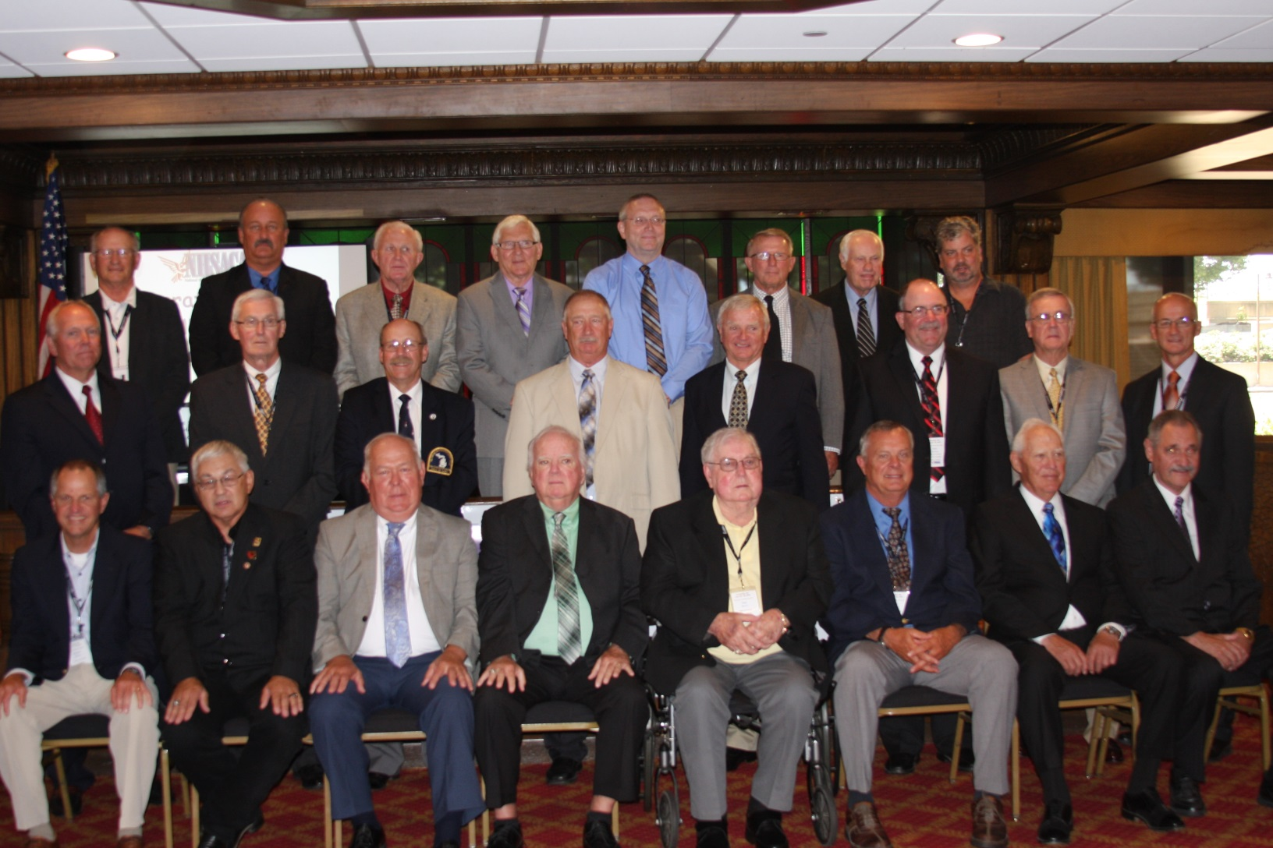
NHSACA HOF Team Photo

Slide 5
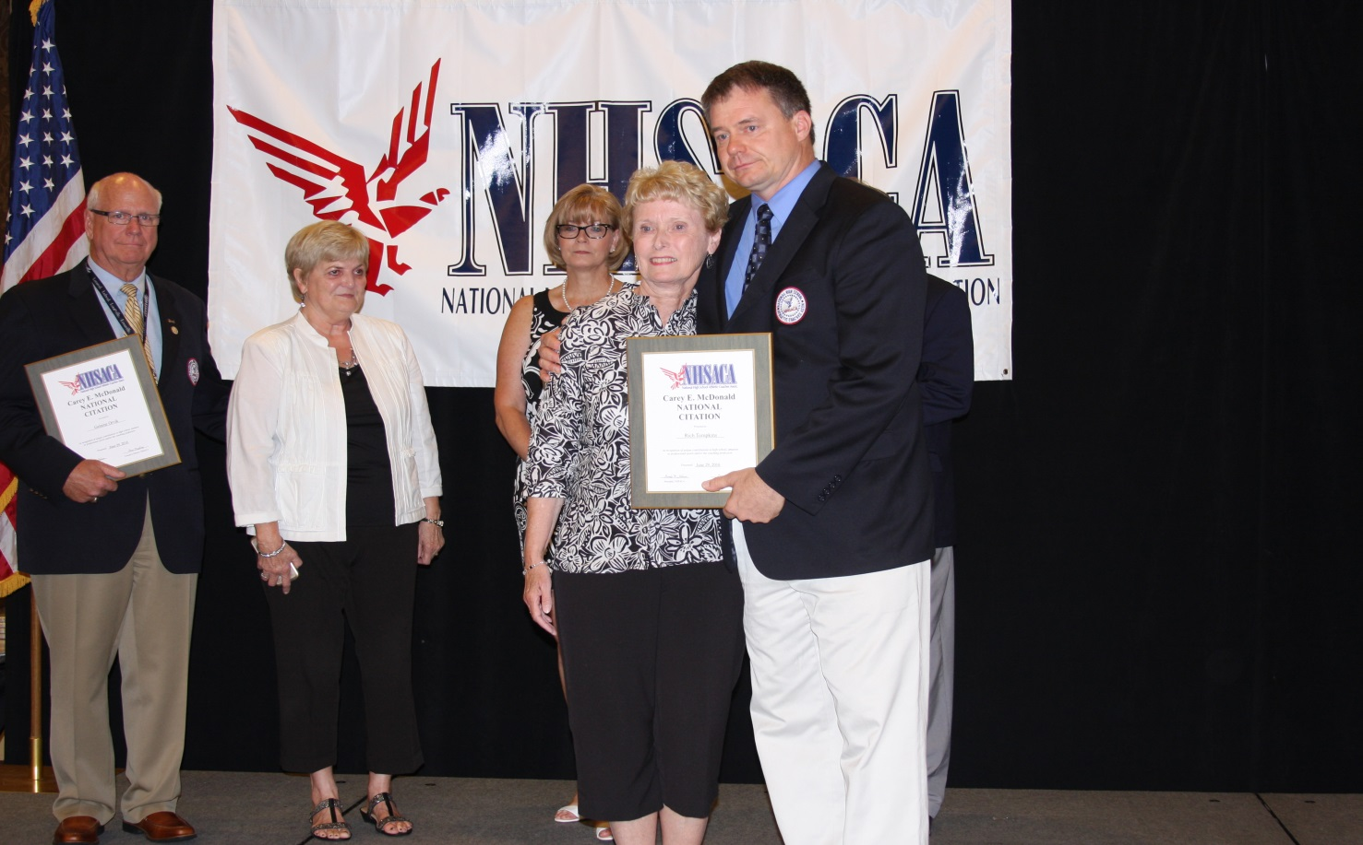
2016 NHSACA Carey E. McDonald National Citation Presented to Rich & Carole Tompkins

Slide 6
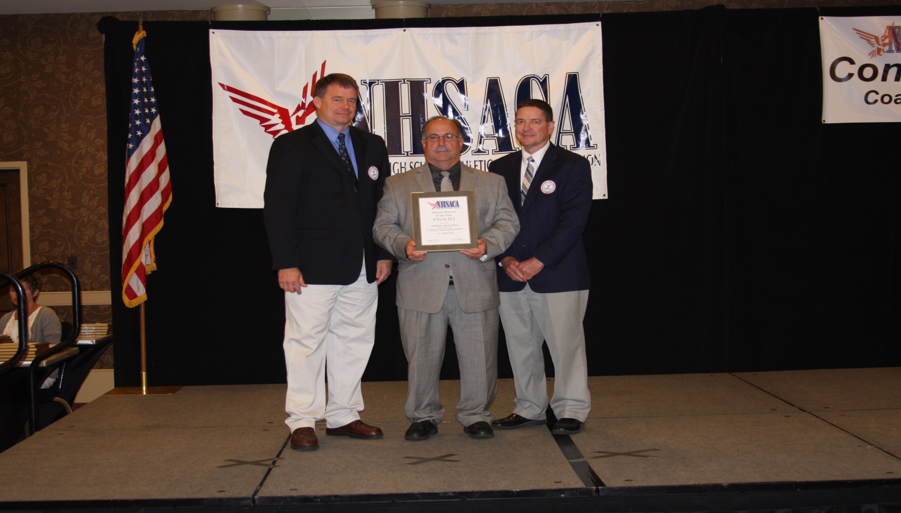
2016 NHSACA Coach of the Year Michigan Honorees
Athletic Director Mike Garvey- Kalamazoo Hackett Catholic Prep

Slide 7
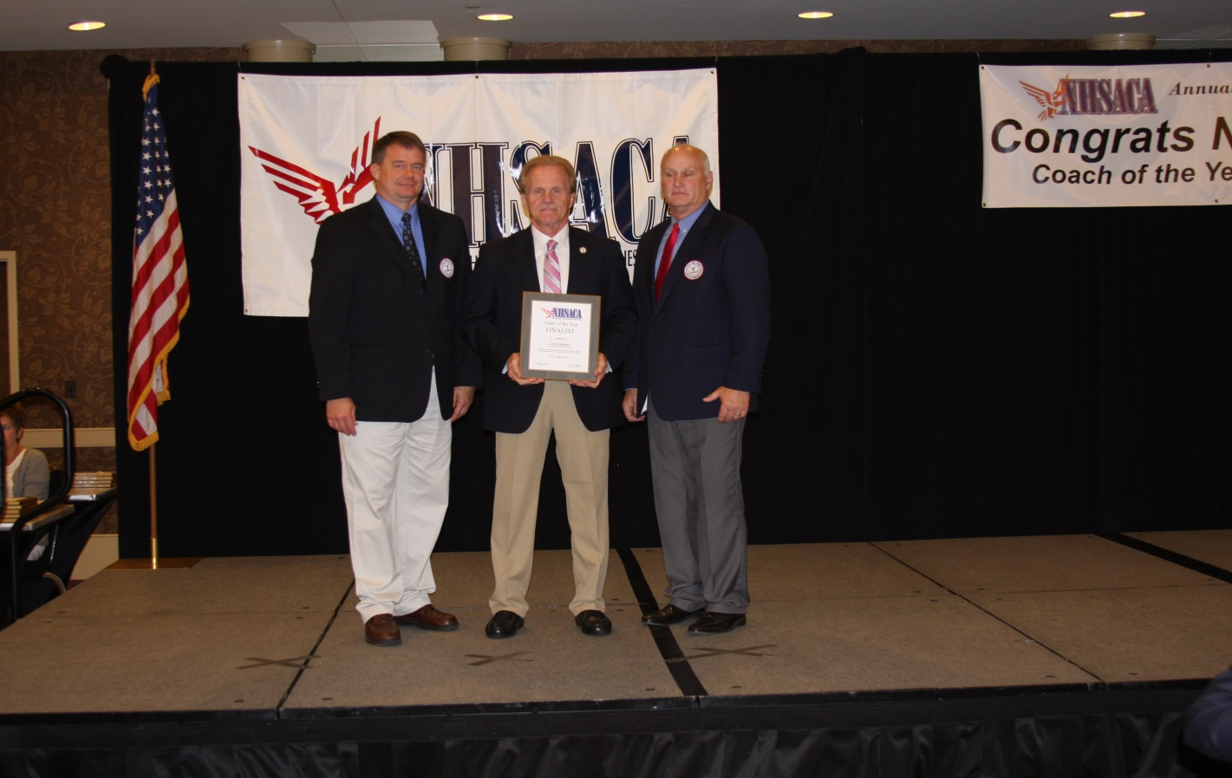
2016 NHSACA Coach of the Year Michigan Honorees
Baseball-Dan Griesbaum -Grosse Pointe South

Slide 8
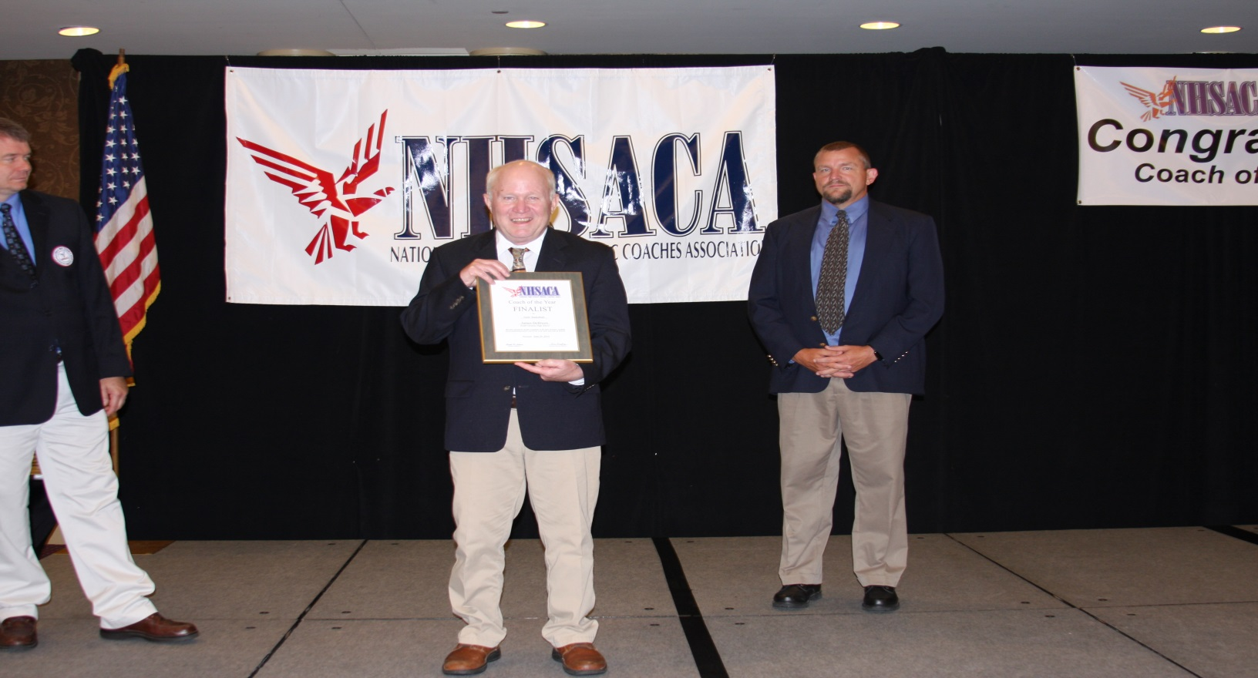
2016 NHSACA Coach of the Year Michigan Honorees
Girls Basketball -Jim DeBruyn- Bryon Center

Slide 9
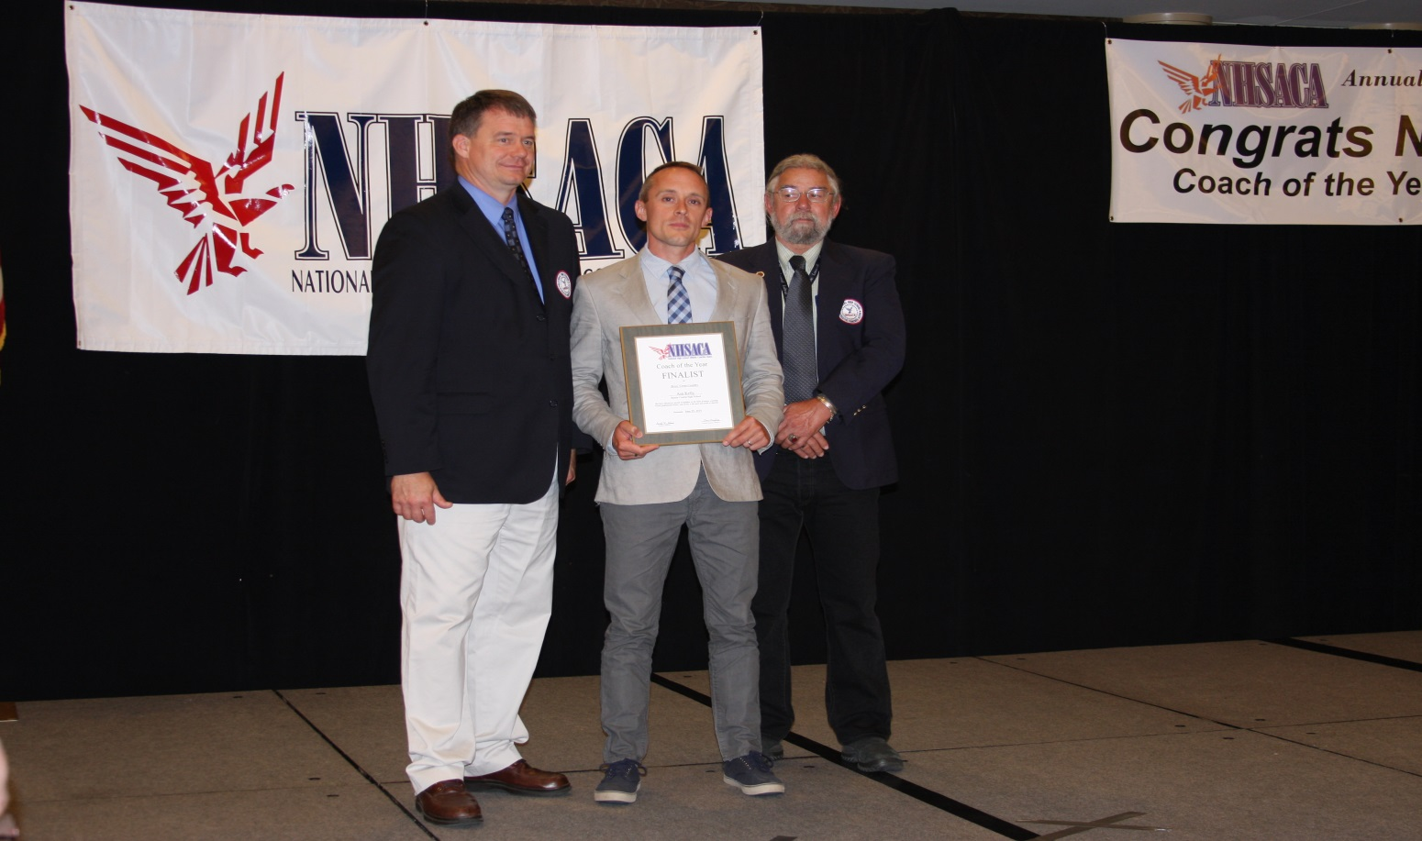
2016 NHSACA Coach of the Year Michigan Honorees
Boys Cross Country -Asa Kelly-Benzie Central

Slide 10
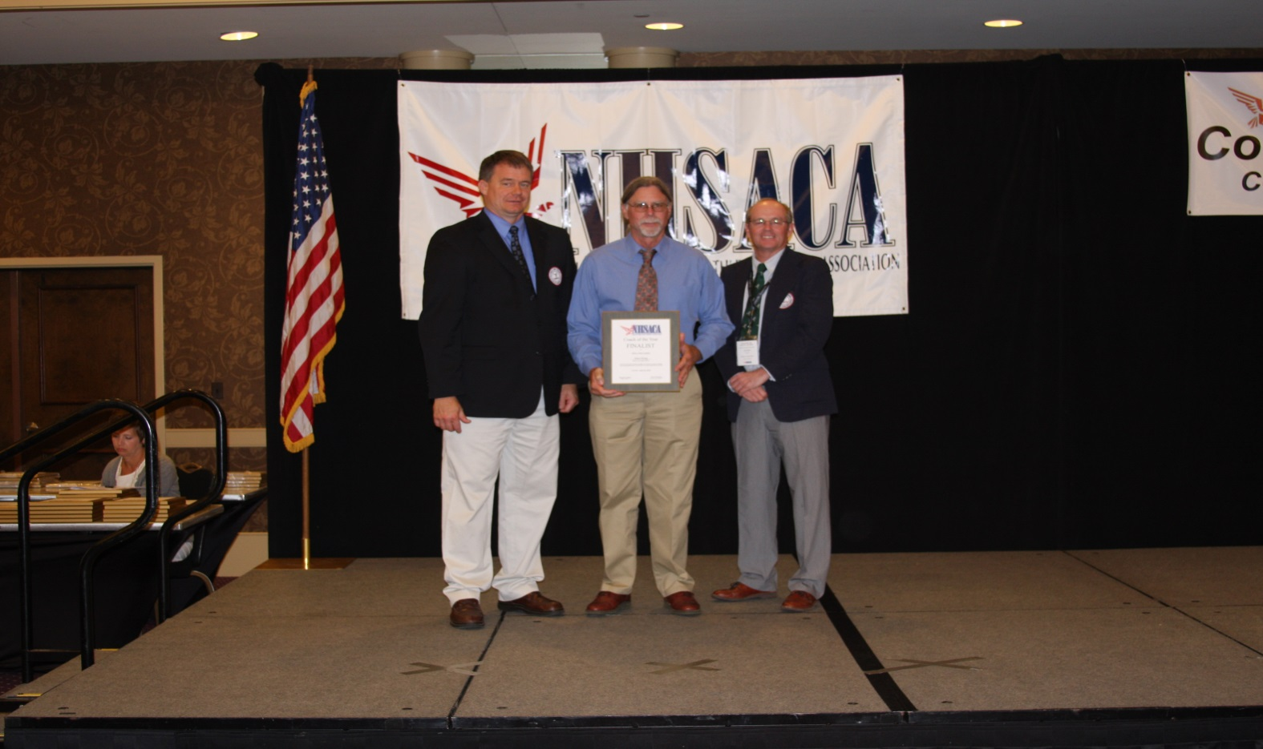
2016 NHSACA Coach of the Year Michigan Honorees
Girls Cross Country -Dave King -Beal City

Slide 11
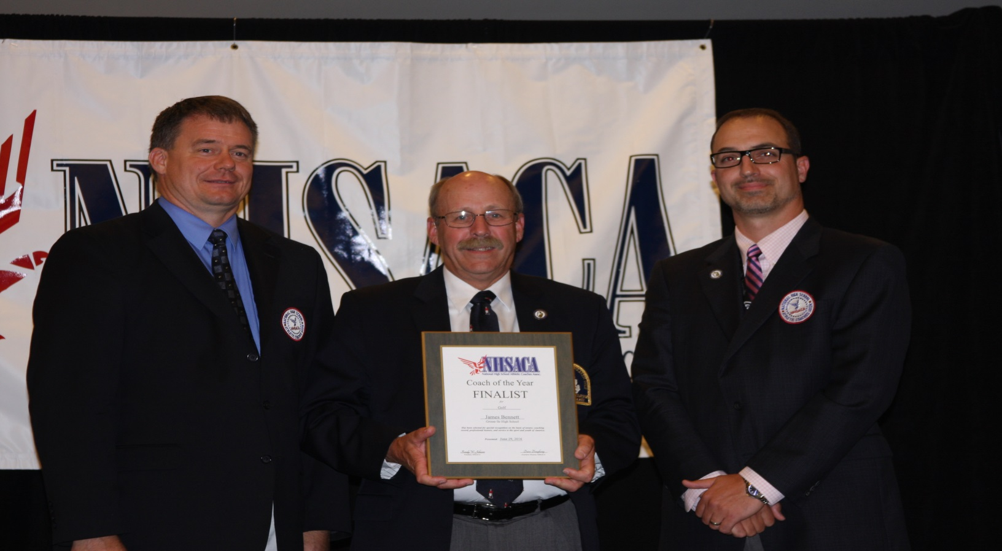
2016 NHSACA Coach of the Year Michigan Honorees
Golf -Jim Bennett-Grosse Ile

Slide 12
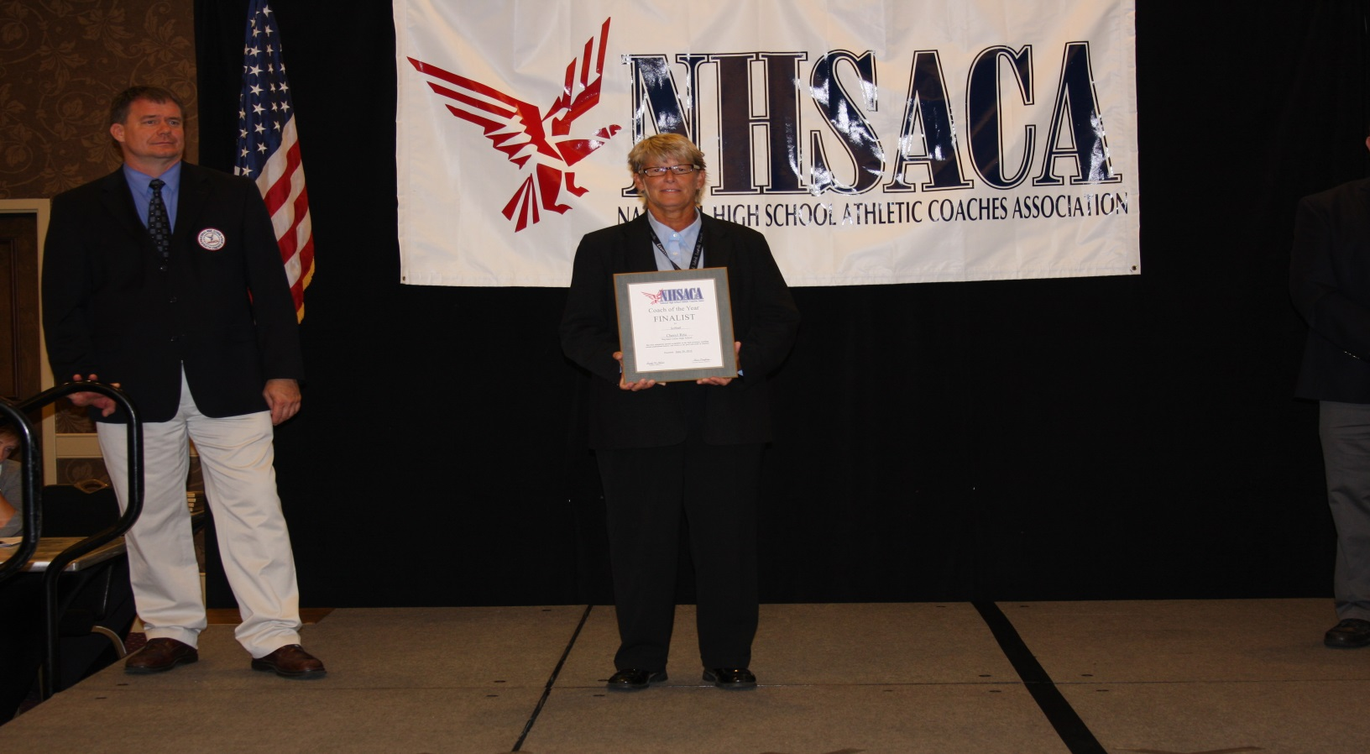
2016 NHSACA Coach of the Year Michigan Honorees
Softball-Cheri Ritz-Wayland

Slide 13
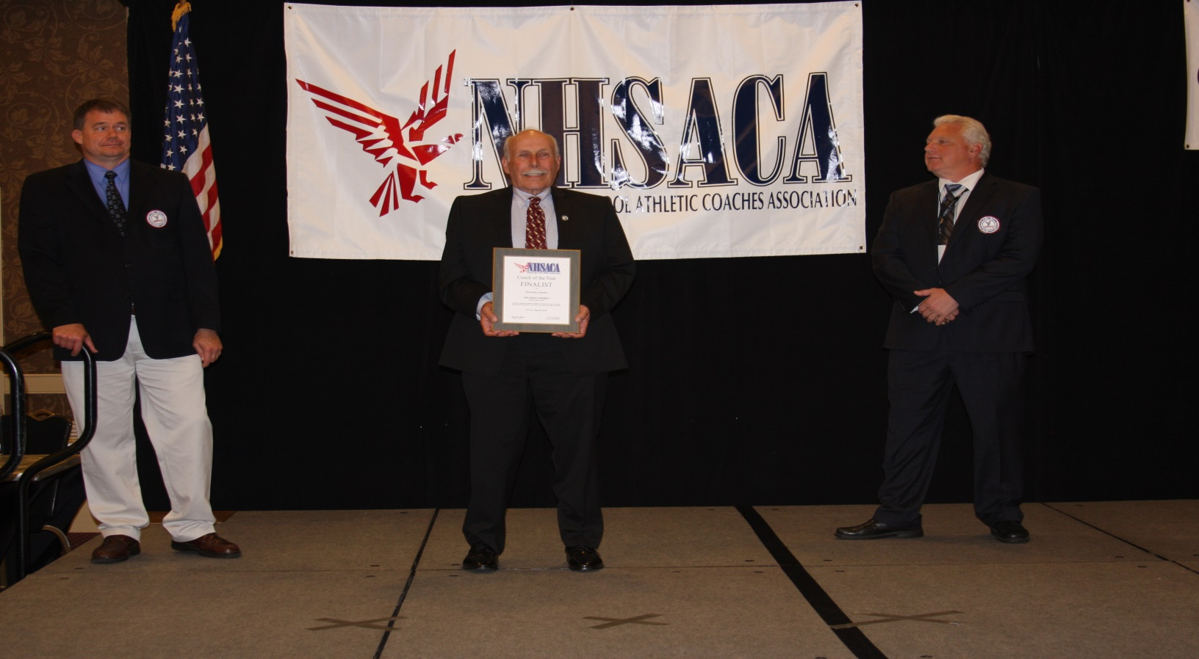
2016 NHSACA Coach of the Year Michigan Honorees
Special Sports Gymnastics-John Cunningham-Canton

Slide 14
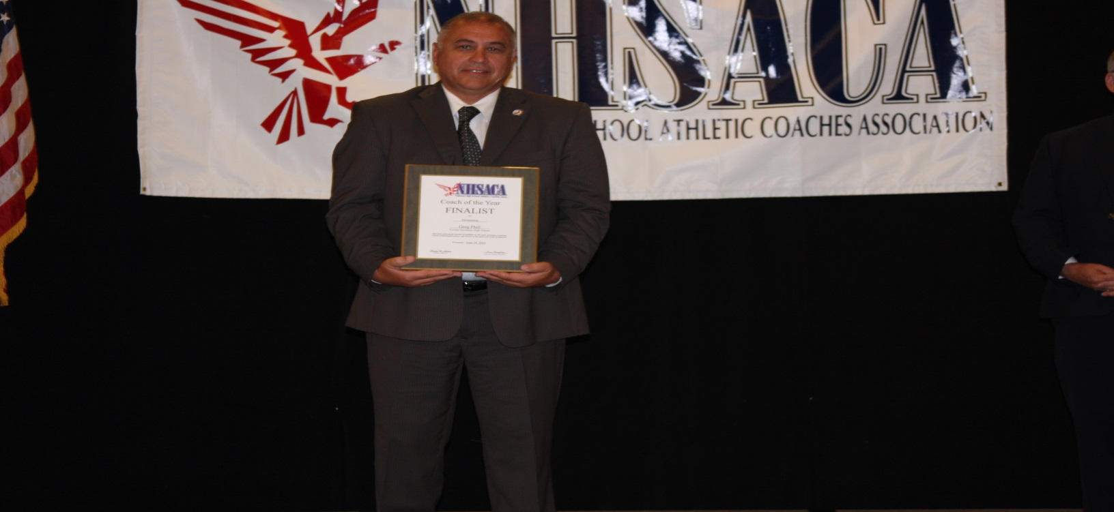
2016 NHSACA Coach of the Year Michigan Honorees
Swimming & Diving-Greg Phill- Lovonia Stevenson

Slide 15
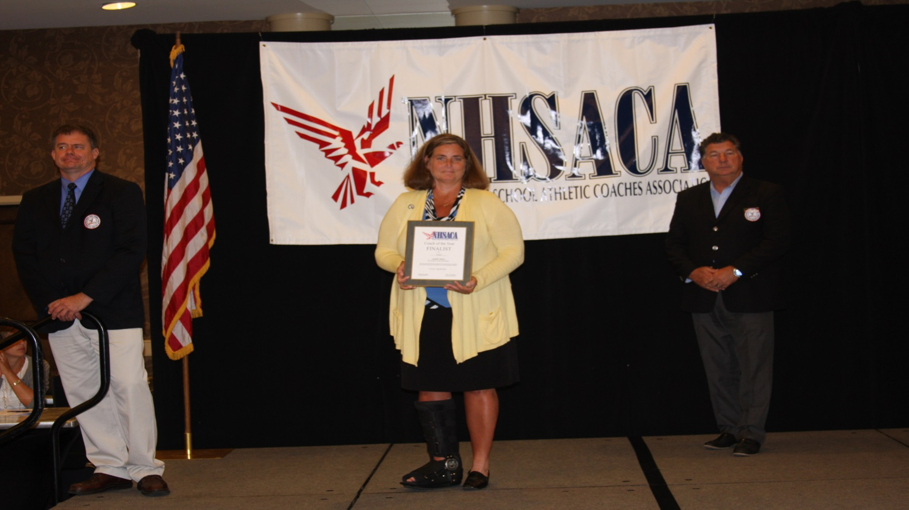
2016 NHSACA Coach of the Year Michigan Honorees
Tennis Judith Hehs-Academy of Sacred Heat Bloomfield Hills

Slide 16
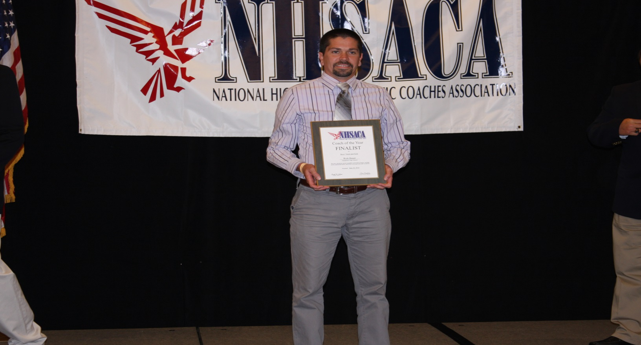
2016 NHSACA Coach of the Year Michigan Honorees
Track & Field Boys-Rick Bauer-Saugatuck

Slide 17
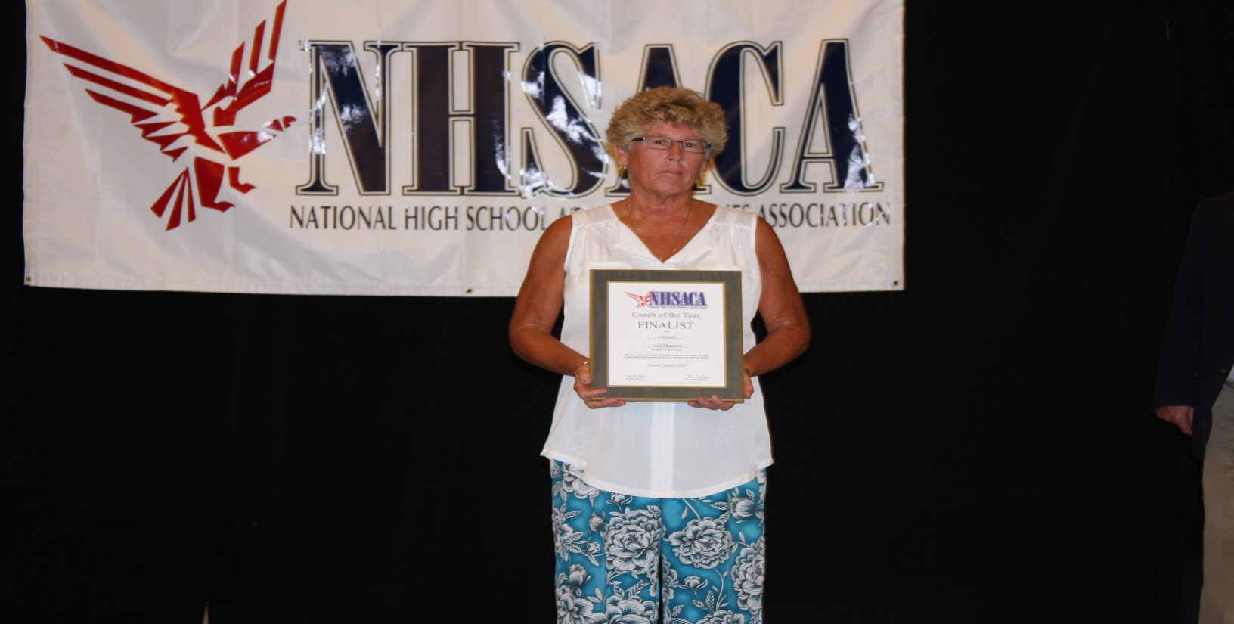
2016 NHSACA Coach of the Year Michigan Honorees
Volleyball-Jodi Manore-Temperance Bedford

Slide 18
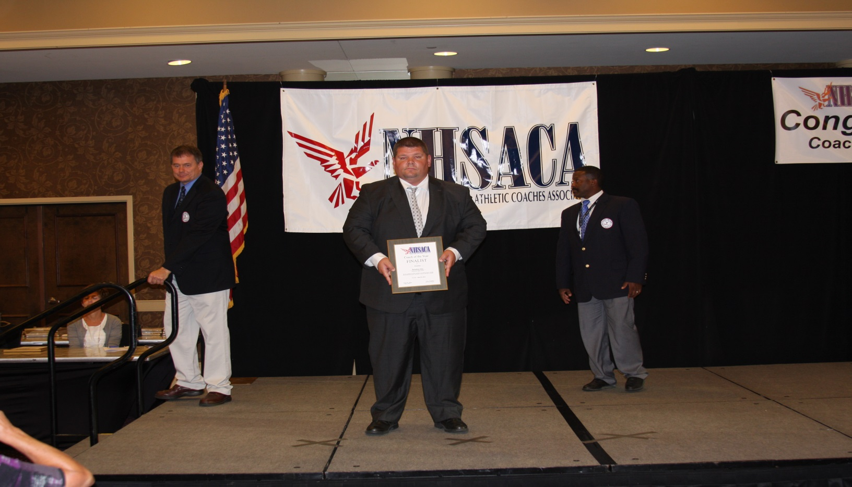
2016 NHSACA Coach of the Year Michigan Honorees
Wrestling-Brandon Day-Richmond

Slide 19
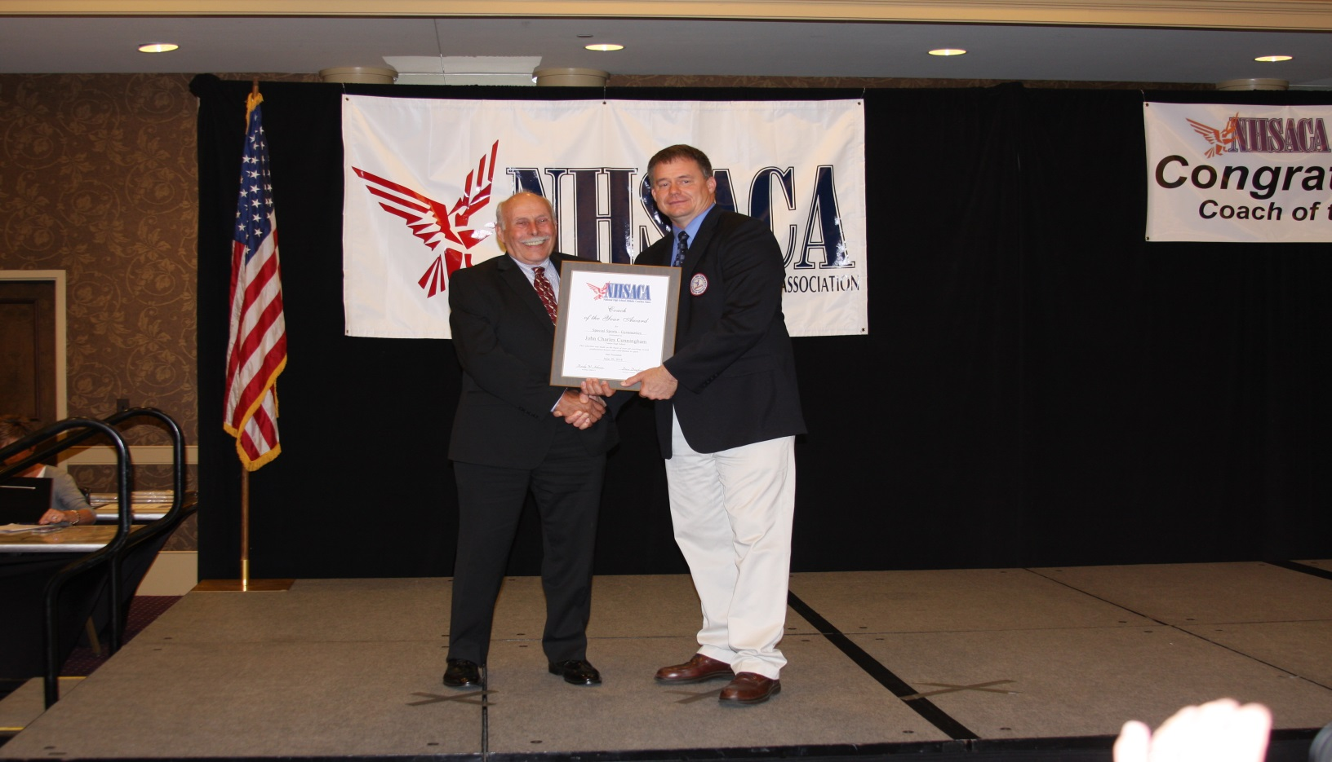
2016 NHSACA NATIONAL COACH OF THE YEAR
Special Sports Gymnastics-John Cunningham-Canton

Slide 20
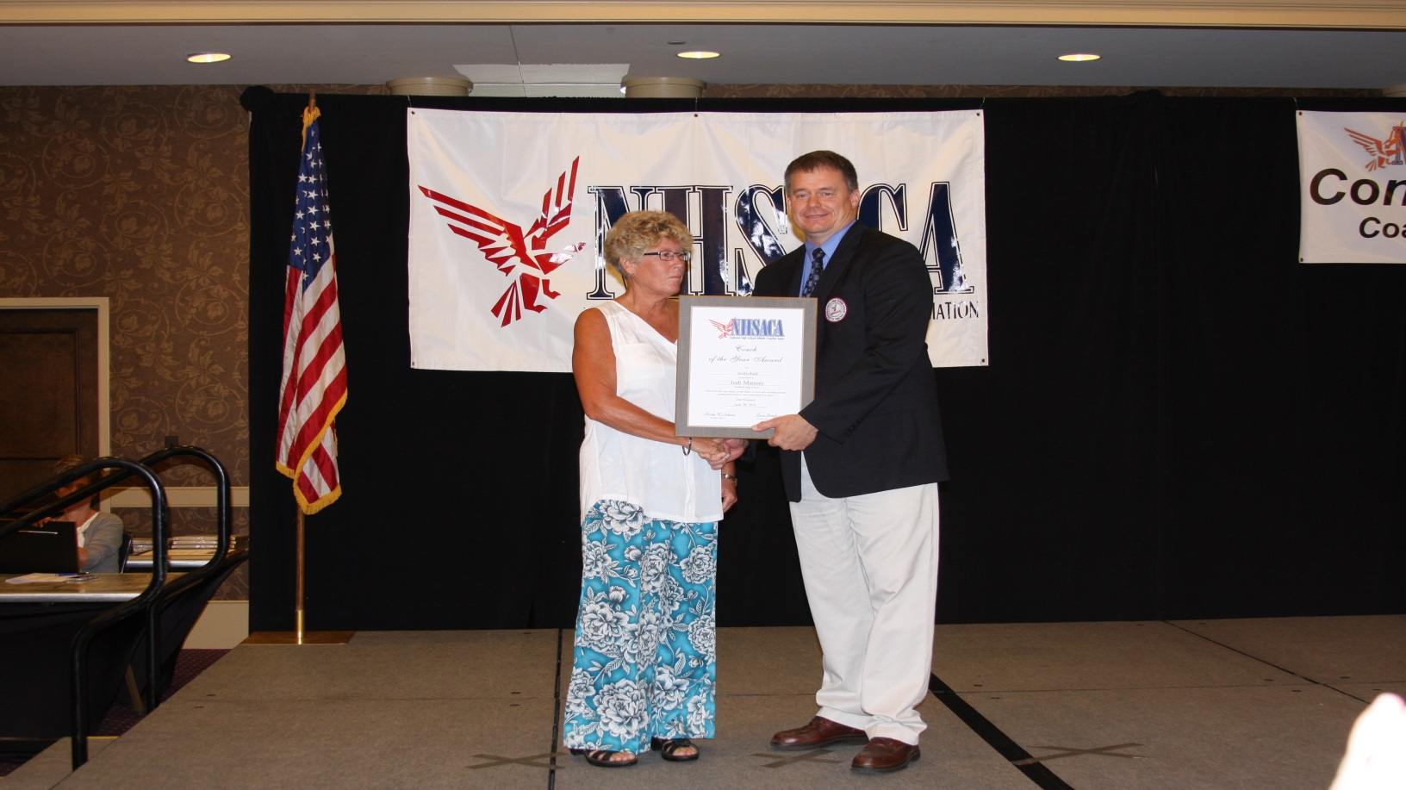
2016 NHSACA NATIONAL COACH OF THE YEAR
Volleyball-Jodi Manore-Temperance Bedford

Slide 21
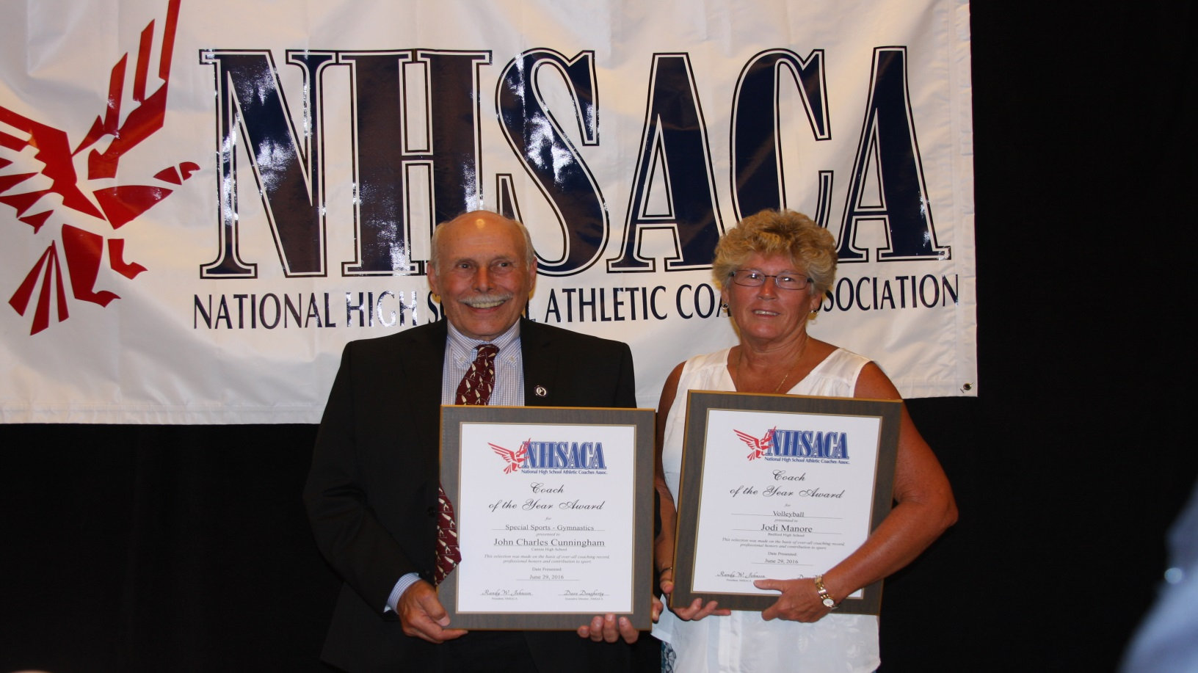
2016 NHSACA National Coach of the Year
John Cunningham & Jodi Manore

Slide 22
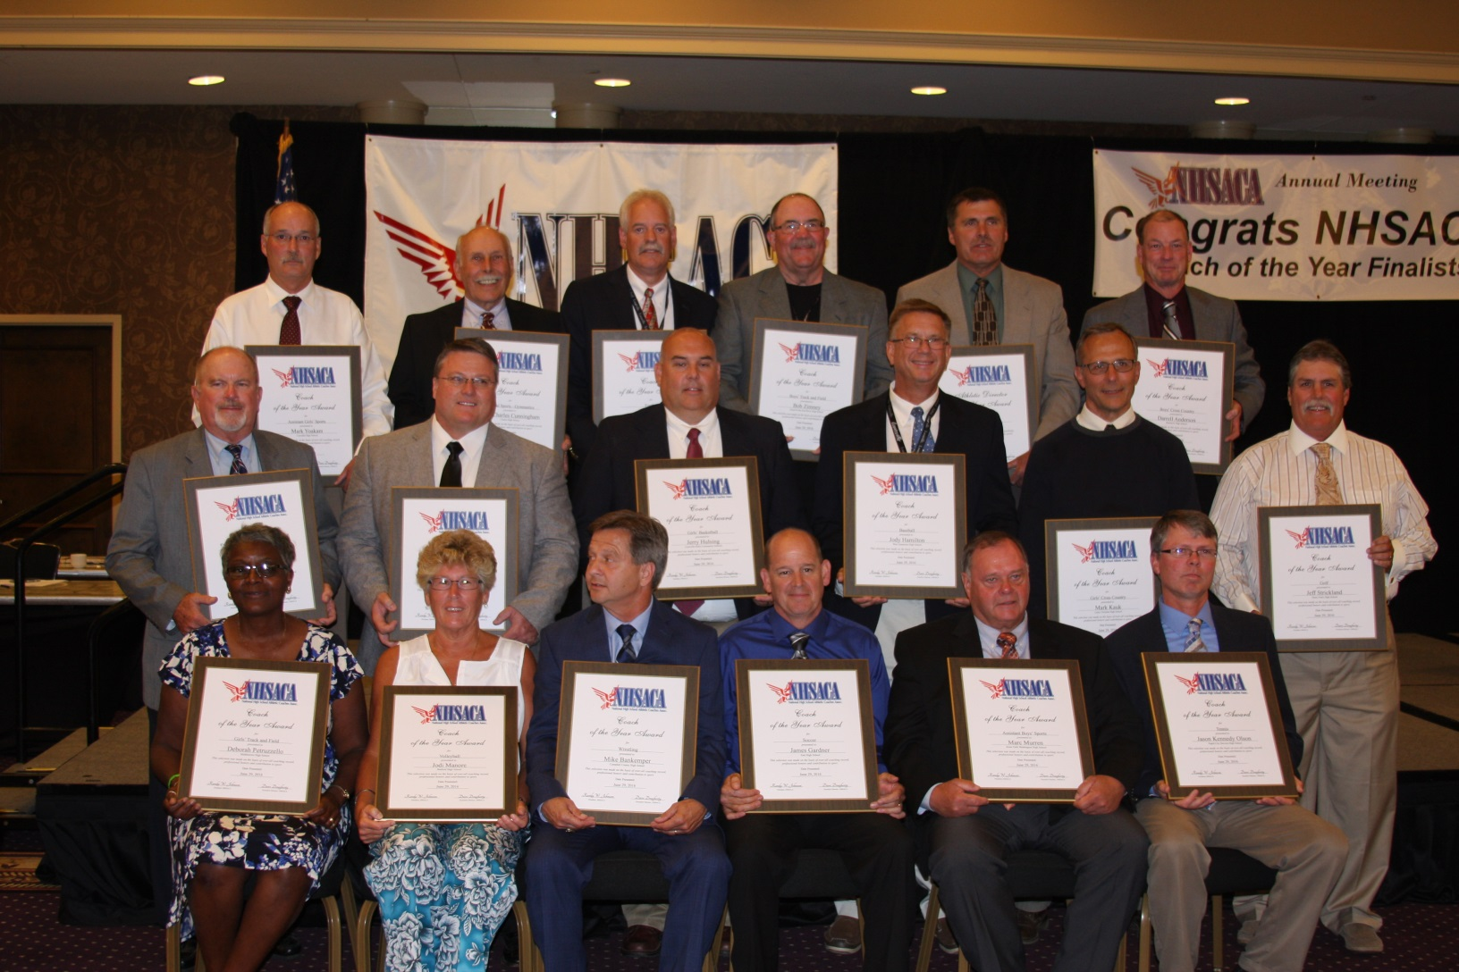
NHSACA NATIONAL COTY TEAM

Slide 23
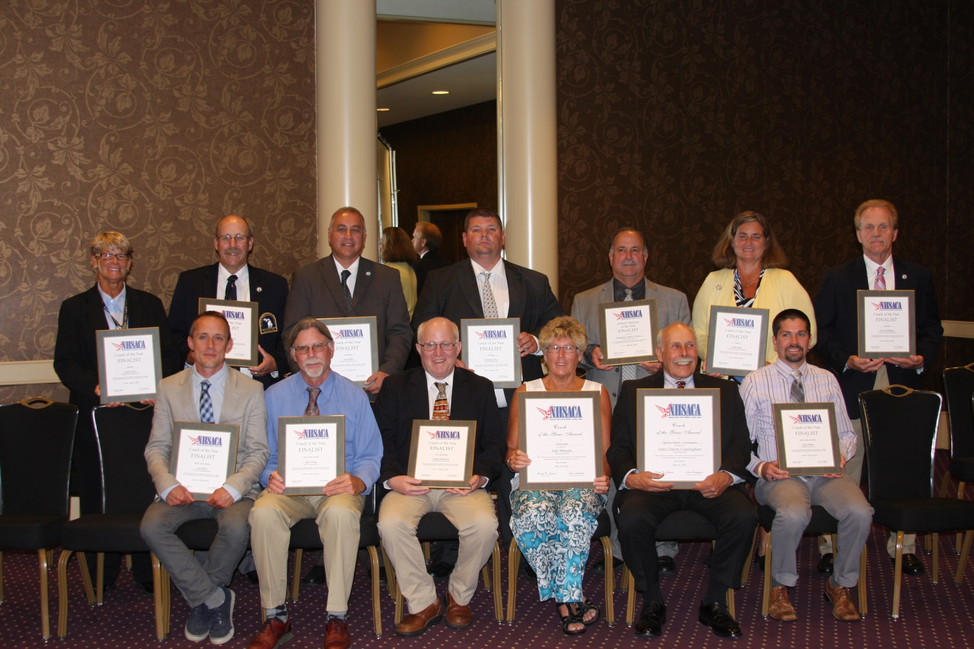
NHSACA COTY MHSCA TEAM

