Slide 1

Fundamentals of cross training
Presented by Lisa Rainsberger
Coronado HS XC/TF Coach

Slide 2
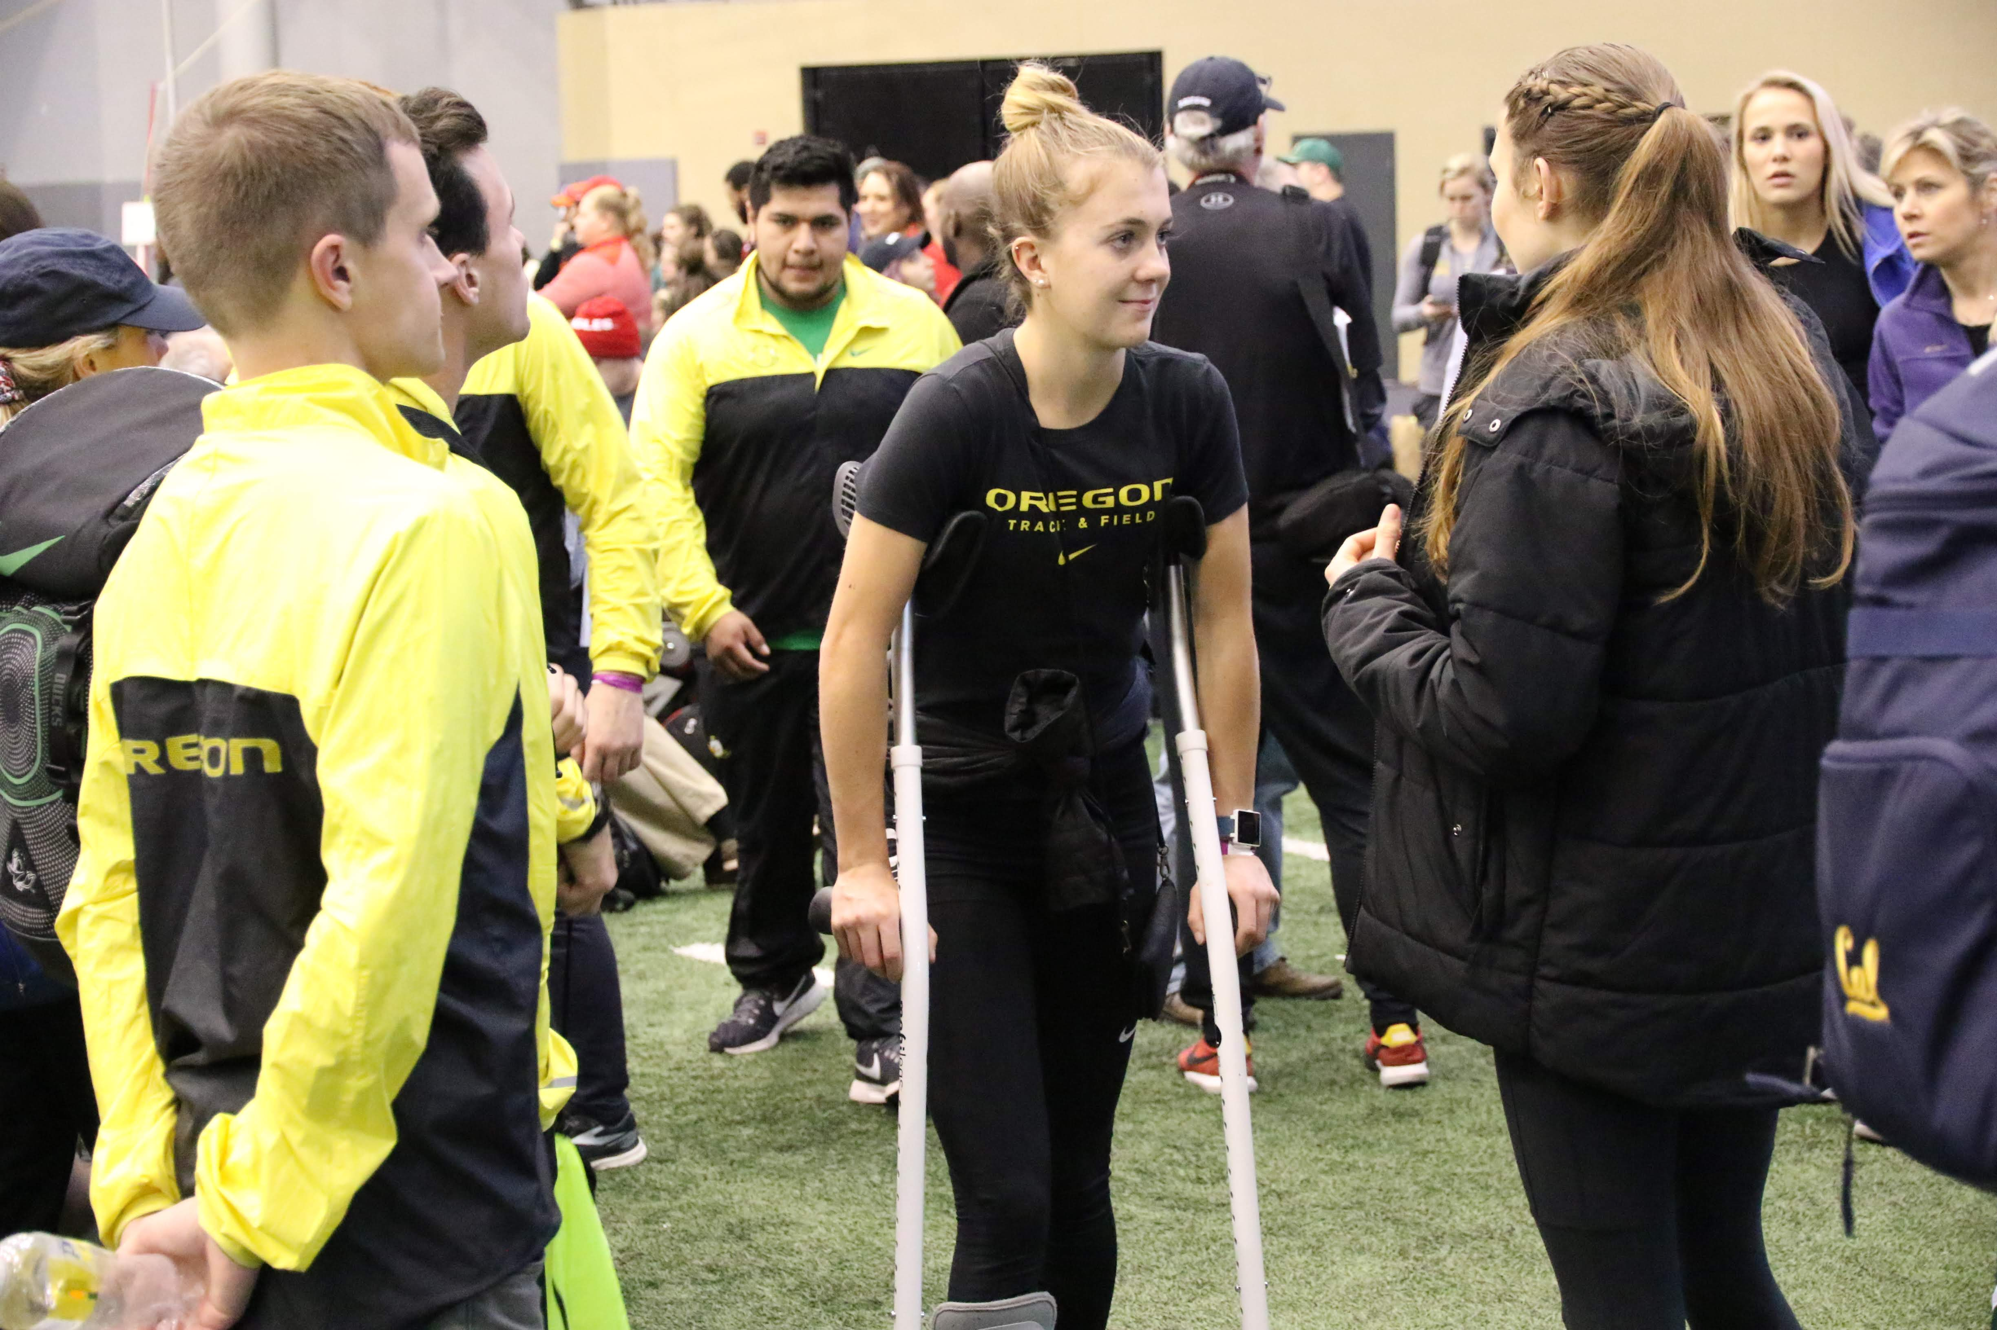
Why Cross Train? Why Have to cross train? injuries happen but
Are they preventable?
Injury Prevention
Rehabilitation through injury
Supplement for increased training volume
Promote Recovery
Enhance motivation through workout variety
Added strength, agility, range of motion

Slide 3
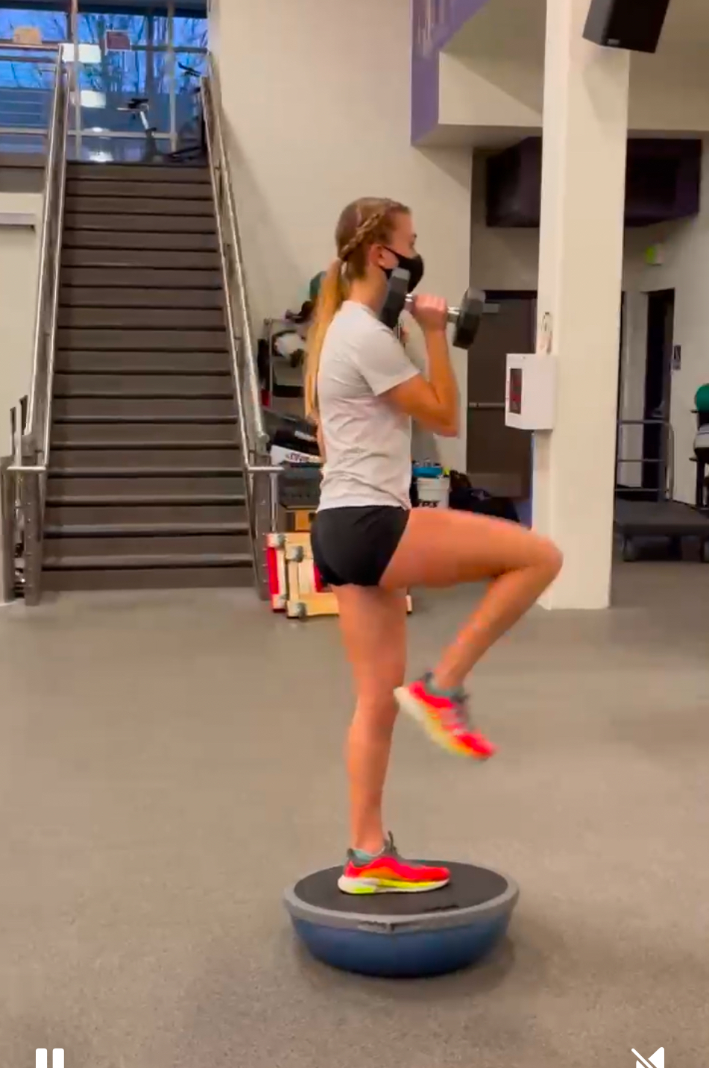
Benefits of cross training
Injury Prevention.
a. Use different muscle groups preventing muscle overload.
b. Improve muscle flexibility and stability
c. Allows active recovery by switching b/t high and low impact training.
Rehabilitate and train through injury.
a. Impact reduction while training through injury,
b. Maintains fitness and strength,
C. Upper Body Strength *blessing in disguise.
d. Improved flexibility and range of motion
e. Mental health benefits. Positively impacts mood and motivation
Added training volume
a. Adds increased training volume,
b. Allows for double training days.

Slide 4
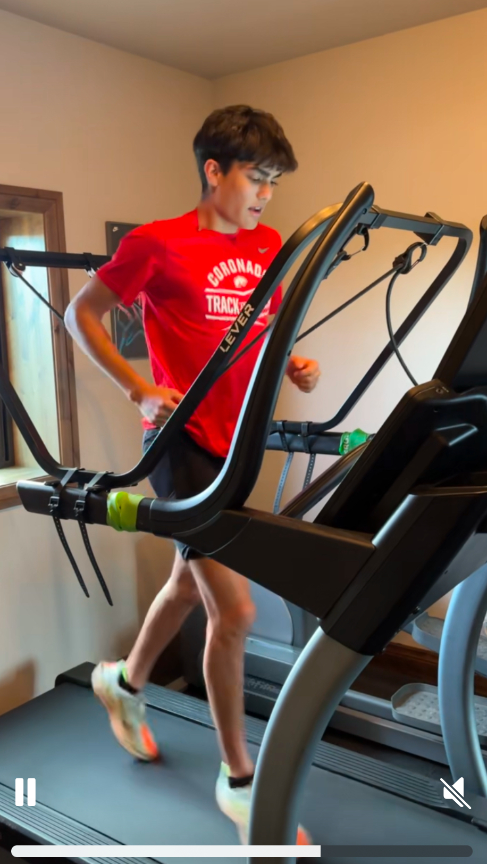
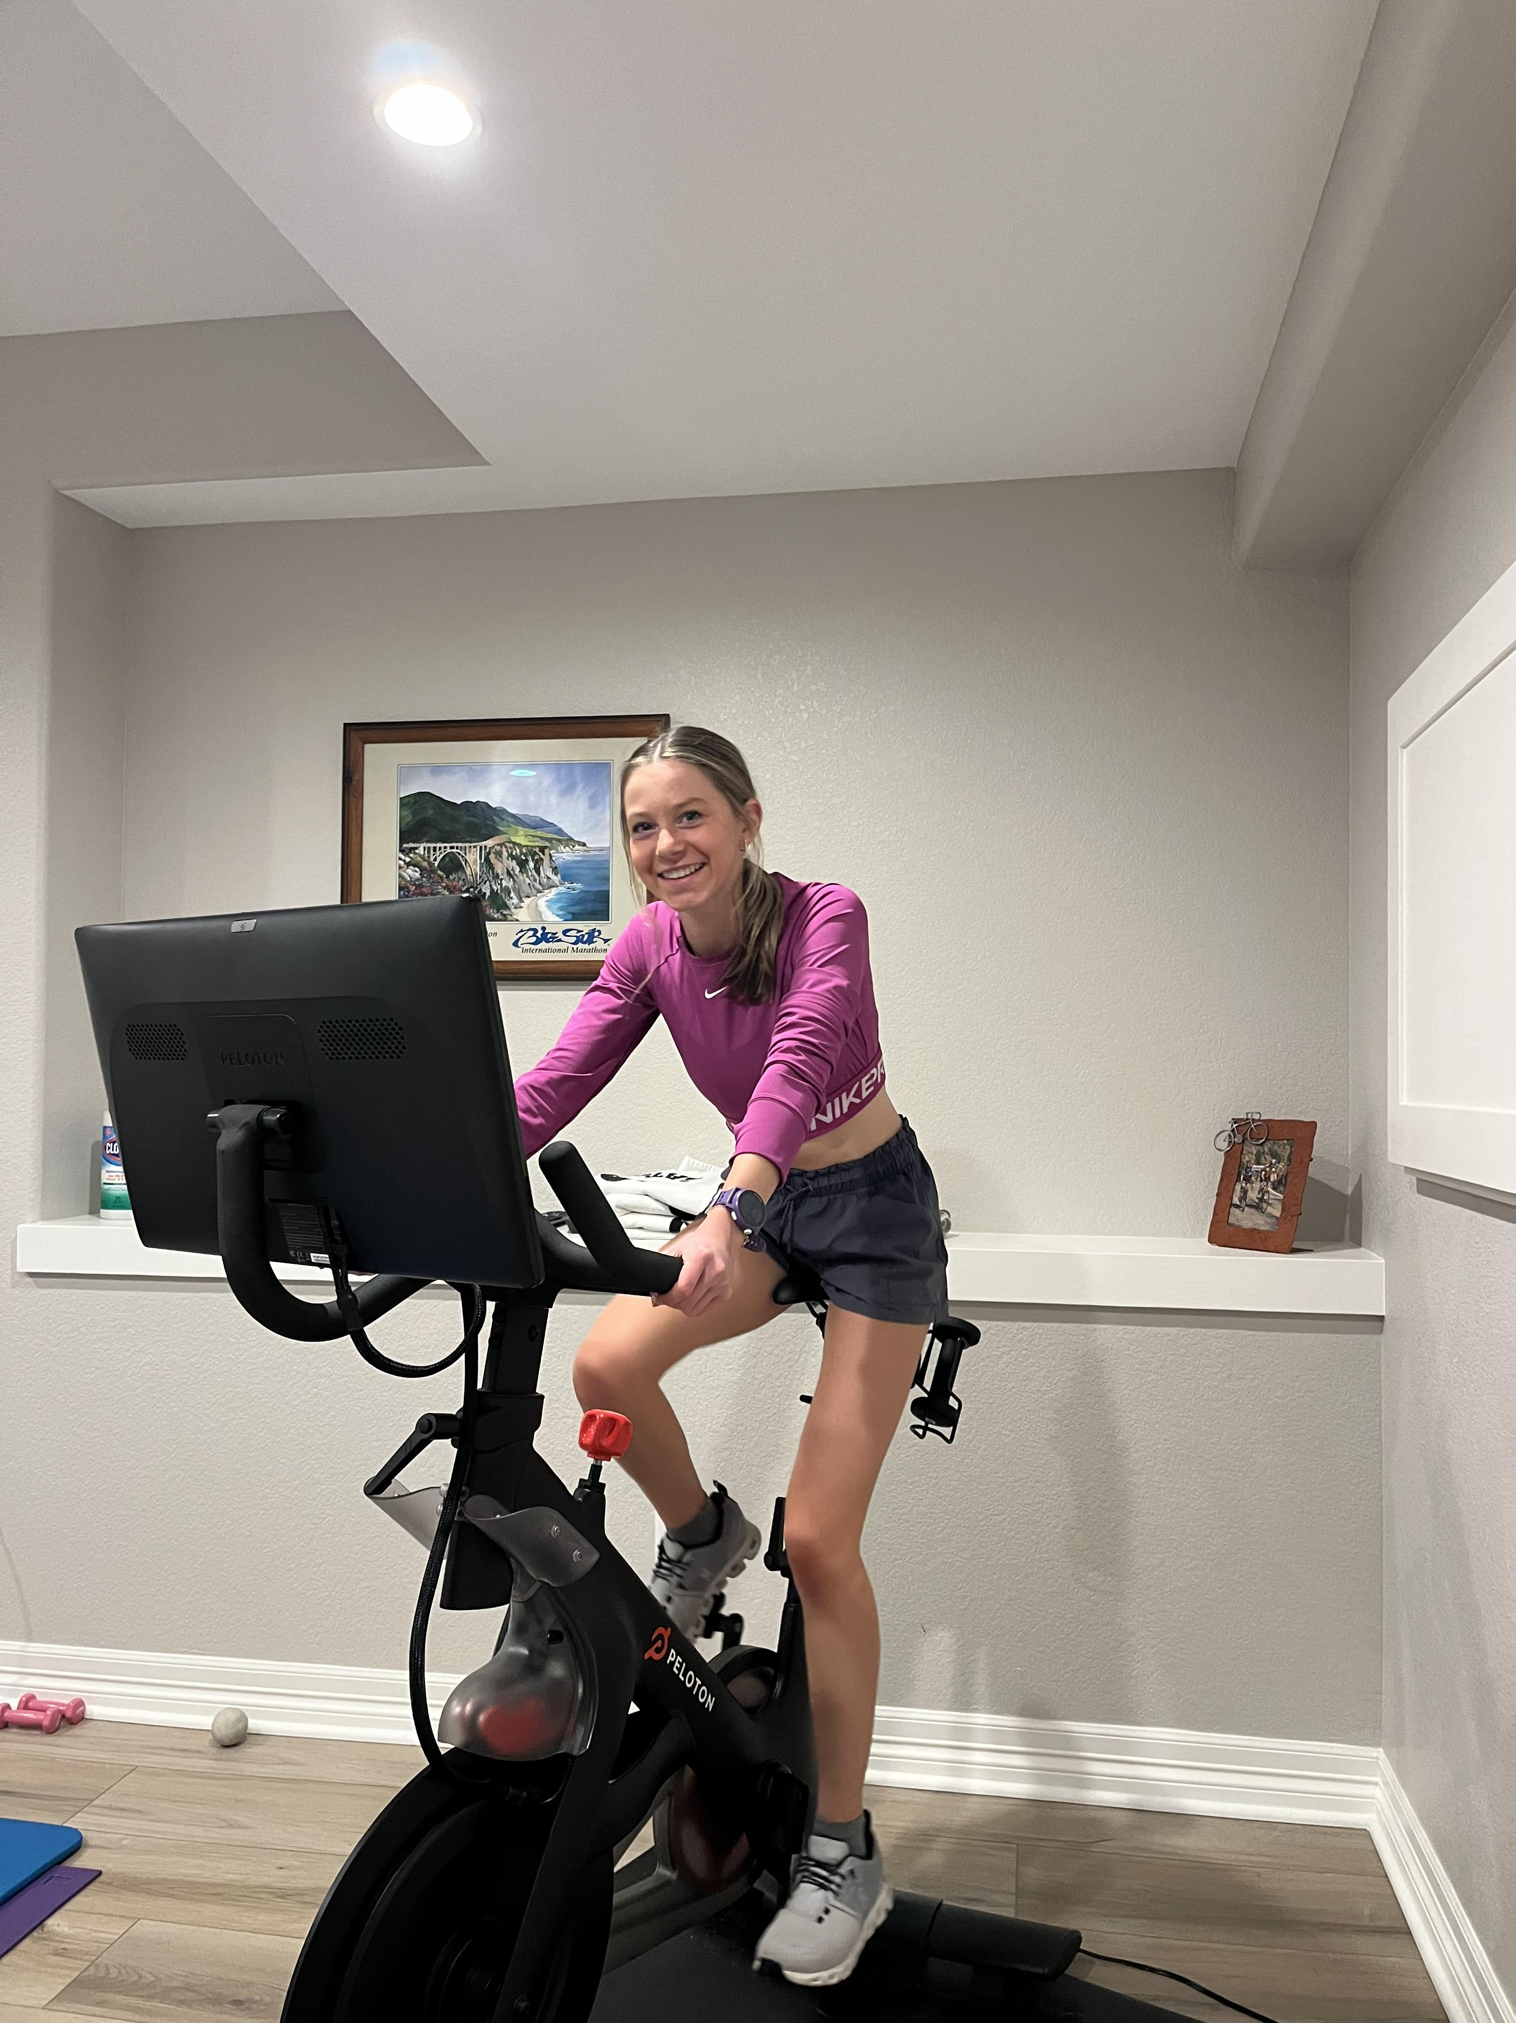
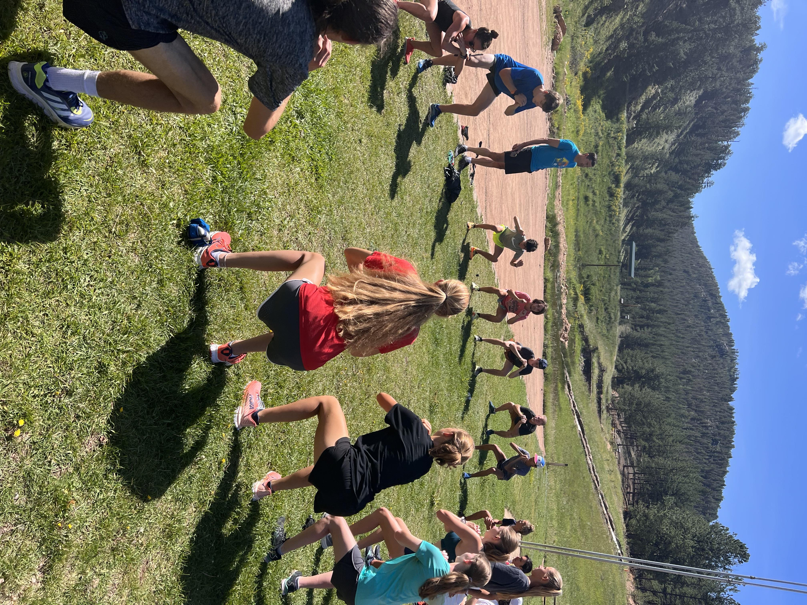
Types of cross training for distance runners
Elliptical Machine
Cycling
Deep water pool running
Yoga
Weights
Lever / Alter-G Machine
Rowing Machine

Slide 5
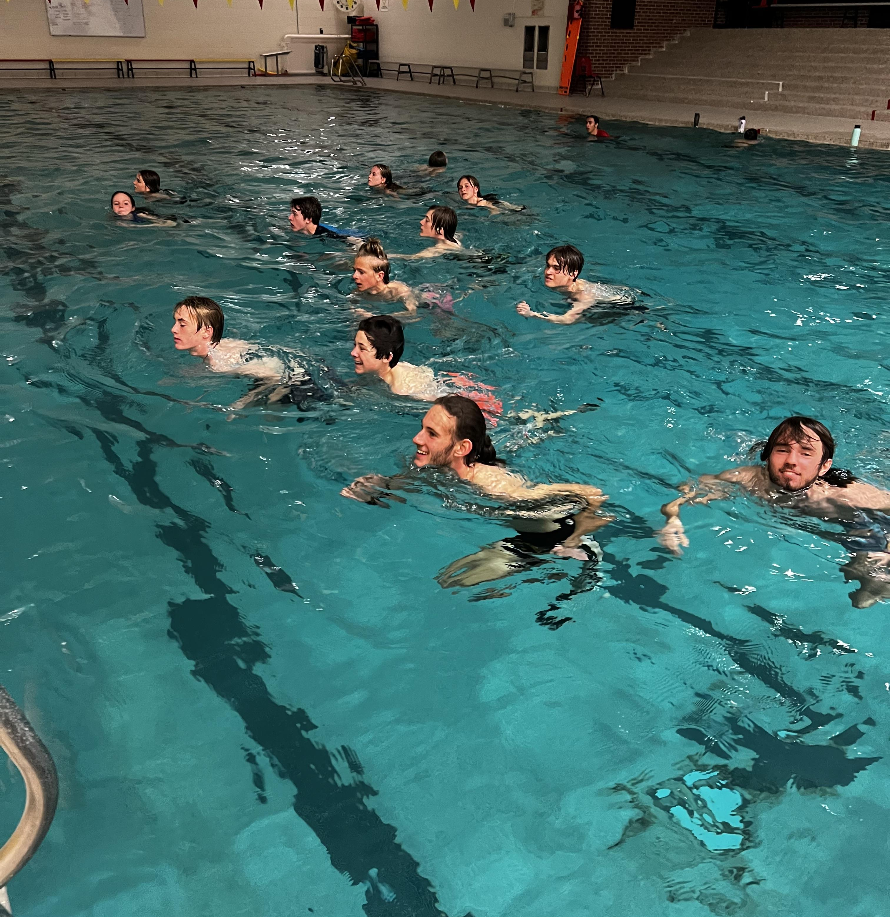
Creating the cross-training program
Athletes look for guidance when injured. They tend to be mentally fragile so giving them a cross training “plan” will help guide them back safely and with added motivation and purpose.
Establish what they have been cleared to do by their health care provider.
Create a training plan based on their injury, length of recovery and training equipment availability.
Incorporate team cross training workouts that will allow injured athlete to train with his/her teammates. For example, pool running workouts, Have injured athlete meet team at long run locations and bike ride their workout.

Slide 6
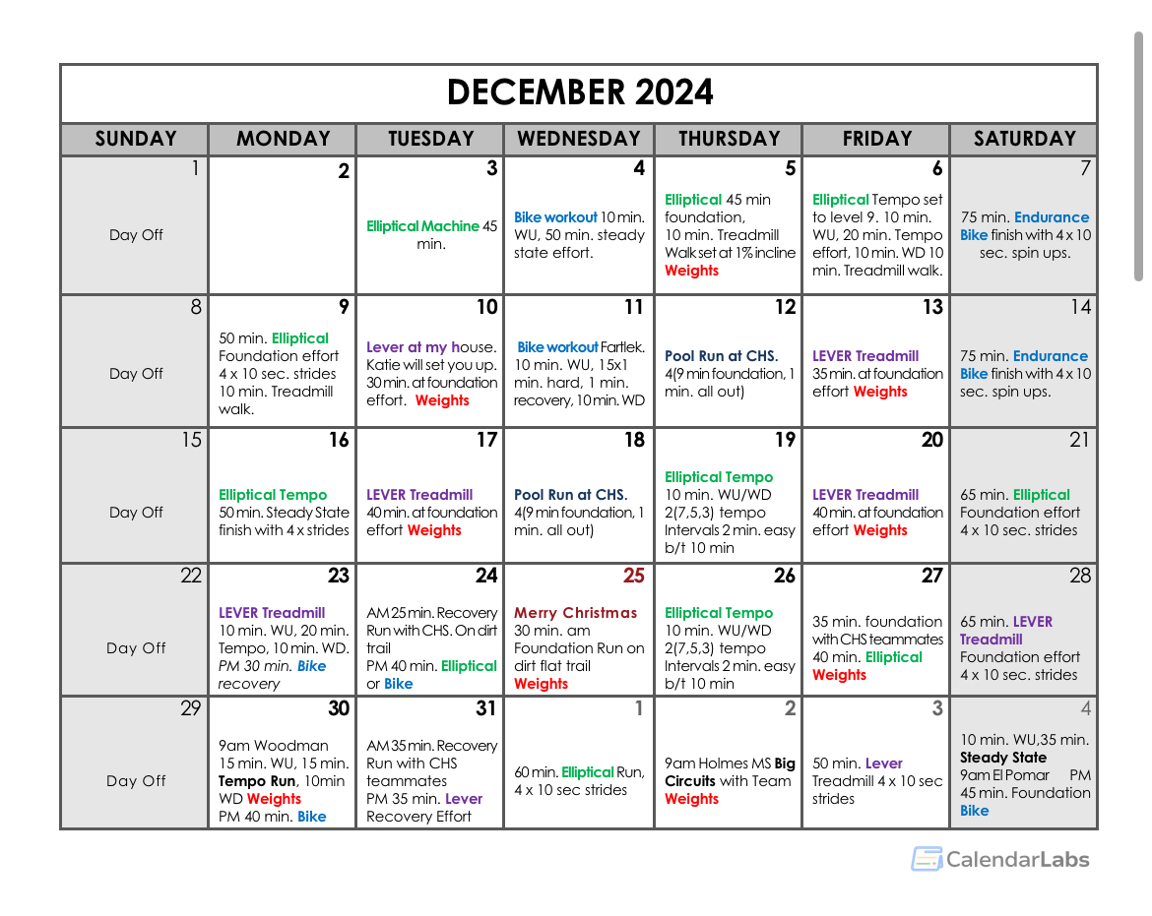
Individualized cross Training plans
1. Create individualized training plans - based on injury, goals, timeframe, and available equipment and gym membership
2. Biggest complaint – Injured athletes feel disconnected from the team. Create workouts that incorporate the team.
3. .Build workouts the athlete is familiar with. Familiar workouts like fartlek, tempo, intervals based on perceived exertion.

Slide 7
Cycling Workouts
Benefits of using cycling to cross train
Allows for increased training volume and training frequency
Allows non-impact training during injury
Can prevent overuse injuries for those prone to injury
Power Meter training: Determine Functional Threshold Power FTP is the sustainable max power output for 1 hour.
  Active Recovery 55% of FTP
  Endurance 56-75% of FTP
  Steady State 76-90% of FTP
  Tempo 76-87%
  Threshold Intervals 91-105% of FTP
*if you don’t have a power meter encourage athletes to train using Perceived Exertion vs. HR ranges.
***Bike Seat Height have athlete sit on bike, place heel on pedal at the bottom of pedal stroke. Leg should be fully extended and hips level not dipped.

Slide 8
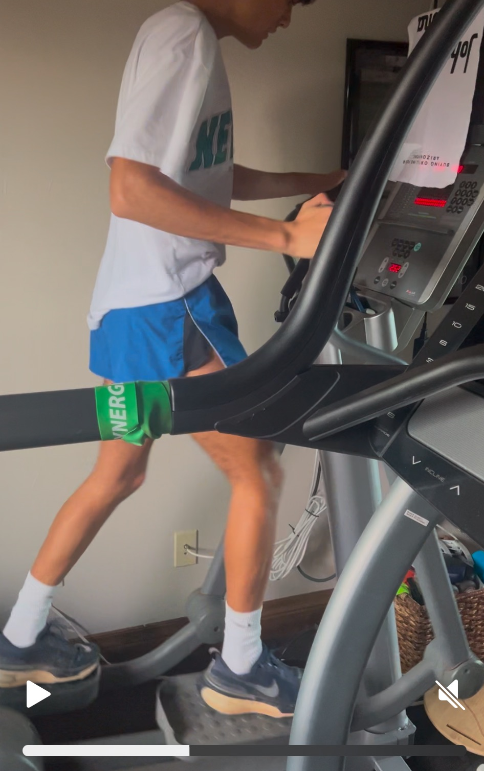
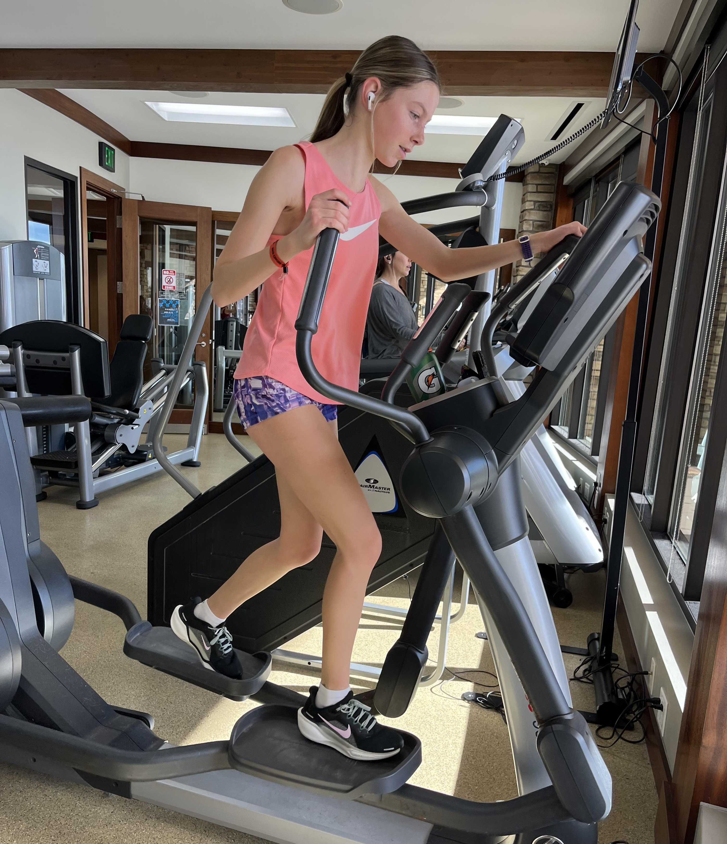
Elliptical Training
1.Elliptical Training is perhaps the closest type training simulation to running. Offers Non-impact with the ability to train at high intensity and duration.
2.Stride Rate/RPM: Depending on the workout, set the level of intensity so that the athlete maintains his/her normal running stride rate. Typical stride rate for an elite runner is 180 steps per minute. This rate can increase and decrease depending on the pace and intensity of the workout.
3. Replicate Running Training Write workouts that athletes are familiar with. Base level of intensity on PE and HR.
4. Arms or no arms? Hands free helps with balance and core stability, however using arms also adds upper body strength I suggest a mix of arms and no arms during the workout.

Slide 9
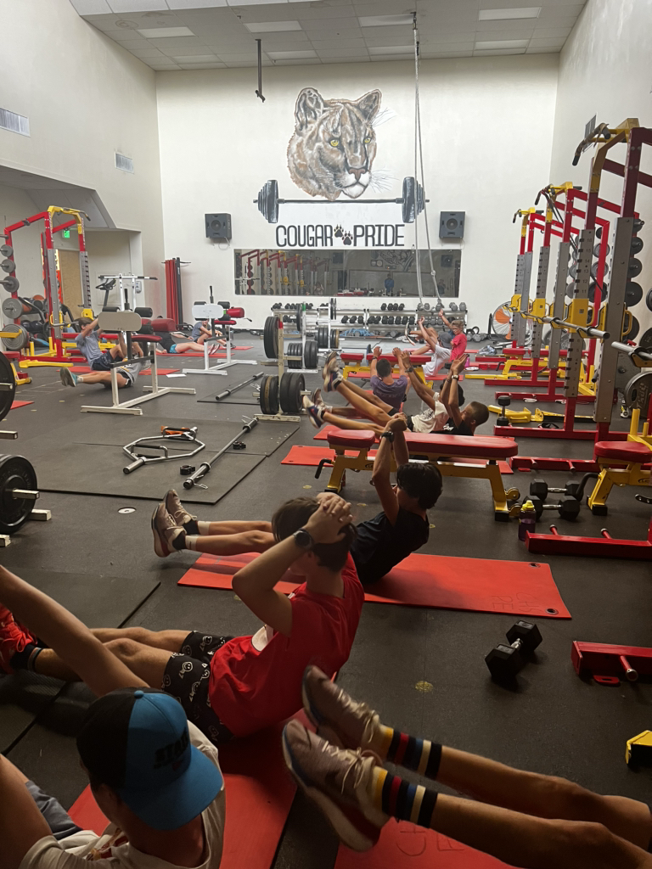

Benefits of Strength & weight Training
1. Increase muscular endurance
2. Increased Power (explosiveness)
3. Improves speed and running economy
4. Reduced risk of Injury
5. Lift 3x week after hard training days *keep hard days hard, recovery days recovery.
6. Allows Injured athletes to train with the team to maintain connection and community.
Notes:
Lever training device

Slide 10
Benefits of Alter-G or Lever Training
1. Allows for earlier and safer return to run after injury
2. Improves gait and stride rate during return to run.
3. Improved coordination and proprioception
4. Allows for cardio training without full force of gravity
5. Helps bone health recovery
6. Helps tendons and bones load in a controlled setting in order to begin repairing.

Slide 11
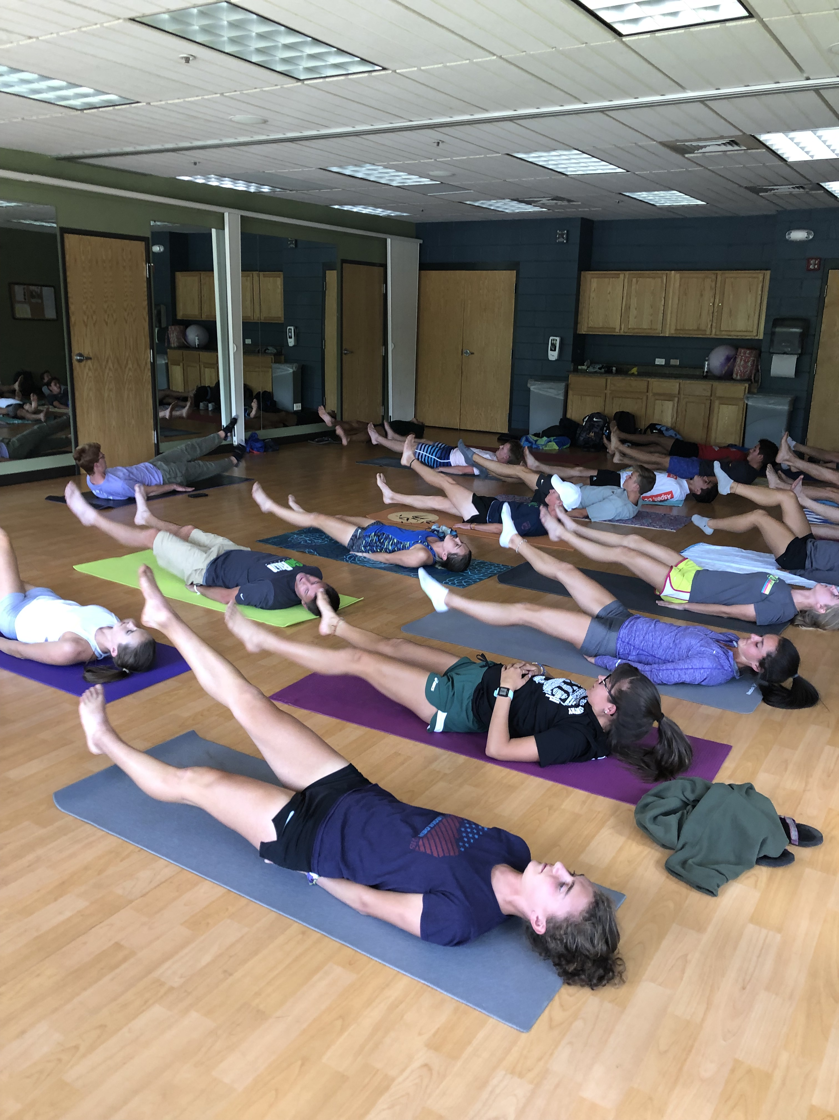
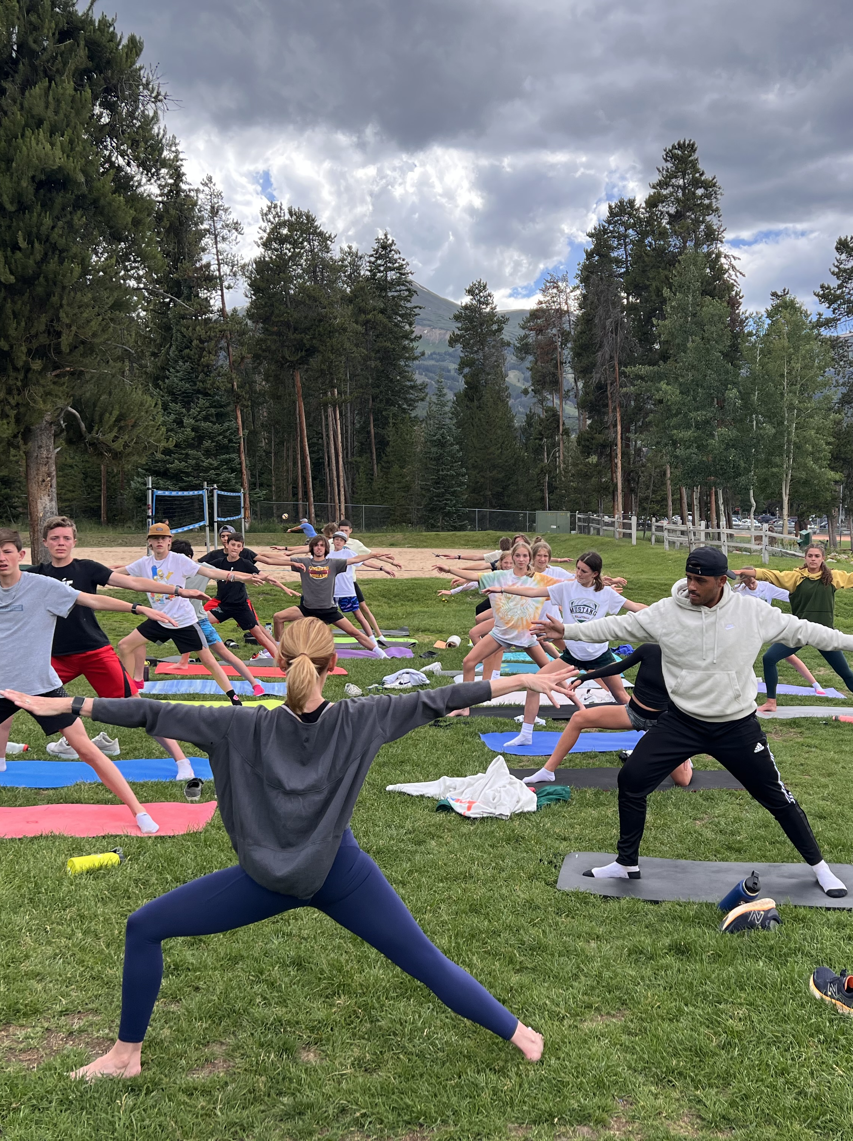
Benefits of Yoga TRaining
1. IMPROVES FLEXIBILITY!
2. Strength Building
3. Enhanced posture and center of gravity
4. Balanced and controlled breathing
6. Reduces stress and cortisol levels
7. Enhances recovery
8. Team bonding, injured athletes can train with the team
9. Peer led class, school yoga teacher, video yoga class,

Slide 12
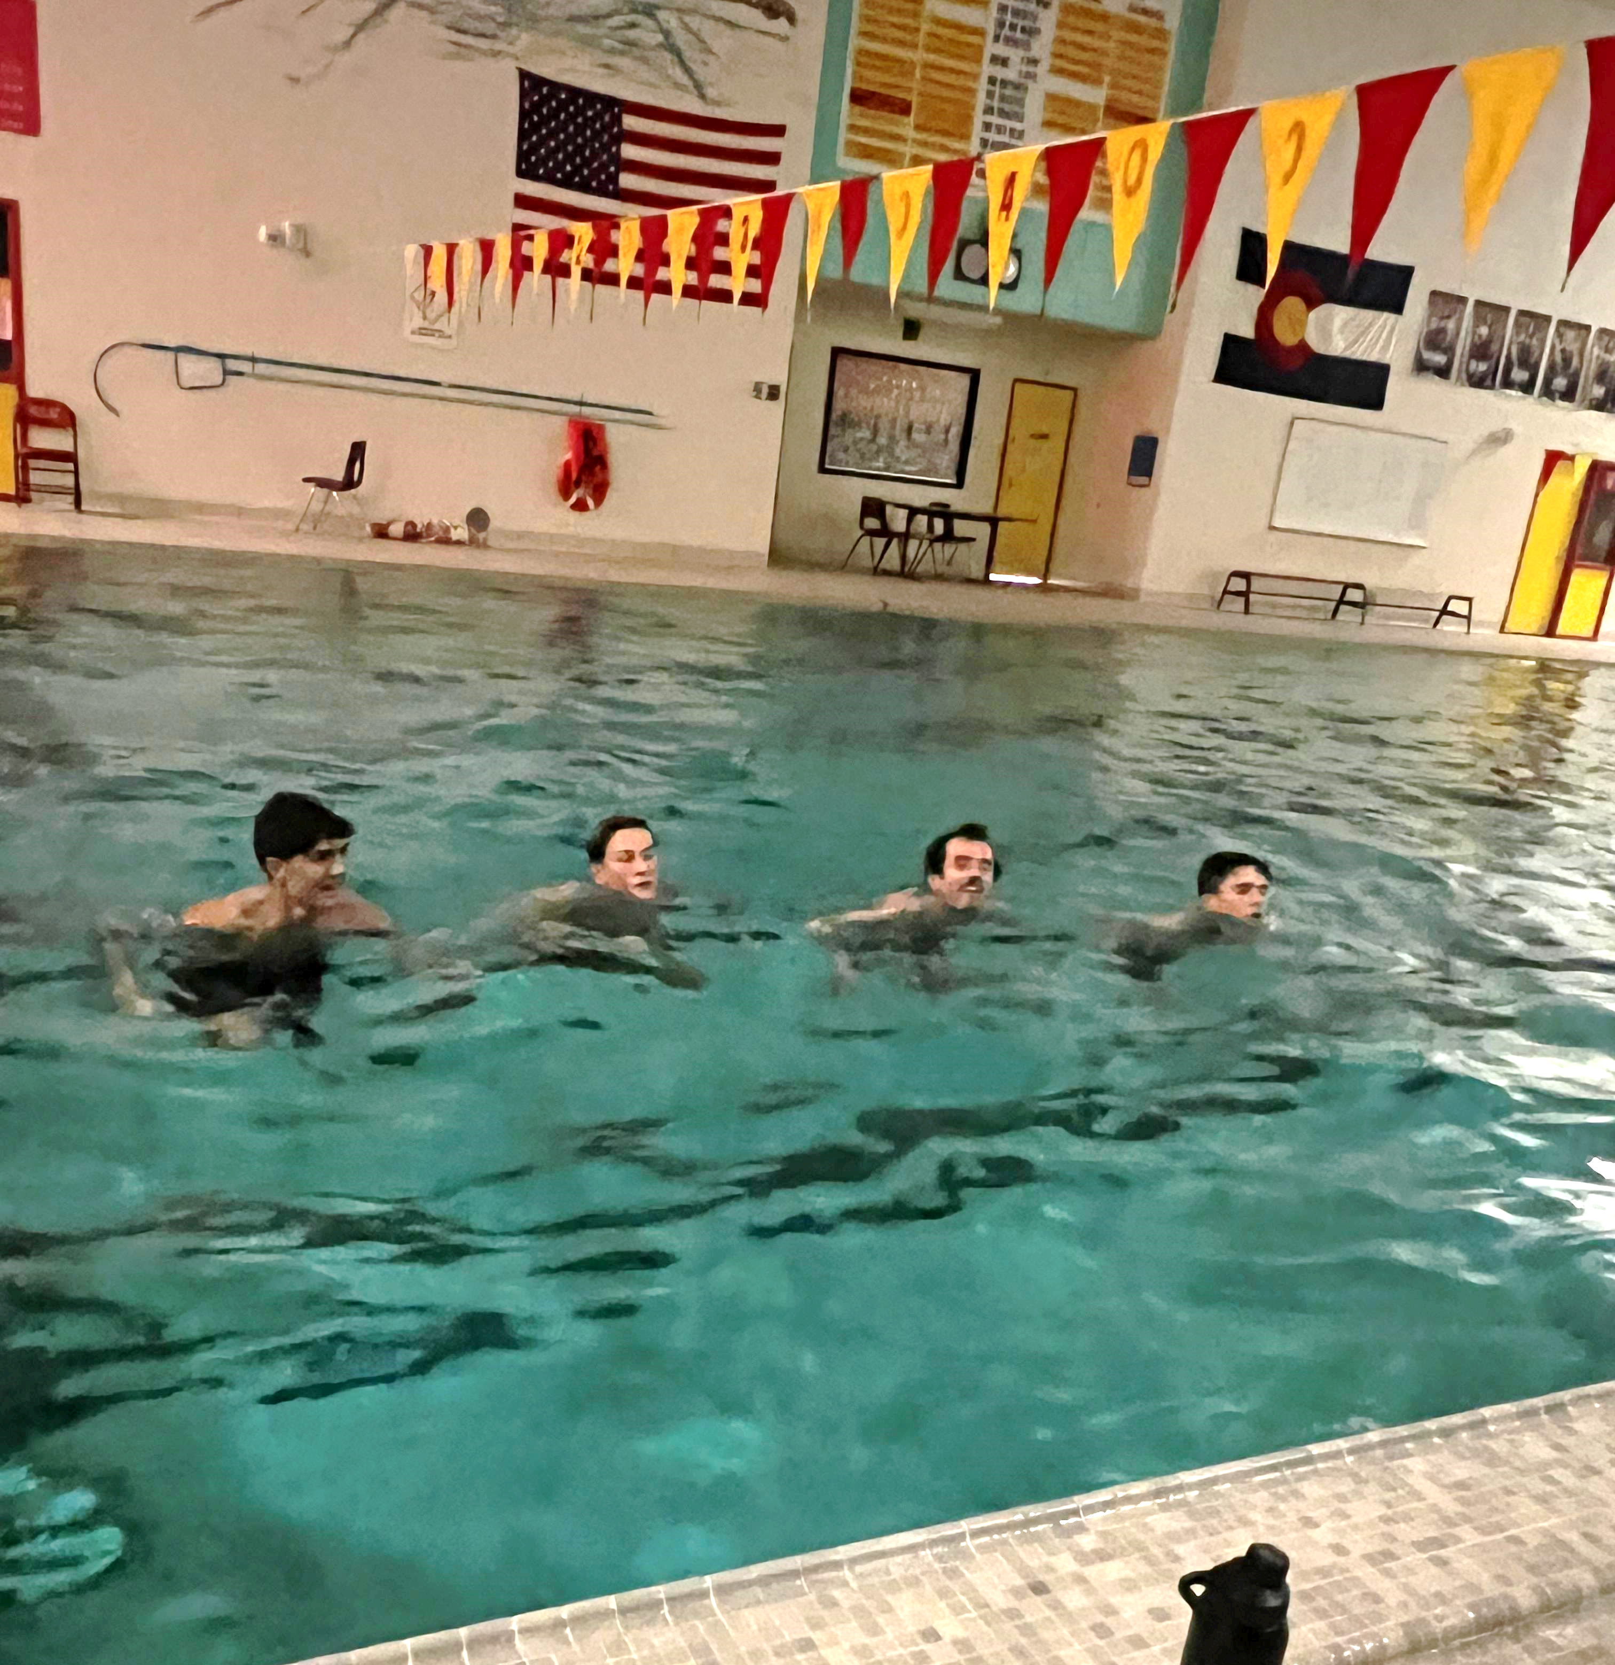
Deep water pool running
Preserves fitness during injury
Aids recovery after hard training days.
Can add low impact training volume
Upper body strength
Range of motion
*Wear an old pair of running shoes for added resistance. No flotation belt.

Slide 13
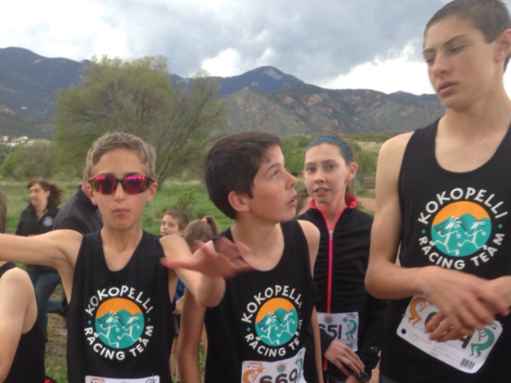
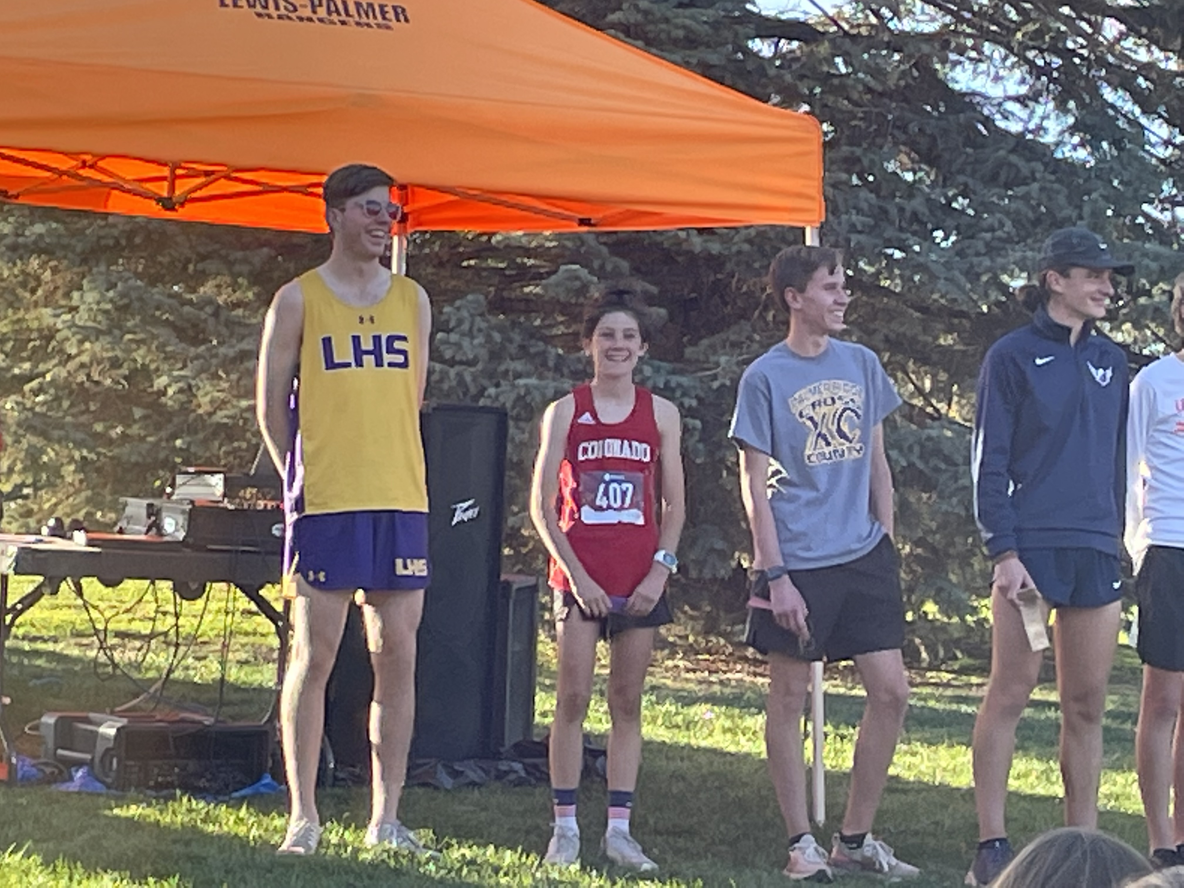
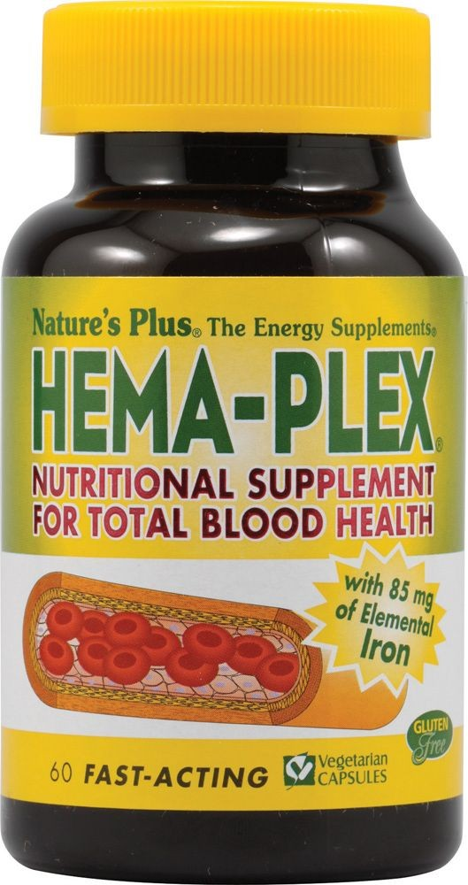
Unexplained STRUGGLES
*These boys are the same age!
What to look for when an athlete displays an unexplained performance plateau or diminished workouts and/or races:
Age of the athlete and puberty. Growth spurts and onset of female menses. Young bodies go through an exhaustive flux during puberty, Strength to weight ratio is altered as well as coordination. Be patient, increase strength development and work to maintain athlete confidence
Over training Encourage athletes keep a log. Some kids pack on mileage or too much training volume too quickly. Some kids take extended breaks of “doing nothing” and try to get back into training too quickly. Encourage time off from running but not from fun fitness – winter months encourage other sports, XC skiing, rock climbing, swimming etc.
Over racing. – Racing may start out strong but diminishes 2/3’s of the way into the season due to reduced weekly volume.
Low Iron and ferritin. Males and females suffer low ferritin levels, elite athlete levels should be over “50” ng/ml. Have ferritin levels checked routinely. Educate your runners on foods high in iron, what food to avoid, and how to enhance absorption.
Under fueling daily. Need daily breakfast, lunch and pre-workout snacks

Slide 14
Resources
Nutrition Support:
Maddie Alm: FuelingForwardNutrition@gmail.com
Cycling and Power Meter Support:
Andy Potts: AndyPottsRacing.com
Elliptical and Pool Running Support:
Lisa Rainsberger: Lisa@traininggoals.com

