Slide 1

Welcome
GOHS Swim Team Parent Meeting
President: Patricia Medranda
Vice-President: Heather Parsneau

Slide 2
Budget
&
Release of Funds
GO PACK:
Brenda Loera
Wendy Correa

Slide 3
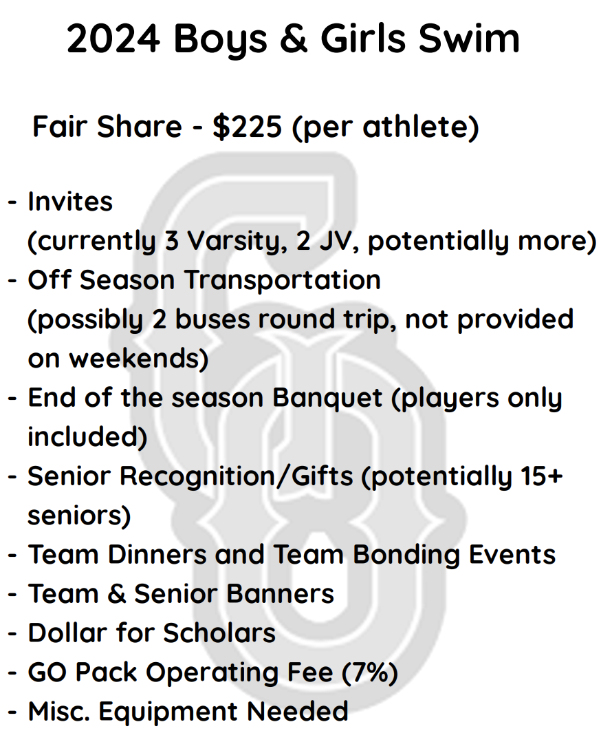

Fair-Share

Slide 4
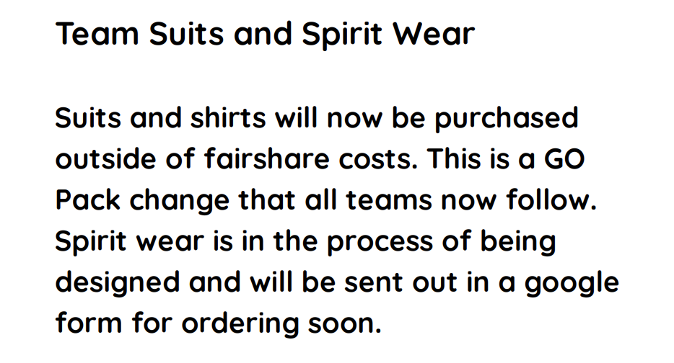
Team Suits
Fitting is Feb. 8th

Slide 5
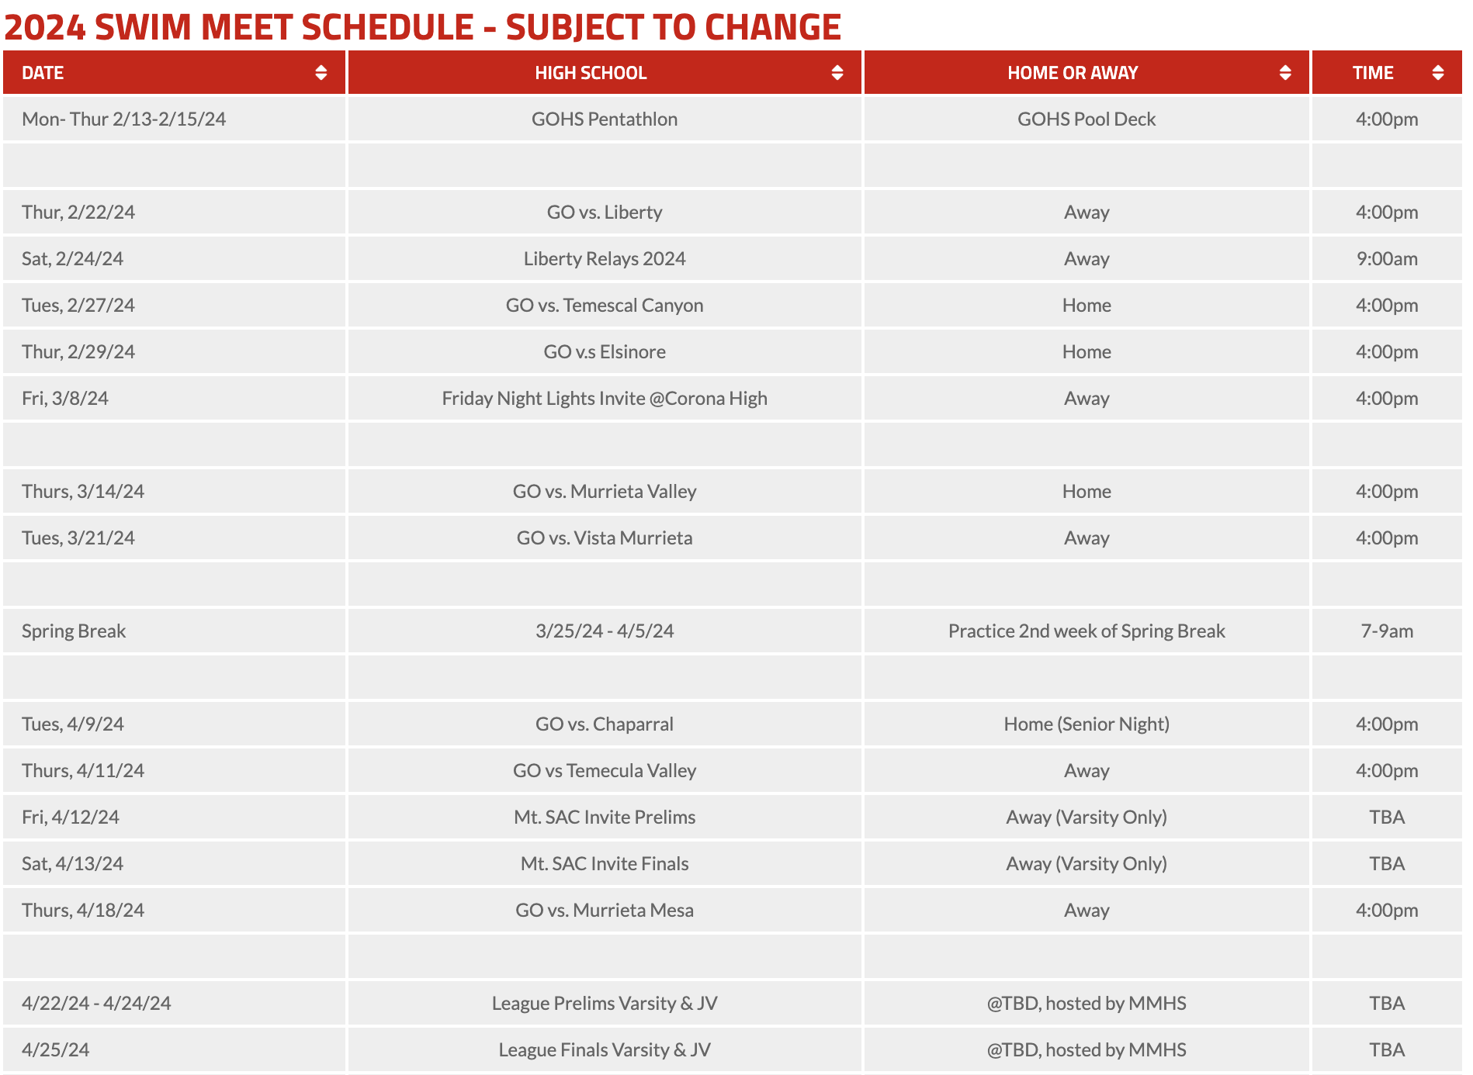
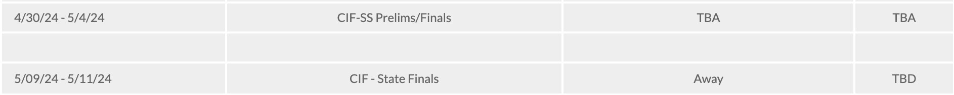

Slide 6




Fundraising
See’s Candies
Home Meet Food Nights
Fan Angel or Vertical Raise
Krispy Kreme
Game Shout Outs and MORE!

Slide 7

Snack Bar Donations
We need to stock the snack bar!
Go to: GOHS Swim website to sign up through the Sign-up Genius
Drop off @POOL DECK dates:
Feb. 20th
Feb. 23rd

Slide 8


We can not have a successful season without you! You make the difference!

Slide 9
Coaches
Head Coach: Katie Sinclair
Assistant Coaches: Coach Pepito

Slide 10

Stack Team app

Slide 11
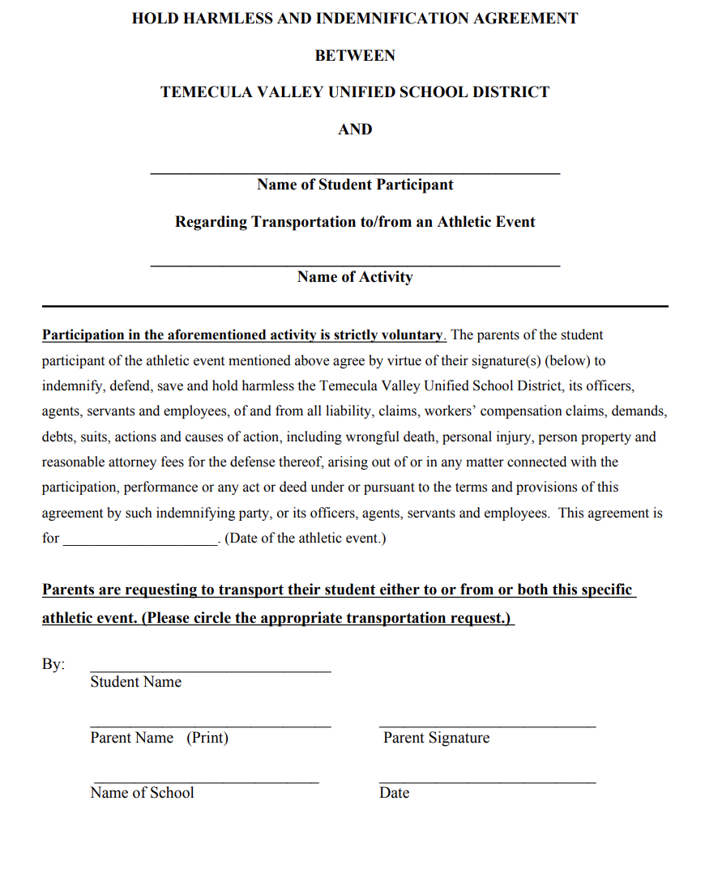

Hold Harmless Form
&
Team Handbook

Slide 12
Thank you for
coming tonight!
We are looking forward
to a wonderful winning season!
email: gohswimteam@gmail.com

