Slide 1

DAYTON JUNIORS VOLLEYBALL CLUB
“New To Club Volleyball” OR to DJRS VBC
Welcome to Dayton Juniors!!
We are excited to start our 27th season.
This presentation will outline the club season and answer our most commonly asked questions.
2025-2026 Club Season

Slide 2
Dayton Juniors Teams
National Teams
  Very large (64+ teams) 2 or 3 day tournaments, typically at convention centers up to 2+ hours away/out of state.
  14 Blue, 15 Blue, 16 Blue, and 17 Blue
  Attend AAU Nationals in Orlando, FL at end of season
American Teams (teams also can participate in National Tournaments)
  Large (32+ teams) 2 day tournaments in and around Ohio.
  13 Blue, 13 Gold, 14 Gold, 15 Gold, 16 Gold
Regional Teams
  Small (16 team) 1 day tournaments within 2 hour driving distance from DJRS Facility.
  12 Blue, 12 Gold, 12-16 White, Black, and Red, 17 Gold, 18 Blue

Slide 3
What is included with your club fees:
Practices: Blue Teams - 3 practices/week. Gold, White, Black, Red – 2 Practices/week.
Coaches: ALL teams are assigned 2 Coaches for the season.
Coaches are OVR Members & have Cleared Background Check screenings. IMPACT, SafeSport, Concussion, and Cardiac Arrest Certified (Lindsay’s Law).
Tournaments:
  13-17 Blue – 17-18 Days
  13-14 Gold & 18 Blue – 12 Days
  12’s & 13-18 White, Black, Red – 9-10 Days
  *14-17 Blue – Nationals is an additional cost
Coaches Expenses: Travel (Mileage, Food, Hotels & Parking- if applicable).
Yearbook
1-2 Evaluations during season from Coaches

Slide 4
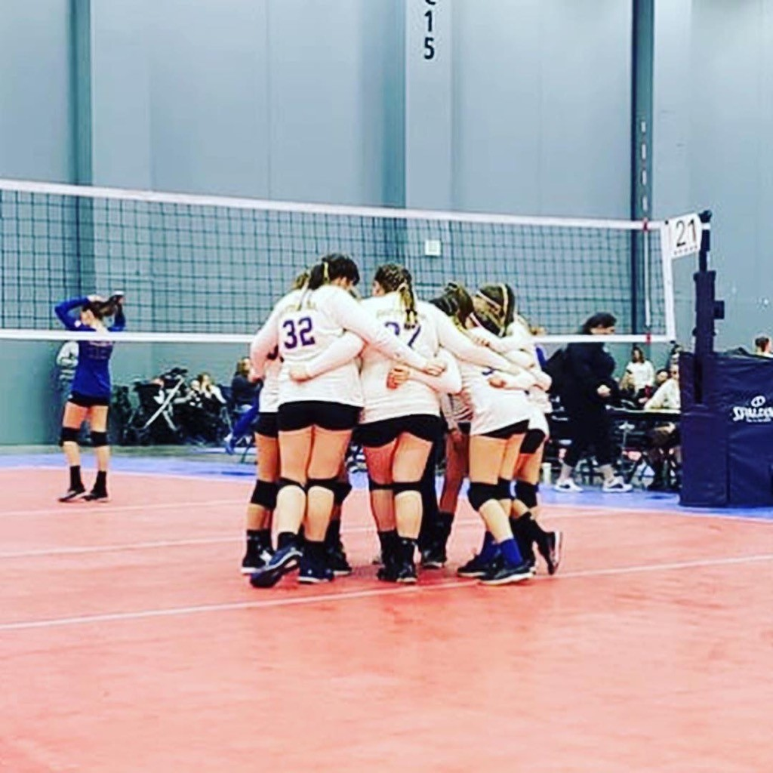
MORE FROM DJRS!
3 Court Facility Exclusive to DJRS to call our HOME!
NEW! Dayton Juniors has invested in new net systems, pole pads (soon), ball carts, training equip. like rubber dots, tennis balls, and cones, ball pump, and 7 new tournament warm up balls per team (game balls). We also resurfaced the parking lot and added solar powered lighting outside. Next up-Cameras, Bathrooms; new toilets and lobby thermostat.
**Separate from fees..
Apparel: 2 Jerseys, 2 Spandex, Knee pads, 2 Socks, and 2 Practice T-shirts (3 for Blue teams). Warm Ups & Bag sold separately. These can be used season to season.
Pictures

Slide 5
Club Fees
Derek Benson; djvbcsports@gmail.com
Two ways to pay:
1. Via credit card through your SportsEngine account/pre-set payment plan
2. Via check. These can be placed in the locked white dropbox just beside the office in the lobby. *Please be sure to write your players name and team on the memo line.
Available Assistance:
Yearbook Ads
Fee Reduction Application
Scholarship - Seniors

Slide 6
Team Parent: Each team will have a Team Parent
  Book Hotel blocks for tournaments
  Embroider apparel for team
  Coordinate things like: snacks, ribbons, etc.
  Organize team bonding event/s – Not required. Ex. Bowling,
  sleepover, etc.
Spirit Wear
  Optional for parents and players
  Two shops per season: December & January
Yearbook Ads – ALL $ raised goes to fees!
  Businesses – Advertisements or business cards
  Family/friends - Well wishes/messages for player/team
Fee Reduction Program
Scholarship Application - Seniors
Family Event – This year we’re discussing Columbus Fury Volleyball Game!

Slide 7

Uniforms - Under Armour
We have contracted exclusively with Under Armour for our uniforms and warm ups.
What does that mean?
At tournaments, players are to wear their Under Armour jerseys, socks, kneepads, and warm ups.
Our contract is ANKLE UP. If at large tournaments, even headbands should be UA. Players may wear the shoe of their choice.
Here’s our vendor’s information if you need help with any of your apparel:

Slide 8
TOURNAMENT EXPECTATIONS
Uniforms
  Under Armour; Ankle Up
  Take both colors
Tournaments
  One & two day events
  All day
    Girls can bring blanket/pillow – Will vary on location, may need chair this year
  Arrival times
  Seating
    Bleachers
    Fold up chairs
  Reading the Schedule
Tournament Cont.
  Girls will have downtime/ref/play
  Admission
  Lodging
    Stay together as team
    Family in area
Snacks
  Venues have concessions
  Snack bags/Coolers
Ribbons
  Up to girls if they want them
  Make enough for coaches ☺
  Have fun with them

Slide 9
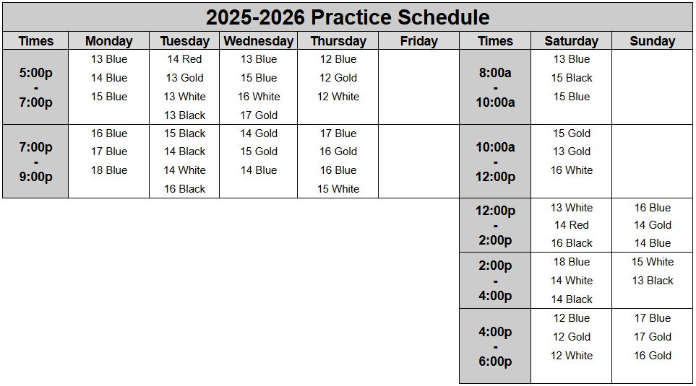
Practices
Parents are welcome to stay in the facility for practice.
The gym will be closed December 22, 2025 - January 2, 2026

Slide 10
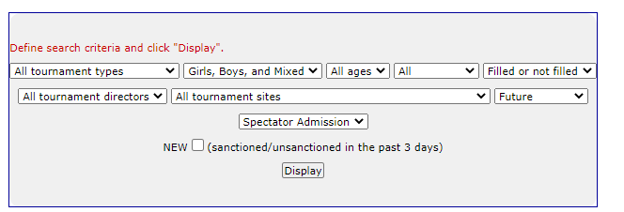
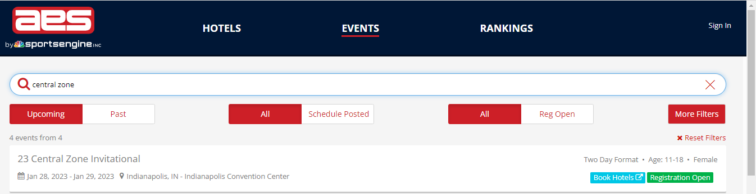
Tournaments
Doors typically open at 7 a.m.
Tournaments usually end around 5-6 p.m.
Schedules are typically posted the Wednesday before the tournament.
Most venues charge admission.
Some venues have seating; some you will need to bring your own.
Tournament websites will provide tournament details
www.ovr.org
www,advancedeventsystens.com
Tournament format:
Pool Play: teams play each other and are ranked for bracket play.
Bracket Play: Gold, Silver, Bronze, etc. Teams play single elimination games for overall tournament ranking.
www.ovr.org > tournament schedule
narrow search by entering search criteria
https://www.advancedeventsystems.com/events
enter tournament name or use more filters

Slide 11
Reading Tournament Schedules
Reading the schedule:
Pool play format: Pool A: Court 4
1 vs 2, 3 1 - Dayton Juniors 14Blue
3 vs 4, 1 2 - Club Ohio
1 vs 3, 2 3 - Club Kentucky
2 vs 4, 3 4 - Club Indiana
1 vs 4, 2
2 vs 3, 4
3 vs 4, 1
Dayton Juniors 14 Blue pool play Schedule
Play
Ref
Play
Sit
Play
Sit
Ref

Slide 12

PDC; PRESIDENTS’ DAY CUP
The PDC Tournament is hosted by DJRS Staff and Parents!
  Greater Columbus CC – 15’s and Up & Spooky Nook (Hamilton) – 14’s and under.
  PDC takes place Presidents’ Day Weekend
  It is a major effort and we require the Parent’s support to pull it off. One parent for each athlete will be assigned a mandatory 3 to 4 hour shift the weekend of the event in Hamilton, ONLY. It’s easy work, but incredibly vital to the event’s success!

Slide 13

Hotel Policy
Stay to Play: More and more tournaments are requiring Stay to Play. This means our teams must use the tournament’s housing authority to reserve rooms at selected hotels in order to be eligible to play in the tournament. Sometimes the club has no choice in what hotels are available, what types of rooms are available, or the distance the hotel is from the venue.
Tournaments that have Stay to Play requirements will be communicated with your team liaison.
Hotel accommodations are blocked by Stay Play Made Simple and passed on to the team liaisons. The team liaison will forward the information to their teams. Please reserve your rooms as soon as possible as some blocks are available for a short period of time. This is the DJRS Housing website; https://stayplaymadesimple.com/djvc-outbound-travel/
Stay Play Made Simple Contact; Anna Terry; anna@stayplaymadesimple.com
It is Dayton Junior’s policy that the entire team stay at the provided hotel, regardless if it’s a stay to play tournament. The only exception is if the player will be staying with family in that city-approval is still required; contact Kali.

Slide 14
Grievance Policy
Step 1: Player speaks with Coach.
Step 2: Player, coach, and parents speak.
Step 3: add club director
See something say something
sooner rather than later

Slide 15
Additional Training for members only
Private lessons are available throughout the season.
Contact the club director, Kali Glase for more information.

Slide 16
DJRS BOARD MEMBERS
Director: Kali Glase; DjrsDirector@gmail.com; 843-540-6844
Club Administrator: Derek Benson; DjvbcSports@gmail.com
Secretary: Bethany Welch; DjrsSecretary@gmail.com
Assoc. Director: Keri Kertesz; kakertesz123@gmail.com
Maintenance Manager: Mike Welch; Djrsfacility@gmail.com
Facility Manager: April Shouse
For all Social Media posts please text Bethany Welch at 937-654-9949

