Slide 1
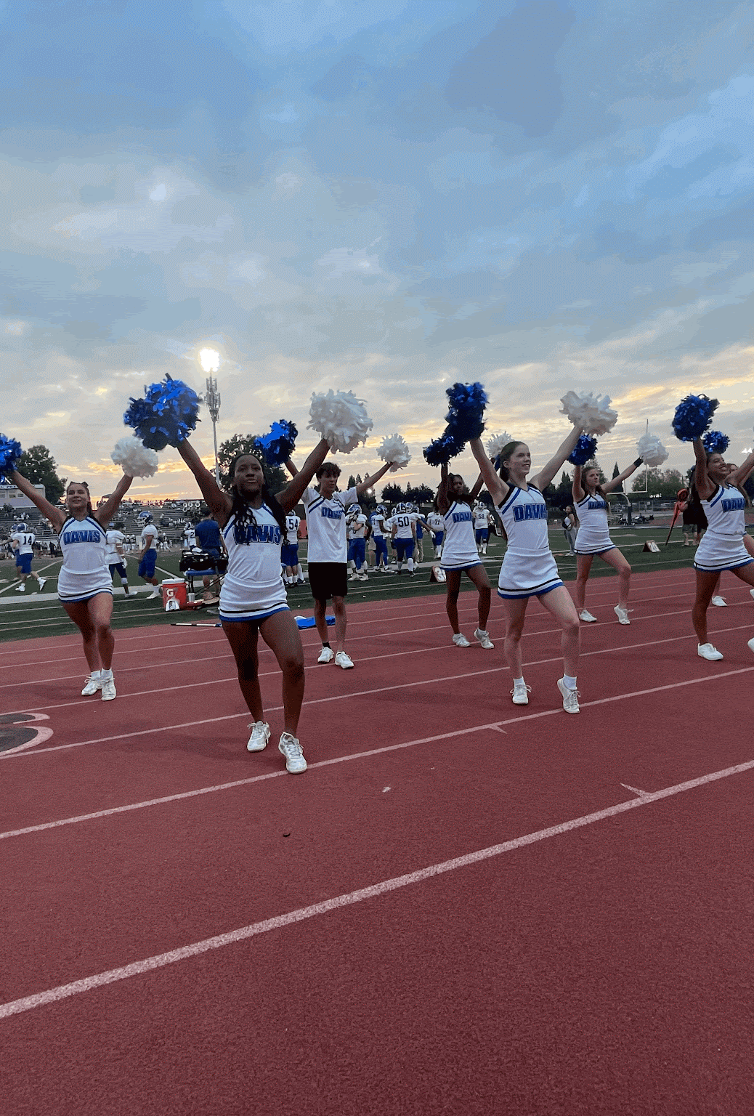
DJBD CHEER
2025-26
SIDELINE
CHEER
CHEER CHEER COACH

Slide 2
TONIGHT’S AGENDA
01
04
02
05
03
06
PRACTICES
OUR MISSION
COSTS/UNIFORMS
TEAMS
COACHES
QUESTIONS
CHEER CHEER CHEER

Slide 3
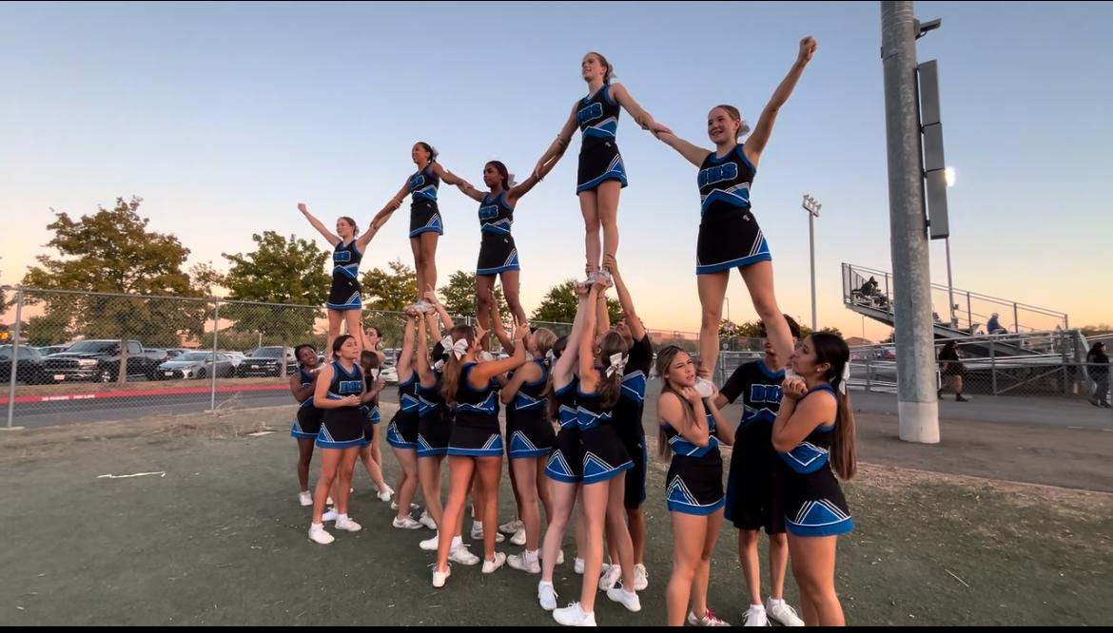
OUR MISSION
As a member of the Jr. Blue Devils family, cheerleaders will not only learn the fundamentals of cheerleading, but also teamwork, sportsmanship, and character development. We are committed to providing a positive and safe environment for our athletes. We strive to promote both physical and mental development throughout the season.
Cheerleaders will work to build a foundation of solid technique to help progress in cheers, stunting and halftime performances.

Slide 4
2025 DJBD TEAMS
TEAMS TEAMS
BLACK (MIDGETS/13U)
6th-8th Grade
3rd-5th Grade
BLUE (JUNIOR MIDGETS/11U)
WHITE (PEEWEES/9U)
Kinder-2nd Grade
We can possibly move kids up or down based on skill level, BUT we also believe being around age appropriate peers and having fun with friends is a top priority!
TEAMS TEAMS TEAMS TEAM

Slide 5
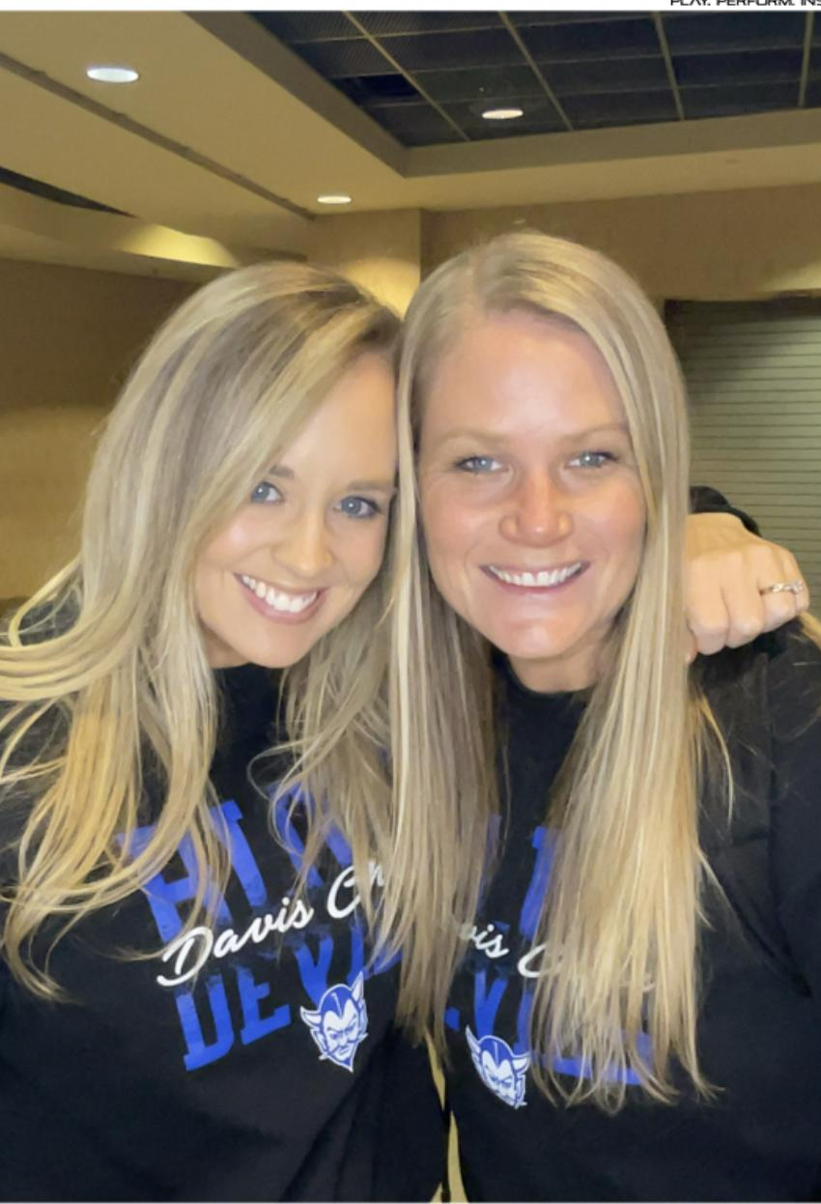
TAM
-11th season as the Head Coach at Davis High School
-Bachelors in Exercise Science and Masters in Sport Management
-20+ years of coaching cheer and gymnastics
-First Aid, CPR, NFHS Certified
JULIA
TAM
JULIA
-9th season with DHS cheer
-Alumni of DHS cheer
-Bachelors in Exercise Science
-First Aid, CPR, NFHS Certified
-Teacher and mom of 3 kids
CHEER COACH CHEER COACH

Slide 6
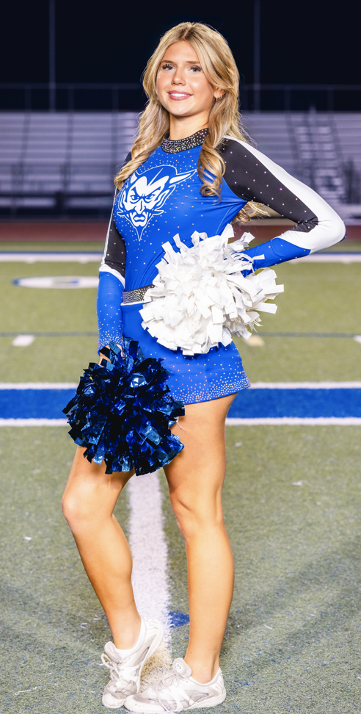
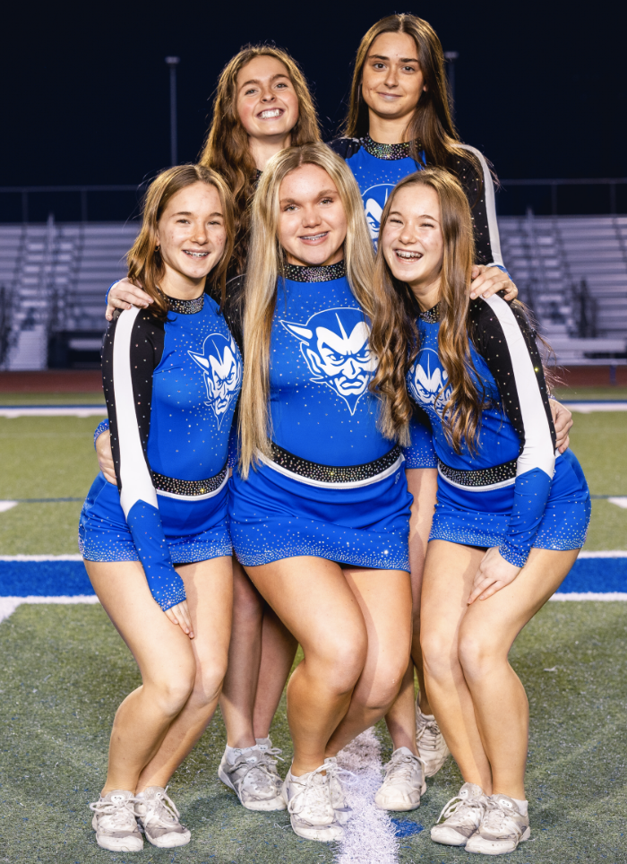
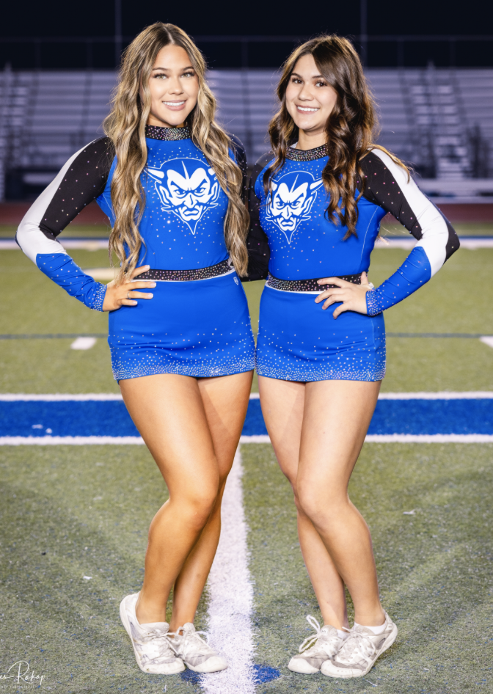
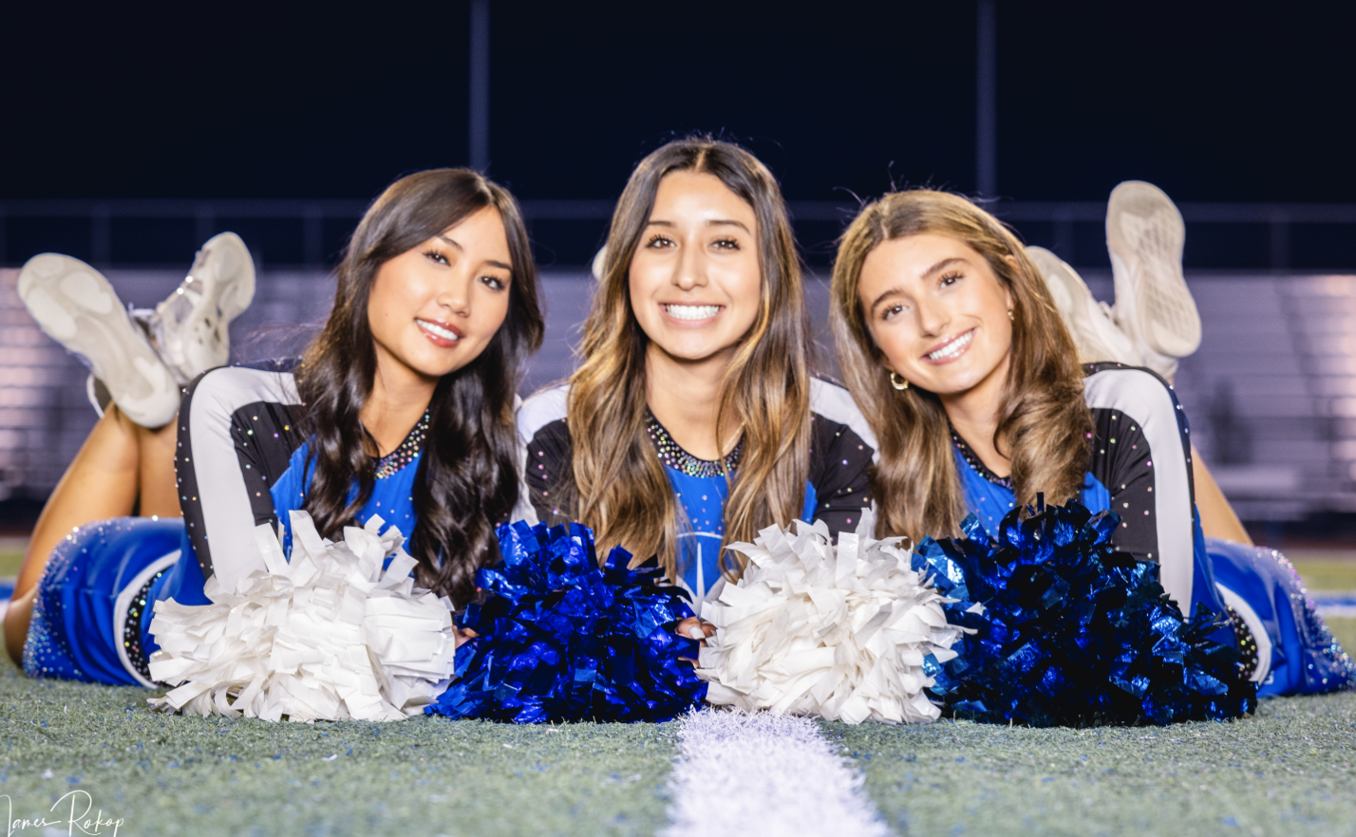
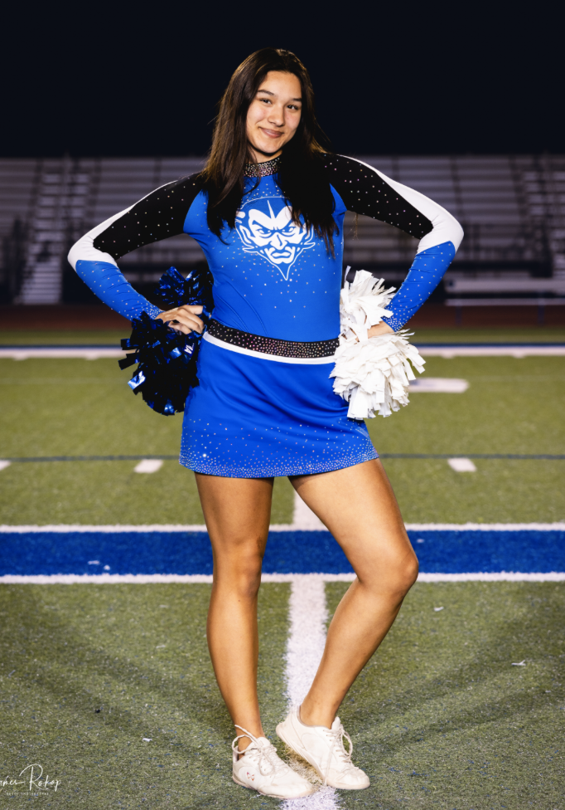
TEAM COACHES
These coaches have been specifically selected by us based on their skill, dedication, attitude, teaching abilities and love of working with kids!
Our goal is to ensure athletes are learning correct techniques and building a solid foundation to grow on.
First and foremost, cheerleading is FUN!
7x JAMZ National Champions
DJBD DJBD DJBD DJBD

Slide 7
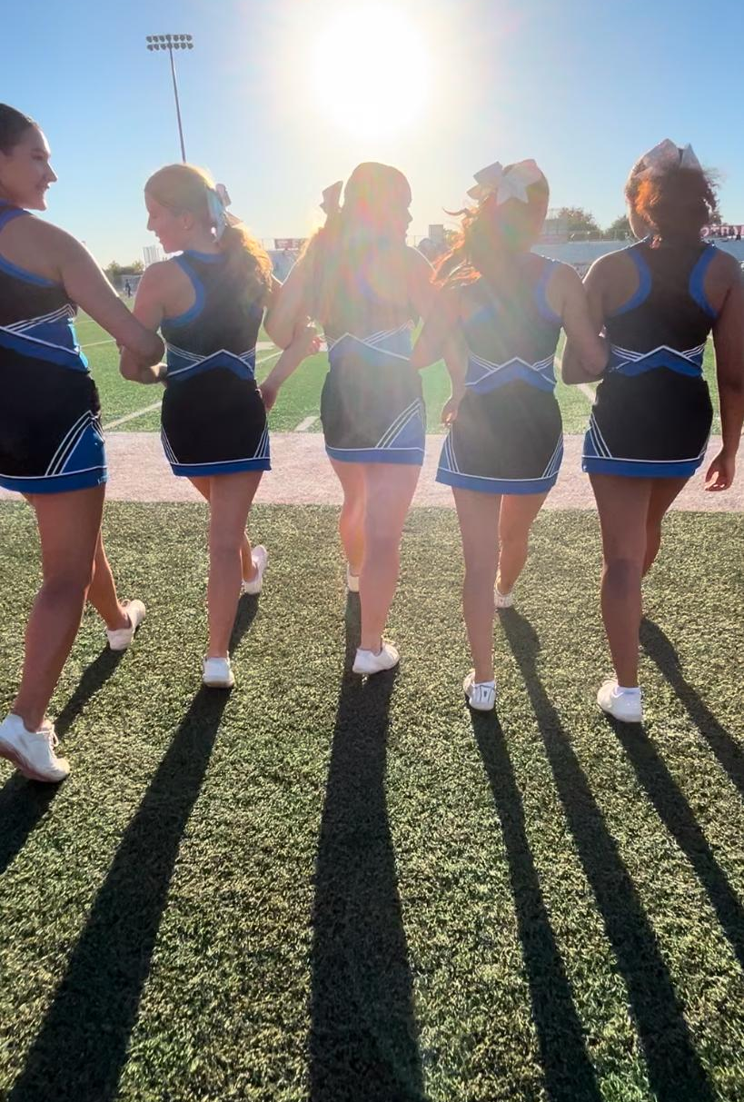
PRACTICES
Practice days/times will be confirmed Wednesday, May 21st
Teams will practice either Tuesday or Wednesday
5:30pm-7:00pm
Practices will be used to quickly learn cheers and begin halftimes
Athletes will be expected to practice cheers at home! Practice time will mostly be used for learning halftimes since this requires the entire team
MINI CAMP: Saturday and Sunday, August 9th-10th

Slide 8
CHEER COSTS
COSTS COSTS
INCLUDED:
-Uniform
-Body Liner
-Game Day Bow
-Pink Bow
-Poms
-ISAC Registration
You are responsible for white no show socks and white cheerleading shoes
ALL IN COST: $200
COSTS COSTS COSTS

