Slide 1





Seacoast United/Exeter Hawks
Home Workout Plan -
April 6th - 12th 2020

Slide 2

Seacoast United & Nike

Slide 3
Seacoast United Home Workout Plan
The Seacoast United Home Workout will consist of a 5-Day Plan to keep our players active in this time away from Team Training Sessions. The activities we have are all designed so players can perform on their own in a limited space, so should be accessible for all our players.
The Home Workout Weekly Plan will consist of the following:
Dynamic Warm Up
Cool Down
Aerobic Workout
Technical Based Workout
Core Workout
Upper Body Workout
Lower Body Workout
Yoga Workout
Soccer Homework
This presentation will include a weekly schedule, plus descriptions of the activities we would like the players to perform in each of the workouts.

Slide 4
Weekly Schedule (4/6-4/10)
Monday 30th March | Tuesday 31st March | Wednesday 1st April | Thursday 2nd April | Friday 3rd April
Dynamic Warm Up | Dynamic Warm Up | Full Body Stretch | Dynamic Warm Up | Dynamic Warm Up
Technical Workout | Technical Workout | Soccer Homework | Technical Workout | Technical Workout
Aerobic Workout (5k Timed Run) | Core Workout |  | Aerobic Workout (Sprint Exercises) | Core Workout
Cool Down | Upper Body Workout |  | Cool Down | Lower Body Workout
 | Cool Down |  |  | Cool Down

Slide 5
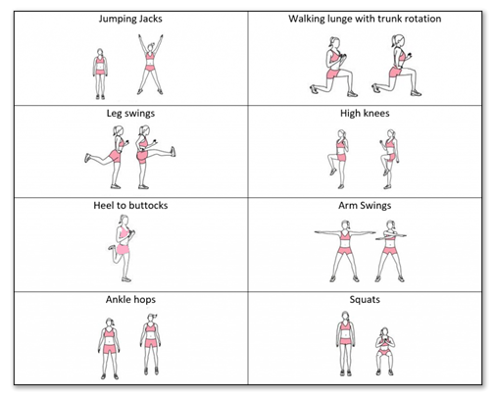
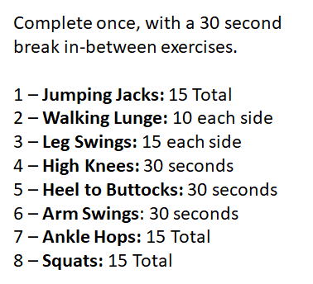
Dynamic Warm Up
~ Mon, Tues, Thurs and Fri ~

Slide 6
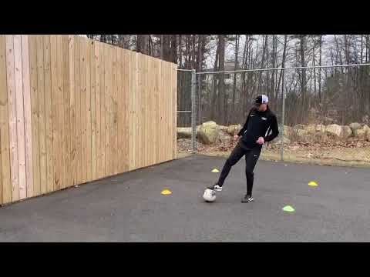
Technical Workout #1
~ Monday, Tuesday, Thursday, Friday ~

Slide 7
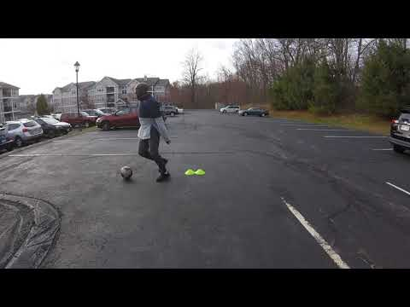
Technical Workout - #2: 1v1 Moves
~ Monday, Tuesday, Thursday, Friday ~

Slide 8
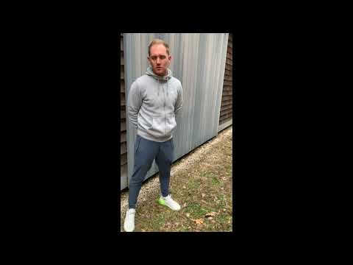
5k Timed Run
~ Monday ~

Slide 9
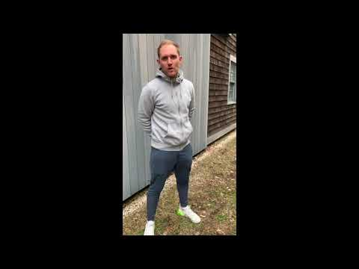
Sprint Endurance Workout
~ Thursday ~

Slide 10
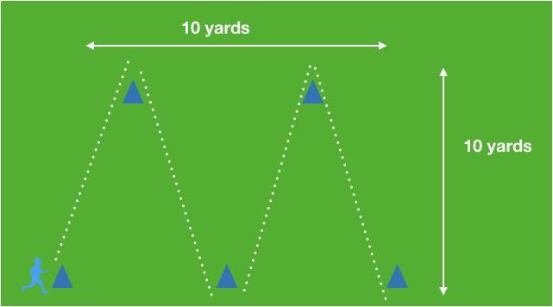
Sprint Endurance Workout
~ Thursday ~
Sprint through whole course back and forth 6 times as fast as you can
1 Minute Active Rest: 30 seconds Sit-Ups, 30 seconds Plank
15 second rest
Repeat 6 times

Slide 11
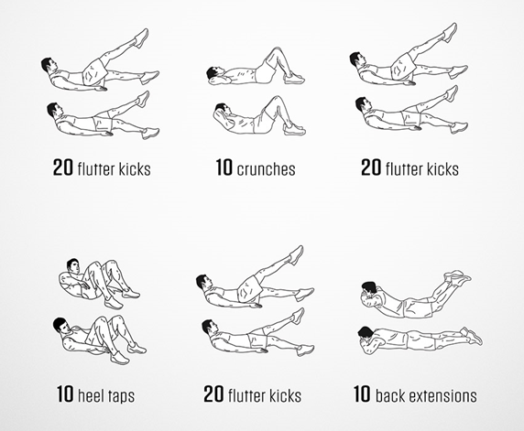
Core Workout
~ Tuesday & Thursday ~
***Players should complete 1 set of all 9 activities, before taking a 2 minute rest.
Repeat this process for a total of 3 times**

Slide 12
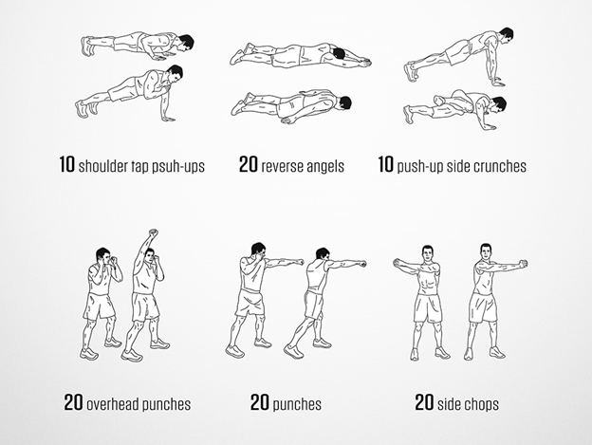
Upper Body Workout
~ Tuesday ~
***Players should complete 1 set of all 3 activities, before taking a 2 minute rest.
Repeat this process for a total of 3 times***

Slide 13
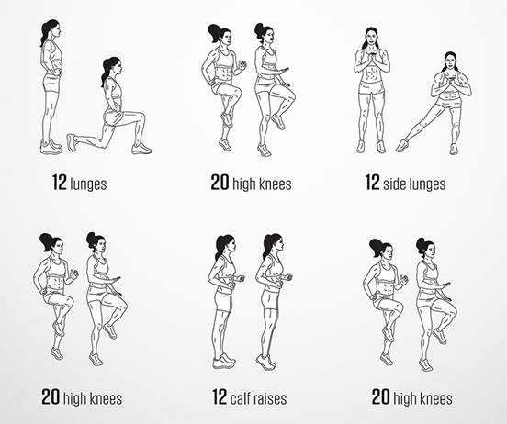
Lower Body Workout
~ Thursday ~
***Players should complete 1 set of all 6 activities, before taking a 2 minute rest.
Repeat this process for a total of 3 times***

Slide 14
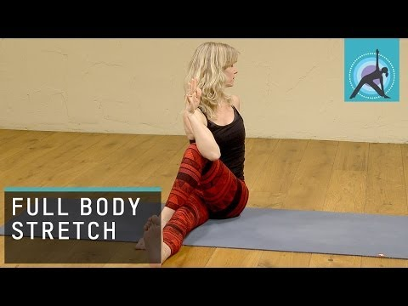
Full Body Stretch
~ Wednesday ~

Slide 15
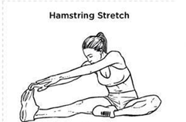
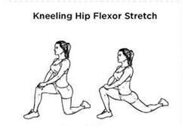
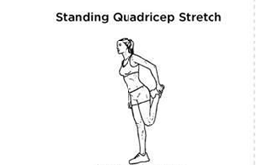
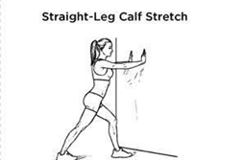
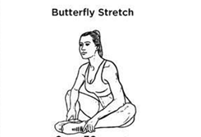
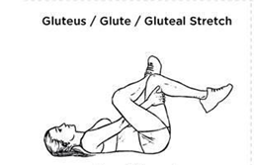

Cool Down
~ Mon, Tues, Thurs and Fri ~

Slide 16
Soccer Homework
~ Wednesday ~
Create an Action Plan with Individual Goals to identify areas you want/need to improve as a player. When setting these goals, please analyze yourself in all 4 phases of the game:
Attacking
Defending
Transition: Defending to Attacking
Transition: Attacking to Defending
These Individual Goals can be related to the Technical, Tactical, Physical & Psychological aspect of the game.
The goals can be Short-Term Goals (1-5 months), Mid-Term Goals (6-12 months) or Long-Term Goals (1 year plus)
(A template of how to set up the Individual Action Plan can be seen on the following slide)
Please email your Action Plan, along with your 5k time to your Head Coach by Friday.

Slide 17
Soccer Homework
~ Wednesday ~
Individual Goal | How am I going to achieve it? | How can I measure/analyze my success? | Target Date

Slide 18

Stay Safe & Stay Fit

