Slide 1





Seacoast United/Garrison City
Home Workout Plan -
May 4th- May 8th 2020

Slide 2

Seacoast United & Nike

Slide 3
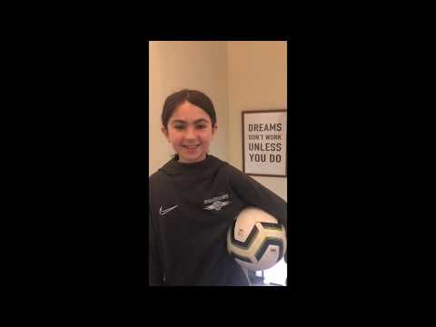
Seacoast United - #InThisTogether

Slide 4
Seacoast United Home Workout Plan
The Seacoast United Home Workout will consist of a 5-Day Plan to keep our players active in this time away from Team Training Sessions. The activities we have are all designed so players can perform on their own in a limited space, so should be accessible for all our players.
The Home Workout Weekly Plan will consist of the following:
Dynamic Warm Up
Cool Down
Aerobic Workout
Technical Based Workout
Core Workout
Upper Body Workout
Lower Body Workout
Yoga Workout
Soccer Homework
This presentation will include a weekly schedule, plus descriptions of the activities we would like the players to perform in each of the workouts.

Slide 5
Weekly Schedule (5/04-5/08)
Monday 4th May | Tuesday 5th May | Wednesday 6th May | Thursday 7th May | Friday 8th May
Dynamic Warm Up | Dynamic Warm Up | Flexibility Workout | Dynamic Warm Up | Dynamic Warm Up
Technical Workout | Technical Workout | Homework | Technical Workout | Technical Workout
Physical Workout: 1 Mile Challenge | Core Workout |  | Physical Workout: Sprint Pyramid Challenge | Core Workout
Cool Down | Upper Body Workout |  | Cool Down | Lower Body Workout
 | Cool Down |  |  | Cool Down

Slide 6
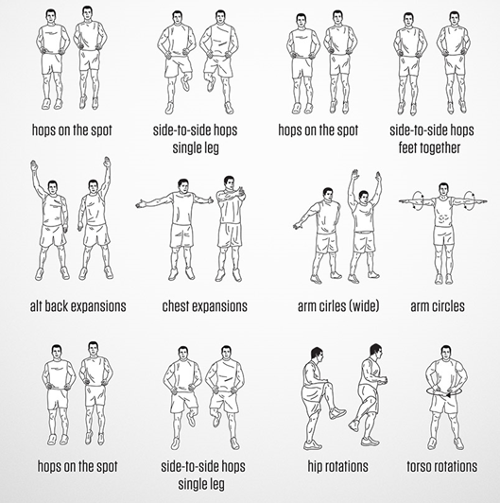
Dynamic Warm Up
~ Mon, Tues, Thurs and Fri ~
***Players should perform each exercise for 10 seconds, before moving onto the next one.
Repeat the exercises for a total of 2 sets***

Slide 7
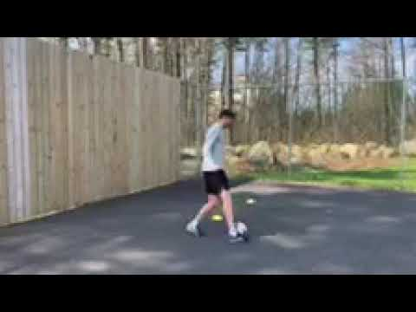
Technical Workout #1
~ Monday, Tuesday, Thursday, Friday ~

Slide 8
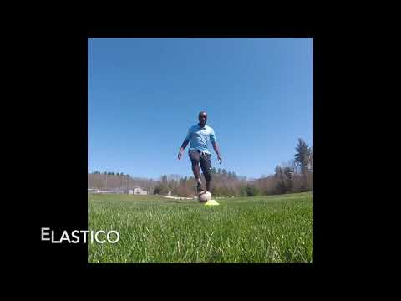
Technical Workout - #2: Advanced Moves
~ Monday, Tuesday, Thursday, Friday ~

Slide 9

Physical Workout: 1 Mile Challenge
Monday
1 Mile Challenge
Please warm up accordingly and then run a timed mile as fast as you can.
Cool Down
Android and IOS apps to track run - Nike Run Club & Strava.
Please email your Head Coach a screenshot of your completed 1 Mile Time.

Slide 10
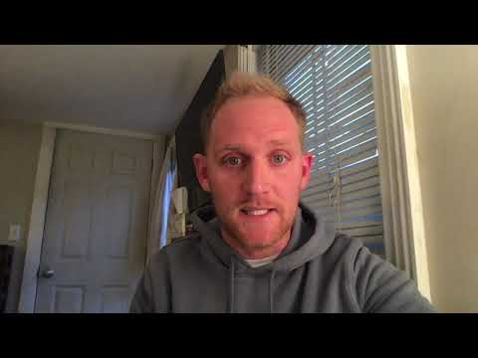
Physical Workout: Sprint Pyramid Challenge
Thursday

Slide 11
Physical Workout: Sprint Pyramid Challenge
Thursday
Sprint Pyramid Challenge
10 minute warm up
30 seconds as quick as you can, 30 second rest period
1 minute as quick as you can, 1 minute rest period
2 minutes as quick as you can, 2 minutes rest period
4 minutes as quick as you can, 4 minutes rest period
2 minutes as quick as you can, 2 minutes rest period
1 minute as quick as you can, 1 minute rest period
30 seconds as quick as you can, 30 second rest period
10 minute cool down
Please email your Head Coach a screenshot of complete Sprint Pyramid Challenge Workout with rest periods included.

Slide 12
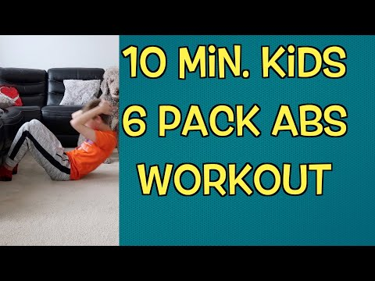
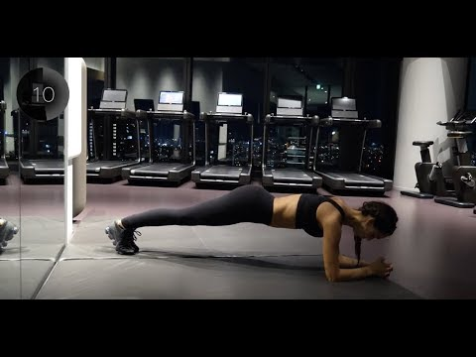
Core Workout
~ Tuesday & Thursday ~
U12 and Below
U12 and Above

Slide 13
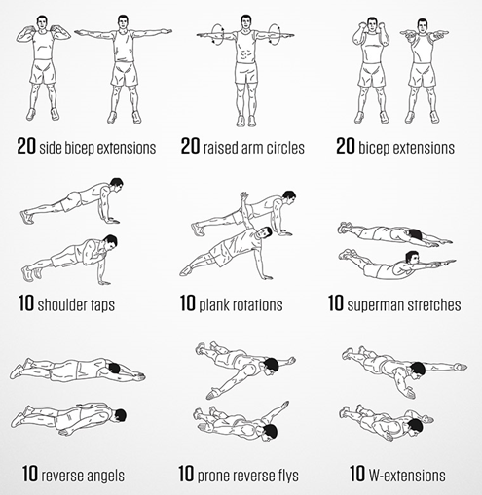

Upper Body Workout
~ Tuesday ~
U14 and Below
U15 and Above
***Players should complete 1 set of all 9 activities, before taking a 2 minute rest. Repeat this process for a total of 2-3 times***

Slide 14
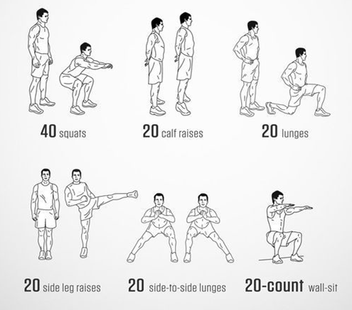
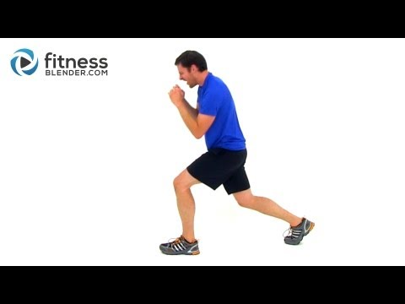
Full Body Workout #2
~ Thursday ~
U14 and Below
U15 and Above
***Players should complete 1 set of all 6 activities, before taking a 2 minute rest. Repeat this process for a total of 3-4 times***

Slide 15
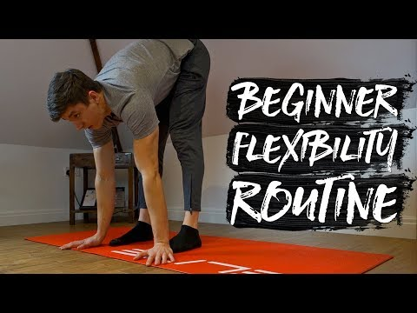
Flexibility Workout
~ Wednesday ~

Slide 16
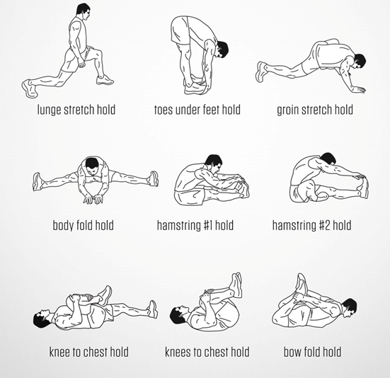
Cool Down
~ Mon, Tues, Thurs and Fri ~
***Players should hold each stretch for 40 seconds before moving onto the next one.
Repeat the exercises for a total of 2 sets***

Slide 17
Homework
~ Wednesday ~
For your homework this week, we want to know the following:
What are the main reasons you play soccer?
Who have been the biggest influences on your soccer career so far and why?
Which professional players do you look up to and try and emulate?
Who is a player in the Seacoast United Program that you look up to and why?
Please email your Head Coach a copy of this homework assignment.

Slide 18

Stay Safe & Stay Fit

