Slide 1

Manager’s Meeting 2026
Welcome!

Slide 2







Thank you to our sponsors!
Thank you sponsors!
2026

Slide 3
STLWEST Manager
Presentation Agenda
1 | Association & League Overview
2 | Ranking, Scheduling/Rescheduling
3 | Fields
4 | Rules
5 | Important Dates and Events

Slide 4

2026 is STLWEST’s 14th Year!

Slide 5

STLWEST welcomes Pacific Youth Association
Address: 650 S. 6th St, Pacific, MO 63059

Slide 6





2026 STLWEST Board Members, STLWEST Park Personnel

Slide 7



STLWEST Board of Directors
PRESIDENT – Pat Murphy (BAA)
VICE-PRESIDENT – Dan Flaschar (EAA)
SECRETARY/TREASURER – Keith Ellis (Pond)
BASEBALL COORDINATOR – Mark Maier (BAA)
SOFTBALL COORDINATOR – Dionna Helfers (Pond)
REPRESENTATIVES
Luke Hollman (Eureka)
Sheri O’Brien (VPAA)
Melissa Feldman (PYA)
Ted Repp (BAA)
Jason Neal (BAA)
Kyle Brown (EAA)

Slide 8


STLWEST Ballpark Presidents
Patrick Murphy (BAA)
Jesse Walter (EAA)
Dionna Helfers (PAA)
Matt Gerling (PYA)
John O’Brien (VPAA)

Slide 9


STLWEST Umpire in Chiefs (UIC)
Jason Neal (BAA)
Dan Flaschar (EAA)
Tim Jones (Eureka)
Amy Schlimpert (PAA)
Jake Meininger (PYA)
Gerald Pfeiffer (VPAA)

Slide 10
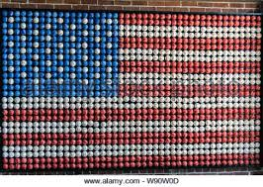
STLWEST League Levels
Blue – Competitive (AA and up)
Red – Semi competitive (A)
White - Recreation

Slide 11

STLWEST League Ranking Process
Our Goal: Each league consists of teams playing at the same level
The three division levels is just the starting point
Strive to have 5-7 teams per league this year
Teams are ranked by the following ways:
Manager submits STLWEST Ranking Form (due 2/8)
Age Group Coordinators and Commissioners
Previous results
League Setup

Slide 12

STLWEST League Ranking Process
For 2026, we will continue to include teams to review their respective rankings prior to creating schedules.
For larger age groups, we may conduct meetings with age group coordinators, as well as invite managers, to assure best setup for league.

Slide 13

Ranking 8U Teams
Consider these things while selecting a ranking
Blue (AA) – Hard hit balls through the lineup, team is athletic and have good middle infield and outfield play.
Red (A) – Hard hit balls through half the lineup, team consists mostly of good athletes with average infield play.
White (Rec) – Minimal hard-hit balls, teams are mix of pool players and friends. Most players are still learning to play and building a basic skill set.

Slide 14

STLWEST League Scheduling
Block Out Dates
Up to 8 dates
Due no later than February 8
Schedules received by March 2

Slide 15

STLWEST Schedule Conflict Meeting
March 8 – Location Ballwin Golf Course Times: TBD (1-4pm)
Softball Age Group | Time
7U
8U
10U
12U
14U
Baseball Age Group | Time
7U (EAA/Eureka/PAA)
8U
9U
10U
11U
12U
13U
14U

Slide 16

Rescheduling after March 8
Section 3.06 A manager may request a game be rescheduled under the following conditions:
If requested prior to 10 days before the originally scheduled game then can be changed at no fee,
If requested within 10 days before the originally scheduled game then can be changed at a fee as determined by the home association,
NO game shall be rescheduled within 72 hours of originally scheduled game time

Slide 17
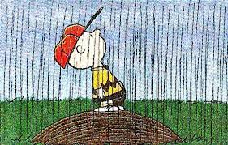
Rescheduling Due to Inclement Weather
Section 5.24 The home team must contact by email the visitor within 7 days of the rainout and offer two dates. The visiting team must respond within nine (9) days of the rainout to the two (2) dates offered. Even with conflicts the game must be rescheduled within fourteen (14) days of the rainout. That does not mean played within fourteen (14) days just rescheduled for a later date. If neither team initiates a reschedule within the fourteen (14) day time frame, the game will go down as FORFEIT for both teams.

Slide 18
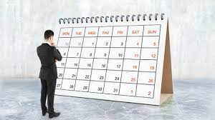
Rescheduling Due to Inclement Weather
Section 5.25 If one team is at fault for the game not being re-scheduled in the two (2) week period, that team will receive the forfeit. This will be determined by email dates and times. A forfeit shall be recorded with a score of 7-0.

Slide 19

STLWEST HEAT/COLD POLICY
Section 5.22 (a) STLWEST games will be canceled/delayed if the heat index exceeds 105° F or if the temperature is below 40°F 1 hour prior to the start of the game at the park where the game is to be played. Games can be delayed up to 30 min. if delaying the start of the game would possibly meet the policy standard. The official weather source that will be used at each park will be the AccuWeather App.

Slide 20
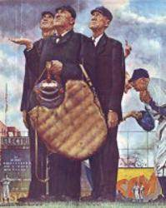

Rainout Line Phone Numbers
(please save on your mobile phones)
BAA 636-229-1110
EAA 636-821-1656
Eureka 636-496-0030
PAA 636-458-9627
PYA
VPAA 636-923-8852

Slide 21

Park Rules
Please leave outside food/drink at home. All parks have great concession stands, which they rely on for revenue for park improvements/operations.
Please leave your pets at home.
Also, no skateboarding or bikes in the park.
Smoking in designated areas only.
Please pass information on to your parents.
Eureka is public park. Some of these rules may not apply at Eureka only.

Slide 22
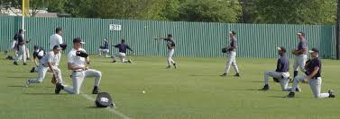
Help Maintain Your Fields
Soft toss on outfield grass is not permitted. Never hit balls into fencing.
Please keep players off the infield/outfield foul lines.
For pregame infield, hit from 3rd to 2nd or 1st to 2nd
Keep off any grass areas on the infield
No batting practice on the field is permitted prior to the game.
Do not warm up pitchers prior to the game on field mound

Slide 23
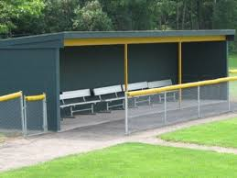
Before and After Games
See something, say something
If you notice an issue with field equipment or conditions, please alert the UIC or board member for immediate attention.
Please clean up your dugout and vacate following your game.
Talk to your team off the field

Slide 24
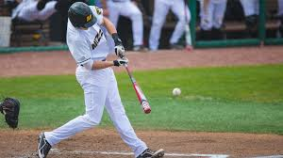



STLWEST Bat Rules (Baseball)
BPF 1.15 stamp (USSSA)
USA Baseball, BBCOR,
and wood bats are allowed
No drop rules
The maximum diameter is two and three quarters inches (2 3/4") and the maximum length is thirty-six inches (36").
Baseball bats only for baseball. No Softball, T-Ball or “coach pitch” bats.

Slide 25

STLWEST Bat Rules (Softball)
All bats must bear the USA/ASA/NSA/USSSA approved certification mark.
The maximum diameter is two and one quarter inch (2 1/4") and the maximum length is thirty-four inches (34"). Max weight is thirty-eight ounces (38oz).
Softball bats only for Fast-Pitch Softball. No Baseball, T-Ball or “coach pitch” bats. No soft-pitch softball bats.

Slide 26
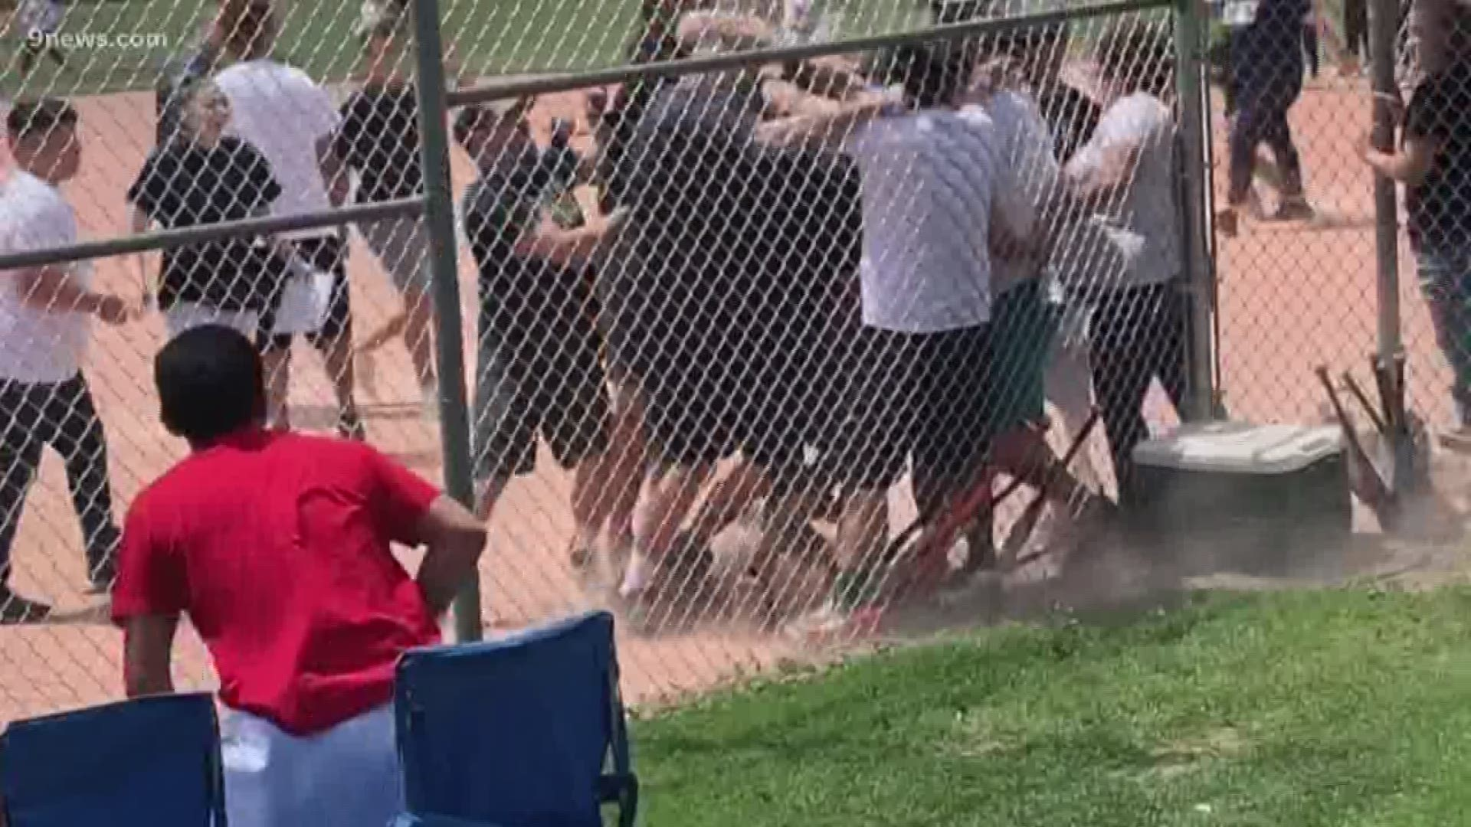
It is Your Responsibility
Managers are solely responsible for their coaches, players, parents and fans.
Hostility between teams, coaches, players, parents, or fans is strictly prohibited
Notes:
Umpire treatment and training
Your son or daughter may be and umpire someday. How would you like them to be treated?

Slide 27
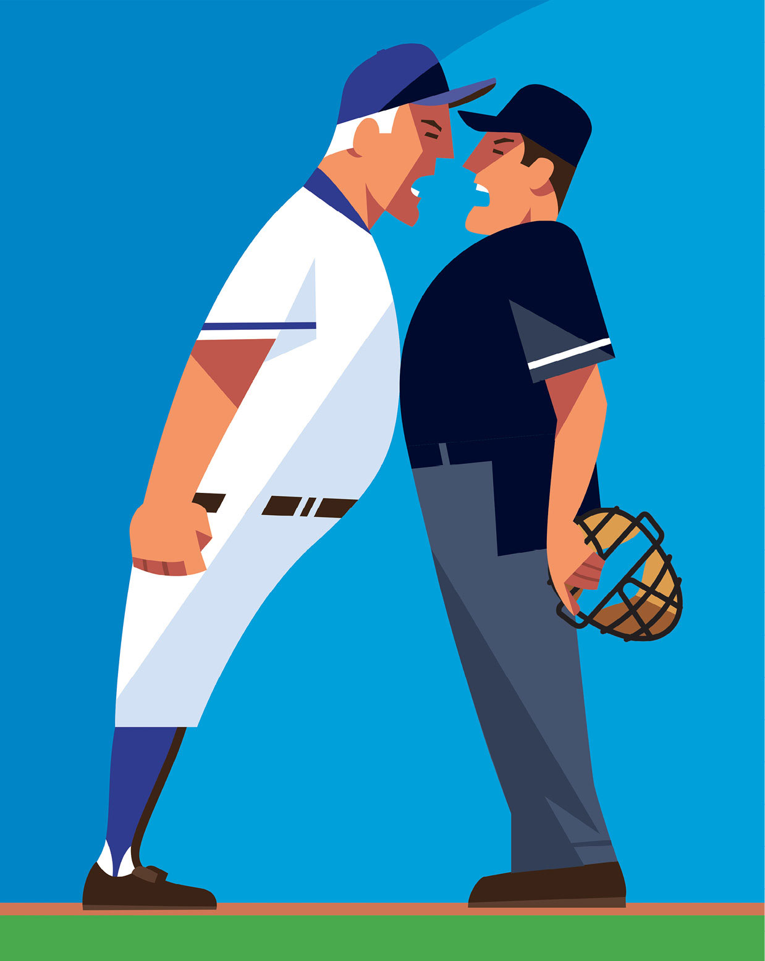
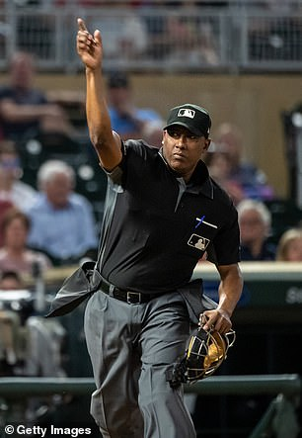
Unacceptable Actions/Behavior Towards Umpires
Constant badgering or yelling
Intimidating or threatening
Vulgar language
Physical contact
Any ejection results in an automatic
one game suspension

Slide 28

New STLWEST Rules for 2026
All games will be one hour and forty minutes (1:40) for all baseball and softball unless otherwise noted (page 8).
In Fall Ball only, no new half inning will begin if there is five (5) minutes or less remaining when the previous inning completes (page 22 and 28).
Guidelines for the Orange safety base have been added (page 29).

Slide 29
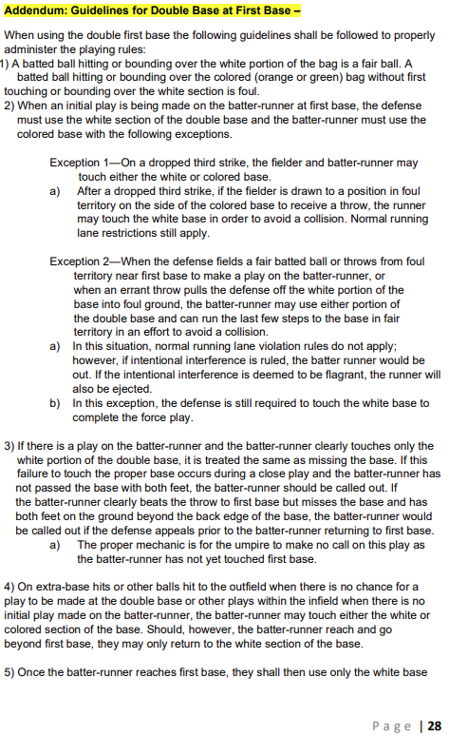
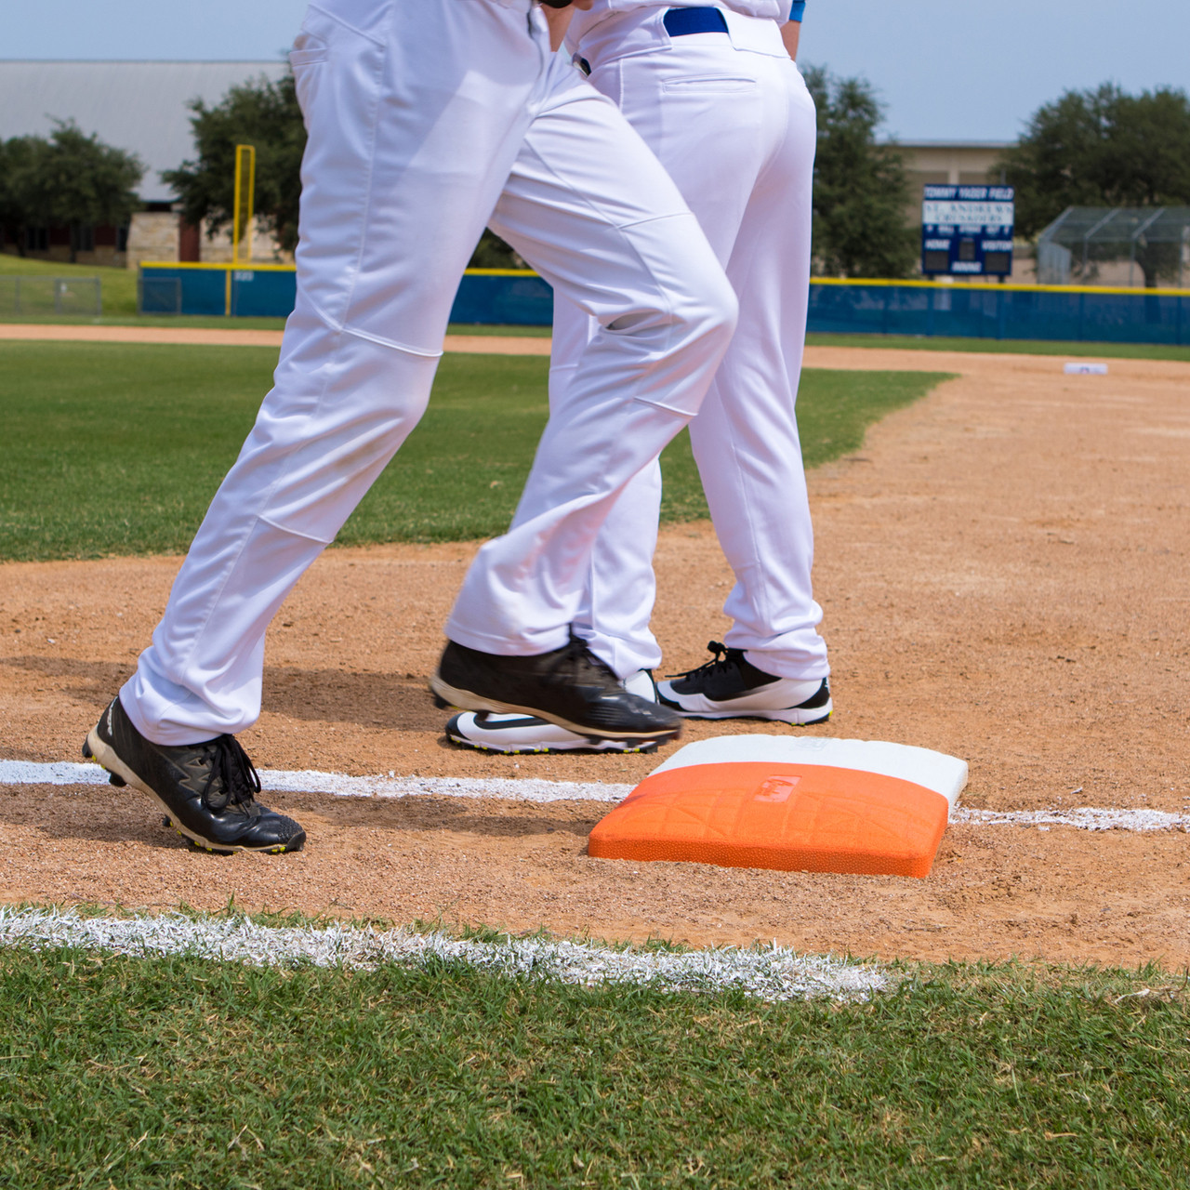
Safety Base
Guidelines

Slide 30
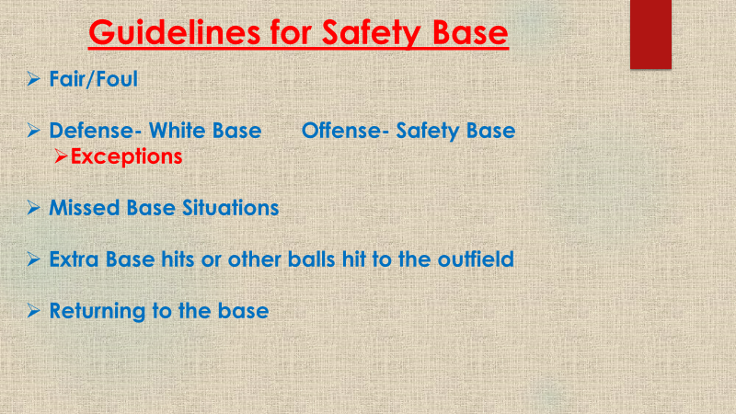

Slide 31
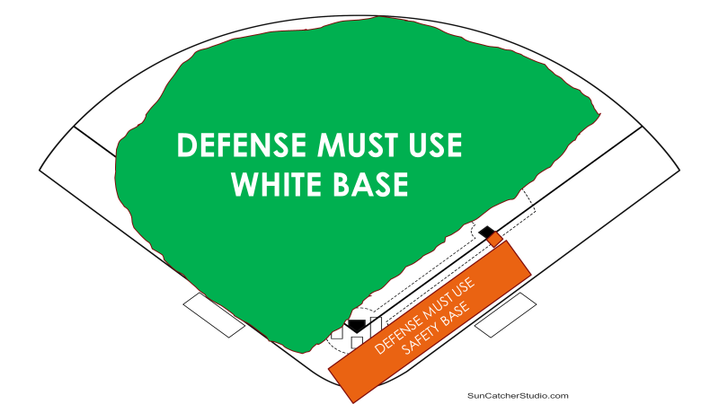

Slide 32

2026 STLWEST Rule Book
Each park website will have a link to the 2026 rulebook for the entirety of the season.
www.baapark.org >> Quick Links
www.eaapark.net >> Quick Links
www.pondathletic.com >> Main Page
www.eurekasports.com >> Quick Links
www.vpaapark.com >> Helpful Links

Slide 33

STLWEST Important Dates
Date | Event
February 8 | Ranking forms due from managers
February 8 | Last day to enter block out dates (8)
March 8 | Schedule Conflict Meeting at Ballwin Golf Course
March 9 | Last day to register for preseason tournament
March 26-April 7 | STLWEST Preseason Tournament
April 8-July 19 | STLWEST Season

Slide 34

STLWEST Glen Herbst Memorial Preseason Tournament

Slide 35


Pacific Youth Association Pack The Park Tournaments
Baseball: April 10-12
Softball: April 17-19
Costs: Free for all PYA teams,
$150 for non-PYA teams
Go to http://www.pyaballpark.com for more information.

Slide 36

Pacfic YouthAssociation
Mother’s Day Classic Baseball Tournament
Dates: May 8-10
Cost: $350 (PYA teams priority entry)
3-game guarantee
Divisions & Format: 7U–8U: Pitch Machine 9U–10U: Player Pitch 11U–12U: Player Pitch 13U–14U: Player Pitch
More information found on www.pyaballpark.com

Slide 37

Ballwin Athletic Association
Stars and Stripes Blast Baseball Tournament
June 18-22
3-game minimum – 2 pool/single elimination format
Cost: 8U; $425, 9U-14U; $550
www.baapark.org to register/more information

Slide 38

Ballwin Athletic Association
Middle School Summer Classic Baseball Tournament
All teams consist of players that will attend same high school
July 20 – July 27
4-game minimum – 3 pool/single elimination format
12u – 14u Baseball Cost: $600
www.baapark.org to register/more information

Slide 39


Join your Association’s Board!
STLWEST consists of parks run by volunteers, except Eureka
Positive impact on our community
Plugged into baseball/softball scene and help keep our leagues consistent with local and national trends.

Slide 40

Sponsorships Available
Consider helping your community by sponsoring your local ballpark.
See a representative from your local ballpark about great sponsorship opportunities!

Slide 41

STLWEST Ballpark Presidents
--Patrick Murphy (BAA) pjmurphy80@yahoo.com
--Jesse Walter (EAA)
President@eaapark.net
--Dionna Helfers (PAA) dionna@sportcourtstlouis.com
--Matt Gerling (PYA)
playballpya@gmail.com
--John O’Brien (VPAA) Jjob119.hv119@gmail.com

Slide 42
If you have any questions, please contact your home association’s commissioner. We wish you all a great 2026!
Thank you!

