Slide 1

Woodbury Royals
Boys Lacrosse
Parent/Guardian & Player Informational Meeting
February 2024

Slide 2
Agenda
Coaching Staff Introductions
Booster Club Board Introductions
Registration & Fees
Fundraising
Season Activities & Volunteer Opportunities
Sponsorships
Season Goals & Opportunities
Player & Parent Expectations
Preseason Activities
Online Registration
Uniforms, Spirit-wear & Player Pack
Important Dates
Game Schedule
Contact Links
THANK YOU FOR COMING & GO ROYALS!

Slide 3
2024 Coaching Staff
VARSITY
  Jason Worwa – Head Coach
  Billy Roberts – Assistant Coach - Offense
  Jack Velte- Assistant Coach - Offense
  Tom Thone – Assistant Coach – Defense/Goalies
JUNIOR VARSITY
Martin Mitsch – Head Coach
  Matt Potter – Assistant Coach
  VOLUNTEER ASSISTANT COACHES
  Gavin Olson
  Cole Peterson
STUDENT MANAGERS
  Kendall Worwa
  Lisa Schiltgen
  TBD
Notes:
Any new managers to add?

Slide 4
Booster Club Board
President: OPEN
Vice President: OPEN
Treasurer: Marne Hunt : Ian Fownes 2025
Secretary: Jennifer Henry
Fundraising: Andrea Hermann
Volunteer and Event Coordinator: Stacy Jacobson (OPEN NEXT YEAR)
Website Manager and Social Media: Melissa Sorensen (OPEN NEXT YEAR)
Sponsorships: Erin Toelke
Apparel and Equipment: Jeremie Baker
All Parents are Booster Club Members – Please get involved!
The Booster Club typically meets on the first Wednesday of every month at Minnesota Athletic Club-MAC.
  Meetings are open and all are invited to attend.
Please contact Jennifer Henry if you are interested in a board or coordinator level position. info@royalslacrosse.com

Slide 5
Booster Club Fees
2024 Fee: $350
Woodbury Royals Lacrosse Booster Club is a volunteer organization that supports every aspect of the player experience for Royals Lacrosse. Your booster fees are used to pay for coaching, uniforms, team activities, equipment, website, and so much more. Please consider these Booster fees integral to supporting our players and program. Included in your Booster Fee, your player will receive a Player Pack (Nike branded sweatshirt/sweatpants and 2 shooter shirts), ticket to the End of Season Banquet, and Royals 2024 season schedule magnet.
Scholarship, payment plan available.
Please take advantage of your employer match programs that may be available.

Slide 6
Fundraising
2024 Fundraiser Cards
We have a new fantastic fundraising card with multiple generous deals.
Price: $25 per card ($17 per card profit to our team)
The card is valued at over $300 and offers 11 free coupons. The free coupons pay for the card!
The expectation is for every player to sell 12 cards. Please pick cards up TONIGHT before you leave. Cards must be sold by March 16th!
Blitz Day: March 15th 5pm to 7pm
NEW!! All players selling 12+ cards will receive an exclusive Royals Lacrosse Jacket!!
We appreciate your support in helping us continue to grow Royals Lacrosse!

Slide 7
Additional Fundraisers
Grocery Bagging
Players encouraged to sign up for one 2-hour shift at
  Kowalski’s or Jerry’s: Fall and Spring Opportunities
Applebee’s Pancake Breakfast
March 16th 8am to 10am
Hosted by both Boys & Girls Royal Lacrosse Teams
Tickets: $10 per ticket. 4 tickets per family to use/sell.
Fall Fan Angel Fundraiser
  We raised over $9,000 toward helmets and equipment
  Players with highest fundraising earnings: Vincent Hunt, Max Henry & Levi Johnson!
  Thank you to all who participated!

Slide 8
Volunteering
Expectations
Opportunities
Volunteers are critical to the success of the program
Require all families to volunteer – minimum of 3 shifts per player
Sign Up will be sent out in early April. Families who do not sign up will be assigned to remaining open slots
If you are unable to fulfill a shift, it is your responsibility to find a replacement
Game Day Volunteers needed for all JV and Varsity Games
Scoreboard (1)
Penalty Table (2)
Concessions (2)
Announcer (required for Varsity only)
Stats (required for Varsity only)
Team Dinners
Serving and Clean Up
We also need help with Senior Night, Staff Appreciation, End of Season Banquet
Please contact Stacy Jacobson is you are interested!

Slide 9
Team Dinners
Team Dinners are a favorite Royals Lacrosse Tradition!
Team Dinner Coordinator: Stacy Hanson
Dates:
Thursday, April 11 Thursday, May 9
Thursday, April 25 Thursday, May 23
Thursday May 2
Dinners are held in the WHS Cafeteria after Practice (both JV, Varsity teams & managers attend)
All families are asked to support our team dinners by contributing a main dish, side dish, beverage or dessert. A meal assignment list will be sent out in early April.
Serving/Clean-up volunteer opportunities will be included in volunteer sign-up that will be sent out

Slide 10
Sponsorships
Gold - $1,000 +
  Logo & contact on webpage; announced at home games
  Logo on banner displayed at home games
  Ability to provide promo materials
  Included in tagline for email communications
Silver - $500
  Logo & contact on webpage; announced at home games
  Logo on banner displayed at home games
Bronze - $250
  Logo & contact on webpage; announced at home games
“In-Kind” - contributions like gift cards, merchandise, catering, or services.
Please take advantage of employer matches for donations or volunteering
PLEASE LEVERAGE your networks!

Slide 11
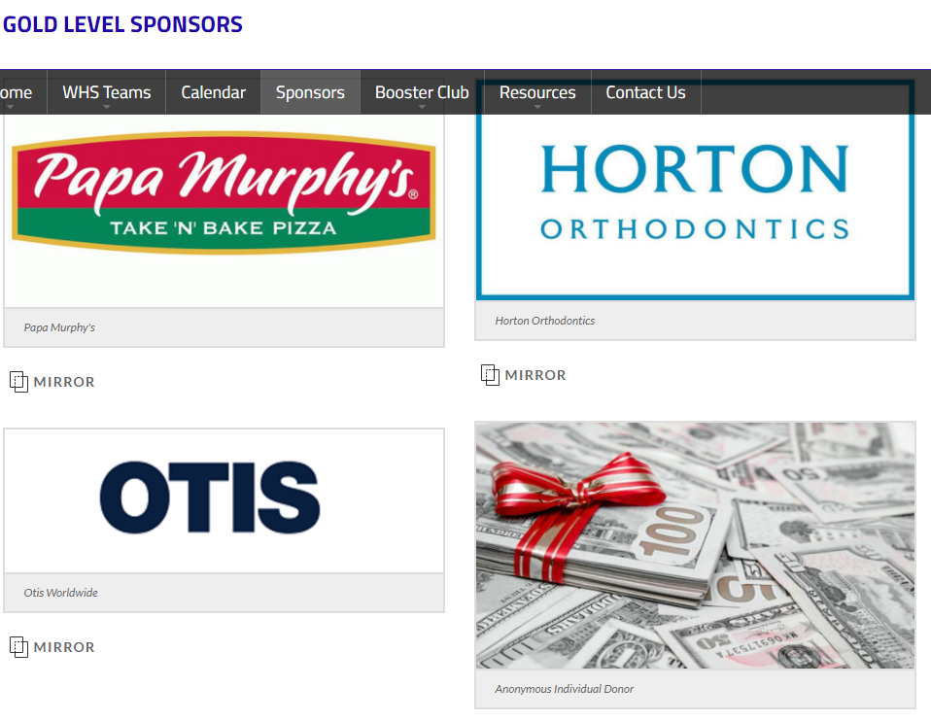

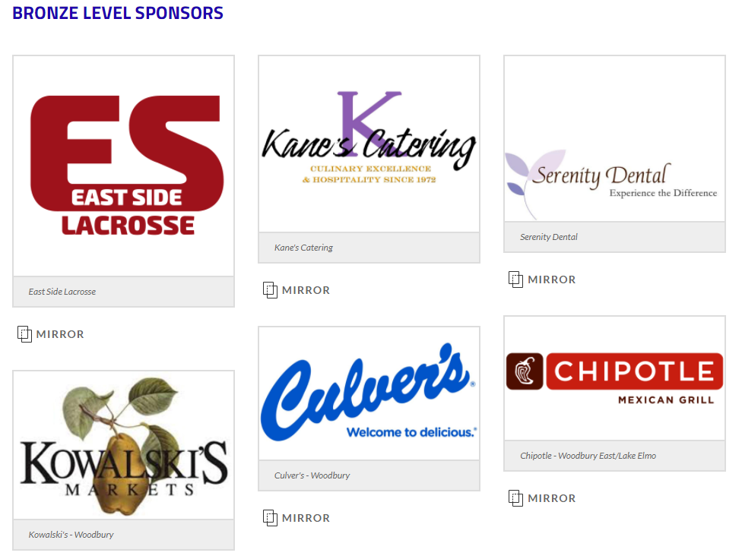
2023 Sponsors
Notes:
These are sponsors from last season. UPDATE 2023 sponsors

Slide 12
Community Outreach
CAMPUS/STADIUM CLEANUP DAY
  DATE: Saturday, March 30th | 1pm at Royal Stadium
WOODBURY UNITED –Tryout Evaluations & Clinics
April 21st and April 28th
TRY LACROSSE FREE
Hosted by players and coaches 1-2 times a year.
We are always looking for ways to connect with the community. Please reach out with any opportunities or ideas.
Notes:
update dates 2024

Slide 13
MSHSL (Minnesota State High School League)
Student Code of Conduct
Academic, Chemical/Substance, Social Media, Harassment, Hazing
As a student participating in my school’s interscholastic activities, I understand and accept the following responsibilities:
I will respect the rights and beliefs of others and will treat others with courtesy and consideration.
I will be fully responsible for my own actions and the consequences of my actions
I will respect the property of others.
I will respect and obey the rules of my school and the laws of my community, state and country.
I will show respect to those who are responsible for enforcing the rules of my school and the laws of my community, state and country
Notes:
Jason will update with info from Jody

Slide 14
Season Goals
Mission Statement
I coach to have a positive impact on the lives of young men. To teach them that there is more to life than just what they're experiencing in high school. It is my job to prepare them for the bigger world as well as to instruct them on how to be better athletes and teammates.
HAVE FUN
PRACTICE HARD & PLAY HARD
BE THE BEST TEAMMATE POSSIBLE
PERSONAL & TEAM ACCOUNTABILITY
LEARN HOW TO LEARN FROM MISTAKES
CONTINUAL PERSONAL, PLAYER AND TEAM EVOLUTION
APPLICATION OF TEAM ATHLETICS EXPERIENCES TO REAL WORLD SITUATIONS.
ON THE FIELD SUCCESS
SEC CHAMPIONSHIP
SECTION TOURNAMENT SUCCESS
STATE TOURNAMENT APPEARANCE
Notes:
Jason may add additional info to this slide, per Covid.

Slide 15
Player Expectations
These expectations will be discussed in detail with the players and coaches at one of our first practices
To remain in good standing for eligibility by following MSHSL and WHS rules prohibiting the use of drugs, alcohol and tobacco for the entire year.
Maintain good academic standing (2.0 GPA or higher). The activities office will be proactive in notifying the coaching staff if a player is falling behind in this aspect.
Be respectful of others.
Be respectful of school and team property.
Be responsible and accountable, including being on time for everything.
Be team conscious in all of your decisions.
Prioritize your commitment as a lacrosse player. School, family and religious commitments come first, lacrosse comes after.
Failure to follow these expectations can and will result in a loss of playing time or potential dismissal from the team.

Slide 16
Parent/Guardian Responsibilities
To provide a positive home and social environment.
To deal properly with injuries.
To balance family commitments with your son’s team commitments.
To support the royals lacrosse booster club.
To support your son and the team and develop a healthy parent/son/program relationship.
To let the coaches coach.
To understand that no parents are allowed on the field or in the locker room before, during or after games or practices unless you are volunteering for game day activities.
If you have questions about anything lacrosse related, ask your son first! If you have the need to discuss anything further with a member of the coaching staff, please allow at least 24 hours after a game before doing so.
To discuss personal, social and academic issues that may affect the way the coaching staff works with your son.
To learn the rules and basics of lacrosse, it will make the games that much more enjoyable to watch!

Slide 17
Rights of Parents/Guardians
To know the guidelines and expectations of your son as a member of our program.
To know the process used to select players for our teams in our program.
To attend your son’s games without distracting the process.
To discuss personal, social and academic issues regarding your son with the coaches at any time.
To discuss lacrosse related concerns with the coaching staff 24 hours after a game or practice.
To know the chain of communication to discuss any other issues. (Son, coach, activities director, principal)

Slide 18
Offseason Opportunities
CAPTAINS’ PRACTICES
  Location: Minnesota Athletic Club (MAC)
  Time: 5pm to 6pm each Thursday
  Dates: 1/18 through 2/29
PRESEASON TRAINING CAMP with Coach Limpert
  Location: MAC
  Time: 4:30pm to 6pm M-Th
  Dates: March 12-14, 18-21, 25-28
OPEN LACROSSE @ MAC
  3:15pm to 6pm Monday through Thursday
  $8 per session; $5 for MAC players
Notes:
Add dates for camp

Slide 19
2024 Royals Kenosha Adventure
A Royal program tradition returns! We are excited to offer the opportunity for our players to travel as a team to Kenosha, WI and take in a D3 Lacrosse game! Carthage vs. Elmhurst game will feature a recent alumni, Sam Hoff! Our players will also have the opportunity to practice on a local field and take a guided tour of Carthage College. This trip has been an overwhelming favorite memory of players in the program for years!.
Dates: April 5th-6th
Bus will leave immediately after school on Friday, 4pm and return Saturday night
Cost: $100
Includes: Coach bus, hotel room (2 players/room), Friday night pizza dinner, Saturday morning breakfast, game ticket

Slide 20
Registration for 2024 Season
IMPORTANT INFORMATION
Deadline: April 1st
  All players must be registered prior to tryouts, no exceptions.
  Don’t wait until last day - important to know in advance how many players we will have at tryouts.
Registration can be completed online at www.Whsactivites.Org
Cost: $190
Sports physical: current (within 3 years) physical must be on file with the activities office. Please check with Susan Garcia if you have questions on status.
Family cap: $520 for the school year. IF ANY OF YOU QUALIFY FOR THIS, PLEASE REACH OUT TO Susan Garcia at sgarcia1@sowashco.Org
Notes:
changed Karleigh to Susan Garcia

Slide 21
Tryouts
Dates: April 1st-3^{rd,} 6pm to 7:30pm
Location: MAC (Minnesota Athletic Club)
Changes of times or locations will be communicated through 2023-24 parent GroupMe chat.
ACTIVITIES REGISTRATION MUST BE COMPLETED AND ON FILE IN THE ACTIVITIES OFFICE BEFORE TRYOUTS!
8th graders must be enrolled at at WHS feeder school (Lake, WMS, or potentially Oltman/CGMS). Any questions about eligibility can be answered by the WHS activities office.
We strongly encourage all 8th graders who are still age eligible for U14 attend the Woodbury United player evaluations. More info is available at www.woodburyunitedlax.com
Notes:
Jason can you speak to U14 players eligibility if they play both JV and WULAX. Can keep or leave last bullet point.

Slide 22
Additional Information - Tryouts
All players are expected to have their own equipment (helmets, mouthguards, sticks, shoulder pads, arm guards, gloves, cleats, etc)
  *New shoulder pad requirements for 2022
  Gloves should be in Woodbury Royals colors (white, black, royal blue)
Players will be evaluated based on lacrosse fundamentals (catching, throwing, shooting, passing, etc.), athletic ability (speed, strength & endurance), field awareness and lacrosse IQ, effort and other intangibles.
All players will be given a fair opportunity to make teams.
Each player will meet with the coaching staff to learn what team he made on the third day of tryouts, near the end of the tryout session.
Uniforms will be handed out to players on April 3rd.

Slide 23
Team Formation
Varsity: 20-23 players
Junior varsity: 20-23 players
Player movement: we do our best to place players accurately at tryouts, however, the team you start on may not be the team you end the season with.
Swing players: we generally have about 3-5 players that swing between jv and varsity. Per MSHL rules, a student athlete may play up to 6 quarters of lacrosse per game day.
Players will find out what team they are on at the conclusion of the third day of tryouts
Notes:
Need a minimum of 54 players to field 3 teams

Slide 24
Practice Information
Practice times: 5:30-7:15pm or 7:15-9:00pm on a two week alternating schedule.
All times will be posted on the royalslacrosse.com website calendar.
Locations: Royal stadium, Woodlane field, WHS activities center.
Varsity locker room: Under the east bleachers in the stadium.
Practice uniforms: player should wear black shorts/sweatpants and a white, royal blue or black shooter shirt to practice daily!
Players are expected to arrive early enough to be dressed and ready 30 minutes prior to the start of practice!
Notes:
Jason, are we going to have JV use school locker rooms?
Athletic Trainer:

Slide 25
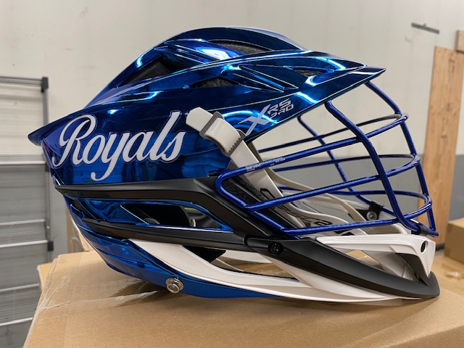
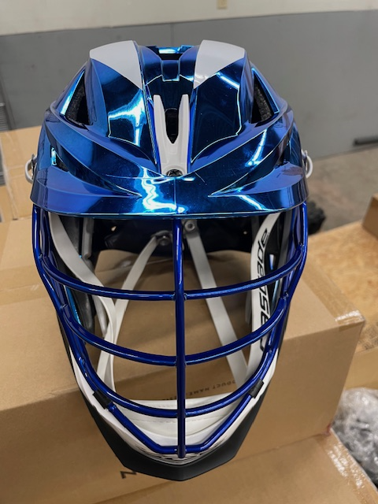
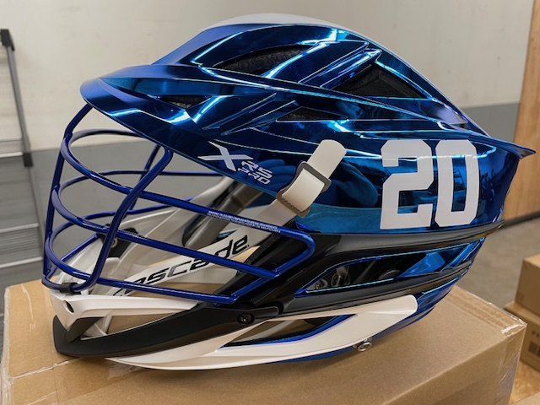
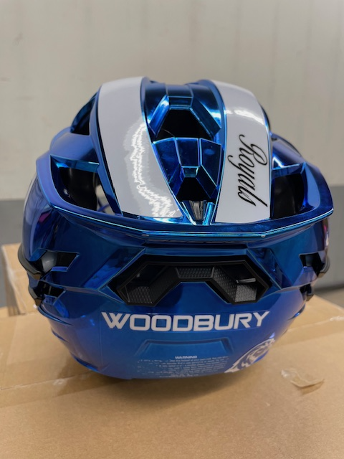
Helmets and Uniforms
New helmets this season!
Player helmets will now be issued as part of their uniform.
Helmets are CASCADE XRS PRO
Notes:
NEW PHOTO OF HELMETS 2024

Slide 26
Spirit Wear Apparel Order
Spirit wear store at Advanced Sportswear
Both player and fan items available
Ordering this apparel is optional and not required.
THE SPIRIT WEAR STORE IS NOW OPEN AND WILL BE AVAILABLE UNTIL MIDNIGHT ON FRIDAY, MARCH 12TH. NO EXCEPTIONS!
Lead time is 4 weeks, so apparel should arrive just in time for the start of the season
Spirit wear can be picked up at Advanced Sportswear in Cottage Grove
Notes:
ADD IN NEW LINK FOR ADVANCED SPORTWEAR AND LINK FOR PLAYER STORE THROUGH BNS

Slide 27
Box Lunches – Away Games
Back by popular demand!!
Jersey Mike’s Box Lunch consists of a sandwich, bag of chips and cookie
$75 for 6 box lunches (Jersey Mike’s is donating the meals for one of our games)
Box lunch will be delivered prior to the bus departure and distributed by managers
Jennifer Henry will coordinate sandwich orders.
Please fill out AWAY GAME LUNCHBOX order form & pay to participate (please note that the sandwich order will be the same for all 6 games)
Notes:
To give our players a dependable source of nourishment for away games.

Slide 28
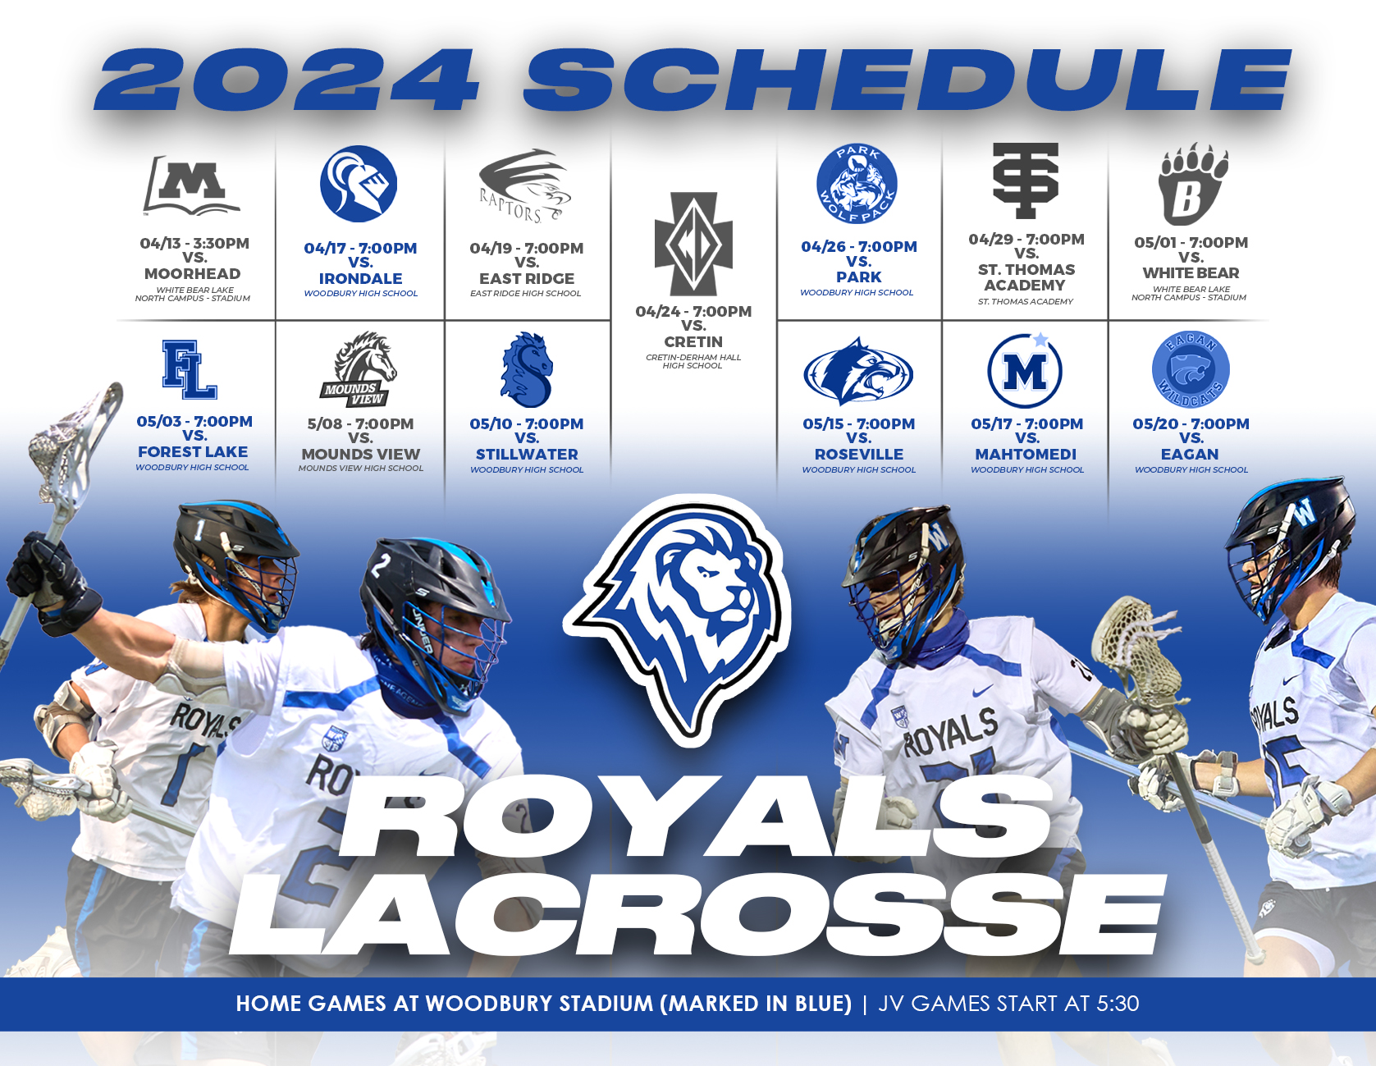
2024 GAME
SCHEDULE
ADDITIONAL INFORMATION CAN BE FOUND AT:
https://WWW.ROYALSLACROSSE.COM/page/show/241564-calendar
&
WWW.SUBURBANEAST.ORG

Slide 29
Important Links
COACH WORWA’S CONTACT INFORMATION
  JLWORWA@GMAIL.COM
  651.248.8199
COACH MITSCH’S CONTACT INFORMATION
  MARTIN.MITSCH@GMAIL.COM
  651.325.8555
BOOSTER CLUB CONTACT INFORMATION
  INFO@ROYALSLACROSSE.COM
WHS ACTIVITIES PAGE
  WWW.WHSACTIVITIES.ORG
MINNESOTA LACROSSE HUB
  WWW.MNLAXHUB.COM
SUBURBAN EAST CONFERENCE
  WWW.SUBURBANEAST.ORG
TEAM WEBSITE
  WWW.ROYALSLACROSSE.COM
STATE HIGH SCHOOL LEAGUE WEBSITE (BOYS LACROSSE)
WWW.MSHSL.ORG/SPORTS-AND-ACTIVITIES/LACROSSE-BOYS
Notes:
NEED COACH MITSCH’S INFORMATION

Slide 30
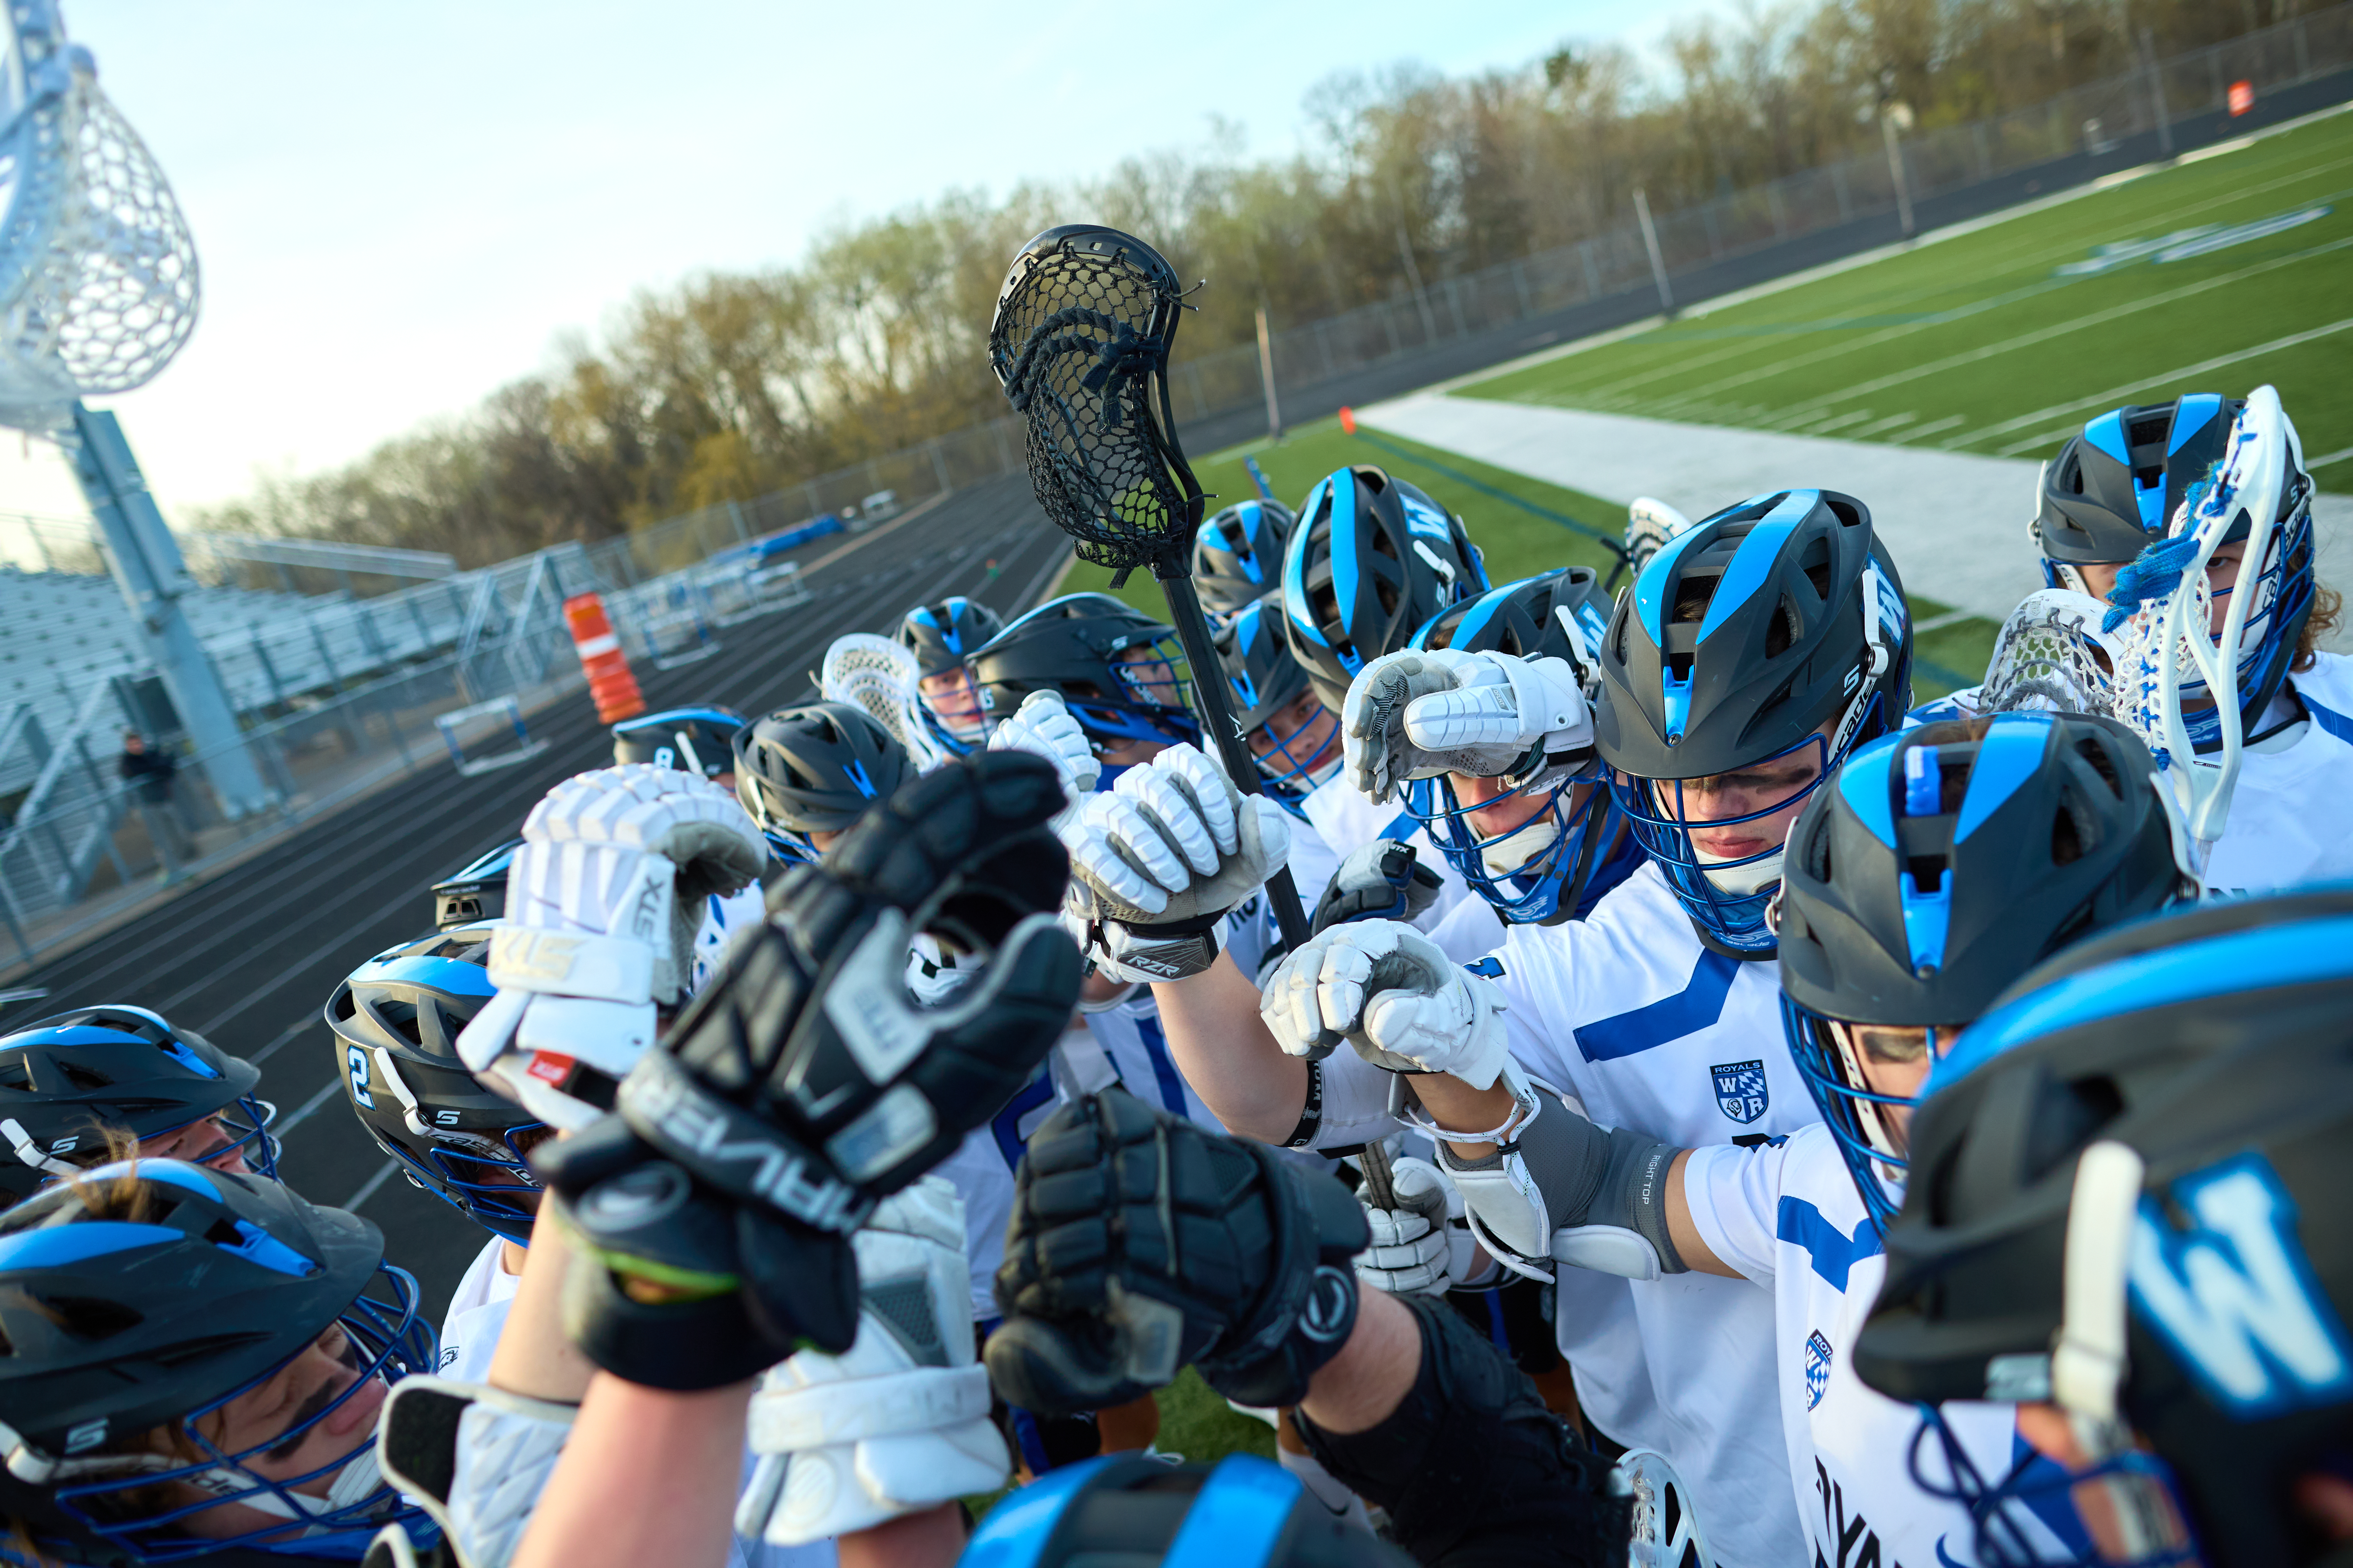
ROYALS LACROSSE

