Slide 1
4th Association Meeting
Tuesday, February 4th, 2025

Slide 2
Time Change for Farmington middle school
The middle school meets that were scheduled for a 4:00 start are now starting at 3:45.

Slide 3
Final Officials for 2025
Last year, we had 13 at the Individuals and 2 at the Teams for a total of 15.
This year we have 17 at the Individuals and 1 at the Teams for a total 18.
From zone 3 we have a total of 19 at the Individuals and 2 at the Teams for a total of 21.
21 out of 48 used for the finals or 44% from Zone 3… GREAT NUMBERS!!!!

Slide 4
Final officials for 2025 are:
John Andrews Tom Arsenault Mike Billiu Mike Carrier (1st)
Chad Davinich Dave Hall Bobby Hearn Kyle Hucul (1st)
Gary Kowalewski Bryan Legree Steve Livings Josh Orzechowski
Ron Nagy Brian Salk (1st) Jerrid Schalk Matt Stabley
Robert Szukala (1st) Dave Witgen
DOESN’T GET ANY BETTER THAN THIS!!!!!!

Slide 5
Post-sEASON
Districts – Team and Individual – With everything going on, if you are working Wednesday and not Thursday or vice versa and are open and available, let me know and if a problem arises, we can contact you at the last minute. Maybe even have your stuff in the car.
We had 8 Individual Districts with 1of ours on Sunday.

Slide 6
Districts information
Arrival time due to weigh-ins.
Draw of wt. class.
Districts the official conducts draw and that is where skin checks and weigh-ins start.
Regionals wt. class is provided by MHSAA.
Dress code :white and black stripes only or is grey an option ? We can wear MHSAA issued finals jerseys.
Emphasize to call official to table to avoid penalties.
How we will call tap-outs as an association.

Slide 7
Post Season
Individual Tournament
District $250.00 •
Regional $250.00
Note: The one assigned head official shall receive an additional $15 for conducting
inspections, observing the weigh-in, and serving on the Grievance Committee.
Team Tournament
District $130.00
Regional $145.00

Slide 8
Team District Schedule
Time Schedule
Wrestling may not begin before 3:30 p.m. but must begin by 6:00 p.m.
Shoulder-to-shoulder weigh-ins are to be conducted on-site 60 MINUTES before the meet is scheduled to begin. Weigh-in shall be conducted as stated in the MHSAA Weigh-In Procedures (MHSAA.com).
A referee and, when possible, a physician (MD, DO, PA, or NP) with experience in skin conditions (dermatologist, for example) shall inspect contestants before they are allowed to weigh-in. After entering, wrestlers are to remain in the weigh-in area until they have completed the weigh-in.
One scale shall be used in the Team weigh-in and begin with the drawn weight class.
The official facilitating the weigh-in shall call up each weight class accordingly. If there is a point where wrestlers choose not to step on the scale (wanting to wait to see who steps on the scale for the other team), the official will call the weight class for a final time and then will move on to the next weight class. The weigh-in concludes after the last weight class
The weigh-in shall be up to one hour in length, and the exact weight of each contestant shall be recorded on the Team Weigh-In Form.
There is to be a ten (10) minute break between the Semifinal and Final rounds of wrestling. The weight drawn shall be the starting weight class for the Semifinal match(es) and weigh-in. For the Final match, the starting weight class shall be one above the Semifinal starting weight as prescribed by NFHS Wrestling Rule 1-1-2.

Slide 9
Inspections and Weigh-Ins
Teams- Weigh-ins: They are 1 hour before wrestling begins
so the officials need arrive at the school 1 ½ hour
prior to the match, get dressed and be ready to
do weigh-ins.
Individual Districts: Weigh-ins are 1 ½ hours prior to wrestling
so you need arrive at 7:30 am to be dressed and
ready for inspections. It takes everyone to get this
taken are of so you can start on time.

Slide 10
Pre-Meet Duties
I would also emphasize how important it is to do your pre-meet duties by advising coached to:
make sure all their wrestlers shoes are double knotted
or taped
they come to the table properly equipped and
ready to wrestler. That means headgear on when
reporting to the table
Make sure you ask each wrestler AT THE TABLE what
weight they are so you do not have the wrong kids
wrestle. This is on you!
Emphasize to call official to table to avoid penalties.

Slide 11
Working Final matches in post season
When working the final match of the team district or Individual finals for the 1st & 2nd or 3rd & 4th, we will be using the two man system.
I know that some of you do not like assistants but they can be your best friend when issues come up. I will tell you from my experience and most veterans, we have no problem with assistants. They can be a useful tool when a locked hands on the opposite site or support from them when you make a tough call. To believe or give the impression that they are not needed, could leave you vulnerable or he could say, didn’t see it because you told him you didn’t need his help.
Be careful!

Slide 12
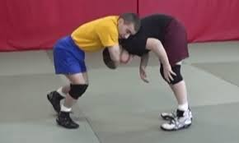
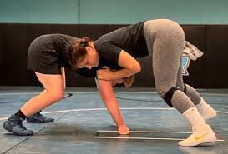
Point of emphasis
Restricted Breathing: Recently, several wrestlers have been "choked out" during wrestling. We need to pay special attention to holds/maneuvers that restrict the airways or blood flow. These are illegal and must be immediately stopped. Rule 5.14.2... Any hold/maneuver with the pressure exerted over the opponent's mouth, nose, throat, or neck that restricts breathing or circulation is illegal
In MOST situations, neck pressure is on the “elbow” side not the hand side.

Slide 13
POINT OF EMPHASIS
Blood Time: The match shall be stopped for any wrestler who is bleeding, has an open wound, has any amount of blood on their uniform, or has blood on themselves, shall be directed to be treated until the bleeding is stopped, the wound is covered, the uniform and/or body is appropriately cleaned, and the uniform is changed before returning to competition. Rule 8.2.8...The official interpretation is to keep blood time running if additional measures are used to control bleeding. That would include, but not be limited to, using tape to keep the nose plug in place or to cover a wound.

Slide 14
Keeping your mind in the match
Make sure you know what has happened in your match – Stalling or warnings
Check with the table before starting overtime so you don’t have a problem.

Slide 15
Assistant Referee
Assistant should:
  Assist with checking equipment
  Always see the clock, start/stop. Help with decisions as time expires.
  Work as a team. Express any opinion to the lead, no visual or verbal that anyone else can see/hear.
Stay outside of the 28-foot circle, unless directed otherwise by the LR and at 180 degrees
Movement and communication should be constant. Ex: good call or nodding your head.
Bring infractions to the LR's immediate attention in a manner that does not draw attention to the AR.

Slide 16
continued
Be responsible for the time. Make sure the clock starts and stops on the LR’s whistle.
Watch the clock with wrestlers in your field of vision.
  The AR should count down “four, three, two, one … Time!” (Especially if no tapper is present).
Assist the LR with injury (including HNC), recovery, and blood time protocol. Support the LR while on the mat.

Slide 17
Releasing the tilt or cradle
Any move that DOES NOT ALLOW the bottom wrestler to get back to a defensible position means they are still in the same situation. DO NOT award the points while in the same situation. Offensive wrestler must release the arm(s) to allow bottom wrestler to be able to defend again prior to awarding near fall points.

Slide 18
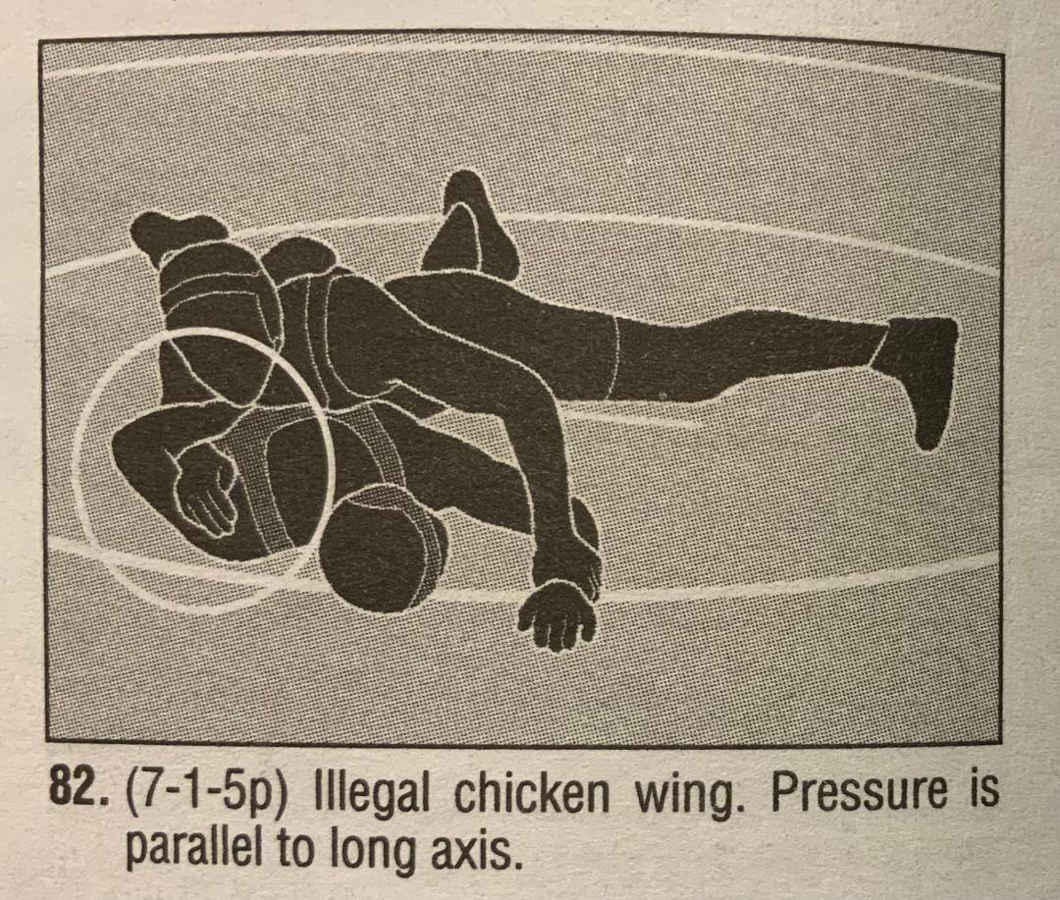
Chicken Wing

Slide 19
Illegal?
As long as there is NO pressure going parallel, you should stop it and call it potentially dangerous. It is NOT an automatic penalty just because the hand is upward.
If you can catch before it goes beyond the limit of normal range of motion, it would be potentially dangerous.

Slide 20
Rules question
Offensive wrestler is on his feet behind the defensive wrestler, who is also on his feet. Referee makes stalling signal (audible and hand signal- Rule 7-6; Art. 4(d)) but does not blow whistle to stop match and enforce warning because in judgment of Referee an escape was imminent. Rule 8-1; Art. 2(e)
Wrestling continues and offensive wrestler drops down to lower portion of defensive wrestlers legs and holds there for a bit but regains control over defensive wrestler.
Question: If imminent situation does not resolve in points and referee gave warning for stalling. Is not stopping the match, when the imminent situation clears, create bad time.

Slide 21
answer
Regarding stalling on the offensive wrestler, as long as the offensive wrestler is stalling when the defensive wrestler is on his feet, you can award a stalling, without a stoppage. Upon the 2nd stalling, you would award the point and wrestling continues. This would be repeated if it happens again except when 2 points are awarded.
At that time, you would stop the match and do a re-start, providing the top man choice of position (top, bottom, neutral).
Imminent is not involved in this situation.

Slide 22
Poke to the eye
I was talking with a coach about Reffing in Battle Creek. He says they were calling a poke in the eye as an automatic unnecessary roughness call. He said it was consistent all day.
Answer: Good question. I agree with the call, and it matches the NFHS interpretation. Any poke to the eye is illegal and should be called as such.

Slide 23
Taunting
Taunting Rule 5.26
Taunting is any act or action which is intended or designed to embarrass, ridicule, or demean others under any circumstances including on the basis of race, religion, gender, or national origin.
NOTE: The NFHS disapproves of any form of taunting which is intended or designed to embarrass, ridicule or demean others under any circumstances including based on race, religion, gender or national origin
E.g... Releasing a defensive wrestler off their back from an obvious pinning situation

Slide 24
Question
Do we caution the wrestler who is asking to go neutral after setting the bottom wrestler. It seems to be different everywhere.
Answer: According to the NFHS and MHSAA interpretation of Rule 5.19.8, the offensive wrestler MUST indicate an optional start or an intent to release the defensive wrestler before the official verbally “sets” the defensive wrestler. Failure to do so results in an improper start and a caution is to be given.

Slide 25
When the Defensive Wrestler Comes to Their Feet:
Pay attention to hand control and fingers.
If the offensive wrestler does not make an honest attempt to return the defensive wrestler to the mat, the referee will warn and/or penalize the offensive wrestler for stalling. YOU DO NOT DO ANY COUNT AND NO 5 SECOND RULE
Do not stop the match when making a stalling call in this situation.
If an arm(s) of the defensive wrestler is trapped, locked to the side, or the defensive wrestler cannot protect themselves when being lifted off or returned to the mat, the referee shall blow the whistle to stop the move or maneuver as potentially dangerous.

Slide 26
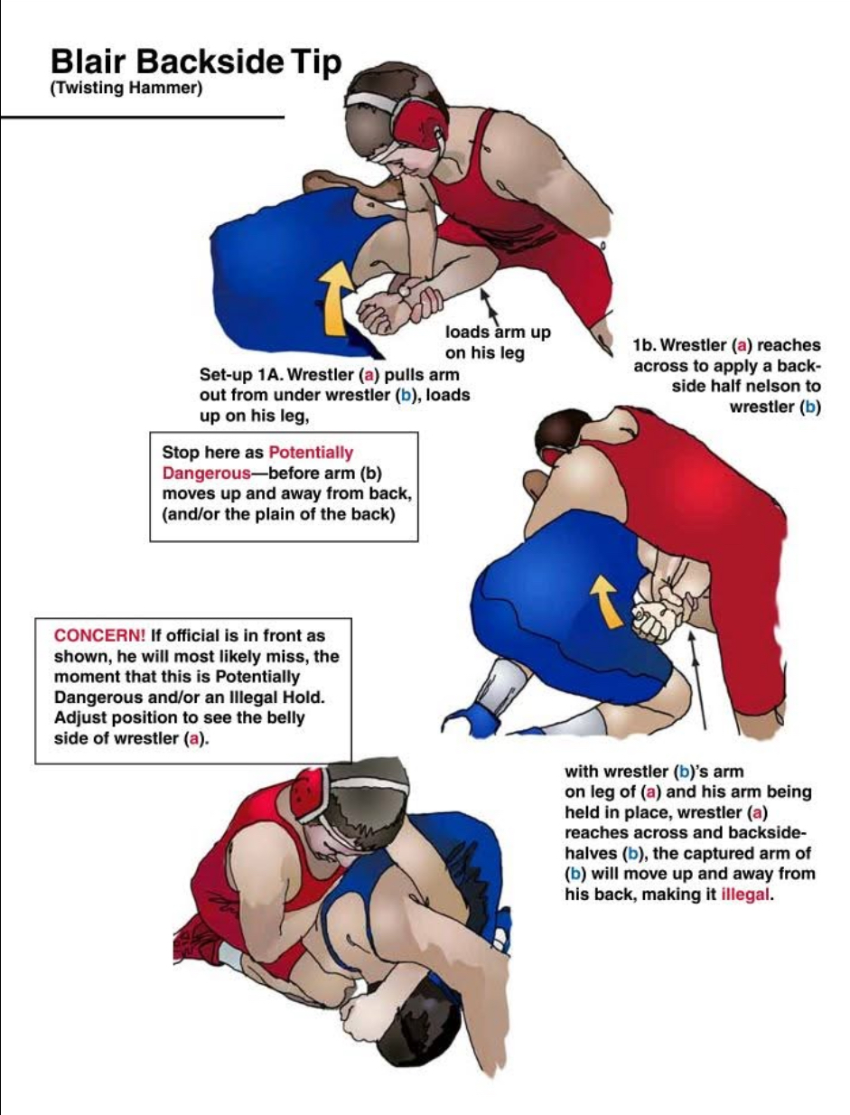
Blair Ride 2.0
The Blair ride (Pictured right) is not Potentially Dangerous by application, but is either PD or Illegal by pressure.
Notice the offensive wrestlers elbow in all three pics. Notice anything in common?

Slide 27
Making calls vs calling what you see
There have been a few instances this year, of officials seeming to be looking to make a call, instead of calling what they see.
Always be prepared to make any call you see.
Never be looking to make “A” call.
When you have a situation that is not repeated, or happening for the first time, if Potentially Dangerous is an option, use it. If something looks weird, Stalemate it.
PD and Stalemate are situations where both sides will most likely be fine, and will avoid further issues.
DO NOT MAKE A CALL TO MAKE A CALL.

