Slide 1

ISWA Tournament rules & regulations
2020-2021 update

Slide 2

Tournament preparation
Must be sanctioned through ISWA to be eligible for insurance coverage
Must be in compliance with local, state, and venue-specific mandates
Required officials:
    Tournament Director
    Head Mat Official
    Head Pairing Official
    Medical Trainer
Entry forms must include signed waiver and emergency medical treatment consent

Slide 3

USA Wrestling competitor’s cards
Valid for current season
Must be age-verified through ISWA
Out of state wrestlers welcome at local events if duly registered with USAW
State finals open to Indiana residents only

Slide 4
Age divisions/Weight classes
Wrestlers cannot move up an age division 2 exceptions:
    Only 16U Cadets who are in high school can move up to Junior.
    University can move up to Senior and Veteran can move down to Senior
Mouthguards and headgear required for 6U Peewee through 14u Schoolboy/girl
Weight classes may be split or combined at discretion of tournament host
Cannot wrestle in more than one weight class

Slide 5
WEIGH-INs
No cell phones in weigh-in room
1 weigh-in and 1 immediate challenge
Cannot leave weigh-in room once entered
Must weigh in competition singlet
Weight must be recorded, cannot go to alternate weigh-in location or return at later time
Can only bump up one weight class (must declare at scale)
Can wrestle in ONE weight class only

Slide 6
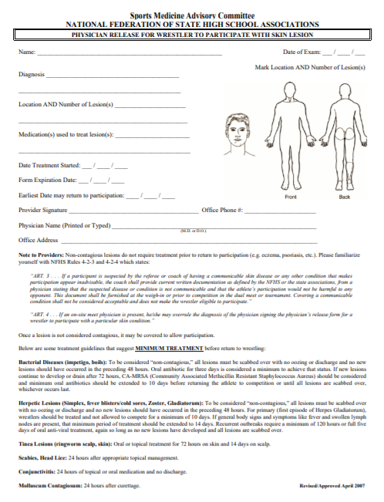
Skin checks
Mandatory for all tournaments and duals, even those with satellite weigh-ins
Cannot occur sooner than 24 hrs prior to event
Trainer/official decisions on participation are final
NFHS physician release form on ISWA website is only exemption form accepted

Slide 7
OFFICIATING
FOLKSTYLE
FREESTYLE/GRECO
15 min. rest between bouts
Error corrections settled matside with officials per NFHS rules
NO JUDGEMENT/VIDEO REVIEW
Line bracketing recommended for 4+, vertical pairing for 3 or less
15 min. rest between bouts
FILA rules from International Rule Book
Challenge bricks at state level for championship matches only
Protests: fees apply, handled by head official, proper documentation, reported to ISWA

