Slide 1

Hutchinson Hockey Association Annual Meeting & Awards Night
March 12th at 6:30pm
Crow River Golf Club

Slide 2
AGENDA
Welcome
Awards
Team Updates
Financial Report
Gambling Recap
Nominations & Elections
Announcements
Election Results
Adjourn

Slide 3
Please consider volunteering!
Position | Candidate #1 | Candidate #2 | Candidate #3
Vice President
Treasurer | Meranda Wacek
Director of Special Events | Melissa Campbell / Erin Knudtson
Director of Tournaments
Director of Girls Teams | Jess Engelsmeier
VP
Treasurer
Director of Special Events
Director of Tournaments
Director of Girls Teams

Slide 4
AWARDS

Slide 5
Initiated by Ivan Hurt of Hutchinson: Ivan was instrumental in organizing the recreation youth hockey program in Hutchinson.
Exemplifies the following:
Hustle at practice and game
enthUsiasim about hockey
Respected by other players
Team player
Ivan Hurt Award
Outstanding HHA Squirt Player
Selected by a vote of all Squirt Players

Slide 6
Outstanding 10U Girls Player
Selected by a vote of all players in that division
Female player who exemplifies:
Hustle at practice and games
Enthusiasm about hockey
Respected by other players
Team player

Slide 7
Kelby was a beloved HHA player that passed away in her PeeWee year in 2005. Her parents, John and Kim Macemon, instituted this award as a memorial to Kelby.
As with Kelby, the recipient of the award demonstrates the following:
Good sportsmanship and shows respect toward fellow players, coaches and parents
Shows enthusiasm and passion for hockey
Team player
Skates with a smile on his/her face
Kelby Macemon Award
Selected by a vote of all players in that division

Slide 8
Outstanding 12U Girls Player
Selected by a vote of all players in that division
Female player who exemplifies:
Hustle at practice and games
Enthusiasm about hockey
Respected by other players
Team player

Slide 9
George was a Hutchinson High School Assistant Varsity Coach, who passed away of cardiac arrest during a High School game in 1977.
He was an active member of the HHA Board and other areas of the Association. He also felt the hockey Defenseman never received the recognition they deserved.
George’s wife and family initiated this award as a memorial to him.
George Tokarzcyk Award
Outstanding Bantam Defenseman
Selected by a vote of the HHA Board of Directors

Slide 10
Keith was a Hutchinson High School Goalie who passed away of cardiac arrest during a Hutch High School game in 1976.
His parents, Mr. and Mrs. Newton Potter, instituted the award as a memorial to Keith.
Keith Potter Award
Outstanding HHA Goalie
Selected by a vote of the HHA Board of Directors

Slide 11
John was a past referee in the Hutchinson program. He was transferred to 3M St. Paul and was killed in a car accident one morning within one year after leaving Hutchinson.
This award is given to a Hutchinson referee who does an outstanding job refereeing.
John Darmody Award
Outstanding HHA Referee
Selected by a vote of the HHA Board of Directors

Slide 12
NEW! HHA Assistant Coach of the Year
Selected by a vote of the HHA Board of Directors
This award was established in 2024 to recognize the importance of Assistant Coaches.

Slide 13
The title of this award was lengthened in 2006 when Joel Starrett passed away due to complications from a form of Lupus.
Joel enjoyed coaching hockey to youth of all ages until the last days of his life.
This award is given to a coach that exemplifies the following:
J = Joy of Coaching
O = Organization
E = Energy and Enthusiasm
L = Love of the Game
Joel Starrett Memorial Award
Coach of the Year

Slide 14
Dick Price was a past HHA President, Coach and Referee. He was very active in many areas of HHA and had a great rapport with young people. Dick passed away from the disease “Lupus” while he was an active member of the HHA.
Dick’s wife and family initiated this award as a memorial to him. It is given to a person or persons who continue to contribute unselfishly for the betterment of hockey.
Dick Price Award
Outstanding HHA Member
Selected by current and past Presidents

Slide 15
Outgoing Youth Skaters
Ethan Block
Weston Borstad
Grady Campbell
Jack Hantge
Grant Haglund
Logan Hagstrom
Isaac Johnson
Lane Leibfried
Rylan Mickolichek
Braxton Schmidt
Charlie Wacek
Dylan Wagner

Slide 16
Outgoing Girl Skaters
Lydia Bassett
Abigail Brandel
Whitley Borstad
Elle Haglund
Jozie Petersen
Ayana Kollar
Izzy Katzenmeyer
Claire Katzenmeyer
Chesney Nelson
Aubrey Mickolichek
Anna Schmalz

Slide 17
USA Hockey Awards
Hat trick award
For a player scoring three goals in one game.
Play maker award
For a player registering three assists in one game.
Zero award
For a goalkeeper playing a complete game without allowing a goal.
Additional terms:
The game was in league competition (not scrimmage or exhibition), a sanctioned tournament or a MN Hockey playoff involving only USA Hockey registered teams.
Eligible player categories: All players Squirt/10U and above.
No patches will be awarded for games in which the goal difference is 10 or greater (i.e. 10 to 0, 12 to 2, etc.).
Limit of ONE of each award per player per season - i.e. one Hat Trick, one Playmaker and one Zero

Slide 18

Hat Trick Awards
Kate Black, 10U
Ryan Brigden, SQ
Dylan Buboltz, PW
Levi Buboltz, SQ
Grady Campbell, Bantam
Brooks Dettman, PW
Nathaniel DuFrene, SQ
Emma Engelsmeier, 12U
Elle Haglund, 12U
Luke Hagstrom, SQ
Jack Hantge, Bantam
Claire Katzenmeyer, 12U
Sydney Katzenmeyer, 12U
Jayla Maurer, 12U
Aubrey Mickolichek, 12U
Montgomery Mirra, SQ
Mason Orwoll, SQ
Kolton Plombon, Bantam
Kaden Schantzen, PW
Kendall Schantzen, 10U
Anna Schmalz, 12U
Owen Simantel, SQ
Ryker Struthers, SQ
Jones Thode, PW
Charlie Wacek, Bantam
Kyrin Yerks, SQ

Slide 19

Playmaker Awards
Dylan Buboltz, PW
Judah Corbin, SQ
Elle Haglund, 12U
Luke Hagstrom, SQ
Jack Hantge, Bantam
Paisley Kaping, 10U
Mallorie Peavy, 10U
Anna Schmalz, 12U
Jones Thode, PW
Charlie Wacek, Bantam
Judson Wendling, PW
Kyrin Yerks, SQ

Slide 20

Zero Award
My goal is to stop yours!
Weston Borstad, Bantam
Whitley Borstad, 12U
Morgan Miller, 12U
Landon Muhs, SQ
Tristan Quast, PW
Hewitt Schaefer, SQ
Kylee Winn, 10U

Slide 21

HHA “Shooters”
Thanks to HHA
goalie coaches:
Brian Murphy
David Winn
Carson Bridge
Austin Carter
Kolton Plombon
Talan Struthers
Ben Van Marel

Slide 22
Coaches Awards
Squirt B
Squirt C
10UB
PeeWee A
PeeWee B
12U Black
12U Yellow
Bantam A
Bantam B
Mites

Slide 23
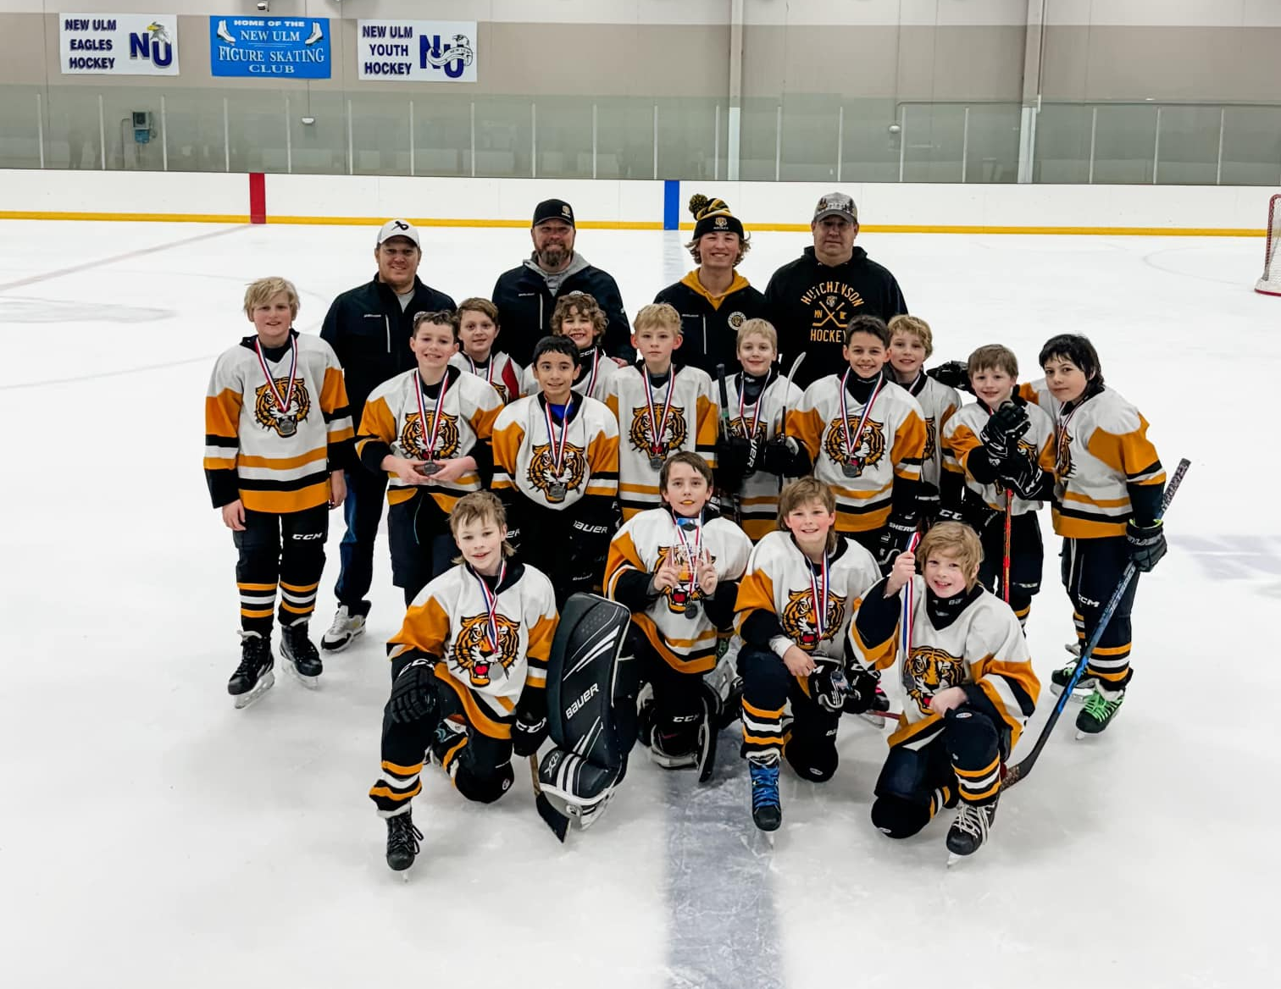
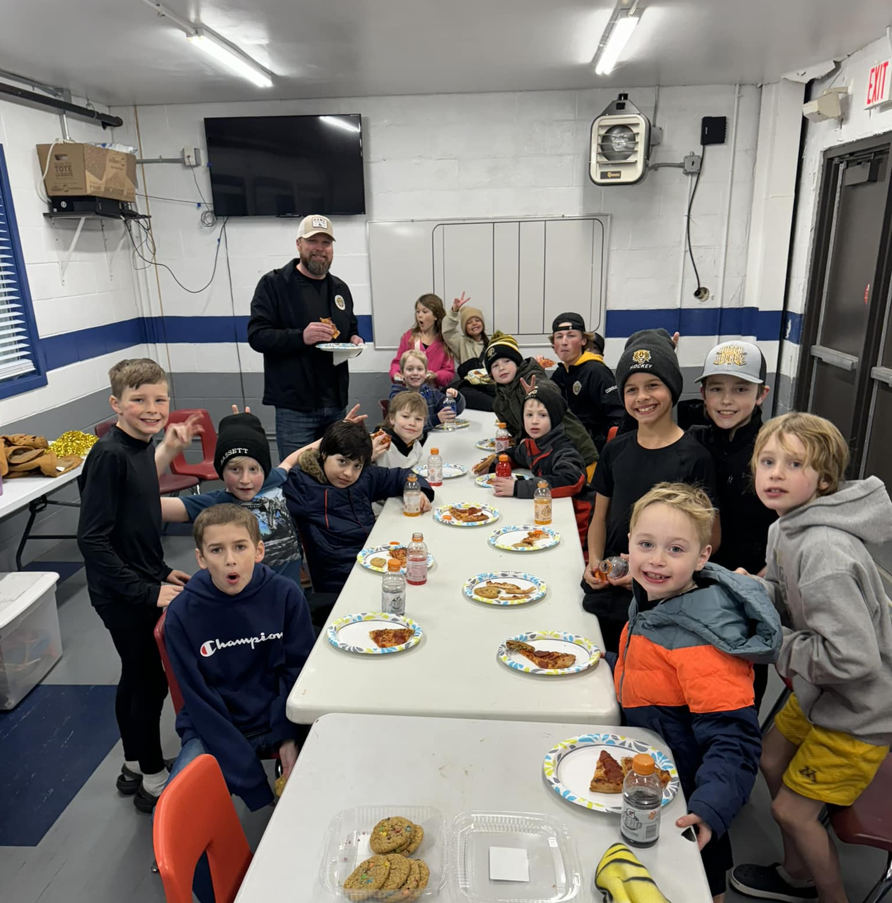
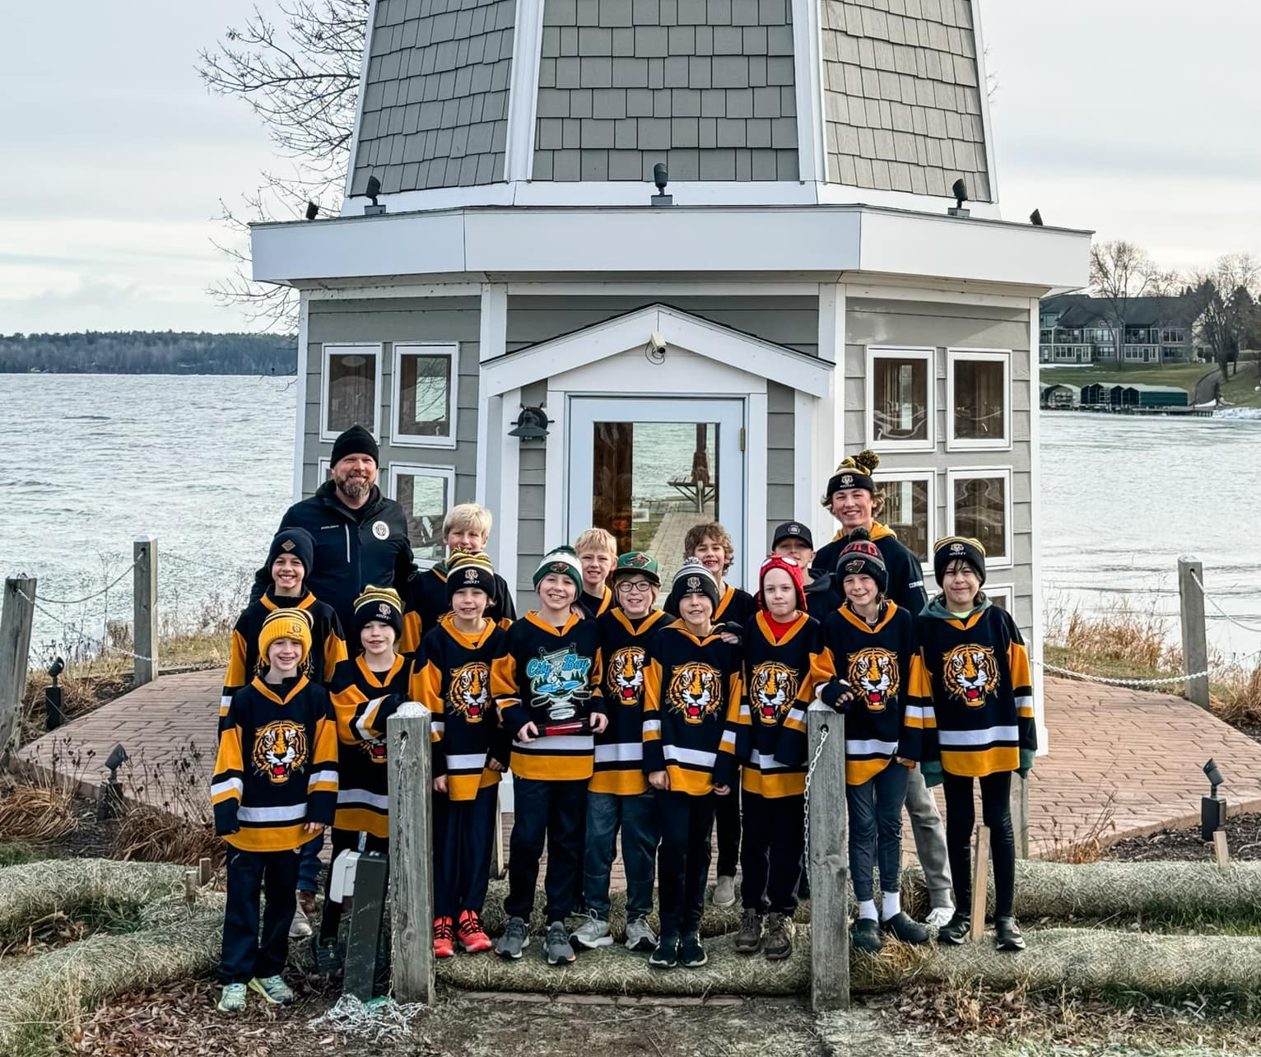
Squirt C Team
Jack Knudtson
Grant Mathwig
Montgomery Mirra
Wyatt Nissen
Mason Orwoll
Hewitt Schaefer
Owen Simantel
Eian Bassett
Easton Betker
Ryan Brigden
Judah Corbin
Cameron Gieseke
Eli Halloff
Luka Hoernemann
Jesus Hulke

Slide 24
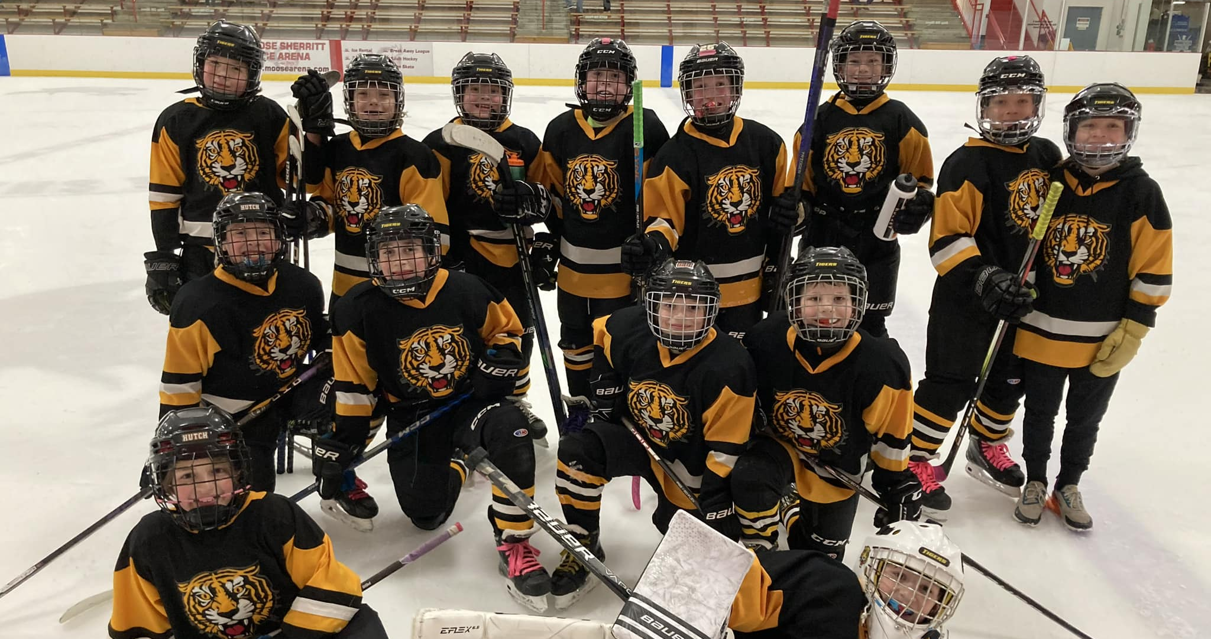
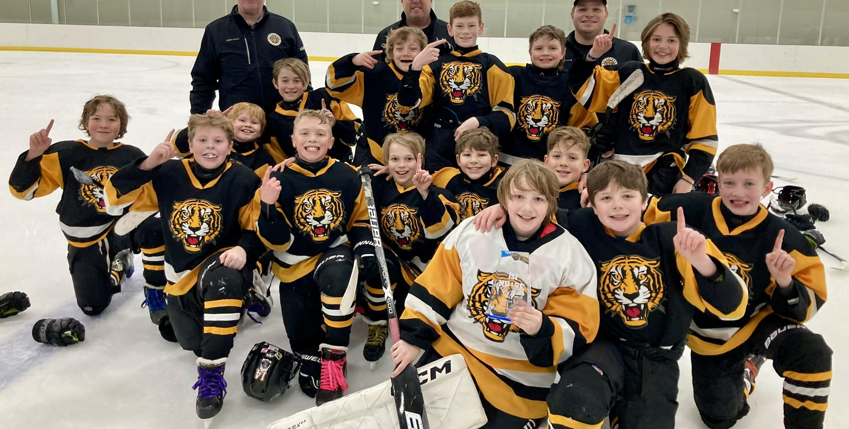
Squirt B Team
Levi Buboltz
Asa Campbell
Makoa De La Barra
Nathaniel Dufrene
Luke Hagstrom
Leighton Kutter
Landon Muhs
EJ Peavy
Benjamin Reiter
Tucker Steinhaus
Ryker Struthers
Ethan Stuckey
Hawkins Thode
Jack Wendolek
Kyrin Yerks

Slide 25
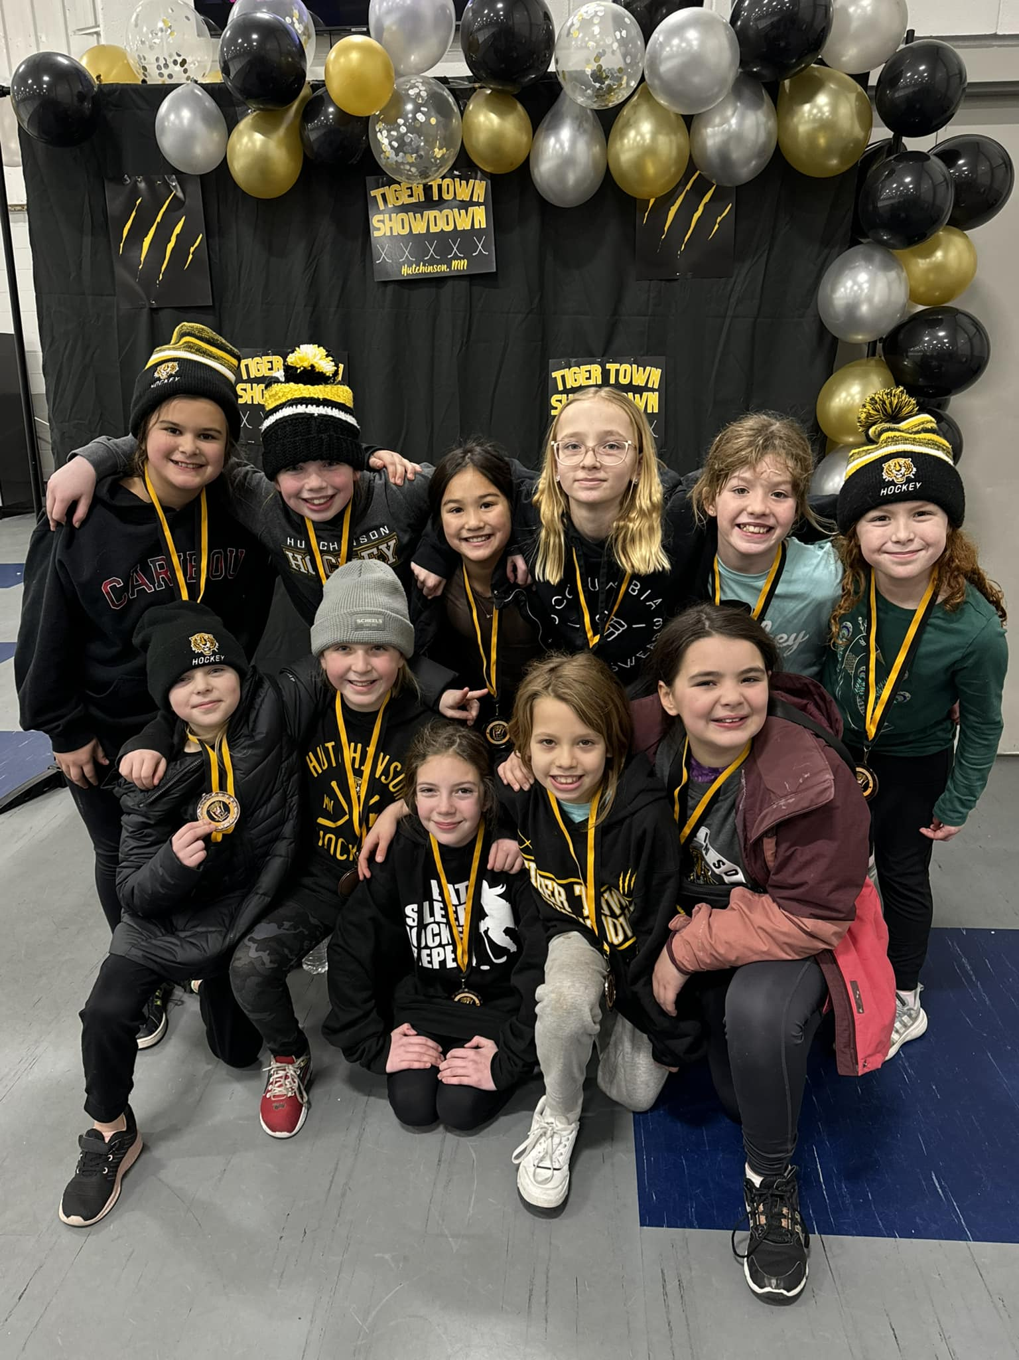
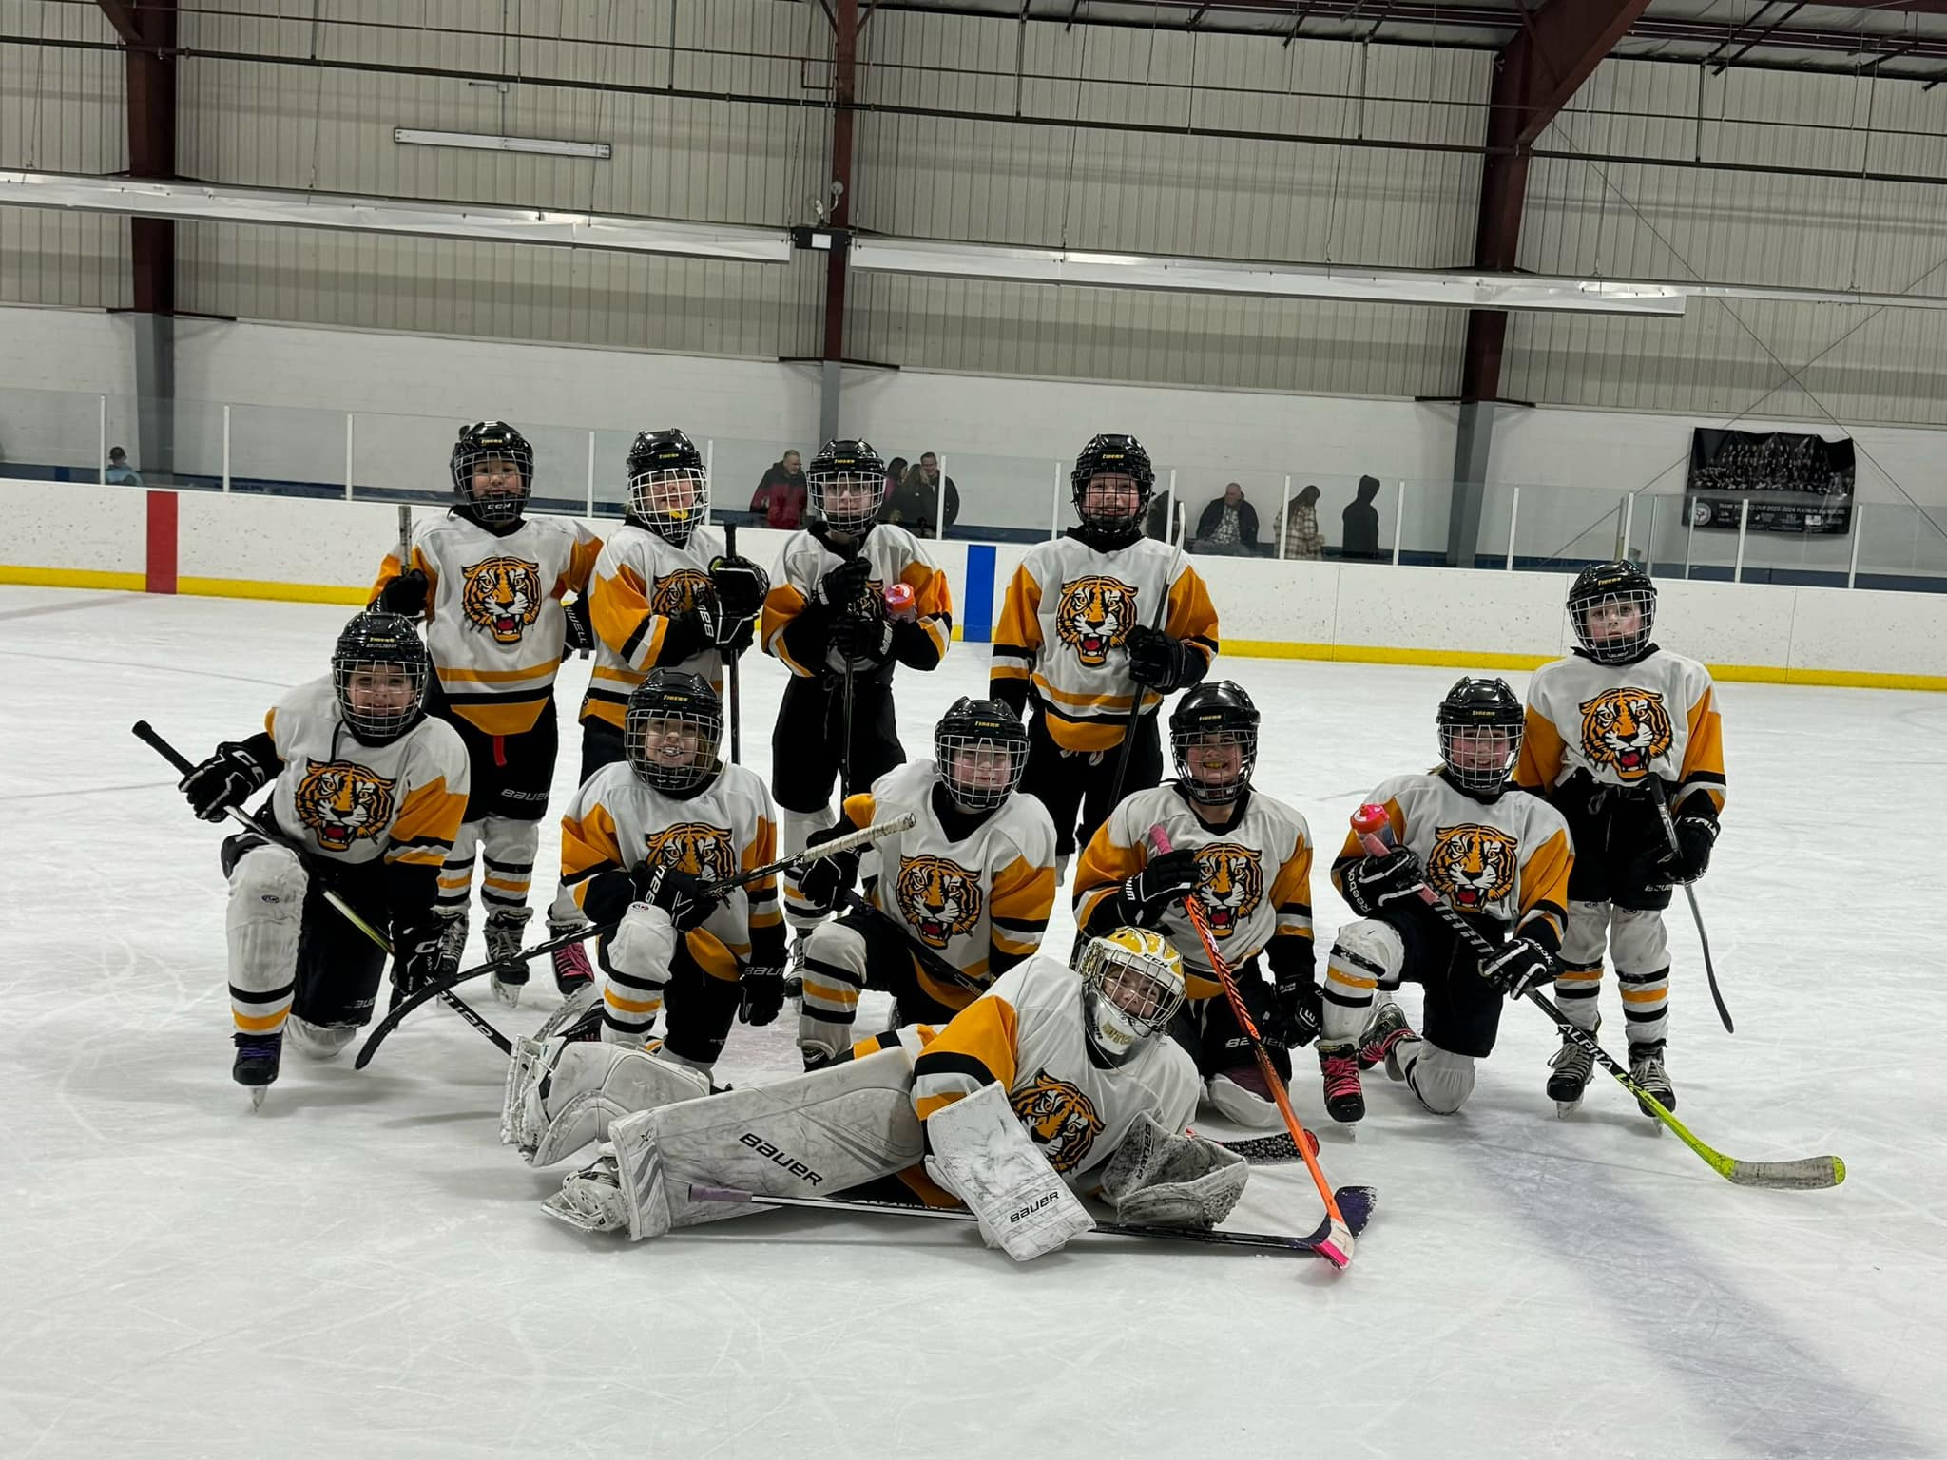
10U B Team
Kate Black
Addison Engelsmeier
Georgie Itzin
Paisley Kaping
Zoey Kaping
Mallorie Peavy
Kendall Schantzen
Ella Schmalz
Addy Vance
Kylee Winn

Slide 26
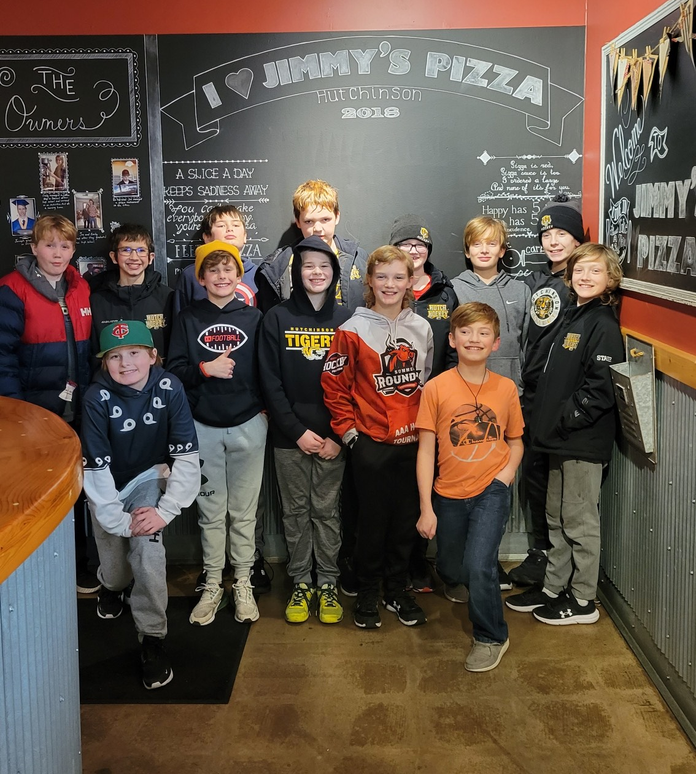
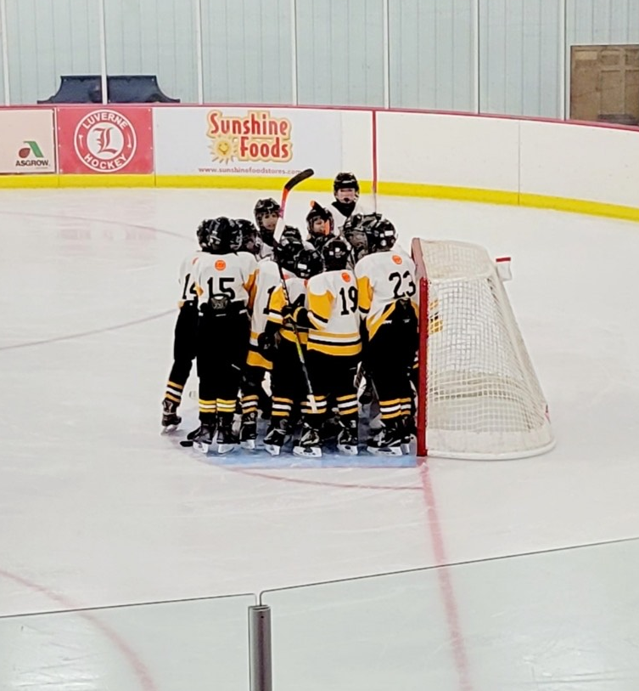
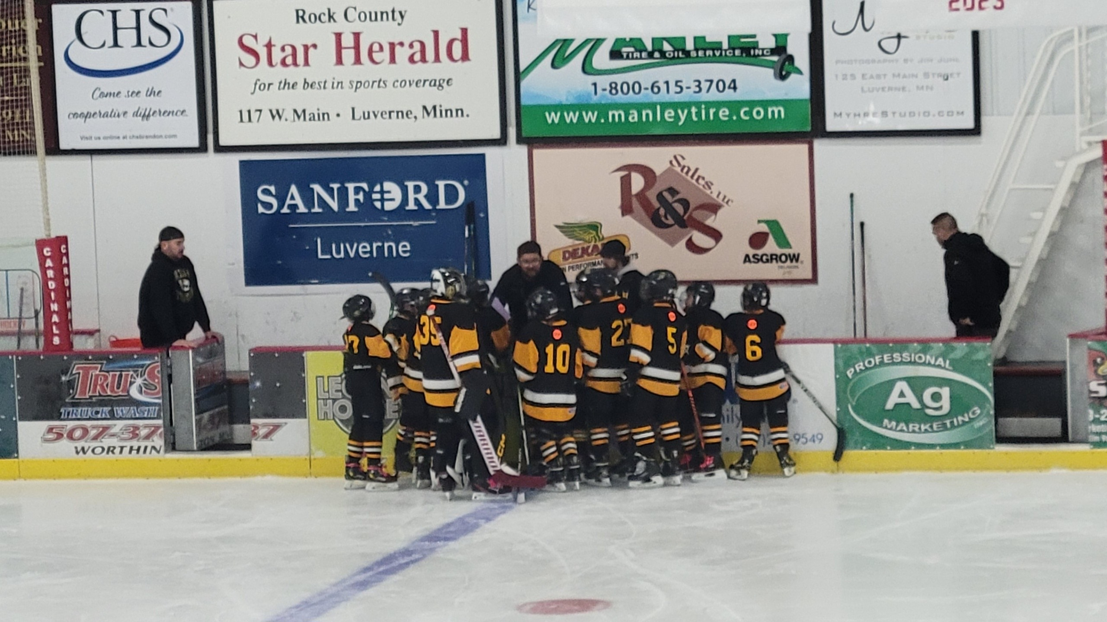
PeeWee B Team
Duncan Beach
Brayden Bell
Justus Corbin
Brooks Dettman
William Fink
Jayce Gregor
Riley Halloff
Wyatt Miller
Matthew Nellis
Tristan Quast
Zeke Smith
August Stage
Levi Travis
Luke Vacek

Slide 27
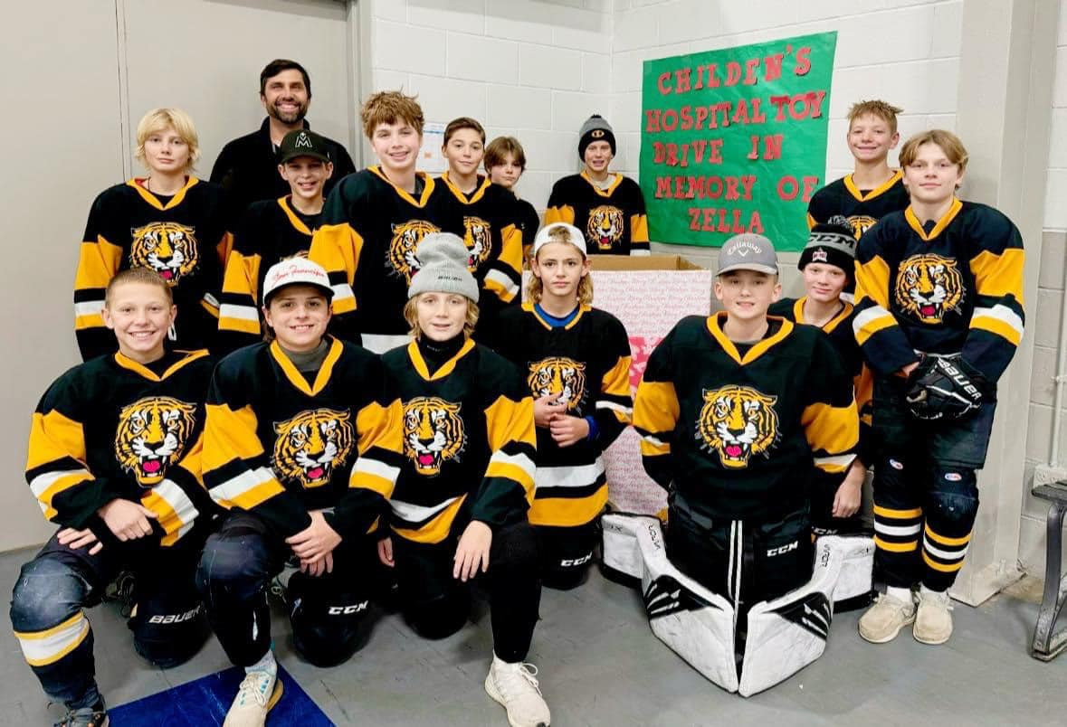
PeeWee A Team
Dylan Buboltz
Jackson Buckentin
Cody Black
Easton Christensen
Malachi DuFrene
Lex Ostlie
Bentley Ritchie
Kaden Schantzen
Gavin Scharfencamp
Bentley Schmalz
Brecken Schweim
Henry Solien
Jones Thode
Judson Wendling

Slide 28
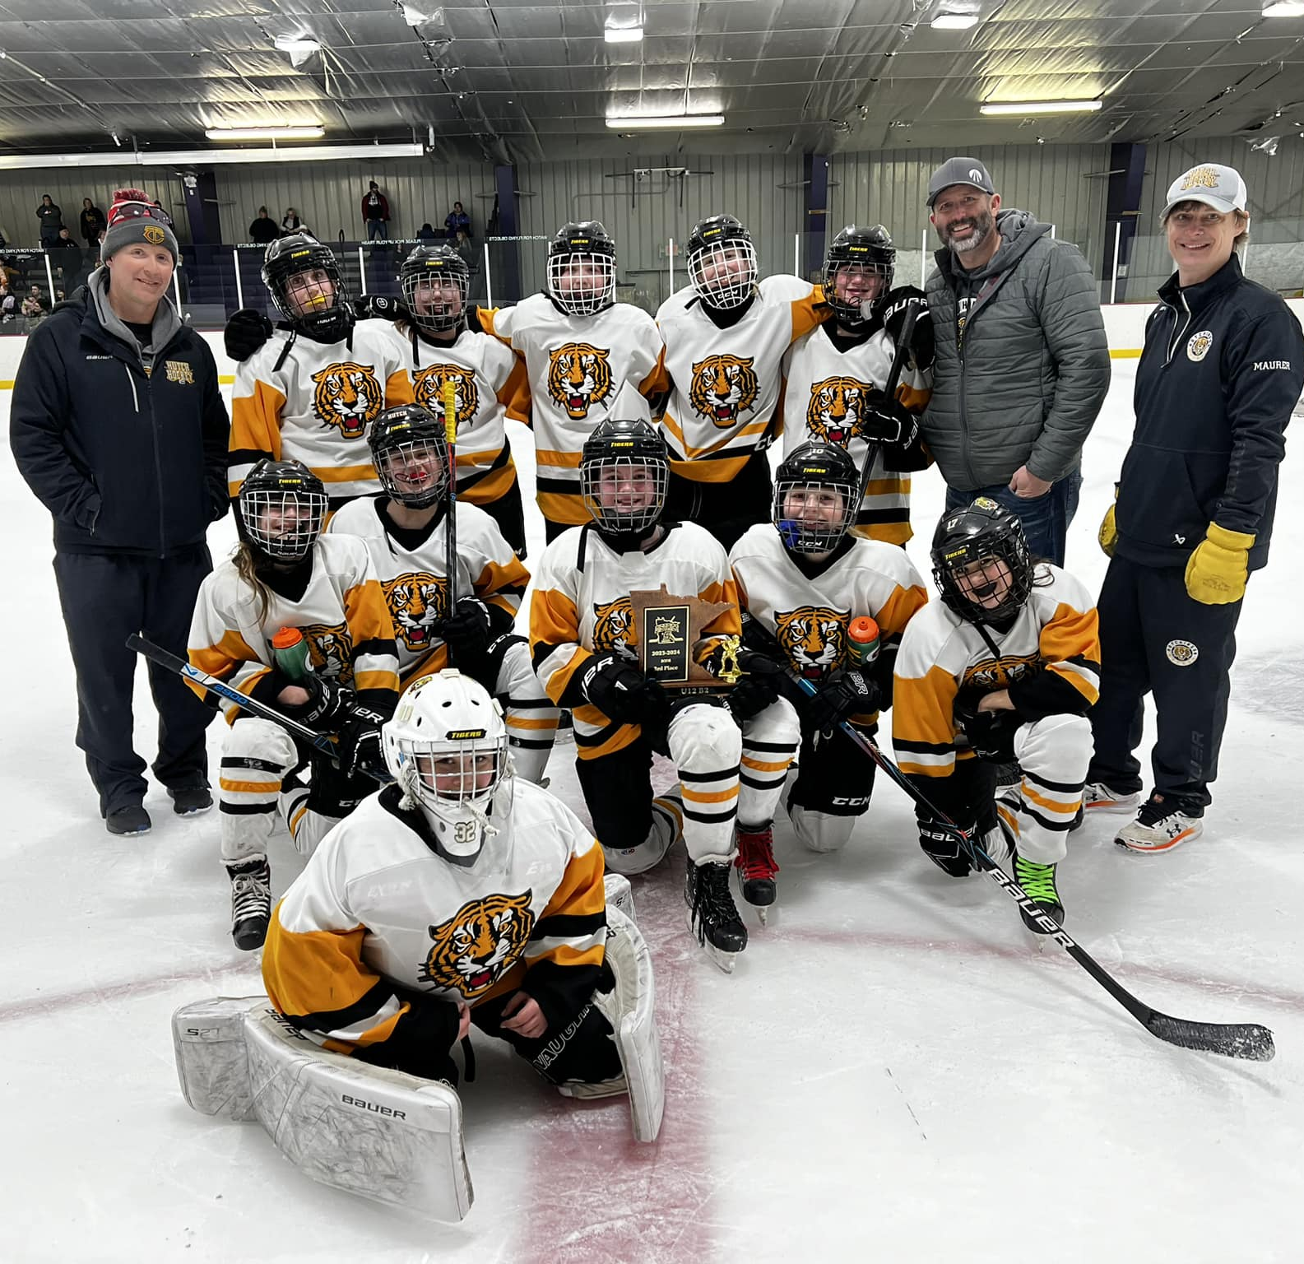
12U Yellow Team
Lydia Bassett
Audrey Briggman
Abigail Brandel
Kiara Durbin
Emma Engelsmeier
Elin Kellen
Ellie Knudtson
Ayana Kollar
Jayla Maurer
Morgan Miller
Gabbi Paulson
Adelyn Schunk
Maya Schroeder

Slide 29
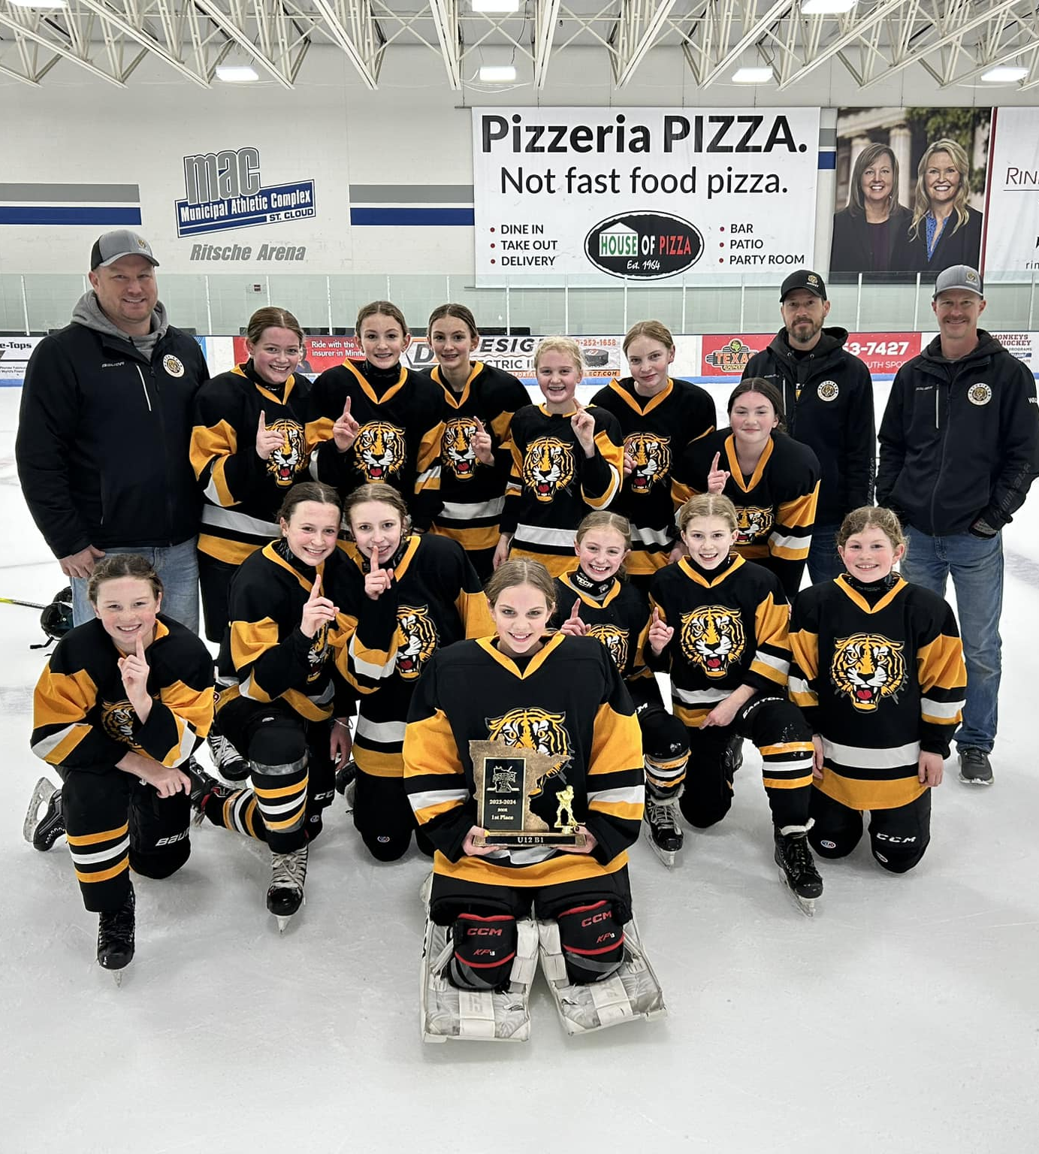
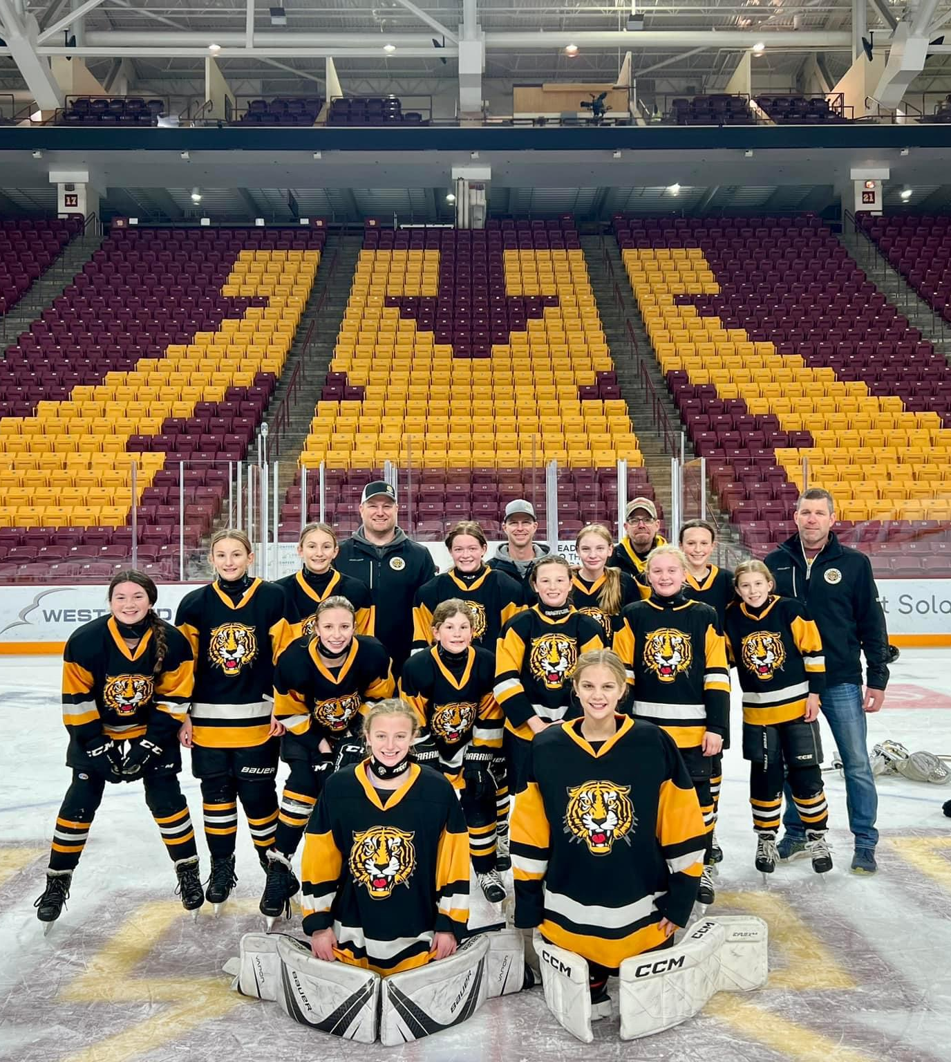
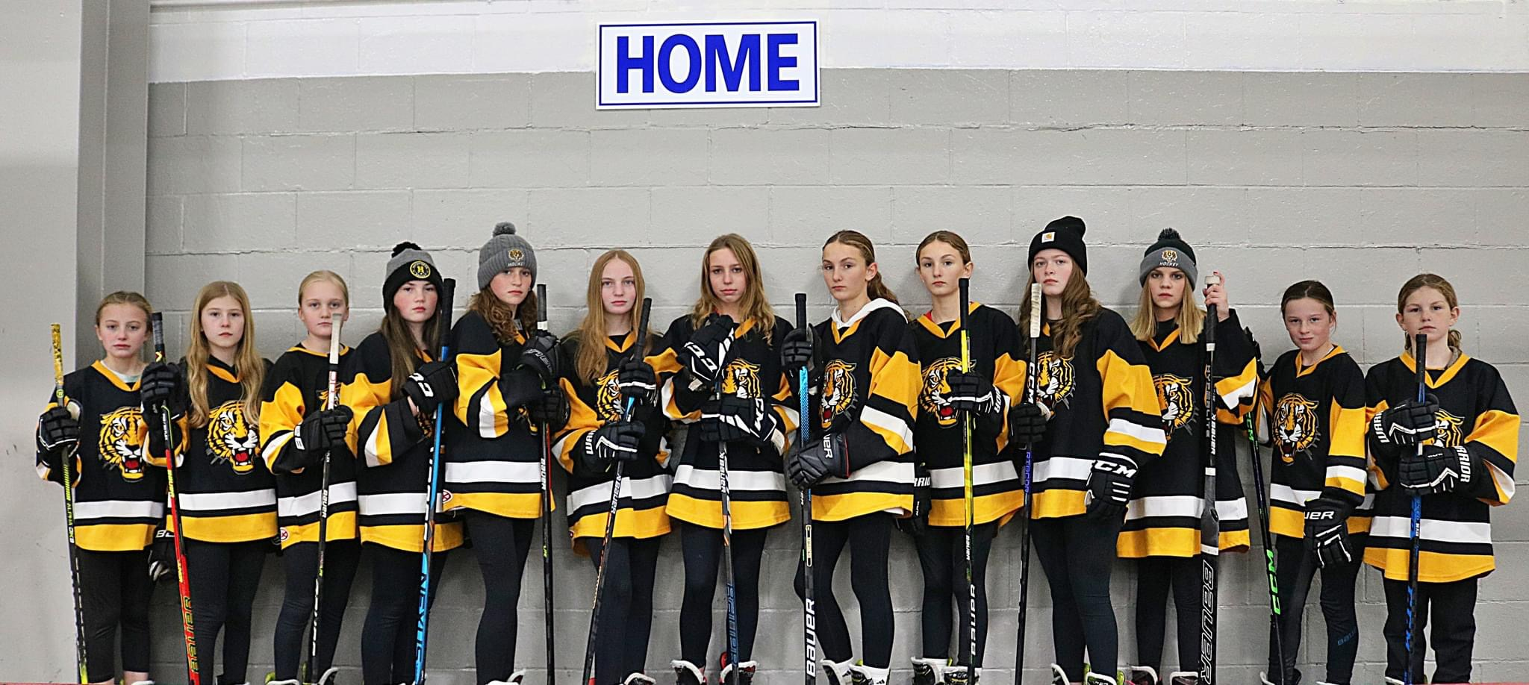
12U Black Team
Evelyn Anderson
Whitley Borstad
Elle Haglund
Betsy Hansen
Sydney Katzenmeyer
Claire Katzenmeyer
Izzy Katzenmeyer
Aubrey Mickolichek
Chesney Nelson
Jozie Petersen
Anna Schmalz
Briella Wacek
Josey Witte

Slide 30
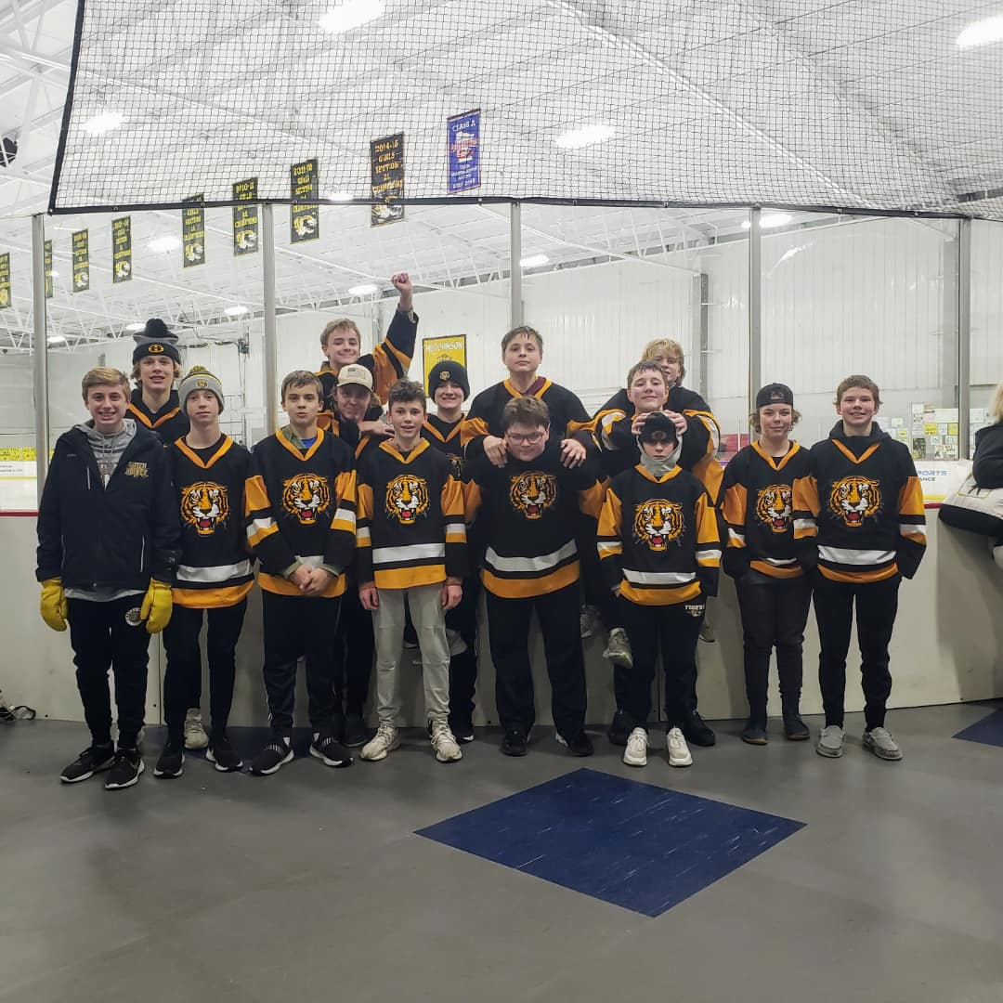
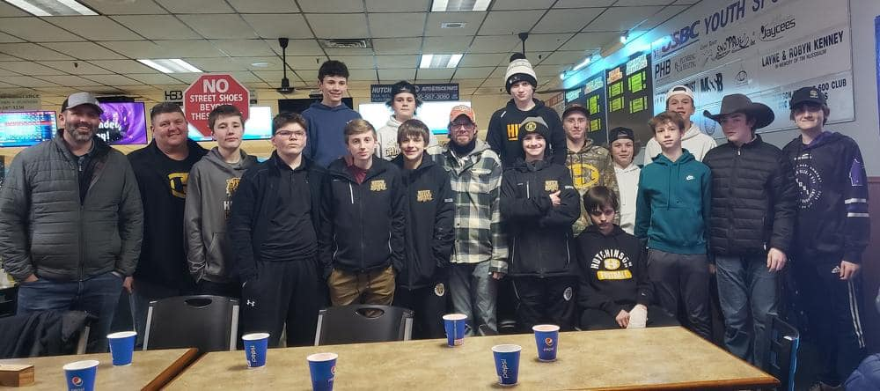
Bantam B Team
Carson Bridge
Nathan Deopere Peters
Easton Engelsmeier
Grant Haglund
Jacob Hanson
Max Knudtson
Lane Leibfried
Rylan Mickolichek
Cooper Neppl
Grant Paulson
Braxton Schmidt
Jaxon Schwartz
Andrew Stiras
Dylan Wagner
Weston Witte
Miles Wurdell

Slide 31
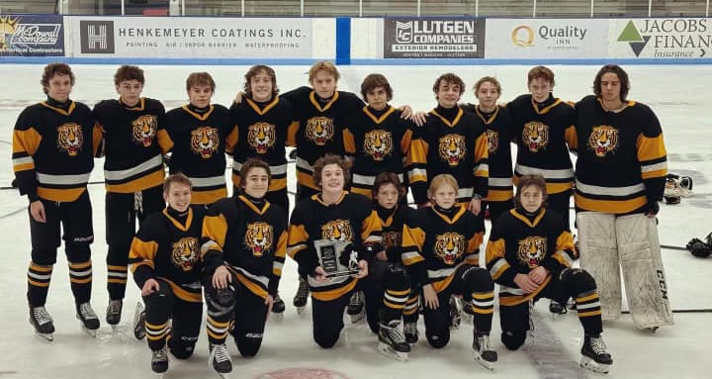
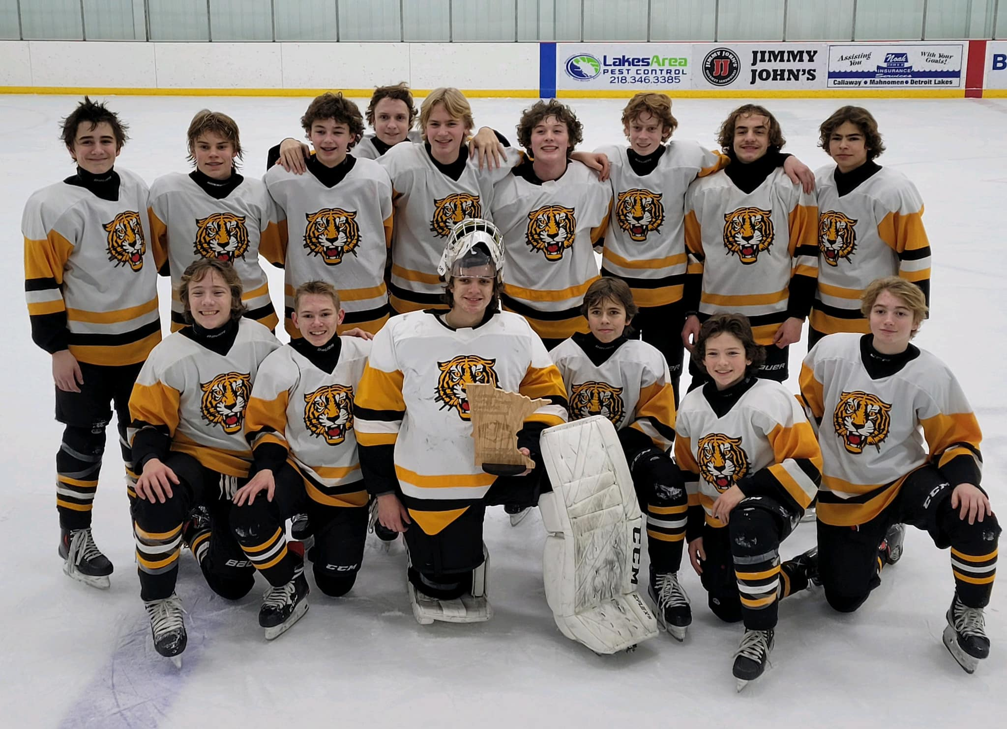
Bantam A Team
Ethan Block
Weston Borstad
Grady Campbell
Austin Carter
Luca Docken
Logan Hagstrom
Jack Hantge
Isaac Johnson
Reggie Murphy
Kolton Plombon
Graydon Rostberg
Benjamin Schroeder
Talan Struthers
Benjamin Van Marel
Charles Wacek

Slide 32
Thanks to the PDC
David Winn, Coach-in-Chief
Ross Wendling
Eric Katzenmeyer
Adam Kaping
Joel Reiter
Josh Knudtson
Supporting roles: Matt Telecky, Boys HS Coach | Andy Tufto, Girls HS Coach | Josh Pearce, Board Rep | HHA President
PDC is the on-ice development authority of HHA, separate from the administrative function of the HHA board
PDC consists of members at-large appointed by the Board to serve two-year terms (can be reappointed), plus Hutchinson high school head coaches
Must have significant knowledge of the game and a high school varsity letter in hockey, at minimum. Additional experience, including coaching experience and a strong history of volunteerism in hockey is highly valued
Talk to David Winn or Eric Borstad if interested in volunteering on the PDC

Slide 33
Mite Acknowledgement
Thank you, Mite Coaches
Thank you, Mite Managers
Thank you to our HHA Equipment Manger
Thanks to the HS hockey programs for being involved with the kids in the HHA program

Slide 34
Position | Name
Registrar(s) | Karen Solien & Sara Thode
Concessions Manager | Dayna Schmalz
DIBS Manager | Sam Elbert
Ice Scheduler | Jeremy Carter
Webmaster | Josh Mirra
Equipment Manager | Bre Stuckey
Skate Sharpening | Matt Buckentin
Swine Barn | Jarrod Pederson
Communications | OPEN
Off-season Camps | OPEN
Sponsorships | OPEN
Meat Raffles | OPEN
Special Thanks
A special thanks to all the Coordinator roles!

Slide 35
Team | Manager
10UB | Lindsey Schantzen, Nicole Winn, Dea Winn
Squirt B | Amy DuFrene, Cara Hemmesch
Squirt C | Courtney Orwoll
12UB1 | Daydrea Nelson
12UB2 | Erika Kellen
PeeWee A | Nicole Ostlie, Melissa Christensen
PeeWee B | Lindsey Vacek
Bantam A | Bethany Carter, Maggie Schroeder
Bantam B | Jenelle Stiras
8U Girls | Jen True
Special Thanks
A special thanks to all Team Managers!

Slide 36
Financial Report & Gambling Recap
Presented by Meranda Wacek, HHA Treasurer

Slide 37
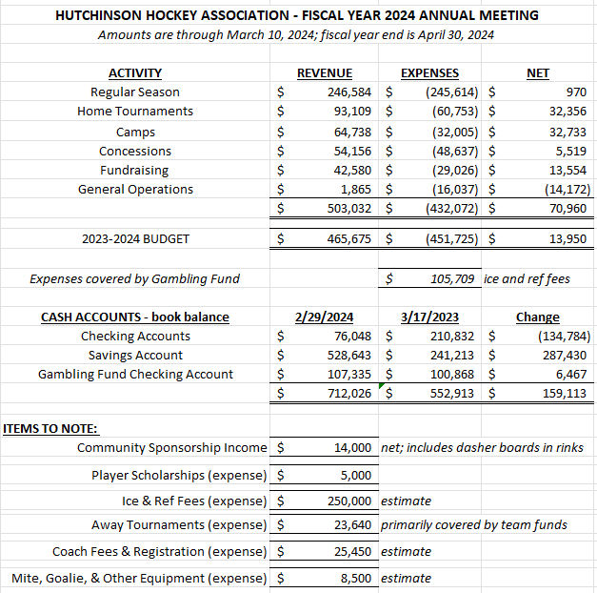
Financial Report

Slide 38
Gambling Recap
Electronic pull tab locations (through Feb. 2024):
Muddy Cow (+ paper tabs, meat raffles; potential to add Bingo): income of $81,257
Oakdale Golf Course: income of $10,426
River House Kitchen + Drinks: income of $16,176
TOTAL GAMBLING INCOME: $107,859
To date, we have spent $105,709 in gambling revenue on:
City of Hutchinson: ice fees (April – December 2023) = $95,899
D5 game officials: initial payment = $9,810

Slide 39
Nominations & elections

Slide 40
Elections
Thanks to the current board
Open the floor for nominations (must be present to accept nomination)
VP
Treasurer
Director of Special Events
Director of Tournaments
Director of Girls Teams
Close ballot

Slide 41
Ballot
Position | Candidate #1 | Candidate #2 | Candidate #3
Vice President
Treasurer | Meranda Wacek
Director of Special Events | Melissa Campbell / Erin Knudtson
Director of Tournaments
Director of Girls Teams | Jess Engelsmeier

Slide 42
Announcements

Slide 43
Registration
 | 2010-2011 | 2011-2012 | 2012-2013 | 2013-2014 | 2014-2015 | 2015-2016 | 2016-2017 | 2017-2018 | 2018-2019 | 2019-2020 | 2020-2021 | 2021-2022 | 2022-2023 | 2023-2024
Bantam | 27 | 19 | 30 | 30 | 24 | 20 | 27 | 26 | 20 | 18 | 17 | 16 | 16 | 32
14U/15U | N/A | N/A | N/A | 11 | N/A | N/A | N/A | N/A | N/A | N/A | N/A | N/A | N/A | N/A
Peewee | 30 | 33 | 24 | 22 | 29 | 27 | 21 | 20 | 26 | 26 | 26 | 39 | 23 | 28
12U | 22 | 27 | 23 | 13 | 17 | 13 | 9 | 15 | 17 | 14 | 11 | N/A | 13 | 26
Squirts | 25 | 24 | 28 | 36 | 24 | 24 | 25 | 30 | 29 | 32 | 37 | 24 | 25 | 30
10U | 25 | 15 | 13 | 12 | 7 | 15 | 20 | 16 | 11 | 8 | 14 | 22 | 22 | 10
Mite Boys | 70 | 69 | 61 | 57 | 68 | 63 | 76 | 74 | 74 | 62 | 68 | 66 | 67 | 59
Mite Girls | 17 | 19 | 15 | 25 | 27 | 30 | 25 | 23 | 32 | 34 | 41 | 37 | 34 | 38
Mite Totals | 87 | 88 | 76 | 82 | 95 | 93 | 101 | 97 | 106 | 96 | 109 | 103 | 101 | 97
Totals | 216 | 206 | 204 | 206 | 196 | 192 | 203 | 204 | 209 | 194 | 214 | 204 | 200 | 223

Slide 44
2024 HHA Camp Options
Spring (6 weeks) – currently in session
March 10-April 25
Summer (6 weeks) – registration opens May 1st
June 11-27, July 9-25
Pre-season (4 weeks)
September 3-27

Slide 45
Call for Volunteers
HHA runs on volunteerism
Helps keep costs down
Leadership positions
Largest impact on your skater
Start by being a Manager, Assistant Coach, or organizing a recruiting/retention or fundraising event
Volunteers enable positive change
Great ideas are nothing without the will to work productively with others to see them through

Slide 46
Election Results

Slide 47
2023-2024 Sponsors
Thank you to all our Sponsors for the season!
A complete list can be found by going to the HHA homepage and selecting Sponsors.

Slide 48

That’s a wrap!
(Motion to adjourn)
Thank you for coming!

