Slide 1
WAHC Annual Directors Meeting
April 28, 2024
7PM
Virtual

Slide 2
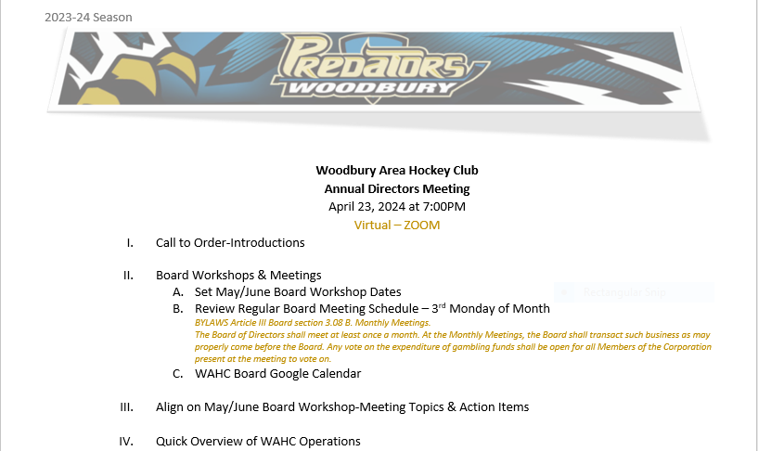
AGENDA

Slide 3
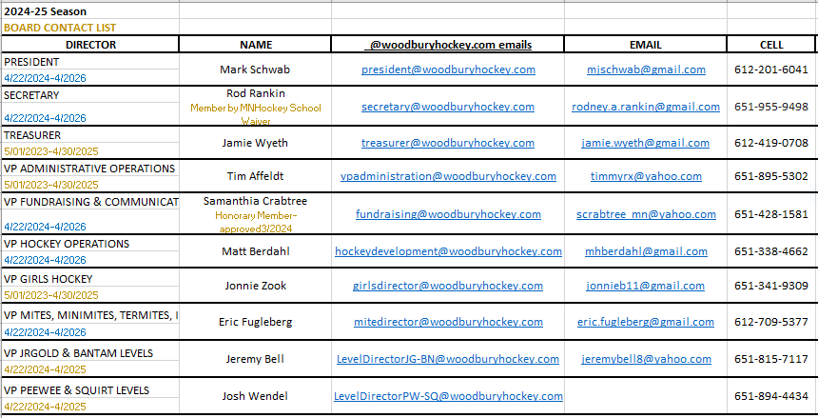
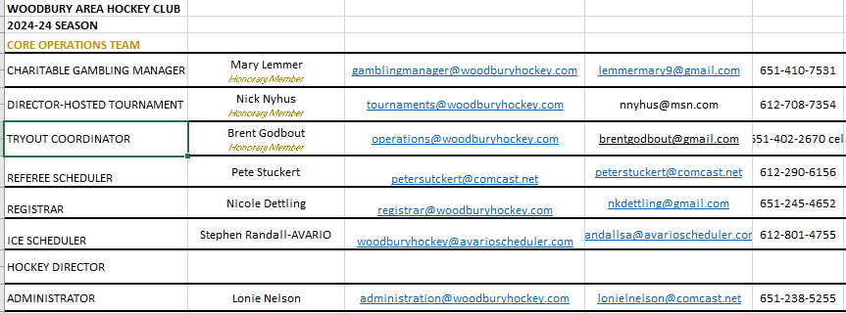
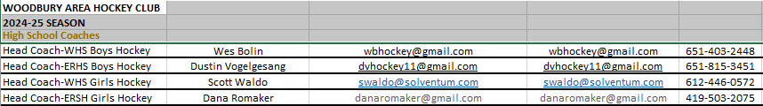
WAHC BOARD & Core Team

Slide 4
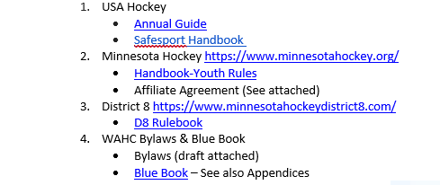
Governance

Slide 5
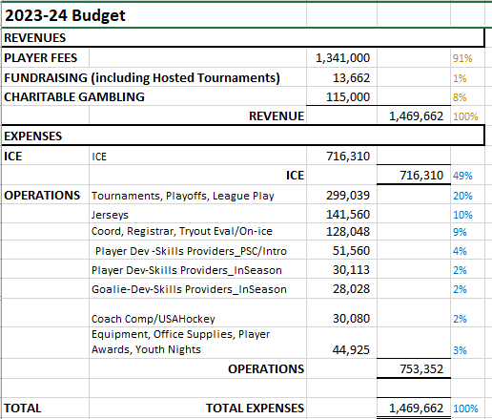
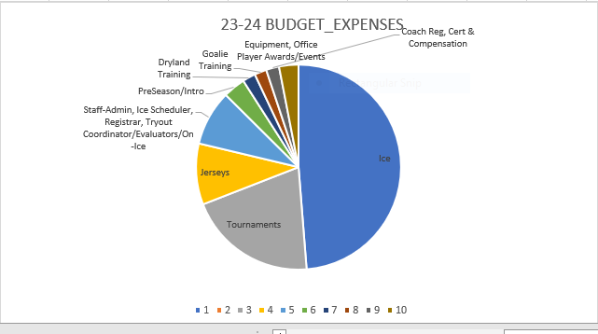
2023-24 Budget Summary

Slide 6
 | WAHC BY THE NUMBERS
1975 | Established 3/2025
896 | 2023-24 Players 834 skaters + 62 Goalie 674 YOUTH + 222 GIRLS
623 | 2023-24 Families
210 | Rostered Coaches
70 | Team Managers
62 | 2023-24 Teams 37 Travel + 25 8&Under 45 YOUTH + 17 GIRLS
10 | Board Directors
4 | 4th Largest Association in MN
3 | “Home” Rinks_ 3200 ice hours
2 | Charitable Gambling Sites 2023-24 Donations_$200K
1 | ONE Hockey Community ISD833 school boundary Woodbury, Afton & Newport)

Slide 7
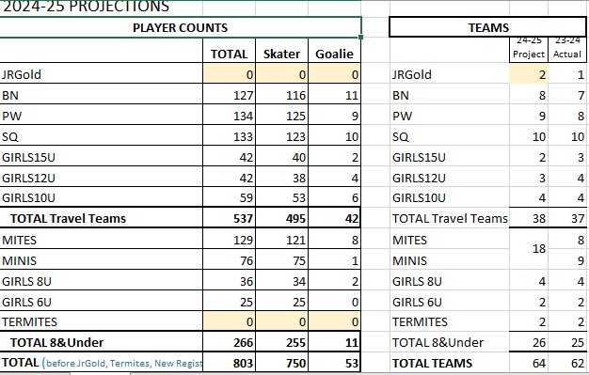
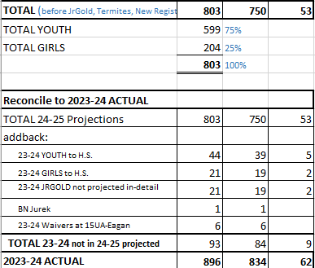
2024-25 Projections Players & TEAMS

