Slide 1
Nike OACA / OBCA Coaches Clinic
Total Offense – False Motions
“Simple Ways to Expand Your Playbook”

Slide 2
4 Phases of Offense
Go
Flow
Move
Execute

Slide 3
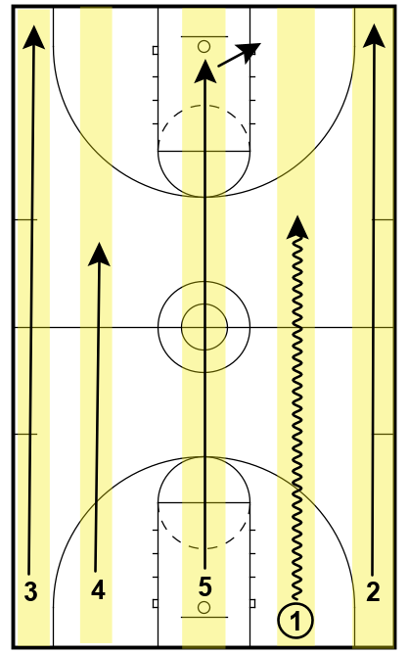
1st Phase = Go
“Go” is our Transition Offense using our numbered break
Ability to adjust quickly to attack pressure
  “Bingo” call
Hunt the 2 v 1
  We want to turn every numbers advantage into a 2 v 1 situation that leads to a shot or a long closeout

Slide 4
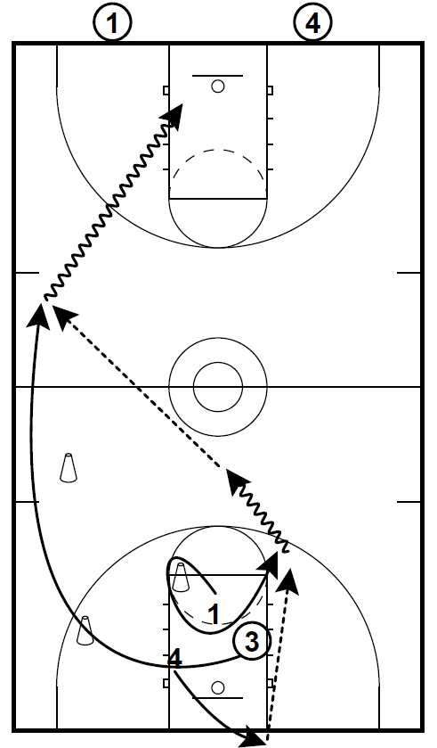
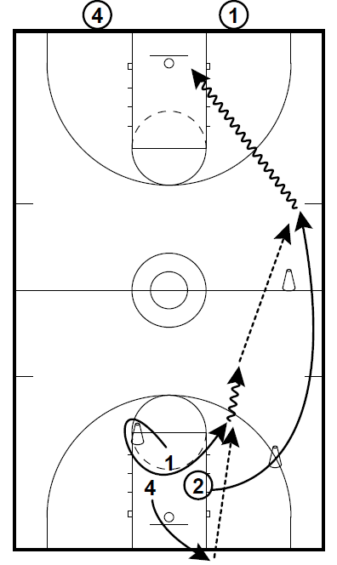
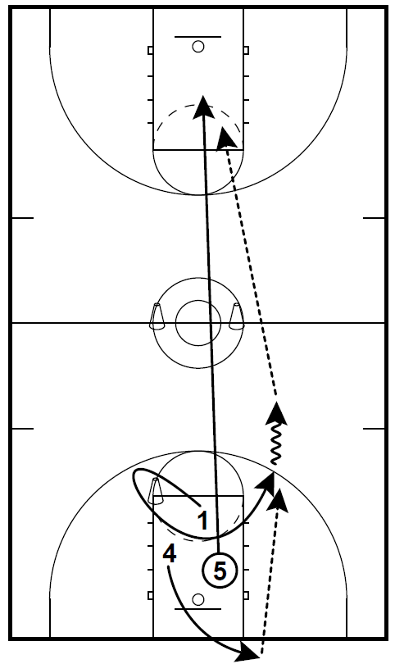
Running Lanes Progressions

Slide 5
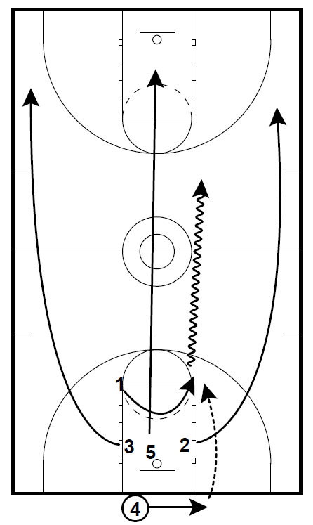
Practice Readiness
Groups of 5 must make 2 ½ consecutive trips up and down the floor with each player making a lay-in within 32 seconds
All groups must complete the circuit consecutively. If one group fails to complete the circuit, we start over
All players must run their lanes correctly by getting wide and passing the FT line at both ends
Each cycle includes:
4-1-2 4-1-4
4-1-3 4-1
4-1-5

Slide 6
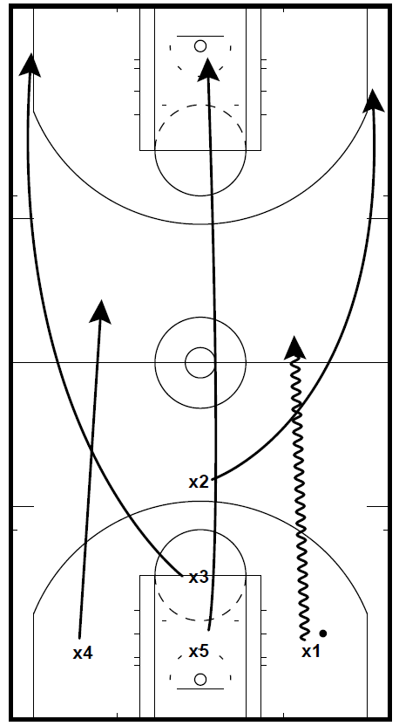
Zone Defense to Offense
Natural transition from our full and half court zone defense
Other benefits include:
  Fewer actions to defend
  Fewer quick hitters to scout for
  10-15mins daily of maintenance drills

Slide 7
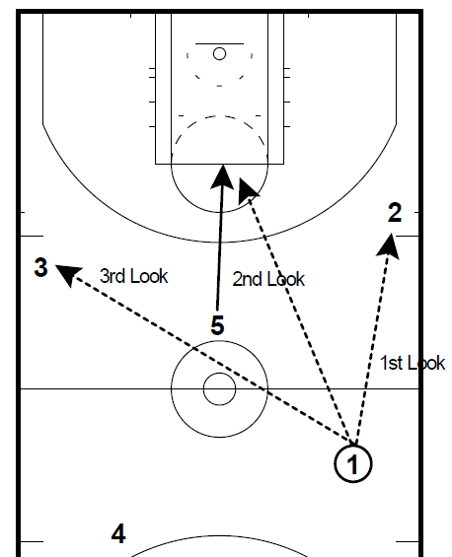
Numbered Break → PG Reads
1st Look = Up the Street
2nd Look = Down the Street
3rd Look = Across the Street

Slide 8
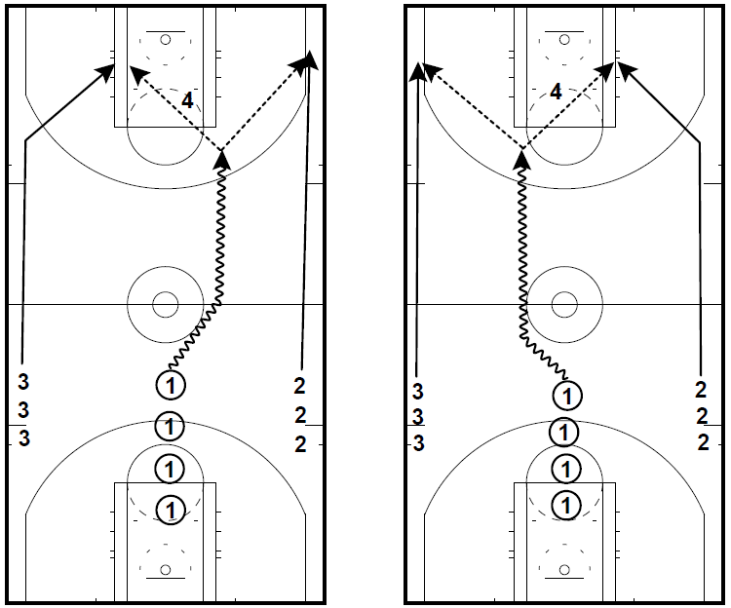
Creating 2v1’s
Get the ball out of the middle
Push best shooter to the corner
Hunt lay-ins, settle for open 3’s

Slide 9
2nd Phase Flow
Seamless transition from our numbered break that attempts to create a 2 v 1 situation or long closeout by the defense
2 passes maximum = easy to remember or add as needed throughout the season
Influences the ball to get to a third-side quickly
Allows for flexibility to hide a weaker offensive player until later in the possession or that struggles to remember set plays
Disguise our best scoring actions by initiating from different spots on the court

Slide 10
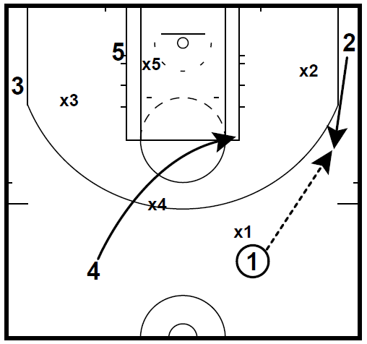
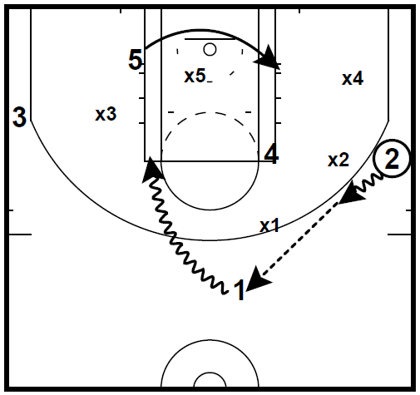
Our Playbook – Zone Flow
“Snap”

Slide 11
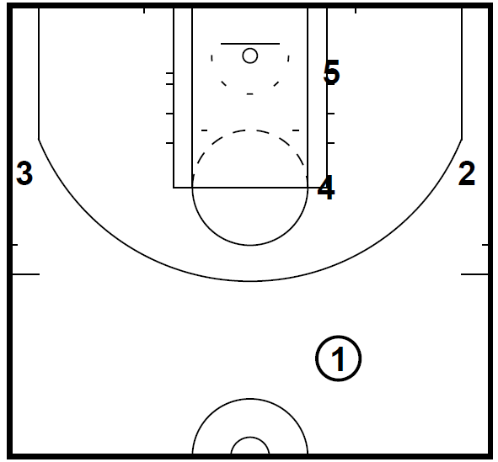
Snap vs Zone Cont.
1-3-1 Alignment Complete with possible advantage
We would now be transitioned into our Move portion of the offense (Continuity)

Slide 12
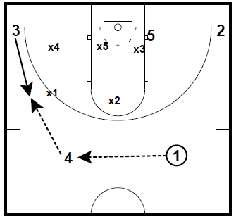
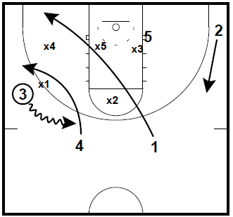
Our Playbook – Zone Flow
“Wave”

Slide 13
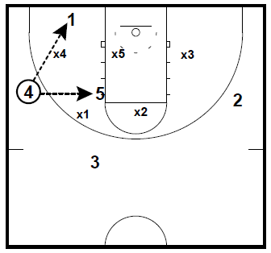
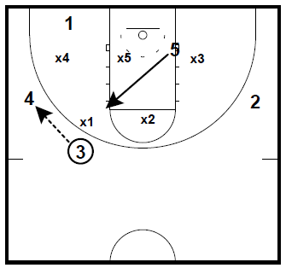
Wave vs Zone Continued

Slide 14
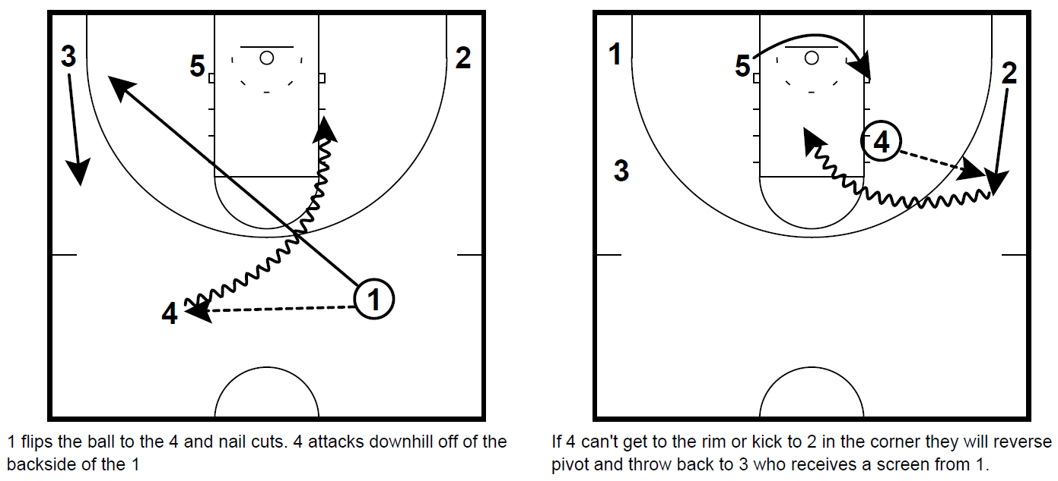
Our Playbook – Flow vs M2M
“Slice”

Slide 15
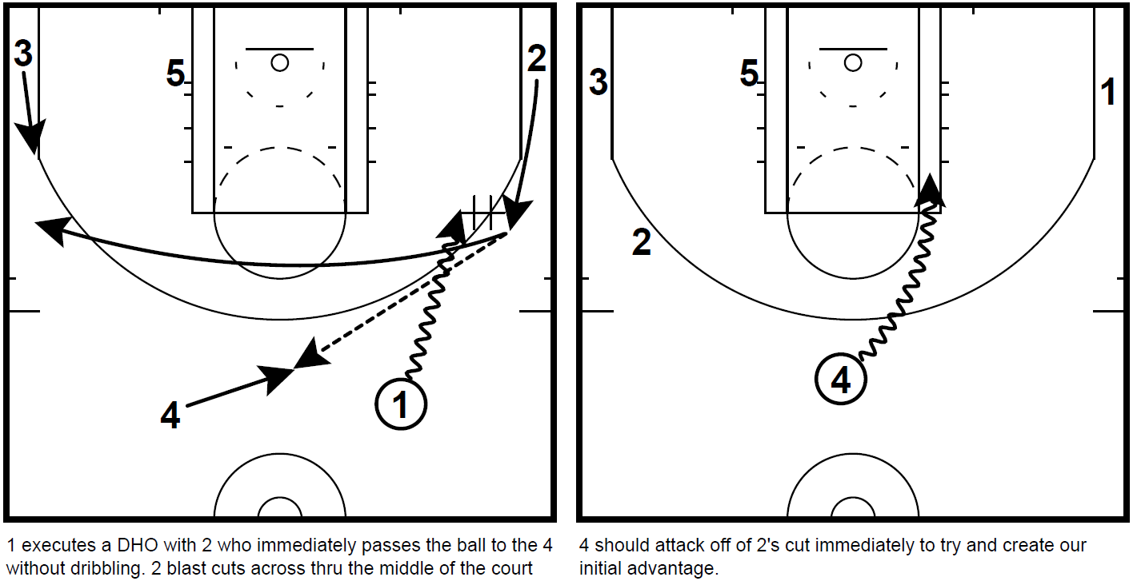
Our Playbook – Flow vs M2M
“Shake”

Slide 16
Collecting Information to Adjust our Attack
We like to run some specific actions early in games to gather information on how our opponent will defend us. This will help us dictate the actions we utilize most throughout the game
Versus M2M Defense (Examples)
Is the defense switching on kick-ups and/or blast cuts? If yes, we run actions with deep basket cuts or actions that will result in a mismatch after the switch occurs
Is the defense helping off the strong side corner on dribble attacks? If yes, we run actions to get our best shooters in the corners with a dribble attack to their side

Slide 17
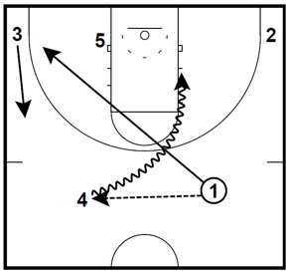
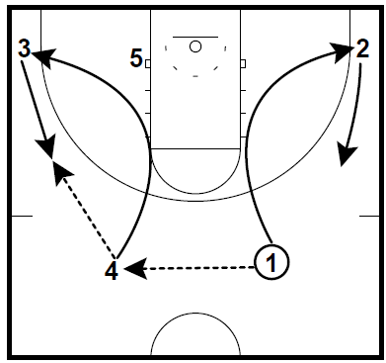
Our Playbook – Defense is Switching on Kick-Ups / Blast Cuts
Run this action early to see if x1 and x4 will switch on the cut
If yes, counter with actions like this that don’t allow it

Slide 18
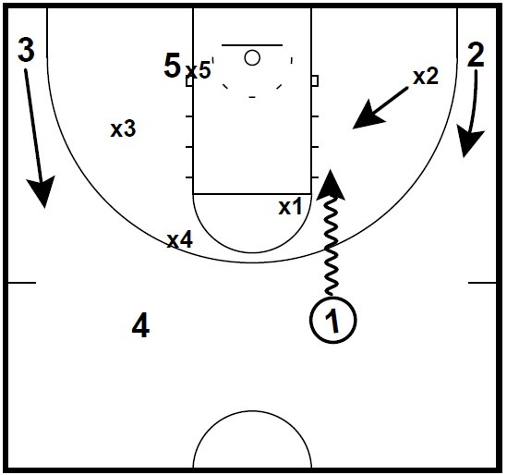
Our Playbook – Defense is Helping Off Strong Side Corner
Is the defense helping off the strong-side corner with no help?
If Yes, what actions can we run that place our best shooter in the corner with an attack on their side?
If No, what actions can we run to get our best attacker on their same side knowing they’ll have more room to get to the rim?

Slide 19
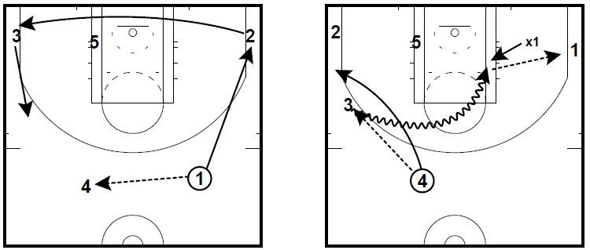
Our Playbook – Defense is Helping Off Strong Side Corner
If yes, counter with actions placing best shooters there. In this case 1 is our best perimeter shooter

Slide 20
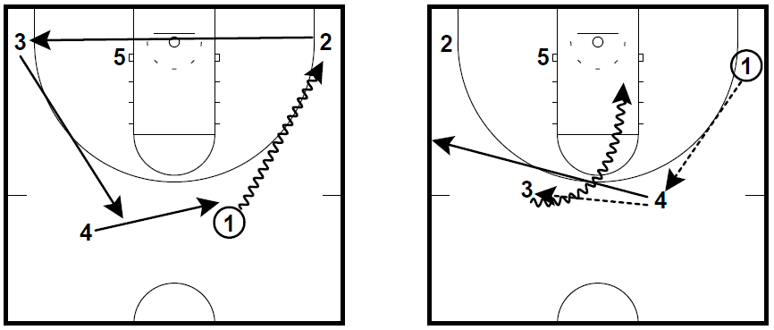
Our Playbook – Defense is Helping Off Strong Side Corner
x1
If no, utilize our actions placing strong attackers in those gaps knowing help won’t likely come from x1

Slide 21
3rd Phase Move
“Move” is our continuity offense designed to maintain our advantage
Allows for continuous play and applies continuous pressure to the defense
Hedgehog Approach: We want to be great at a few things within our Move concepts and then use our flow actions to get us to them

Slide 22
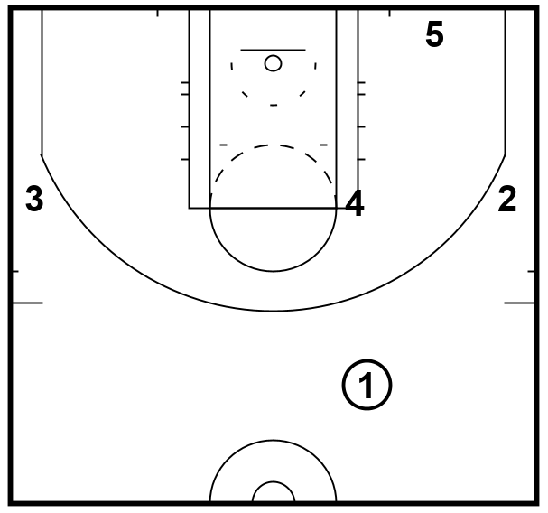
Our Playbook – Zone Continuity Alignment
1-3-1 Alignment
  Pg, Wing, Wing, High-Post, Short Corner
Simple Rules + Scoring Actions
  -High Post Entry
  -Short Corner Entry
  -Gap Attacks / Spacing

Slide 23
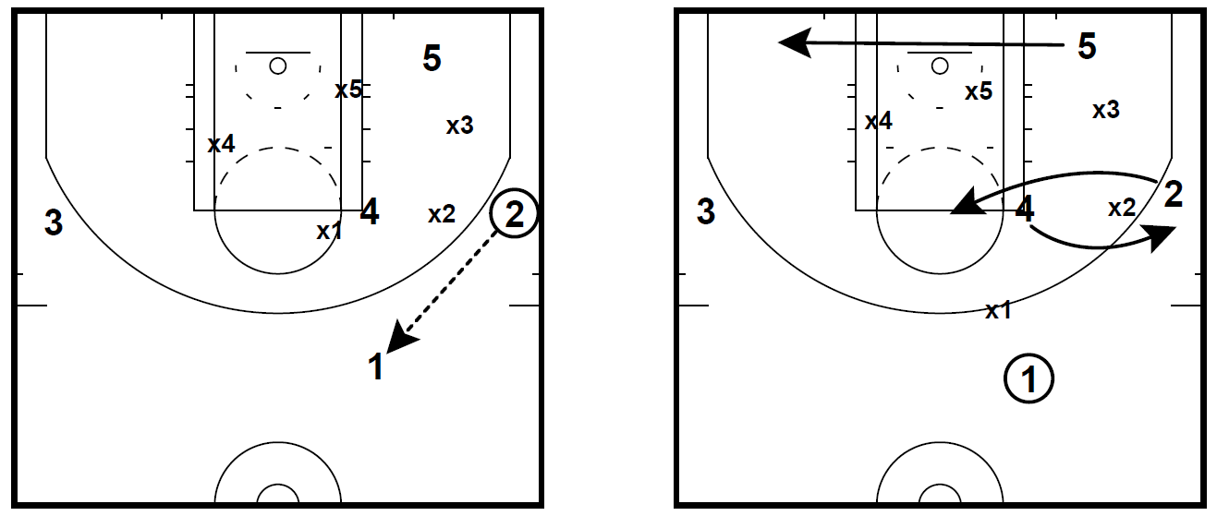
Zone Continuity
Wing / High Post Exchanges

Slide 24
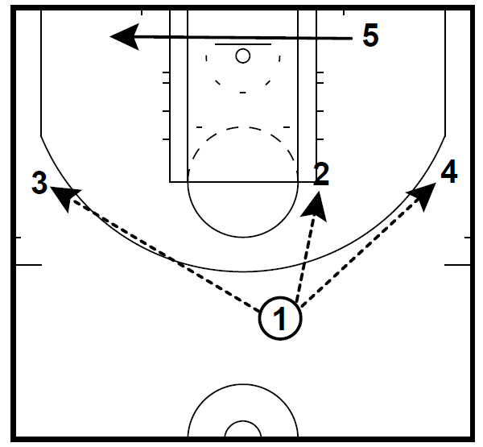
Zone Continuity
Wing / High Post Exchanges Cont.
Any wing to top pass initiates the exchange with the high post
Similar to John Beilein’s zone offense at Michigan

Slide 25
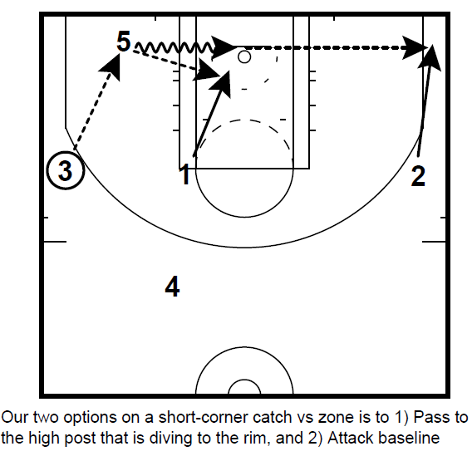
Zone Continuity - Short Corner Entry
We want to be very aggressive on any short-corner catch and allow for two options:
- Pass to High-Post diving to the rim
- Drive baseline

Slide 26
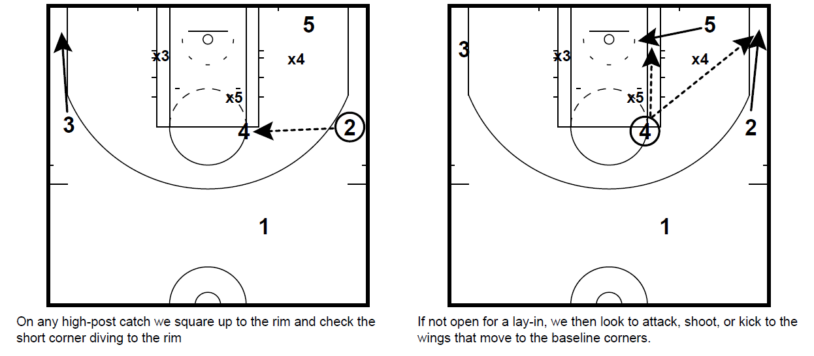
Zone Continuity – High Post Entry

Slide 27
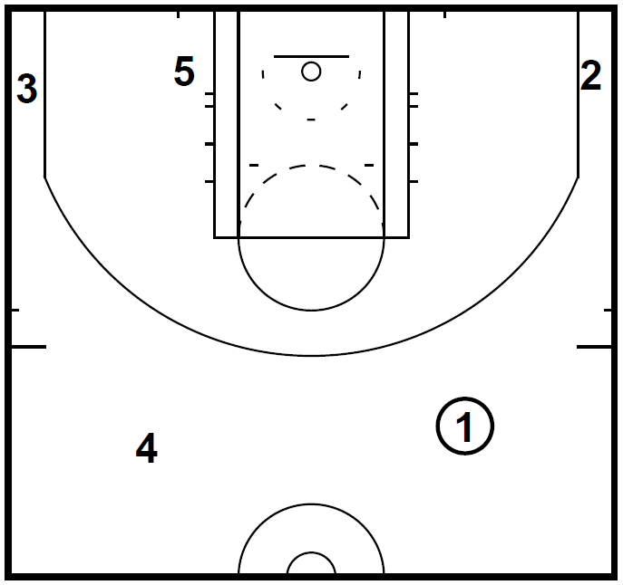
Our Playbook (Move) – M2M
4-Out, 1-In Alignment
-Dribble Drive Principles
-Limit Consecutive Drives
Simple Rules + Scoring Actions
  Great Positioning + Spacing
  0.5 Decision Making – No Triple Threat
  You’re either attacking space or creating space

Slide 28
4th Phase Execute
Set plays that should not be altered
Looking for a specific opportunity for a specific player
Almost always utilized in dead ball situations
Typically, does not flow into our continuity
We like to save our best “Execute” play for when the opposing team changes their defense

Slide 29
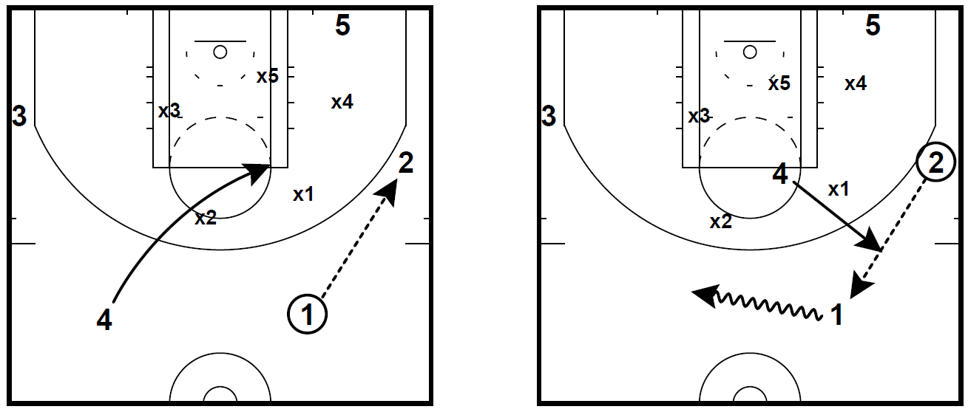
Our Playbook – Execute v Zone
“Slide”

Slide 30
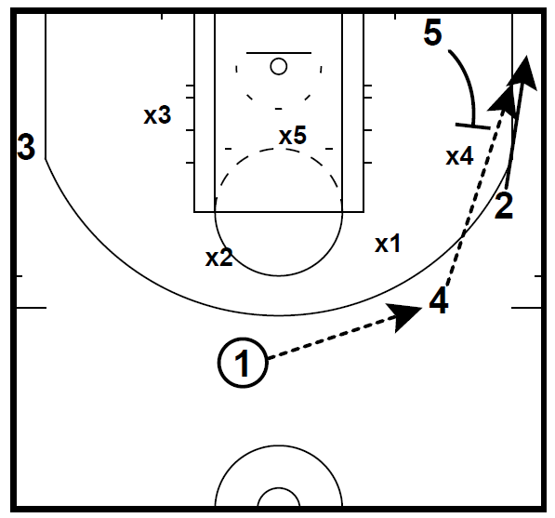
Our Playbook – Execute vs Zone
“Slide” Cont.

Slide 31
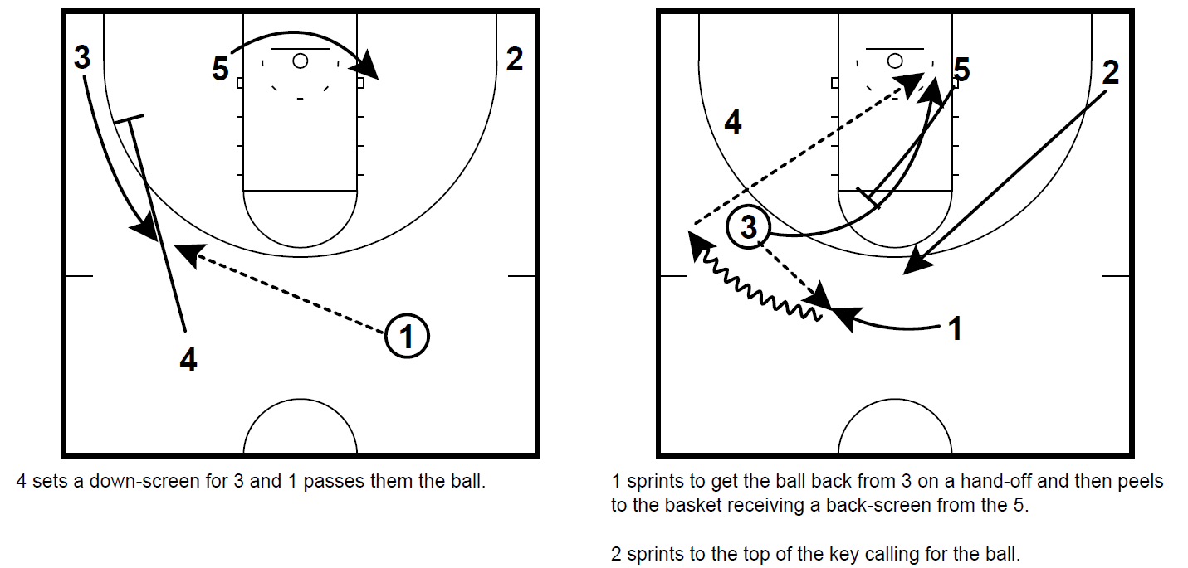
Our Playbook – Execute vs M2M
“Jersey”

Slide 32
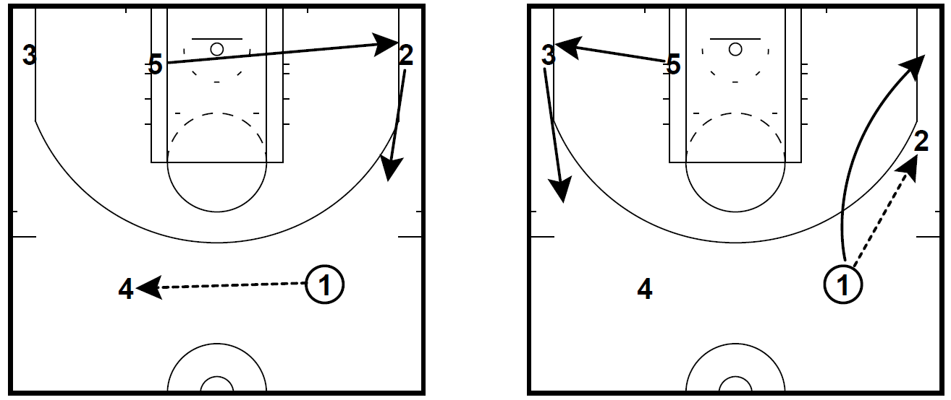
Go → Execute (5-Out Alignment)

Slide 33
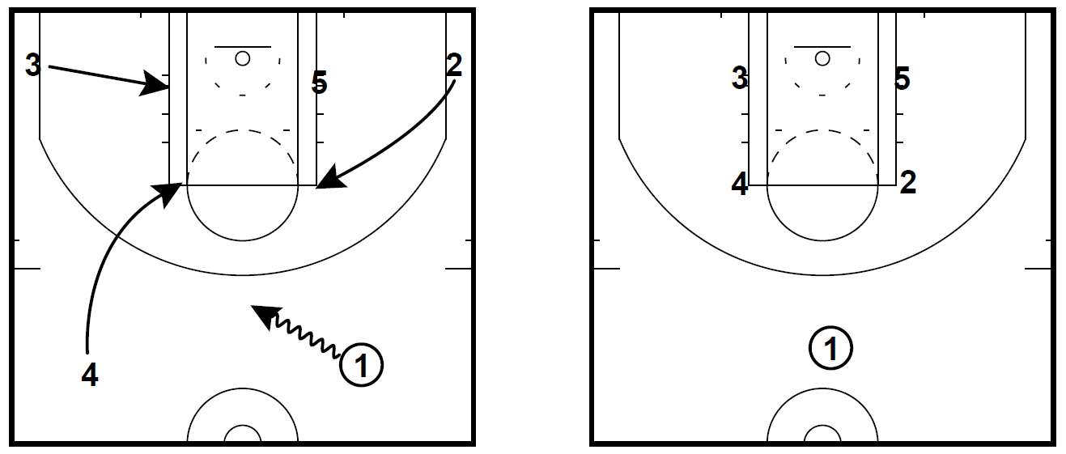
Go→ Box Alignment

Slide 34
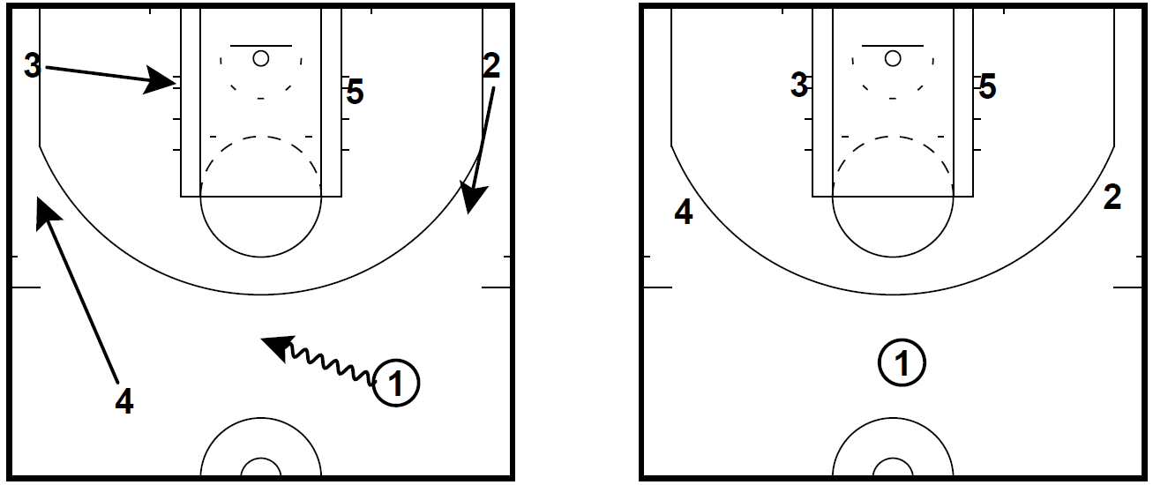
Go→ 3-Out, 2-In Alignment

Slide 35
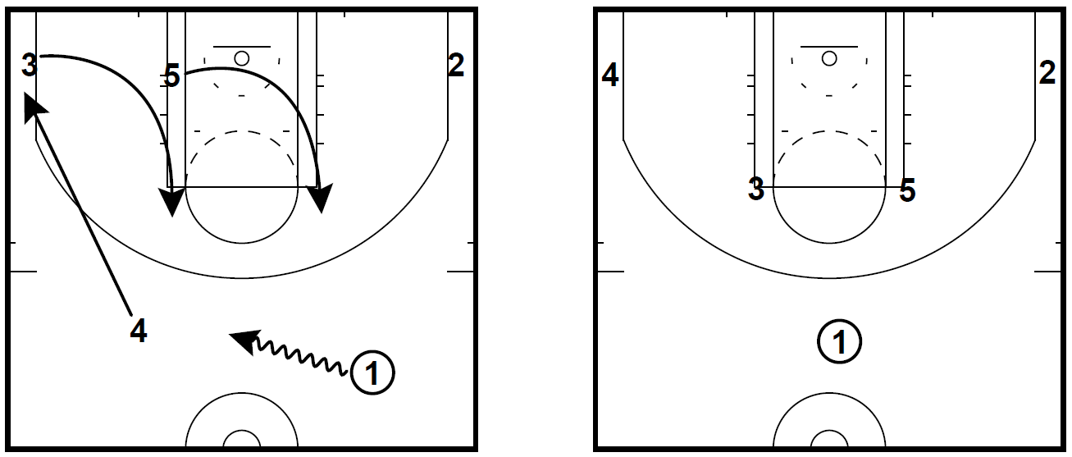
Go→ Horns Alignment

Slide 36
Advantages to 4 Phases
Reduce time spent implementing set plays and focus on what happens most in games
Allows players to play with freedom while still influencing who we want to create advantages for
Easy to diversify your playbook from season to season and build around your team’s strengths and not forcing players into a system they aren’t suited for or spending time implementing a new system
Utilize the same flow actions for different positions on the court

Slide 37
Total Program Approach
Introduce “move” continuities with youth program
Add “flow” actions as youth players develop toward HS program
More time for player development
Most important decisions and things that happen most are being learned at earliest ages
Use pieces of different offenses to build your customized season playbook
  (Dribble Drive + Triangle)

Slide 38
Our Terminology
We utilize hand signals for all flow actions
Easy to communicate during games
Expand playbook by pairing actions together
  -Easier to remember and implement rather than trying to add another set play
Examples:
  -Shake - 3-In - Twist - Wave
  -Snap - Side - Zipper - Hang Loose
  -Push - Chop - Elbow

Slide 39
Pairing Flow Actions Together
Easy to create new plays on the fly or make in-game adjustments
Tempo Control – Two consecutive flow actions ensure we don’t get a bad shot and quick possession
Use successful actions with different players by shifting their alignment before initiating

Slide 40
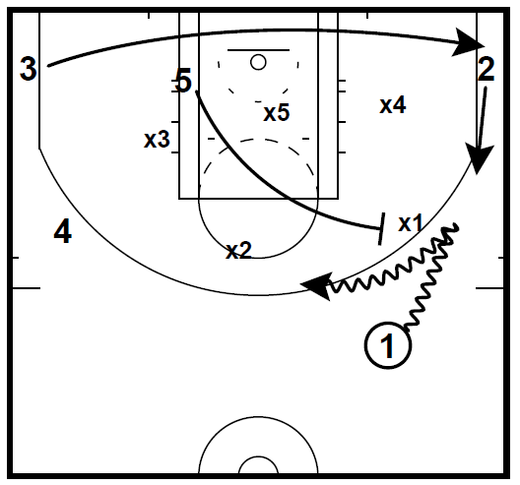
Side, Push 3 Paired Together
Side = 5 ball-screens for 1
Push = Player relocates to designated spot
Number (3) = Designates player

Slide 41
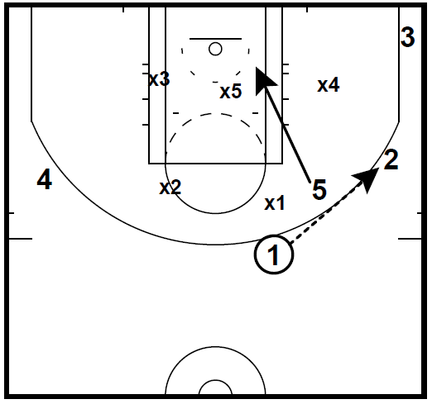
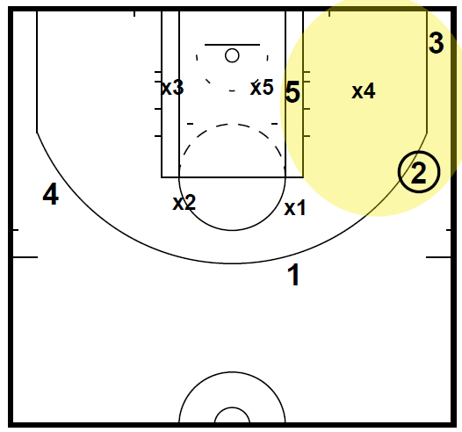
Side, Push 3 Continued

Slide 42
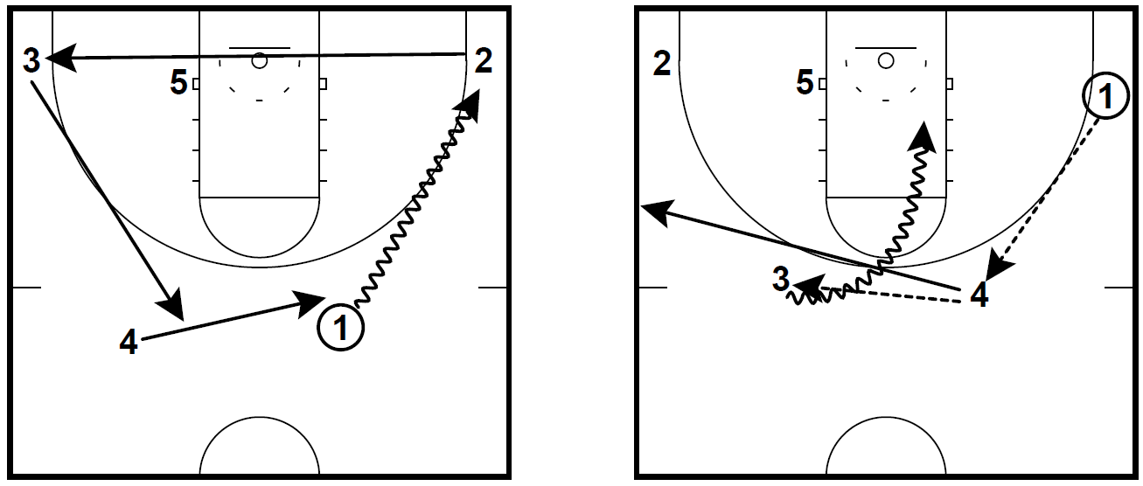
Push 2, Slice Paired Together

Slide 43
Triggers + Automatics
Allows us to play faster but with more purpose
Less pressure to create when no initial advantage exists
Only Coach and PG need to communicate versus all 5 players on the court

Slide 44
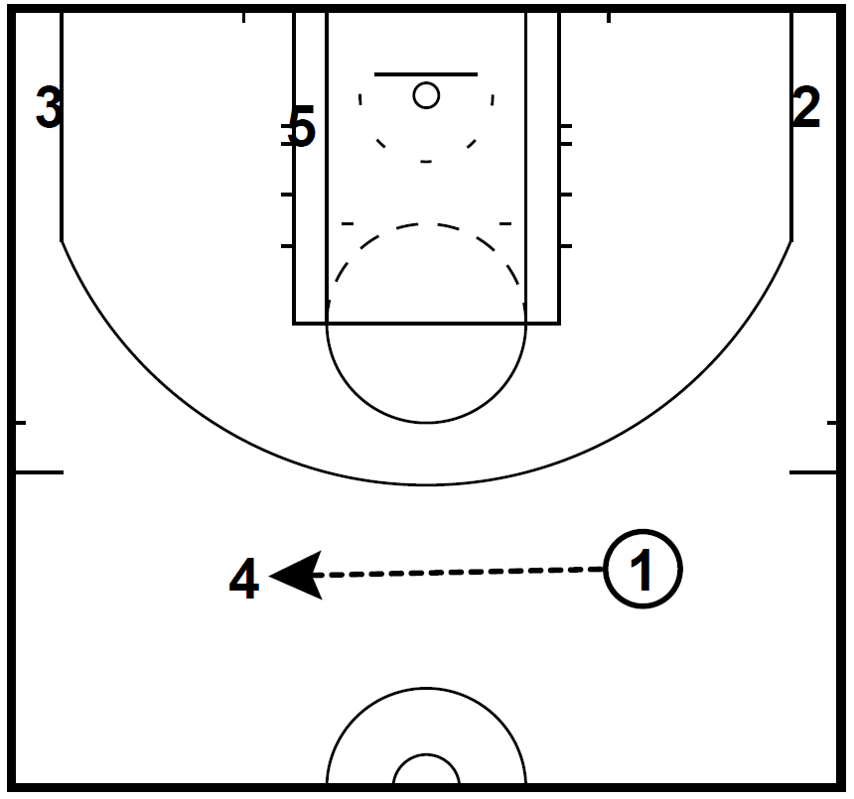
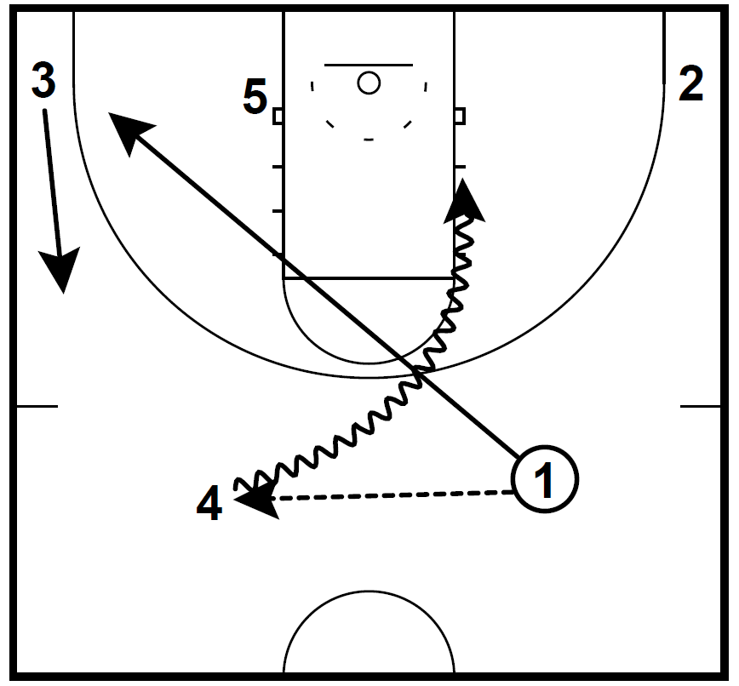
Trigger -“Flip”
Flip = 1→ 4 Pass to the trigger spot
Option 1 = 4 drives off 1’s cut in our Slice action

Slide 45
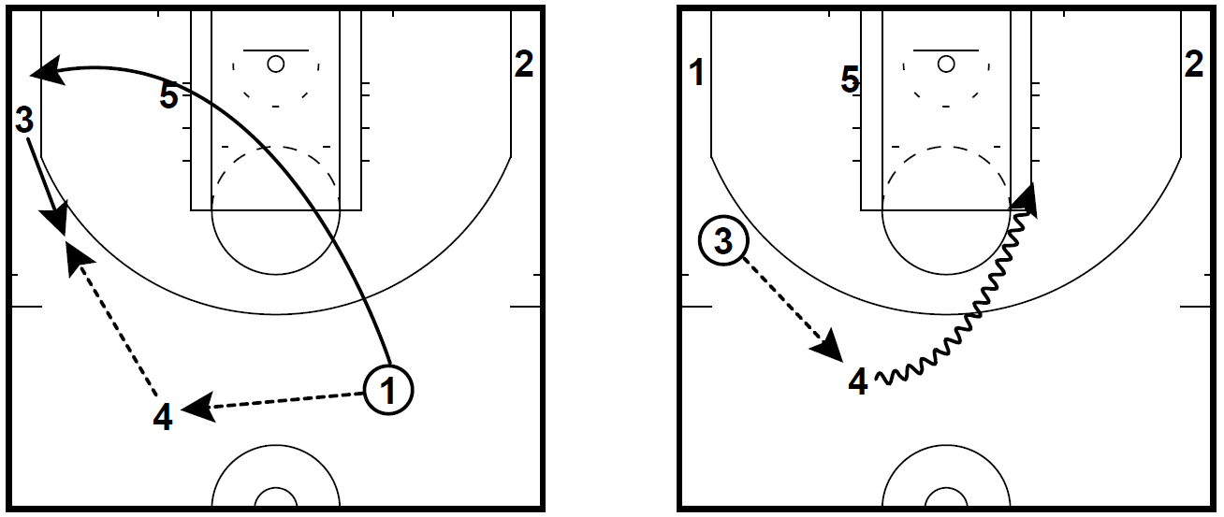
“Flip” – Option 2
Option 2 = Snap Action

Slide 46
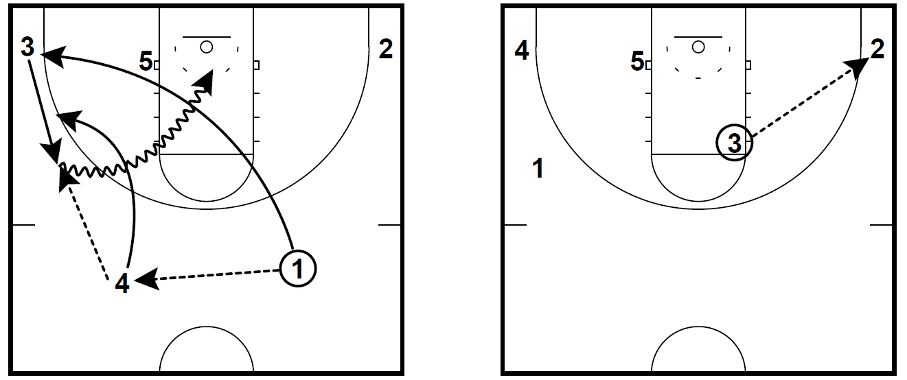
“Flip” – Option 3
Option 3 = Wave Action

Slide 47
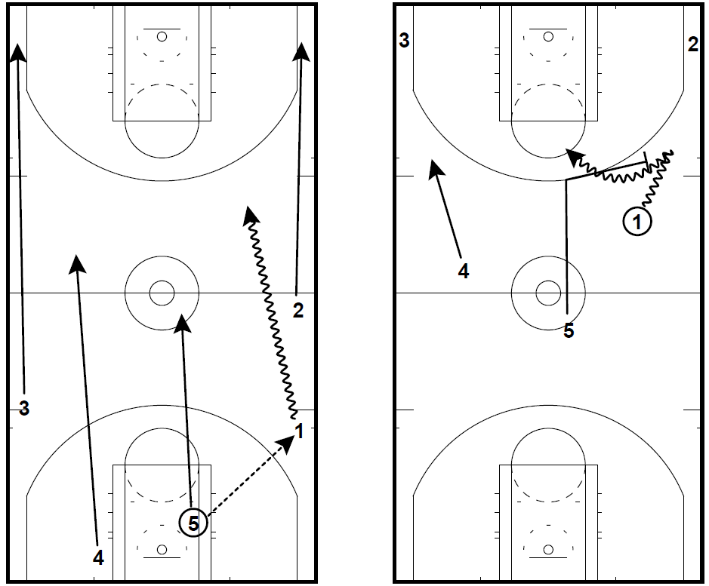
Automatic -
Post Rebound
5 hunts the ball-screen instead of rim running when trailing the action

Slide 48
Our Program, Our Culture
Time Out Talk – 60 secs to teach, then go
No Jump Balls / OOB at practices
Winners Run / Losers “Fix It”
Team Time Out – Fix it before the coaches do
Players Choice – Practice Block for players to choose what to do

Slide 49
Our Program, Our Culture Cont.
Celebrate Every Win – Count ‘Em Up
Parent Meetings – Player Must be Present to Meet
3 Positives – Framing Your Closing Message
Allow Players to Make Choices About Practice – Increase Buy-In
“Go” Trap – Best and Most Simple Press from Youth to HS

Slide 50

Contact Info
Justin Duke
Wilsonville High School
(541) 619-5309
Justin.Duke@assurant.com

