Slide 1
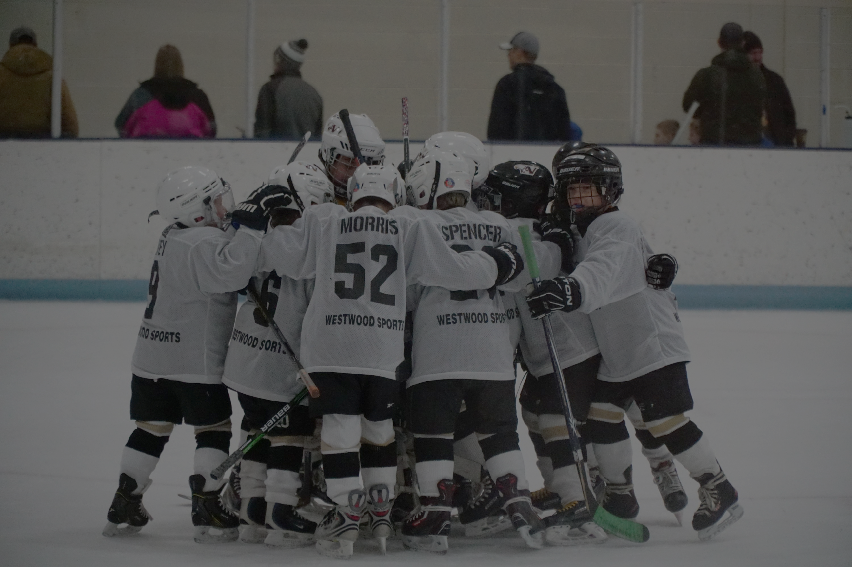
Apple Valley Burnsville Hockey Team Manager Meeting
2025-2026 Season

Slide 2
Team Manager Requirements

Slide 3
Manager Requirements
Register as a volunteer with AVB Hockey
Volunteer Registration on https://www.avbhockey.com/volunteerregistration
You will need:
USA Hockey Number
Free for volunteers
SafeSport Certification
Initial coursework
Continuing education
Can be accessed on usahockey.com

Slide 4
Manager Requirements
Background Screening
Needed every two years
Who needs it?
Coaches
Managers
Volunteers
Locker Room Monitors

Slide 5


Slide 6
Locker room monitors must be IN the locker room at all levels, Mites to Bantams, until rooms are empty when coaches are not present.
Same Sex
U10/U12 – Female
Squirt/Peewee/Bantam – Male
BE PRESENT!!! Help the kids as needed
Primary responsibility is to prevent misbehavior and bullying activities; to be clear, you are expected to say something/stop it if it does occur.
Mobile electronic device and phone use is PROHIBITED

Slide 7
Team Websites & Requirements

Slide 8
Team Websites
Each team has its own page on avbhockey.com
Make it your own!!!
Include:
Coach, Manager, & Scrimmage Coordinator names and contact information
Email or phone
Team pictures
Family volunteer requirements
Do NOT include
Names next to pictures

Slide 9
Family Volunteer Requirements
District 8 Home team provides:
Scoreboard/Clock
Penalty box attendants
GameSheet
Music (if available)
Coach family exception
Each team provides
Locker room monitors
Check with coaches on whether they want to handle LRM

Slide 10
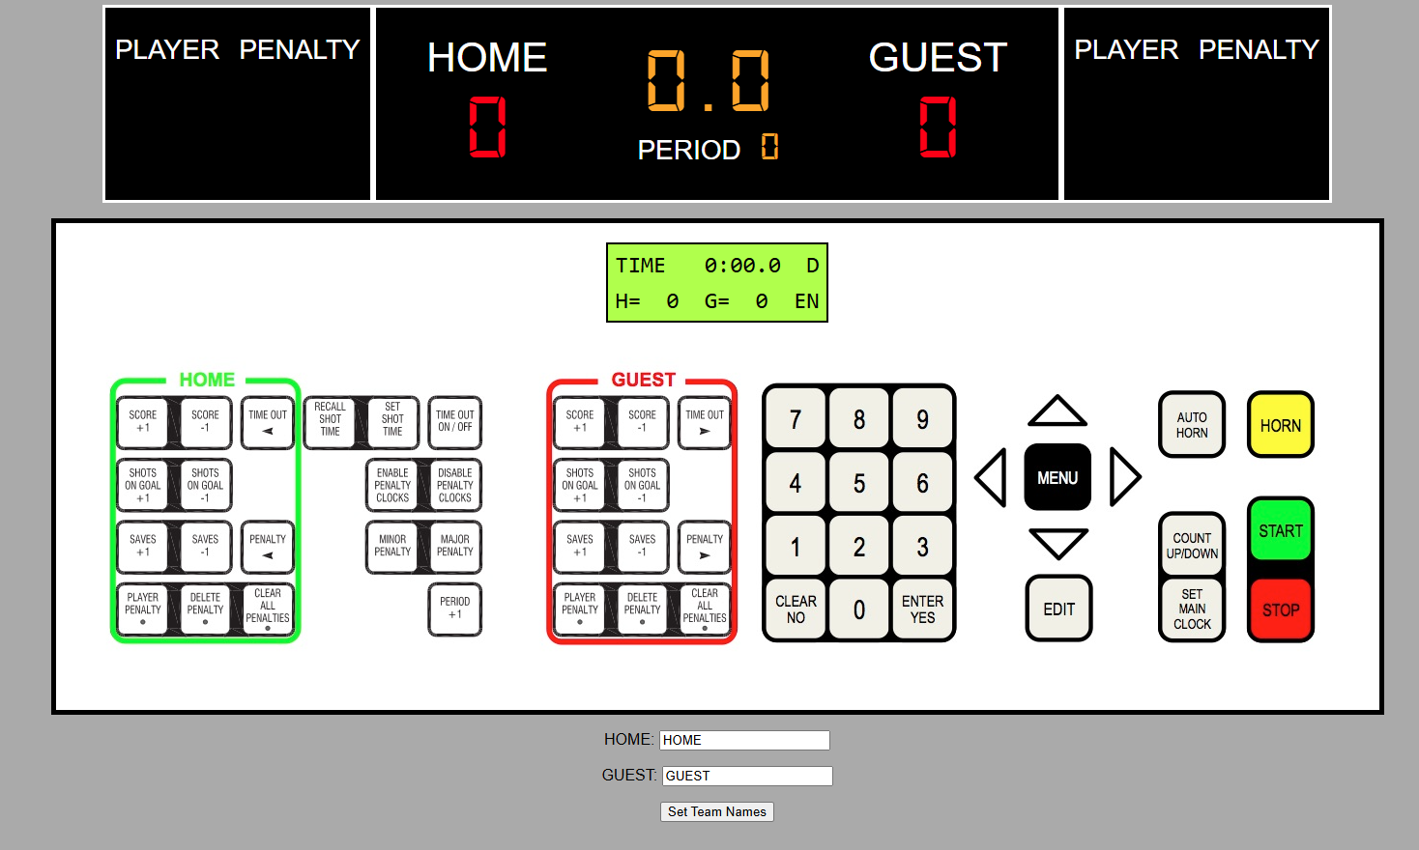
The Dreaded Scoreboard…
Scoreboard/Clock Simulator
www.avbhockey.com/scorekeeper

Slide 11
DIBS
AVB – 7.5 hours per family
EVHA – 5 hours + 3 hours in concessions
AVB Coaches/Managers
Traveling Head Coaches – exempt from DIBS
Assistant Coaches – Head Coach will receive 12 hours to distribute to their assistants; up to 3 allotments
Managers – 4 hours per team; if you have multiple managers decide how you want to split it up
Please send 1 email to Charles Rosenfield & Jodi Oster letting them know how Dibs will be distributed for your team – discuss with your coach who will be sending that email

Slide 12
Tips
Ask for help – you likely have parents on your team with skill sets they are willing to contribute whether they are crafty or have a contact to share
It’s a good idea to have a treasurer
Single Parents/Special Circumstances – there may be a family who can’t do LRM, work something out with them
Tournaments in WI – you will need to fill out a travel request
Communication – Emails are sent to managers when important association information should be given to your team
i.e. DIBS being released
Please provide best email contact up front
Subs – if you will be under 10 skaters you can sub to get back up to 10 skaters from the same level or below
Rest Rules – be aware of these when scheduling multiple ice events in one day
This applies to subs as well – if you need to fill out a sub form and that player is rostered on another team, District 8 will check their schedule to verify rest requirements are met

Slide 13
Scheduling

Slide 14
Ice Scheduling
Linda Moran
ice@avbhockey.com
Please use email for all ice requests
Allow up to 24 hours for response
Managers should create/edit/delete all of their own non-ice events
Team meetings, parties, etc.

Slide 15
Ice Scheduling
Scrimmages
All scrimmages (home or away) need to be emailed to the ice scheduler so the master schedule can be updated
Email Linda and Rink Managers with scrimmage information
Apple Valley Rinks – Brian (bchristianson@ci.apple-valley.mn.us)
Burnsville Rinks – Dean (dean.mulso@burnsvillemn.gov) AND Jill (jill.culver@burnsvillemn.gov)
Request Referee with District 8
Information Needed to send to Sean Kelly
Email iceref@juno.com to book refs
Ref Rates

Slide 16
Swapping/Giving Ice
Please be aware there is potential for ice bills this year, if your team is giving up ice and cannot find a team to take it, this ice is still included in the allocations when bills are being considered
We had a lot of ice simply forfeited last year
Email chain to swap and pick up ice between managers, sign up on the table if your team would like to be included and who to contact
Reach out to Mindy/Emily if you would like to speak to your coach first, sometimes it’s best if the coaches handle it, but that’s up to them

Slide 17
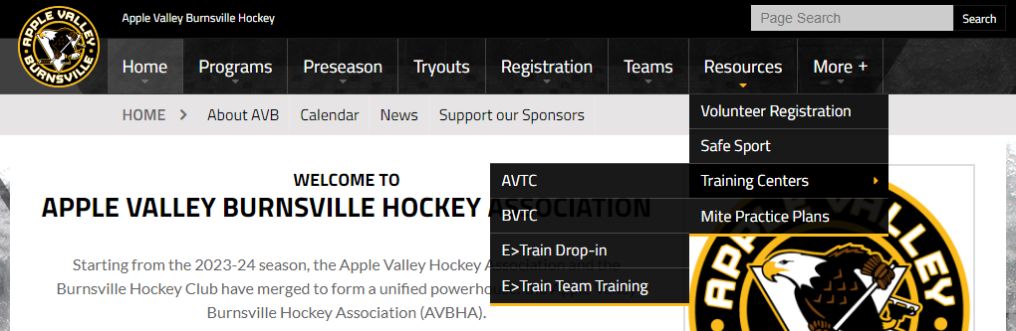
Training Centers
Apple Valley Training Center – 14760 Pennock Ave, Apple Valley
Burnsville Training Center – Former Burnsville Public Works building
E>Train

Slide 18

Picture Day
Tuesday, November 4th (December 15th is Make Up Day)
At the Burnsville Training Center
Times will be posted to team calendars

Slide 19
Playoffs & Additional Tournaments

Slide 20
Additional Tournaments
Tournaments beyond those booked by the association are on the team to pay for them
Note – Squirts have a game limit, be conscious of that if scheduling ref’d scrimmages or adding a tournament
Game reschedule fees are on the team as well if a district game needs to be moved for a tournament

Slide 21
District 8 Playoffs
All teams are automatically in D8 Playoffs
District 8 Playoffs – you will receive an email as playoffs get closer on where your check needs to be sent, keep an eye out for that
Your team may choose to opt out of district playoffs, the deadline to do so is Dec. 31st
If your team opts out, you can apply the cost of playoffs toward a different tournament
Opt-out link

Slide 22
Budgeting

Slide 23
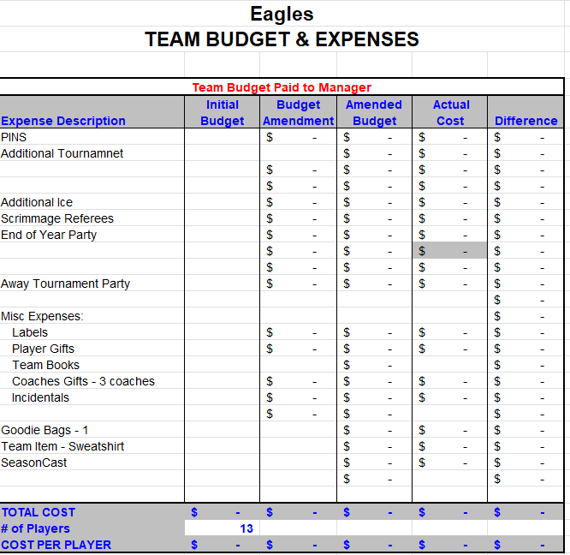
Team Dues
Specific for each team
Personal financial information should not be shared – please keep all payments and payment plans private
Only account balance should be shared, not who has paid or how much they have paid
Work with coach to determine season activities
Scrimmage referees (EVHA does not pay for scrimmage refs, co-op team dues discussed on another slide)
Team warm-ups
Team meals
Tournaments – bags, door signs, etc.
Trading pins (check your tournaments!)
Miscellaneous other team related expenses
Paid Coaches Expenses (i.e. Out of Town Tourney Hotel)

Slide 24
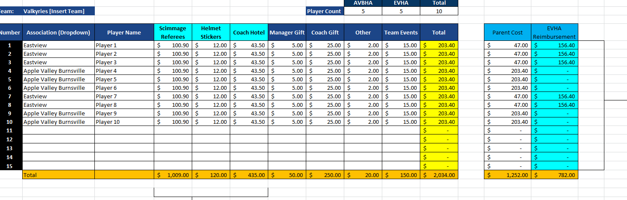
Co-op Teams
Co-op teams checking out an iPad must utilize an AVB member for checkout
You must utilize this budget spreadsheet: Co-op Spreadsheet if you will be using ref’d scrimmages
The link to request reimbursement for refs from EVHA is built into the budget sheet

Slide 25

Support Our Sponsors!!

Slide 26
QUESTIONS?

Slide 27
THANK YOU
Let’s have a great season!

