Slide 1
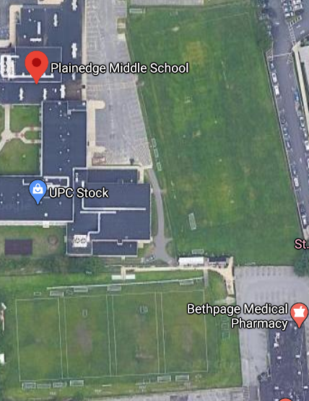


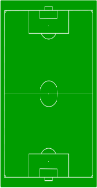

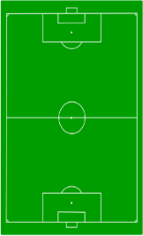
B
10
9
8
7
13
6
LITTLE FEET
SUNDAY FIELD
MAP
5
12
4
11
3
CHECK IN
2
Stewart Ave
Entrance
1
Stewart Ave
Entrance
Office
Bath
Room
16
16
B
A
15 14

