Slide 1
RECAP OF:
CAYBBA
BOARD MEETING
3.18.2025
7PM
Notes:
‹#›

Slide 2
AGENDA
  Weclome
  Roles / Open Roles
  Season Recaps (what went well, learnings / changes for next season, etc.)
    In-house 1-3th; 4-8th
    Travel: Boys, Girls
    Financial update
  Girls Tournament recap / discussion (learnings / changes for next year)
  Tournament Dates for ‘25 - ‘26 season
  Donations
  Need: 2 for Scholarship committee
  Other Organizational Feedback
  Summer Training (camps, 10k shot club, etc.)
  Season Planning
    Paid Coaches Discussion
    Travel Philosophy updates
    Platform exploration (Crossbar, SportsEngine)
  Annual Meeting Planning (early June)
    Goals, Requests, etc.
  Other Updates / Needs
  Closing
‹#›
Notes:
Season Theme
Long range planning
Volunteer Fees
Web domain
Coach Fee Discount
‹#›

Slide 3
Tenure / Position chart. Plan 3 years in role
Role Descriptions
 | ‘23-24 | ‘24-25 | ‘25-26 | ‘26-27 | ‘27-28
President | Olson / Herzog | Herzog | Herzog | (Election June ‘26)
Vice President |  | Riggs | Riggs | Riggs | (Election June ‘27)
Treasurer | Middendorf | Middendorf | Mareck | Mareck | Mareck
Past President | Olson | Olson | Olson
Scheduler | Whitney | Whitney | Whitney | Whitney
Boy Travel | Coddington | Coddington | Coddington
Boys Travel Asst | Herzog | Beakman | Beakman | Beakman
Girls Travel | DeBruine | DeBruine | DeBruine
Girls Travel Asst | Tenwinkel | Tenwinkel | OPEN | OPEN | OPEN
Boys Tourney | Richardson | Richardson | Lunde | Lunde | Lunde
Boys Tourney | Lage | Lage | Lage | OPEN
Girls Tourney | Kennan | Kennan | Gunderson | Gunderson | Gunderson
Girls Tourney | Welter | Gunderson | Phillips | Phillips | Phillips
Bracketologist |  | Clint Prescott | Clint Prescott | Clint Prescott
Concessions | Brandt | Levitt | Levitt | Levitt
Concessions | Moger | Swaggert | Swaggert | Swaggert
1st - 3rd in-house | Abrahamson | Abrahamson | Abrahamson
1st - 3rd in-house Asst |  | Mareck, Kathy | Mareck, Kathy | Mareck, Kathy
4th-8th in-house | Mitcham | Mitcham | Mitcham | OPEN | OPEN
4th-8th in-house Asst |  | Michael Mcguire | Michael Mcguire | Michael Mcguire
Fundraising / Events | Walton | Walton | OPEN | OPEN | OPEN
Communications | Walton | Walton | OPEN | OPEN | TBD
Player / Coach Dev |  | Ohme | Ohme | Ohme
Member at Large |  | Williams | Williams
‹#›
Notes:
‹#›

Slide 4
Upcoming Open Rolls
UPCOMING OPEN ROLES
Term: June 2025 - June 2028
Note: We ask for a 3 year commitment for each role
Director of Communications / Fundraising
Manage our CAYBBA Social Media accounts and other channels to promote and foster community within the CAYBBA
Create social media posts to promote CAYBBA information, events, fundraisers, player highlights, contests, etc.
Build a comprehensive fundraising program to achieve budgeted fundraising goal
Plan and execute annual fundraiser(s)
Initiate and organize CAYBBA social events (e.g., U of MN, St. Thomas, Timberwolves, Lynx, etc.)
Advertise and communicate about fundraisers to the org
Assistant Girls Travel Director:
Assist in tournament selection, ensuring feedback from past season is incorporated into selections as necessary
Assist in tryout process, support the check-in process on tryout dates
Manage the overall jersey process including working with the vendor, getting player sizing / numbers, and distributing the jerseys
Distribute coaches bags at the beginning of the season and collect them at the end of the season (make tags, fill with whiteboard, markers, whistle, first aid kit scorebook, ball pump, pencils, cones).
Manage coaches shirt selection and distribution
Help coordinate team picture schedules with Sunshine Photography
https://docs.google.com/document/d/1rkkcZKUaR7Ma9kb_YxxKzhPsZ_f30y3NREiSKvI-8D0/edit?tab=t.0
‹#›
Notes:
‹#›

Slide 5
SEASON RECAPS
Notes:
‹#›

Slide 6
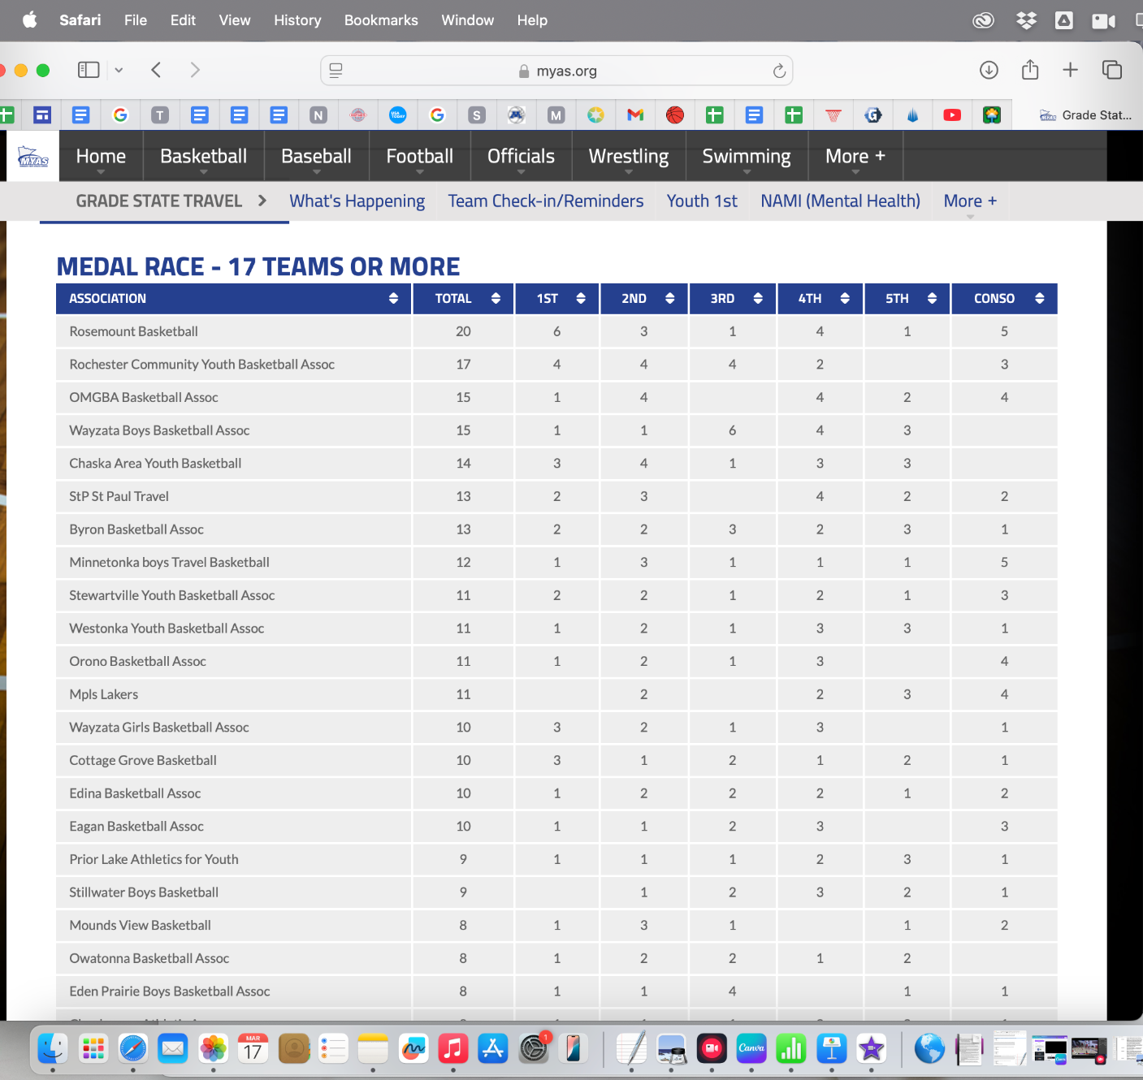
Travel
Grade State
‹#›
Notes:
Sept way busier this year
‹#›

Slide 7
Travel
Survey Results / Feedback
‹#›
Notes:
Sept way busier this year
‹#›

Slide 8
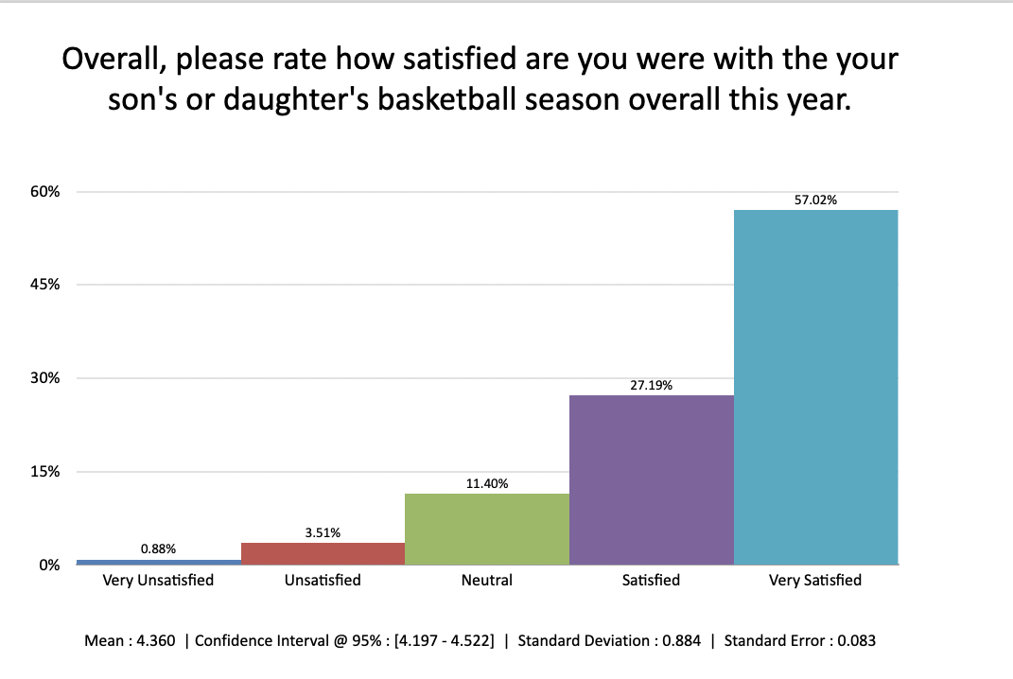

Slide 9
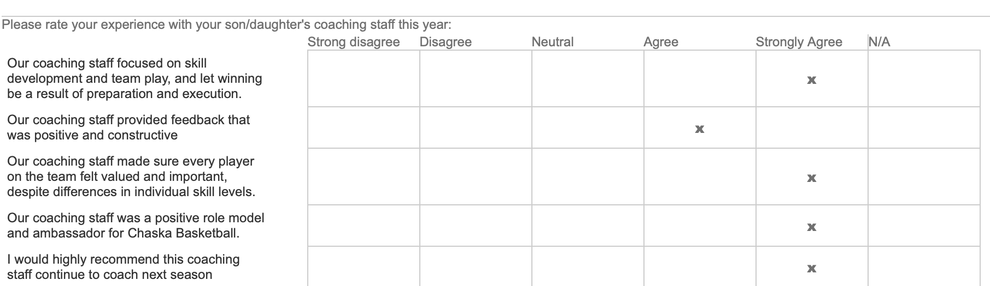
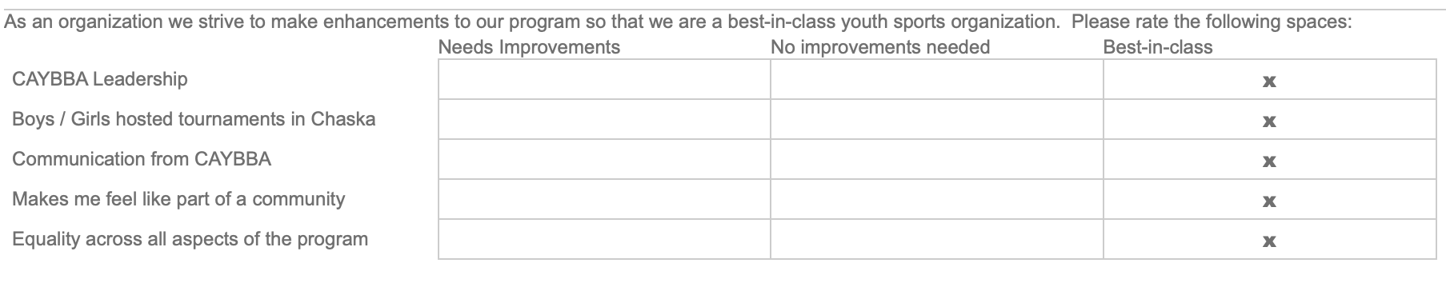

Slide 10
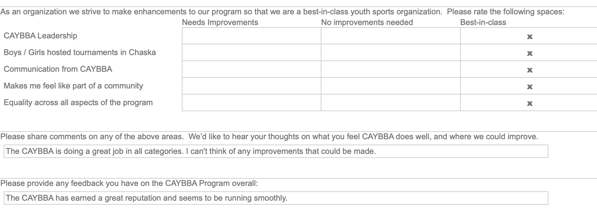

Slide 11
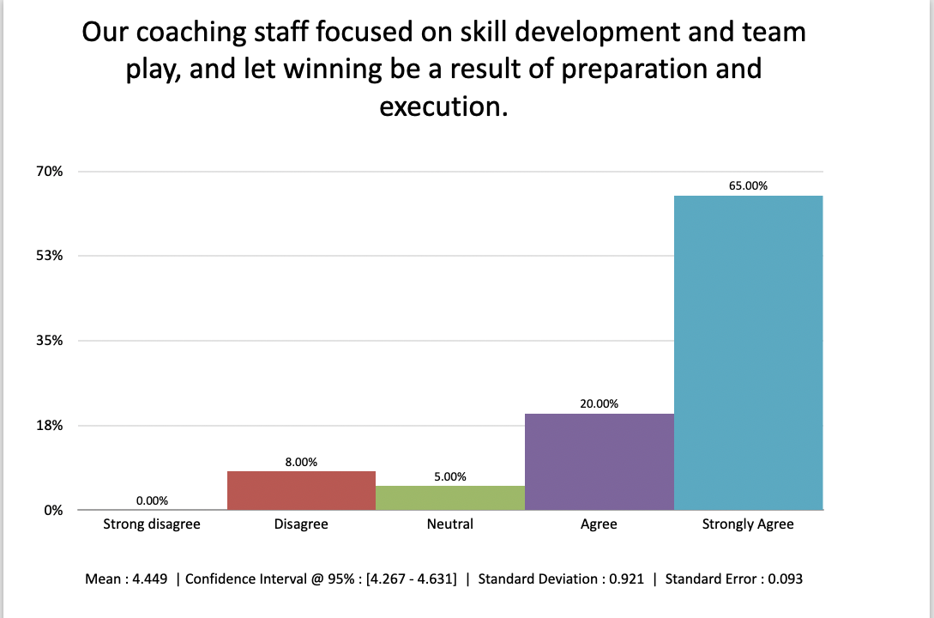
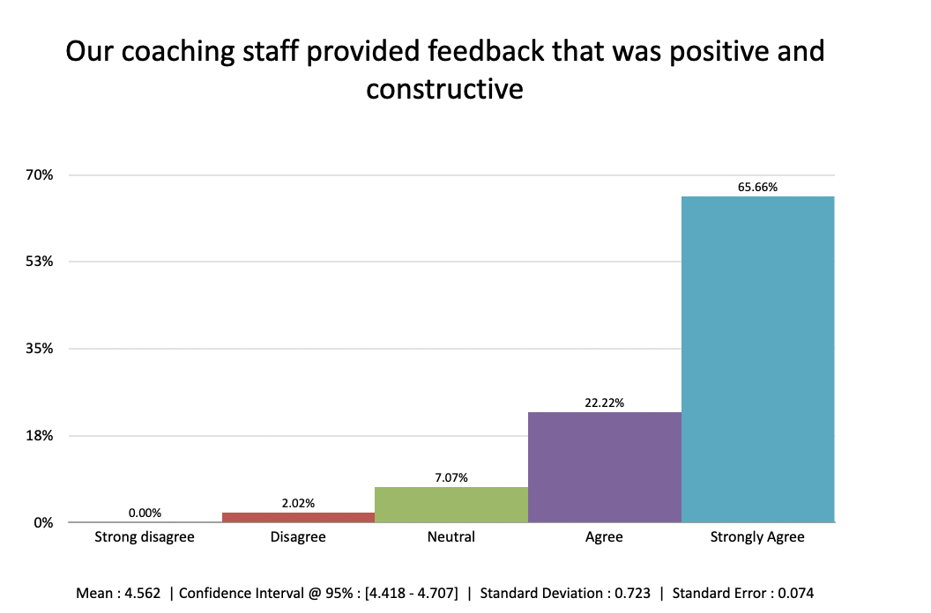
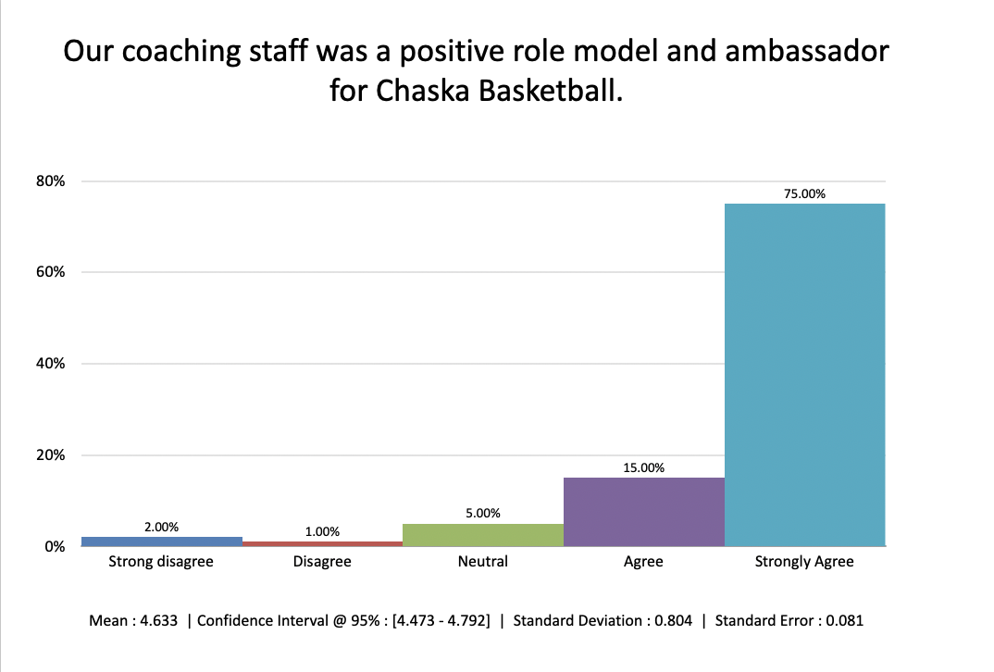
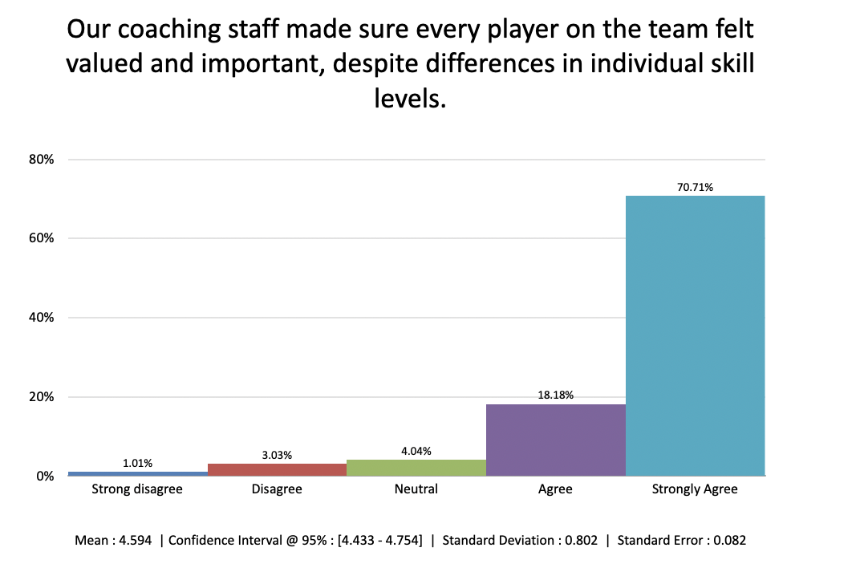

Slide 12
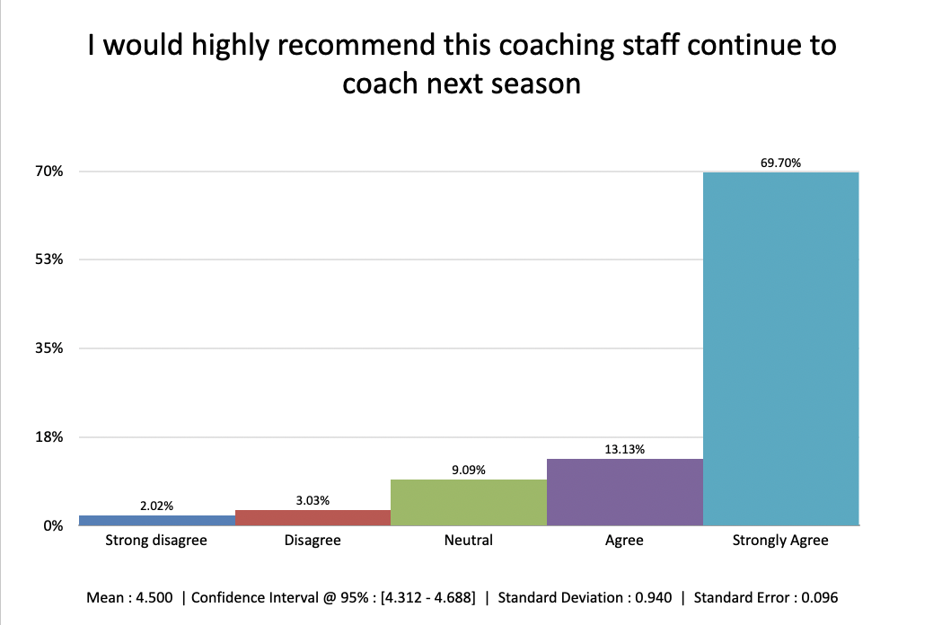

Slide 13
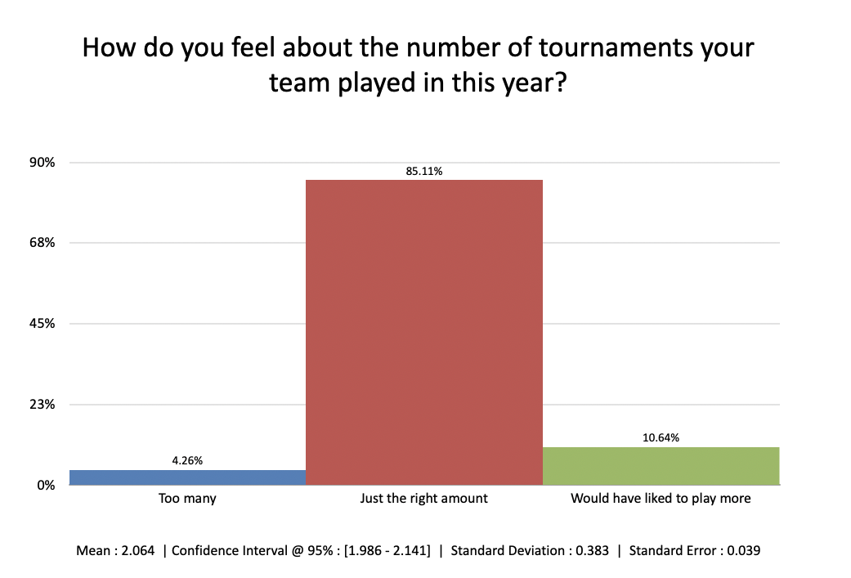

Slide 14
Selected Comments - Boys
The season started off tough and the boys struggled to compete at times, but they definitely improved throughout the year and were competing with all teams by the end of the season. My son also said he had a lot of fun, enjoyed the challenges along the way and appreciated his teammates and coaches.
My son had a wonderful season this year. He grew a lot individually as a player, learned a lot, and enjoyed his teammates. The coaching staff was incredibly organized, thorough, and fair. The boys showed tremendous growth throughout the season, and the coaches did a fantastic job of meeting the needs of all players. Communication was excellent, and it was clear that the coaches were truly player-focused. Their dedication and approach made for a great experience!
My sons team competed, played well, and had fun all season. All were challenged but also had some success. Hats off to the coaches for the time they invested.
Best season we have had so far. By far the best coaching staff. All coaches worked well and pushed the boys and it paid off. A lot of wins, great attitudes, great sportsmanship.
The coaching was phenomenal. The time in practice was extremely efficient. They had structured drills, and my son often said that the games were easy because the practices were so much harder! The team worked so hard in practice. The coaches/team were incredibly well conditioned and organized.
A number of kids were probably not ready for travel. Both emotionally and physically. I still do believe that 3rd grade is still quite young for the demand and duration of the season. Some of the practices were not very well organized and were chaotic at times.
Our coaches have been amazing. We had a successful year with them. I am concerned about next year’s tryouts would really like to see an outside company evaluate the kids.
My son’s season was very rewarding. The coaching he received, and the way he was used on the team, allowed him to develop basketball IQ and his skill set more than past years. My only concern, and why my rating wasn’t “Very Satisfied” is he wasn’t challenged to the level that he could’ve been had he been placed at a higher level. I believe he can compete at the A level, but was moved from B to C this season with minimal movement from the A team in this grade.Our son grew to love basketball by the end of the year and is excited to play next year. He also experienced a lot of frustration tied to behavior issues of his teammates during practices throughout the year, which I feel need to be addressed in the form of a different head coach next year for the team.
I hated how late practices were. It is not acceptable to have 4th grades having practice after 8pm on school nights.

Slide 15
Selected Comments - Girls
Great first year of travel basketball. The team was very successful, good coaches, and player development.
Great families! My daughter came out loving the sport even more which is the main point of 3rd grade basketball. She also improved a lot as a player.
We absolutely love our coaching staff. They’ve created such a great community amongst the team. Our daughter continually learned new skills throughout the season
The coaches were wonderful this year. They did a great job balancing fun and improving skills. They also promoted teamwork throughout the season
Very positive experience with practives and games. Our daughter ranked it first/top spot of all years she has played basketball
Overall the season was great, our daughter progressed in her skills and she had fun and for the most part it was a great team.
Our daughter learned a lot, became a better player, and thoroughly enjoyed her time with her teammates. As parents, we had a great time getting to know the parents of the other players.
We had the best coach this year! She did a great job individualizing feedback for each girl. Only bummer is that we seemed to play a lot of top teams that entered into the B bracket. Not sure that’s something the org has control over, but it’s really a morale deflater when the girls lost so often.
Coaches were very nice. Good communication. Playing time was very even. Focusing more on teaching the kids about team play- playing team defense and how rotations work, how to break a press, how to attack a zone- would benefit the kids a great deal.
Girls all improved throughout the season and had fun
I felt my daughters experience decreased her love for the game, which is what I am struggling with as a parent.
We enjoyed the team, and the coaches worked hard with the girls. Unfortunately partly due to the size of the team and the varying skill levels on the team the playing time was very very imbalanced.
It was great experience. On thing I would have changed was the scheduling early in the year. We didnt have many tournaments early in the year, and had a bit of a hole in our schedule.

Slide 16
Recognition
Multiple Coaches Praised (during the season)
  Discussion - how to recognize
    Sportsmanship
    Taking great interest in players
‹#›
Notes:
Sept way busier this year
‹#›

Slide 17
Boys Travel- discussion
What went well
Learnings / Potential Changes for next year
Survey Feedback
‹#›
Notes:
Sept way busier this year
‹#›

Slide 18
Girls Travel- discussion
What went well
Learnings / Potential Changes for next year
Survey Feedback
‹#›
Notes:
Sept way busier this year
‹#›

Slide 19
In-House 1st-3rd
What went well
Learnings / Potential Changes for next year
Creating a FAQ document for families so aware of 3rd grade options
‹#›
Notes:
Sept way busier this year
‹#›

Slide 20
In-House 4th-8th
What went well
Learnings / Potential Changes for next year
Survey Feedback
‹#›
Notes:
Sept way busier this year
‹#›

Slide 21
4th-8th grade in-house results
Overall, please rate how satisfied are you were with the your son or daughters basketball season overall this year.
Very Unsatisfied | 0 | 0.00%
Unsatisfied | 1 | 4.35%
Neutral | 0 | 0.00%
Satisfied | 7 | 30.43%
Very Satisfied | 15 | 65.22%
Statement | Strong disagree | Disagree | Neutral | Agree | Strongly Agree
Our coaching staff focused on skill development and team play, and let winning be a result of preparation and execution. | 0 | 0 | 1 | 1 | 17
 | 0.00% | 0.00% | 5.26% | 5.26% | 89.47%
Our coaching staff provided feedback that was positive and constructive | 0 | 0 | 1 | 2 | 16
 | 0.00% | 0.00% | 5.26% | 10.53% | 84.21%
Our coaching staff made sure every player on the team felt valued and important, despite differences in individual skill levels. | 0 | 0 | 0 | 2 | 17
 | 0.00% | 0.00% | 0.00% | 10.53% | 89.47%
Our coaching staff was a positive role model and ambassador for Chaska Basketball. | 0 | 0 | 0 | 2 | 17
 | 0.00% | 0.00% | 0.00% | 10.53% | 89.47%
I would highly recommend this coaching staff continue to coach next season | 0 | 0 | 0 | 2 | 17
 | 0.00% | 0.00% | 0.00% | 10.53% | 89.47%

Slide 22
In-house quotes
[coaches] were very encouraging and uplifting for the girls. They used positive encouragement and constructive coaching.
[coaches] were cool as cucumbers through the whole season. They always focused on running plays and working as a team.
Registration, app, organization. All good
You run the program really well. The girls learned a lot. Appreciate the focus on the developing the skills and playing as a strong and collaborative team. The positive messaging to the girls from the coaches was so refreshing.
Practice schedules.... I know gym time is tight, so I'm being picky, but we had so many Friday evening practices... would have been nice to be during the week instead of Friday :)
LOVE. thank you for offering the community/ in-house program. Not every player is competitive, and not every family can afford the travel rates. We LOVE that you provide a community / in-house team too. Thank you for being inclusive. Can I say LOVE one more time.
Great program!
Well organized.
Great program. Just tournament scheduling was super last minute and then our scheduled game that was on Sports Engine apparently was a mistake? We all found out, family friends and players when we arrived for the game.
Thank you for dedicating so much time/effort/energy into running a flawless program. The girls loved it.

Slide 23
Financial Updates
Transitioning Account Ownership
Good Cash on-hand
Exploring investments
Overall
Similar YoY
Boys Travel income/expense up due to more teams
Girls travel income down, expenses down
‹#›
Notes:
Sept way busier this year
‹#›

Slide 24
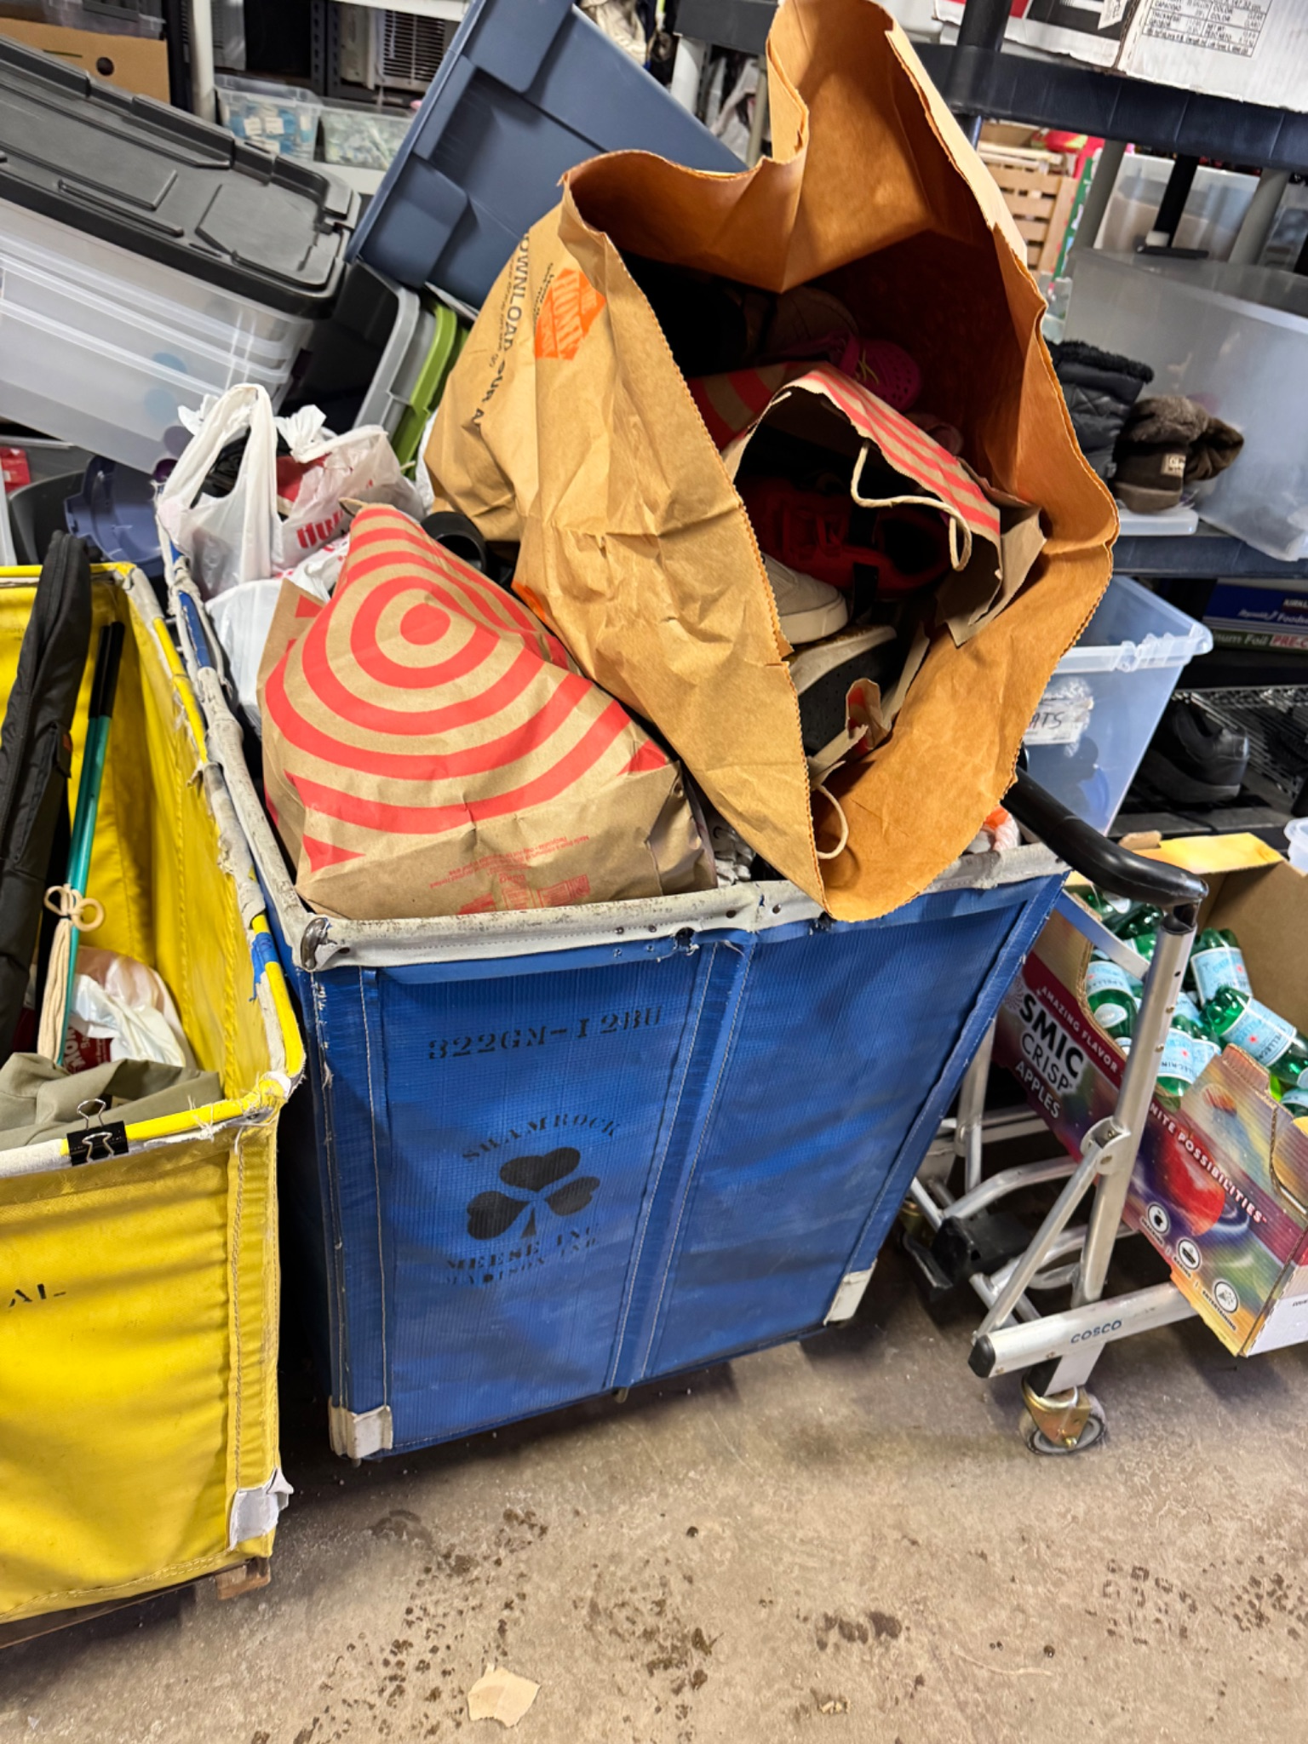
Other Season Notes
Shoe Drive - Exceeded Expectations
Discussion: Other donations (balls, clothing, etc.)
Weather / School Closures (late Feb)
Teams participating in Varsity games
‹#›
Notes:
Sept way busier this year
‹#›

Slide 25
Girls Tournament Recap
Notes:
‹#›

Slide 26
2025-2026 Tournament Dates
Notes:
‹#›

Slide 27
Donations
Notes:
‹#›

Slide 28
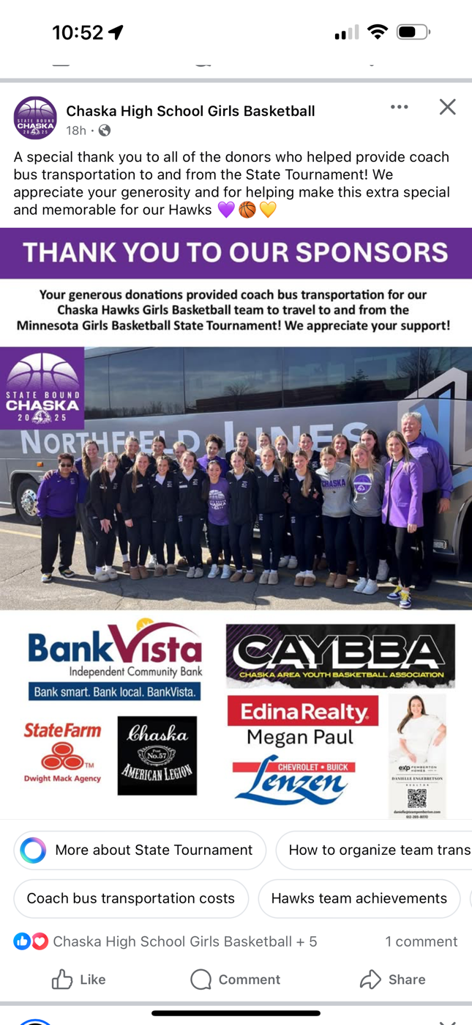
Donations / Scholarship Review
Chaska Bash - 2 registrations: APPROVED
Chaska Girls HS support: Previously APPROVED
Senior Party $500: APPROVED
Scholarship Committee: request for two people to help read / review and a rank CAYBBA Scholarship applications: Herzog, Williams, Tenwinkel
‹#›
Notes:
Sept way busier this year
‹#›

Slide 29
Other Organizational Feedback
Notes:
‹#›

Slide 30
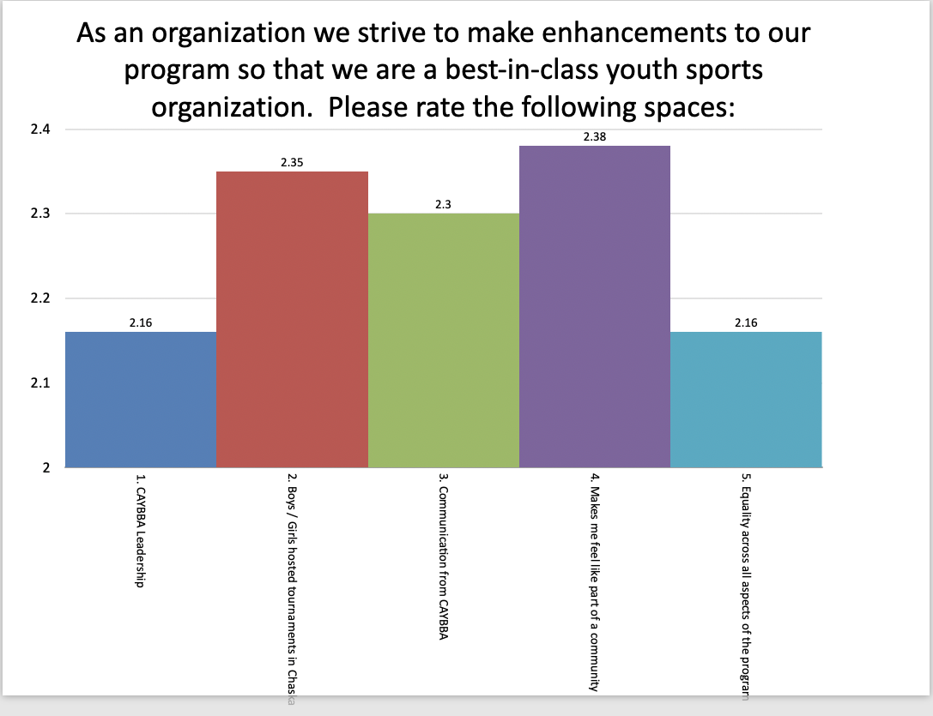
Organizational Feedback

Slide 31
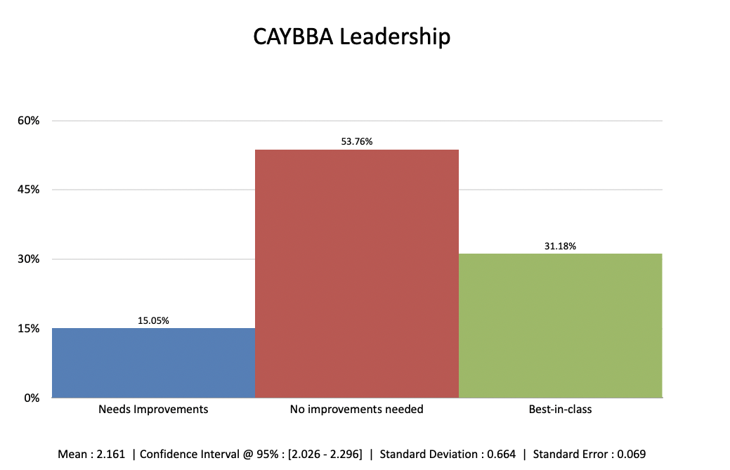
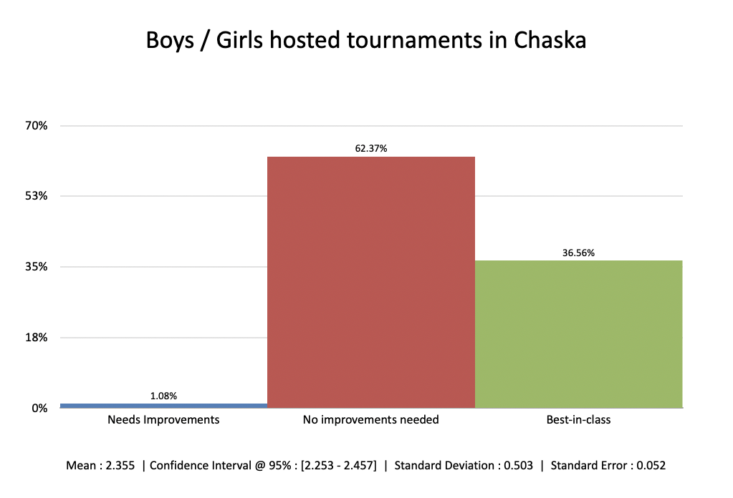
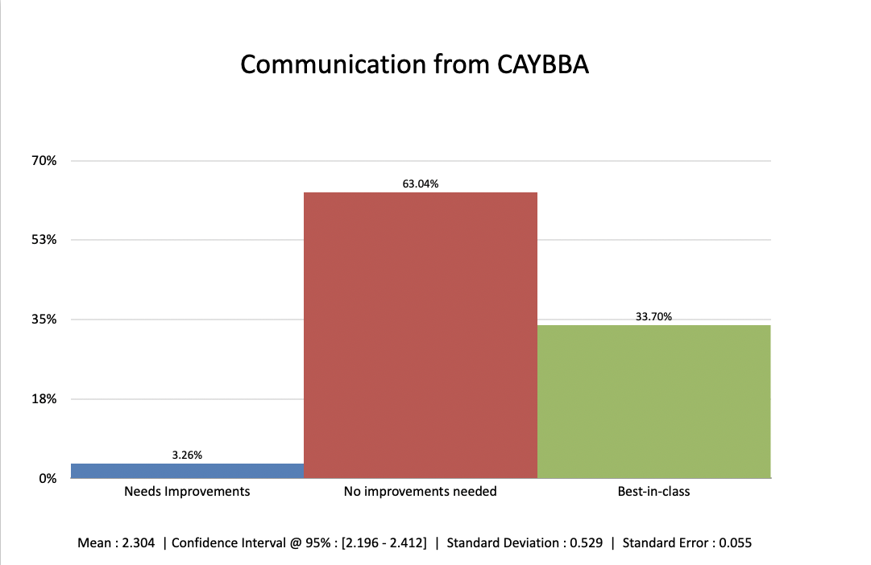
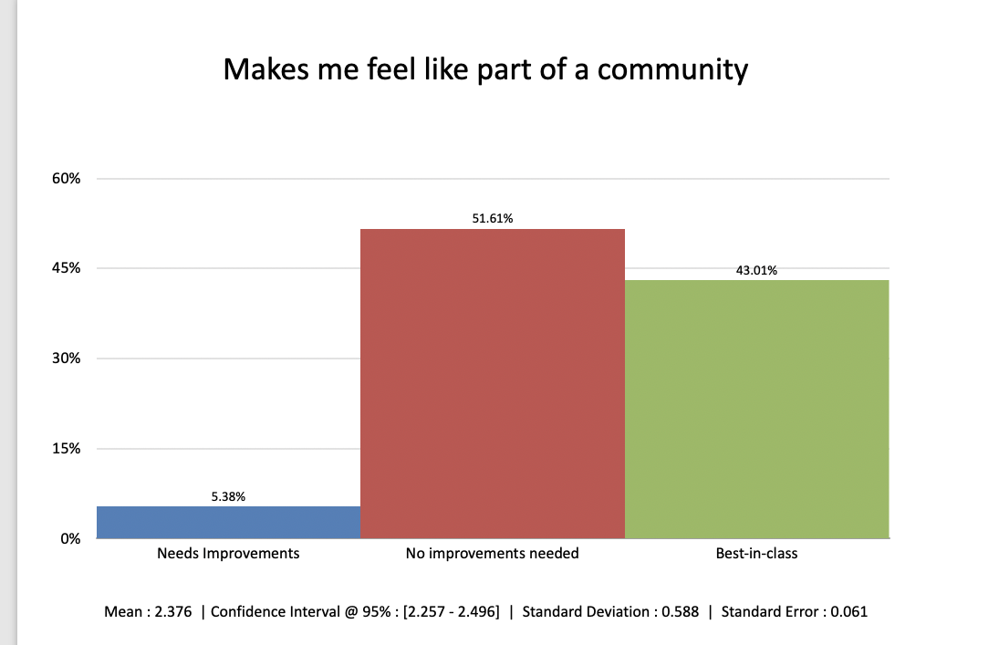
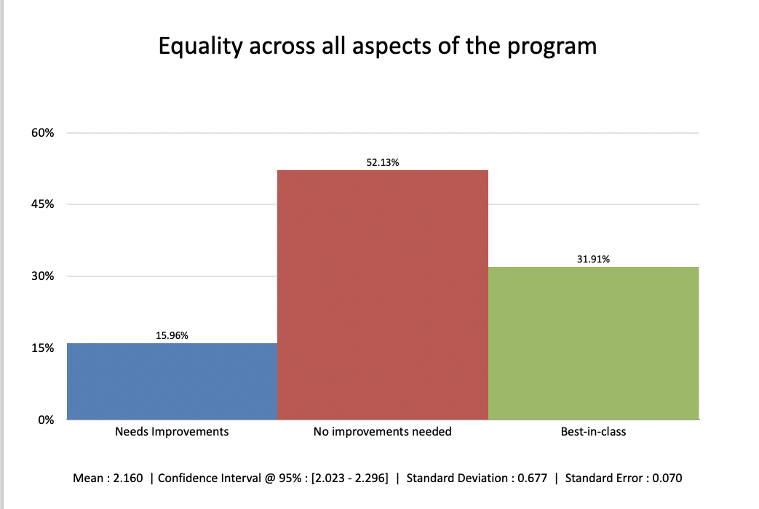

Slide 32
Themes of Constructive Feedback
Addressable Points
Tryout process (10+)
Transparency (5)
Groupings of parents on Board
Tournament selection
Common Complaints:
Practice Times
Team Placement
Next Steps:
Working on CAYBBA Handbook
Document what HS Coaches look for during tryouts
Document and share process for evaluations
Share coach evaluations categories (which should be generally aligned with tryout details)
Earlier FAQs or some sort of information on exiting 2nd graders from our program and maybe a simple FAQ for what the next year can bring whether it is travel or in house. This is more near and dear to me right now as our pocket of 3rd grade had only 6 girls go out and then we also have two 2nd graders on the team. Knowing fully well that our 2nd graders need to stay at their own level next year for a multitude of reasons, I think a proactive informational thing for kids leaving the 1-2nd grade program and what to expect would help with numbers. I fully understand that we could just have a unique pocket of numbers and Chaska versus Chan as the Chan 3rd graders have 2 travel teams of 10. Last year our 3rd graders had 2 teams, so maybe it all was a perfect storm.
Has there been any thought to asking for team managers to assist coaches with communications/calendar events/other admin during the year?
Fun overall season, boys seem to really like the design of the new black jersey. Would suggest allowing more coach discrepancy to tournament selections over a one size fits all approach as some levels/grade years warrant a more challenging schedule than others. I believe this suggestion would require tryouts earlier to ensure tournament availability.
Encourage more families to attend high school games by offering a season pass for travel players (at minimum) and a family option for an additional cost. Provide more direction/information on AAU tryouts and programs as well as opportunities for more basketball outside of season: MYAS tourneys, camps (local HS and beyond), and other basketball and fitness training opportunities. So much of it is word of mouth and subjective.
I would love it if our team's head coach was given the opportunity to provide input into the tournament schedule for next year.
The program the should be more mindful around finding the appropriate level for teams over treating each grade level the same with the objective to let players continually be challenged to benefit Chaska high school basketball overall
I would love to see the youth basketball program partner with the high school programs. In our previous association each youth team had 2-3 “big sisters” that were girls from the high school teams. They came to a few practices and acted as role models for our girls. The youth program girls really enjoyed this.

Slide 33
Themes of Positive Feedback
Well run organization
Good communication
After significant turnover, CAYBBA leadership really found their groove this year. Communication, while frequent, was valuable. It really felt like one big community invested in each other’s success, as opposed to individual teams.
I enjoyed how the CAYBBA encouraged teams/families to support the high school girls team - it was very cool seeing all the young players at each game cheering the high schoolers on!
I love that Chaska families get involved in the travel teams like they do, everyone is welcoming and happy to be part of the CAYBBA family. It really feels like a sense of community between the families and it is great how all are around and helpful to all.
Loved the summer training option and open gym/scrimmages made available to the kids.
It’s a well run program and there are good people leading the way with a bright future ahead.
The CAYBBA has earned a great reputation and seems to be running smoothly.
I am very happy to see a couple of the grade levels have 4 teams this year and hope this trend continues. This area is growing and interest in basketball is high among the boys. In the past, I have been discouraged when large numbers of kids have been cut due to gym space limitation. If there is anything we can do to help brainstorm how to continue to make this happen with the space challenges, we are happy to help and provide input.
CAYBBA is a great program. I also wanted to comment on having a practice at MBT, I thought that was a great idea and would have liked to see more opportunities to go there. I understand it’s an added cost but maybe there can be “optional” practices there were if you want to go with your selected team, you can pay that additional money at the time of going there. Just a thought. I also loved how we went away from warm up TSHIRTS and had the warm up hoodie this year, paired with the uniforms, it looked great. I didn’t love the new chaska basketball logo on sweatshirts but glad there was another option.
We think the program is wonderful!
Kudos on your policy updates, making sure the focus is Chaska
The CAYBBA is doing a great job in all categories. I can't think of any improvements that could be made.
Communication has improved and appreciate the feedback requests regularly.
We really liked the season kickoff event at Schram, it was a fun way to connect with other families before the season. We have also liked seeing some new tournaments on the schedule this year. These new tournaments allow us to play a wider variety of teams than last year, and that's been great.
Well run program with strong communication and transparency.
I would say the association did the right thing by focusing on players that will one day play for the High School.
We have experience in both Chan and Chaska now. I feel that Chaska seems to have better communication and events than Chanhassen.

Slide 34
Summer Training
Notes:
‹#›

Slide 35
Summer Training Options
CAYBBA led
10k shot club
open gyms (structured)
CAYBBA Partnerships
Communicate out HS staff programs
Courtney / Hoop Habits (TBD)
Other Training Options - Discussion

Slide 36
SEASON PLANNING
Notes:
‹#›

Slide 37
Paid Coach discussion
Discussion: Organizational feedback and benchmarking other organizations suggests we consider paid coach options for 7th and 8th grade
  Notes: Not mandatory
  Costs: absorbed
  Voting at Annual Board meeting in June
‹#›
Notes:
Sept way busier this year
‹#›

Slide 38
Travel Philosophy Updates
Last Board meeting requested volunteers to look at the 10+ year old Travel Philosophy
https://docs.google.com/document/d/1EeCp3-pCipf0-J1TcaZaYKGiANscCvEzKBSfSjoqWdE/edit?tab=t.0
Note: Red text is document is updated verbiage
If interested, please review the above link.
Provide any feedback by April 30th.
We will be voting on final version during the Annual meeting
‹#›
Notes:
Sept way busier this year
‹#›

Slide 39
Platform Exploration Committee
SportsEngine vs. Crossbar
Context: Crossbar is a fast growing SE competitor with some basketball and other organizations moving to it.
Request for two people to review pros and cons of Crossbar to come back with a recommendation to the Board during the annual meeting in June.
‹#›
Notes:
Sept way busier this year
‹#›

Slide 40
DIBS
Implementing DIBS this upcoming season to help with Volunteers
Handouts with details
Note: Subsequent to our meeting, we have decided to up the cost and create a buyout option. The buyout would be $350 and Total cost would be $400 if not fulfilled.
‹#›
Notes:
Sept way busier this year
‹#›

Slide 41
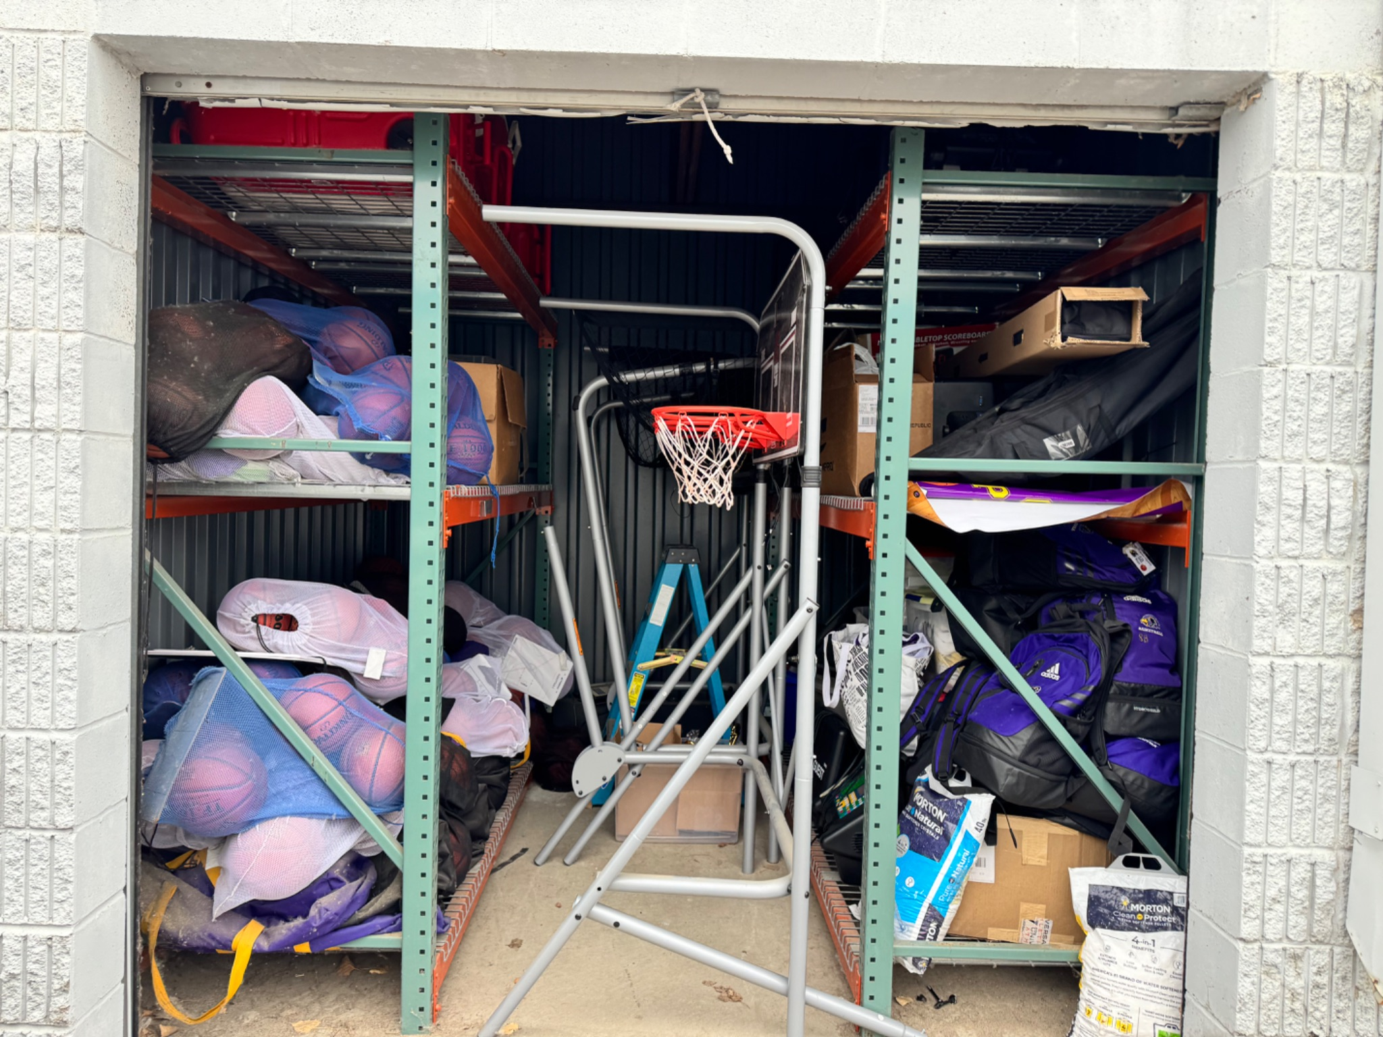

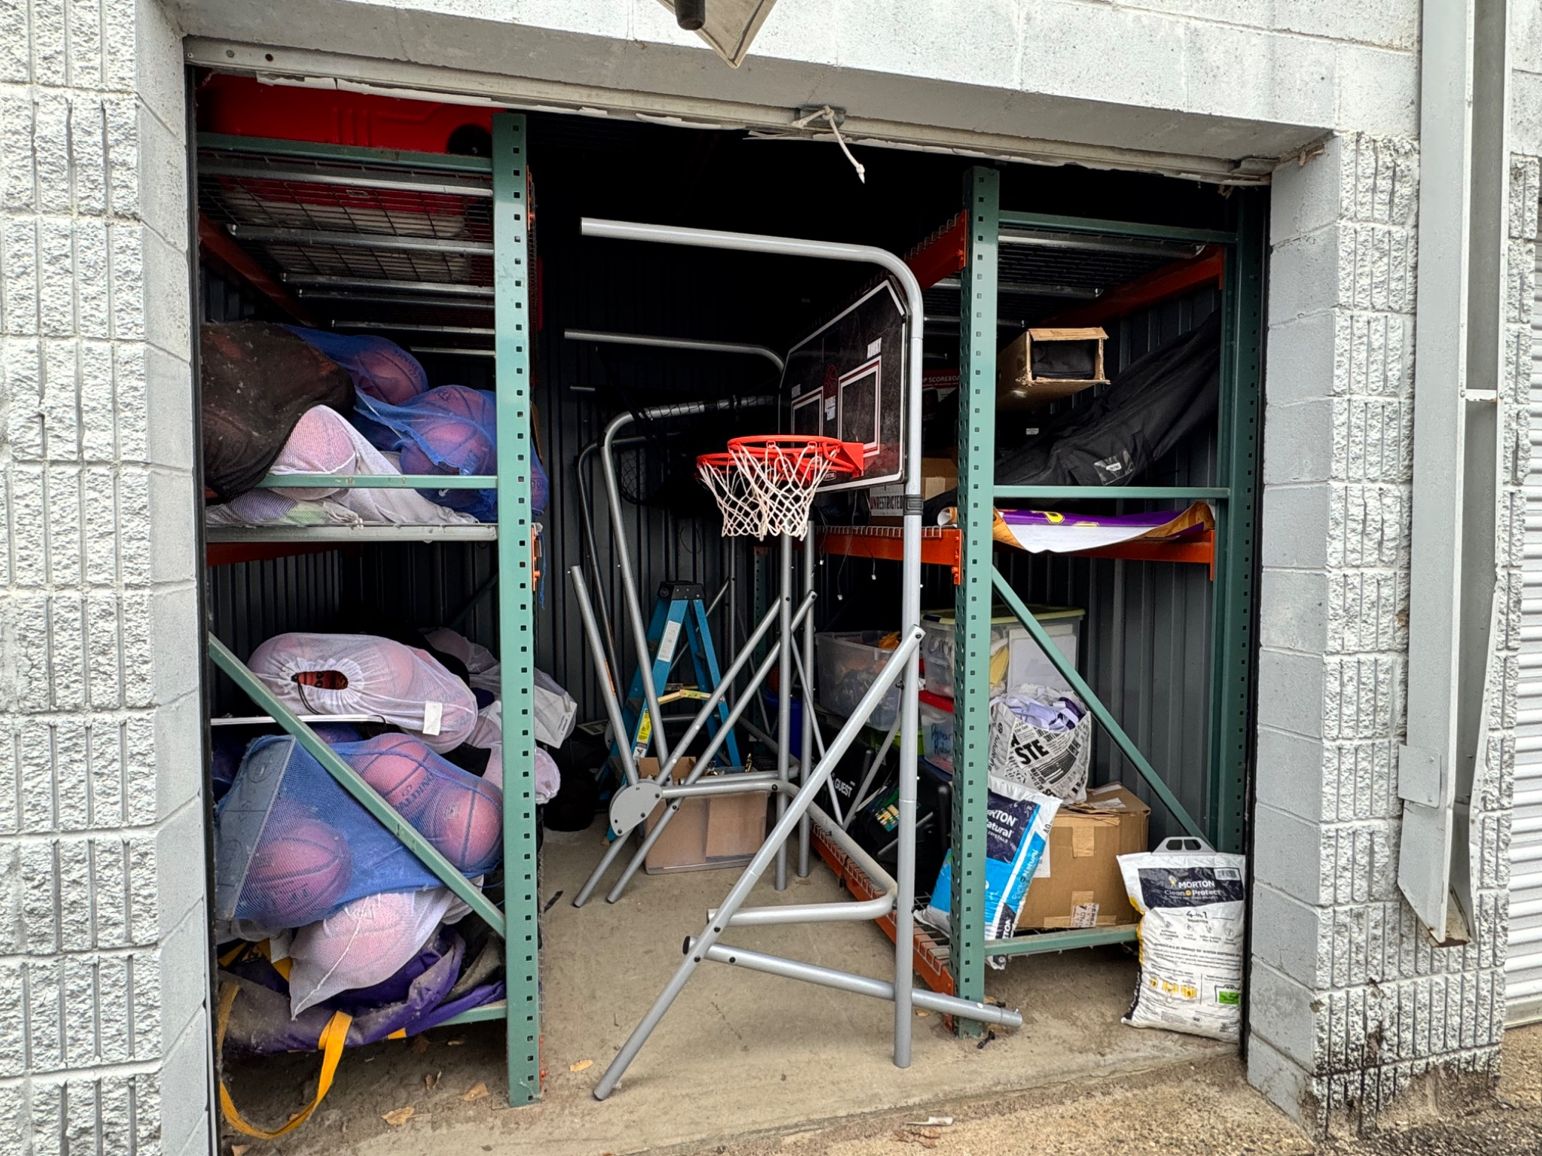
Other
Storage Shed
  Look for more cost effective space
  Help with cleanup / cleanout (DIBS Opportunity)
  Note: I dropped a few things off at the shed today and for those curious - pictures are to the right.
Create policy around gym space / CAYBBA rentals
Committee: Henry, Ryan, myself
  Who we work with to use gym space and at what rate
‹#›
Notes:
Sept way busier this year
‹#›

Slide 42
Annual Meeting Planning
Notes:
‹#›

Slide 43
Annual Meeting
Early June
Each Program should come with a detailed, documented plan for the season. Details should include:
Rates/Fees, Discounts (aligned with President, VP, Treasurer)
Tryout Dates
Number of tournaments / expected tournament plan
Other Topics will Include:
Retirements / Backfills
DIBS Process
Events
Policy Updates
‹#›
Notes:
Sept way busier this year
‹#›

Slide 44
THANK YOU
Mark Herzog
612.207.5554
Mark.Herzog@gmail.com
‹#›
Notes:
‹#›

Slide 45
Committees
Code of Conduct (needed to review complaints / grievances and decide action)
President, Vice President, Boys and Girls Travel Dir
Transfer Committee (review transfer requests and vote)
President, Boys Travel Director, Girls Travel Director
Interview Committee (conducts interviews for Executive positions and recommends to Board for approval)
President
Vice President
Director of Communications
Travel Philosophy Verbiage (NEW: needed to consider updates to philosophy)
President - Herzog, VP - Riggs, Boys Travel - Coddington, Girls Travel - DeBruine, 4th-8th in house asst. - McGuire
‹#›
Notes:
‹#›

