Slide 1
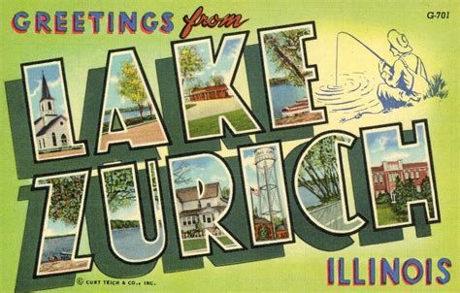



Lake Zurich Things-to-do
While you are in town, Visit the Best of LZ
Thank you for joining us for the Annual Lake Zurich Bear Claw Tournament. While you are with us, please stay and enjoy our community. We have provided you with a list of our favorite places to visit, dine and enjoy.

Slide 2

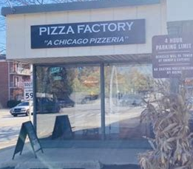
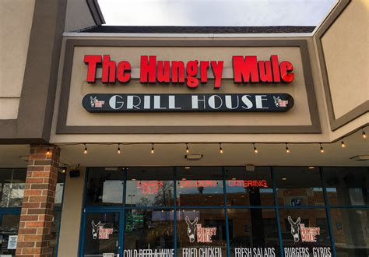


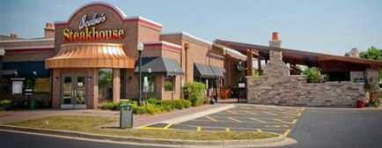



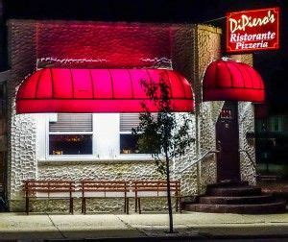
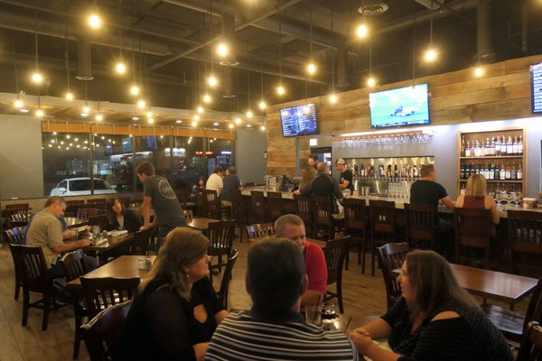
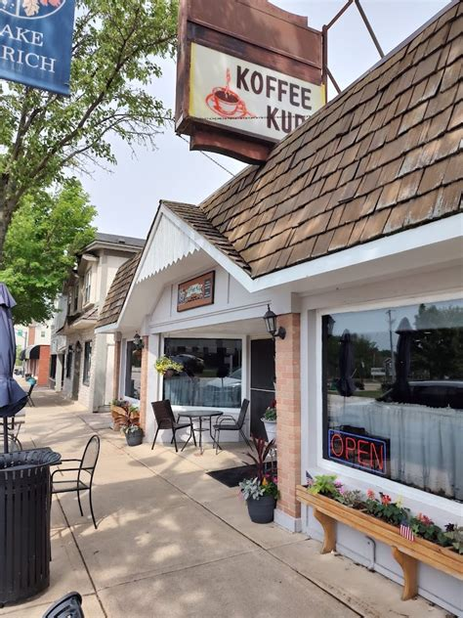
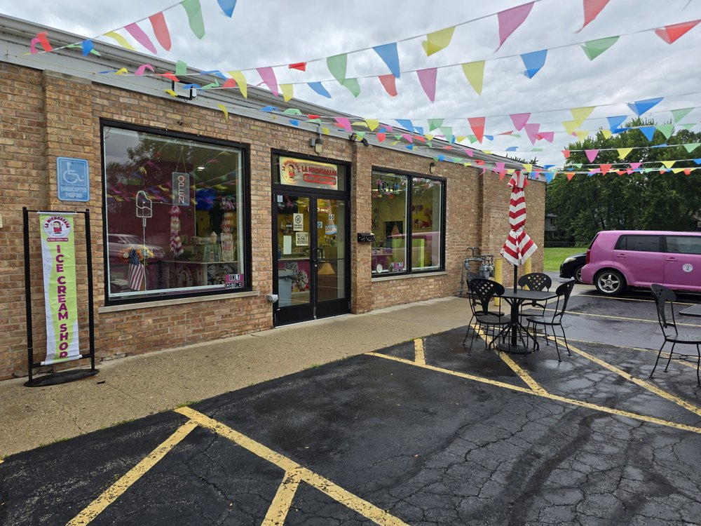
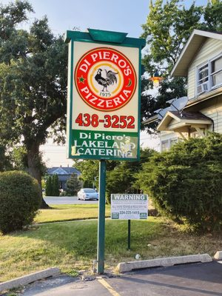

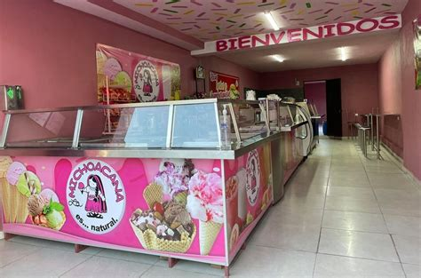


Where to eat: Lake Zurich
Fine Dinning
Casual Dinning
Fast Dinning
763 S Rand Road LZ
847-540-0600
101 W Northwest Highway Barrington
847-381-6740
463 S Rand Road LZ
847-540-8000
645 N Rand Road LZ
847-540-6700
193 S Rand Road LZ
847-540-6183
La Michoacana
60 N Main Street LZ
224-667-5117
17 East Main Street LZ
847-438-3253
569 W State Route 22 LZ
847-550-4801
30 E Main Street LZ
847-438-8110
44 Old Rand Road LZ
847-438-3253

Slide 3

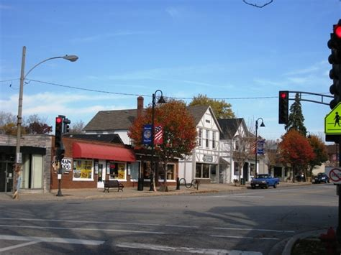
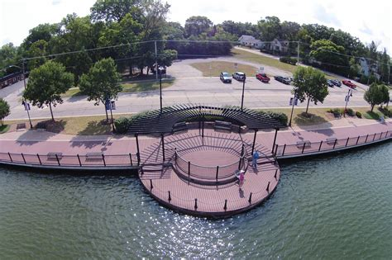
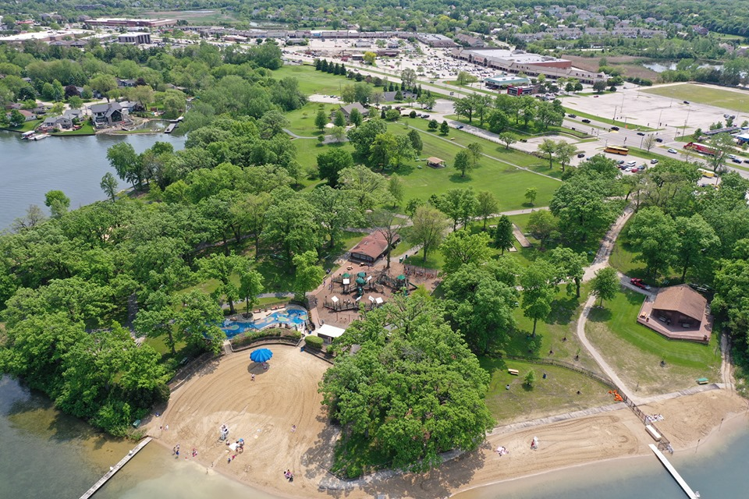
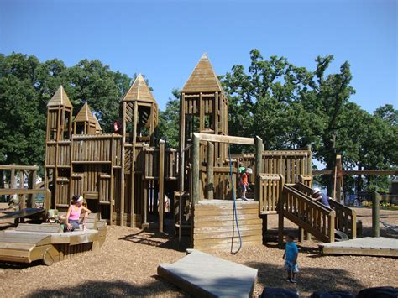
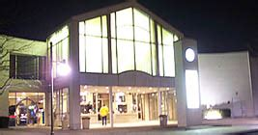

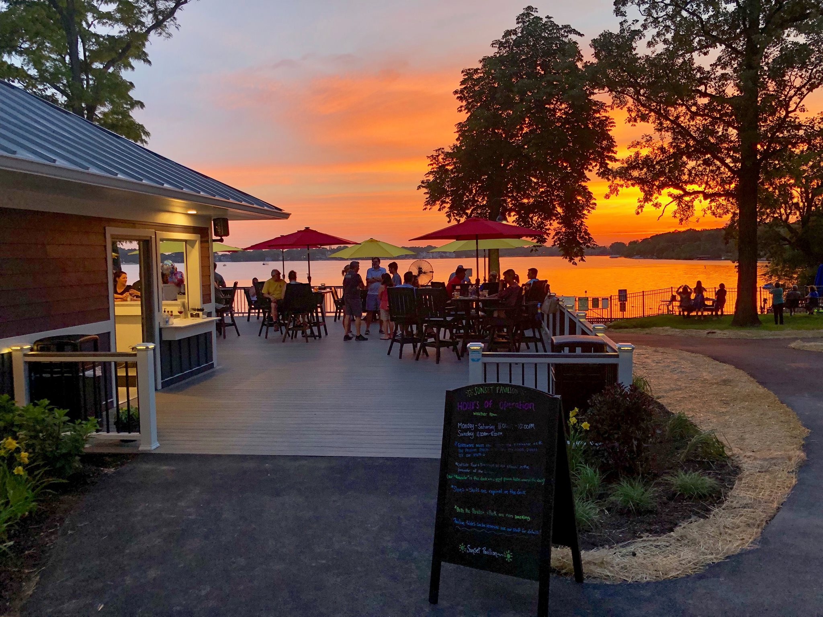
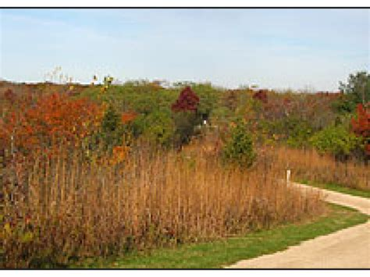
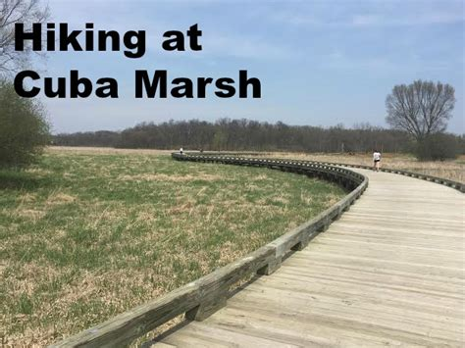
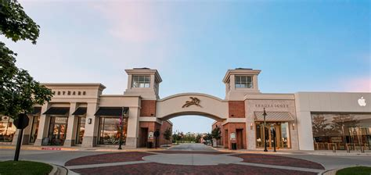
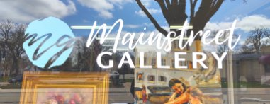

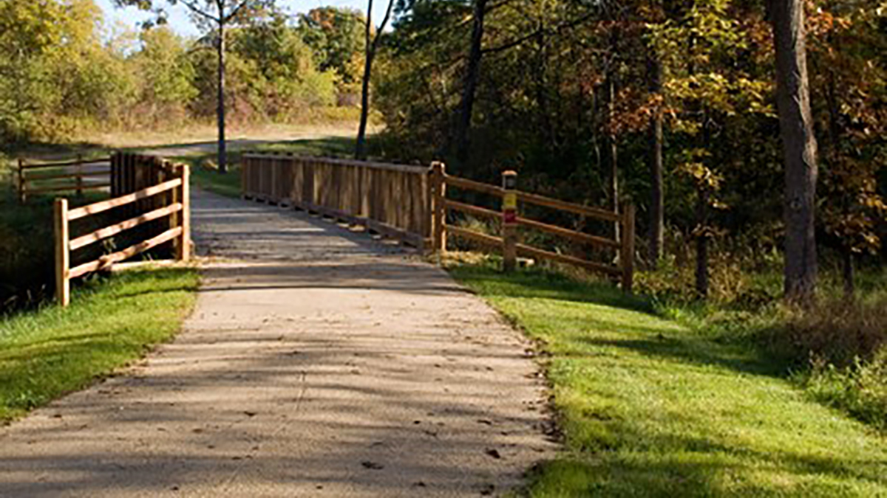
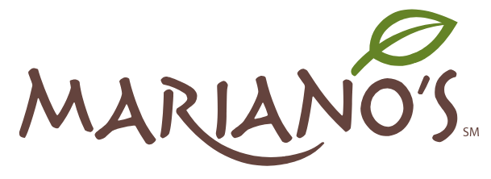
Other Things to DO
Shopping
Walking / Hiking / Outdoors / Entertainment
Paulus Park Lake Zurich
200 S Rand Road LZ
21830 W Long Grove RD Deer Park
847-550-1527
Downtown Lake Zurich
NEXT TO LIONS PARK
70 E Main Street LZ
125 N Old Rand Rd LZ
224-77-6333
Regal Cinema
755 S Rand Road
844-462-7342
Off Beat Music
Stompin Grounds Café
Koffee Kup Restaurant
DI Piero’s Ristorante
DI Piero’s Pizzarea
Lake Zurich Florist
Mr Tux Formal Wear
My Flavor It Place
Sunset Pavillion
Craving Gyros
Orchard Prime Meats
Mainstreet Gallery
Scoreboard Bar & Grill
Cuba Marsh Forrest Preserve
24205 W Cuba Road Deer Park
Deer Park Town Center
Outdoor Mall
20530 N Rand Road
20 East Main Street LZ
847-550-0016
Supermarket
1350 E Route 22 LZ
847-438-4003
Heron Creek Forest Preserve
22890 N Old McHenry Rd LZ

Slide 4



Where to eat: FOX TRAIL Park port Barrington
380 W Liberty Street Wauconda
847-865-3120
1200 N Old Rand Road, Wauconda

