Slide 1



Georgia Amateur Wrestling Association
Team Georgia
USA Wrestling
2025 Annual Spring Business Meeting
May 4, 2025

Slide 2

2025 Spring Business Meeting
2025 SPRING MEETING AGENDA
10:00 AM – 1:00 PM
Introduction – Chairman, Jason Griner
Review Vision and Mission Statement
Executive Board Elections
Old Business
Executive Reports
  Treasurer’s Report
  Kids Director Report
  Women’s Report
Proposal Presentations
New Business
Adjourn

Slide 3
2025 Spring Business Meeting
TEAM GEORGIA VISION AND MISSION STATEMENTS
Vision:
Team Georgia's Vision is to be:
The premier organization enabling Georgia to be a “Top Tier” wrestling state
Mission:
The GAWA Vision will be achieved by:
Expanding participation and promoting excellence in Georgia wrestling

Slide 4
2025 Spring Business Meeting
Opening of Meeting (Jason Griner, Chairman)
Current Board Members – Thru 8/30/2025
Executive Board Members
Chairman- Jason Griner First Vice Chair- Jeremy Paradice
Second Vice Chair – Scott DeGraff Secretary – Raquel West
Treasurer - Open Women’s Director – Donell Bradley
Registration Chair- Amanda Prado Incoming/Outgoing - Leslie Paradice
Official’s Liaison- Kenny Cook
Board of Directors
Kids Director- Jeremy Downing Olympic Styles Director- Terry Allison
Volunteer Director- Amiy Downing National Team Director- Donovan Panone
Communications Director: Mary Necula IT Director- John Stulak
Official’s Director- Shane Haff At-Large Member- Greg Hart
At-Large Member- Omi Acosta
Open Board Positions
Equipment Director – Open
Travel Director- Open

Slide 5
2025 Spring Business Meeting
Chairman
  Chief Executive Officer of the Organization
  Responsible for the day to day operations of the organization.
  Responsible for maintaining the mission and vision of the organization.
  Responsible for keeping the organization in compliance with the TGA Bylaws and shall oversee the application of all TGA policies and procedures.
  Responsible for creating strategic partnerships with corporations and organizations that will help Team GA. with maintaining our mission, vision and financial goals of the organization.
First and Second Vice Chairpersons
  Responsible for filling in for Chairman when needed.
  Responsible for overseeing committees as needed
Secretary
  Responsible for recording of minutes for all meetings
  Responsible for documenting and publishing all of the Policies and Procedures of the corporation
  Responsible for assisting the Chairman with the corporation correspondence
  Responsible for keeping required incorporation documentation current with the Georgia Secretary of State’s office.

Slide 6
2025 Spring Business Meeting
Treasurer
  Chief Financial Officer of the organization.
  Responsible for maintaining the corporate checkbook, credit card accounts, and other appropriate corporate financial records.
  Responsible for meeting the financial obligations of the corporation and shall make timely payment of appropriate fees to USA Wrestling.
  Responsible for the continuation of the tax-free status of the corporation and will file an annual income tax return to that effect with the IRS.
  Responsible for providing a detailed report on income/expenditures, as well as capital assets, at the annual Fall Business Meeting.
Registration Chairperson
  Primary officer in charge of registering and collecting fees from club and individual members of the G. A. W. A.
  Responsible for obtaining and distribute as appropriate all club and individual registration materials
  Responsible for providing necessary documentation to USA Wrestling as required.
  Responsible for providing a detailed report on membership at the annual Fall Business Meeting.
USWOA Liaison
  Primary liaison between the USWOA officials’ organization and the G.A.W.A. The purpose of this position is to ensure that the G.A.W.A. proactively considers the needs and requirements of officials in every program offered, so that by the time new programs are offered, officials requirements have been considered as well.

Slide 7
2025 Spring Business Meeting
Women’s Director
  Women’s Director shall work to develop and grow Women’s wrestling at all levels of the organization. This position shall endeavor to work with the state high school association(s) to develop Women’s programs at the high school level, and ensure that Georgia women’s wrestling is represented at all national USA National Women’s Wrestling events.
Incoming/Outgoing
  Responsible for performing tasks as designated by the Executive Board.

Slide 8
2025 Spring Business Meeting
Board of Directors
  Kids Director
      Oversees the Folkstyle Season
      Folkstyle Growth and Participation
      Recruiting Folkstyle kids to wrestle Olympic Styles
  Olympic Styles Director
      Oversees the Freestyle/Greco-Roman Season
      Olympic Styles Growth and Participation
      Recruiting Olympic Styles kids to wrestle National Teams
  Coaches Education Director
      Oversees the Coaches Education (NCEP) Program in Georgia
      Ensures all Georgia NCEP classes/courses are in compliance with USA Wrestling National Office
  Official’s Director
      Recruits Officials to Team Georgia
      Works to provide opportunities for all Georgia Officials Regionally and Nationally
      Assists Official’s Liaison with specific tasks
  Officials Education Director
      Coordinates all Officials training for Olympic Styles
      Assists Official’s Liaison with specific tasks

Slide 9
2025 Spring Business Meeting
Board of Directors (Cont.)
  National Team Director
      Oversees our National Team Programs
      Oversees Coaches and Curriculum
      Works with Olympic Styles Director recruiting kids for National Teams
  Travel Director
        Coordinates all travel related bookings for Team Georgia
        Airline Flights, Hotels, Rental Vehicles, Buses, etc.
  Volunteer Director
        Coordinates all Volunteers for Team Georgia Events
  Equipment Director
        Arranges delivery/pickup and organizes all Team Georgia equipment for setup and teardown at all Team Georgia Tournaments
        Oversees all Team Georgia equipment uses by outside organizations
  Social Media Director
      Responsible for all Social Media content publishing and creation
        Twitter, Facebook, SnapChat, Instagram, etc.
      Responsible for Website content publishing and creation
  At-Large Members and Athlete Representatives
  The At-Large and Athlete Representatives provide a voice on the Board of Directors for the Clubs, Coaches and Athletes​
  Assist in Board related items and Team Georgia tournament operations as available.

Slide 10
2025 Spring Business Meeting
Elections:
Chairman – Jason Griner - Running for Re-Election
2nd Vice Chair – Scott DeGraff – Running for Election
SECRETARY – Amanda Prado- Running for Election
Officials Liaison – Kenny Cook – Running for Re-Election
Incoming/Outgoing – Leslie Paradice – Running for Re-Election

Slide 11
2025 Spring Business Meeting
Folk Style Officials Director – Shane Haff – Running for Election
Travel Director – Open
Communications Director – Mary Necula – Running for Re-Election, Running for Election - Jessica Dupree

Slide 12
2025 Spring Business Meeting
OLD BUSINESS

Slide 13
2025 Spring Business Meeting
Treasurer Report is presented at the Fall Meeting.
If you have questions, please reach out to treasurer@teamgeorgiawrestling.com

Slide 14
2025 Spring Business Meeting
Kid’s Director
Report
Jeremy Downing

Slide 15
2025 Spring Business Meeting
Focus Area
• Goal
• Attain 5% growth of total number of wrestlers
• Retention
• Increase participation at events • Improve tournament experience • Develop a path and empower progression through the different levels(beginners, open, elite)

Slide 16
2024 Tournament Participation
Event | Total Number of Participants
Broncos Stampede | 152
Life U/ Club Lucha | 223
Eagles Open | 293
Parkview’s Thanksgiving Classic* | 565
Life U/ Club Lucha Open #2 | 354
War Eagle 1st Year | 200
Iron Tiger Rumble | 466
Iron Tiger Rumble (beginners) | 86
Creekview Grizzly | 458
Creekview Grizzly 1st Year | 218
Goldmine Classic | 485
Lumpkin First Year | 99
John Wayne Memorial Beginners Tournament | 236
Event | Total Number of Participants
John Wayne Memorial Open | 513
SGAC Devil Dog | 576
ES/MS State Duals | 45 teams
Efren Pedraza | 502
706 Novice | 199
Life U Club Lucha Open #3 | 402
The Mean Streak* | 451
Ridgeland State Qualifier
Sugar Hill State Qualifier
Team Georgia State Qualifier
State Qualifier-Fitzgerald
Georgia Freshman State | 239
Beginners Bash/Girls State/ Kids State | 1495

Slide 17
Kid State, Girl State, and Beginner’s Bash
Overall Division Placements
6U | 12U | Girl’s ES 3-5
Backyard Brawlers The Storm Wrestling Center Dendy Trained Wrestling | The Storm Wrestling Center Level Up Wrestling Glasgow Wrestling | The Storm Wrestling Center Bison Takedown Wrestling Level-Up Wrestling
8U | 14U | Girl’s MS
Backyard Brawlers Morris Fitness Pedraza Wrestling | Level Up Wrestling Roundtree Wrestling Grindhouse Wrestling | Glasgow Wrestling Troup Wrestling The Storm Wrestling Center
10U | Girl’s ES K-2 | Girl’s HS
Backyard Brawlers Roundtree Wrestling The Storm Wrestling Center | Bison Takedown Dendy Trained Wrestling Junior Indian Wrestling 3. Richmond Hill | Team Alpha Wrestling Glasgow Wrestling Rush Training Center

Slide 18
Kid State, Girl State, and Beginner’s Bash
Team Points
Kid State | Total Medal Count
Backyard Brawlers- 440.5 pts Level-Up Wrestling- 433 pts Roundtree Wrestling- 428 pts | The Storm Wrestling Center- 26 Level-Up Wrestling- 23 Backyard Brawlers- 23 4. Roundtree Wrestling- 21
Girl’s State (Overall) | Total Champions
The Storm Wrestling Center- 139 pts Bison Takedown Wrestling- 110 pts Glasgow Wrestling- 108 pts | Backyard Brawlers- 12 The Storm Wrestling Center- 11 Roundtree Wrestling- 8

Slide 19
2025 Spring Business Meeting
Women’s Report
Donell Bradley

Slide 20
High School Participation Numbers
2025 Spring Meeting Women’s Report
1st Sanctioned State | NFHS 2018-2019 | NFHS 2019-2020 | NFHS 2020-2021 | NFHS 2021-2022 | NFHS 2022-2023 | NFHS 2023-2024
2019 | 427 | 650 | COVID | 816 | 1222 | 1836
 | 44.03% | 34.31% | n/a | 20.34% | 33.22% | 33.44%
Source: USA Wrestling Girls High School Development Committee Co-Chairs Joan Fulp and Andrea Yamamoto

Slide 21
2025 Spring Meeting- Women’s Report
USAW Female Membership Numbers
Female Athlete Memberships | 2024 | 2023 | 2022 | 2021 | 2020
Georgia | 463 | 491 | 409 | 319 | 367
Change From Previous Year | -6% | 20% | 28% | -13% | 15%
**2024 Membership numbers are as of March 13th, 2024. Although the current number is 6% lower than 2023 we are mid year for the USAW membership season. With the start of Olympic Styles season we should expect to see more memberships as High School Girls have completed their season and are shifting over to FS/GR and looking to train for national team events.

Slide 22
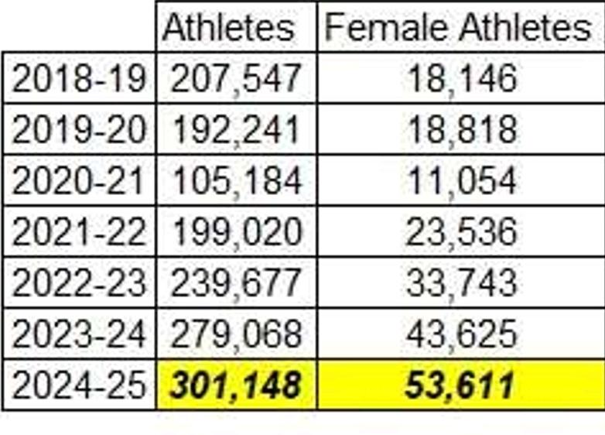
2025 Spring Meeting- Women’s Report
USAW Female Membership Numbers- Nationwide

Slide 23
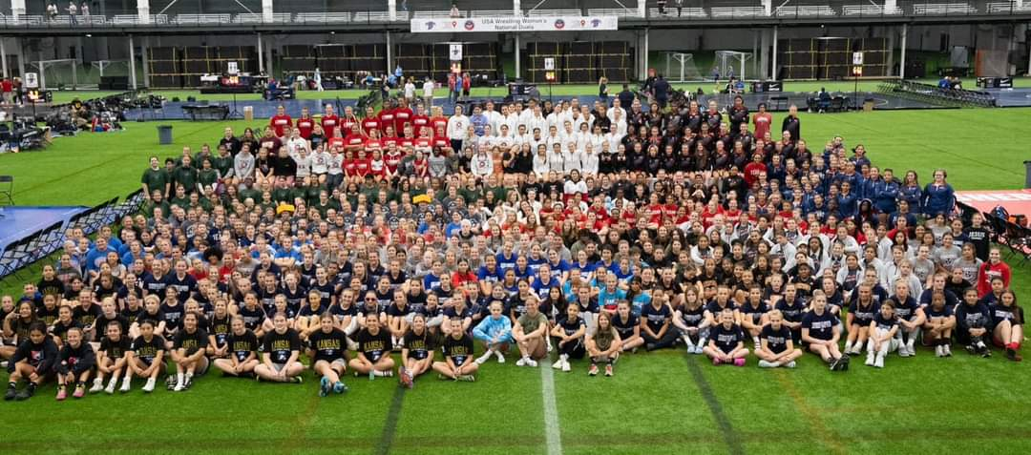
2025 Spring Meeting- Women’s Report
2024 Women’s National Dual Teams-
Junior Women’s Duals (Tulsa, OK)
    2 Teams FS
      GA Blue- 3rd Place in Red/Blue Pool
      GA Red- 7th Place in Yellow/Green Pool
    1 Team Greco
      1st Place in Red Pool
16U Women’s Dual
    Freestyle
      7th Place on Copper/Bronze
    Greco
      6th Place in Bronze/Copper Pool
14U Women’s Dual (1st Year ever!)
    Freestyle
      6th Place in Bronze/Copper Pool
    Greco
      6th Place in Bronze/Copper Pool
Participants forms 2024 Women’s Duals. In June 2025, all three women’s age groups will be at the sam location (Westfield, IN)!

Slide 24
2025 Spring Meeting- Women’s Report
Fargo 2024 By The Numbers
Tournament Participants
Fargo Entry Numbers | 2024 | 2023 | 2022 | 2021
16U Women’s Freestyle | 896 | 747 | 518 | 349
 | 20% | 44% | 48%
Junior Women’s Freestyle | 1149 | 858 | 944 | 663
 | 34% | -9% | 42%

Slide 25
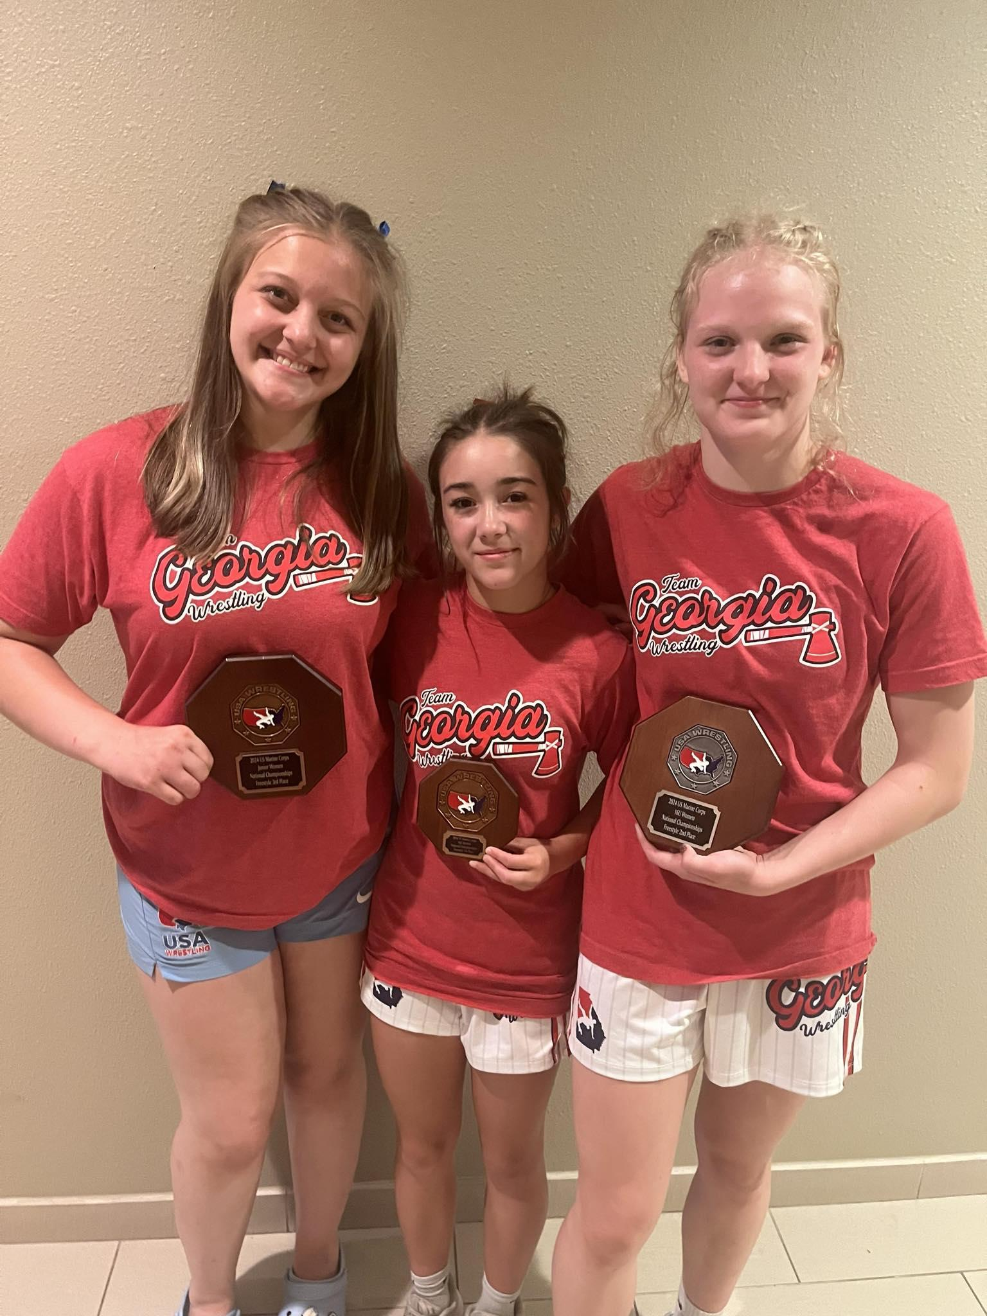
2025 Spring Meeting- Women’s Report
Fargo 2024 By The Numbers
Fargo GA Entry Numbers | 2024 | 2023 | 2022 | 2021
16U Women’s Freestyle | 4 | 11 | 12 | 8
 | -64% | -8% | 50%
Junior Women’s Freestyle | 23 | 16 | 16 | 12
 | 44% | 0% | 33%
To the right: Fargo Women’s AA- Cadence Grulla (7th-16U, 88lbs), Greta Garbozouvas (2nd- 16U, 142), and Genevieve An ( 3rd-Jr Wmn, 190).

Slide 26
2025 Spring Meeting- Women’s Report
How do we continue to grow the girls/womens division?
Upcoming Events
  First ever Women’s National Duals! (all three age groups under one roof)
Education to Ease Transition From Folkstyle to Olympic Styles
  Girls Freestyle & Greco Technique Curriculum Posted on TGA Site (https://www.teamgawrestling.org/girlsfreestylegrecotechnique)
Upcoming items for region meetings (held during SER)
  Madison Brackets at national/ regional events
    provide opportunity for more matches
  207 Weight Class
    will look to review the numbers at Regionals and Fargo for 2025
  Girls Greco
    How do we include a Girls Greco National Championship into the yearly event schedule?
      Fargo?
      When does Greco move from “festival” at Jr. Duals?
    National Duals currently has Greco scheduled
    UWW Perspective- Beach vs Greco
  Modified Rules at TOA, Preseason Nationals, and Folkstyle Nationals
    “Build a Bridge” between Folk and Free for girls
      step out, neutral starts

Slide 27
2025 Spring Meeting- Women’s Report
Contact Information
email: donell@teamgawrestling.org

Slide 28
2025 Spring Business Meeting
PROPOSALS

Slide 29
2025 Spring Business Meeting
Proposal #1 By law Changes
Proposal #2 Tournament Schedule Changes
Proposal #3 Paid Board Position
Proposal #4 Qualifier Changes
Proposal #5 Sabbath Observance
Proposal #6 Fargo Wrestler Travel options
Proposal #7 Request for Weight Class Flexibility for Beginner Bash and Regular Season Open Division Wrestlers
Proposal #8 A & B: Bracket Modifications and Seeding Criteria for Georgia Wrestling Tournaments
Proposal #9 Proposal to Re-Implement the Two-Year Experience Limit for Beginner Division Tournaments
Proposal #10 Proposal for Transparent and Timely Communication of Freestyle/Greco Fargo National Team Coaching Opportunities

Slide 30
2025 Spring Business Meeting
Proposal #1 Bylaws changes
The Team Georgia board requests to make the following changes to the bylaws to keep the bylaws in line with the current wrestling needs.

Slide 31
2025 Spring Business Meeting
Old:
4.4.2. Birth Date Certification - Upon request, each individual registering with the corporation must provide a legally registered document which proves date of birth.
New: Add Residency requirements
4.4.2 Birth Date Certification/Residency - Upon request, each individual registering with the corporation must provide a legally registered document which proves date of birth. Upon request, each individual registering with the corporation must provide report card, utility bill, lease or deed.

Slide 32
2025 Spring Business Meeting
Old:
6.1. G. A. W. A. Divisions – G.A.W.A. shall establish divisions within itself in order to operate quickly and efficiently to most effectively meet the needs of the members of the corporation. These divisions of the corporation shall function as operational arms and are under the jurisdiction of G. A. W. A. The divisions recognized by the corporation shall include but not be limited to Kids, Cadets, Juniors, Open, Women, Officials, Pairing, Duals, Education and Communication.
New: Remove list of positions
6.1. G. A. W. A. Divisions – G.A.W.A. shall establish divisions within itself in order to operate quickly and efficiently to most effectively meet the needs of the members of the corporation. These divisions of the corporation shall function as operational arms and are under the jurisdiction of G. A. W. A. The divisions recognized by the corporation shall include but not be limited to the positions listed in 6.5

Slide 33
2025 Spring Business Meeting
Old: 6.3. Election/Term - Directors shall be elected at the Spring Business Meeting by a majority vote of all chartered clubs present and voting they shall serve a term of two years beginning September 1 following the annual Spring Business Meeting at which they are elected.
New: Add positions and list voting years
6.3. Election/Term - Directors shall be elected at the Spring Business Meeting by a majority vote of all chartered clubs present and voting they shall serve a term of two years beginning September 1 following the annual Spring Business Meeting at which they are elected.
Odd Years Even Years
Travel Director Volunteer Director
Officials Director Kids' Director
Olympic styles director Coaches Education Director
National Teams Director Equipment Director
Communication Director At-Large Board Member x2
I.T. Director
Male and Female Athlete Representative

Slide 34
2025 Spring Business Meeting
Old:
6.5.1. Age Group Directors - Age Group Directors must have been involved in G.A.W.A. any age group activities for a minimum of two consecutive years.
New: Remove this position we have not had anyone in this position for over 6 years and is covered under National Teams Director/Duals Director
Old:
6.5.2. The Officials Director – The Officials Director must have been involved with G. A. W. A. activities for a minimum of two consecutive years, must be a current USA Wrestling category 1 or higher ranking official “in good standing with USWOA”, must be able to attend two national level USA Wrestling tournaments each year, must be able to attend all G. A. W. A. State Tournaments, and must be able to conduct two officials’ clinics each year.
New: Change to add both Officials Directors Voting will be done on odd years for Folkstyle Officials Director
New: 6.5.2. The Officials Directors – The Officials Director must have been involved with G. A. W. A. activities for a minimum of two consecutive years, must be a current USA Wrestling category 1 or higher ranking official “in good standing with USWOA”, must be able to attend two national level USA Wrestling tournaments each year, must be able to attend all G. A. W. A. State Tournaments, and must be able to conduct two officials’ clinics each year.
6.5.2.1 Olympics Style Director
6.5.2.2 Folkstyle Director

Slide 35
2025 Spring Business Meeting
Old:
6.5.3. The Pairing Director – The Pairing Director must have been involved with G. A. W. A. activities for a minimum of two consecutive years, must be able to attend two national level USA Wrestling tournaments each year, must be able to attend all G. A. W. A. State Tournaments, and must be able to conduct one pairing clinic each year.
New: Remove this position, we have not had anyone in this position for over 6 years and we now have a pairing committee.

Slide 36
2025 Spring Business Meeting
Proposal #2 Tournament Schedule Changes
Author: Kenny Cook
I’m proposing that next year's FS/GR schedule be changed to:
Add an additional tournament to the beginning of the season.
Replace the tournament on the weekend of the US Open with a clinic/camp, led by national team coaches.
We have struggled to have enough officials to staff Team Georgia’s local tournament the weekend of the US Open. The Open has several tournaments/trials for athletes. It’s also important to attend as a referee for trials selection and education.
We could provide the opportunity for Georgia’s best athletes and officials to attend the US Open, without hurting numbers at our local tournament.
In turn, we can focus local efforts on still attending something like a “pre-national teams camp” to have something to attend and get better before State/Regional.
We would also not shorten our season by doing this, but rather extend the season at the beginning by a week.

Slide 37
2025 Spring Business Meeting
Proposal #3 Paid Board Position
Author: Donovan Panone
Create a paid full time (could be part time) position for an operations manager that oversees year-round activities. The board would hire for this role and pay an annual salary. The role would be responsible for making sure all tasks are done on time and that all volunteers are held accountable for deadlines and responsibilities. The role would also take on certain operational tasks to be clearly defined
We need a glue person who can oversee all the stuff.

Slide 38
2025 Spring Business Meeting
Proposal #4 Qualifier Changes
Author: Jason Griner
Proposed change to the Qualifications for Kids State.
Current format:
Qualifying for Kids State
This year, the following requirements will be strictly enforced in order to attend Kids State.
1. Must have a valid USA Wrestling Card.
2. Must be a Georgia Resident to participate.
3. Cannot be in High School (9th thru 12th Grade) even if age eligible. Must be 14U or below regardless of grade.
4. MUST PLACE 1-4 AT ONE OF THE TEAM GEORGIA QUALIFIERS ON FEBRUARY 24TH.
5. If a qualifier only has 3 qualifiers, we will pick up the 4th spot from the 5th placer at the largest qualifier. So, if Qualifier A only has 3 kids in a bracket. All 3 will qualify, you must weigh in. However, there is a spot open in the bracket. The 5th placer from the largest qualifier will then qualify. (Questions on this? Reach out to Amanda@teamgawrestling.org)
Proposed change to Section 5:
5. If a qualifier only has 3 qualifiers, we will pick up the 4th spot from the 5th placer at the largest qualifier. So, if Qualifier A only has 3 kids in a bracket. All 3 will qualify, you must weigh in. However, there is a spot open in the bracket. The 5th placer from the largest qualifier will then qualify.
In the event where there are 16 or less wrestlers in a weight class throughout the State, all wrestlers from that weight class will be pulled into the Kids State Tournament in order to fill out the 16 man bracket. Wrestlers will still be required to qualify for Kids State at the Kids State Qualifiers and will be required to weigh in and compete for their qualification to be valid.
Wrestlers who are the only wrestlers in their respective weight classes at a Qualifier are required to make weight at the Qualifier to qualify for Kids State.

Slide 39
2025 Spring Business Meeting
Proposal #5 Sabbath Observance
Author: Tobias Stephens
This proposal aims to address the scheduling of wrestling tournaments in a way that accommodates athletes who observe the 7th day Sabbath. Many students and amateur athletes are unable to participate in competitions held on Saturday due to their religious beliefs, which can limit their opportunities to compete and excel in the sport.
Background
"Remember the sabbath day, to keep it holy. Six days shalt thou labour, and do all thy work:
But the seventh day is the sabbath of the Lord thy God.." - Exodus 20:8-11
The 7th day Sabbath is a day of rest and worship for many individuals and communities. For those who adhere to this tradition, participation in events during this time is not an option. As a result, these athletes may miss out on valuable competition experience, recognition, and the chance to showcase their skills.
Proposed Changes
1. **Alternative Scheduling:**
- Consider shifting tournament schedules to Friday evenings or Sundays, whenever possible.
- Consider weekday competitions to provide more flexibility for athletes who observe the Sabbath.
- Alternative scheduling offers more scheduling flexibility and cost benefits in comparison to Saturday dates.

Slide 40
2025 Spring Business Meeting
Proposal #5 Sabbath Observance continued
2. **Consultation with Stakeholders:**
- Engage with athletes, coaches, and parents from the affected communities to gather input on scheduling preferences and concerns.
- Create a committee to evaluate and recommend scheduling changes that accommodate diverse needs.
3. **Increased Awareness:**
- Raise awareness within the wrestling community about the significance of the Sabbath for certain athletes.
- Provide educational resources to coaches and organizers about religious observances and their impact on sports participation.
- Consider using the pre-season to try out the newly proposed schedules, allowing for adjustments based on feedback from participants.
- Prioritize inclusivity, ensuring that all athletes have equal access to competition.
Conclusion:
Reconsidering the scheduling of wrestling tournaments is essential to create an inclusive environment for all athletes. By accommodating those who observe the 7th day Sabbath, we not only uphold the values of respect and diversity but also enhance the overall integrity of the sport. This proposal seeks to foster a wrestling community where every athlete has the opportunity to compete and thrive. I humbly and graciously submit this proposal to the relevant governing bodies and stakeholders for review and discussion. I look forward to your consideration and feedback in the upcoming spring meeting.

Slide 41
2025 Spring Business Meeting
Proposal #6 Fargo Wrestler Travel Options
Author: Leslie Paradice
Proposal:
Wrestlers will have multiple choices for Marine Corp National travel and attendance.
Rationale:
More cost efficient
  For Team Georgia (hotel expense, trip lead, coaches)
  For the wrestlers (club fundraising, food/cooking options, travel choices)
More personable so it can lead to better results
  Travel with parents or coaches/club can allow for a certain amount of comfort (staying with family, teammates, coaches)
Flexibility with schedule
  Departure if a wrestler is no longer in the tournament
  Travel to and from the venue
  Sightseeing/experience opportunities
Less accountable for Team Georgia
  Coaches will be responsible for their wrestlers. In the event of an infraction, coaches will be responsible for following through with Team Georgia’s Guidelines as set forth in the code of conduct.

Slide 42
2025 Spring Business Meeting
Proposal #6 Fargo Wrestler Travel Options continued
Travel with Team Georgia Wrestling
Fees set forth by TGA covers:
  Tournament Registration
  Local Transportation
  Fargo Camp
  Coaching
  Hotel Accommodations
  Meals
  Gear Package (2 singlets, shorts, jacket, 4 shirts, gear bag, and joggers)
Wrestlers must qualify for Marine Corp Nationals
Athletes are responsible for their travel booking and expenses

Slide 43
2025 Spring Business Meeting
Proposal #6 Fargo Wrestler Travel Options Continued
Traveling with a Parent
Fees set forth by TGA covers:
  Tournament Registration
  Fargo Camp
  Gear Package (2 singlets, shorts, jacket, 4 shirts, gear bag, and joggers)
  Coaches
Athletes are responsible for:
Travel booking and expenses
Local Transportation
Hotel Accommodations
Meals
Stipulations:
Wrestlers must qualify for Marine Corp Nationals
Clubs must attend FARGO camp
Athlete’s must attend Team Georgia Practices that are scheduled in Fargo, ND
Athlete’s must attend Team meetings that are scheduled by the TGA coaches
Athlete’s must adhere to the TGA Code of Conduct
  Parents will be responsible for their wrestlers. In the event of an infraction, parents will be responsible for following through with Team Georgia’s Guidelines as set forth in the code of conduct.

Slide 44
2025 Spring Business Meeting
Proposal #6 Fargo Wrestler Travel Options continued
Travel with Club
Fees set forth by TGA covers:
  Tournament Registration
  Fargo Camp
  Gear Package (2 singlets, shorts, jacket, 4 shirts, gear bag, and joggers)
  Miscellaneous (camp/travel coaches, TGA board fees)
Clubs (Athletes and Coaches) are responsible for:
Travel booking and expenses
Local Transportation
Hotel Accommodations (must secure a hotel or house that the club stays in together)
Meals
Chaperones
Stipulations:
Wrestlers must qualify for Marine Corp Nationals
Clubs must attend FARGO camp
Clubs must attend Team Georgia Practices that are scheduled in Fargo, ND
Clubs must send a representative to attend Team meetings that are scheduled by the TGA coaches
Athletes and Coaches must adhere to the TGA Code of Conduct
  Coaches will be responsible for their wrestlers. In the event of an infraction, coaches will be responsible for following through with Team Georgia’s Guidelines as set forth in the code of conduct.
Coaches must have an active Bronze Level Certification with USA Wrestling
Coaches traveling with their club teams are responsible for their fees associated with Marine Corp Nationals.
Clubs will receive one floor coaches pass for every 5 qualifying wrestlers that travel with their club (ie. a club that has 15 wrestlers, will be allowed 3 coaches on the floor

Slide 45
2025 Spring Business Meeting
Proposal # 7 Request for Weight Class Flexibility for Beginner Bash and Regular Season Open Division Wrestlers
Author: Antoine Glasgow, Glasgow Wrestling Academy
This proposal respectfully requests that Team Georgia Wrestling adopt a more flexible and
developmentally focused policy regarding weight class adjustments for both:
1. Beginner Division (Regular Season and Beginner Bash Championship)
2. Open Division (Regular Season and Qualifiers)
The goal is to increase participation, reduce forfeits or disqualifications due to minor
Weight discrepancies, and keep the emphasis on growth, mat time, and long-term athlete
development, especially for younger or less experienced wrestlers.

Slide 46
2025 Spring Business Meeting
Proposal # 7 Request for Weight Class Flexibility for Beginner Bash and Regular Season Open Division Wrestlers - continued
Section 1: Regular Season and Beginner Bash Championship – Beginners
Proposal:
Allow same-day weight class adjustments at weigh-ins for beginner wrestlers participating in the Beginner Bash Championship.
• Wrestlers who are underweight may bump down a weight class.
• Wrestlers who are overweight may bump up a weight class.
• Weight class changes should be confirmed by a coach and updated prior to the start of competition.
Justification:
• First-year wrestlers are still learning the fundamentals of nutrition, hydration, and weight management.
• Families new to the sport may not yet understand proper weight-cutting practices.
• Offering flexibility reduces stress and prevents athletes from being scratched or disqualified unnecessarily.
• These updates can be easily managed through Flo Wrestling or similar platforms, requiring only minimal bracket adjustments.

Slide 47
2025 Spring Business Meeting
Proposal # 7 Request for Weight Class Flexibility for Beginner Bash and Regular Season Open Division Wrestlers - continued
Section 2: Open Division – Regular Season and Qualifiers
Proposal:
Allow wrestlers in the Open Division to change weight classes throughout the regular season and up to the final qualifier event.
• Wrestlers who are over their registered weight at weigh-ins may bump up.
• Wrestlers who are under their registered weight may bump down.
• Once a wrestler qualifies for the State Championship, they must wrestle at the weight class they qualified in—no changes allowed at State.
Justification:
• Many nationally recognized wrestling states already implement this approach successfully.
• USA Wrestling implements this policy with their TOA series and National Events.
• Scratching wrestlers for narrowly missing weight at local events discourages participation and reduces valuable mat time.
• This policy encourages consistent competition throughout the season and supports the development of young athletes.
• It also helps coaches and parents better manage athletes’ health without undue pressure.
Conclusion:
By allowing minor, real-time weight adjustments for both beginner and open division wrestlers, Team Georgia Wrestling can foster
a more positive, inclusive, and developmental experience for all participants. The focus at the youth level should be on learning,
improvement, and participation, not punishment for small errors in weight management.

Slide 48
2025 Spring Business Meeting
Proposal #8 : A & B: Bracket Modifications and Seeding Criteria for Georgia Wrestling Tournaments
Author: Antoine Glasgow, Glasgow Wrestling Academy
Proposal A: Bracket Modifications for No-Shows and Weight Class Changes
Subject:
Request to Allow Real-Time Bracket Adjustments When Wrestlers Scratch or Change Weight Classes
Overview:
This proposal requests that Team Georgia Wrestling permit tournament directors to make real-time bracket adjustments in the event of:
• Wrestlers not showing up to an event
• Wrestlers changing weight classes at weigh-ins
Platforms such as FloArena (FloWrestling) allow for quick and efficient bracket editing. Redrawing brackets before matches begin ensures fairer and more competitive matchups, improving the overall flow and integrity of the tournament.
Current Issue:
When brackets are left unchanged despite scratches or weight changes, the result is:
• Empty spots and unfair byes
• Unbalanced brackets (e.g., 3 top wrestlers on one side, none on the other)
• Frustration among coaches, athletes, and parents

Slide 49
2025 Spring Business Meeting
Proposal #8 : A & B: Bracket Modifications and Seeding Criteria for Georgia Wrestling Tournaments continued
Proposal:
• Permit and encourage tournament directors to regenerate brackets after weigh-ins when scratches or weight changes occur
• Ensure updates are made prior to the start of matches
• Utilize bracket management software (e.g., FloArena) to make efficient updates
Rationale:
• Many states already follow this successful practice
• FloArena and TrackWrestling support real-time updates without delay
• Balanced brackets promote fairness and improve the overall quality of competition and experience

Slide 50
2025 Spring Business Meeting
Proposal #8 : A & B: Bracket Modifications and Seeding Criteria for Georgia Wrestling Tournaments continued
Proposal B: Bracket Separation and Seeding Criteria for State Placers and Top Wrestlers
Request for Bracket Seeding System or Placement Separation to Prevent Early Elimination of Top Wrestlers
Overview:
This proposal recommends that Team Georgia Wrestling adopt a bracket separation protocol for regular
season and Hammer Series events, to help prevent early matchups between top-tier wrestlers
(e.g., returning state placers, champions, and nationally ranked athletes).
Current Issue:
Brackets often rely on random draws or incomplete inputs, resulting in:
• Elite wrestlers facing off in early rounds
• Premature elimination of top talent
• Unbalanced competition paths and diminished overall bracket quality
This undermines the competitive structure and can discourage participation from both top athletes and developing competitors.

Slide 51
2025 Spring Business Meeting
Proposal #8 : A & B: Bracket Modifications and Seeding Criteria for Georgia Wrestling Tournaments continued
Proposal:
• Implement a bracket separation system using available data such as:
• Prior year state placements
• FloArena or TrackWrestling rankings
• Known match history (where applicable)
• Require tournament directors to:
• Place returning state champions on opposite sides of the bracket
• Spread Top 4 state placers evenly across the bracket
• Allow coaches to flag top athletes during the registration process
Rationale:
• Improves fairness, excitement, and competition integrity
• Prevents “finals-level” matches from taking place in round one
• Creates more balanced paths to the finals
• Reflects best practices already used in other leading wrestling states

Slide 52
2025 Spring Business Meeting
Proposal #8 : A & B: Bracket Modifications and Seeding Criteria for Georgia Wrestling Tournaments
Conclusion:
Both of these proposals aim to enhance fairness, competitiveness, and the athlete experience in Georgia wrestling tournaments. By leveraging modern technology and widely available data, Team Georgia Wrestling can create a tournament structure that better serves both developing athletes and elite competitors.
We respectfully ask Team Georgia Wrestling to adopt these proposals for the upcoming season.

Slide 53
2025 Spring Business Meeting
Proposal #9 : Proposal to Re-Implement the Two-Year Experience Limit for Beginner Division Tournaments
Author: Antoine Glasgow, Glasgow Wrestling Academy
This proposal respectfully asks Team Georgia Wrestling to reinstate the original two-year experience rule for eligibility in beginner division tournaments, rather than the current restriction allowing only first-year wrestlers. The intent is to create a fairer competitive environment, better aligned with the original mission of beginner events—to develop confidence and provide match experience for less seasoned wrestlers.

Slide 54
2025 Spring Business Meeting
Proposal #9 : Proposal to Re-Implement the Two-Year Experience Limit for Beginner Division Tournaments continued
Proposal Summary:
1. Allow wrestlers with two years or less experience to participate in beginner tournaments.
2. Prohibit wrestlers who have placed at the State Championship from entering beginner tournaments, unless:
• The placement occurred by default (i.e., they placed 3rd or 4th in a 3- or 4-man bracket without winning any matches).
• In such cases, coaches may submit a written request for exception, detailing the wrestler’s development status.
3. Emphasize coach integrity and responsibility in determining whether a wrestler belongs in a beginner bracket.
4. Disallow any wrestler with a first-place or competitive placement in a full bracket at State from entering beginner tournaments in subsequent seasons.

Slide 55
2025 Spring Business Meeting
Proposal #9 : Proposal to Re-Implement the Two-Year Experience Limit for Beginner Division Tournaments continued
Rationale:
• Many wrestlers with one year of experience are still not ready to compete effectively in the Open division. Expanding eligibility back to two years gives them the appropriate developmental runway.
• The beginner division was never intended to be a proving ground for wrestlers who are already dominant or have Open-level success.
• State placements by default (e.g., placing fourth in a four-man bracket) should not disqualify a wrestler who is still green and learning.
• Other states and reputable wrestling organizations have successfully implemented two-year novice systems, balancing fairness with opportunity.
Addressing Misuse:
• Coaches and parents have occasionally abused the beginner division by entering experienced or high-performing wrestlers—undermining the purpose of
these events.
• We believe this can be addressed through:
• Clearer eligibility guidelines
• Accountability within the coaching community
• An honor system backed by review, allowing Team Georgia to assess questionable entries upon request

Slide 56
2025 Spring Business Meeting
Proposal #9 : Proposal to Re-Implement the Two-Year Experience Limit for Beginner Division Tournaments continued
Conclusion:
Reinstating the two-year beginner eligibility rule—with fair exceptions and coach accountability, will improve competitive integrity, build wrestler confidence, and retain more athletes in the sport. The Beginner Division must remain a safe space for growth, not a place for lopsided mismatches or inflated records.

Slide 57
2025 Spring Business Meeting
Proposal #10 : Proposal for Transparent and Timely Communication of Freestyle/Greco Fargo National Team Coaching Opportunities
Author: Antoine Glasgow, Glasgow Wrestling Academy
Request for Designated Communication Timeline and Visibility for Fargo National Team Coaching Applications
Overview:
This proposal requests that Team Georgia Wrestling establish a clear, designated timeline and multi-platform communication
strategy for notifying coaches about freestyle/Greco coaching opportunities, particularly those related to the Fargo National
Team. This will ensure all interested and qualified coaches are aware of the opportunity and have a fair chance to apply.
Current Issue:
During the most recent season, the application window for Fargo coaching positions was reportedly opened during a time that
overlapped with the youth folkstyle qualifiers and the youth state championship, a period when coaches are deeply focused on
preparing their wrestlers and wrapping up the folkstyle season.
• Some coaches, including myself, did not receive the email notification, despite being registered USA Wrestling coaches.
• The application information was not clearly posted on the Team Georgia Wrestling website.
• Although social media (e.g., Facebook) was used to share the information, not all coaches are active on that platform.
Relying solely on social media risks missing significant outreach opportunities.

Slide 58
2025 Spring Business Meeting
Proposal #10 : Proposal for Transparent and Timely Communication of Freestyle/Greco Fargo National Team Coaching Opportunities continued
Proposal Request:
1. Designate a Standard Application Window
• Open the coaching application process after the conclusion of the youth folkstyle state championship.
• This gives coaches the ability to focus on the application without the distraction of in-season responsibilities.
2. Implement a Multi-Channel Communication Strategy
• Post the application announcement on the Team Georgia Wrestling website, ideally in the Freestyle/Greco section.
• Email all registered USA Wrestling coaches in the state using a verified distribution list.
• Announce via official Team Georgia Wrestling social media accounts, such as Facebook.
3. Provide At Least Two Weeks’ Notice
• The application window should remain open for a minimum of 14 days, with a clearly stated deadline to ensure coaches have sufficient time to apply.
Rationale:
• A clear and transparent communication process will improve fairness and accessibility for all interested coaches across the state.
• Ensures more diverse and qualified representation for the Fargo coaching staff.
• Builds trust, professionalism, and transparency between Team Georgia Wrestling and its coaching community.

Slide 59
2025 Spring Business Meeting
Proposal #10 : Proposal for Transparent and Timely Communication of Freestyle/Greco Fargo National Team Coaching Opportunities continued
Conclusion:
A consistent and public application process will elevate the integrity of our program and
help ensure that Georgia is represented at Fargo and other national-level events by the
most qualified, committed, and prepared coaches. I respectfully ask that this proposal be
adopted moving forward for the upcoming Freestyle/Greco season.
Thank you for your time, leadership, and continued dedication to Georgia wrestling.

Slide 60
2025 Spring Business Meeting
New Business

Slide 61
2025 Spring Business Meeting
ADJOURN!!
Thank you for attending!!

