Slide 1

All Aboard: A Parent’s
Introduction to Crew
ADMIT ONE
All Aboard
2nd Thursday each month
7:30-8:30 pm
DEPARTURE:
2nd Thursday each month
SEAT ASSIGNMENT:
meet.google.com/yix-nfqb-hib
SEAT CLASS: Parent
Langley Crew Booster Club
Notes:
Thank you for taking time out of your evening to join us
We won’t be recording this evening, but we will post the slide deck, including the Q&A on the All Aboard page, which you can find on the dropdown menu under the Parents tab and under the Info tab
Just like last month, if you have a question, please type it in the Chat. Once we finish the 15-minute presentation, we’ll spend the rest of our time on questions
All the questions are being noted and we’ll add them to the slide deck before we post it on the website.
Please mute yourself during the presentation, but feel free to unmute once we go to Q&A
This evening, we’ll be talking about:
Winter Conditioning
Uniforms
Registration FAQs So Far
Bus Chaperoning

Slide 2

Winter Conditioning
What you need to know:
Winter conditioning is considered off-season training. It is not mandatory, but if your child is not doing a winter sport or other extra-curricular activity, we’d really like to see them at practice. If they are doing a winter sport, it would be helpful if they could attend as many practices as they can.
We hold practice every day except Sunday – after school Monday through Friday and on Saturday mornings. The point of pre-season workouts is to increase their physical fitness and endurance while reinforcing the muscle memory of the rowing motion. During winter conditioning, your child will spend about half their time working out on the ergs and the rest stretching, running, doing yoga, or working out in the weight room.
With the anticipated size of the team this year, we plan to initially follow last year’s schedule, staggering the practice times and practice activities. We’ll follow this schedule at least into December and adjust as necessary.
If you or your child is uncertain about joining crew or their ability to handle the schedule, we recommend coming to winter conditioning between Thanksgiving and Winter Break. That gives you three solid weeks in the middle of a quarter to test it out and see how it works.
Notes:
No, it’s not mandatory, but we really want to see your kids there as much as they can. If they’re doing another sport, they get the physical conditioning from that other sport, but we do hope they can come to some practices, as it really helps. If they aren’t doing another sport, they really should be there as much as they can.
We practice 6 days a week – after school on weekdays and on Saturday mornings.
Practice involves about an hour of erging, and about an hour doing other activities – weights, running, stretching, or yoga.
Because of the size of the team, we’re going to stagger the training schedule even more than usual this year. We have a limited number of ergs
We’ll try the initial format for the first few weeks, then adjust if necessary

Slide 3
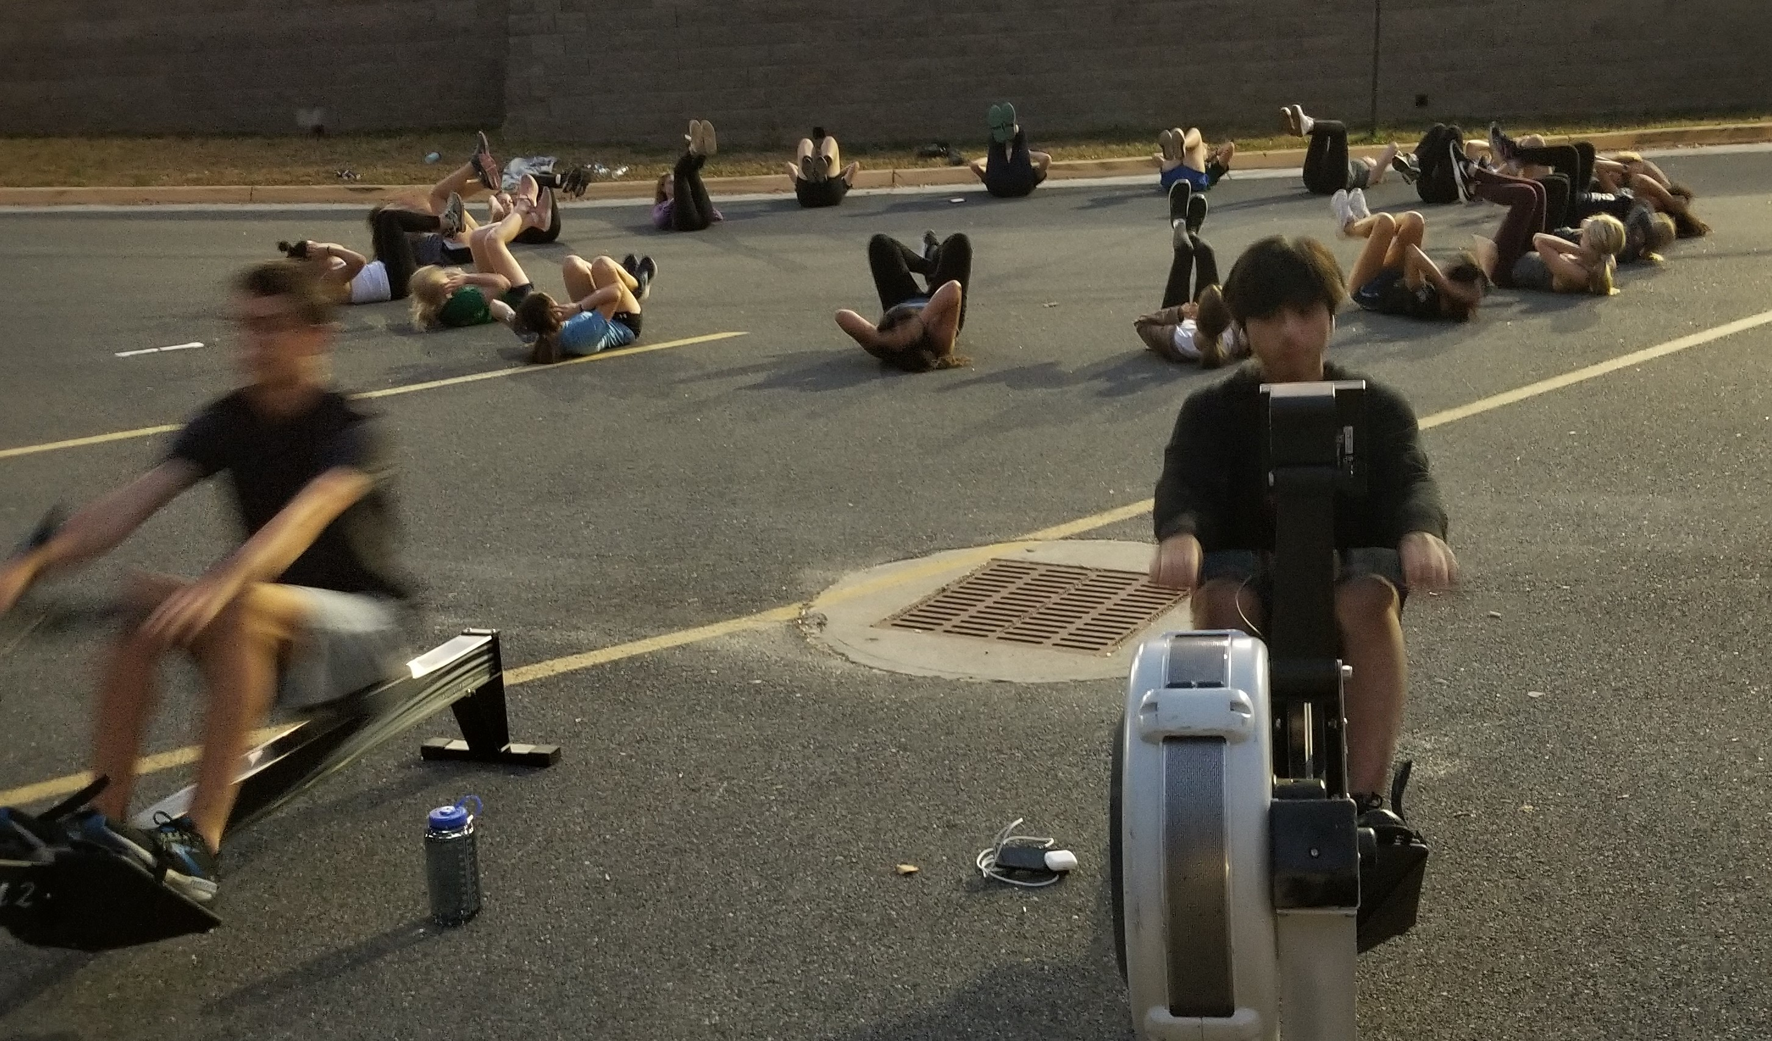
Practice lasts for 2 hours, regardless of day or schedule.
The girls will practice from 3:45 until 6:00, with the first 15 minutes dedicated to getting ready to practice and getting the ergs out.
The boys will practice from 4:45 until 7:15 with the first 15 minutes dedicated to getting ready to practice and the last 15 minutes dedicated to putting the ergs away.
Times for Saturday practices have not been finalized yet, but one gender will likely start practice at 9:00, and the other will start at 10:15. The coaches are still working that out, and we’ll let you know as soon as we do.
There is no practice over Thanksgiving Break, but we will be holding practice December 27-29.
Notes:
So, here’s the schedule, at least to start!
The girls will have an hour after school before coming to practice. They’ll get the ergs out and set them up in the hall.
If we have more girls than ergs, as is likely, we will have those girls start with the cardio/stretching/weight portion of practice
After an hour, the two groups of girls will switch erging and conditioning.
The boys will have 2 hours after school before practice starts. They start an hour in to the girls’ practice.
If there is a second group of girls already on the ergs, the boys will fill up the rest of the ergs. Those who don’t get on an erg at the start will do the conditioning portion of practice
Once that first hour is up, the two groups of girls will switch erging and conditioning.
Once their second hour is up, they will put the ergs away

Slide 4
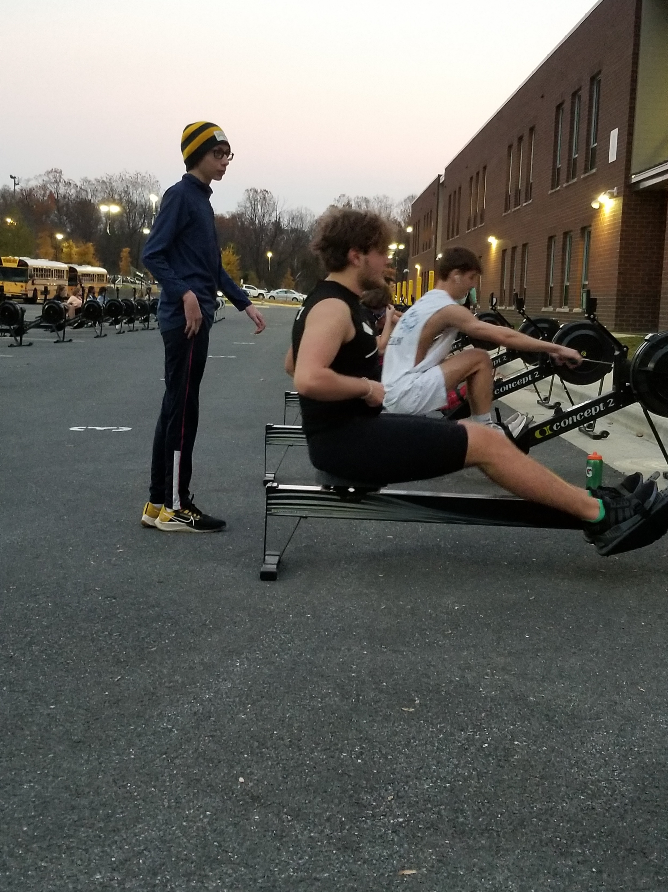
What does this mean for you?
They will be home late every day
Your grocery bill will likely go up
You may want to watch their academic performance, to help them with time management
Lots of travel back and forth to Langley
What does this mean for your kid?
They will be home late every day
They will be sore, at least at first
They will be tired
They will be hungry. Very, very hungry
Free time is going to be in short supply
Notes:
This is when, for the new kids, you’ll want to keep an eye on how they’re doing academically. The time management required is an adjustment, and they may need a little support from you in helping them make it
The girls will have about an hour after school before practice, so time to wind down and maybe do some homework
The boys will have 2½ hours between school and practice, so they should be able to get most of their homework done before they get home
The girls should be home between 6:30 and 7:00, depending on where you live
The boys should be home between 7:30 and 8:00, depending on where you live

Slide 5
What do you need to do?
Set up the carpool. We will start sending out the list of people interested in carpooling in the next week or so. Keep in mind, it will only have those who have registered through SportsEngine, not those who’ve registered through Langley. We will update the list as more people register
You might want to send them to school in the morning with some snacks, especially the boys
Make sure you’ve registered both with LHS and through SportsEngine
Submit their VHSL physical to LHS before sending them to practice
What does your kid need to do?
They will need to start working on their time management skills
They will need to start focusing on what’s due in their classes further out than “tomorrow”
Get plenty of sleep – their bodies need to recover
Eat and drink sensibly – replace the calories burned with healthy stuff, not Doritos and Coke
Manage the initial soreness with hot showers, hot bath soaks, heating pads, and pain-relieving products such as Icy Hot, Arnicare, or Ben-Gay
Notes:
We will start sending out the carpool lists as people register, but each list will be somewhat incomplete as it will only include those who’ve registered through SportsEngine. That may not be everybody at first. As of right now, there are about 70 kids who’ve registered for crew through Langley’s extra-curricular site that haven’t registered through SportsEngine.
We will send out updated carpool lists as we get more people registering
We strongly want them to be fully registered with both Langley and the Booster Club. It is essential to our planning that we know who – and how many – are joining the team as soon as possible. The kids MUST have submitted their VHSL physicals – dated after May 1, 2022, to practice. Please, please, please don’t make me turn your child away – they’re embarrassed in front of their friends, and I feel like the worst person ever created.
Your kids will need to start being more focused on what their bodies need as they demand more from it, both physically and mentally.
There’s a long time between their school lunch and when they get home for dinner – it might be a good idea to pack them some healthy snacks to hold them over. The Nutrition pages on the website have some guidance and examples.

Slide 6
Winter Conditioning FAQs
From your past experiences, were there kids who felt overwhelmed and dropped after winter conditioning?
Generally, the kids who stick in there all through winter conditioning stay on for spring. There have been a few kids drop out of winter conditioning, but very few, and they usually drop out after the first few weeks. Those who do drop out usually do so because they find that it’s not for them rather than because they feel overwhelmed. I’m not sure we’ve had anyone leave because they feel overwhelmed, at least not that they’ve told us.
Are the coaches at winter conditioning?
Yes, the coaches run the winter conditioning practices
Where will winter conditioning be held?
At Langley, either in the Science Hall or outside in the bus loop. The kids have asked to practice outside if the weather is nice. If they will be warm enough in long-sleeved shirts and long pants, they’ll be outside. If it’s colder than that, they’ll be inside. They won’t be outside in parkas or heavy jackets.
Notes:
Handling the time demands is the parents’ primary question, and their biggest fear. We’ve found that worry to be almost always unfounded. The kids who feel concerned about the time demands usually don’t consider joining the team after Learn to Row in the first place. Those who start out with winter conditioning but don’t continue with it usually drop out because they simply don’t like it rather than the time demands.
There are usually at least 4 coaches at each session
If the weather is nice – not raining and over 45 degrees – we will erg outside. During COVID, we had to practice outside, and the kids really liked it. They wanted to continue working out outside as long as the weather allowed. To be frank, it’s nicer outside – the Science Hall gets very warm, and is not the most romatic location as time goes by, particularly for the last batch of boys to erg

Slide 7
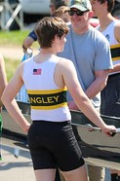
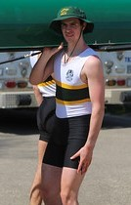
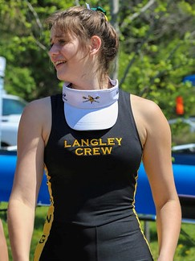
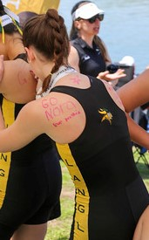
Uniforms
Uniforms will be ordered in early December
Uniform delivery will take 8-10 weeks from order date, so in mid February
We will give you more details on ordering as we get closer
You will need to order your uniform before the season begins
Your child MUST have a uniform to race
Uniforms comprise the uniform, a hat/visor, and a tech shirt
Uniforms cost $175 last year; we do not anticipate an increase
Another reason to register early!
Notes:
Uniforms require your child’s measurements, as they are form-fitting
To make sure we have the uniforms in time for reqattas, we order them in early December
This means you may order a uniform before you register for crew
All the rowers in the boat must be dressed exactly alike during a regatta
We don’t know prices for sure but will let you know as soon as we do.
We charge the pass-thru price for uniforms – we do not mark them up for profit in any way
If you are unsure about registering, we suggest ordering the uniform anyway. If you register after we order uniforms, your child cannot race.

Slide 8
Registration FAQs So Far
I feel like I’ve registered over and over. How do I know if I’m done?
There are three different sites where you need to register:
LHS Activities – if you’ve already created an account for a different activity, you still need to register for crew with LHS. Pick “spring” and “crew.”
SportsEngine – If you rowed last year, or did Learn to Row, you already have an account, but still need to register for this season.
US Rowing – your child must be a member to participate in the regattas and membership must be renewed every year
We get lists of who has registered from all three places (at different times). We compare those lists to see who has checked all the boxes and who still has some things outstanding.
The LHS registration puts you on the list of people who want to participate – it does NOT actually get your child on the team. You must register through both LHS AND SportsEngine to get your child on the roster. Your child must join USRowing to race.
Notes:
There are 3 different registrations – LHS, LCBC, and USRowing. All three have to be done. There is detailed information on the website, particularly in last month’s All Aboard slide deck
A lot more people have registered on the LHS site than have registered on SportsEngine. That is common, as people will check “crew” on LHS if they’re interested, but they’re not obligated to register. Not all of those kids end up joining the team.
To be able to practice in the winter, your child must have submitted a current VHSL physical to Langley
To be able to practice in the spring, your child must get the ‘green light’ from LHS and be registered via SportsEngine.
We always have kids join in January and February, so we don’t close registration until after water training has started, but you should register as soon as you can.

Slide 9
When does registration end?
We hold registration open until spring training, and we always get people joining during winter conditioning. That said, your child cannot begin training – spring or winter – until they have registered both with LHS and SportsEngine.
How do I register for winter conditioning? I don’t see it on the LHS site.
Winter conditioning is actually an off-season training activity rather than a winter sport, so it’s not on the LHS site. Just register for “boys crew” or “girls crew” under “spring” sports. That will get you LHS’s green light to begin winter conditioning.
Where do I send the physical form?
LHS gets this, not the Booster Club. Send it to Beth Longo – eelongo@fpcs.edu.
Notes:
There is no registration for winter conditioning on LHS’s site. You register for crew, which is a spring sport.
Physical documents go to Beth Longo at LHS. You can scan and email it to her or provide a hard copy. I strongly recommend handing the hard copy in to the Athletics Office, not the main office. Things get lost.

Slide 10
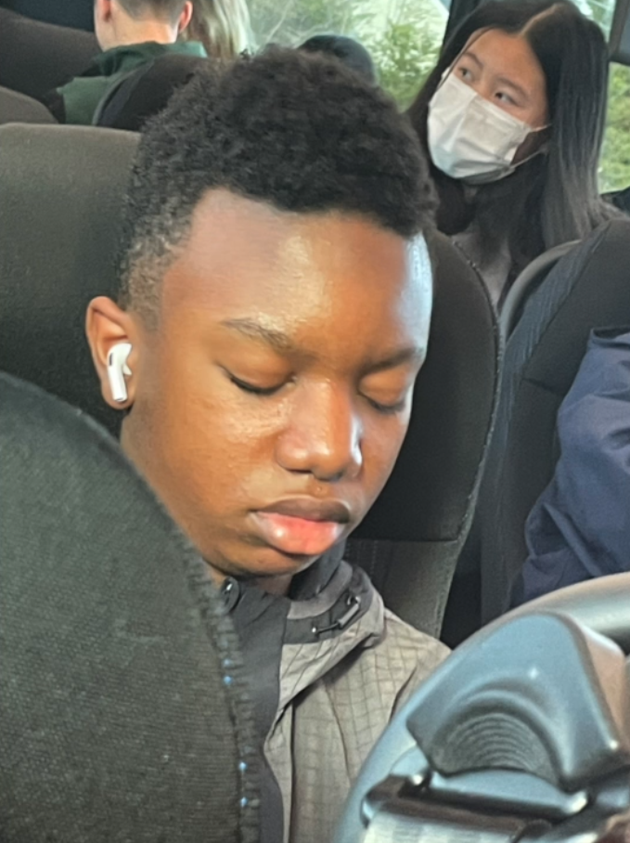
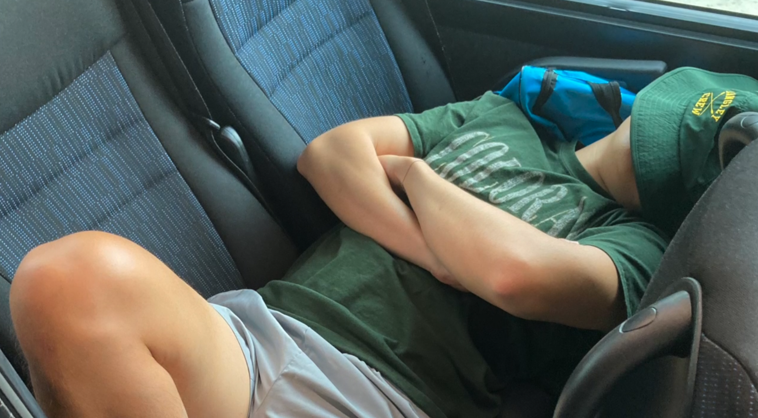
Bus Chaperoning
What you need to know:
Every family is required to take a turn chaperoning the bus trip to the Occoquan and back for spring water training. Chaperoning is easy and can be fun. You get to spend a lovely spring afternoon at the park, possibly tagging along in the launch with a coach. Alternately, you can read, hike, or take advantage of the bus wi-fi to catch up on your streaming.
Essentially, you have two jobs:
(1) Be the non-driving adult on the bus and
(2) stay at the school until all the kids have been picked up
When it gets close to the date you’ve signed up for, we send you
a reminder and instructions.
Notes:
Every crew family is required to chaperone the trip to spring practice at least once
We’ll create a Signup Genius in January
Pro parent tip: Sign up early to get your choice of dates. The returning parents tend to descend on the signup like locusts, trying to book the warm spring days for themselves.

Slide 11
What does this mean for you?
You’ll spend a spring afternoon riding the bus to Sandy Run and back
While at Sandy Run, you can do whatever you want, including ride in the coaches’ launch
You get a chance to see up close what your child’s afternoons are like
You’ve fulfilled one of your required volunteer obligations
What does this mean for your kid?
It means they will be able to practice—no chaperone means no practice for 55 kids
What do you need to do?
Sign up for at least one chaperone slots on the SignUp Genius
Make sure you chaperone on that date – if you don’t show up, 55 kids don’t practice
What does your kid need to do?
Nothing - they’re doing their part to have a successful team, and they need you to do yours
Notes:
If you want to go out on a launch, go down to the dock when you get to the park. One of the coaches will offer to take you out.
We know that plans change, so you may not be able to chaperone on a date you signed up for.
If that happens, please delete your signup as soon as possible and let us know. We can and will reach out to other parents to take that date. That’s okay.
What’s not okay is to just not show up, or to show up late. If you have something else scheduled that day and it looks like time might be tight, delete your signup and take another day.

Slide 12
Questions??

