Slide 1

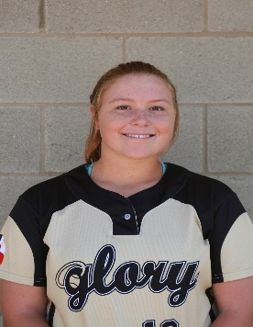
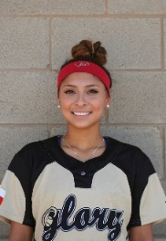
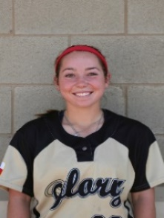


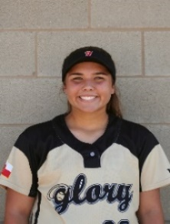
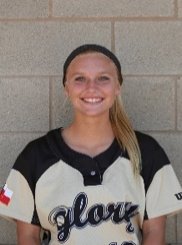
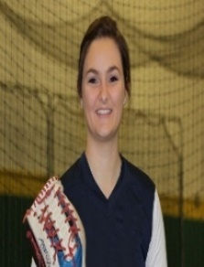



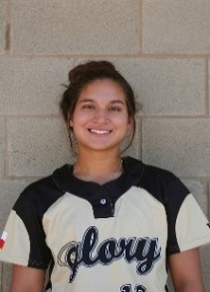
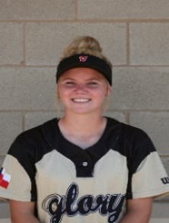
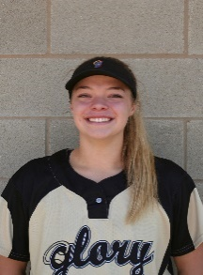



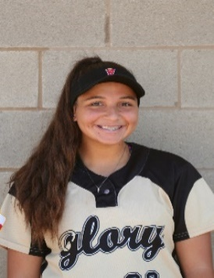
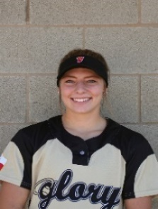
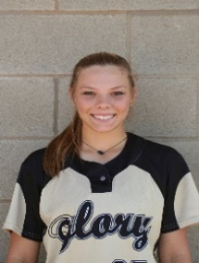

Texas Glory Adkins 18U Gold
#13 - 2018
Abby Stuart
3B / RF / DP Bat: Right
Throws: Right
HT 5' 6"
Southlake HS
GPA 3.8 of 4.0 817-475-2095 abstaurt@gmail.com
#1 - 2017
Marisa Arriaga
OF / C / MI
#3 #44 – 2018 Billie McFadyen
2B / SS / OF
#5 - 2018
Bronte Rhoden
RHP / 3B / DP
#10 - 2017
Parker Smith
C / MI / OF
#12 - 2017
Sydney Casteel
DP / OF / 1B
#14 - 2017
Sierra Lange
Pitcher / IF / OF
#15 – 2018
Grace Meador
CF / LF / 2B
#17 - 2017
Georgia Capell
1st / 3rd / DP
#20 – 2018
Alexis Perry
C / 3B / 1B
#23 - 2018
Peyton Blythe
RF / CF / LF
#25 - 2017
Brooke Makemson
SS / 2B / 3B

Slide 2
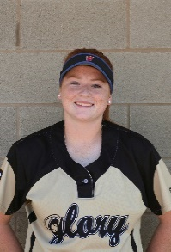
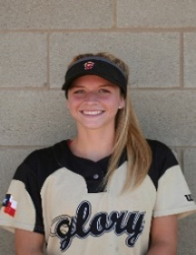
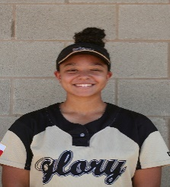



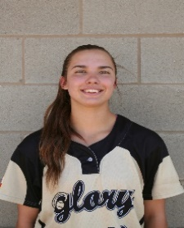
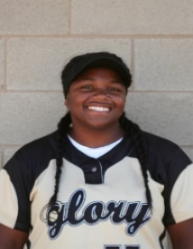
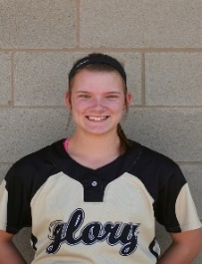



Texas Glory Adkins 18U Gold
#27 - 2018
Sophie Hannabas
LHP / 1B / OF
#32 – 2018
Maggie Black
SS / 3B / OF
#33 - 2018
Riley Cantrell
1st / 3rd / C / DP
#42 – 2018
Gabrielle Kowalik
SS / OF / P
#55 - 2018
Mya Stevenson
LHP / 1B / DP
#99 – 2018 Mikayla Kowalik
Catcher / OF
Head Coach Keith Allen
(214) 876-0724 coachkeithallen@gmail.com Assistant Coach Jack Fultz
214-557-7722 jsfultz@txglory.com
NOTES:_____________________________________________________________
_____________________________________________________________________
_____________________________________________________________________
_____________________________________________________________________
_____________________________________________________________________
_____________________________________________________________________
_____________________________________________________________________
_____________________________________________________________________
_____________________________________________________________________
2016 GOLD FALL SCHEDULE
09/09-11/2016 18U Stars Over Texas Fall Showcase Beaumont
10/01-02/2016 TXGlory/Wilson/Demarini Invite McKinney
10/07-09/2016 SKGSL College Tournament Spring
10/14-16/2016 Bombers Classic Scrap Yards
10/21-23/2016 Ronald McDonald Scrap Yards
11/11-13/2016 Texas Gold Cup Sugar Land
WWW.GLORY.NET

