Slide 1


TEA REC. SOCCER (Pre-K – 2nd Grade)
OUTDOOR SPRING & FALL SOCCER

Slide 2
IMPORTANT INFO TO REMEMBER FOR Pre-K-2nd Grade
FIELD DIMENSIONS: 15 yards X 25 yards (Pre-K-KDG)
30 yards X 40 yards (1st-2nd Gr.)
SOCCER BALL SIZE (Pre-K-2nd Gr.): SIZE 3 (PLAYERS ARE RESPONSIBLE TO BRINGING THEIR SOCCER BALLS TO PRACTICES & GAMES)
NUMBER OF PLAYERS: PRE-K & KDG – 3 VS. 3 (No Goalie)
1ST & 2ND GR. – 4 VS. 4 (*No Goalie)
Each player on the team will receive an equal amount of playing time during each game. A player should not play the entire game unless there are only 3 or 4 players present.
2ND GRADE ONLY: Coaches can decide if they want to do goalies halfway through the season. Both coaches must agree to do goalies. If one coach doesn’t want to do it but another coach want too, then there will be no goalies for that game. Coaches can decide this before the game. We allow this for 2nd Grade since they’ll have goalies the following year for 3rd grade.

Slide 3
DURATION OF MATCH
PRE-K & KDG – Two - 12-minute halves (3-minute halftime). There’s a 20-minute practice before each game. That time is included into the schedule.
Example: If you have a game at 9am-9-50am. Included is the practice time and game time into that time frame.
1ST-2ND GRADE – Two - 20-minute halves (3-minute halftime). There’s a 10-minute warm-up before each game. That time is included into the schedule.
Example: If you have a game at 11:10am-12:05pm. Included is the warm-up time and game time into that time frame.
Recommend putting a timer on your phone. That way you can hear the timer go off instead if you where you wouldn’t if you put it on stopwatch.

Slide 4
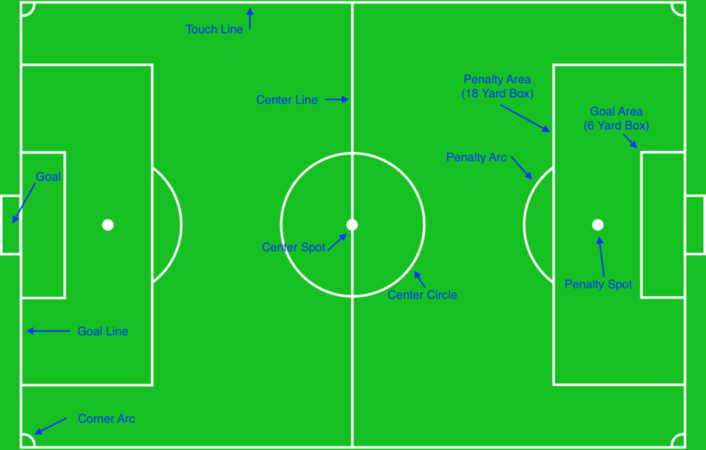
Get to Know Field Terminology

Slide 5
IMPORTANT INFO TO REMEMBER FOR U5-U8
EQUIPMENT:
Players must wear their team uniforms colors for games. All players are required to wear shin guards, which must be covered by an appropriate sock.
Players are allowed to wear tennis shoes, turf shoes, rubber cleats (no toe cleat), or screw-in cleats (no toe cleat) provided they are deemed safe by the referee/coach. Absolutely no metal cleats or metal tip cleats!
Necklaces, bracelets, watches, earrings, other body pierced jewelry, and other jewelry are NOT allowed.

Slide 6
IMPORTANT RULES TO REMEMBER FOR U5-U8
Substitutions will be unlimited. Free substitution will be allowed in all age groups. The substitute players can enter the field only after the replaced player leaves. All players will enter the field at the half line. Players who are being substituted may leave the field of play at the nearest point on the boundary line unless the referee/coach indicates otherwise. Substitutions can only be made with the consent of the referee/coach at the following times:
Prior to either team's throw-in with the consent of the coaches.
Prior to a goal kick by either team.
After a goal by either team
After an injury by either team, if allowed by the referee/coach.

Slide 7
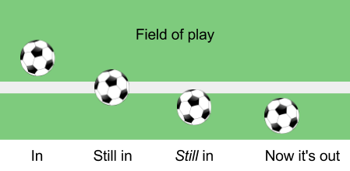
IMPORTANT RULES TO REMEMBER
The lines are considered part of the field of play and part of the area they define on the field. The ball is out of play when the whole ball crosses the entire goal line or the entire touch line either on the ground or in the air.

Slide 8
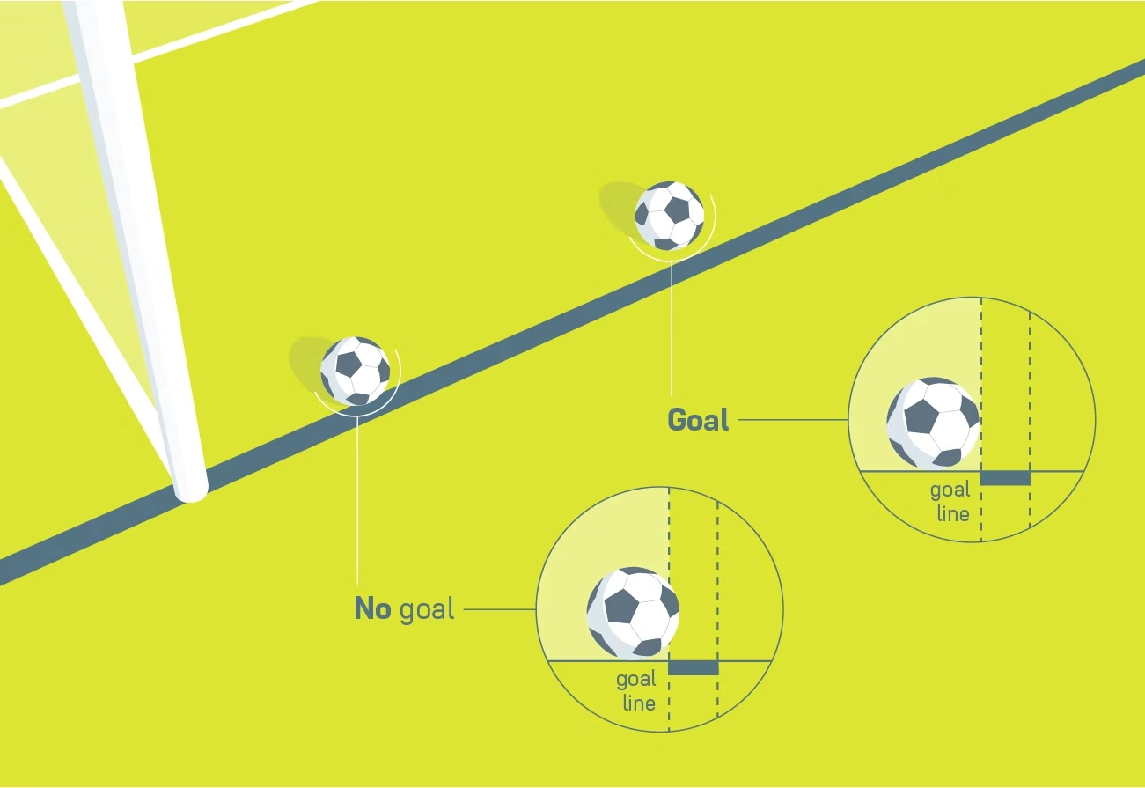
IMPORTANT RULES TO REMEMBER FOR U5 & U6
A goal is scored when the whole ball has passed over the goal line, between the goalposts, and under the crossbar, provided no infringement of the Laws of the Game has been committed previously by the team scoring the goal. Scores are not recorded. We ask that coaches respect the other team and be mindful of the number of goals scored against an opponent.

Slide 9
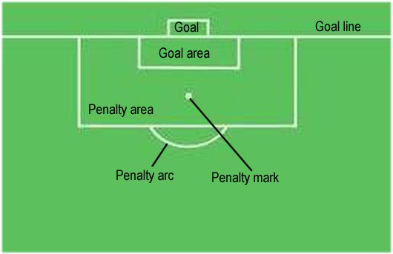
Goalie Rules (2nd Grade Only)
Once in possession of the ball, they have 6 seconds to pass it to another player.
They can kick or throw the ball to a teammate.
Goalies CAN NOT use their hands if the ball is kicked back to them from a teammate. This also applies on a throw-in but is much less common.
Once the goalkeeper puts the ball back into play on the ground, they CAN’T pick it up again with their hands.
Goalies CAN NOT use their hands to pick up the soccer ball if they’re outside of the Penalty Area.
Goalies must kick the ball in the Goal Area if the opponents kick the ball out of the Goal Line. If there’s not a goal area, it’s typically 3 yards from the goal.

Slide 10
IMPORTANT RULES TO REMEMBER FOR Pre-K-2nd Gr.
No Hands, please
First, the rule for a hand ball includes using any part of the body from the tips of the fingers to the shoulder. Second, the proper way to look at this soccer rule is that a player cannot “handle” the ball. A ball that is kicked and hits a player’s hand or arm is not a hand ball. This means that the referee/coach must judge whether or not a hand ball is accidental contact, or the player handled the ball on purpose to gain an advantage.
Fouls
The common rule of thumb on fouls is “If it looks like a foul, it probably is.” A player cannot kick, trip, jump at, charge, strike, push, hold, or spit at an opponent. Bumping, leaning or going shoulder-to-shoulder while competing for a ball is not a foul until the hands or elbows come up. ABSOLUTLEY NO SLIDING FOR Pre-K-2nd Grade!

Slide 11
IMPORTANT RULES TO REMEMBER FOR Pre-K-2nd Gr.
Pre-K-2nd Gr. WE WON’T HAVE REFEREES. THE COACHES WILL ACT AS THE REFEREE.
KICKOFF
A kickoff is a way of starting or restarting play:
at the start of the match
after a goal has been scored
at the start of the second half of the game
at the start of each period of extra time if applicable
A goal may NOT be scored directly from a kickoff.
All players must be on their own (defending) half of the field - except the player taking the kickoff.
Opponents must be at least 5 yards away from the ball until it is put in play (PRE-K-2ND GRADE).
Helpful Tip: Recommend the coach being 5 yards away from the half line and telling the kids to stand even from where you are. Tell them once they kick it then they can go for the ball.

Slide 12
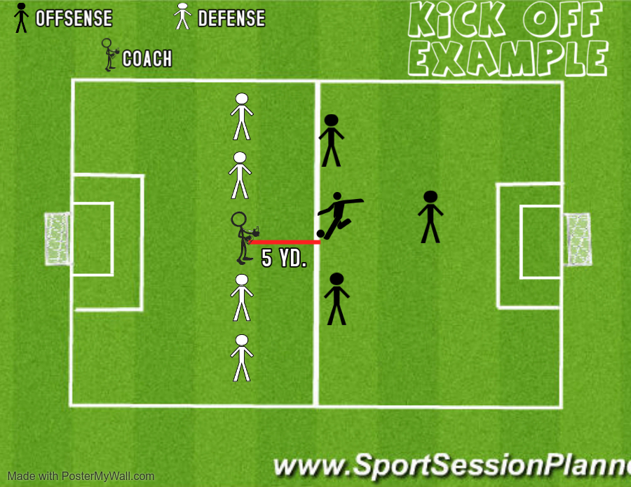
KICKOFF EXAMPLE
At these age levels players must pass to another player during kickoff. Let your team know before they do a kickoff that they must pass it to a teammate.
Even if you have goalies for 2nd Grade (halfway through the season). We still encourage them to pass to a teammate on kickoff. This is very common for all age levels to pass to a teammate during kickoffs.
You can see that that the defense is about 5 yards away from mid-filed before the kickoff. It’s always good for the coach to be 5 yards away and tell the team they should be even with them. Once the ball is kicked then the defense can go attack the ball.

Slide 13
IMPORTANT RULES TO REMEMBER FOR Pre-K-2nd Gr.
OFFSIDES: There is no offside violation in Pre-K-2nd Gr. play.
- But still encourage kids not to “cherry pick”.
For PRE-K-2ND GRADE All free kicks will be Indirect Free Kicks.
What’s an Indirect Free Kick?
When an indirect kick is awarded, it is taken from the spot where the foul was committed. The player taking the kick cannot touch the ball again until it has touched another player-- and if the indirect kick goes into the goal before touching another player, a goal kick is awarded
Opponents must be 5 yards away when the indirect kick occurs.
THE PENALTY KICK
For PRE-K-2ND GRADE there will be no penalty kicks - in the case of an infringement 5 yards within the goal (coaches’ discretion), the ball will be placed in the center of the field 5 yards for U5/U6 & 10 yards away for U7/U8 from the goal, and play will resume with an indirect free kick.

Slide 14
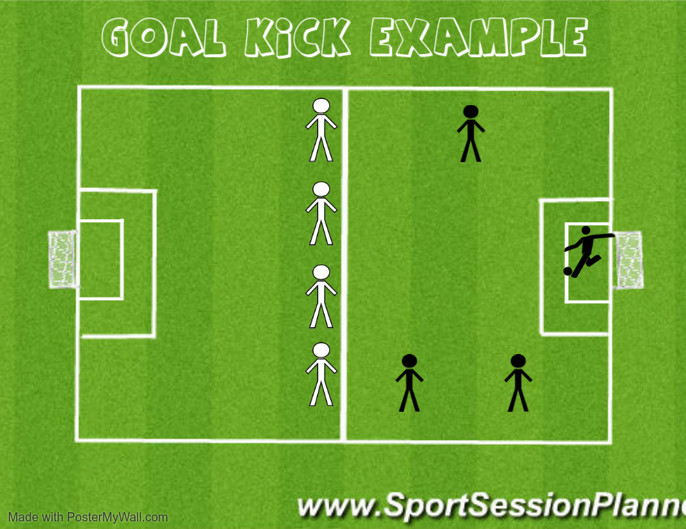
IMPORTANT RULES TO REMEMBER
THROW IN:
- PRE-K-KDG the throw-in will be replaced by the kick-in
- 1ST-2ND GRADE will do a throw-in. Just make sure to let the players know they need both feet on the ground and throw over their head for a throw-in.
GOAL KICK (Pre-K-2nd Gr. ONLY): The kick is taken from the goal line or yards in front of the soccer goals and the opposing team should be on their own half. Once the ball kicked into play the opposing team may cross the half line.
*WHY DO WE HAVE THIS GOAL KICK RULE? Just like basketball at younger grade levels they don’t allow pressing. It give the participants an opportunity to advance the ball.

Slide 15
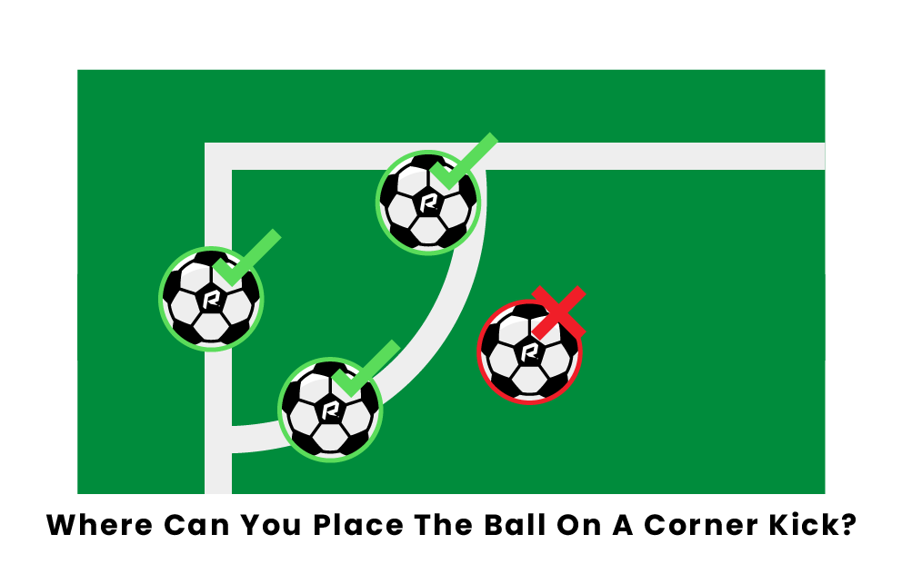
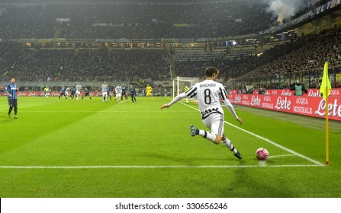
IMPORTANT RULES TO REMEMBER FOR Pre-K-2nd Gr.
CORNER KICK
A corner kick is a method of restarting a game.
A goal may be scored directly from a corner kick, but only against the opposing team.
A corner kick is awarded when the whole ball, having last touched a member of the defending team, passes over the goal line in the air or on the ground and a goal is not scored

Slide 16
PRACTICE INFORMATION
PRE-K & KDG: will have a 20-minute practice before the start of each game.
1ST & 2ND GRADE: We ask the coaches to provide one practice a week for 1 hour. A google docs. Sheets (practice example) will be provided to coaches to set up date and time that works to practice with your team. Due to schedule conflicts & amount fields we have available there maybe some teams that will have to share a field for practice. Teams in 1st-2nd Grade will also have 10 minutes to warm-up before each game.
It’s recommended to try to be consistent with your practice schedule. Example: Practice every Wednesday on Field 1, 6:00pm at the Tea Community Building.
Coaches can share the practice google doc. with parents or coaches can also add the practice times on their SportsEngine Team too (coaches get admin rights to do so). Only coaches will be allowed to edit the google doc. for practice times.
Also, to communicate with parents with SportsEngine. That way if you must cancel a practice, and you can directly contact the parents on your team. No need to contact the Rec. Director on practice cancellations.

Slide 17
Volunteer Coach Unable to Coach a Game
If you’re a volunteer coach and is unable to coach that week, you can do the following:
Ask the parents on that team to see if anyone can fill in to coach.
Move the game to a weeknight game. The other teams coach and team must also agree to move the game.
- (2.) Please let the Tea Parks & Rec. Director know if you’re moving a game to a weekday, so he/she can change the schedule and make sure the field is available.

Slide 18
Helpful Tips for Coaches
It’s good to remind all players of rules that occur
Example: A defensive player intentionally uses their hands. It’s a great time to stop the game and explain the rule (to both teams). Tell them that you’ll be doing an Indirect Kick because of this penalty. Explain to them that during an Indirect Kick the defense must be 5 yards back from the spot of the ball (where the foul/penalty occurred), and the offense player must pass to a teammate before they can score a goal.
Another tip I’ve found helpful is anytime there’s a Goal Kick, Throw In, or Corner Kick to tell the players that. Eventually throughout the season the players will know where to go, and it helps them learn soccer terminology.
Example: “Hey guys the Red Team has a goal kick, we must go the Center Line/Mid Field. Once they kick it in, then we can get the ball!”
Example: “Hey guys we have a corner kick! Samantha why don’t you kick it in and everyone else spread out around the Penalty Area.” First game you may have to explain where to line them up.

