Slide 1
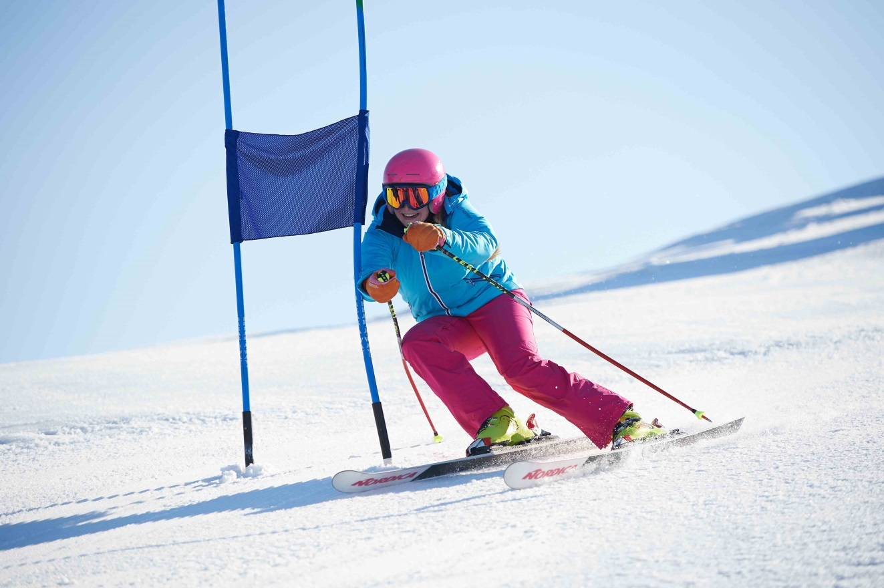
Welcome Back!
Bogus Basin School Race Program 2023

Slide 2
The program’s philosophy has 3 goals:
Provide a safe environment on the slopes in which to participate.
Encourage students to represent and compete for their school in a life sport activity. This provides a venue for many students to represent their school that might not otherwise.
Provide a level of competition in which the maximum number of students can participate.

Slide 3
2023 Bogus Basin school race program contact list
Head advisor: Hannah Buchhauser hbuchhauser@bk.org
Co advisor: Billy Buchhauser
Co advisor: Brian Bockenstette
Race Coordinator Bogus Basin Mountain Recreation: John Foley johnfoleyski@gmail.com

Slide 4
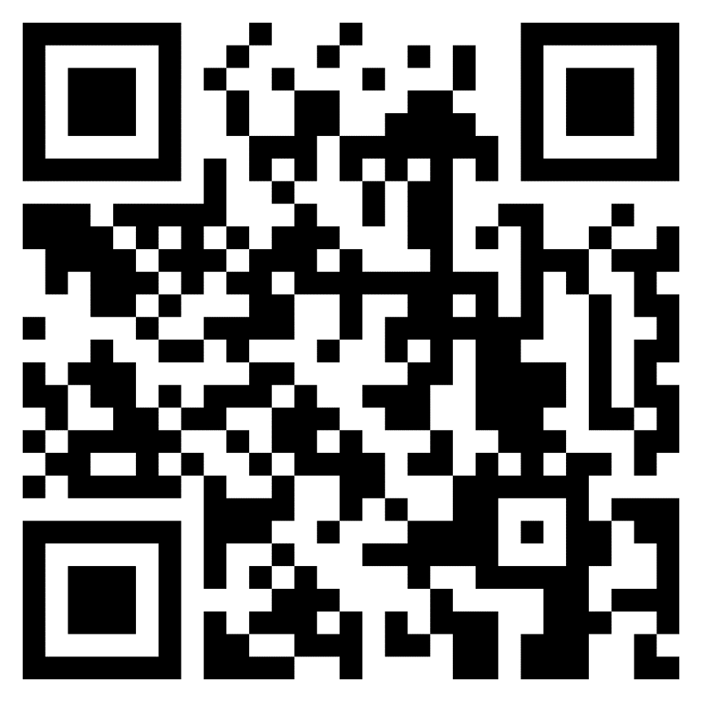
Steps to get signed up by Dec 2nd
1) BK Sign up google form 2) Bogus basin sign up
Go to the Bogus Basin website
    Go to: Your Mountain
    Go to: About Bogus
    Go to: Competitive Education
    Go to: Bogus Basin School Race Program
    Scroll down to Middle School or High School Registration
    You must respond to each question to move on
    Parents must fill out the registration unless the student is 18 years of age or older.

Slide 5
3) Bk Health exam & consent form
Form needs to be printed, filled out, and turned into Mrs. B in order to participate by Dec 2^{nd.}
https://www.bkathletics.org/forms

Slide 6
Parents and students: Join remind to keep up with communication all season!
Smartphone App: Go to rmd.at/8d8dh8a and follow instructions to download the app.
Or
Text option: Text @8d8dh8a to 81010
Team Page https://www.bkathletics.org/page/show/7518216?subseason=851174&tab=content

Slide 7
Participants info
Fee: The season club fee will be $25. This does not include gear this year. Bring cash or check made to BK to Mrs. Buchhauser by December 1st.
Gear: Gear will be available for individual purchase through the following link. Only open until Nov 20th. https://bsnteamsports.com/shop/BKski22
Lettering: Students must race in all 6 races plus Dotty Clark if applicable, to receive letter. In addition students must make all team masses except for 1 acceptation.
Mass: Team mass will start the first Monday after our first race, 1/16/23.
Qualifying for Dotty Clark: A racer needs three races in a discipline to qualify for Dotty Clark. Ex: Nate races Ski Novice one time and two times in Ski Intermediate – he qualifies for Dotty Clark. We will use the last level Nate skis in to determine his race level for Dotty Clark, unless the Adviser notifies us differently
Travel: students are responsible for getting themselves up and back from the mountain. There will be a bus only for Dotty Clark and end of season trip.

Slide 8
Participants info cont.
After December 2nd, a registered student should let their Adviser know if they want to make a change, add a discipline or if a mistake was made while registering.
If a racer wants to add a discipline or change a skill level/category contact your school Adviser by 12:00 PM on the Wednesday before their race.
New Student registration After December 2nd must be completed by Wednesday, 10:00 pm before that Saturday’s race. (For example, Mikaela Shiffrin wants to race January 21st, 2023, and submits her registration at 9:59 PM Wednesday, January 18th, 2023. She is good to go!)
NO add-ons will be allowed to race if they did not complete the online registration by Wednesday, 10:00 pm before they race. (For example, Bode Miller wants to race January 28th, 2023, and submits his registration at 10:01 pm Wednesday, January 25th, 2023. Sorry Bode, you are not eligible for the January 28th race but are eligible for the following weeks race.)

Slide 9
Pass & Discount info
Students who are registered in the program and do not have a season pass will be able to obtain a day pass for $30.74 including tax at these ticket locations on Race Days (If a student purchases a discounted race day pass and does not participate in the Saturday race, THEY WILL NOT BE ELIGIBLE TO PURCHASE ANOTHER DISCOUNTED PASS FOR THE REST OF THE SEASON)
      Bogus Basin Downtown office
      Simplot Lodge
      Pioneer Lodge (Not Open on Dotty Clark for ticket sales)
Nordic:
    Season Pass holders can add Nordic for $25.00
    $5.00 per race on individual race basis.
    Rental gear is free for race only.
    We have plenty of Nordic gear this year.
      Race day tickets are sold until 1:00 PM
Discounts: Rental packages (not individual pieces of equipment) $4.00 off.

Slide 10
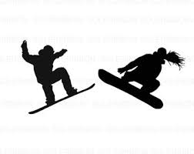

Disciplines and Categories
Ski Slalom
EXP – Expert Ski
ADV- Advanced Ski
INT – Intermediate Ski
NOV – Novice Ski
Freestyle Ski
FSE – Freestyle Skier Expert
FSI – Freestyle Skier Intermediate
Snowboard Slalom
SBE – Expert Snowboarder
SBI – Intermediate Snowboarder
SBN – Novice Snowboarder
Freestyle Snowboard
FBE – Freestyle Snowboarder Expert
FBI – Freestyle Snowboarder Intermediate
Nordic
NEX – Nordic Expert
NIN – Nordic Intermediate
NNO – Nordic Novice

Slide 11
Helmet Stickers
All Racers, except Nordic must have a Helmet Sticker
Students will receive initial helmet stickers from their Adviser if they register for the 1st race.
If a student adds a discipline, changes a skill level/category they must get a new helmet sticker from the info booth on the 3rd floor of Pioneer Lodge
New student racers will get their helmet sticker from the info booth on the 3rd floor of Pioneer Lodge
Replacement stickers can be obtained at the info booth, 3rd floor Pioneer Lodge
Nordic Racers: Nordic racers will use chip timing, a Velcro band that can be worn around their ankle or wrist. They will have the same number all season long. Racers will need to return their chip after they race.

Slide 12

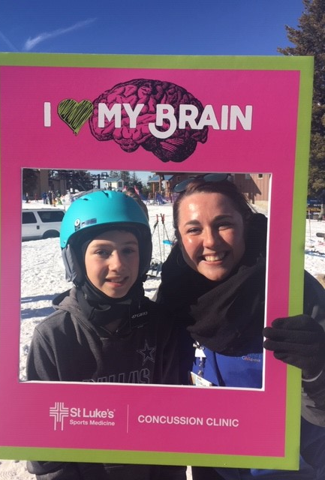
Helmets for Students
Notes:
Now if you have athletes or students in need of a helmet. If buying a helmet is a barrier for their participation you can contact St. Luke's children's hospital and they can provide a helmet.

Slide 13
2023 Schedule for all race days
Saturday, January 14th, 2023 Race #1
Saturday, January 21st, 2023 Race #2
Saturday, January 28th, 2023 Race #3
          Nordic HS 11:30 AM start MS 12:00 PM start
Saturday, February 4th, 2023 Race #4 No Nordic Race
Saturday, February 11th, 2023 Race #5
Saturday, February 18th, 2023 Race #6
Thursday, February 23rd, 2023, High School Dotty Clark

Slide 14
2023 Schedule of events
Competition Time Location
Nordic 10:00 Frontier Point Lodge (Nordic Center)
Snowboard Expert MS/HS 10:30 B-3
Freestyle HS -11:30 Bitterroot Basin
High School Slalom 12:30 Bitterroot Basin
Middle School Slalom 1:30 Bitterroot Basin
There will be a bus running from the Nordic Lodge to Simplot Lodge.

Slide 15

Bogus Basin Racer Meal Deal
Where 3rd Floor Pioneer Lodge
What: 2 Tacos, beef or chicken and a drink
Cost: $12.00 including tax
Must have a helmet sticker
One deal per student
Race Days only

Slide 16
Parent INfo:
Please stay off Cat Track while attending races
Parents without a Season Pass will need to go on-line to get a Saturday day pass – see the Bogus Basin website
All race results will be posted on the Bogus Basin website no later than Monday at noon. Normally posted on Sunday
For Live Results & Slalom Results, download the Brower Timing app to see race times live. You must be with 20’-30’ of the finish line as these results use Bluetooth
For Nordic Results, use the Zone 4 app to see live results- more info will be available at Frontier Point/Nordic Lodge
Review results and contact your school Adviser if there are any discrepancies or missing times.
Please let your Adviser know if your student is not participating in any or all of the disciplines you signed them up for

Slide 17

Concussion Protocol Responsibilities/Injuries on the racecourse
  A student cannot return to competition unless they are released by a medical professional (MD, DO, PA or Advanced Practice Nurse if a concussion is suspected
  The students Adviser and John Foley will conduct the concussion protocol to ensure the student is cleared to return to participate in the program.
  The Student’s parent will need to have a medical professional complete the Return to Sport release and get that to John Foley by Noon on the Friday prior to that Saturday’s race.

Slide 18
Team Scoring System
The Saturday races will be divided into 2 Divisions again this year. Each racer can earn up to 10 points for their school for each race: The more racers, the more points. Points are awarded for Saturday Races by the following criteria:
      10 pts – 100% > 90% of the fastest time
      9 pts – 89% > 80% of the fastest time
      8 pts – 79% > 70% of the fastest time
      7 pts – 69% > 60% of the fastest time
      6 pts – 59% > 50% of the fastest time
      5 pts – 4 9% > 40% of the fastest time
      4 pts – 39% > 30% of the fastest time
      3 pts – 29% > 20% of the fastest time
      2 pts – 19% > 10% of the fastest time
      1 pt – Finished race or Disqualification

Slide 19
Team Scoring System – dotty clark
The Dotty Clark Championships will also be split into Large & Small School Divisions. A team trophy for the champion and individual medals will be awarded for 1st, 2nd & 3rd places in each division and for each category. School size is decided according to roster. Small School is defined as any school with 25 or less student categories (a student in two categories counts as two students) and Large School is any school with 26 or more student categories.
School Size is not defined by racers but by roster at week 4 of the season.
Team Trophy Determination
Dotty Clark School Championship
  Total points earned at Dotty Clark will determine large and small school winners.
Bogus Basin School Race Program Champion
  The highest average points per race for the entire season:
    Determined by total points for the season earned by all racers in all categories divided by the number of racers in all categories at Dotty Clark.
  To be eligible for this award a school must have a minimum of 5 race entries for small school and 15 for large school trophies.
      Entries are defined as a category being raced
        Vickie races NOV and Freestyle Expert = 2 entries
Race Results will be posted on the website and emailed to all Advisers

Slide 20
Snow dance Contest and Party
When: 10:00 AM January 21st, 2023
Where: Outside Pioneer Lodge
What: The school with the best snow dance team will win their school race fee waived for the 2024 Season and receive 5-day passes to use for fundraising. Your Adviser must be part of your snow dance team.
Best Adviser Snow dance – The Adviser with the best snow dance will have their school fee waived for the 2024 season and win the Adviser or the Year Snow Dance Award
    Judging for the best Adviser snow dance will be done by crowd noise, so make sure your team is there to support you.

Slide 21
ST Luke’s Helmet Decorating Contest
When: 10:00 AM to 1:00 PM February 11th, 2023
      Drop off your helmet between 10 AM and 11:00 AM to be judged for the contest at the event table.
Where: Southside of Pioneer Lodge
What: Decorate a helmet and win prizes for your school
    Limited supply of helmets available or use your own helmet.
      Helmet will be available at the Continuing Education Class
      On the third floor of Pioneer Lodge on race days
      Contact John Foley 208 870-4488 or johnfoleyski@gmail.com
Prizes: 1st Place $200.00 in Wahooz gift cards. Last year the winning team received enough gift cards for Wahooz to take their team there for pizza and games.

Slide 22

End of season trip
There will be an end of season trip that is TBD. It mostly will be 1 or 2 nights. The trip will be funded individually. Chaperones will be needed! Please reach out if you would be interested.

