Slide 1

WELCOME!!!!
2024 BPAA BASEBALL PARENT MEETING

Slide 2

BPBA Volunteer Board Members
Brian Oxborough President
Tammy Hoff Vice President
Chad Dose Secretary
Jackie Wickman Treasurer
TBD MYAS/House Tournament Director
Bobby Hoff Traveling Director
Kelly Morin Head Commissioner
Tammy Morin Concession Stand Director
Tammy Hoff Field Director/Game Scheduler
Kelly Oxborough Apparel Director
Michelle King DIBS Director
Tyler Klose Registration Director
Brad Gumz Dome Night Director
Steven Scott Tryout Director
Melissa Strong Coach Director
Bobby Hoff Equipment Director
Sarah Pomales Event Director
Steve Killborn Senior League Director

Slide 3
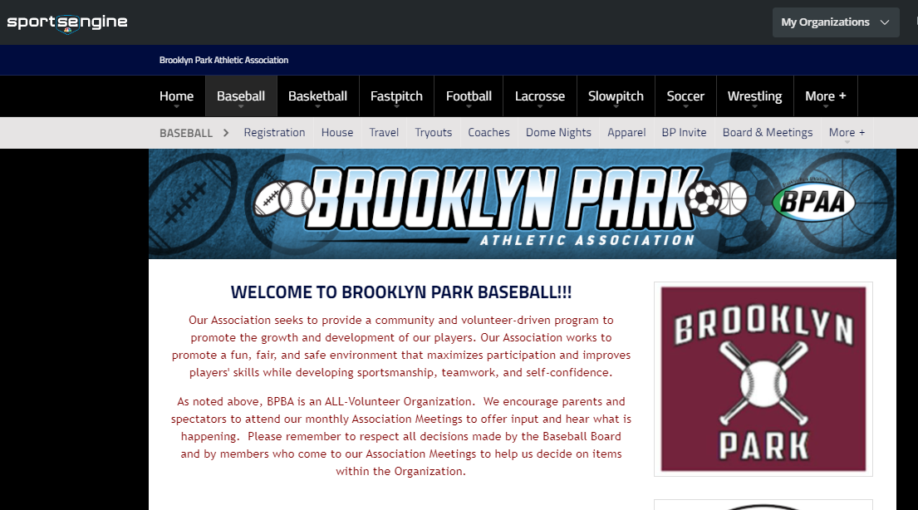
BPAA BASEBALL
bpaasports.org/baseball

Slide 4
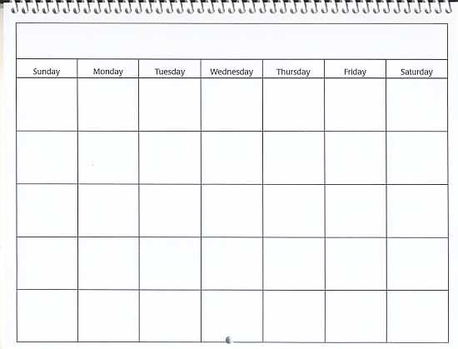

BPBA Board Meetings
Learn more about BPAA Baseball - attend our board meetings!
Typically held the 2nd Sunday of every month
All parents are invited
Look to www.bpaasports.org/baseball for exact time and place with the majority of the meetings being a virtual Zoom meeting

Slide 5
BPBA Email Blasts
Not Getting BPBA Email Blasts?
BPBA sends email blasts to parents from time to time, including:
Meeting notices
League Updates
DIBS (volunteer) opportunities
You should login to SportEngine with the primary parent account attached to your player. Once logged in, click the down arrow button next to the account name in the upper left and choose Profile. Now click the Add button in the Linked Accounts tool in the bottom left of the page. In the popup window, click the link “add a secondary email to your account” and enter another email. Now everyone will receive the BPBA emails.

Slide 6
BPBA Objectives
To teach the game of baseball to hundreds of Brooklyn Park area players
To develop confidence in themselves, their team, and their teammates
To develop respect for team, opponent, and most importantly themselves
To learn teamwork and sportsmanship
Most importantly, to have FUN

Slide 7
BPBA Program Structure
House League (5-19 year olds)
Kelly Morin– Head Commissioner
National League
5/6 Year Old T-Ball 3 teams
6/7 Year Old National League 8 teams
8/9 Year Old National League 6 teams
11/12 Year Old National League 4 teams
13 Year Old Northstar 1 team
14/15 Year Old Northstar 1 team
American League
9/10 Year Old American League (Tryouts, Draft) 6 teams

Slide 8
BPBA Program Structure
Traveling League (10-15 year olds)
Bobby Hoff– Traveling Director
All require tryouts and additional fees
10 Year Old 10AAA 1 team
11 Year Old 11AAA 1 team
12 Year Old 12AAA, 12AA, 12A 3 teams
13 Year Old 13A 1 team
14 Year Old 14AAA 1 team
Tournament Teams
9 Year Old Tournament Team (Tryouts, additional fees) 2 teams
10 Year Old Tournament Team (Tryouts, additional fees) 1 team

Slide 9
Which One Are You?
Players
Play the game while listening to the coach and the umpire
Coaches
Coach the game and teach their players
Umpires
Do their best to make accurate calls
Parents
Cheer to support the game, the coach, the players, and the umpire.
Know your role at each game!

Slide 10
BPBA
Collective Expectations
Players
Sportsmanship and respect for ALL, especially the umpires
Work hard
Give 100% in games and in practice
Ensure you leave the field in better condition than you found it
Support your teammates
Accountability – don’t blame the coach, the ump, or teammates

Slide 11
BPBA
Collective Expectations
Coaches
Be professional. Be a leader. Be an educator of the game
Bad memories are hard to erase – be in control
Remember – it’s for the kids. It’s for the kids. It’s for. . .
Remain at all events until the last player gets picked up
Our goal is to have the players look forward to the next practice, the next game, and the next season
The players will remember the FUN long after they’ve forgotten the wins and losses.

Slide 12
BPBA
Collective Expectations
Parents
Support your player, their team mates, and their coaches. Cheer for your players not against the opponent players.
Communicate when your player will be unable to be on-time, or unable to make a practice or game.
Encourage your player’s mental and physical skills development.
Be respectful of the umpires, they are people too.
If you have Traveling or AL players, manage their expectations. It took WORK to make the team, it’ll take MORE WORK to stay on the team. There are no guarantees for next season.
Traveling parents – you are a reflection of our city. Please be respectful to your hosts and ensure you leave the host field at least as clean as you found it.
Accountability – don’t let your players blame the coach, the ump, or their team mates. Your boys will win as a team, and loose as a team.
Brooklyn Park forbids smoking around the players during practice and games at all locations.
Meet your volunteer obligation. This is not the Board’s program. It’s our community baseball program collectively. Embrace the opportunity to make new friends, enjoy a few hours at the ball park, and participate in your players’ baseball experience.

Slide 13
BPBA
Expectations
Game Requirements
How many parents does it take to run a baseball game??
1
Team Manager who organizes the players, parents, coaches and manages the dugout
1-2
Parents to bring the snack for after the game
2-3
Parents to prep the field for play (bases, mounds, etc.)
3-4
Parents to help to coach the game (Base coaches, bench coaches, pitching, backup the catcher)

Slide 14
BPBA Uniforms
Your player and team will receive the following from BPBA once you have turned in your VOLUNTEER CHECK:
Jersey
Pants
Socks
Hat
Note: Tball does not get socks or pants
You will need to provide the following items for your player:
Athletic Protector
Cleats
Baseball Glove
You may also provide these optional items:
Batting Helmet
Batting Gloves
Baseball Bat

Slide 15
BPBA
Volunteer Requirements
Michelle King– DIBS Director
House League Requirements
6 hours of volunteer time; this can usually be completed within 2 shifts.
Traveling League Requirements
12 hours of volunteer time; this can usually be completed within 4 shifts
Family Max
A family max of 18 volunteers hours will cover a family and all children in our baseball program for the season
One shift is (typically) 3 hours.
This requirement is on a per child basis

Slide 16
BPBA
Volunteer Requirements
Michelle King– DIBS Director
Why do we require Volunteers Hours (DIBS)?
Our concession stand at Northwoods benefits every child in the program by reducing league fees. We are the cheapest baseball association to play for in the area.
We would prefer families fulfill their DIBS hours versus having to cash their volunteer check and hire workers for our stand.

Slide 17
BPBA
Volunteer Checks
In order for players and teams to receive uniforms:
Each House League or Traveling player is required to give their coach a deposit check, made out to BPBA prior to uniform pick up. The amount for house leagues is $200 and for travel leagues is $400. This check will be held through the season and we will shred it once your volunteer hours are complete
Volunteers MUST be 16 years of age or older, NO EXCEPTIONS
If you would like to OPT OUT of House League volunteering, please provide a $175 check that we will cash upon receiving. There is NO opt out option for traveling.
NOTE: Please put players name in check memo for better tracking

Slide 18
BPBA
DIBS Opportunites
DIBS opportunities this season:
-Coaching/Team Managers
  Each team gets 1 head coach and 1 asst coach for full DIBS hours
  Each team gets 1 team manager which gets 3 DIBS hours for house or 6 DIBS hours for traveling
-Dome Nights (Jan-Mar)
-Concession stand
-Field maintenance for tournaments
  5/31 - 6/02 House Mid-Season Tournament
  6/15 - 6/16 MYAS 12AAA, 12AA & 12A Mid-Season Tournament
  6/26 - 6/30 House End-of-Season Tournament
  7/16 - 7/18 MYAS 10AA Tournament of Champions
-All Star game help

Slide 19
BPBA
DIBS Website
What is DIBS?
-It is our system of claiming and tracking volunteer hours
Instructions are on the following slides

Slide 20
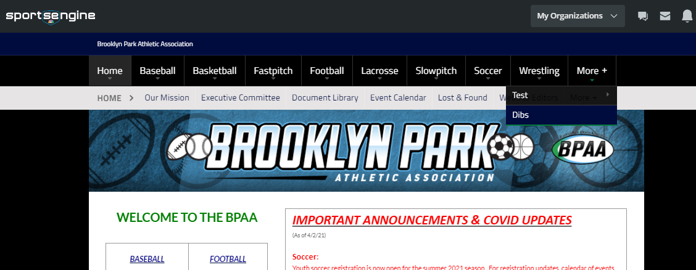
Make sure you are logged in and then go to More -> Dibs

Slide 21
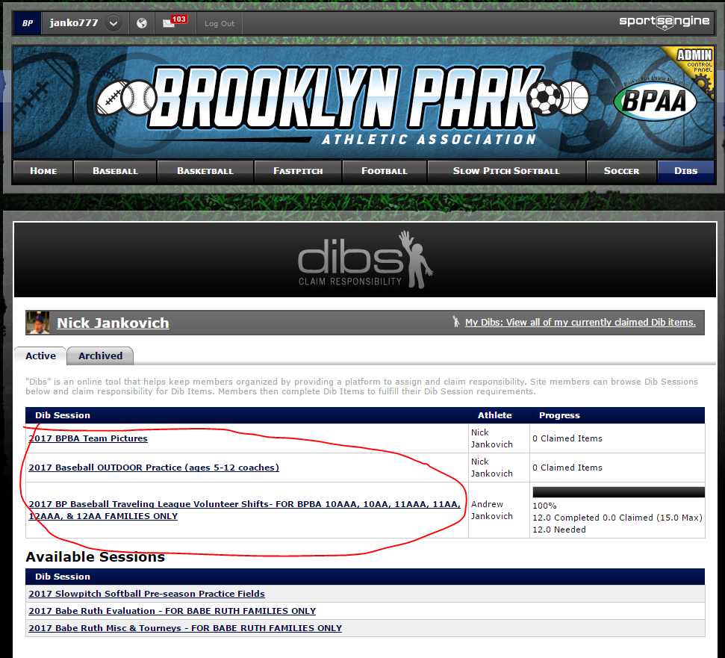
Find and click your DIBS session for the baseball season for volunteer shifts

Slide 22
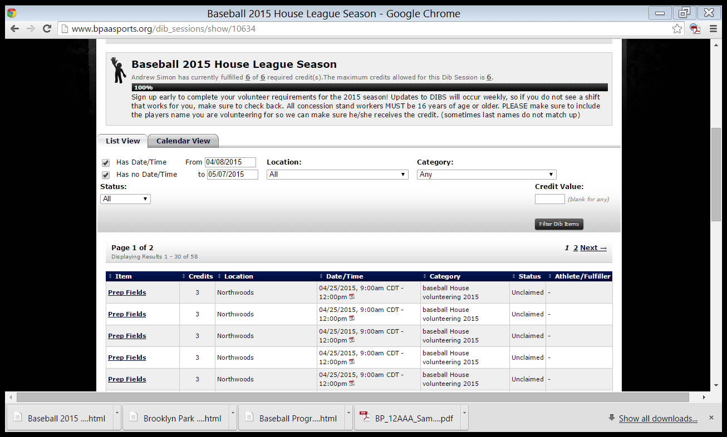
Click on the Item you want – the system will lead you through the rest

Slide 23
BPBA
Concession Stand
Tammy Morin– Concession Director
Requirements for working Concession Stand
Concession shifts are 3 hours long
We would prefer families fulfill their DIBS hours versus having to cash their volunteer check and hire workers for our stand.

Slide 24

BPBA Umpires
Umpires Wanted
We are always looking for individuals willing and able to umpire. Must at least 14 years old.
Umpires make $40-$75 PER GAME
Go to our Website for more information
https://www.bpaasports.org/page/show/2024526-umpires

Slide 25
BPBA Rainouts
We will update our Facebook page and send email blasts as soon as we know if games will be cancelled. Always be prepared to attend your games. Umpires may call the game at the field, COACHES DO NOT make the call.

Slide 26
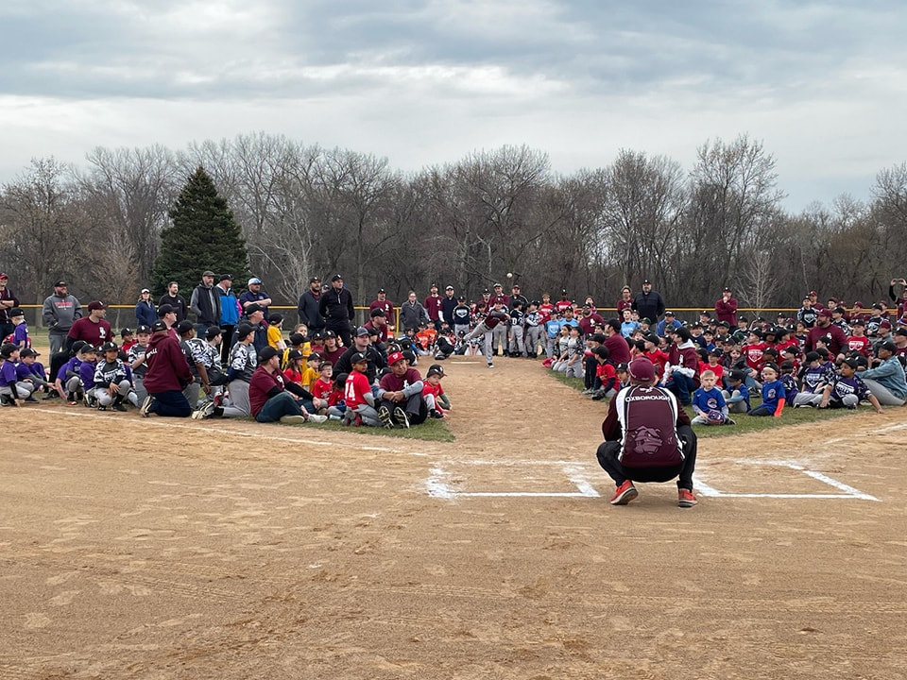

BPBA
Opening Day
Saturday, May 4th@ Northwoods Park
10:00am Opening Ceremony - Games will begin shortly after
Concession stand is OPEN!

Slide 27
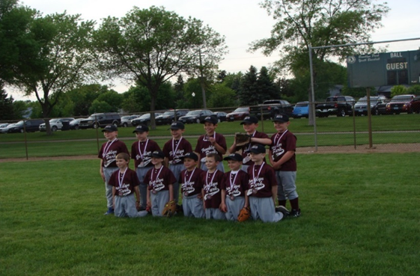
BPBA
Team Pictures
DATES TBD
@ Northwoods Park
Your player’s coach will select a time for your team and let you know what date and time

Slide 28
BPBA House League Tourney Schedule
May 31-June 2 Mid-Season Tournament 6/7NL, 8/9NL, 9/10AL, 11/12NL
June 26-June 30 End of Season Tournament 6/7NL, 8/9NL, 9/10AL, 11/12NL

Slide 29



BPBA All Star Games
Monday, July 1st@ Northwoods Park
Games start at 6:00pm – 3 games total
8/9 NL
9/10 AL
11/12 NL
Each league has 2 All-Star teams that play each other

Slide 30
BPBA Donations
Did you know...
BPAA is a 501(c)3 non-profit organization. Therefore, your donations are tax deductible. See your tax advisor for filing instructions.
Many companies will match your donation!
Designate BPAA Baseball on your United Way pledge card.

Slide 31
BPBA BASEBALL
Volunteers
THANK YOU!!!!!!
Coaches and Assistant Coaches
Team Managers
Team Photo Coordinators
Food Drive Coordinators
Board Members
Other Volunteers

Slide 32

We Need You!
BPAA Baseball is an All-Volunteer organization!
Please consider running for the Board of Directors
There are always opportunities available each year – we will find the right fit for you.

Slide 33
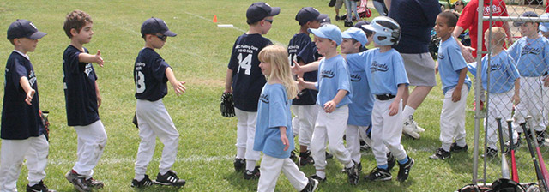
QUESTIONS?

