Slide 1

Wolves Hockey Summer Challenge
-212 Degree Award
-10,000 Shot Club

Slide 2


Slide 3
212 Degree Award
When you have a pot of water on the stove and it reaches a temp of 211 degrees Fahrenheit, you have only a pot of hot water. By adding only one degree, you increase the temp to 212 degrees Fahrenheit, the boiling point of water, and now you have steam power- a force that can move mountains. By simply elevating one degree, there is no telling what you may accomplish, and by everyone on our team elevating their game one degree, we can move mountains as a team.

Slide 4
212 Degree Award
One point for each completed activity per week.
140 total points available over the next 7 months.
Goals:
70 Points (50%) - Stickhandling Ball.
105 (75%)-New Hockey Stick or Equivalent Gift Certificate.

Slide 5
212 Degree Award Points
Stickhandling - 15 minutes per week.
Shooting - 180 per week.
Dryland - 3 age appropriate per week.
Post videos to Facebook: #Walkeryouthhockeyicewolves
Attend Spring/Summer ice in Bemidji.

Slide 6
Dryland and Stickhandling Link
Dryland Training (usahockey.com)

Slide 7
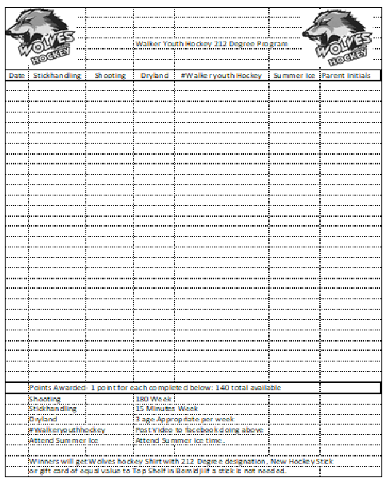

Slide 8
10,000 Shot Club
7 Months to Complete.
1,430 Shots per Month.
360 Shots per Week.
52 Shots per Day.
**Banner will be displayed at the arena with names of kids that completed the challenge.**

Slide 9
