Slide 1
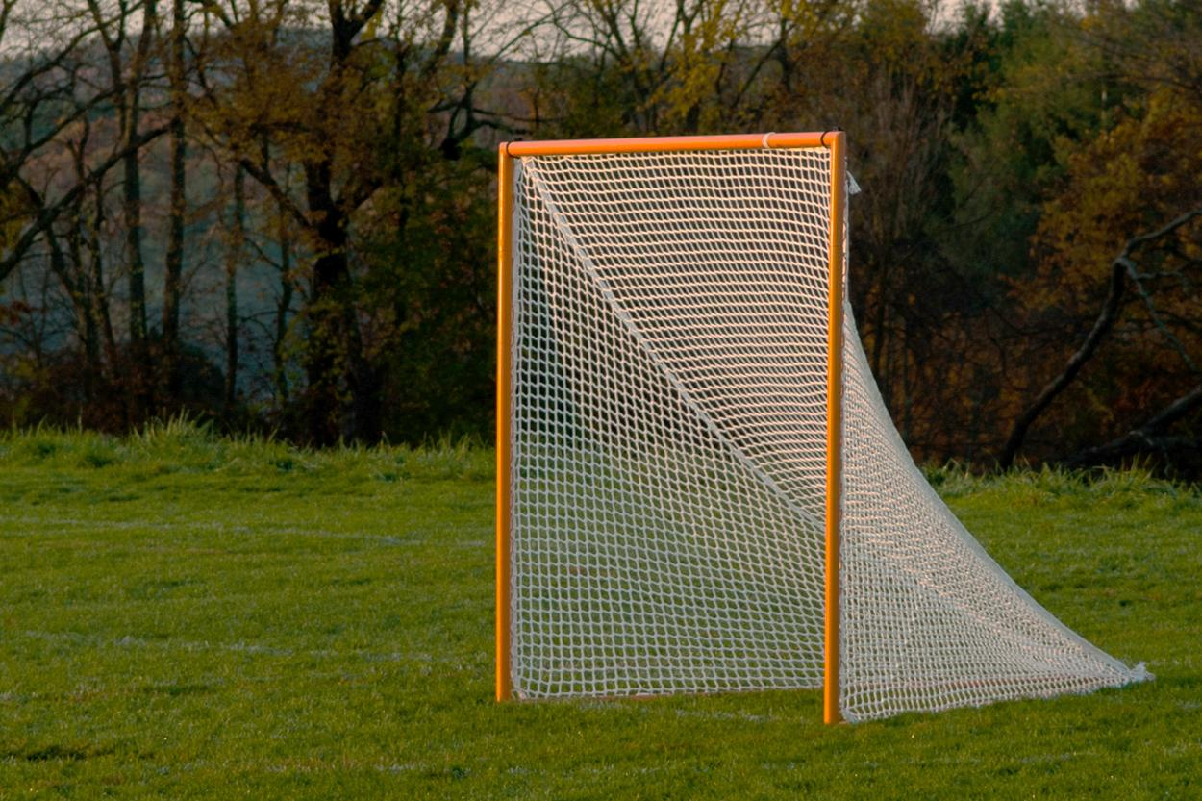
2025 NHYLA COACHES RULES CLINIC
Permission to use photograph granted by Mark Finerty

Slide 2
2025 RULES CLINIC
This is a clinic – it is NOT the rule book or the mechanics manual.
This is an overview of the general rules for boys youth lacrosse.
This will address rule changes as well as points of emphasis.
This is an opportunity to review the rules, not discuss previous misapplications or incorrect adjudications.
The more involved you can be in this clinic, the more you will be able to take from it.

Slide 3
YOUTH POINTS OF EMPHASIS REVIEW
Contact: (Violent Collisions)
Therefore, there is no justification for deliberate and violent collision by any player at any youth level, especially intentional player-to-player collisions with defenseless players (so-called “blind side” and “buddy-pass” checks), checks involving the head and/or neck, and excessive body-checks (“take-out checks”).
Body Checking: There is no Body Checking at 8U,10U and 12U. Only legal pushes and holds are permitted
Illegal Stick Checking (Slashing): Any stick checks that are not on the stick or the gloved hand on the stick is considered a slash.
Coaches and Team area: At 12U and 14U Coaches are to remain in their Coaches area. Exceptions are; To warm up a Goalie, To attend to an injured player or at Halftime.
Only 3 Coaches are allowed in the Coaches area.
Mouth Guards are required and must be worn properly (No “Fish-hooking”)
A Mouth Guard violation is a Technical foul

Slide 4
NEWER RULES REMINDERS
Quick Restart- The official will start play once an offensive player is ready. He no longer needs to wait for the defender to back up 5 yds. It is up to the defender to either get 5 yds away, leave a straight line for the offensive player to pass or, at some point, get 5 yds of separation before engaging or “playing” the ball carrier. Offensive players must also be 5 yds away from the ball carrier at the whistle. The penalty for a defender engaging the ball carrier before reaching 5 yds distance is a technical foul for delay of game
Stick Penalties- All stick penalties (14U & 12U) are 2 mins full-time serve. The stick is allowed to be fixed and must be fixed before being used in the game again.

Slide 5
“NEWER” RULES CONT.
Face-Offs are Standing Neutral Grip (SNG)-No knee on the ground. Hand closest to throat (right hand) is palm up.
8U &10U Small sided- 4x4 Goals are REQUIRED
Goalies must wear chest protectors that meet NOCSAE ND 200 standards and have the SEI Certification mark
Field players are required to wear shoulder pads that meet the NOCSAE ND 200 standards and have the SEI Certification mark.
5 Min. Misconduct -A player that is assessed a time serving penalty can also be assessed a 5 Min. Misconduct. Once his time for the original penalty is over, his team sends a player in. The player who was assessed the Misconduct then starts serving his 5 Mins of game time.
Substitution box is 10 yds (5 yds either side of midfield) with an additional 5 yds each side for a “Coaches Area”

Slide 6
NEWER RULES CONT.
12U,10U and 8U: All stick checks must be initiated with the checkers’ stick starting below the shoulder level of the smaller of the players involved
Goalies are not required to wear arm pads (recommended)
Stalling rule at 12U and 14U: Stall rule is in effect in the last 2 mins unless the leading team is up by 5 goals, then there is no stall “Keep it in” call.
A player can legally hold another player using the portion of the stick between his hands as long as his hands are no wider than shoulder width and only equal pressure is applied.
A player can legally “ward” off as long as both hands are on his crosse and he only contacts the defenders crosse. Warding with one hand off and/or warding against a defenders body is still illegal.

Slide 7
NEWER RULES CONTINUED
(4-14-3)-“over and back” – Rule to keep the ball in play in the offensive half of the field once possession has been established in goal area (satisfied the 10-second count). 12U & 14U ONLY
(4-22-2,3) When ball is restarted in goal area – Offensive team starts laterally outside of box – Defense can start within defensive goal area (Box)
(4-18-4) No defensive player, other than a properly equipped goalkeeper, can enter his own crease with the perceived intent on blocking a shot or acting as a goalkeeper. Penalty: Conduct foul on the defensive player. A second violation by the player or his team will be enforced as a releasable unsportsmanlike conduct
In 8U and 10U small field games, during a face-off, all other players are to stay behind GLE until “Possession” is called. (essentially a 2v2) w/ face-off men and wings). For 10U small field, players release on the whistle. No contact with other players. Play the ball only.

Slide 8
NEWER RULES CONT.
Designated Defender-A team must choose a starting defender to serve penalties for the goalkeeper if a team does not have a back-up goalie suited up and appropriately equipped ( Pre-game w/ Officials) 10U, 12U and 14U

Slide 9
PRE-GAME
Home Team Responsibilities
“Securing Dedicated Scorekeeper and Timekeeper for the game. Preferably this is two separate people; however one person may do both timing and scorekeeping (timer/scorer should have a record keeping book AT the bench). However under no circumstances can this be a coach or assistant coach of the teams playing the game.”
Game Clock
Scoreboard visible to both teams’ benches
A working horn

Slide 10
PRE-GAME
Officials ask coaches for captain(s)’ numbers.
-Captains will be part of the coin-toss
Away captain calls “head” or “tail” during captain meeting
Winner of coin toss gets choice:
First Alternate possession
or
Choice of goal to defend
Officials asks for “In-Home” and “Designated Defender”
In-Home is a starting attack, “DD” is a starting defender
In-Home serves all bench penalties and “DD” serves Goalie penalties. (If team does not have a back-up dressed)
Designated Defender is used in 10U,12U and 14U

Slide 11
PRE-GAME
Officials Certify Coaches
Official will ask, “Coach, do you certify all your players are properly equipped by rule?” Rule 1-11 A.1
What you are saying yes to is that ALL players:
Have been informed what equipment is mandatory and what constitutes illegal equipment.
Have been provided the equipment mandated by rule.
Have been instructed to wear and how to wear mandatory equipment during the game.
Have been instructed to notify the coaching staff when equipment becomes illegal through play.
Have had their crosses, uniforms and all other equipment inspected by the head coach and meets specifications.

Slide 12
PRE-GAME
Starting line-up
Left shoulder to the goal team is defending.
Official provides additional instruction.
Goalies shake hands/touch gloves
Go to respected goals
Players come across and meet their opponents
Touch gloves
Players get to positions

Slide 13
FACE-OFF
Official places the ball on the ground
Players come down together in a “Standing, Neutral Grip (SNG) position”
Sticks are straight up and down and parallel to the line
EVERYTHING is to the left of the plastic (of the head). – Stay out of neutral zone.
Official may adjust player
Official says “set”
Official backs out, varying cadence of whistle, blows whistle to start faceoff
Unsportsmanlike Conduct (touching with hands)

Slide 14
FACE-OFF
8U and 10U
6 goal mercy rule
Have choice of possession or face-off
Official will only ask once, Coach can change his mind
8U &10U (Short Field) must attempt a pass or bring the ball through “X” before they can shoot
12U and 14U
ALL NFHS rules with the exception of the required tape.
Cannot carry ball in back of stick
Can clamp, must be moved, raked, or directed immediately (within one step)

Slide 15
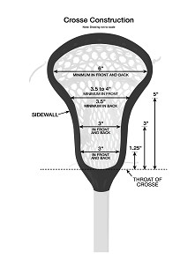
LEGAL CROSSE DIMENSIONS
8-U AND 10-U (37” – 42” for ALL players (NO long-poles)
12-U AND 14-U (40” to 42” and up to 4 long-poles from 52” to 72”)

Slide 16
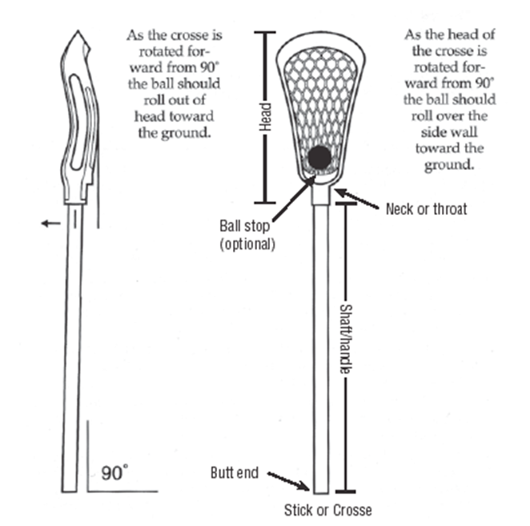
POCKET/STICK CHECK
‹#›

Slide 17
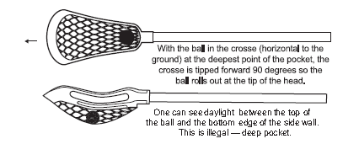
LEGAL CROSSE

Slide 18
LEGAL EQUIPMENT
Gloves
Helmet
Mouth piece (visible color not white or clear)
Arm/Elbow pads
Shoulder pads meeting New NOCSAE ND 200 standards
Protective cup (required)
Rib pads (recommended)
Goalie equipment
All of the above (with the exception of shoulder pads and elbow pads ) PLUS throat guard and chest protector (that meets NOCSAE ND 200 standards)
‹#›

Slide 19
PERSONAL FOULS
One, two or three minute fouls:
Cross-check
Illegal Body-Check
Illegal Crosse (2 mins full-time)
Use of illegal equipment
Slashing (intentional contact could be full-time)
Tripping
Unnecessary roughness (full-time served)
Unsportsmanlike conduct (could be full-time)
If a check is made with contact to the head or neck it is a minimum of 2 minutes full time served.
‹#›

Slide 20
PERSONAL AND EJECTION FOULS
“In keeping with the overarching emphasis on player safety and sportsmanship at the youth level, US Lacrosse expects stricter enforcement of the Cross Check, Illegal Body Check, Checks Involving the Head/Neck, Slashing, Unnecessary Roughness, and Unsportsmanlike Conduct rules than is common at the high school level.”

Slide 21
FOULING OUT
10U through 14U:
3 personal fouls OR 5 minutes in personal foul penalty time.
8U: 3 personal fouls. (Player “serves” time but teams do not play short)
It is important to have some system at scorer’s table to track player penalty infractions and penalty time.

Slide 22
CHECKS TO HEAD/NECK
TWO-, or THREE-minute non-releasable foul, at the official’s discretion.
This can no longer be a one-minute foul.
An excessively violent violation of this rule may result in an ejection.

Slide 23
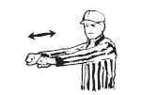
CROSS-CHECK
CROSS-CHECK
A check “with the part of the handle of the cross that is between the players hands by either,”
Thrusting away from the body
OR
Holding it extended from the body

Slide 24
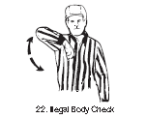
ILLEGAL BODY-CHECK
NO TAKE-OUT CHECKS ARE PERMITTED BY ANY PLAYER AT ANY AGE LEVEL
ANY body check in which the player lowers his head or shoulders with the force and intent to put the other player on the ground.
14U: Body checking is permitted.
“delivered in a generally upright position with both hands on the stick and the player initiating the check may not use his lowered head or shoulder to make the initial contact.”
8U,10U and 12U: NO body checking of ANY kind is
permitted
Legal pushes and holds – “play the ball”
‹#›

Slide 25
ILLEGAL CROSSE - EQUIPMENT
Every crosse on a team is subject to inspection, and the crosse need not have been in the game to be inspected.
Officials conduct a minimum of two random equipment checks per game.
8U and 10U: Not looking for penalty, youth officials might check for practice but all sticks need to meet specs.
12U and 14U follow NFHS rules
2 Minute full-time penalty for all stick violations

Slide 26
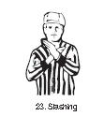
SLASHING
Swinging a crosse with deliberate viciousness or reckless abandon, regardless of whether contact is made.
12U,10U and 8U: All stick checks must be initiated with the checkers’ stick starting below the shoulder level of the smaller of the players involved
Striking an opponent: Where player’s crosse strikes some part of the attacking player’s body.
The gloved hand (in contact with the crosse) is considered part of the crosse
All Levels: One handed check is a slash

Slide 27
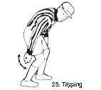
TRIPPING
Obstructing an opponent at or below the waist with the crosse, hands, arms, feet or legs…..
If an opponent falls over a player’s crosse when that player is attempting to scoop a loose ball, no foul has been committed.

Slide 28
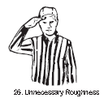
UNNECESSARY ROUGHNESS
ALL Unnecessary Roughness penalties are one-, two-, or three-minute non-releasable penalties.
Excessively violent hold or push
Deliberately running through a screen
Avoidable contact that is deliberate and violent
A check delivered with a gloved hand (punching blow)
‹#›

Slide 29
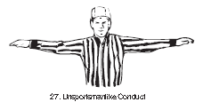
UNSPORTSMANLIKE
NON-RELEASABLE – FULL TIME SERVED
Arguing
Threatening, using obscene/profane language (starting with damn).
Baiting or calling undue attention
Grabbing ball during face-off
Releasable: 2nd offense of Defender in crease with intent to block a shot
A player or coach is ejected after receiving his second unsportsmanlike conduct.

Slide 30
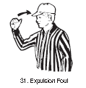
EJECTION
Fighting
2nd unsportsmanlike conduct foul
ANY action deemed to be a flagrant misconduct
Note:
ALL ejections get reported to NHYLA.
Individual (player/coach) are suspended for the next game.
The 2nd ejection is suspension for the next two games.
The 3rd ejection is a suspension for the remainder of the season.

Slide 31
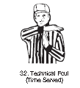
TECHNICAL FOULS
Holding, Pushing
Illegal Screening
Interference
Warding off
Withholding
Crease Violations
Offside
Stalling
Illegal Procedure
Conduct Foul
Player Control
Special Enforcement
Catch-all
Behavior
‹#›

Slide 32
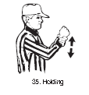
HOLDING
Impeding the movement of an opponent or his crosse
With the handle that is between the hands spread more than
shoulder width apart
Stepping on the crosse.
Hold or pin the opponents crosse against the their body.
Hold with the free hand that is off the crosse.
Pinning opponents crosse on a face-off.
Attackman locking down on D-pole
Legal holds:
An opponent from front or side within in 3 yards of loose ball.
Holding opponent’s crosse with their crosse.

Slide 33
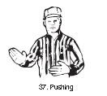
PUSHING
Thrust or shove an opponent from the rear
Not a violent blow
A legal push (from front and not violent) can take place within 3 yards of loose ball

Slide 34

ILLEGAL SCREEN INTERFERENCE
Making contact with a defensive player when attempting to set a screen.
Moving any part of body
Extending crosse
Contact MUST occur
INTERFERENCE:
Interfering in any manner with the free movement of an opponent
UNLESS opponent has ball, or
Ball is in flight or loose and contact is within 3 yards.

Slide 35
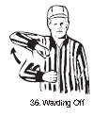
WARDING
A player in possession shall NOT use his:
Free hand
Arm
Or any other part of his body to
HOLD
PUSH
CONTROL THE DIRECTION OF THE MOVEMENT OF THE BODY OF THE PLAYER APPLYING CHECK.
*DOES NOT APPLY IF 2 HANDS ARE ON THE CROSSE*
A player in possession MAY
Protect (BLOCK) his crosse with his hand or arm or other part of his body when opponent makes a play to check his crosse.

Slide 36

CREASE VIOLATIONS GOALIE PRIVILEGES
LOOSE BALL
Outside the crease
Free play
Inside the crease
CAN’T make contact with goalie’s crosse – Play-on (possession outside the box if ball not successfully moved out of crease).
POSSESSION
Outside the crease
Free play
Inside the crease
CAN’T make contact with goalie (4 seconds) – Play-on (free clear if ball not successfully moved out of crease).

Slide 37
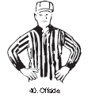
OFF-SIDES
Off-sides.
When team has more than 6 players in offensive half
When team has more than 7 players in defensive half
NOT OFFSIDES – with too few players at either half and team has NOT gained an advantage.
Offense is off-sides
Turn-over ball awarded at spot when whistled.
Defense is off-sides
Flag down or play-on
Restarted at mid-field or 20 yards laterally from goal.

Slide 38
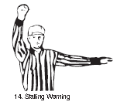
COUNTS AND STALLING
8U and 10U:
NO counts
12U and 14U:
20 Seconds to get ball over midfield
10 seconds to get ball into offensive box
Once gained have entire midfield to work in – Over and Back Rule in effect if ball crosses midline
Under 2-minutes (team ahead) or considered not attacking goal
“Get it in/Keep it in”
Until goal scored, defense gains possession, quarter ends resulting in a face-off,
If ball comes out of box by attacking team – Delay of game
Unless team is leading by 5 goals or more

Slide 39

ILLEGAL PROCEDURE
24 illegal procedures can be called:
Illegal touching of the ball
Illegal actions with the crosse
Delay of game (avoidable lateness of team)
Entering game before penalty ends
Having more than 4 long-poles
Playing from out of bounds
Failure to advance the ball in a timing situation
Not restarting play within 5 seconds of when the officials are ready to restart play
A player loses equipment; regardless of proximity of opposing players

Slide 40
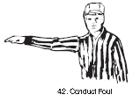
CONDUCT
Similar to an unsportsmanlike conduct but less severe in nature
Technical foul rules apply
Coaches, when asked by officials, will assist with inappropriate spectator conduct.

Slide 41
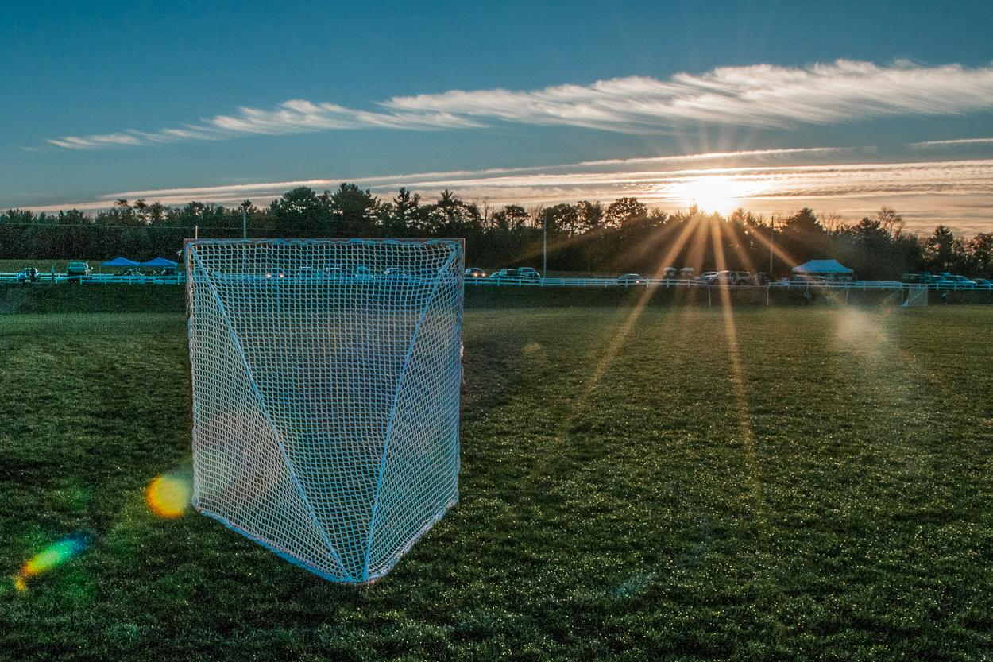
QUESTIONS
Permission to use photograph granted by Mark Finerty

