Slide 1

SIYSL COVID-19 Safety Guidelines for 2020-2021 Seasons
THESE GUIDELINES ARE TO BE CARRIED OUT BY ALL LEAGUE CLUB AND TEAM PERSONNEL TO ENSURE THE HEALTH AND SAFETY OF ALL

Slide 2

PRIOR TO ANY PRACTICE OR COMPETITION
TEAMS SHOULD COLLECT A PLAYER HEALTH QUESTIONNAIRE PRIOR TO ALL PRACTICES AND COMPETITIONS. THE LEAGUE OFFICIALS MAY ASK TEAMS TO PROVIDE EVIDENCE THAT ALL PLAYERS HAVE ATTESTED TO BEING IN GOOD HEALTH
TEAMS MUST ENSURE ALCOHOL BASED HAND SANITIZERS ARE AVAILABLE FOR THE TEAM
PROHIBIT ANYONE WITH COVID-19 SYMPTOMS FROM ENTERING THE SPACE . ANYONE WITH SYMPTOMS MUST BE SENT HOME OR TO A HEALTH CARE PROVIDER
HAVE EMERGENCY CONTACTS FOR PLAYERS ON HAND AND DESIGNATE AN ISOLATION AREA FOR ANYONE WHO MAY START EXPERIENCING SYMPTOMS DURING THE EVENT.

Slide 3
PRIOR TO ANY PRACTICE OR COMPETITION
PARENT /SPECTATOR CHECKLIST
Ensure child is healthy and check your child’s temperature daily
All attending match should take temperatures prior to and stay home if 100 degrees or higher
Wear mask to and from and during a match
No more than 2 spectators per player
Always maintain minimum of 6 feet of physical distance from other family’s
Do not assist coach with equipment before or after training
Be sure your child always has sanitizer with them
Avoid going to the opposing team’s side of the field
spectators may not sent up tents or canopies at the facility

Slide 4
PRIOR TO ANY PRACTICE OR COMPETITION
COACH CHECKLIST
COLLECT HEALTH QUESTIONNAIRE OR VERIFY ELECTRONIC SUBMISSION
Ensure all players have their individual equipment (ball, water bottles, bag, etc.)
The use of scrimmage vests or pinnies is not recommended at this time
Coach is the only person to handle all practice equipment. (cones, disk etc.)
ENSURE ALCOHOL BASED HAND SANITIZERS ARE AVAILABLE FOR THE TEAM
ENSURE THAT PLAYERS OR PARENTS WHO ARE SYMPTOMATIC IS NOT ALLOWED INTO THE AREA

Slide 5
ON PRACTICE AND COMPETITION DAYS
COACH CHECKLIST
MAINTAIN AN ATTENDANCE LOG ON ALL PRACTICE AND COMPETITION DAYS FOR POTENTIAL TRACING
TAKE SANITATION BREAKS DURING PRACTICES AND DURING HALF TIME OF COMPETITIONS
LIMIT THE SHARING /HANDLING OF EQUIPMENT WHERE POSSIBLE TO LIMIT THE PASSING OF CONTAGIONS
CLEAN AND DISINFECT EQUIPMENT AND ANY SHARED MATERIALS OR COMMON SPACES
LIMIT SPECTATORS TO 2 PER PARTICIPANT AND ENSURE SOCIAL DISTANCING COMPLIANCE (6FT) UNLESS WITH MEMBERS OF THEIR HOUSEHOLD OR CLOSE SOCIAL CONTACTS

Slide 6
ON PRACTICE AND COMPETITION DAYS
COACH CHECKLIST
HELP ENSURE SPECTATORS MAINAIN SOCIAL DISTANCING AND THAT THE NUMBER OF SPECTATORS DO NOT EXCEED THE 2 PEOPLE PER PARTICIPANT LIMIT ESTABLISHED BY NYC PARKS
USE THE LEAGUE’S SIGNAGE AND FIELD MARKINGS TO HELP ESTABLISH PROPER SPACING WHEREVER POSSIBLE
FOR ADDITIONAL REFERENCES PLEASE SEE Physical Distancing (NYS DOH Interim Guidance for Sports and Recreation pages 5-6)

Slide 7
ON PRACTICE AND COMPETITION DAYS
PLAYER CHECKLIST
Take temperature daily before arriving at the field
Arrive to and leave field fully dressed (uniform, shoes, guards, etc.)
Wear mask to and from the field
Wear mask when on the bench
Maintain minimum of 6 feet of physical distance from all others when on bench (players, coaches, etc.)

Slide 8
ON PRACTICE AND COMPETITION DAYS
PLAYER CHECKLIST
Bring and use hand sanitizer with you to every training
Do not touch or share anyone else’s equipment, water bottles, energy drinks, etc.
Wash and sanitize all equipment before and after every training
No group celebrations, no high fives, chest bumps, hugs, handshakes etc.

Slide 9
ON COMPETITION DAYS
REFEREE CHECKLIST
Wear gloves
Wear mask during check in, pregame, and coin toss
If you feel you need to wear a mask and it does not affect your ability to ref the game, wear it
Avoid touching player passes
You may allow league administrator or team manager to secure passes after player check-in

Slide 10
ON COMPETITION DAYS
REFEREE CHECKLIST
If a player or coach is sent off with a red card, report it to the League via the appropriate format immediately after the game-at this time you are under no obligation to keep the players pass if not comfortable doing so
Wash hands and/or use sanitizer frequently
Avoid close contact with players whenever possible
Try not to handle the ball when possible
Do not share water bottles
Social distance from your fellow referees
Instruct the teams to socially distance and avoid celebrations

Slide 11
ON COMPETITION DAYS
REFEREE CHECKLIST
Do not share water bottles
Social distance from your fellow referees
Instruct the teams to socially distance and avoid celebrations
Avoid shaking hands with players before and after gamES
Substitute players should be wearing a mask on the bench
If you feel an unsafe condition exists, do not play the game
.

Slide 12
ON COMPETITION DAYS
REFEREE CHECKLIST
It is always recommended that you take the appropriate precautions to protect yourself. Please consider the following:
o Exclude referees and players that have symptoms from participating in activities
o Exclude referees and players that have been exposed to the coronavirus and have been directed to by health officials to self-isolate / self-quarantine from participating in activities
o Expectation of cooperation with local health officials and contact tracers if a referee or player tests positive for the Coronavirus.

Slide 13


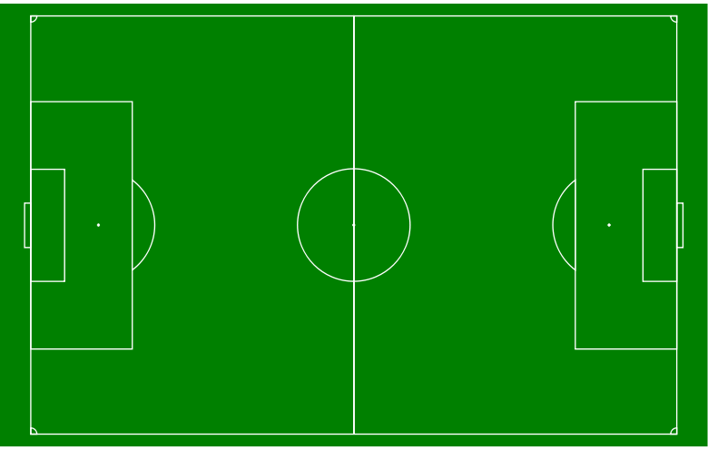
NEW FIELD SPACING AMD TEAM SIDELINES
VISITING TEAM MASKS AND 6FT APART
VISITING TEAM PARENTS MASKS ( OFF THE SIDELINE) 6FT
HOME TEAM AND PLAYERS WILL OCCUPY ONE ENTIRE SIDELINE WITH TEAM SITTING ON ONE HALF OF THE FIELD AND HOME TEAM PARENTS ON THE OTHER HALF OF THE SAME SIDLINE
VISITING TEAM WILL OCCUPY THE OPPOSITE SIDE LINE IN THE SAME MANNER
TEAMS ARE DIAGONAL OF EACH OTHER
PARENTS ARE DIAGONAL OF EACH OTHER
HOME TEAM PARENTS MASKS AND 6FT APART OFF THE SIDELINE
HOME TEAM MASKS AND 6FT APART

Slide 14

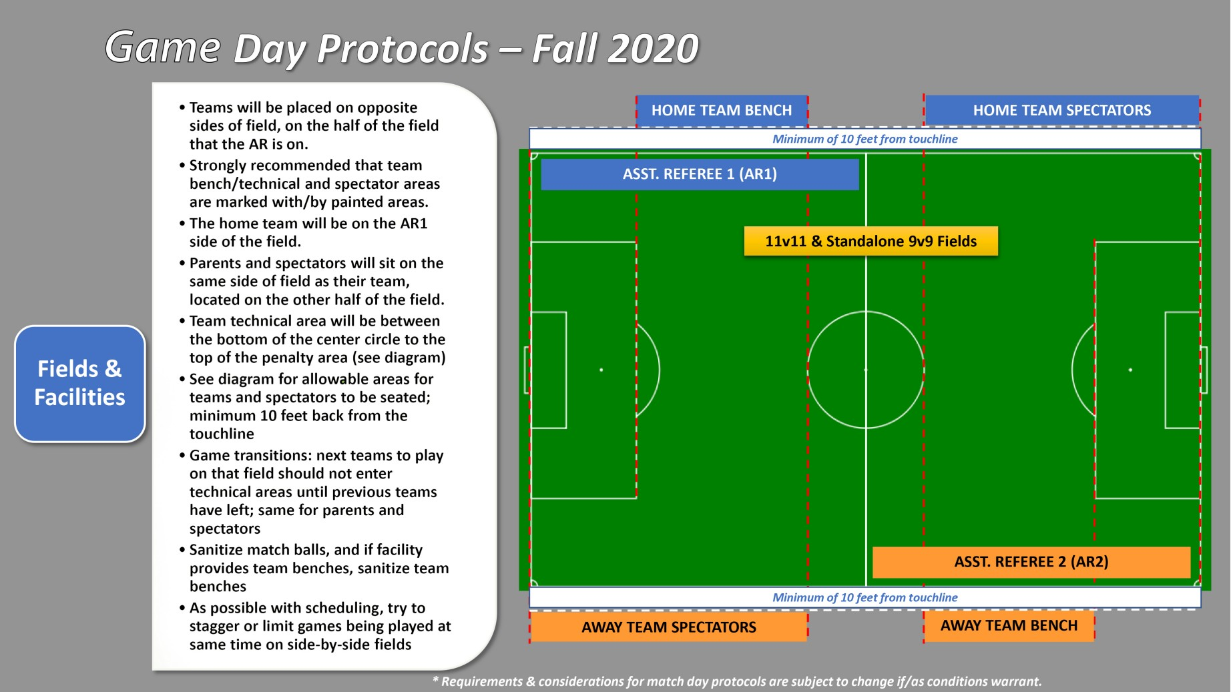
EASTERN NEW YORK YOUTH SOCCER ASSOCIATION
and Its Participating Leagues
RETURNING TO THE FIELD SAFELY
Eastern New York Youth Soccer Association
Game Day Protocols Fall 2020

Slide 15
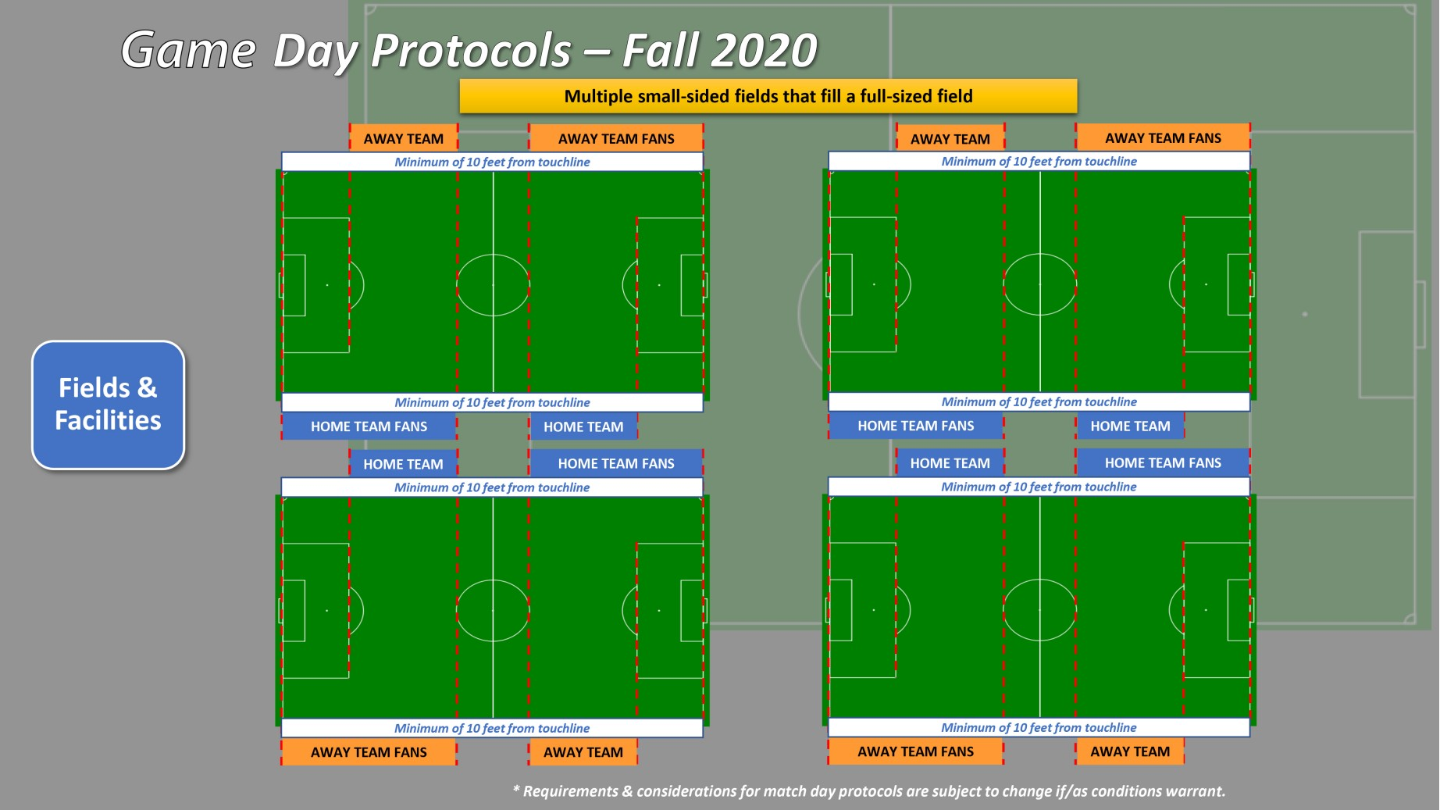
EASTERN NEW YORK YOUTH SOCCER ASSOCIATION
and Its Participating Leagues
RETURNING TO THE FIELD SAFELY
Eastern New York Youth Soccer Association
Game Day Protocols Fall 2020

Slide 16
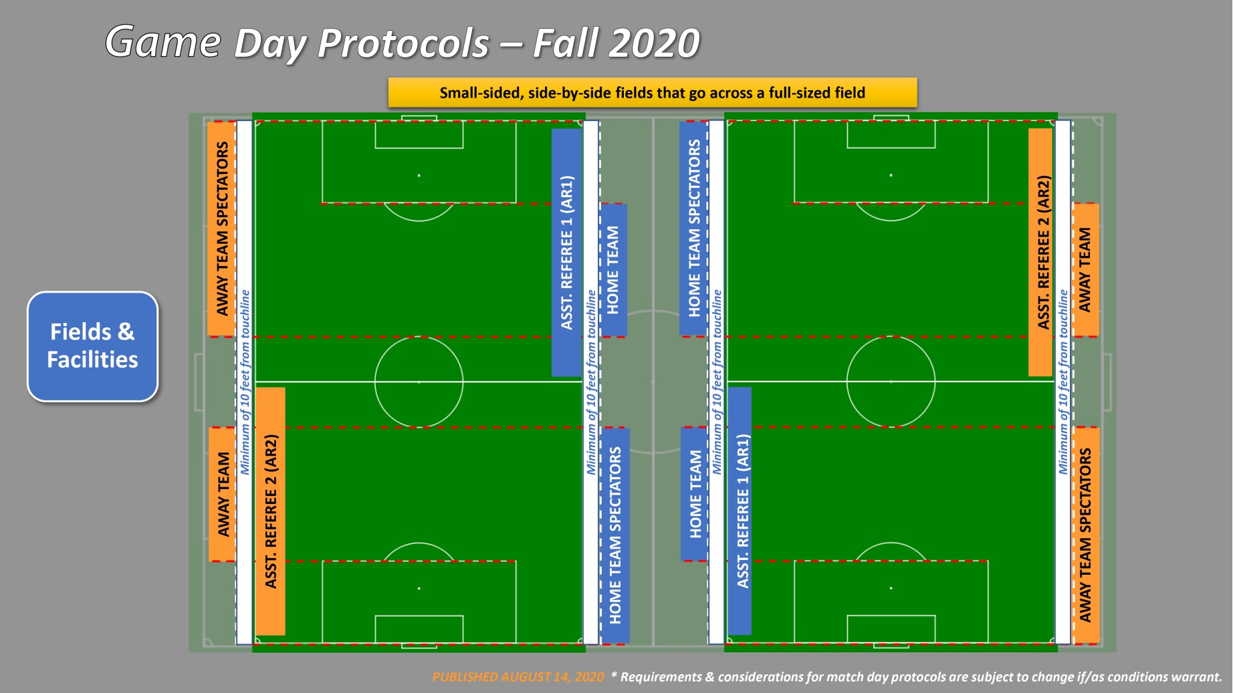
EASTERN NEW YORK YOUTH SOCCER ASSOCIATION
and Its Participating Leagues
RETURNING TO THE FIELD SAFELY
Eastern New York Youth Soccer Association
Game Day Protocols Fall 2020

Slide 17
POST EVENT GUIDELINES
PROHIBIT CONGREGATION OF GROUPS POST EVENT. ENCOURAGE RAPID DEPARTURE FROM THE AREA
ENSURE ALL PPE AND OTHER GARBAGE ARE PICKED UP AND DISPOSED OF. PPE SHOULD BE DISPOSED OF IN AN OFF SITE DISPOSAL AREA
IN THE EVENT OF ANY PARTICIPANT TESTING POSITIVE FOR COVID-19 AFTER THE EVENT/ OR HAS HAD POSSIBLE EXPOSURE TO COVID-19:
IN THE EVENT OF POSSIBLE EXPOSURE: COACH MUST NOTIFY THE DIRECTOR WHO WILL NOTIFY THE LEAGUE. PLAYER OR COACH SHOULD ISOLATE FOR 10 DAYS ANS SELF MONITOR.
COACH MUST NOTIFY THE CLUB DIRECTOR THAT A PERSON HAS CONTRACTED THE VIRUS
CLUB DIRECTORS MUST NOTIFY THE LEAGUE IMMEDIATE SO OPPONENTS AND OTHER TRACING MAY BEGIN
ALL PARTIES MAY NEED TO COOPERATE WITH LEAGUE AND LOCAL HEALTH OFFICIALS IN THE CONTACT TRACING PROCESS
PARTICPANT TESTING POSITIVE MAY ONLY RETURN WITH PROOF OF MEDICAL CLEARANCE
IF TWO OR MORE PLAYERS OR COACH BECOME POSITIVE FOR COVID-19 , TEAM ACTIVITIES ARE SUSPENDED FOR A MINIMUM OF 2WEEKS AND CONTACT TRACING PROCESS WILL BE ENACTED
NOTE THAT THESE REQUIREMENTS MAY CHANGE AS CDC AND LOCAL HEALTH AND SAFETY GUIDELINES CHANGE

Slide 18
SIYSL COVID-19 Safety Guidelines for 2020-2021 Seasons
BILL SMITH PRESIDENT ROB LIBERTELLI VP, ANTHONY PISCIOTTANO VP. RICH NELLIS VP, MIKE SEGRETTO VPMAUREEN MOTLEY SECRETARY, FRED CIPRIANI TREASURER
LIZ MORANO DEVELOPMENT OFFICER , TONI MOLLOY OFFICE ADMINISTRATOR

