Slide 1
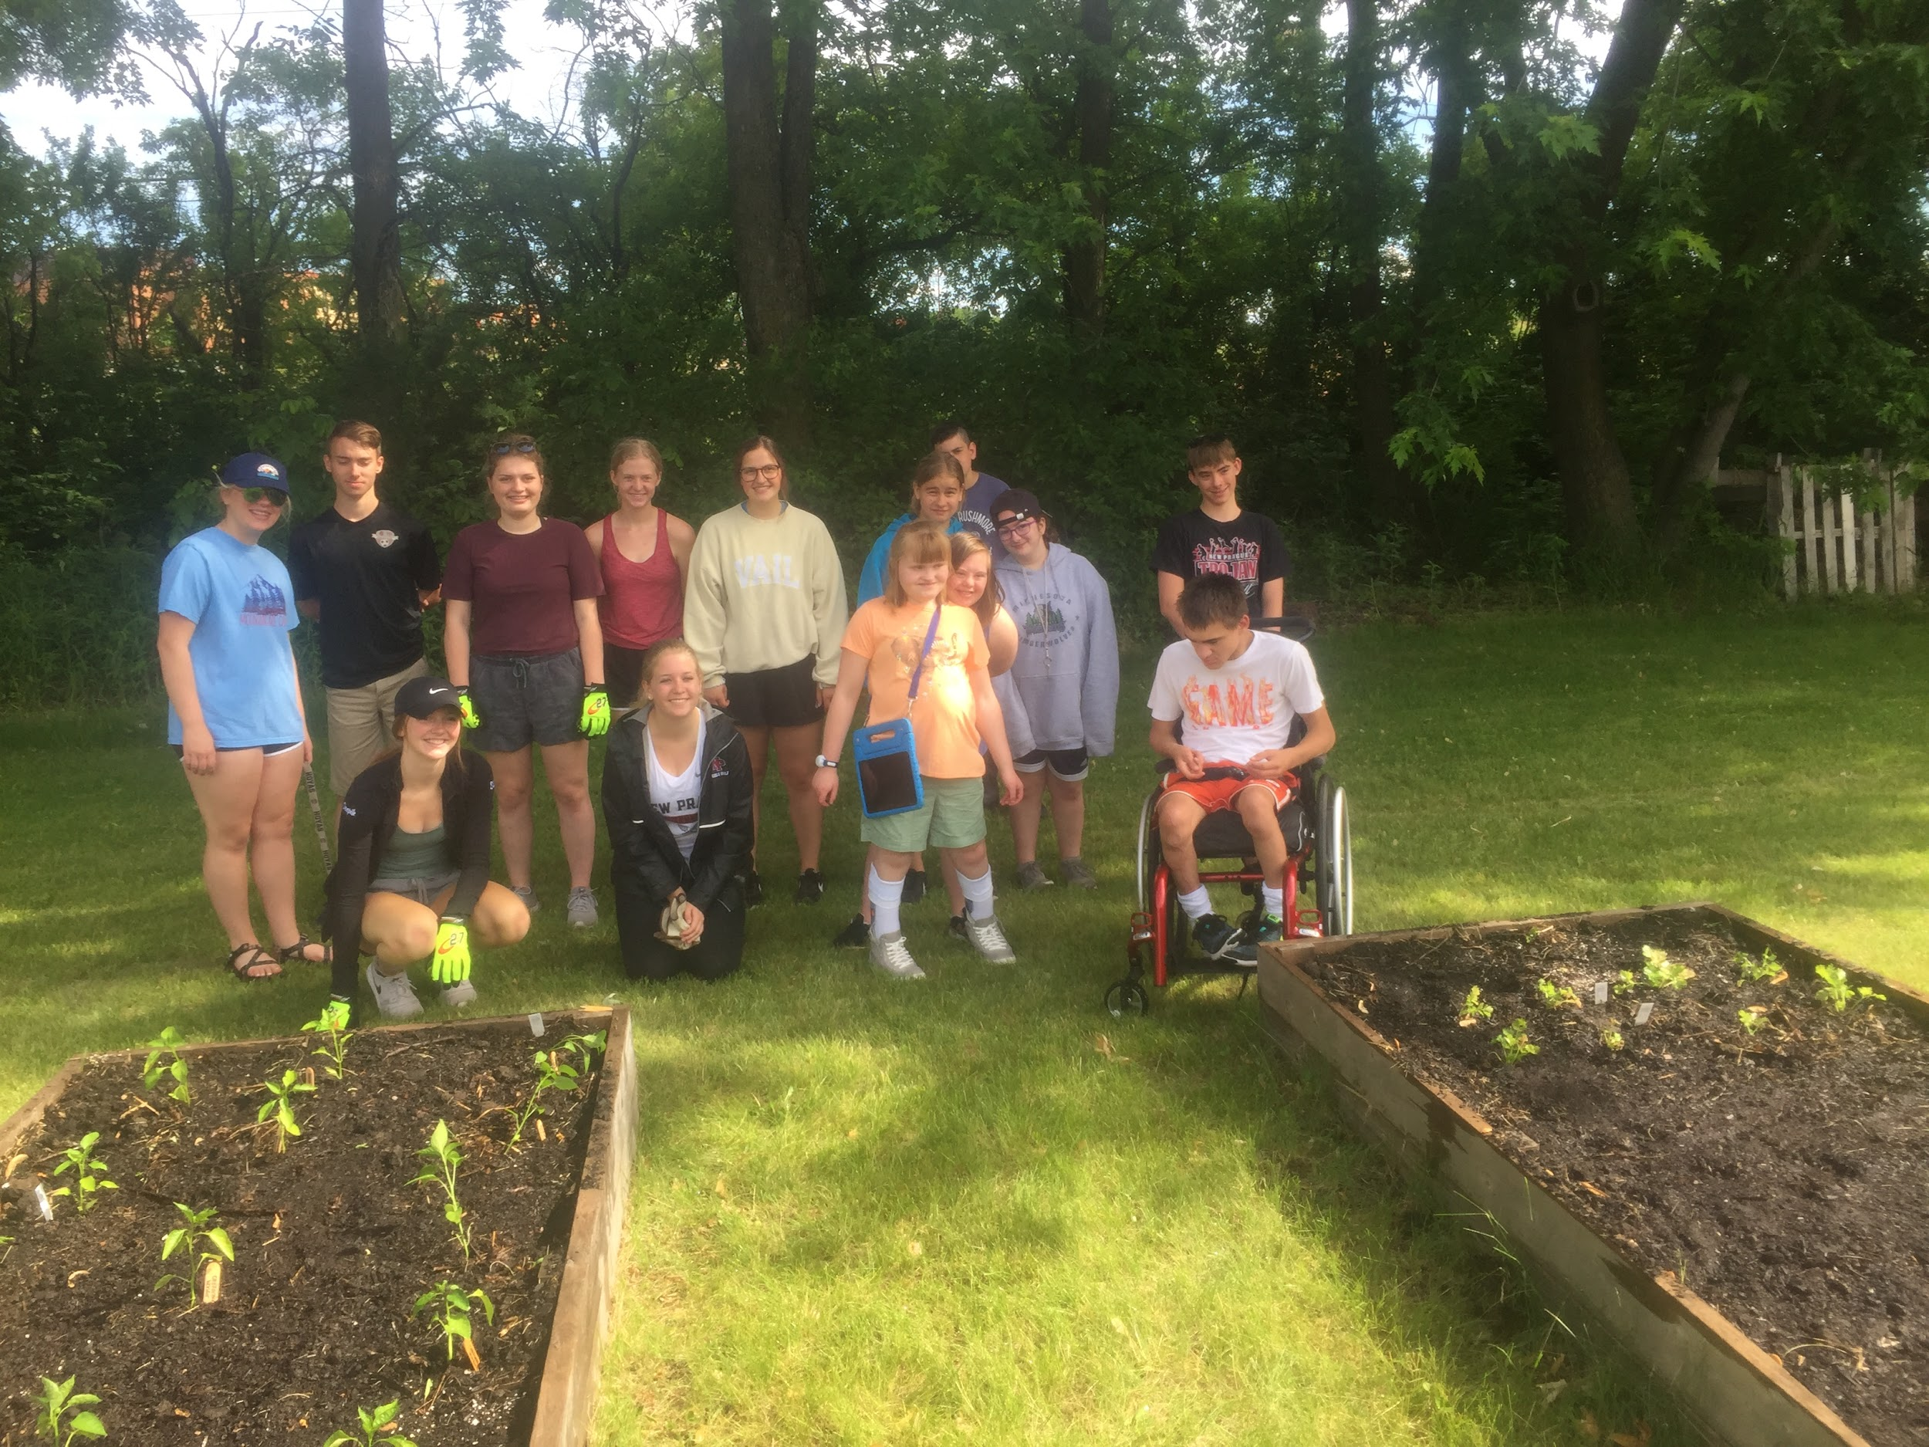
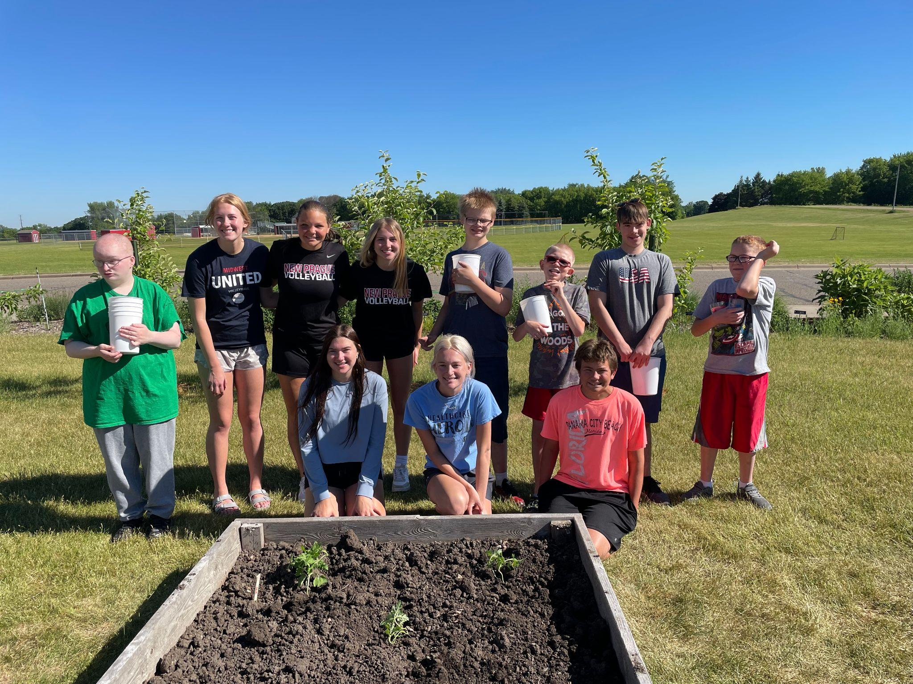
2021 Summer School Garden
Planting in June

Slide 2
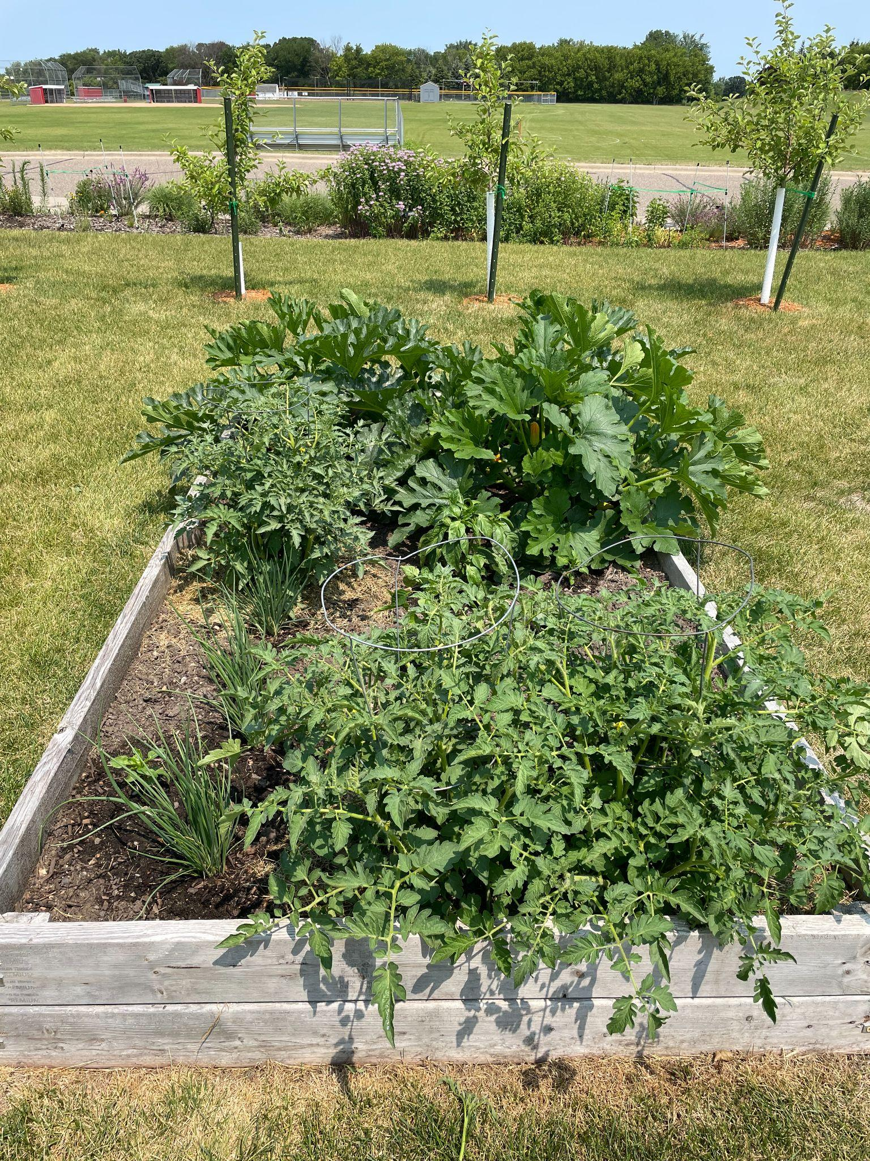
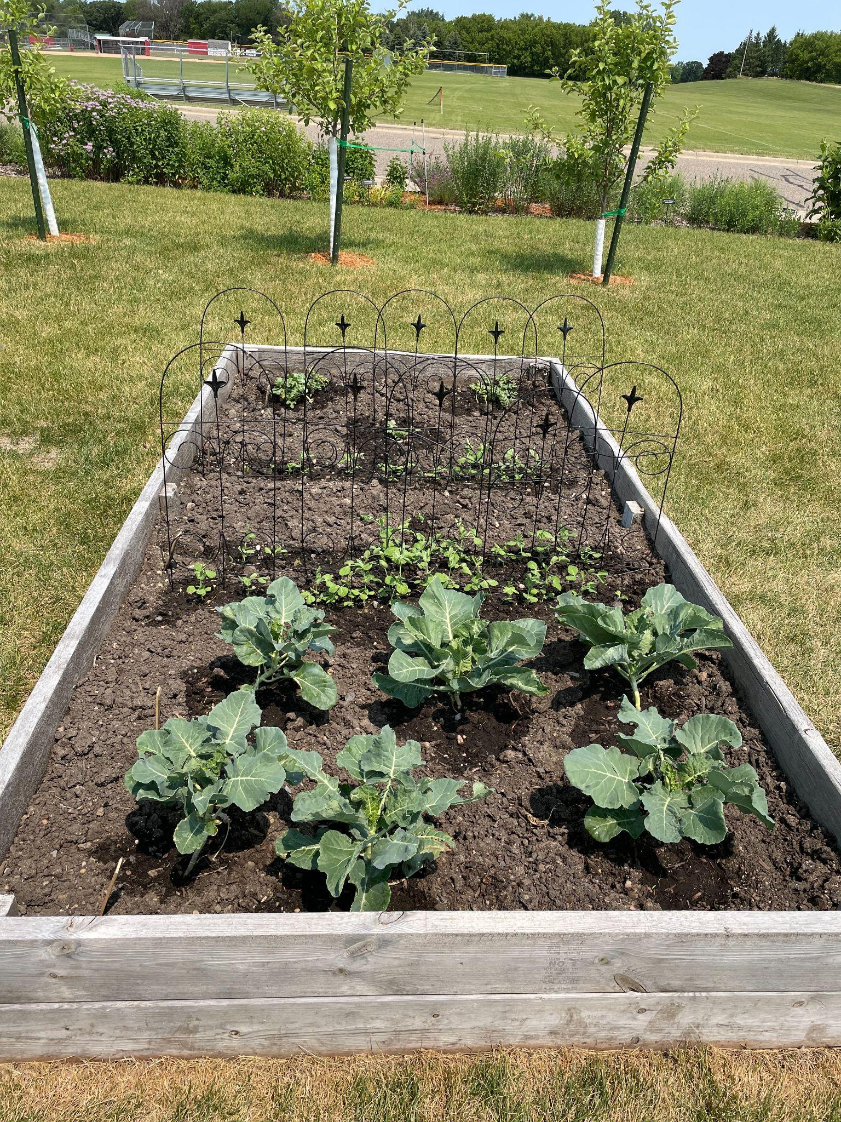
NPHS Gardens

Slide 3
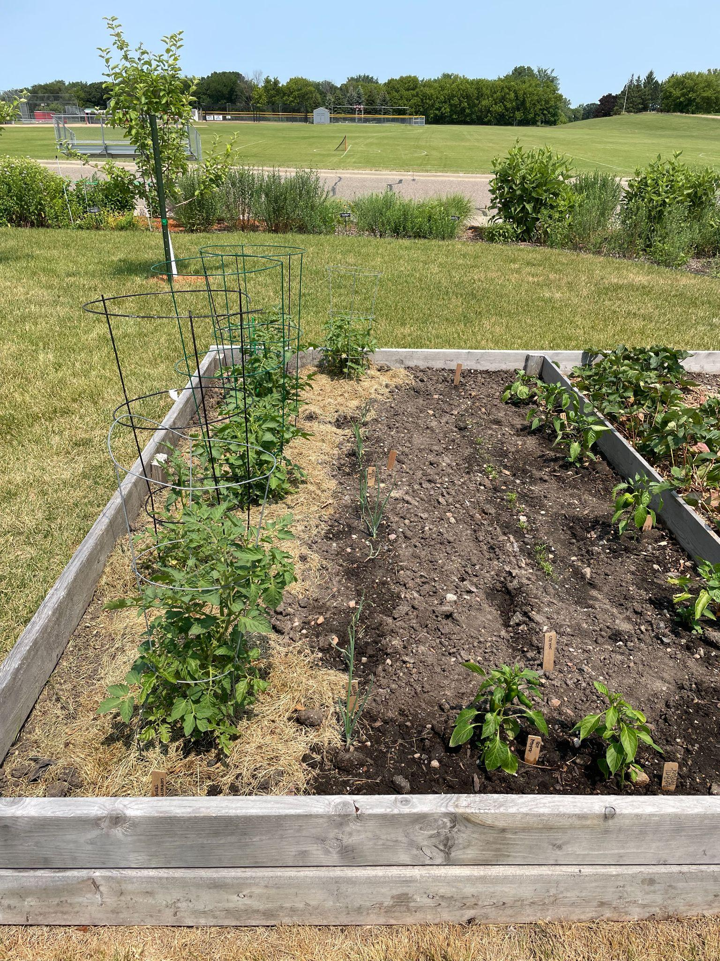
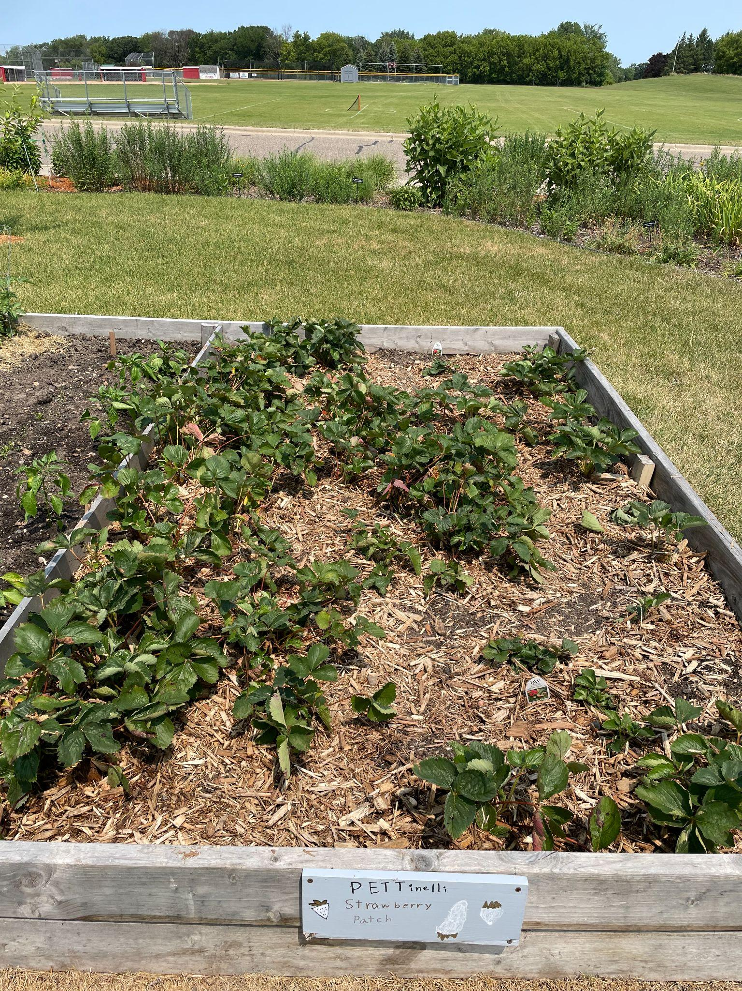
NPHS Gardens

Slide 4
Mission and Goals
Mission of the club is to make a positive impact on our environment by raising students and community awareness on environmental topics.
Goal this year is to provide produce through the school gardens.

Slide 5

Green Team Expectations
Be present at club meetings and club events. Club meetings will be on the third Wednesday of each month 7:00AM-7:30AM.
Sign up Genius and Volunteer throughout the school year and summer!

Slide 6
2020-2021 Green Team
Student Board Members
President- Laci Kratochvil
Vice President- Abby Molstad
Secretary- Anna Molstad
Treasurer- Izzy Fiecke
Social Media- Mariah Marek & Lily Moravchik

Slide 7
Sign up for REMIND
https://www.remind.com/join/nphsgrntm
Or
Send a text to 81010
Text this message
@nphsgrntm

Slide 8
Sign up Genie to volunteer a week to water/watch/harvest school gardens!

Slide 9

Check Out our WEBSITE

Slide 10
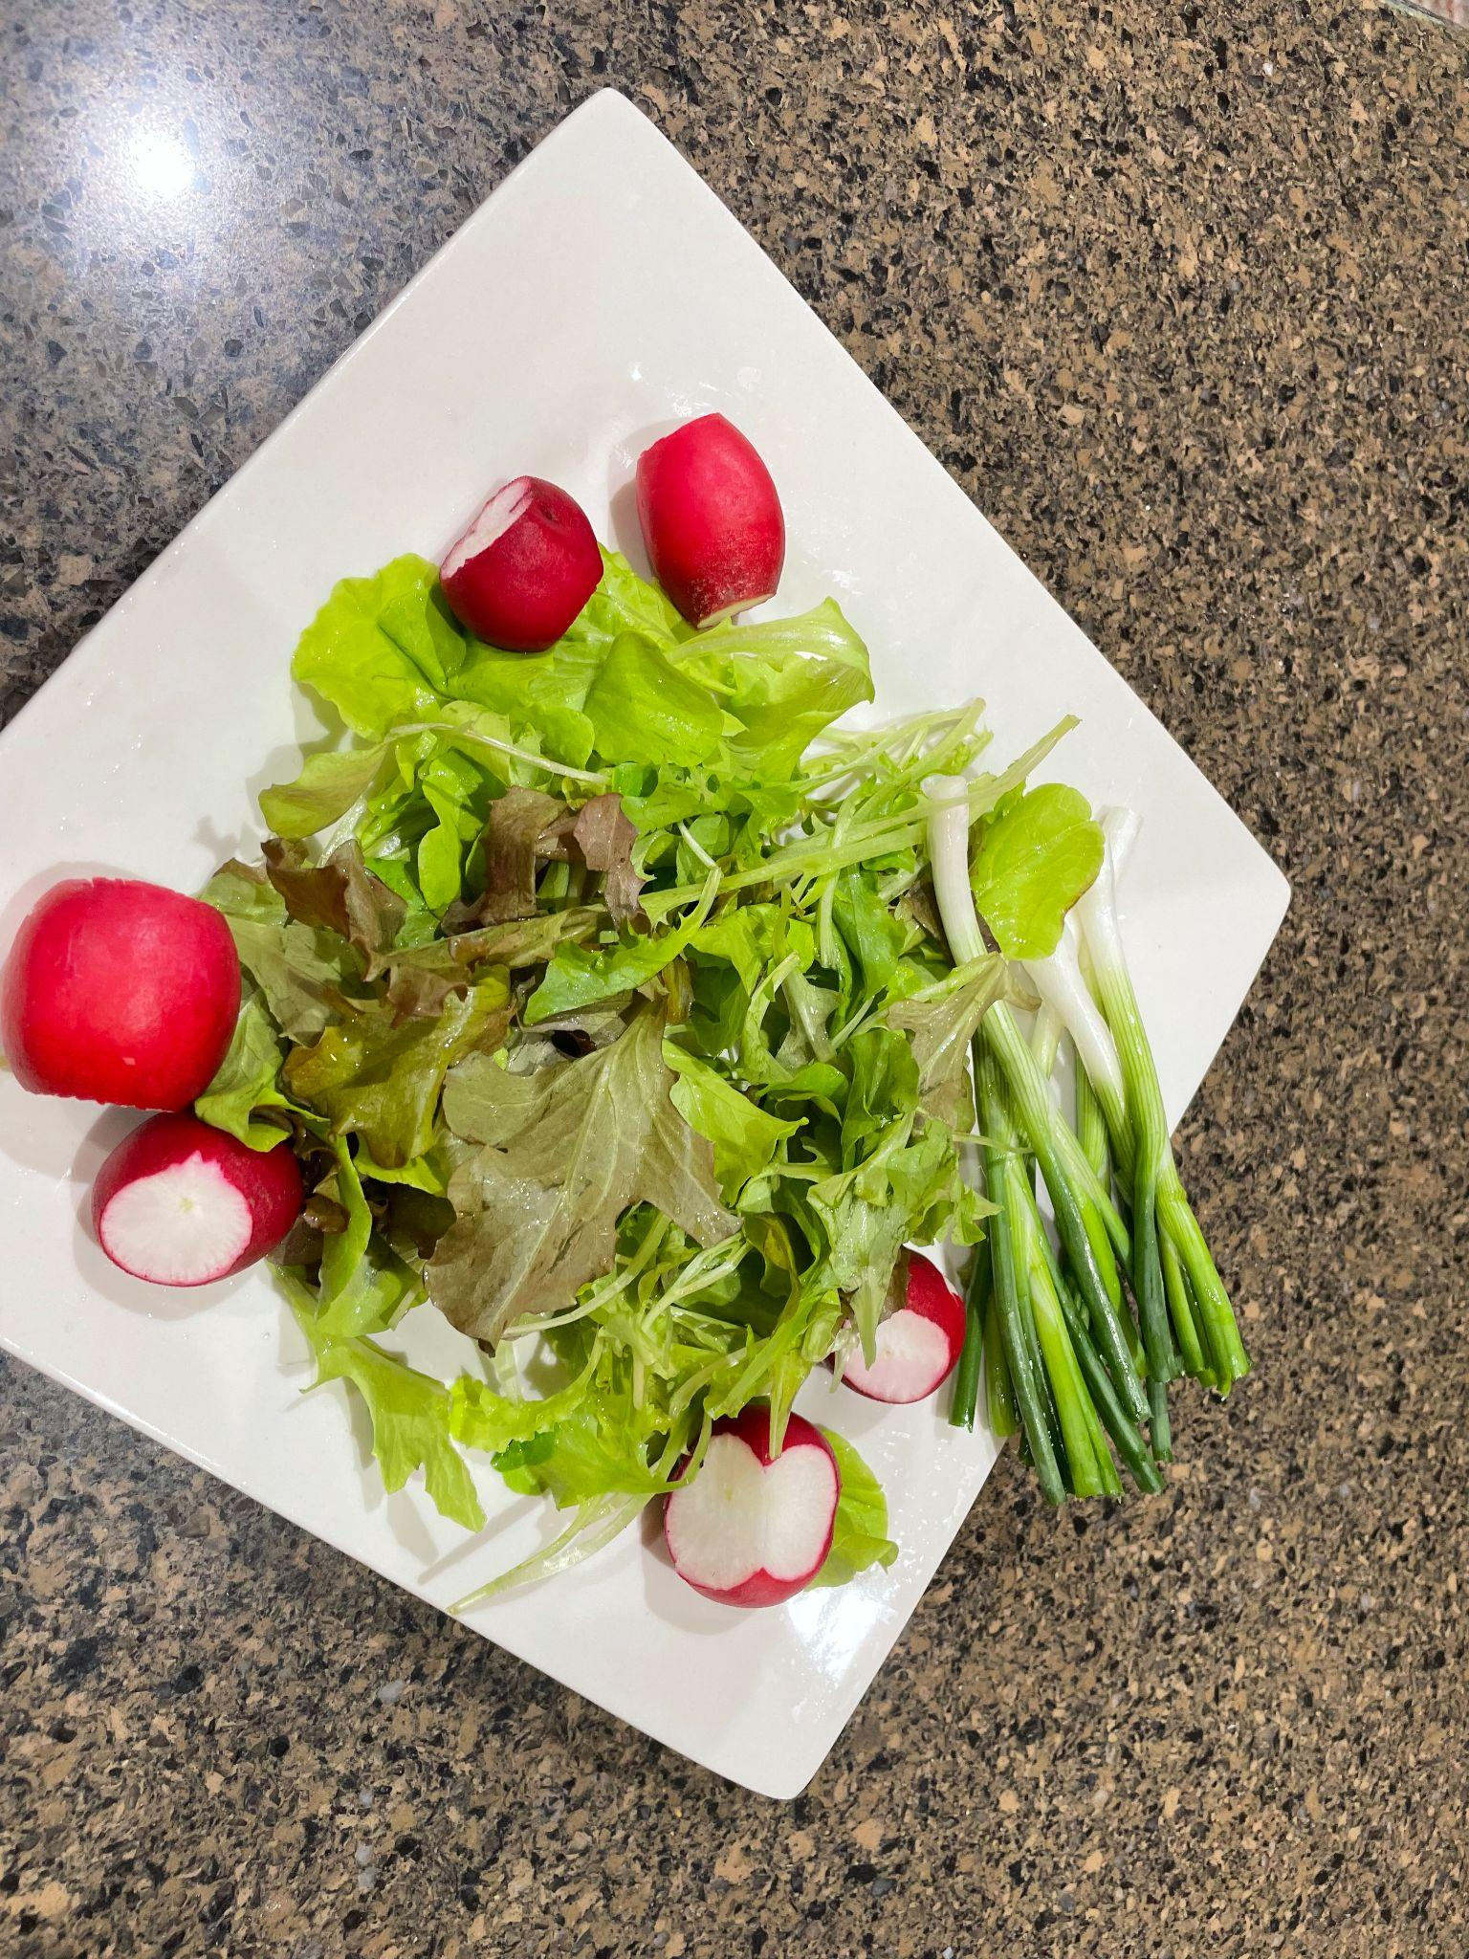

Slide 11
Lets Go PLANT Activity
Station 1 - 2 people to plant Parsley into two different pots
Station 2 - 2 people to plant Cilantro into two different pots.
Station 3 - 2 people to plant Basil into two different pots
----------------------------------------------
Station 4 - 3 to 4 people to plant “Loose Leaf Blend LETTUCE” in the Raised garden bed (10-12 rows of lettuce)
Station 5 - 3 to 4 people to plant “Loose Leaf Blend LETTUCE” in the Garden Bed.
Direction for lettuce: Place seeds thinly in rows about 12” apart and cover with ¼” of soil. Seedlings emerge in 7 to 10 days.
Another Group could pick the carrots; Peppers; and any tomatoes.

Slide 12
2021-2022
Oct Meeting

Slide 13
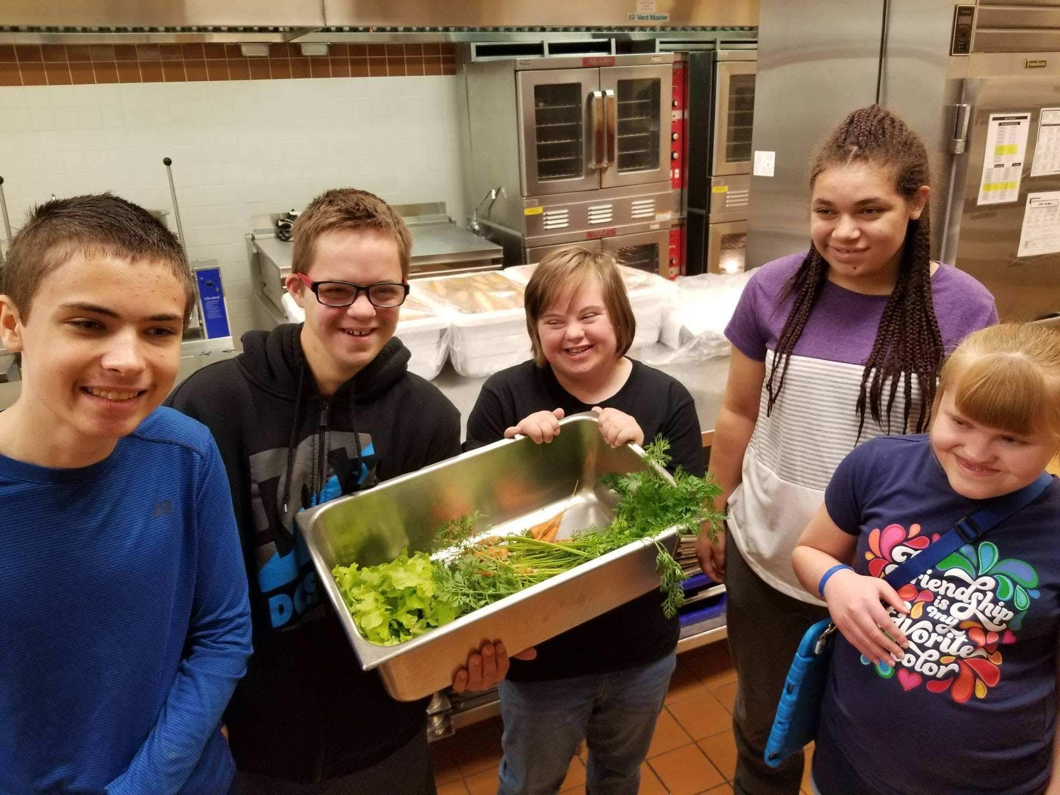
Providing vegetables from our school gardens to the Cafeteria

Slide 14

October is National Farm to School Month!

Slide 15
Projects/Ideas this year
Fall Harvest in school gardens-lettuce.
Aquaponic Living Tower Garden System and Hydroponic Gardening System - GROW LETTUCE for school cafeteria.
RESTART the Food Sharing Cart during lunch.
Annual Community Green Day in May! Plant sale!!
Partnership with NP Lions to build Garden Beds for Praha Village.
Maintenance and pruning of HS Apple Trees.
Maintenance of Pollinator Garden & Rain Garden
Manage Green Team Website; Facebook; Instagram.
Summer GARDENS!
Green Team Website; Facebook; Instagram
Make Compost and do it.

Slide 16
Upcoming Events
October is FARM TO SCHOOL MONTH
Do we want a float in the Homecoming Parade? If so, theme/directions who is in charge?
Partnership with NP Lions to put in garden beds at Praha Village.
In May, our annual Community Green Day at Cedarbrook Garden Center and is our annual fundraiser.
Set up CSA with high school Teachers to help/get veggies from coming school gardens.

Slide 17
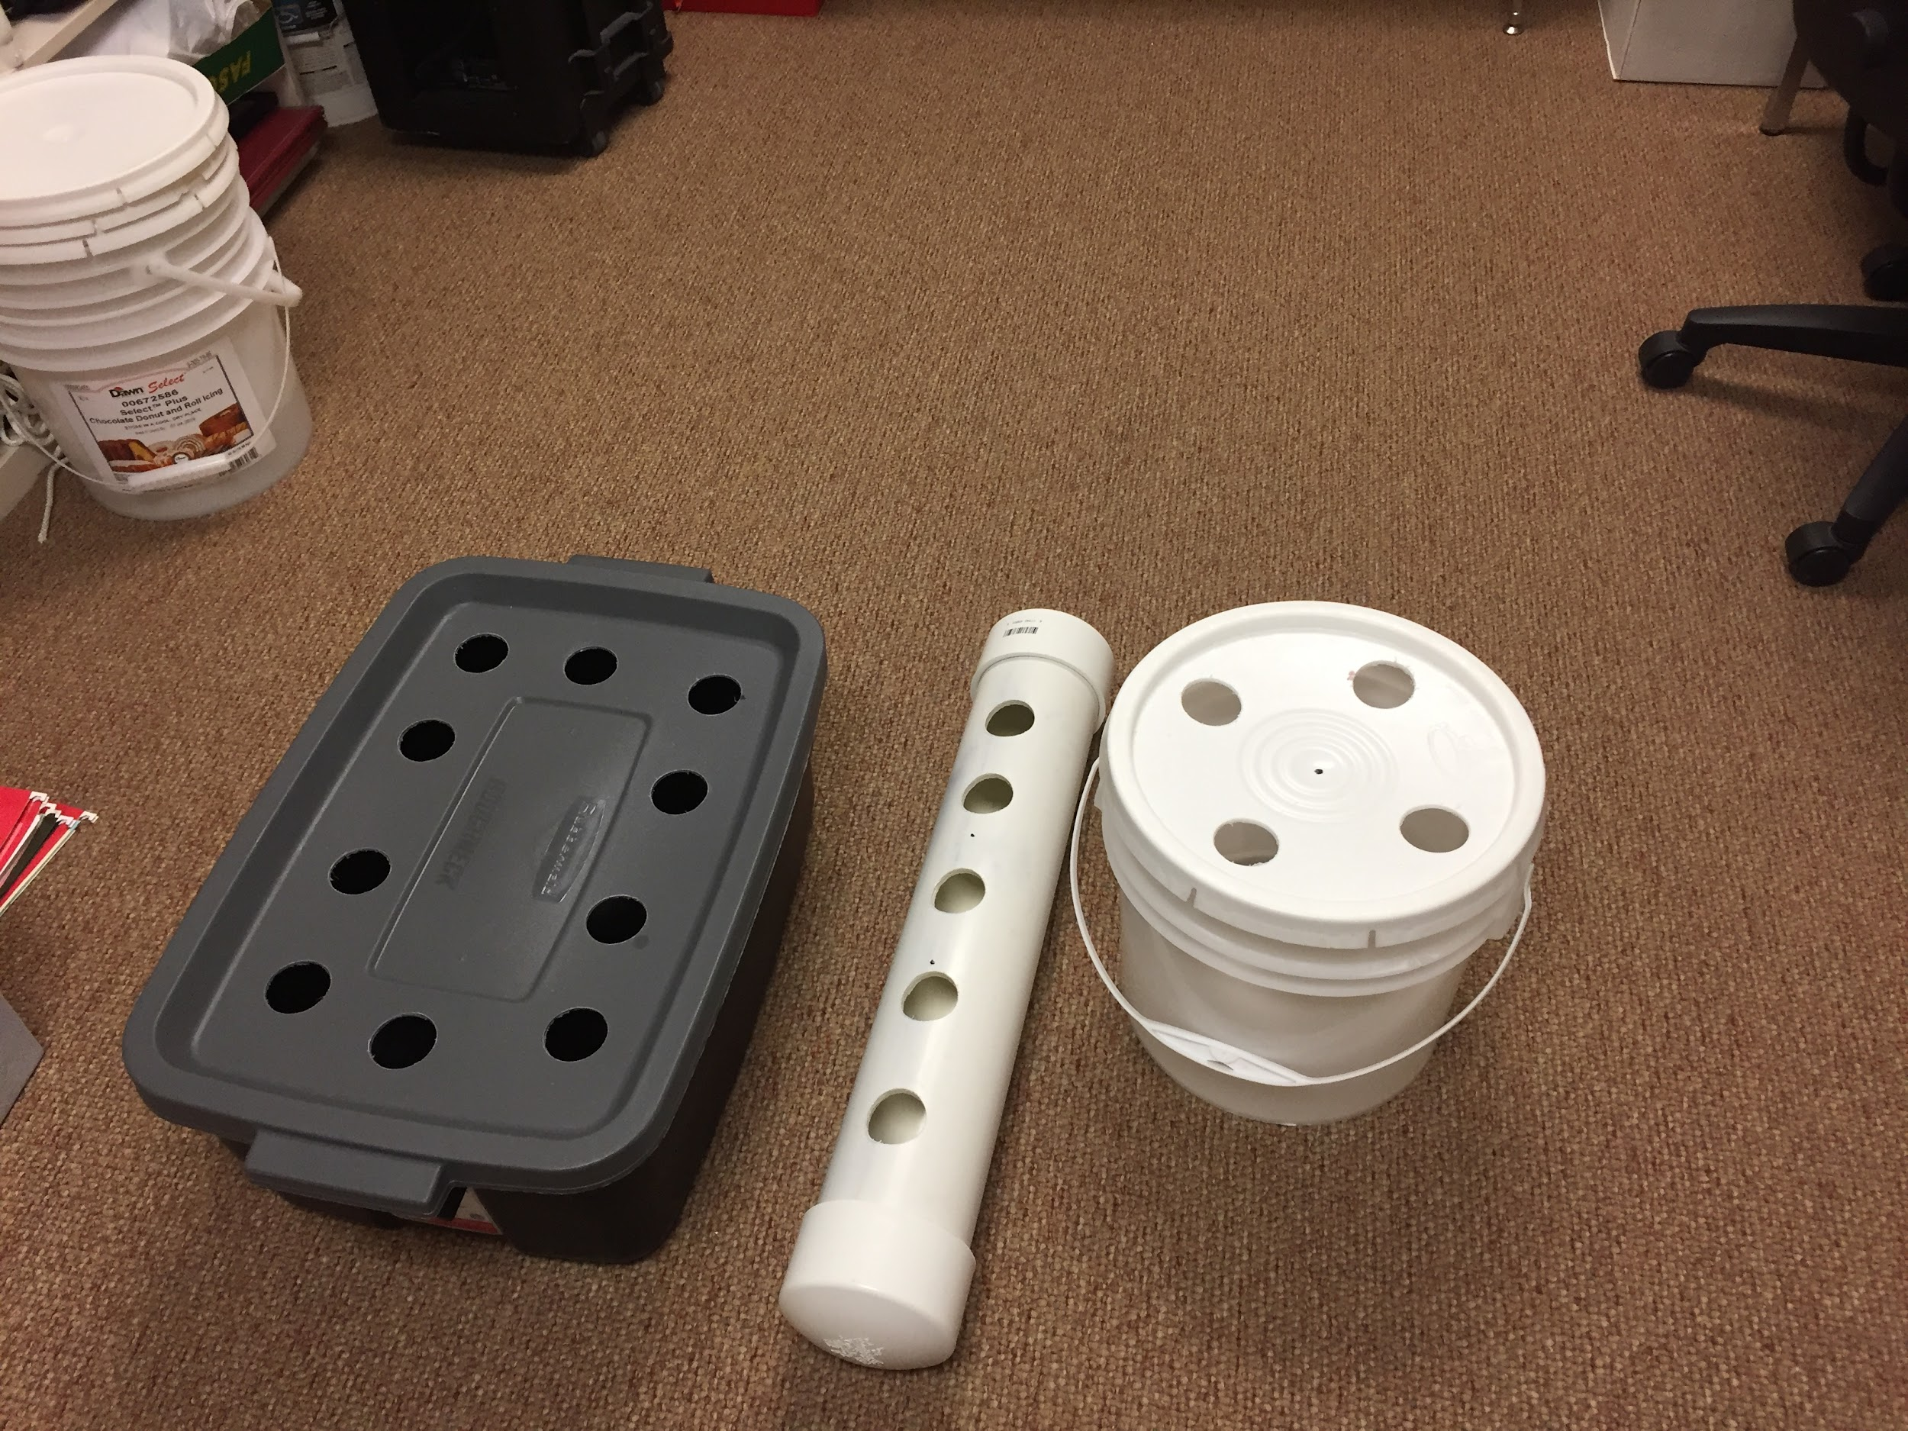
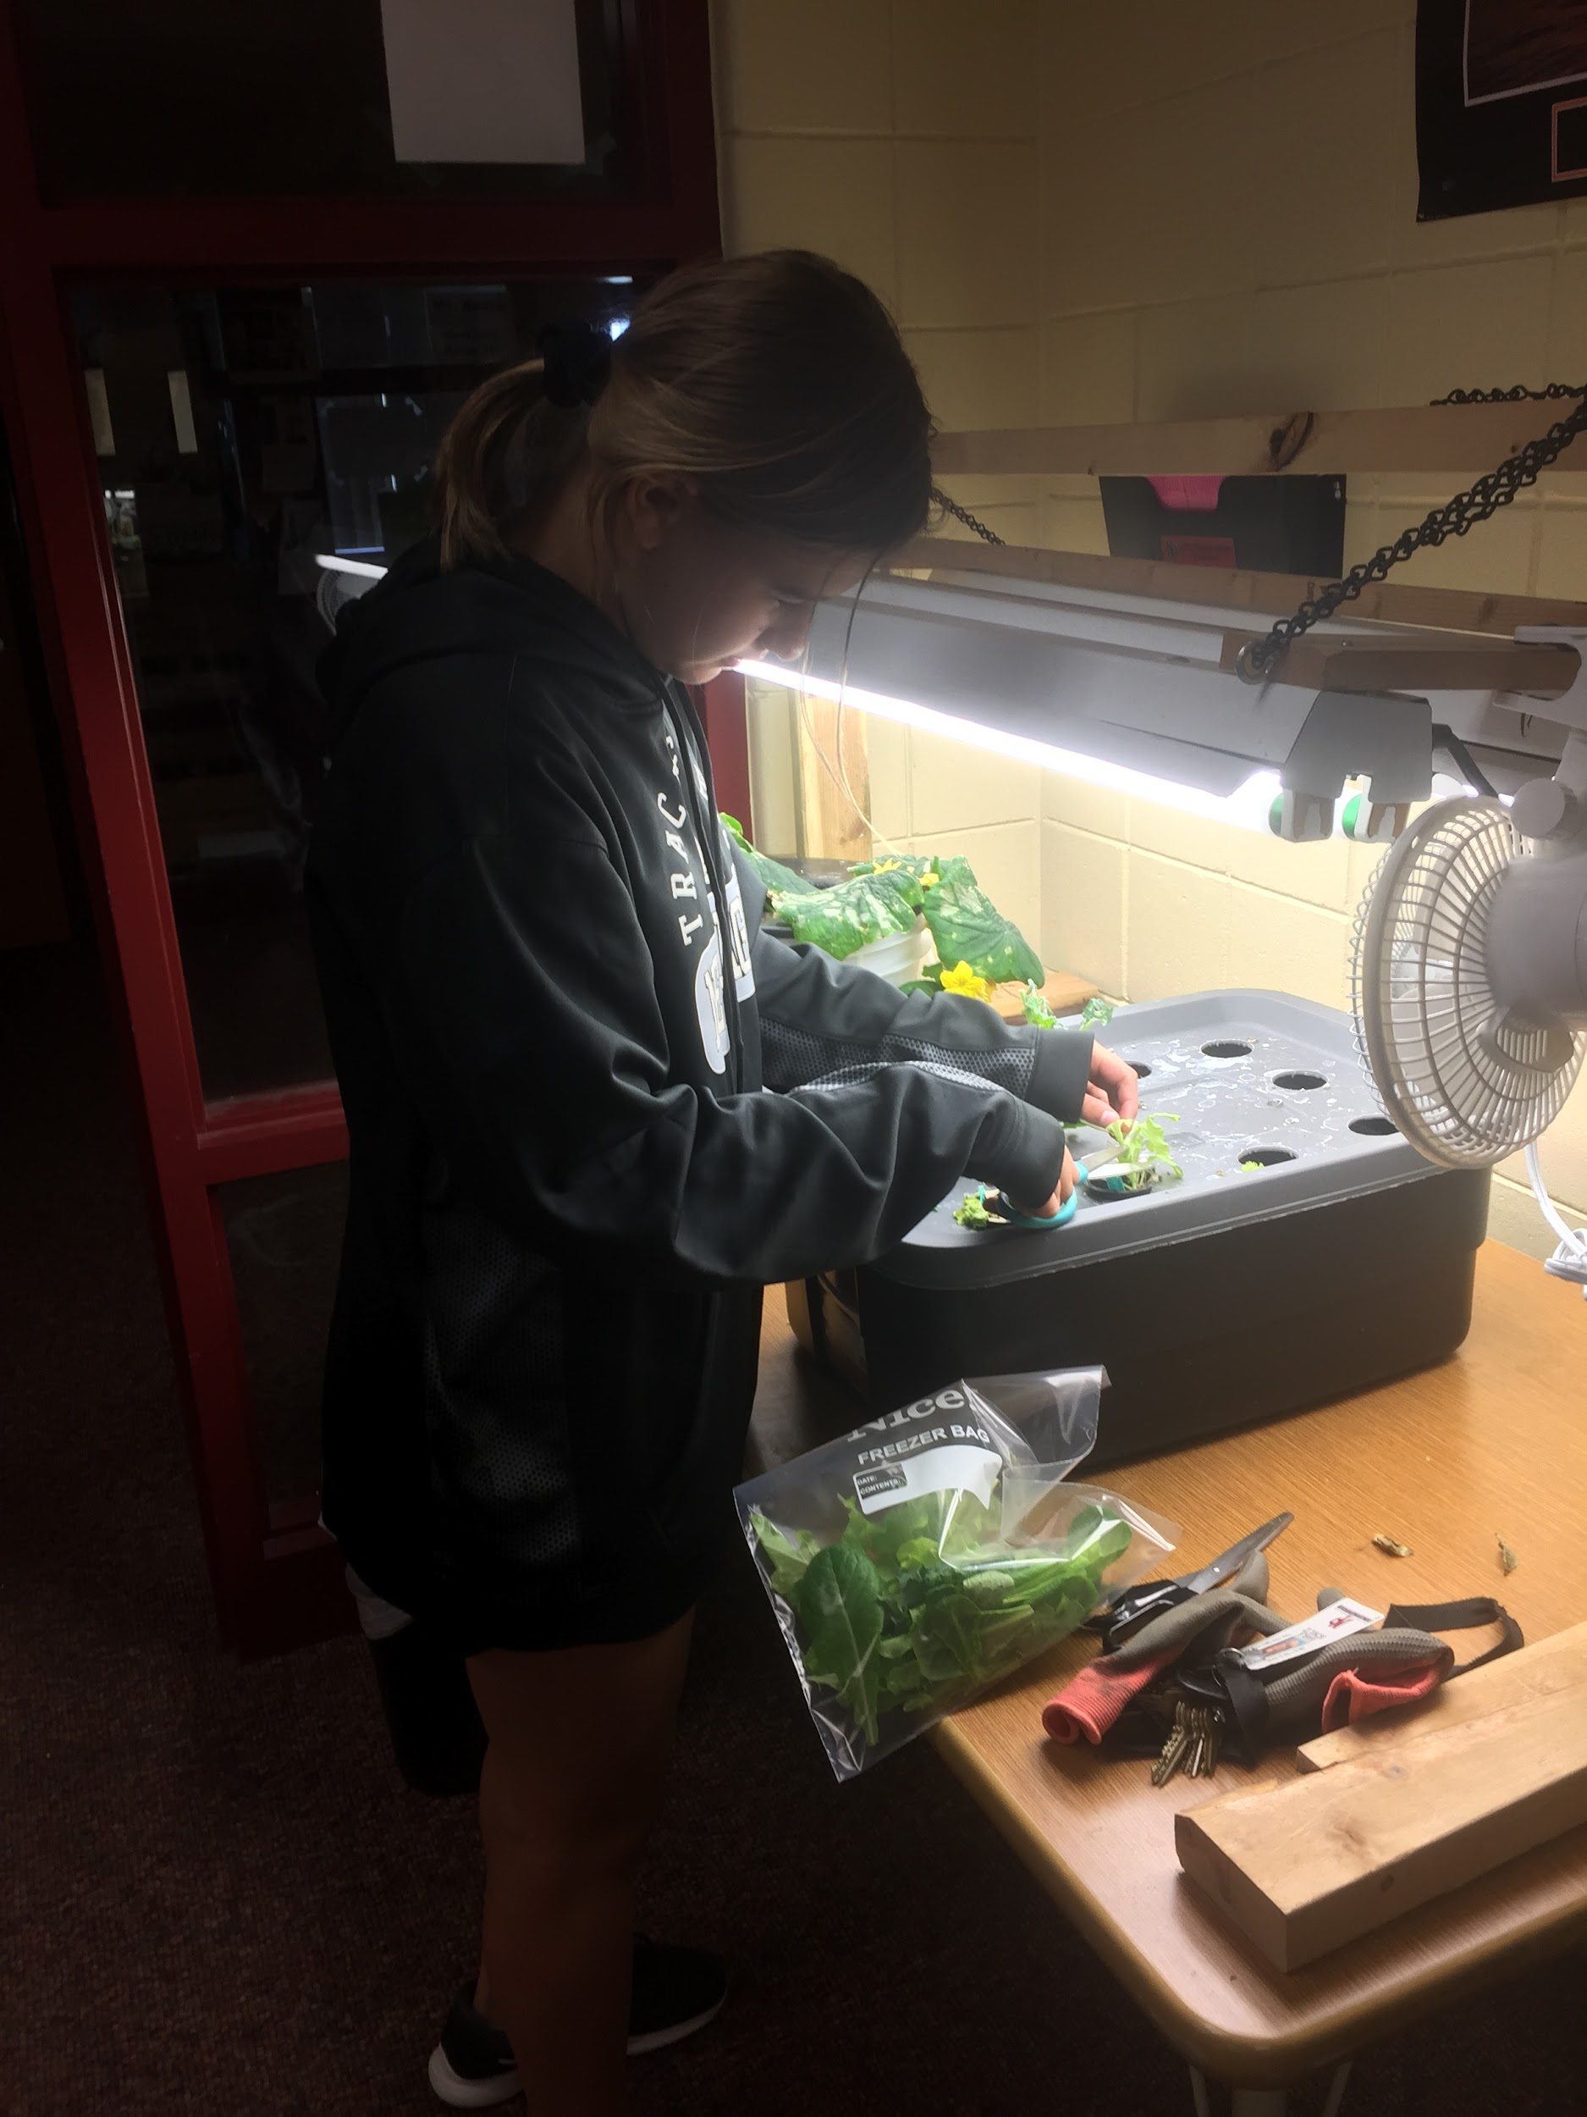
Hydroponic System
Just another way to grow vegetables indoors

Slide 18
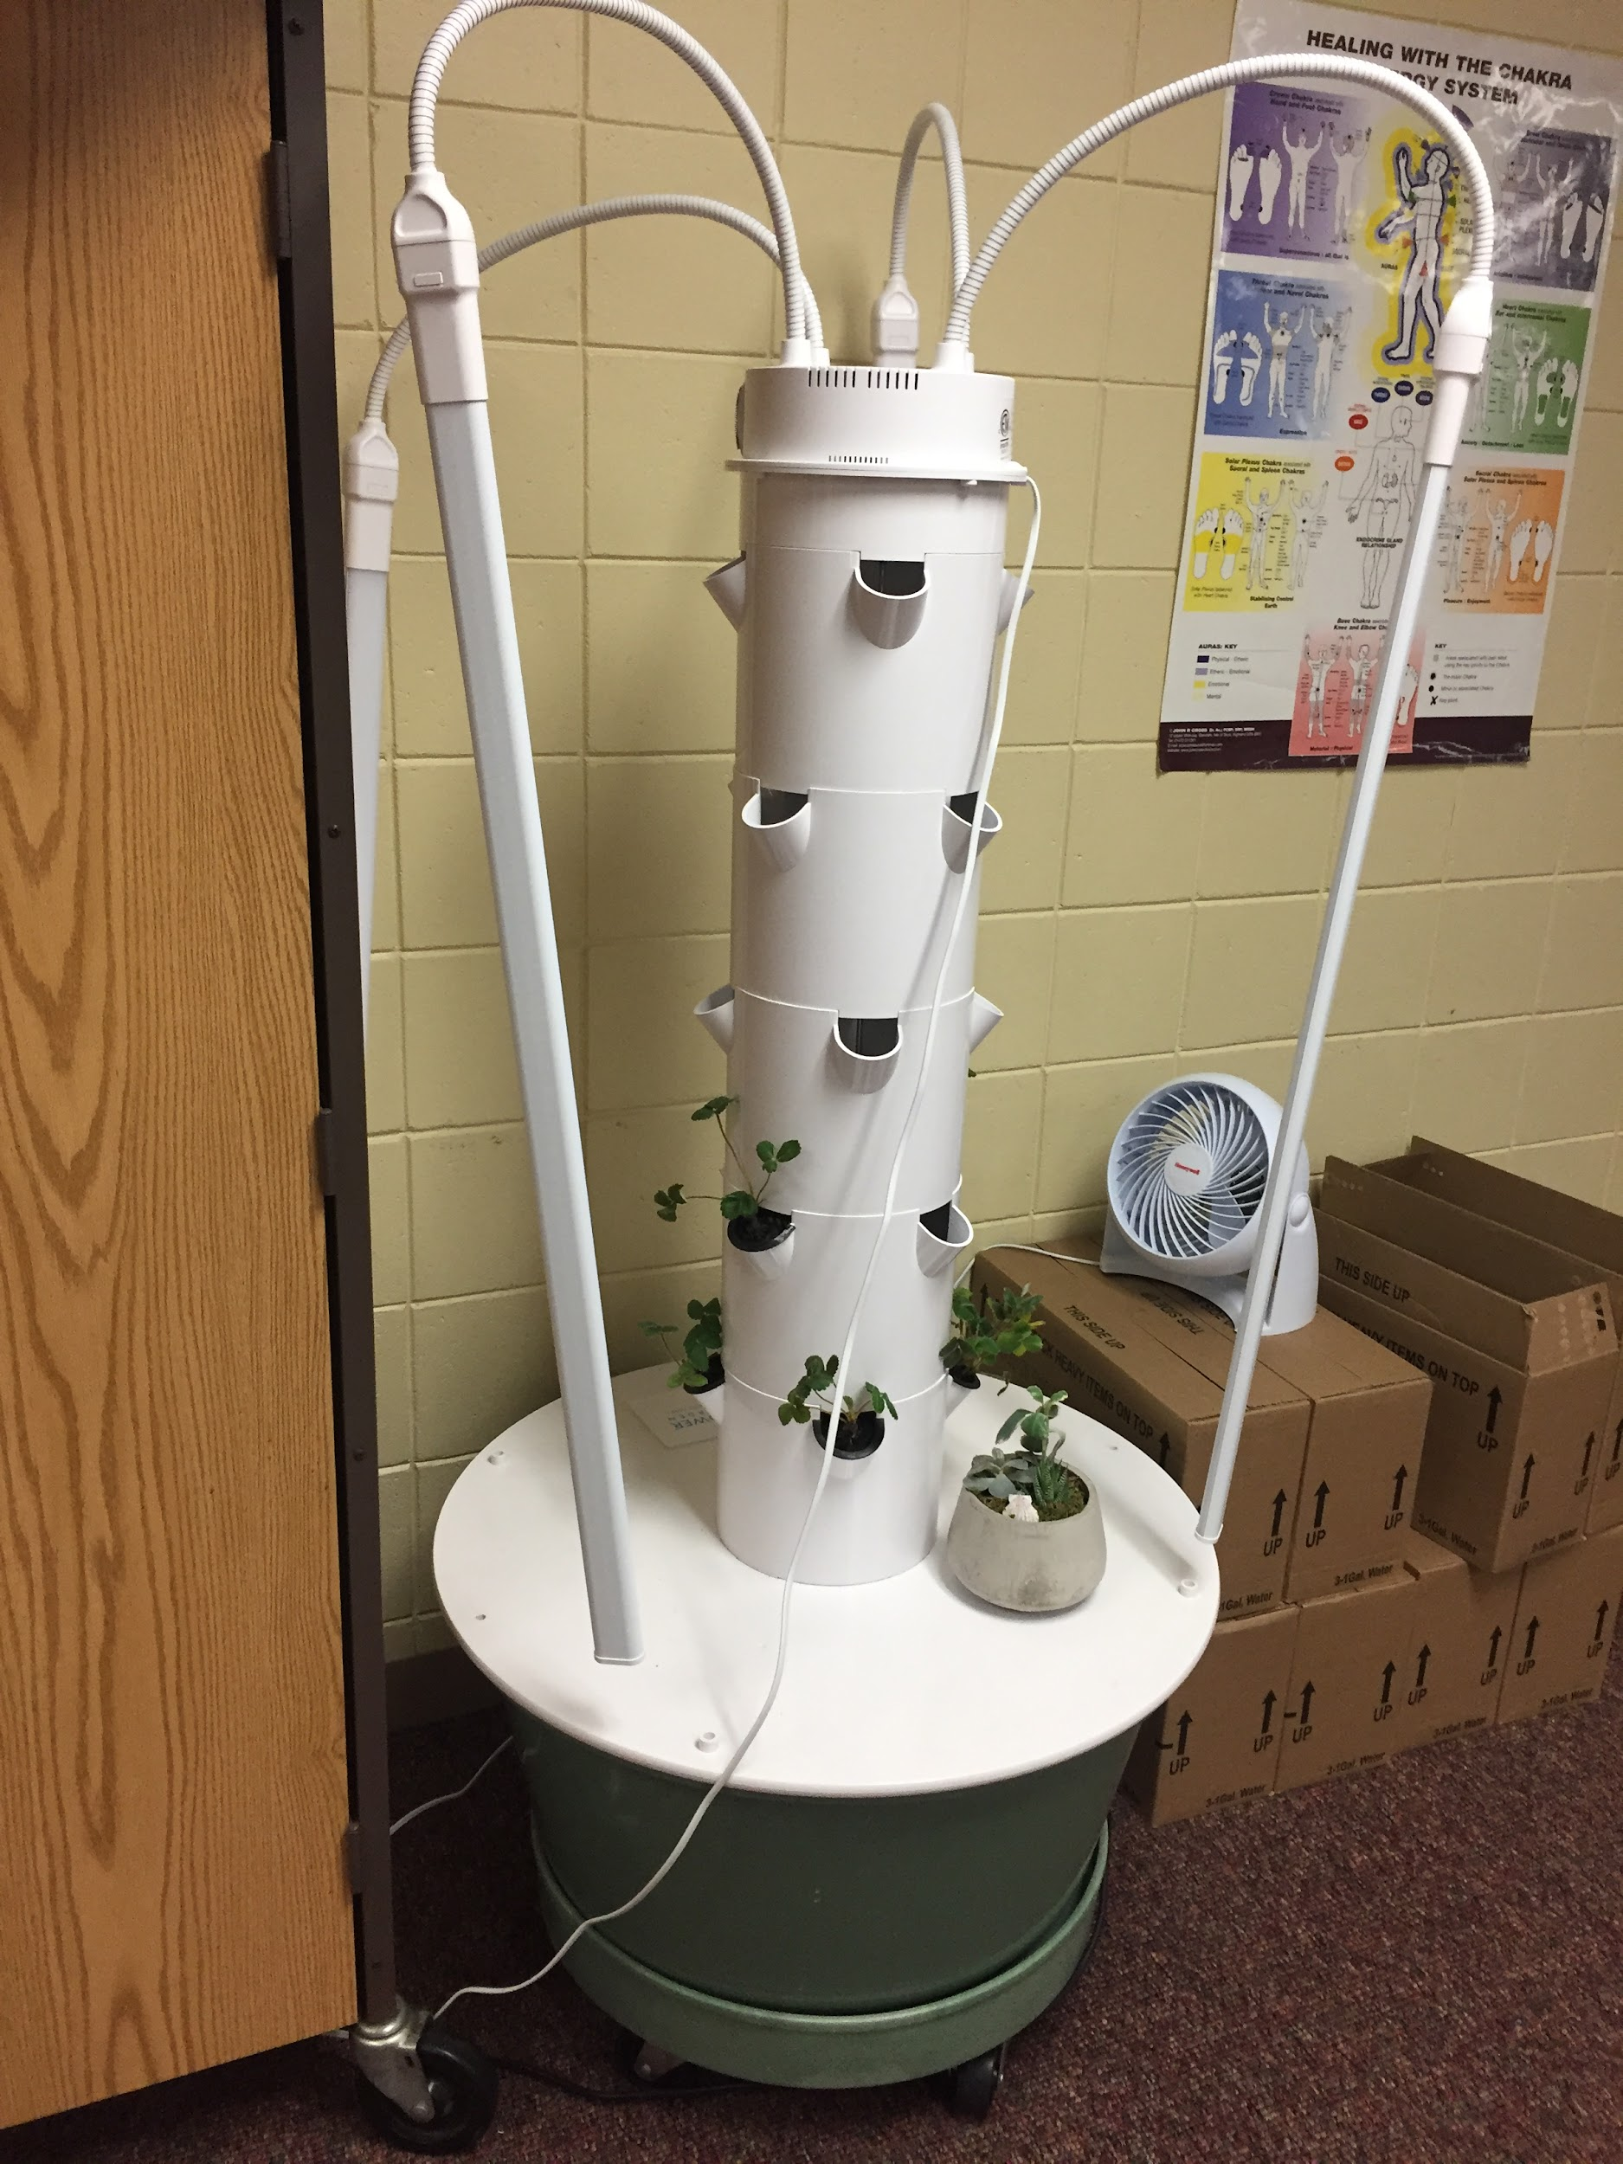
Tower Garden System
This fall bottom will hopefully will be strawberries and Tom’s hybrid Cherry Tomatoes

Slide 19
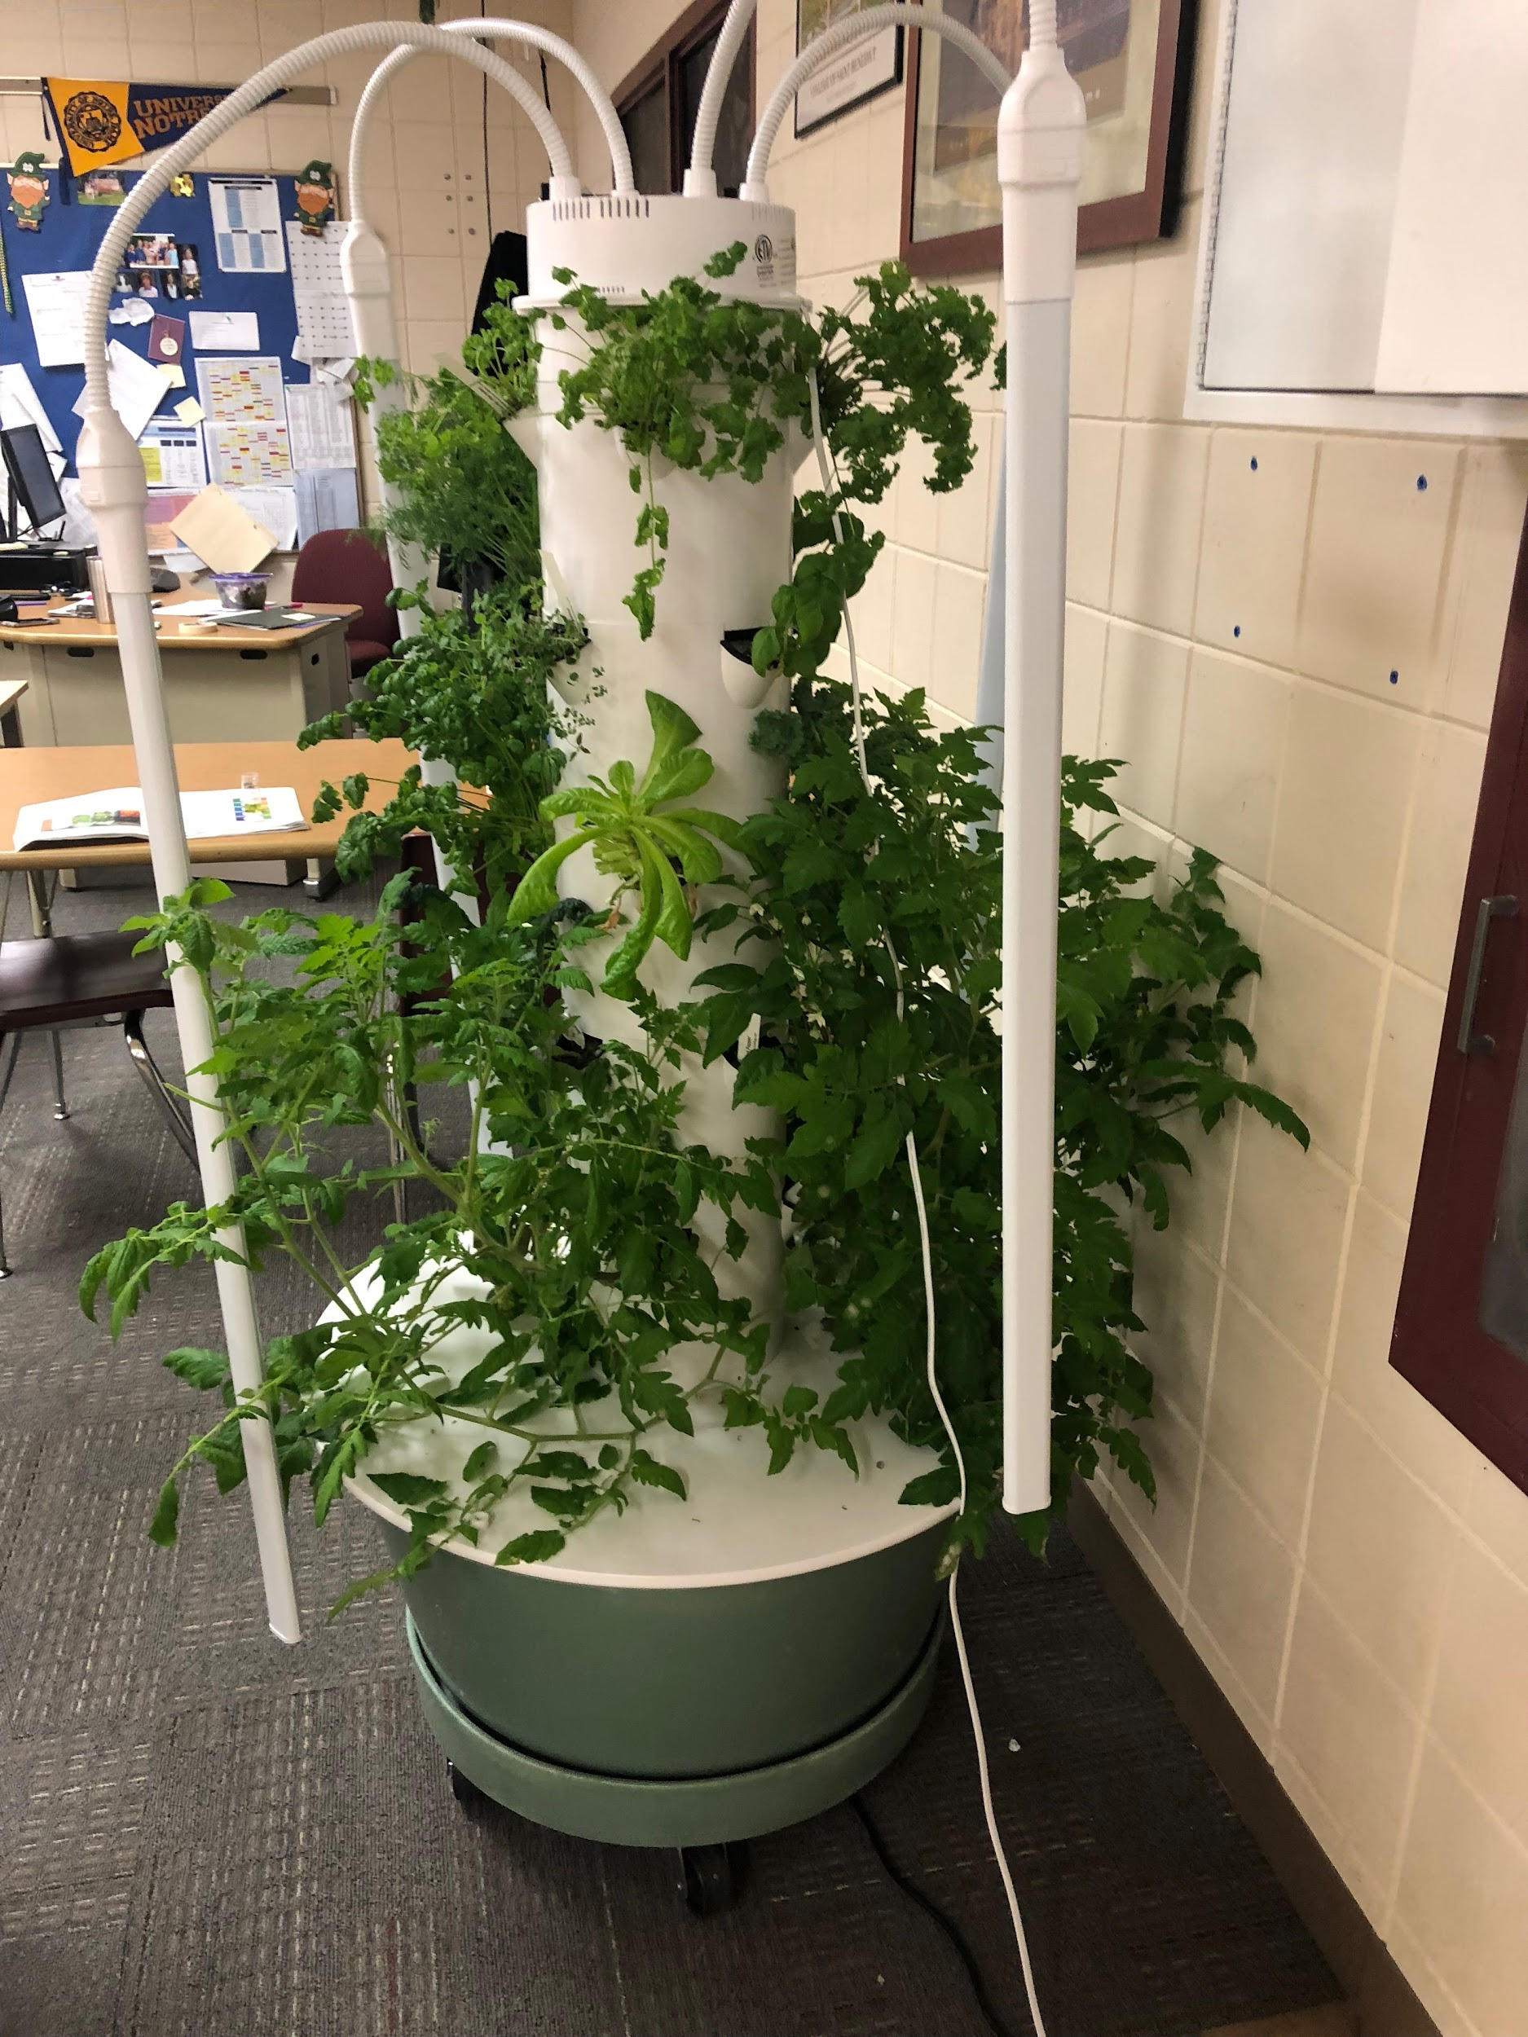
2018-2019 Recap
Living Tower

Slide 20
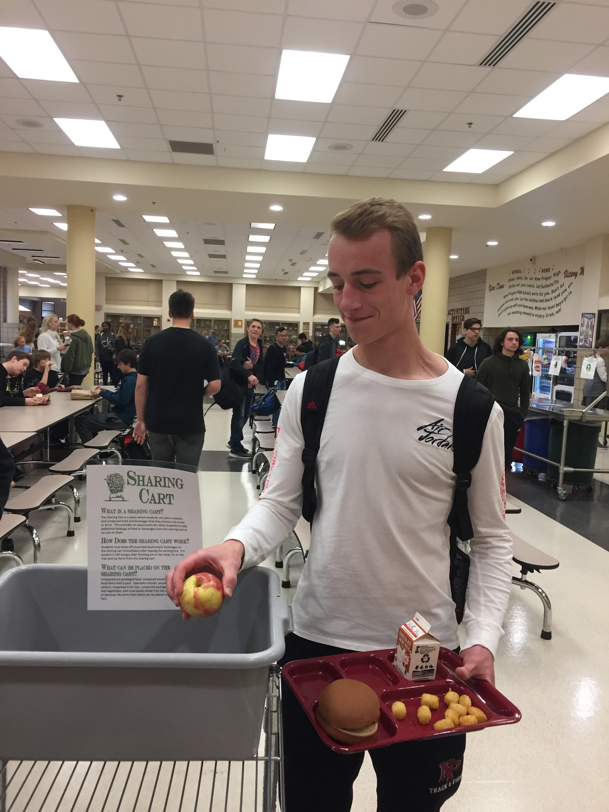
Relaunch Sharing Cart Initiative!

Slide 21
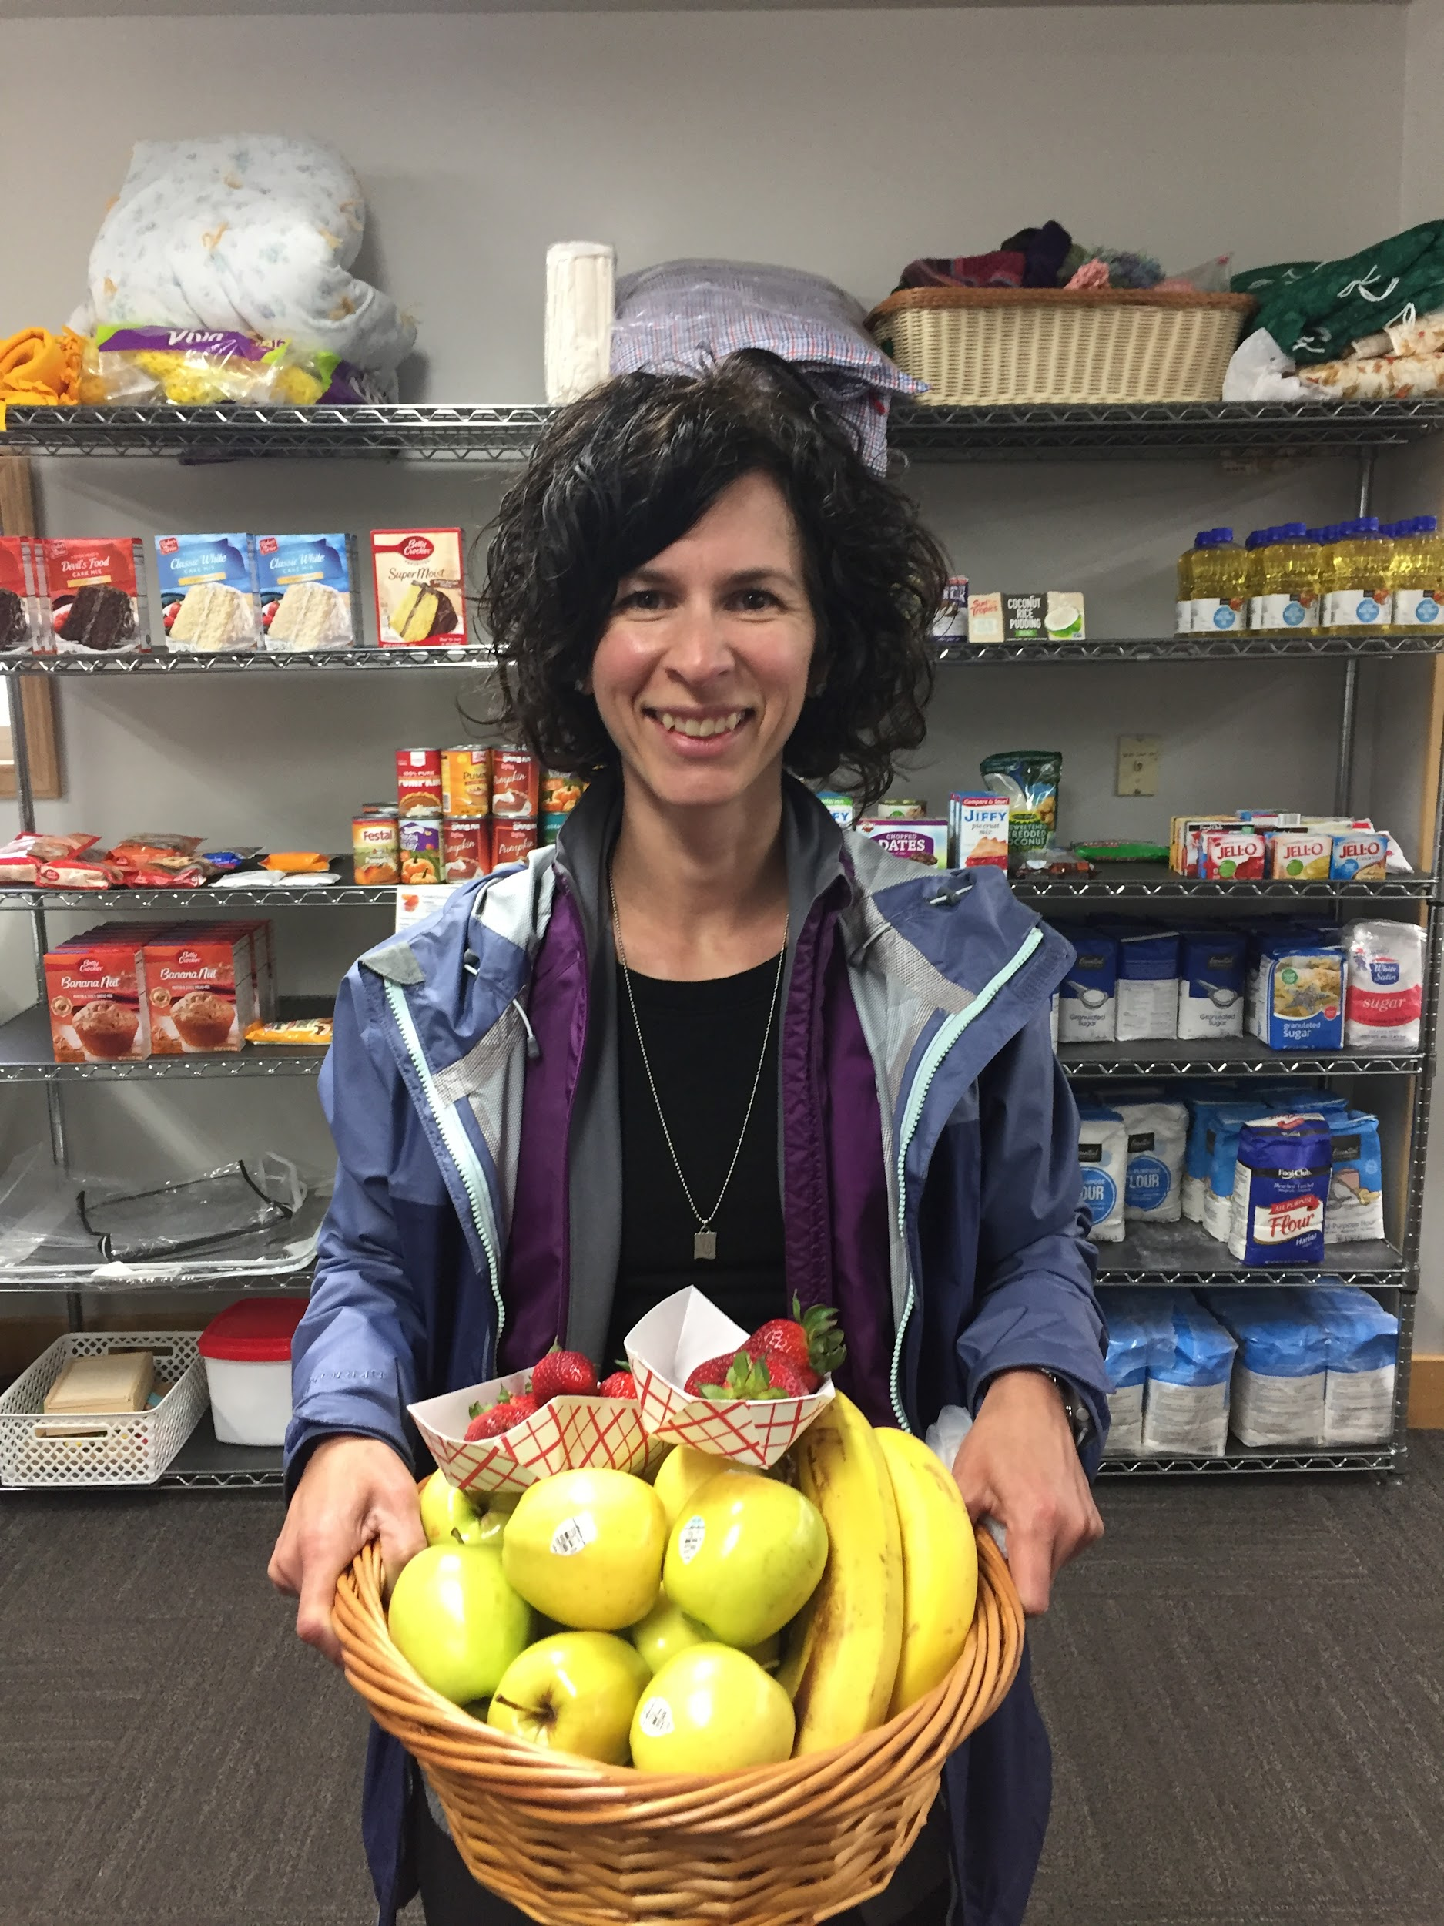
Years pst we have donated over 100 pounds of fruit.
Their favorites are the bananas and kiwi!

Slide 22
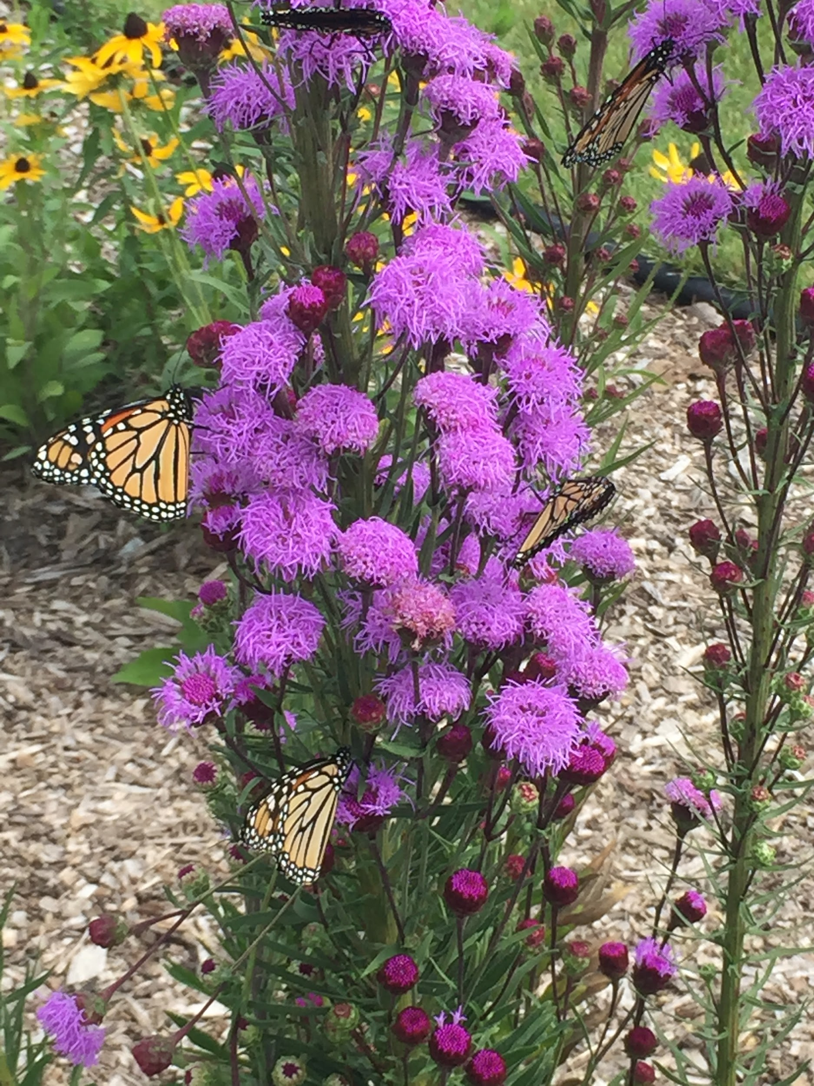

Slide 23


Slide 24


Slide 25
MORE Upcoming Event
Next Thursday, October 3, will be our first MN Thursday where Nutrition Services:
Going to feature grass-fed hot dogs from Thousand Hills Cattle Company in Cannon Falls.
Have locally-grown corn on the cob and cucumber slices from Riverside Farm in Elk River.
Already been offering local apples from Montgomery Orchard.
Just wanted to give you all a head's up that this is coming and hopefully the kids can get excited about it!
Thanks so much for your support,

