Slide 1

2026 season

Slide 2
agenda
Mission
Registration & Try-outs
• Leagues
• 8U
Tournament information
• Jerseys
Coaches compliance
Umpires
Youth softball night
• Fundraiser
Player Development
Board members

Slide 3
Mission
Our Alexandria Youth Fastpitch Softball Association is a youth sports organization dedicated to teaching softball fundamentals and life skills through good sportsmanship, leadership, positive coaching, and peer and parent communication. It is our goal to prepare young female athletes to learn and play the game of softball in a fun, healthy and safe environment. Our overarching goal is to continue to grow our program and get more young athletes involved in the game of softball.

Slide 4
Registration/Try-outs
Registration opens in September for the upcoming season. This is done via sportsengine
No refunds will be given. You have the option of taking the insurance through sportsengine when registering
Tryouts are conducted end of September to create travel teams. These tryouts are skills based and evaluated or nominated by Alexandria high school softball coaches
All 10U-14U players are encouraged to attend at least one try-out session
Dates & times of registration and tryouts will be visible on the alexandriagirlsfastpitch.org website and our facebook page, Alexandria fastpitch softball association
Registration is open for 8U players

Slide 5
Leagues
New: We envision all 10u-14u teams will play in Big West League B or C divisions. Coaches coordinate game schedule with other north/west teams in April in Medina.
  12U –Play Monday and Wednesday; Games start in May
  10U/14U –Play Tuesday and/or Thursday; Games Start early May for 10U once a week, and May 19 for 14U
  10U: Equal play/rotating positions in league. Playing time/rotation may be unequal in tournaments
  12U-14U: Coach may flex based on practice, attendance and at tournaments – Playing time/rotation may be unequal in tournaments
**AFSA will work with coaches to determine what league is the best fit for the current team**

Slide 6
8u
Focus on coaching the fundamentals of the game. Emphasis of hitting, throwing, catching and positioning. Advancing skills throughout the season
Pitching machine and Girls/Coach Pitch for league games
Equal Play and Equal Positions
Games on Thursday and Practice on Tuesday or Wednesday
One tournament entry is covered by AFSA, June 13th Becker Roundup
*this is subject to change as we explore best league options for this group*

Slide 7
Tournaments
10u-14u teams will have 3 tournaments (big west teams may qualify for a 4th tournament at State which is paid for by association)
Any additional tournaments will be at cost to the team
Tournament schedules can be found under specific team on our website

Slide 8
jerseys
Jersey tops are provided by AFSA
Extra jerseys may be purchased via online clothing store by March 22nd.
Players must provide red socks, black pants, black undershirt, belt, glove, cleats, facemask (optional but encouraged)

Slide 9
Coaches compliance
As promised, the association is asking that each coach complete compliance items for this season as required by Big West, and a way to show our athletes safety is of the upmost importance. Any compliance requirement costs to you, you will be reimbursed by the association.
Go to MN softball website and sign in to your account. Home | Minnesota Softball
All coaches need 1 Safesport training per year, Background Check per year and concussion training (good for 3 years)
  One coach from each team also needs ACE training, which can be bundled with your background check
Compliance items can be initiated through your dashboard at https://mnsoftball.com/pages/dashboard.
All compliance items should be completed before your first game
Please upload certifications to your dashboard under the compliance button next to your name

Slide 10
Coaches
BIG WEST COACHES MEETING:
Tuesday, April 7th, 2026, in the ballroom upstairs (enter on the west side) at Medina Entertainment Center
10U/12U - meeting to start promptly at 6:00PM.
14U - meeting to start at 8:00PM.
Big West staff pre-divide teams into groups by age, class, and area.

Slide 11
umpires
Umpires will be hired and paid by AFSA
If you are interested or know someone who would like to umpire and are at least 16 years of age, have their own equipment, please reach out to us

Slide 12
Youth softball night
May 8th at AAHS – come support our high school softball teams!

Slide 13
fundraisers
To be determined…

Slide 14
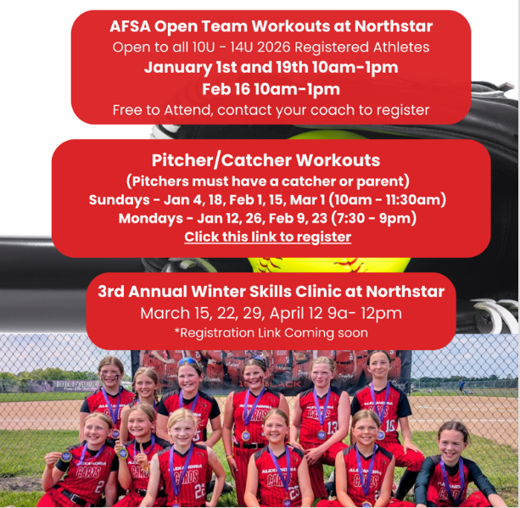
Winter workouts

Slide 15
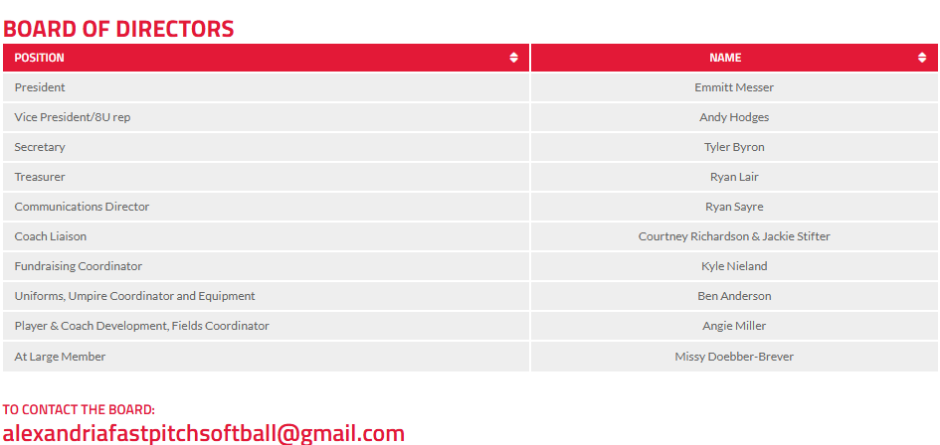
Board membership
We need board members like you! (minimum 1 year commitment)
We meet monthly
AFSA goals include: more clinic/skills opportunities for players, hosting tournaments, field updates via grants, equipment needs, fundraising
If interested, please fill out an application Welcome | AFSA Board Application | Alexandria Fastpitch Softball

