Slide 1
April 2024 Booster Club Meeting

Slide 2
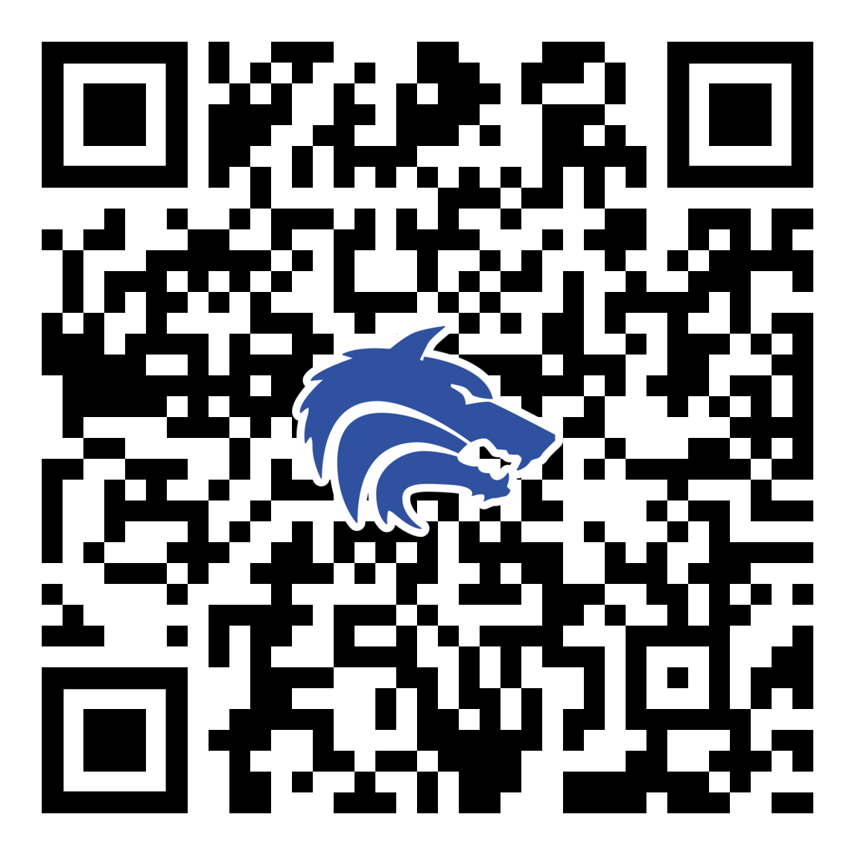
April 2024 Booster Club Meeting

Slide 3
Agenda
Approve March Meeting Minutes
2024 – 2025 Board Positions
Treasurer Report
Remaining Spring Calendar
Theme Nights
Team Dinners
Concessions
2024-25 Physicals
Coach’s Corner

Slide 4
2024 – 2025 Board Nominations
President:
Vice President:
VP Marketing:
Treasurer:
Secretary:
Email Nominations or Interest to jpaschal01@gmail.com

Slide 5
Treasurer’s Report: APRIL 2024
BEGINNING BALANCE as of 2/28/24:
REVENUE
First Pitch Dinner Tickets (cash/venmo)
Concessions
Booster Club Sponsorships
Game Day Meals (collected for entire season)
Total Revenue:
EXPENSE
EOS Banquet Reservation Deposit
Concessions (Food, Candy, Supplies)
Baseball Equipment (Locker Magnets/Pocket Wrist Watches/Pitching Machine Baseballs)
Individual & Group Senior Banners
Media Day/Team Pictures/Banners
Game Day Program Printing
Varsity Team Rain Delay Meal (3/7/24)
Hats
Printer for Coaches' office/Line Up Cards/Scorebooks/Buckets
Game Day Meals (Dilla's – 3/13 & 3/19/24)
Rapsodo Subscription (*1/27/24 check cashed)
Total Expense:
$21,999.86
$150.00
$1,372.50
$1,476.50
$2,050.50
$5,049.50
$560.00
$1,009.14
$965.44
$1,301.00
$1,200.00
$211.20
$118.19
$1,092.20
$200.55
$660.00
$1,500.00
$8,817.72
ENDING BALANCE as of 4/5/24
$19,455.13

Slide 6
Important Spring Dates
Sat 4/20: Senior Day
Non-Senior parent volunteers needed
Sun 5/5: Baseball Banquet
Collin College - Frisco Campus

Slide 7
Theme Nights
Date
FRI 4/12
TUES 4/16
SAT 4/20
FRI 4/26
Theme
PSA Night
Teacher Appreciation Night*
Senior Day*
Blue Out / Senior Sendoff*
Sponsor
Rudick Construction Group
Messick Peacock & Associates
*Help Needed:
If you are available to help drop invitations tomorrow to Teachers at Plano West, Shepton, Barksdale, Rose Haggar, Jasper, Mitchell, etc. Please meet Natalie at the table after this meeting. It's a quick drop and much appreciated.
4/20 Non-Senior Varsity Parent Volunteers needed for help with Senior Day.
4/26 Looking for someone to lead this night

Slide 8
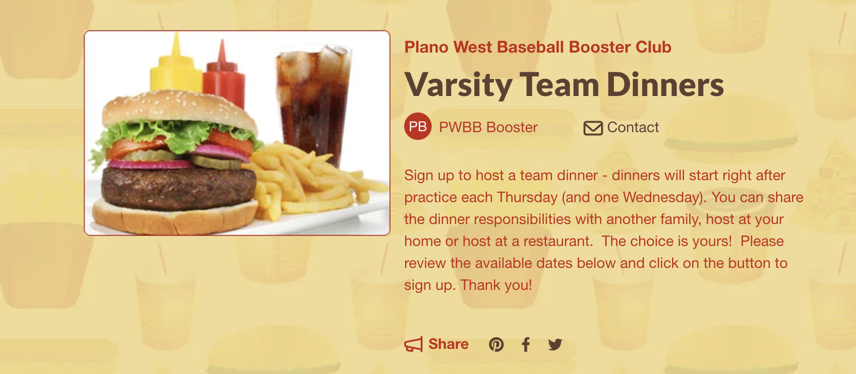
Team Dinners
Thank you for everyone that has hosted or will host!
Only remaining opening is JV2 on April 25!

Slide 9
Concessions
A million thanks to all the volunteers to date!
Two shifts MINIMUM per family (that's minimum – don't be shy if you want to sign up for more!)
Openings:
4/12: Varsity Game (1)
4/16: Varsity Game (1)
4/26: JV Game (2)
4/26: Varsity Game (2)
We have great student volunteers that will help!
We are always up for donations including soda & chips. Please write "baseball" on any donations and drop at concessions on the table in the middle or on the baseball rack

Slide 10
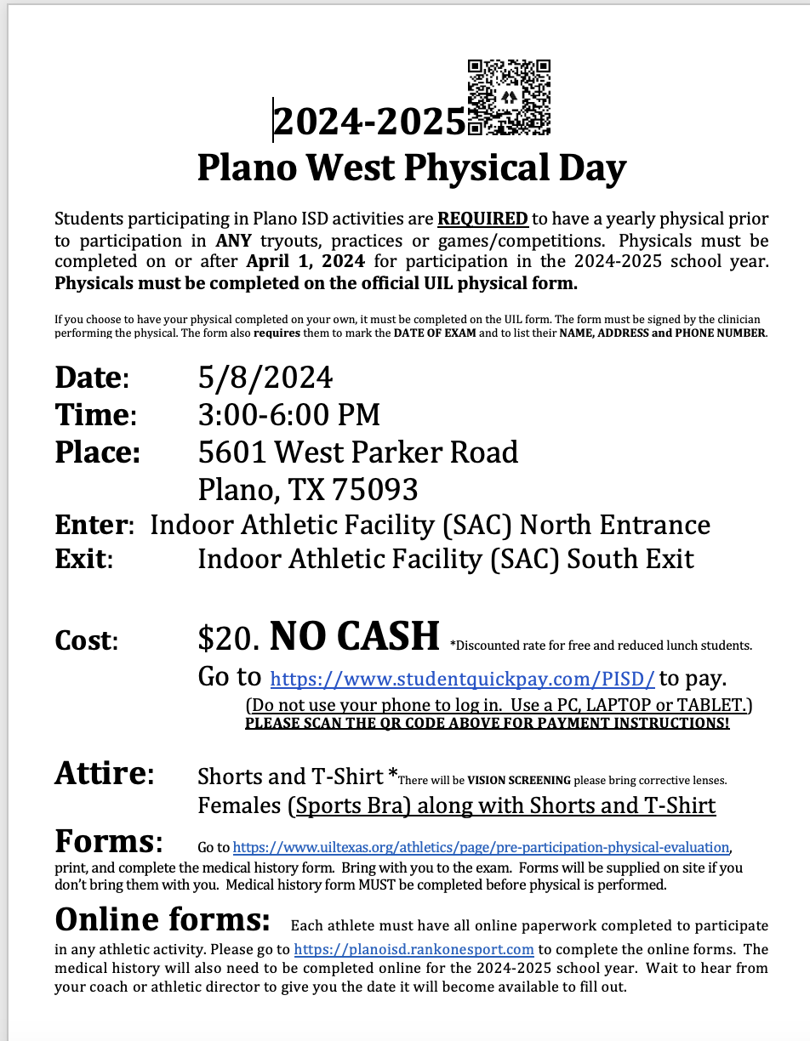
2024-25 Physicals
May 8th
3:00 PM
Forms in Rank1
Payment due in advance

Slide 11
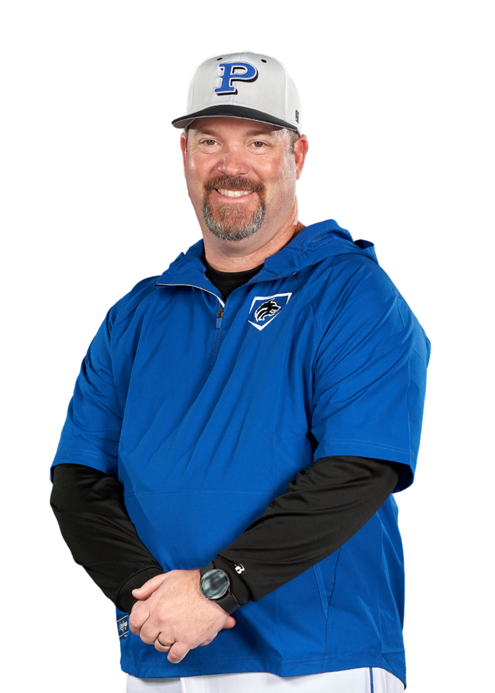
Coach’s Corner

Slide 12
April 2024 Booster Club Meeting

Slide 13

SportsYou
DCMN-ZE9D

Slide 14
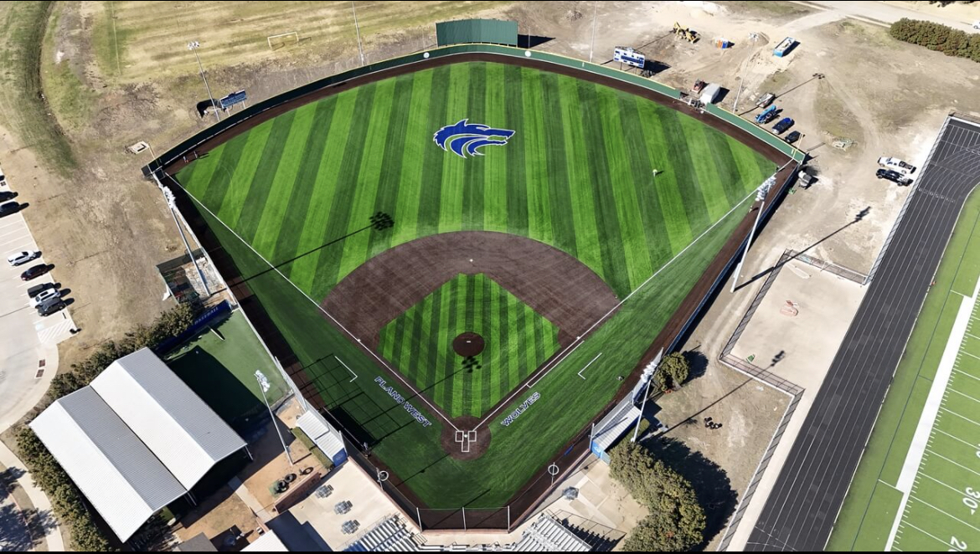
Ballpark Turf

Slide 15
Booster Club Votes
Approve December 2023 Meeting Minutes
JOIN THE BOOSTER CLUB
26 members (we had 37 member families in 2022-2023 school year)
$5,150 in membership dues! ($500 increase from prior meeting)
www.planowestbaseball.org/join

Slide 16
Debit Card
Why – recurring payments that must be made via Credit / Debit card
Examples – domain name renewal, Rhapsodo renewal, Coaching conventions and associated hotel stays
New for 2023 – 2024: PISD employees cannot be reimbursed by booster clubs!
Proposal: Booster club obtain a debit card for our checking account. Prior to use, 2 of the 3 booster club designated signees must provide email authorization for the use of the card

Slide 17
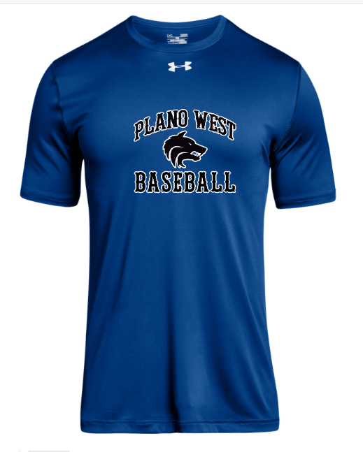
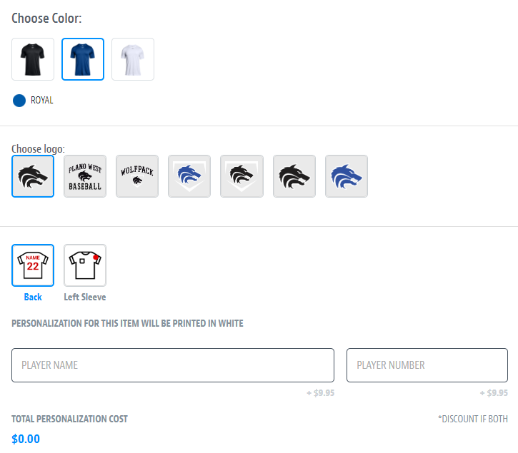
Spirit Wear – powered by SQUADLOCKER
Order your Plano West Baseball gear from Squadlocker via www.planowestbaseball.com

Slide 18
Committees / Task Needs
Concessions: Angela Thompson/Ginger Cox/Mary Wade
End of Season Banquet: Julie Raecek
Gameday Program: Tracy Sievers
Senior Night: Tracy Sievers
Theme Nights: Natalie McDaniel

Slide 19
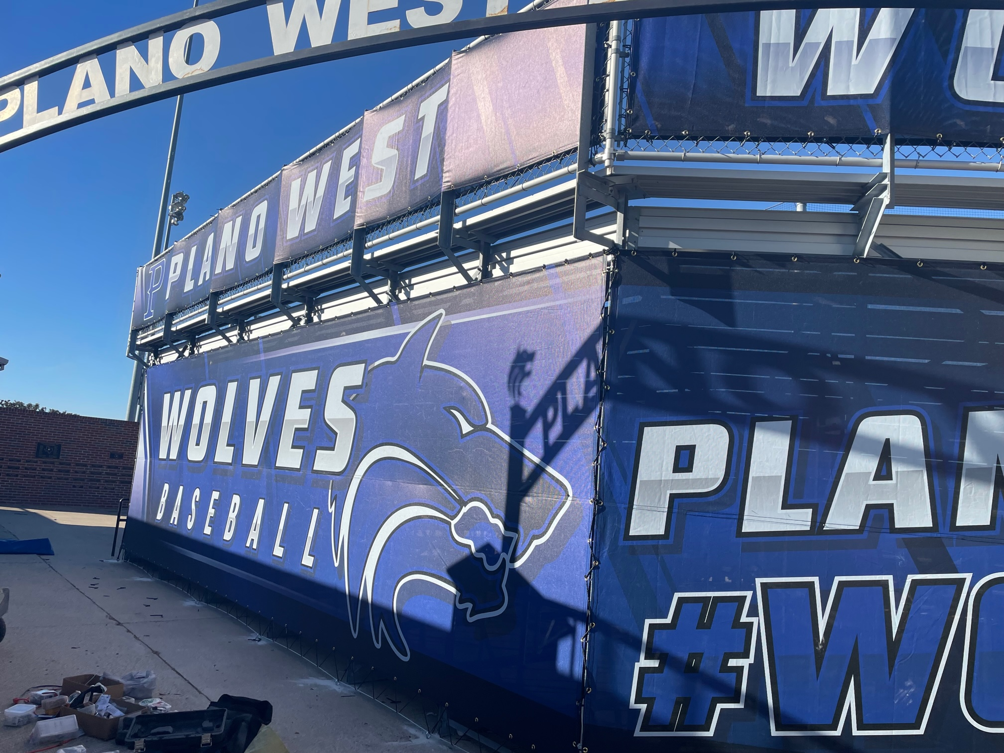
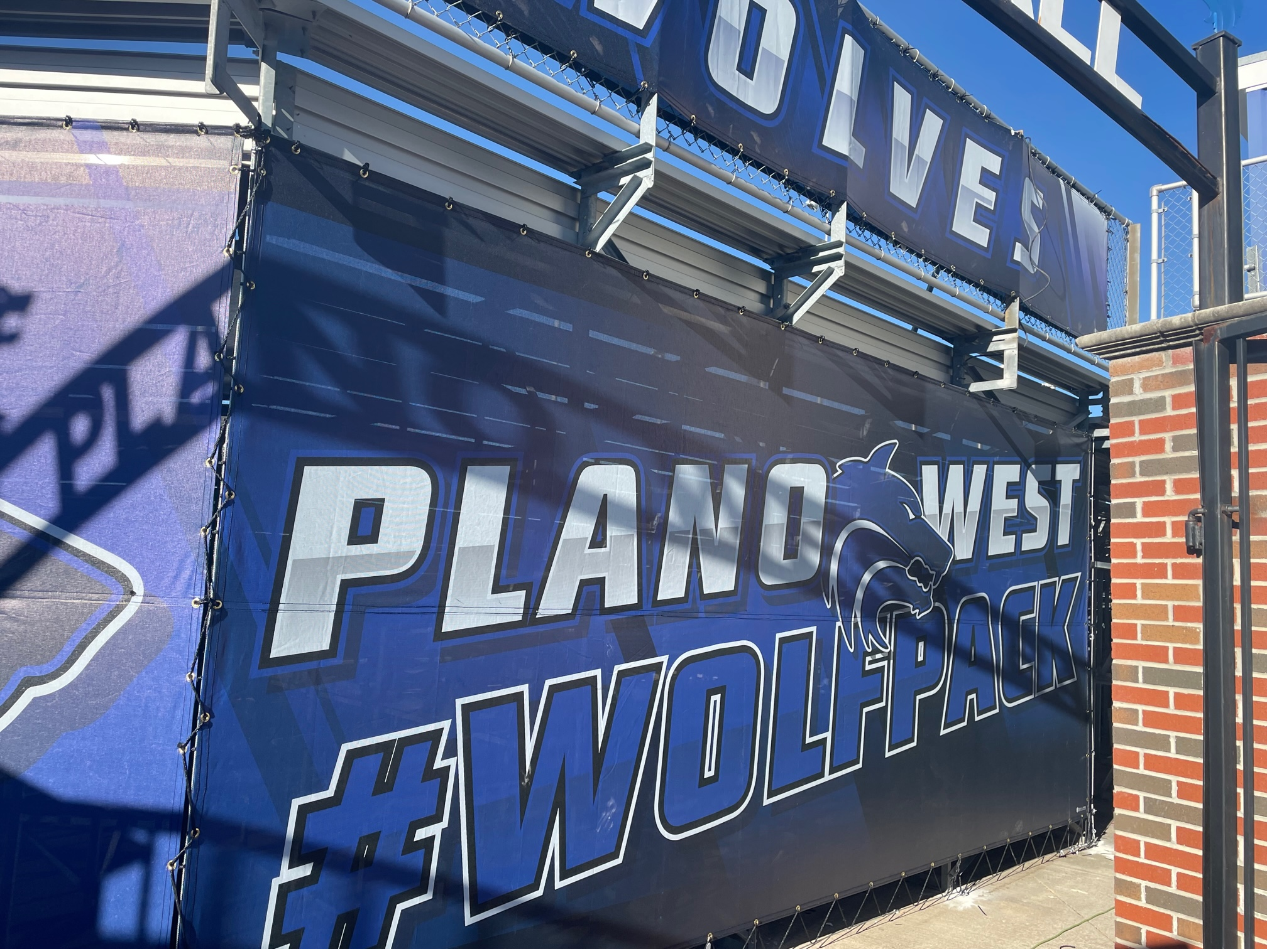

Ballpark Branding Upgrades

Slide 20
Sponsors
2024 Sponsors
Name Level Amount ($)
Camp Bow Wow Triple 1,250
Jalin Jewelers Single 350
Full Circle Counseling & Consulting Single 350
The Reynolds Company Triple 1,250
Innerlight Chiropractic Single 350
Hempkins Insurance Single 350
Rudick Construction Group Home Run 2,000
Dilla's Restaurant Single 350
McBride Orthodontics Single 350
Messick Peacock & Associates Double 750
Ms. Kitty's Pet Concierge Single 350
Keller Williams Realty Single 350
First Call Mechanical Double 750
Total $8,800
BIG Thanks to the JV2 parents (especially Britton Lankford!) who have been a great help in bringing in many of these sponsors.
Banners will be up for the Triple and Home Run sponsors by the end of the week.
Team Calendar is finished so we'll go back out and deliver some to sponsors and a few prospects.

Slide 21
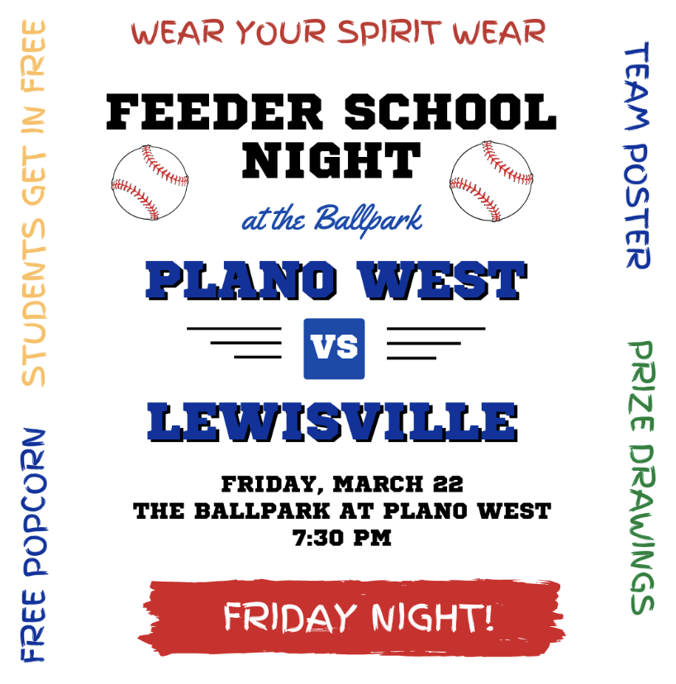
Elementary School Visits
Players will promote event by visiting Elementary Schools on the morning of 3/21. This year we will be combining this event with Softball.
Packets will be given to team leads on 3/20 after practice:
Flyers and instructions will be included in packets
Players are assigned to the grade school they attended or to a school that needs coverage if you did not attend one of the feeder schools.
Players will wear black sweats or shorts and the jersey selected by coaches
March 21 - School visit day
Players arrive at 7:15 am to work the carpool lane
Players will distribute flyers, hold doors, greet students
Parents will be needed to take pics etc.

Slide 22
Final Packfunding Update
$16,950 Raised
$ 722 Credit Card Fees
$16,228 Raised After Fees
214 Donations
THANK YOU!!

Slide 23
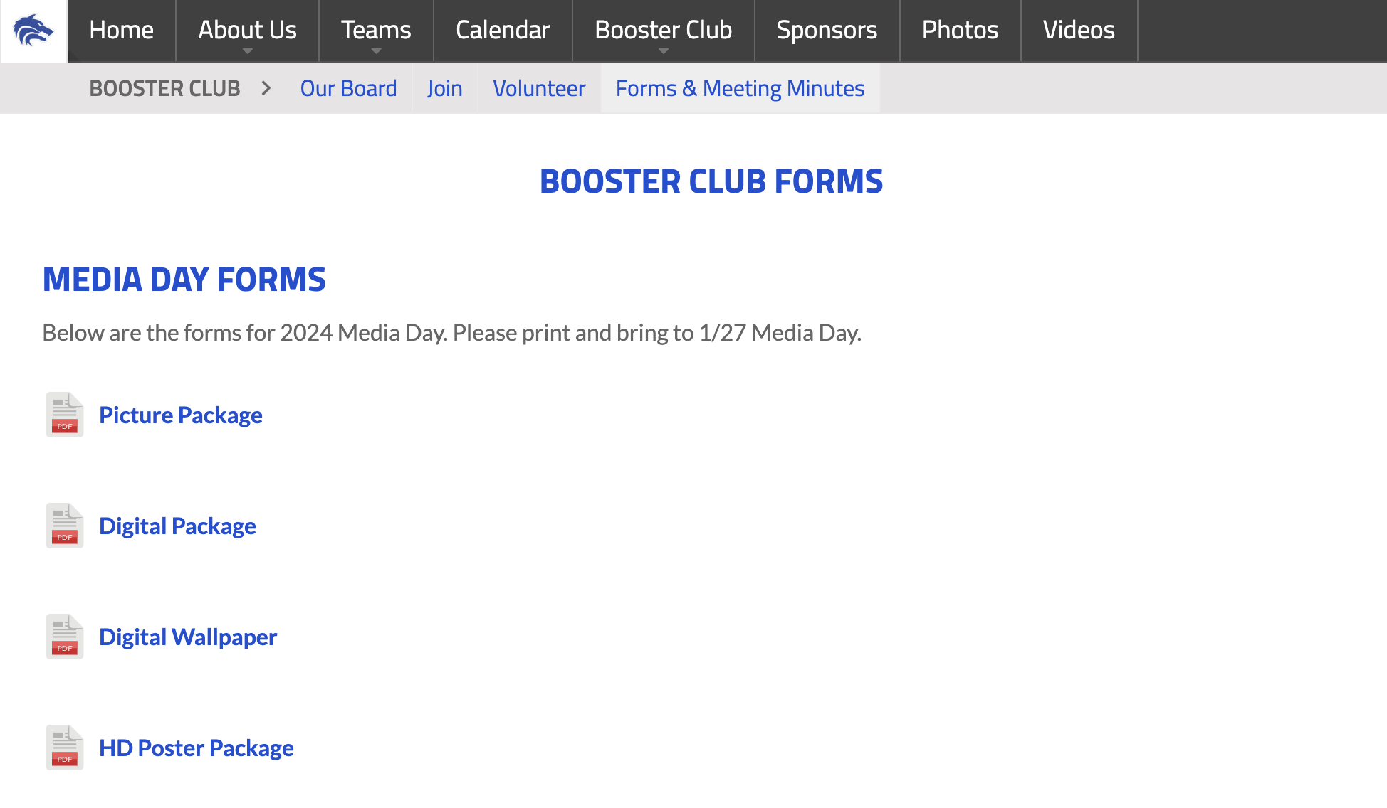
Media Day – 1/27
This Saturday 1/27 in the SAC @ 9 am
Coaches will communicate with players what uniforms they should wear
Parents are welcome to come and join the players as they have pictures taken and learn about Packfunding
Please have your player bring their form(s) and check for the package you want to Media Day
Forms are found on the site in the Booster Club>Forms & Meeting Minutes>Media Day Forms
There are several different options so print them all or just the ones you need

Slide 24
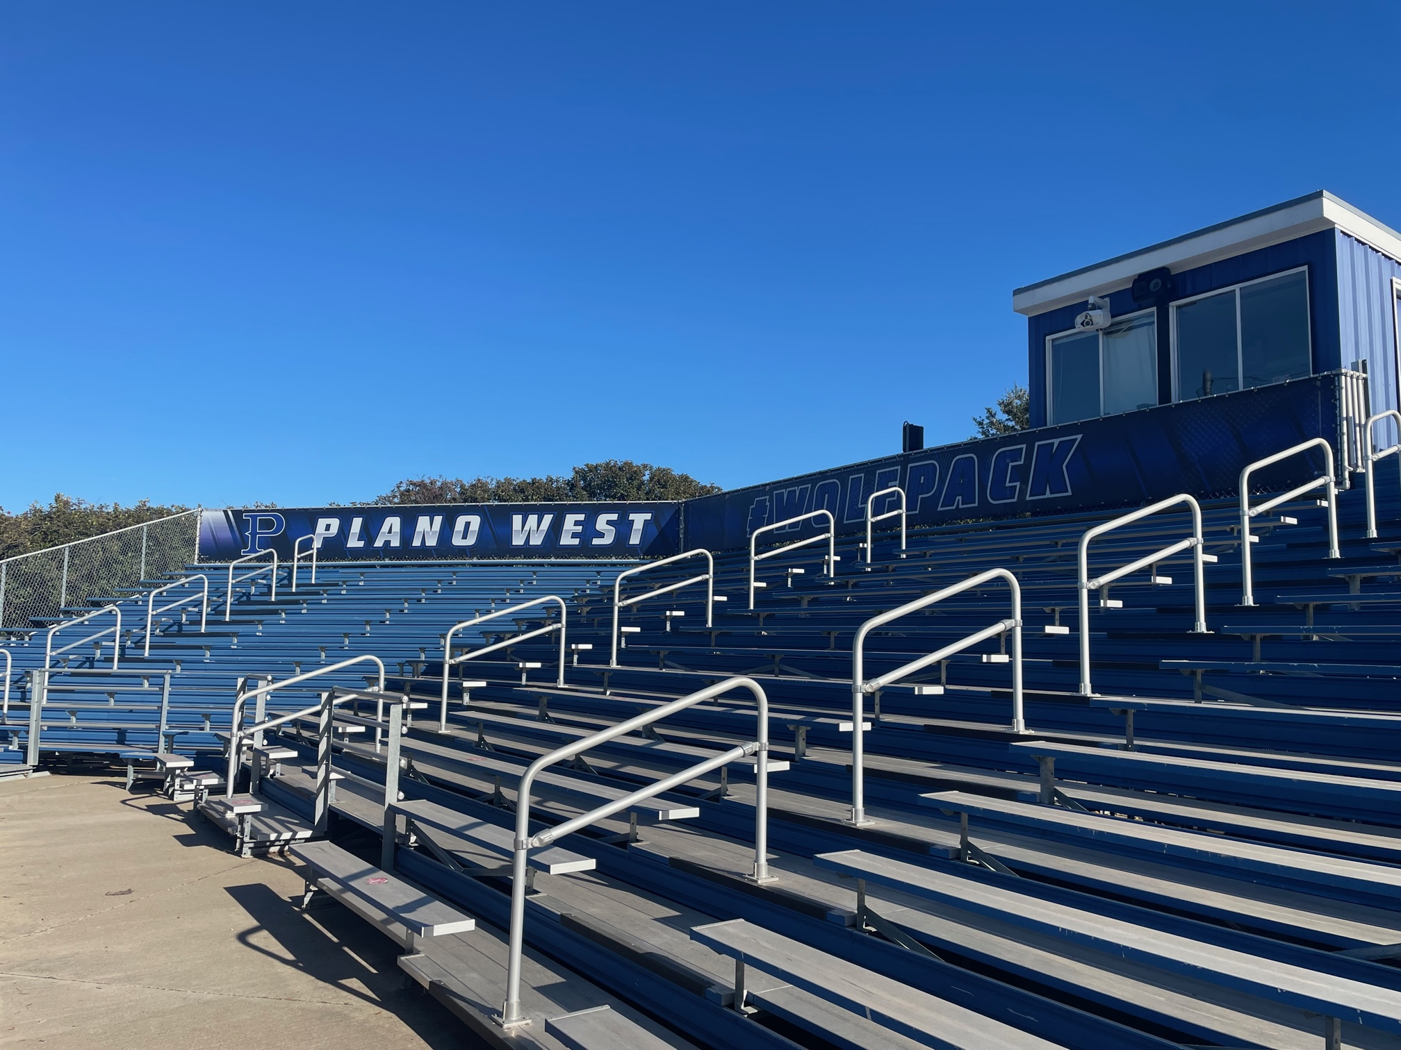
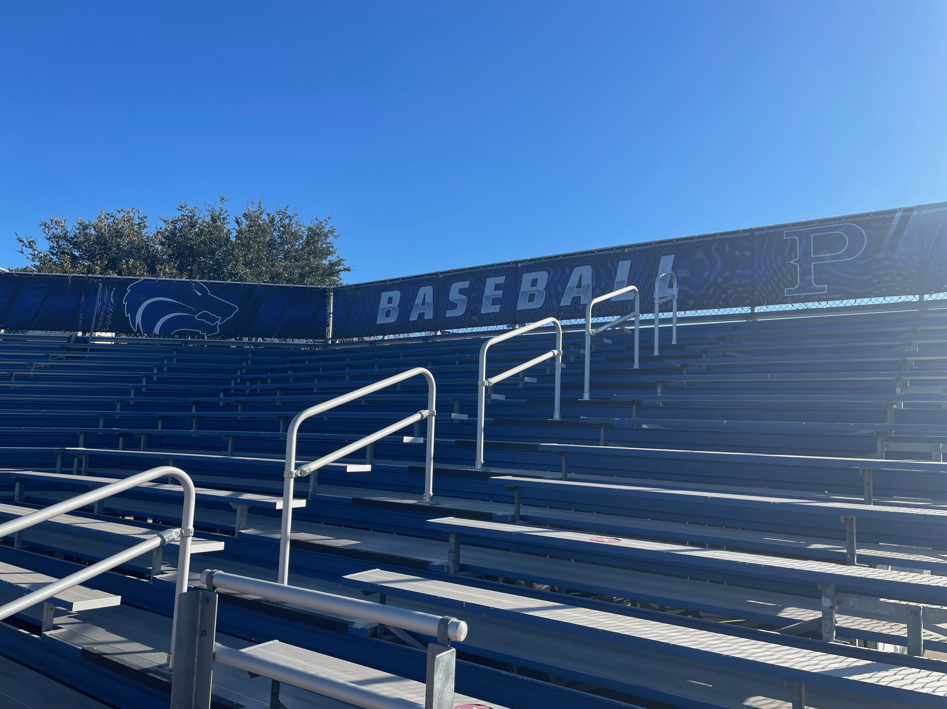
Ballpark Branding Upgrades

Slide 25
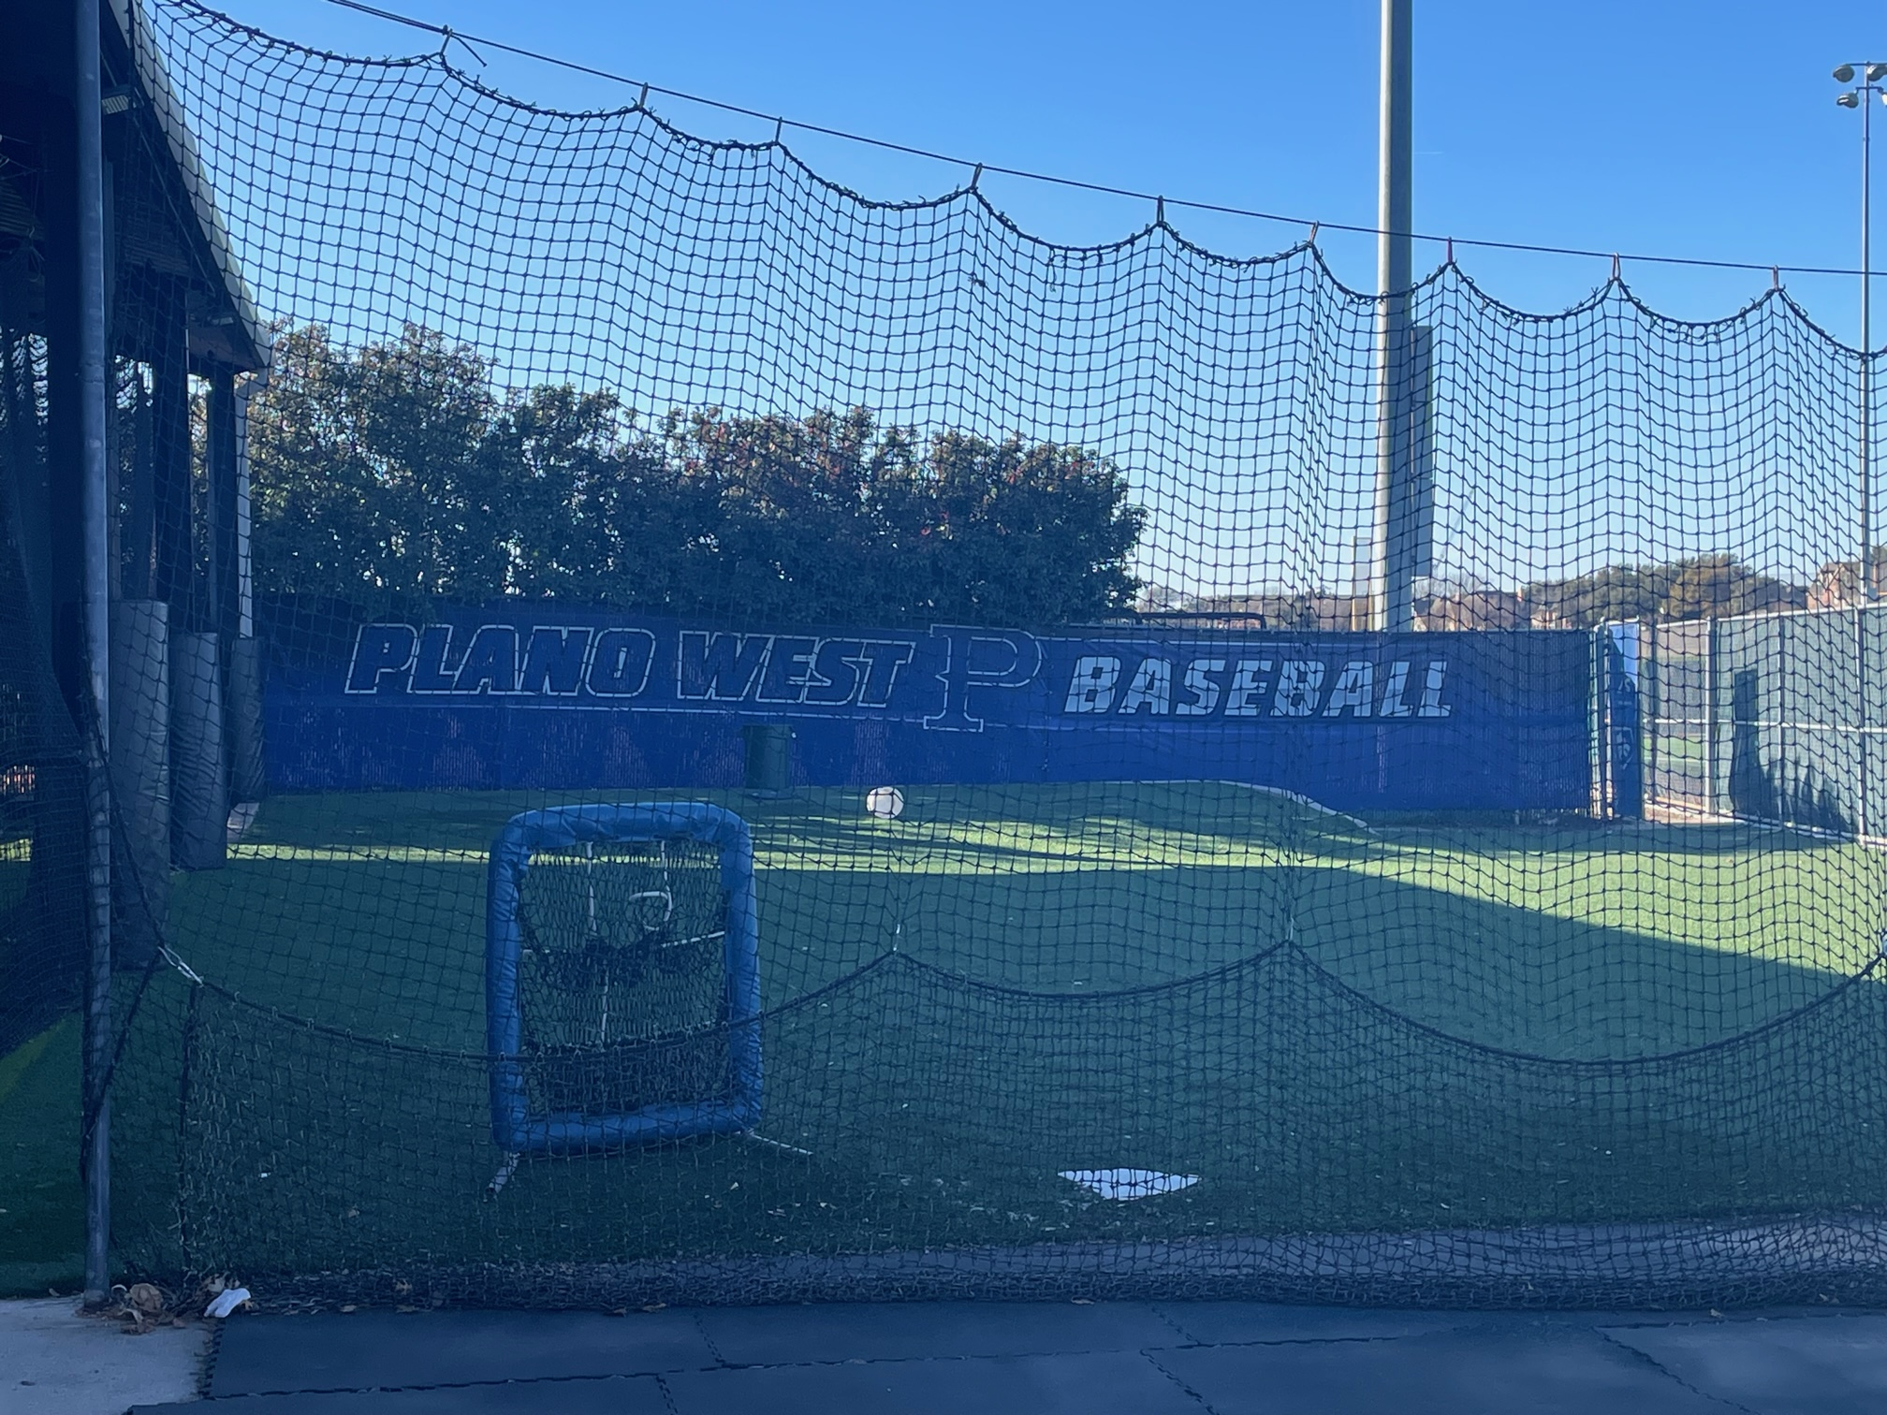
Ballpark Branding Upgrades

Slide 26
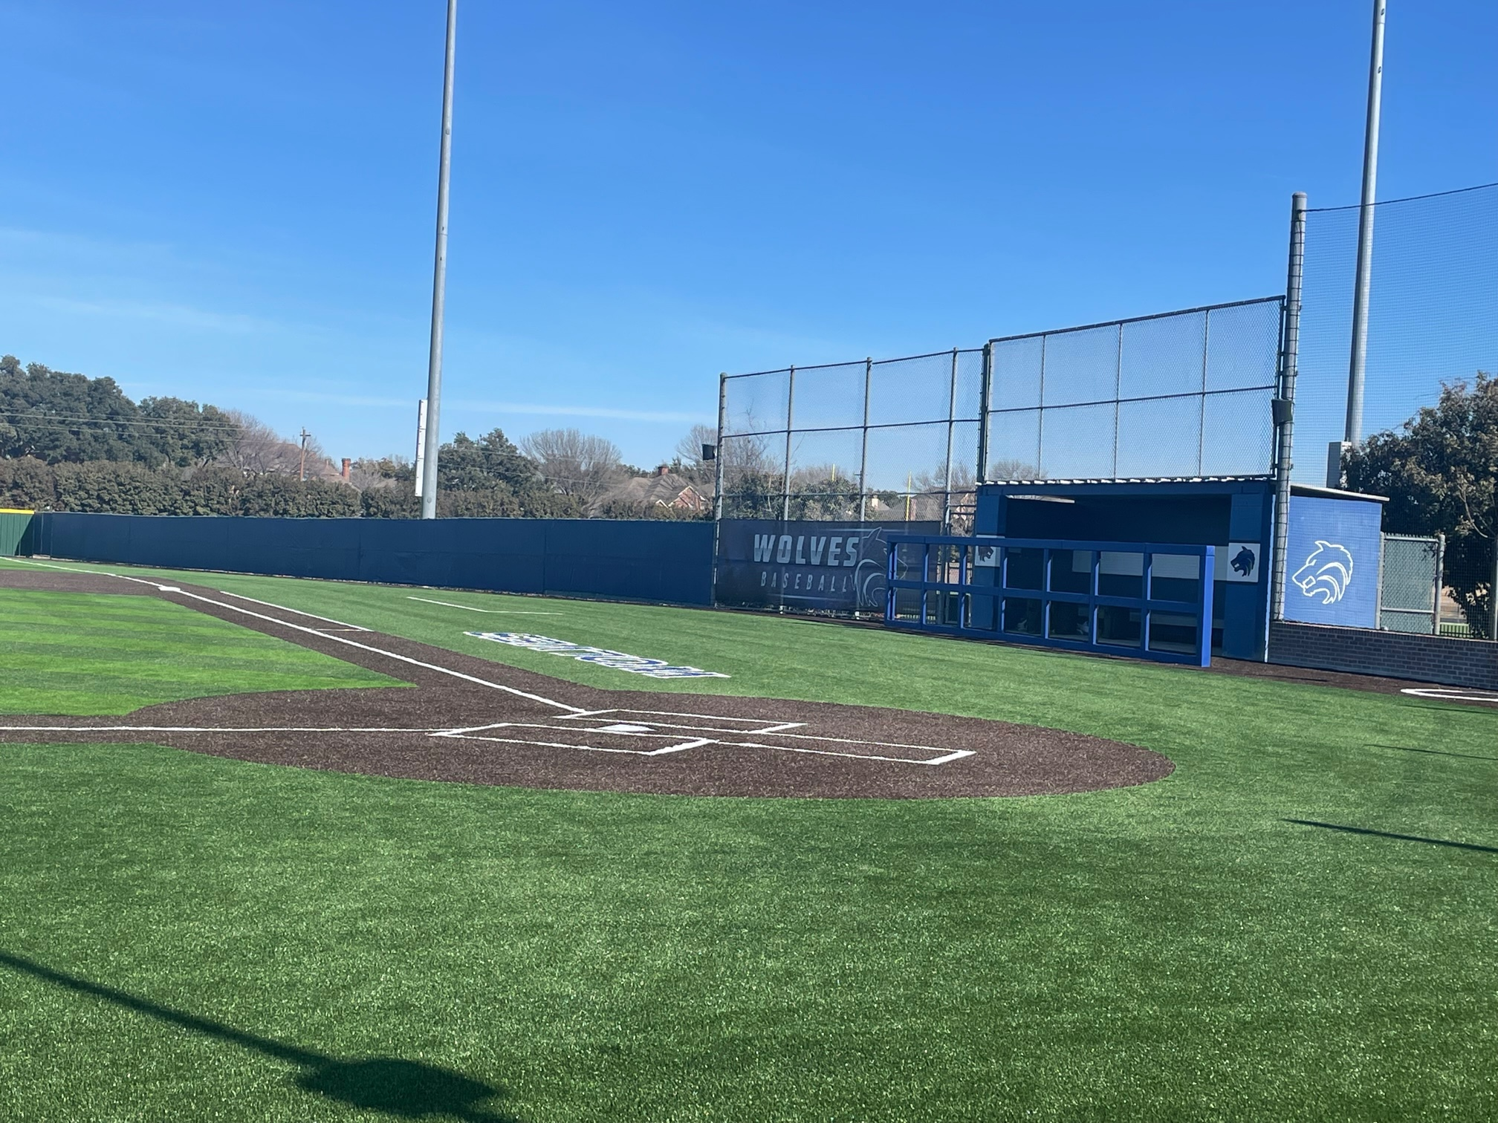
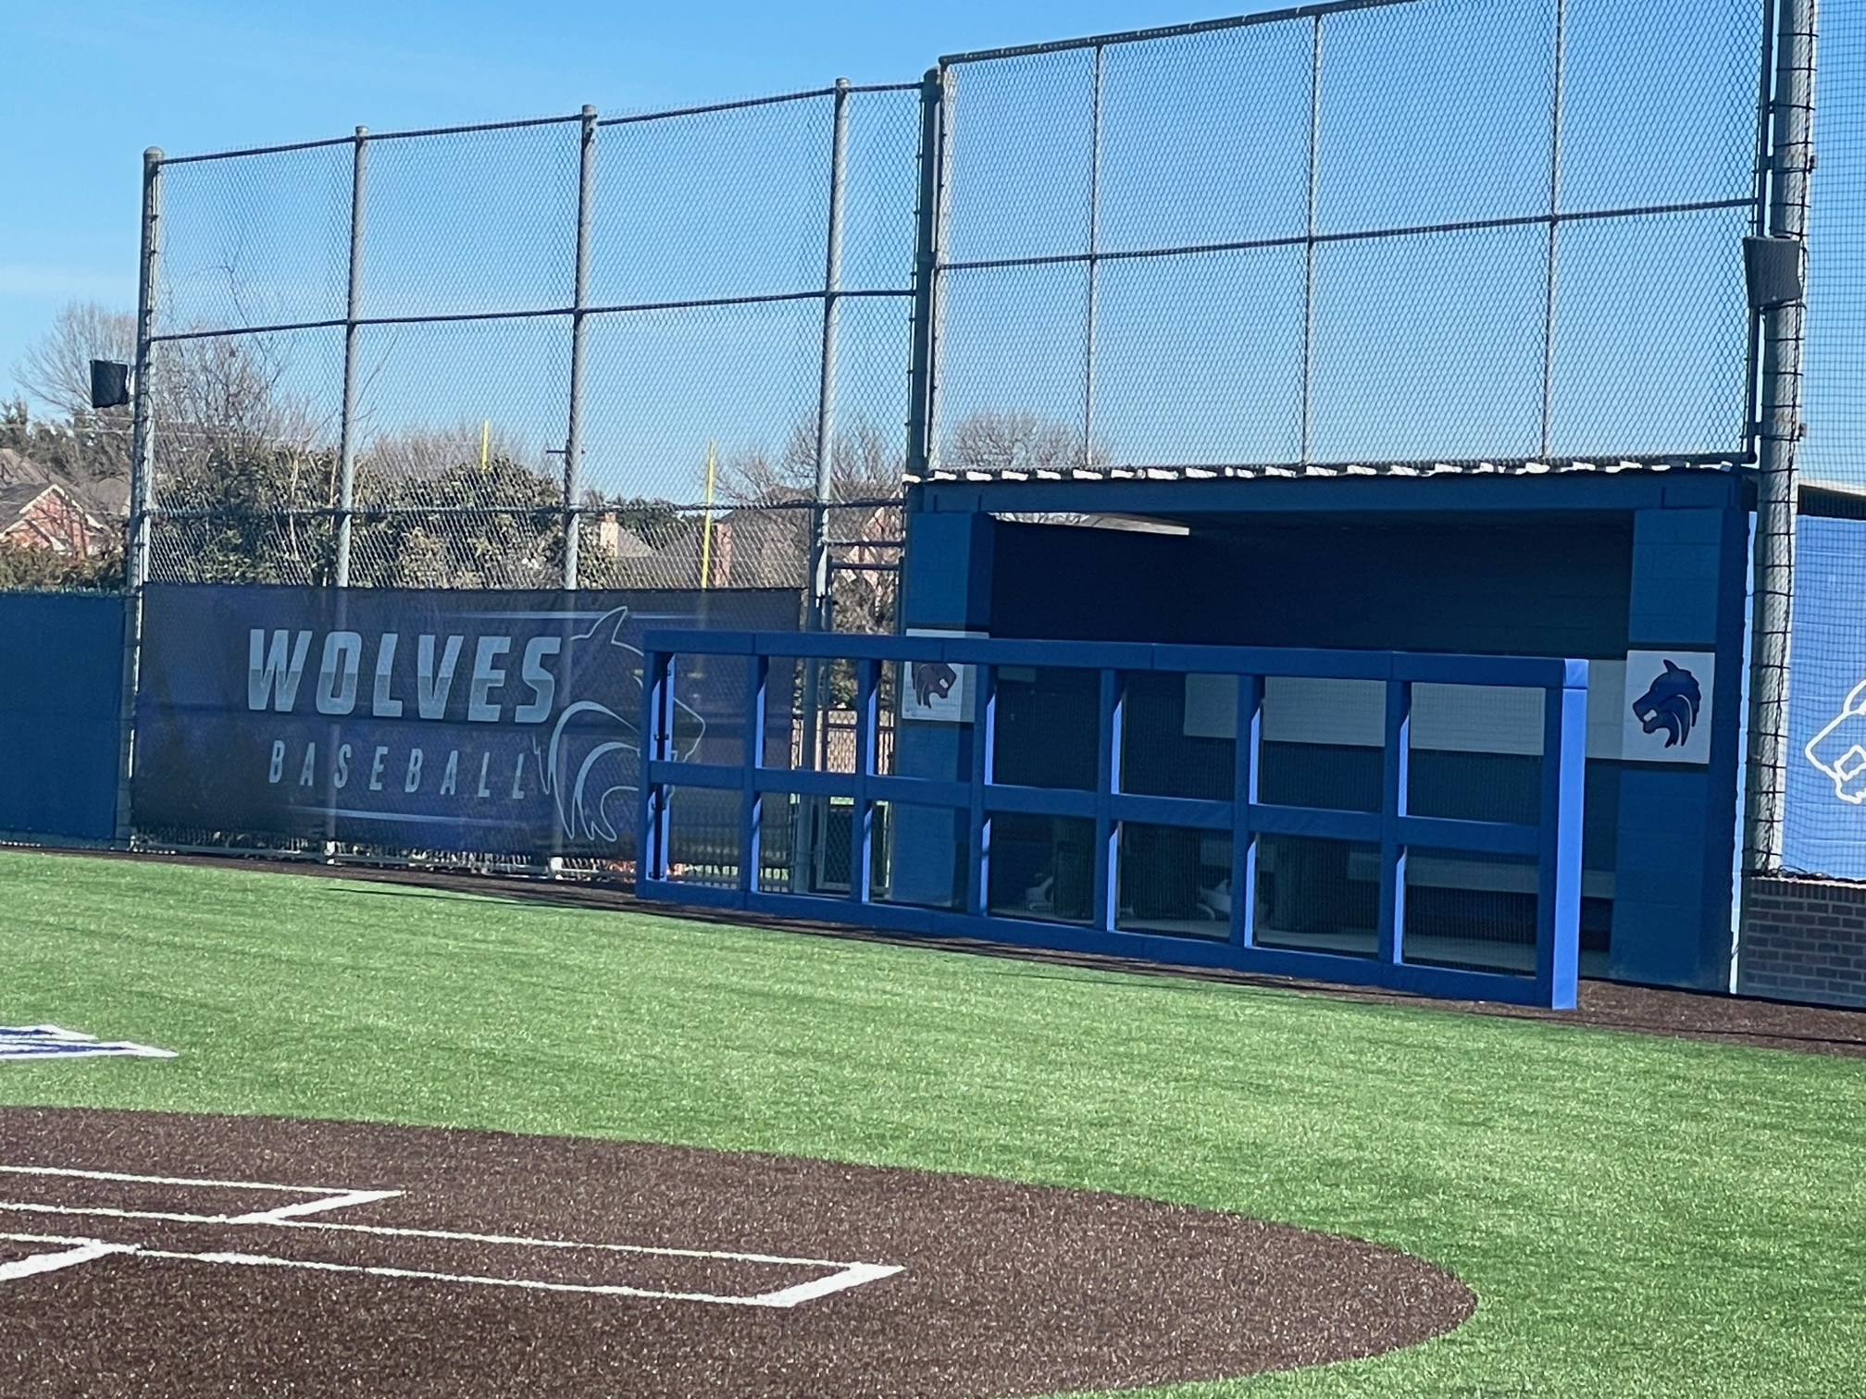
Ballpark Branding Upgrades

Slide 27
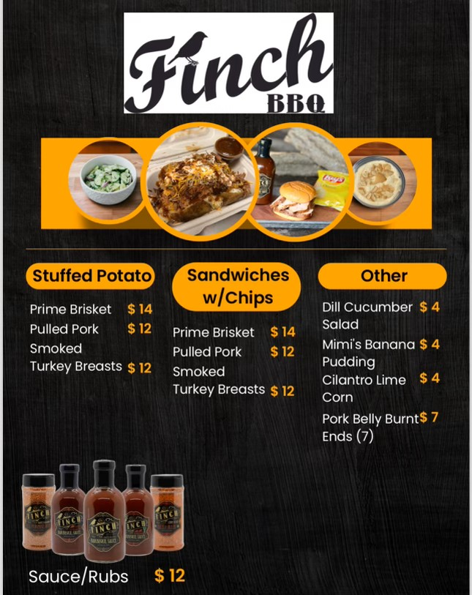
Plano West Baseball Spirit Nights
BBQ Dinner Drive Through
When: Thursday, November 9th
Where: PW Baseball Field Parking Lot
Who: Anyone that orders BBQ ahead of time for pickup
Benefit: 20% back to Plano West Baseball!

Slide 28
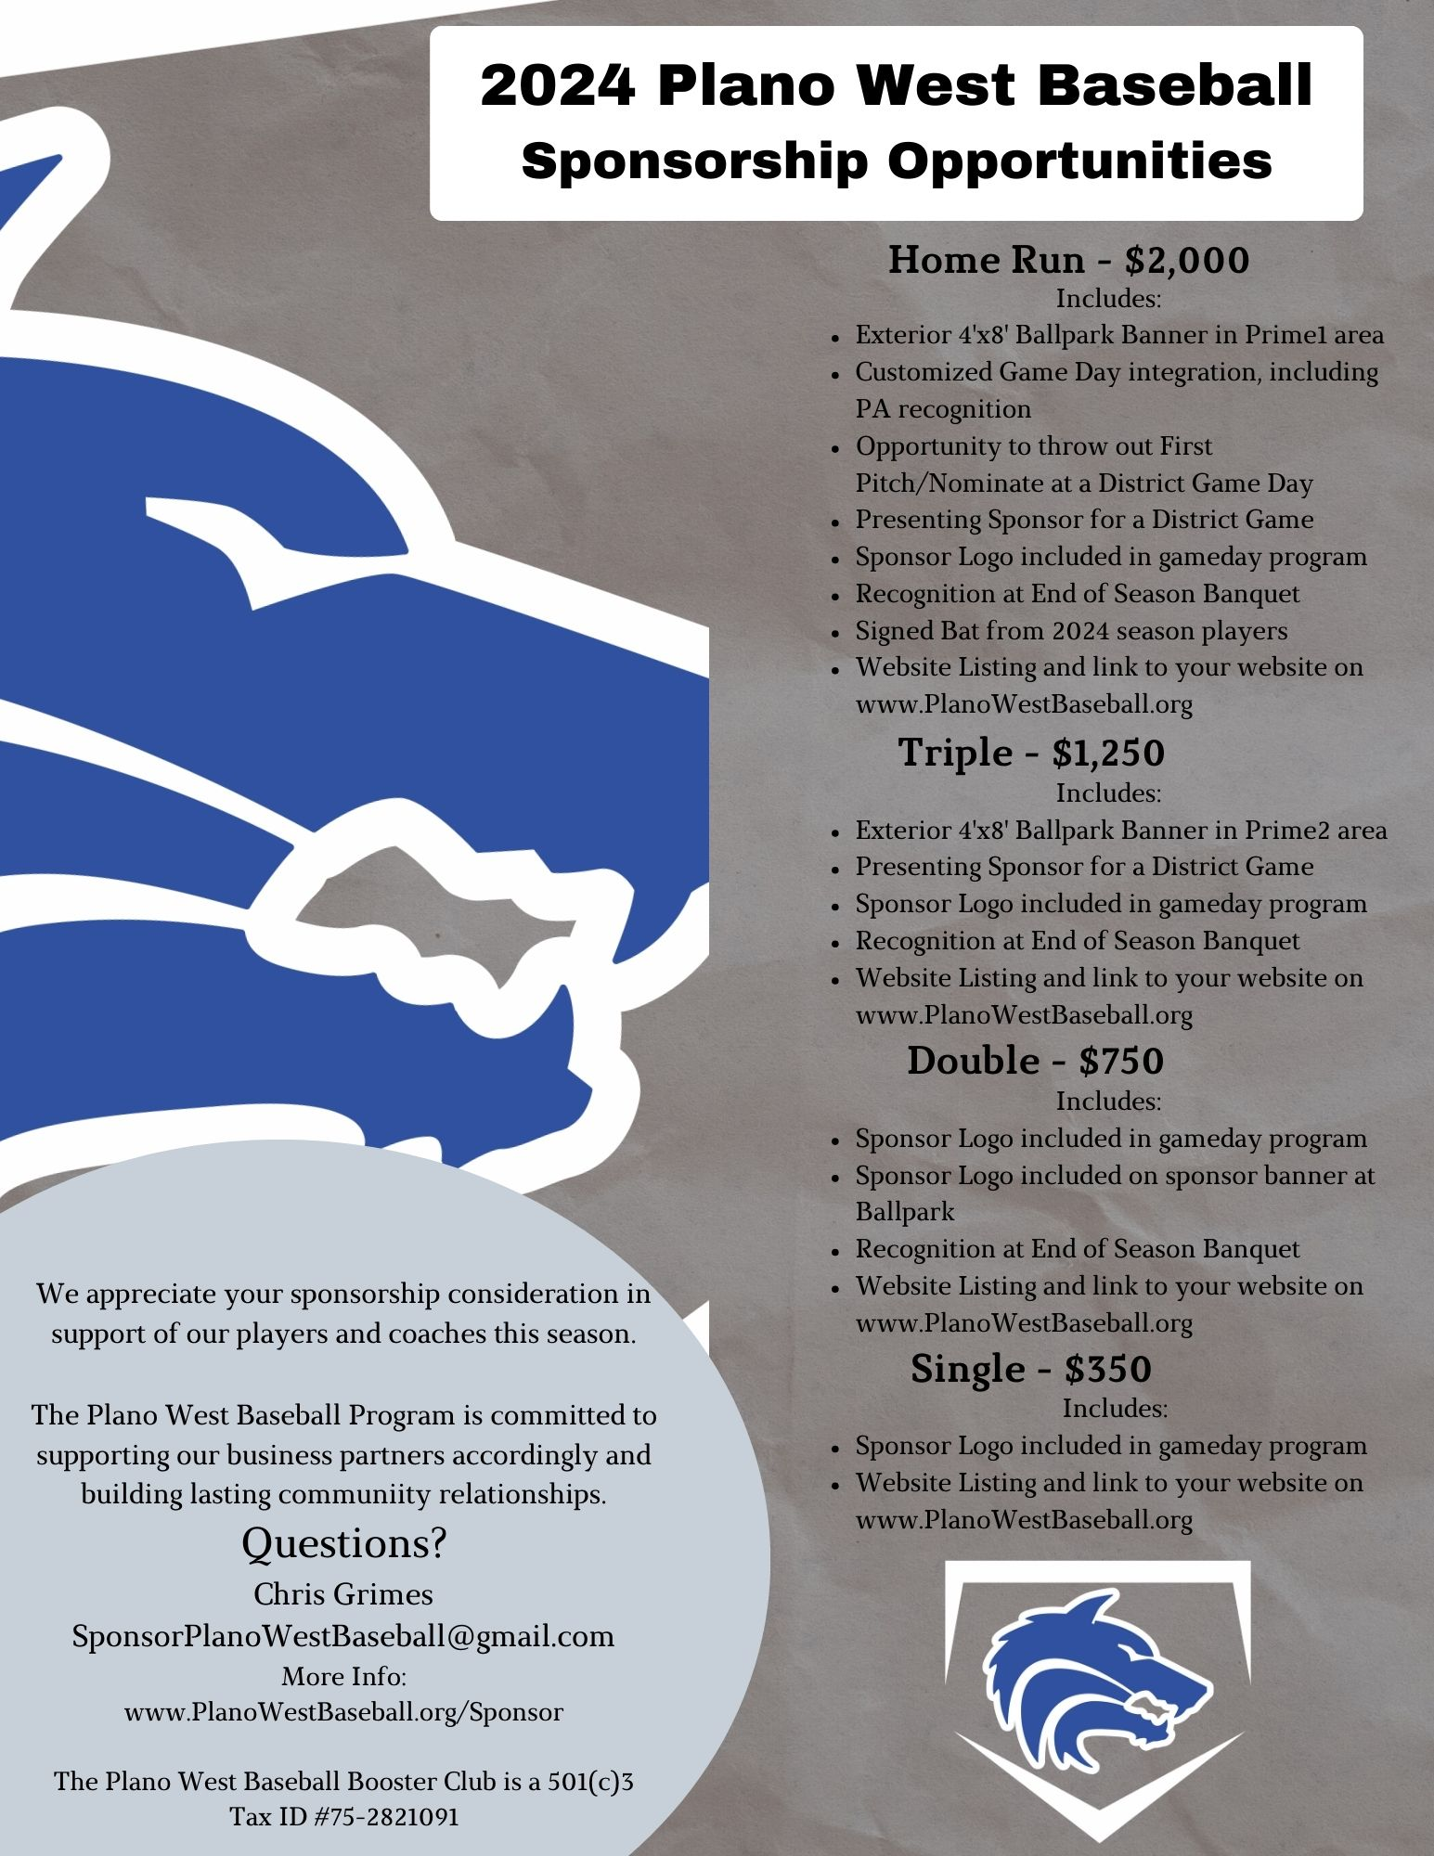
Sponsorships
Sponsor Day Sat – 1/20 @ 12:00
Thanks to all players and especially the parents
Contacted at least 100 potential sponsors across 9 areas
Committee will start calling the prospects this week
Sponsors brought in during the last 2 weeks:
1 HR, 2 Triples, and 5 Singles (over $6k in sponsorships) Thanks Parents!!
Board members and Sponsor Committee members are working with each sponsor to get images and websites loaded and to produce banners for HR and Triple sponsors.
Sponsorship Ideas for/from Parents:
Restaurants, Gyms, Insurance Agents, Car Dealers, Realtors, Baseball Clubs, Contractors, local companies, etc
Team Picture/Calendar
Leave behind and give to all sponsors as soon as possible after Media Day

Slide 29
2023 – 2024 Booster Club Budget

Slide 30
2023 – 2024 Booster Club Budget

Slide 31
2023 – 2024 Booster Club Budget

Slide 32

Plano West Baseball Spirit Nights
Plano West Baseball Spirit Night!
When: Monday, October 23rd
Where: Coit and Spring Creek Location
Who: Anyone that mentions PW Baseball
Time: 5:00 p.m. - 10:00 p.m.
Benefit: 15% back to Plano West Baseball!

Slide 33
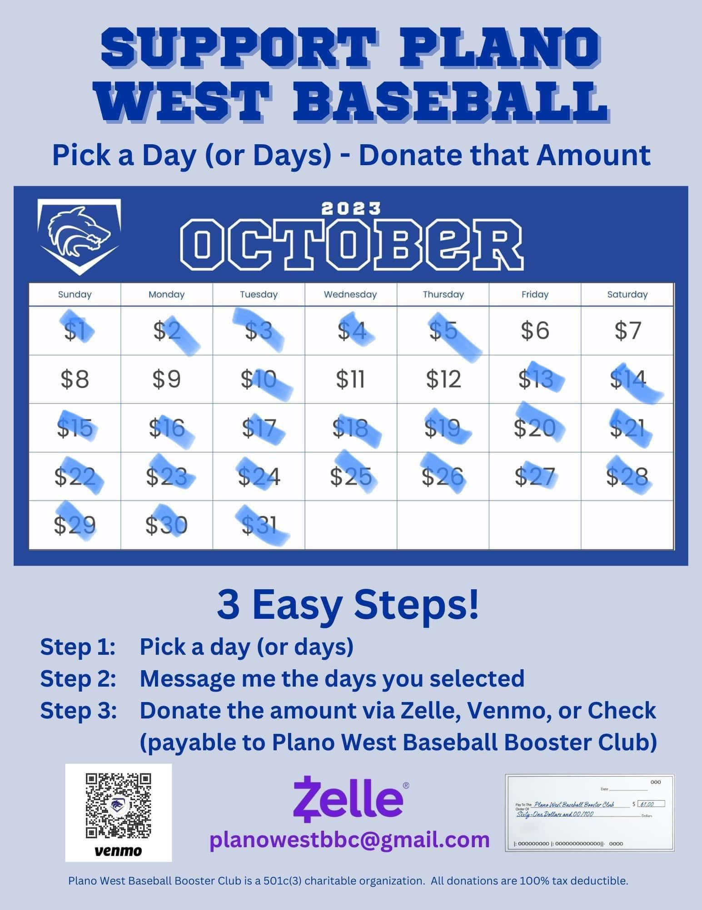
October Fundraiser
Calendar Fundraiser - $3,884 raised

Slide 34
Homecoming Parade
Wednesday, September 20th
Thank you Courtney Donkervoet & Joelle Novick for taking on float!
Candy donations needed!
Plan:
After practice: decorate & pizza until 5:30 pm
Make way to staging on Yeary by Brinker 5:40 pm
Parade starts at 6:30 pm (goes down Yeary and into Plano West Lot)
Pep Rally after in gym for Students
Parents please help clean up float etc.
Players wear: fall jersey/shirt, black shorts (or sweatpants) and fall team hat

Slide 35
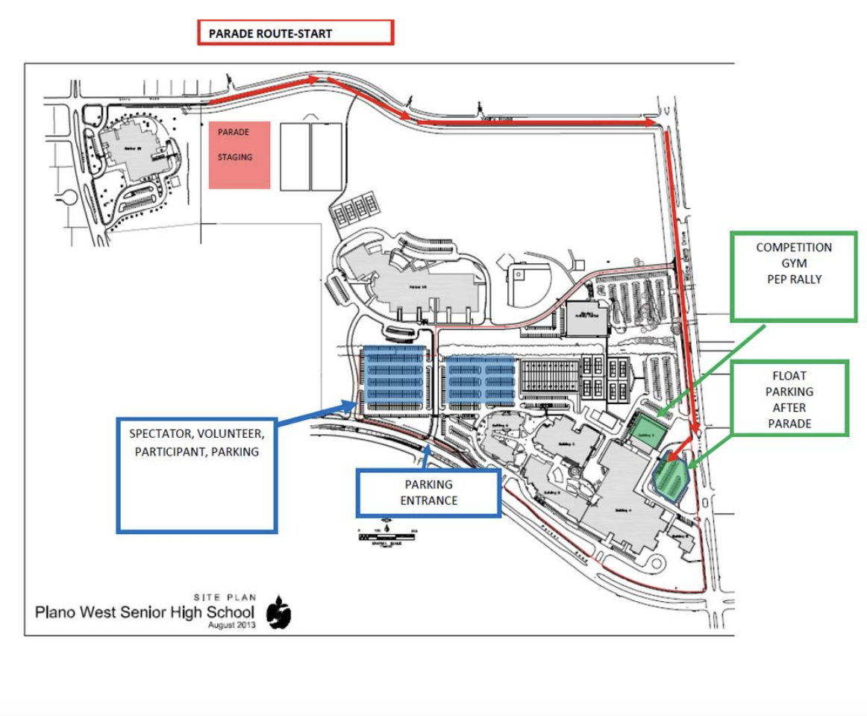
Homecoming Parade Route

Slide 36
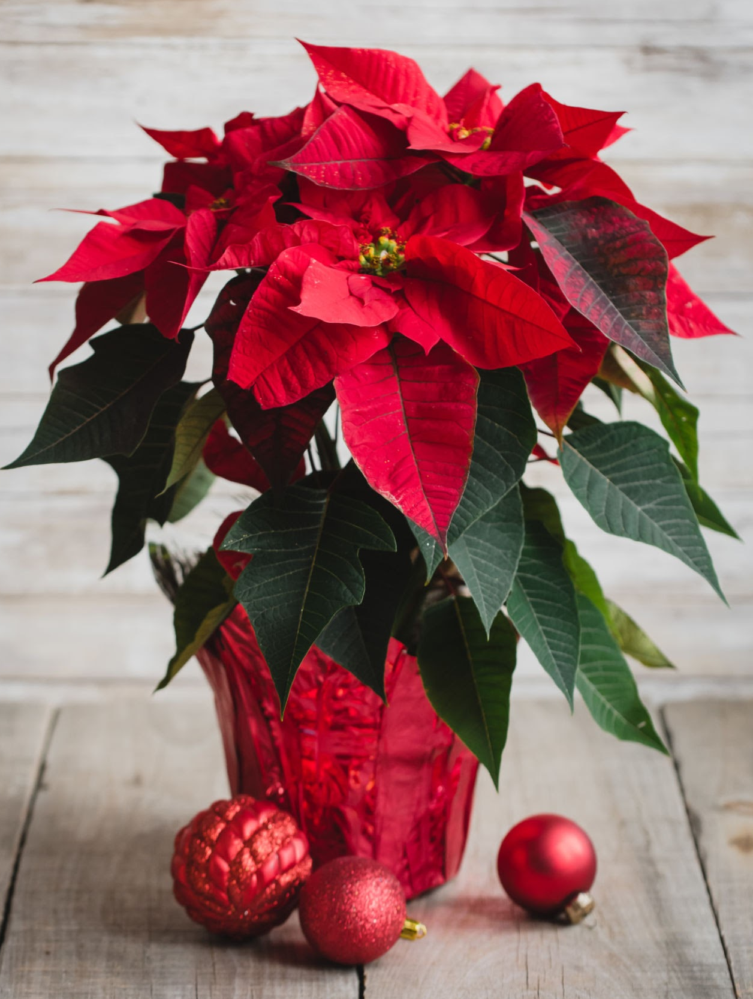
November Fundraiser
Poinsettia Fundraiser
Working with Website provider to have all orders go through website.
Look for ordering link soon!

Slide 37
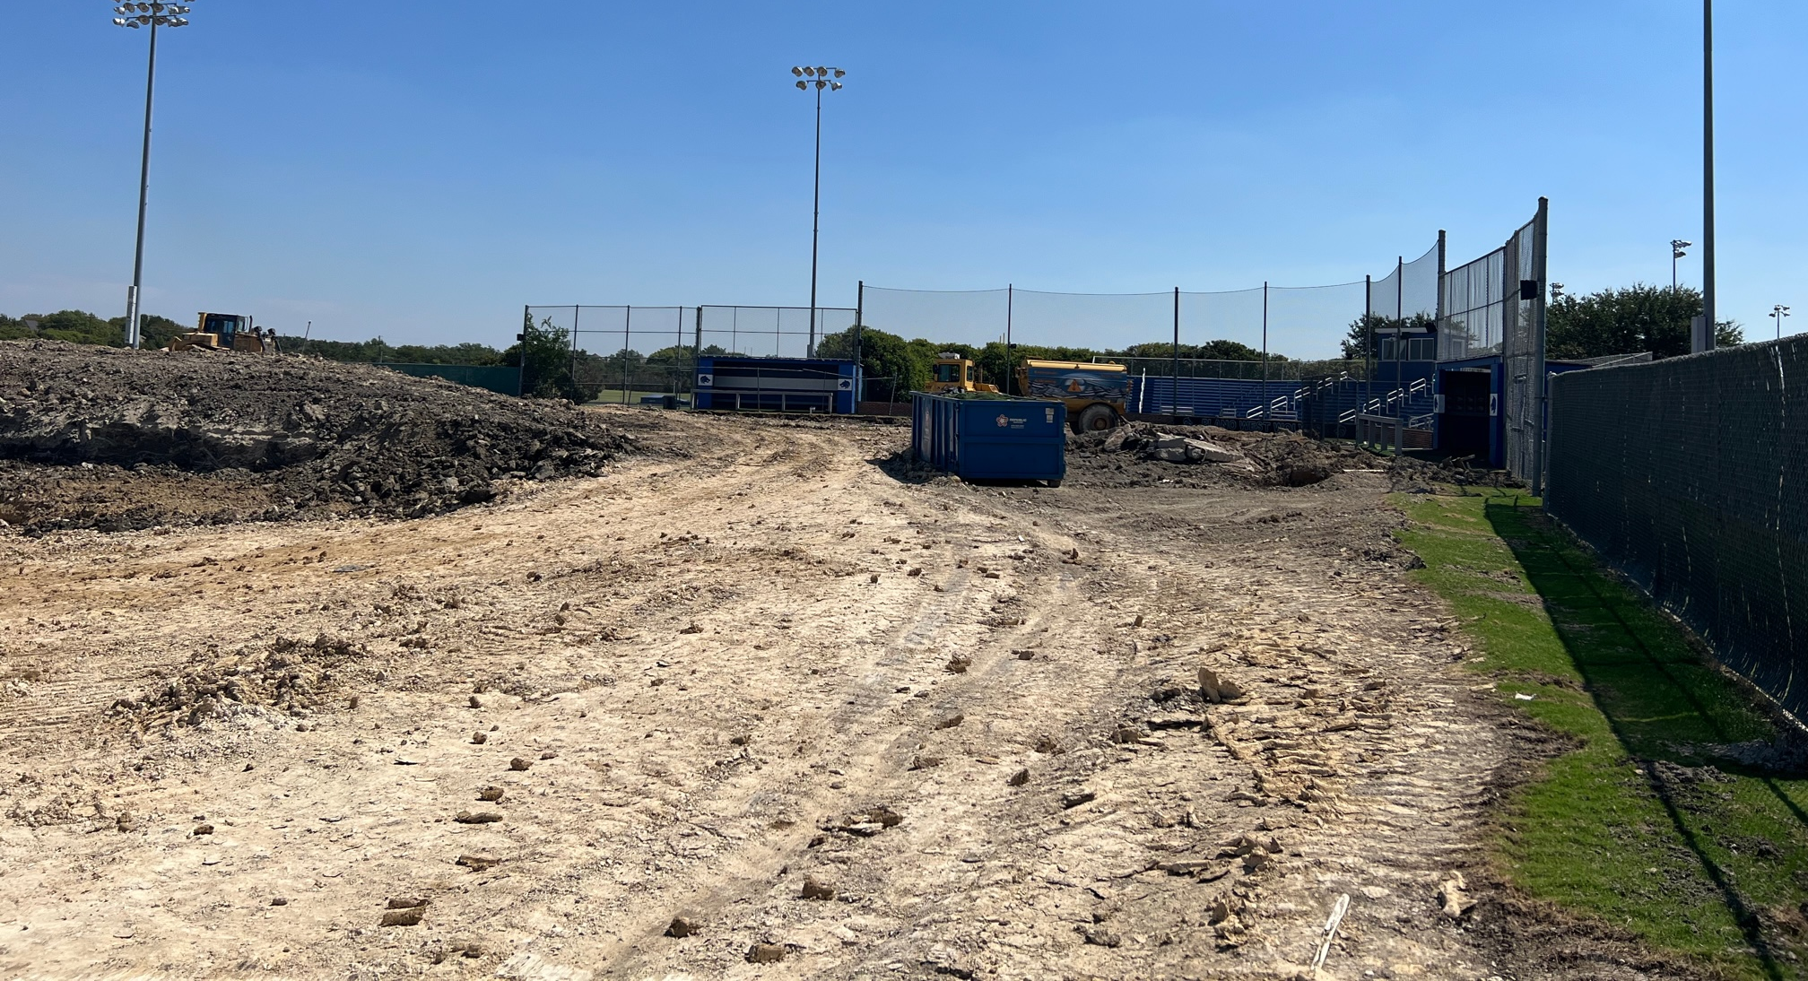
Ballpark Update

Slide 38
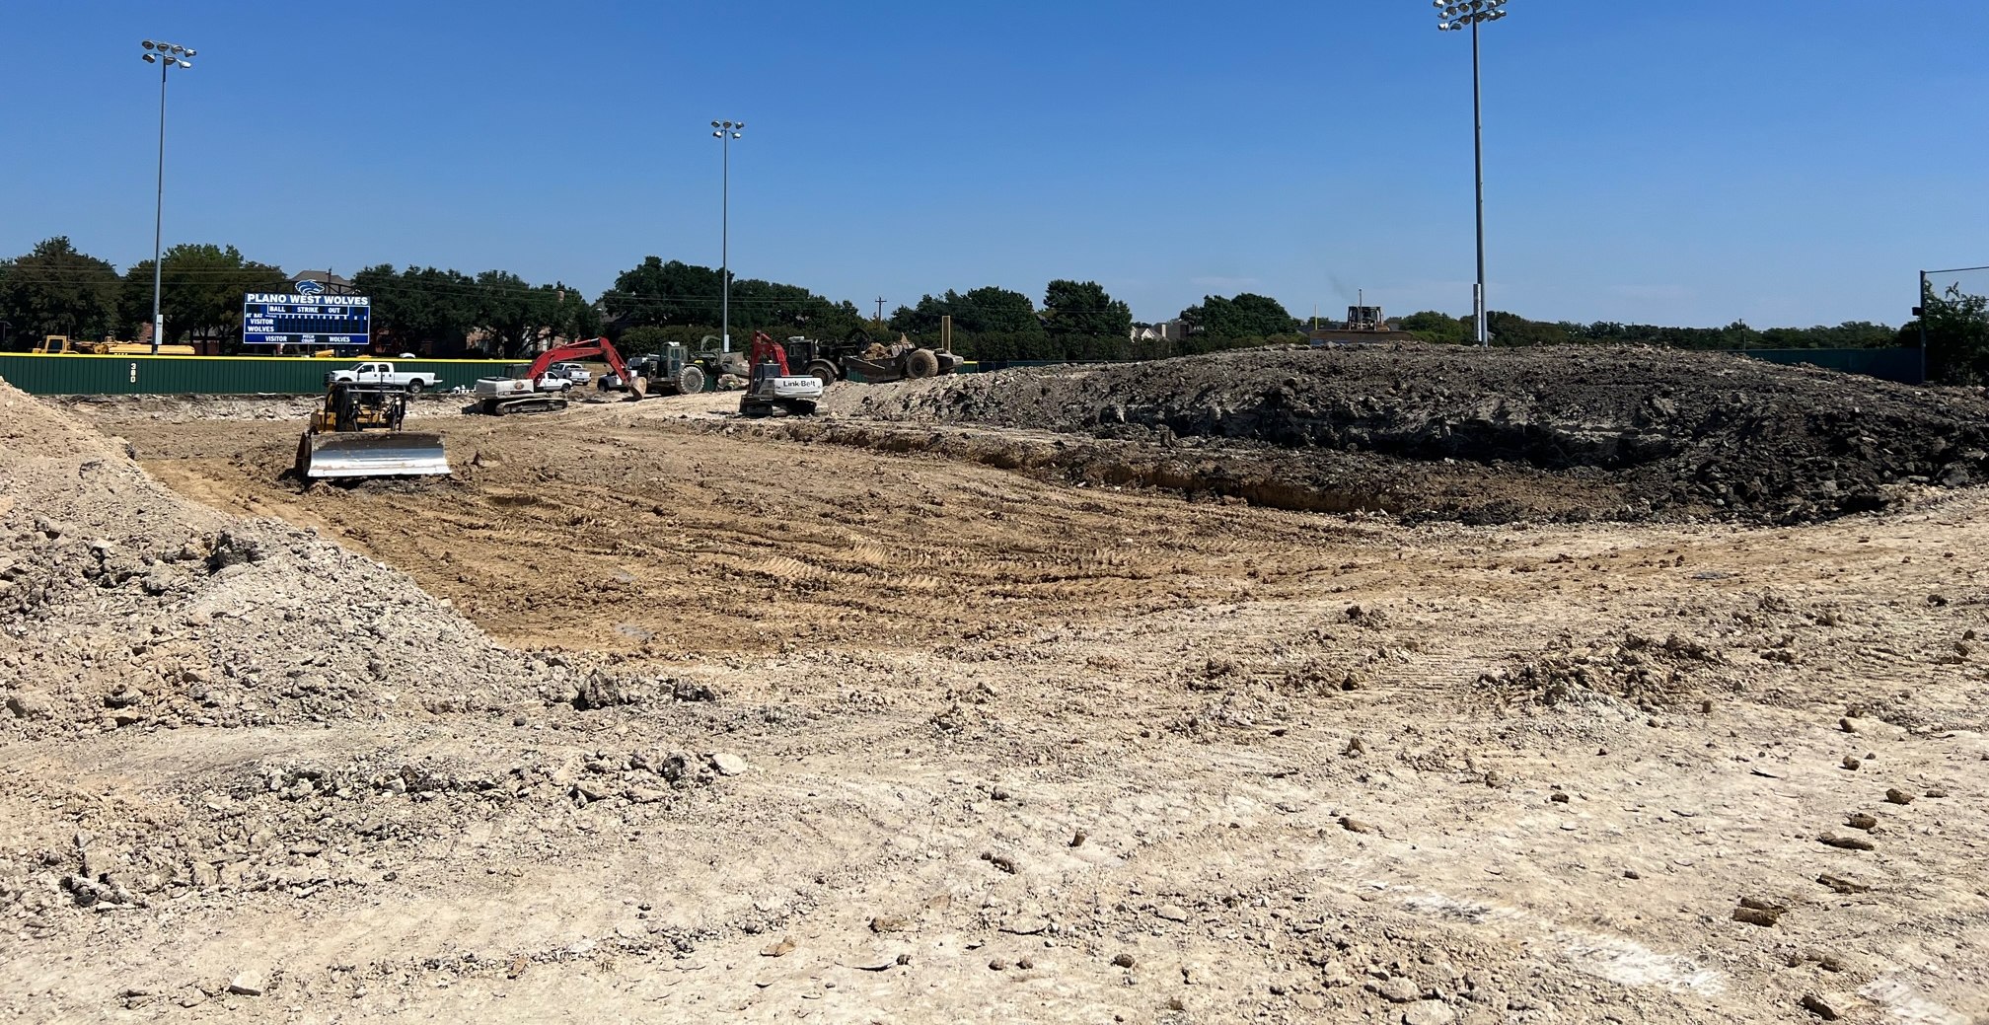
Ballpark Update

Slide 39
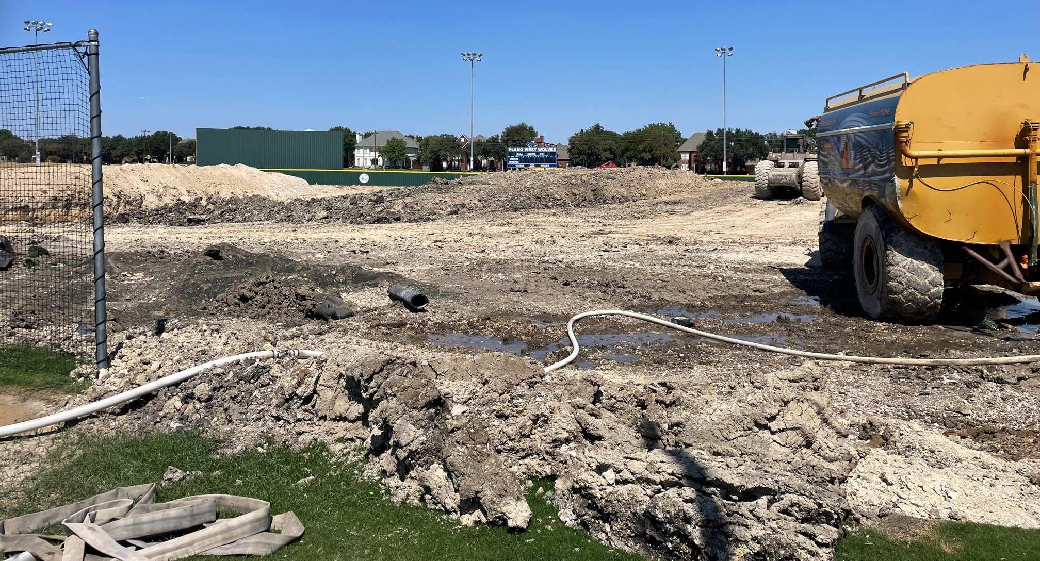
Ballpark Update

Slide 40
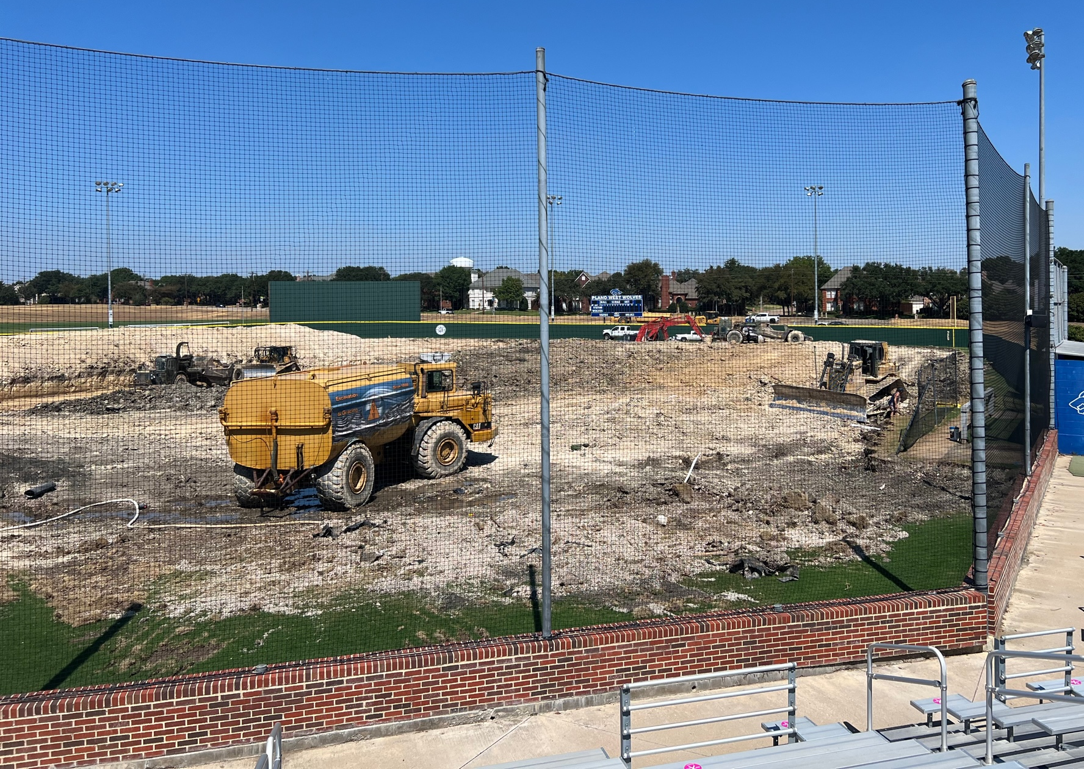
Ballpark Update

