Slide 1

2024 CAA Softball Parent Meeting
Travel and League teams
K/1/2, 8U, 10U, 12U and 14U

Slide 2

Agenda
CAA Mission & Values
CAA Board / Job Descriptions
Program Update and Changes
Program Overviews and Key Dates
Evaluation Overview
Volunteering & Coaches
Equipment & Safety
Storm Fastpitch Apparel

Slide 3

CAA Softball Mission & Values
Mission Statement:
To provide girls in the Chanhassen-Victoria area a place to play the great game of softball while developing lifelong physical and interpersonal skills, learning to compete and be a good teammate, and most importantly, having fun.
Core Values:
Team work - We work together to achieve more
Hard work - We give our all in everything we do
Pride - We are proud to represent our team, association and our communities
Respect - We treat ourselves and others with dignity, kindness and respect
Fun - We have a positive attitude and enjoy being with our team on and off the field

Slide 4
CAA Softball / Baseball Mission & Values
CAA Softball / Baseball is committed to:
Quality instruction and positive coaching that teaches fundamental skills, tactics and strategies for the game
Preparing players for the next level of play
Establishing standards of participation for all volunteers, board members, coaches, officials, athletes and spectators
Creating a positive environment in which we all work together to achieve our mission
Developing character, encouraging personal responsibility, fostering the quality of good citizenship and encouraging the growth of our players

Slide 5
Total Participants
We will have over 150 girls playing softball for CAA this summer!
We would love to see it keep growing and keep teaching more and more girls about softball!
Thank you for spreading the word about our amazing program!

Slide 6
Softball Operating Committee (SOC)
Brett Sween– VP Softball
Kelli Strauss – Travel Director
Open – Player Agent and Tryouts Director
Matt Birkenholz – Director of Player Development
Open – K/1/2 – 8U Director
Julie Vasatka – Uniforms Coordinator ***
Jamie Bruemmer – Equipment Coordinator ***
Open – Hosted Tournaments Coordinator ***
Special thanks to Mark Stay for his years of service to CAA – we will miss him!
***=Non-Voting Board Member

Slide 7
Openings – Job Descriptions
K/1/2 – 8U Director
Coordinate with Chaska, Carver, and Eden Prairie programs
Reserve fields
Coordinate parent volunteers for coaching
Ensure positive learning environment
Player Agent and Tryouts Director
Plan & coordinate player evaluations
Manages evaluation scoring & roster creation
Hosted Tournaments Coordinator
Serves as Tournament Directors for 2 hosted tournaments
Coordinates with CAA Tournament & Concessions Director
Partners with MN Softball on event planning

Slide 8
Program Updates/Changes
Open roles
Dome/Mission time
Increased costs (umpires, league registration)
NEW: “A” Level Teams for 10U & 12U
Equipment Purchases:
We have the opportunity this year to purchase some new equipment! CAA is a non-profit organization with all revenue going towards league fees, umpires, tournament registration, many administrative fees (insurance, etc), and equipment.

Slide 9
Program Overview: K-2 Coach Pitch
Girls entering K/1st/2nd Fall 2024
Nights of Play – Monday & Wednesday
Season runs May 13th to June 28th
Get girls playing, build confidence and have fun
Use 11” soft-sided ball
NO evaluations
CAA uniforms -- shorts and tank jersey (Indicate size at time of registration, no need to attend uniform fitting session)
Play neighboring communities (Chaska, Carver, Eden Prairie)

Slide 10
Key Dates – K / 1/ 2
K / 1/ 2 (Monday and Wednesday nights)
May 8 – Start practice
Week of May 13 – Start games
Practices will be Mondays, Games will be Wednesdays
League Games (versus Chaska, Carver, Eden Prairie, or other Chan teams)
No practice May 27th (Memorial Day)
End of Year Bash - June 28th – Chaska Community Park

Slide 11
Program Overview – 8U Machine Pitch
Girls with birth dates September 1, 2014 or later
Get girls playing, build confidence and have fun!
NO evaluations
Same uniforms as Travel (uniform fitting March 6th or 12th)
Wednesday night games start on May 1st
65 minutes (last 2 weeks of season will be double headers)
Part of Big West League (same as 10U, 12U, 14U teams)
State Tournament – June 29-30
Additional tournaments will be up to each team to consider and pay for individually – there are great options available. Most 8U tournaments are 1 day only.

Slide 12
Key Dates – 8U
8U (Monday and Wednesday nights)
Practices Start – mid April (whenever fields dry out)
Practices Mondays, Games Wednesdays
May 1 – June 26 – League Games (last 2 weeks will be double headers)
State Tournament – June 29-30 (all teams are in; location TBD)
Other Optional Local Tournaments Are Available (typically they are 1 day events)

Slide 13
COMMON QUESTION: My daughter is in 2nd grade, should she play 8U or K/1/2?
ANSWER: IT DEPENDS….
Experience?
Friends?
Familiarity with softball or baseball?
Athleticism?

Slide 14
Program Overview – Travel – 10U & 12U
10U: Birth dates September 2012-August 2014
12U: Birth dates September 2010-August 2012
Uniform Fitting: March 6th or 12th
Season Timing: April - June
10U: Tuesday Doubleheaders: Thursday Double Headers or Practice
12U: Monday & Wednesday Double Headers; additional practice @ as set by coach
Weekend tournaments:
3 weekend tournaments + state qualifier (included in registration fee)
Teams may opt for additional tournaments
State Qualifier -- June 22 and June 23
State Tournament -- June 29 and June 30 (must qualify)
Nationals (must qualify)

Slide 15
Key Dates – 10U and 12U
10U (Tuesday and Thursdays) | 12U (Monday and Wednesday**)
Practices Start – April 9 | Practices Start – April 8
April 30– June 20 League Double Headers (Tuesdays in May, Tuesdays and Thursdays in June) Practices Thursday nights in May | April 29 – June 19 League Double Headers (Mondays and Wednesdays) Practices Tuesday or Thursday nights (determined by coach)
3 tournaments – TBD | 3 tournaments – TBD
State Qualifier – June 22-23 | State Qualifier – June 22-23
State Tournament – June 29-30 (Must qualify) | State Tournament – June 29-30 (Must qualify)
Nationals: Must Qualify | Nationals: Must Qualify
** = PRACTICES AND GAMES COULD BE ADDED ON ANY DAY

Slide 16
Program Overview – Travel – 14U
14U: Birth dates September 2008-August 2010
Uniform fitting: March 6th or March 12th
14U Season Timing: May - July
Double Headers Tuesdays, Practice Thursdays (TBD)
Weekend tournaments:
3 weekend tournaments + State Qualifier (included in registration fee)
Teams may opt for additional tournaments
State Qualifier -- July 13th and 14th
State Tournament -- July 20th and 21st (must qualify)
Nationals (must qualify)
Looking for additional players for Summer 2024 Season!

Slide 17
Key Dates – 14U
14U (Tuesday and Thursday nights TBD)
Practices Start – end of May (coinciding with end of High School season)
Practices Thursday, Games Tuesdays TBD
May 23 – July 15 – League Games
3 tournaments – TBD
State Qualifier – July 13 – 14
State Tournament – July 20 - 21 (must qualify)
Nationals: Must Qualify
** = PRACTICES AND GAMES COULD BE ADDED ON ANY DAY

Slide 18
Travel Expectations
Participants in the Spring/Summer program dedicate to Softball as their main in-season sport and attend all practices, weeknight games and weekend tournaments
Practice and game absences should be communicated to the coach as soon as possible
Expect to travel!
Please play catch with your daughter! It’s fun, it’s the best thing you can do to improve her confidence.

Slide 19
Program Overview – Rec – 10U & 12U
10U: Birth dates September 2012-August 2014
12U: Birth dates September 2010-August 2012
NO player evaluations required
Uniform Fitting: March 6th or March 12th
Same Rules as Travel – Big West League
Season Timing: April - June
Double Headers on Tuesdays, Practices Thursdays
Double Headers Tuesdays and Thursdays in June
Optional Tournaments
Metro Tournament Options (team must cover the cost)
State Qualifier
State Tournament (if qualifies)

Slide 20
MAIN Difference between Rec and Travel…..
# OF GAMES:
Travel will play at least 20 MORE games over the course of the Summer than Rec, due to the games played in tournaments
Lower cost due to no tournaments included in registration fee

Slide 21
Off Season Happenings
Batting time in dome
10U and 12U teams
Pitching, Catching and Hitting clinics to be held in March/April
Held at Mission Fastpitch in Eden Prairie
Small player : instructor ratio
Great value $$$
4 week session < 1-2 private lessons
Registration is open
Coach training
More information to come
Chanhassen High School Softball events
Fastpitch Friday: Friday, April 12th
Youth night: Tuesday, April 16th
More information to come
Umpire training
For ANYONE (boys, girls, adults) >/= 14 years old
March 11th @ 6 – 8pm; Bluff Creek Elementary
$40 per participant
https://mnsoftball.com/pages/event/1241192398

Slide 22
Player Evaluations Overview
2024 Evaluations
Dates TBD – expect similar timing to last year (early fall)
Pitchers and Catchers should plan on separate evaluation
ALL Travel 10U, 12U and 14U players should plan on attending
Why do tryouts in the fall?
No “perfect time”
Allows girls moving to a new age level to play a season at that level prior to evals
More time for team selection
Allows for FUN to be the emphasis of fall ball
Provides more of a break between summer and fall seasons for families (i.e. player evals do not interrupt vacation plans any more)
Why have player evaluations?
To place players at the best skill level to have fun and to also be competitive
Additional details to be provided in parent meeting prior to evals

Slide 23
Uniform Fitting
Wednesday 3/6 @ 6-8pm OR Tuesday, 3/12 @ 6-8pm
Bluff Creek Elementary
Sample merchandise for parents and players
Players will be able to use the bathrooms to try on
$400 volunteer check MUST be turned in before a uniform is ordered

Slide 24
Volunteering
WE CAN’T DO IT WITHOUT YOU
CAA is a parent volunteer organization
Volunteers are CRITICAL to making our kids’ programs a success
Each family must complete 8 hours of volunteer time by July 31, 2024.
$400 volunteer check required for all, except Board Members and Key volunteers.
No player will be placed on a roster unless there is a check on file
Head Coach and 3 Assistant Coaches/Team Manager meet volunteer requirement
Coaches are required to complete the safety trainings and participate in majority of teams events to qualify for the volunteer requirement
Other key positions also meet requirement (and some don’t) – need official signup
Please talk to a Board member if you have questions
All volunteer sessions will be posted on Dibs
https://www.chanathleticassociation.com/dib_sessions

Slide 25
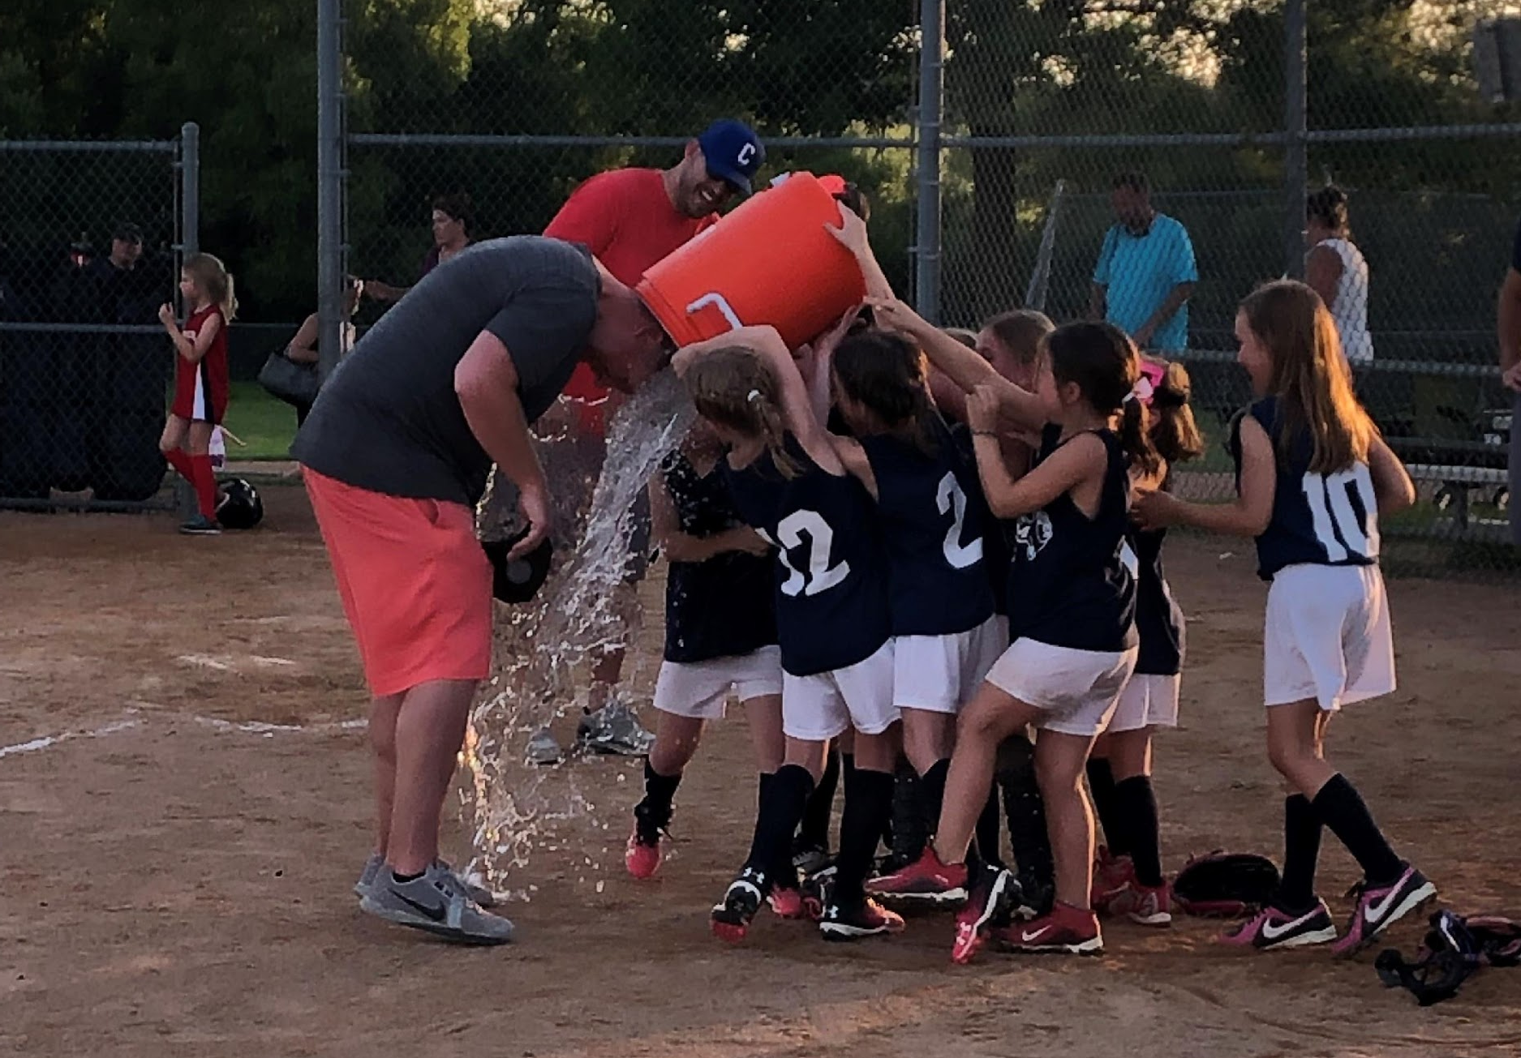
Coaches…..WE NEED YOU!!!
Coaches Registration:
Register on same site as softball registration

Slide 26
Equipment
Each player must provide their own batting helmet w/ cage, fielder’s mask, glove and bat
Fielder’s masks ARE required up through 12U
Catching gear and other coach’s equipment provided by CAA
Nice to haves:
Batting gloves
Equipment bag (made for softball)
Cleats (must be molded plastic through 12U, metal is allowed in 14U)

Slide 27
Player Safety
Abuse Awareness Training and Concussion Certification:
All on-field officials and coaches must complete concussion training and Adult Abuse Awareness Training
See safety information at:
https://www.chanathleticassociation.com/baseball-safety
Should take about 30-60 minutes to complete
For safety issues, contact Safety Officer (contact info on website)
Proud to partner with TCO and OSR as Diamond Sponsors:
TCO offers sports performance, sports chiropractic services, physical therapy, and nutrition solutions in 39 locations across the Twin Cities (https://tcomn.com)
OSR offers free 15 minute injury consults, physical therapy (including throwers programs), concussion rehab, and ACL prevention programs (https://www.osrpt.com/)
Both organizations supply athletic trainers for all Chanhassen hosted tournaments

Slide 28
Fastpitch Apparel & Equipment
Game One – local Chanhassen business
CAA Softball receives 10% of sales as a fundraiser
Store stays open and orders are shipped directly to your home
https://shop.game-one.com/minnesota/chanhassen/chanhassen-storm-fastpitch
Password: storm
Scheels – CAA sponsor

Slide 29


