Slide 1
TOWN HALL
INDOOR CLUB ADMINISTRATION
2023-24 SEASON
August 21, 2023

Slide 2
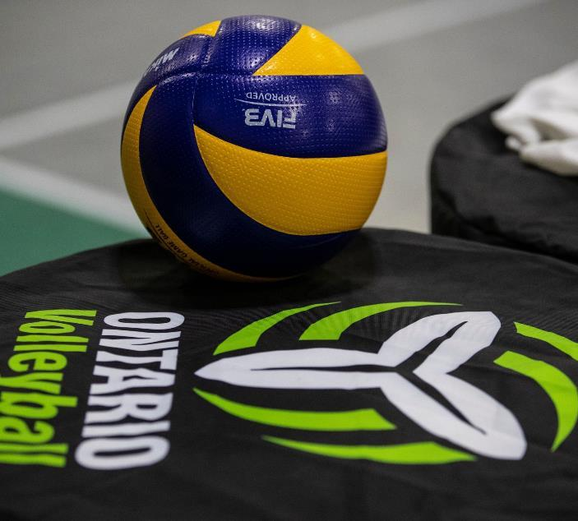
AGENDA
Regional Council Update
Club Resources
  Playtime Tracker for Clubs - LP
  Holly Club Support? - LP/Holly?
  CBC Pixellot Camera Pilot – Kerish
  Club Grant Opportunities
Q&A’s

Slide 3
Regional Council Club Leader Survey Results

Slide 4
Club Engagement Next Steps
By September 15th:
  Summary of Survey Results Posted online
  Direct Response FAQ to questions in Survey
  Slide deck from August 21 & 28th Town Hall Sessions posted under Club Leader Resource page
Communications
  Direct email blasts to Club Leaders prior to information going out to all members
  Town Hall Sessions continue throughout the indoor season
  Ongoing review of website to streamline information for Club Leaders
  Investigating Club Leader Portal options
  Club Administrator Checklist created and emailed out by August 22nd
Upcoming Town Hall Sessions
  Monday September 25th – Club Resource – Policy Creation & templates
  Monday, October 23rd – ONCA & Insurance
  Monday, November 27, 2023 – Topic TBD
  For Club Topics you would like covered, please email your suggestions to Jo-Anne at jljubicic@ontariovolleyball.org

Slide 5
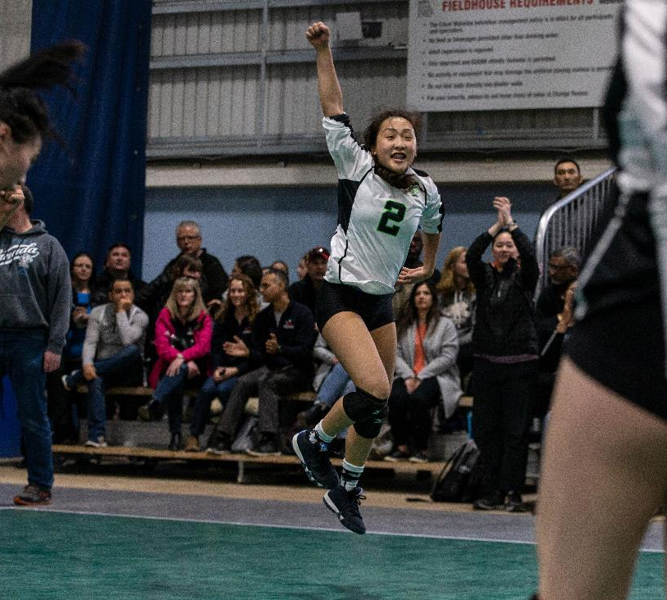
COMPETITION REMINDERS
Welcome back to another indoor season!
Soft uniform policy for event 1 for all age groups
All registration deadlines are 6 weeks prior for regular season events
Youth Competition calendar and What's New was published June 15th
Indoor Competitions manual was posted August 15th

Slide 6
ONTARIO CHAMPIONSHIPS REMINDERS
6 events split over two locations:
RIM Park (Waterloo) - 4 events
EY Centre (Ottawa) - 2 events
Teams are permitted to play in multiple OCs provided they are not playing 6 days in a row.
Athletes can only be listed on one roster per event
OC's age splits were released June 15th
OC’s Stay to Play Hotel booking process opens January 22nd

Slide 7
MRS RETURNING CLUB FORM

Slide 8
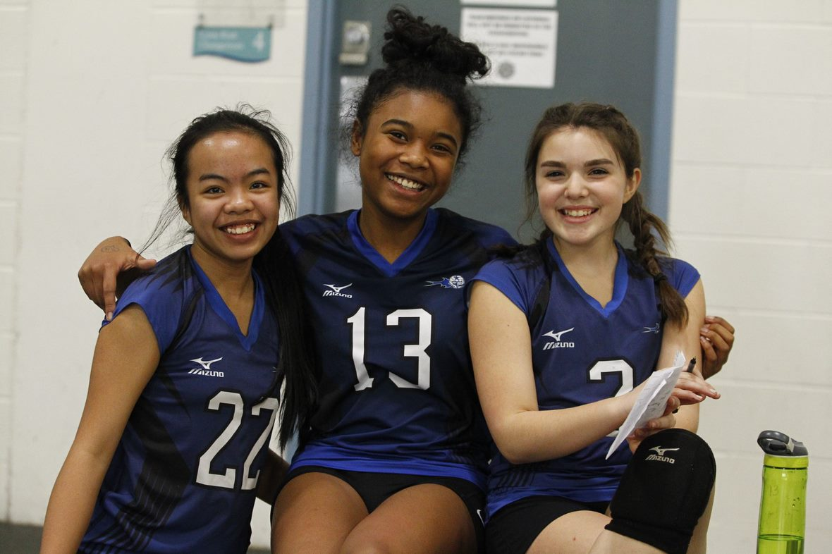
SAFE SPORT: CLUB LEADER ELIGIBILITY POLICY

Slide 9
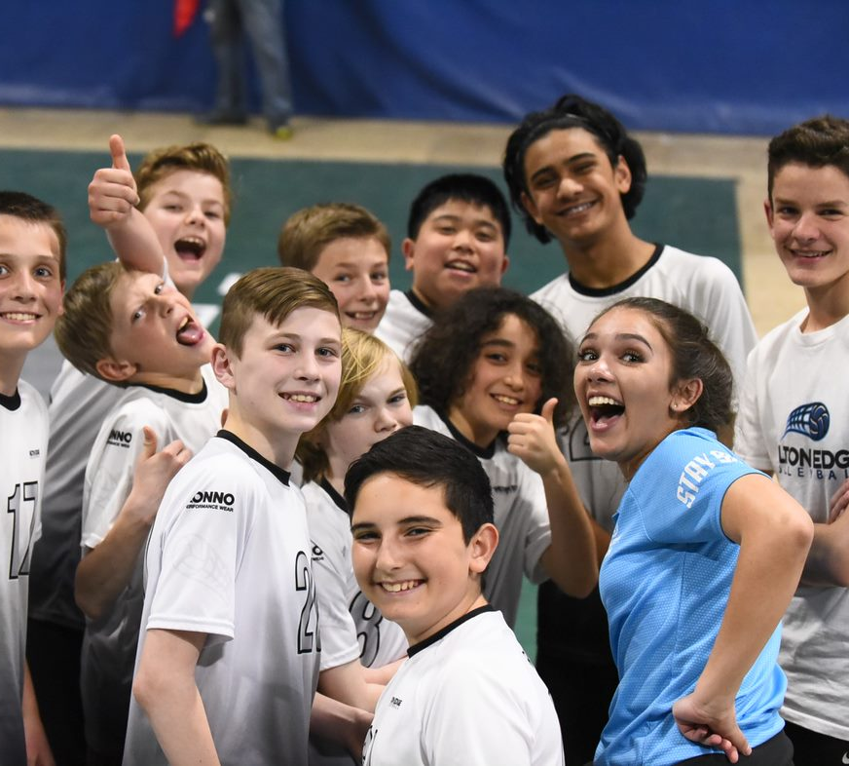
SAFE SPORT: OSIC UPDATES

Slide 10
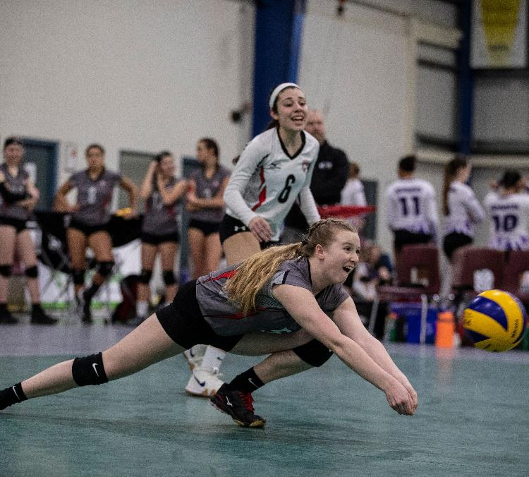
SAFE SPORT: RECIPROCATION POLICY

Slide 11
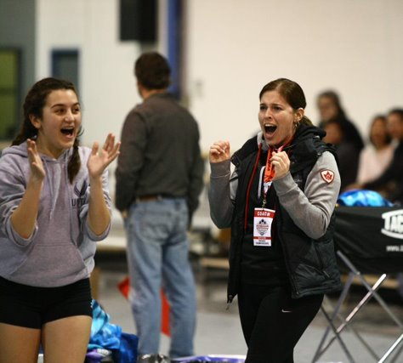
CLUB RESOURCES: PLAYER TRACKER

Slide 12
CLUB RESOURCES: SPORT SCIENCE SUPPORT

Slide 13
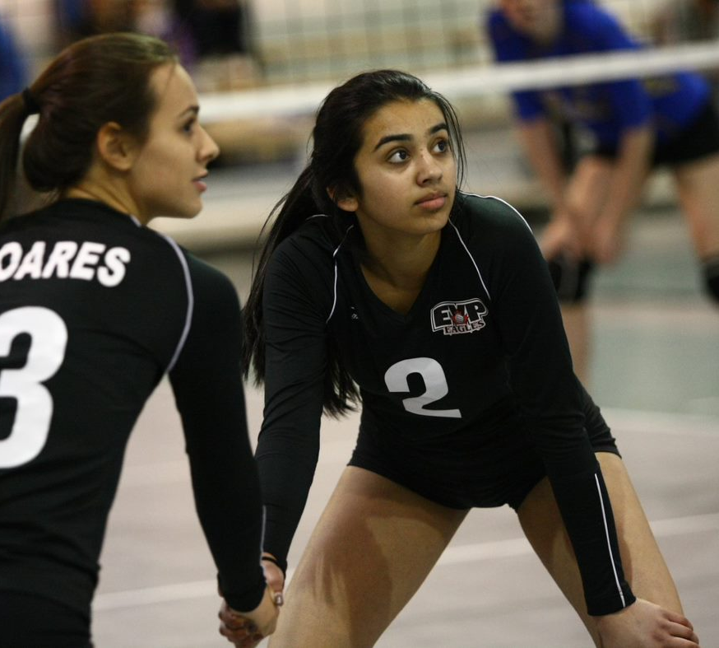

Slide 14
MEMBERSHIP & CLUB FEES
Membership Type | OVA Fee +HST | VC Fee* | Total
Tryout Player | $0 | $0 | $0
Recreational Player (4v4 Rallyball athlete) | $7 | $5 | $12.91
Competitive Player (6v6 Rallyball to 19U) | $55 | $35 | $95.15
Leader (Club Contact, Team Contact, Coach, etc.) | $55 | $35 | $95.15
Returning Club Fee | $350 | $0 | $395.50
New Club Fee | $500 | $0 | $565.00
    *Pending Board approval

Slide 15
TOURNAMENT ENTRY FEES
Indoor Youth Competition Tournament Fees All Fees are +HST
4v4 Rallyball Regular Season | $180
6v6 Rallyball to 15U Regular Season | $400
16U to 18U Regular Season – single day events | $425
16U-18U Regular Season – two-day events | $775
4v4 Rallyball Ontario Championships (2 days) | $995
6v6 Rallyball to 15U Ontario Championships (3 days) | $1480
16U to 18U Ontario Championships (3 days) | $1605
*Pending Board approval

Slide 16

VOLLEYBALL CANADA UPDATES
By: Dawna Sales - Director, Athlete and Coach Pathways
Club approval process
Two 19U athletes allowed on 18U team for Nationals
New Long Term Development Manual (LTD) publication coming fall 2021
Nationals 2022:
  May 5-8: Ottawa, ON – 14U girls and boys
  May 18-21: Edmonton, AB – 15U & 17U girls and boys
  May 21-24: Edmonton, AB – 16U & 18U girls and boys
Letters of Good Standing are being issued
VC is not providing these as an endorsement of travel, as the participants must follow the travel guidelines issued by the Canadian and American governments.
  VC recommends reviewing any medical coverage, as many changes have occurred since March 2020
  Form is available on the OVA website: https://www.ontariovolleyball.org/club-resources

Slide 17

SCREENING UPDATE
New OVA Screening Policy approved in April 2021, aligned with Volleyball Canada
Individuals in a position of trust or authority which may relate to finances, supervision, or vulnerable individuals required to complete screening
High Risk – occupy a position of trust or authority, have a supervisory role, direct others, involved with finances, frequent or unsupervised access to vulnerable individuals. Examples:
  Athlete support personnel
  Full-time coaches, assistant coaches
  Coaches, representatives and/or contractors who travel or be alone with athletes
  Referees
  Staff and/or directors and supervisors
  Complete Screening Disclosure Form
  Complete E-PIC (myBackCheck)
Low Risk – Individuals involved in low risk assignments - not supervisory, not directing others, not involved with finances, no unsupervised access to vulnerable individuals. For example:
  Parents, youth or volunteers who are helping on a non-regular or informal basis
  Non-coach employees or managers who do not travel with the athletes
  Complete Screening Disclosure Form
    https://www.mybackcheck.com/Secure/Invitation/SelfInvite.aspx?selfInviteId=70DIy5HaaMC0FvsgO0Xo0g==&lang=1

Slide 18
SCREENING UPDATE
Police background checks can now be completed online through the OVA's link to mybackcheck.com (valid for 3 years)
    This is not a mandated service to use → it’s a tool in place for members to easily obtain their PRC
    Must be an Enhanced Police Information Check (EPIC) with local police information
    Please send a copy to your club contact in charge of screening (downloadable PDF) for them to track for the Club's screening process/to enter on the Club form.
    If you already have a current PRC/VSS on file with your club, you do not need to re-do this process.
    Cost: $26.25
    https://www.mybackcheck.com/Secure/Invitation/SelfInvite.aspx?selfInviteId=70DIy5HaaMC0FvsgO0Xo0g==&lang=1

Slide 19
RULE OF TWO
Anyone working with vulnerable individuals need to be screened and trained. Examples:
  Coaches
  Managers
  Supervisors
  Support staff
  Contractors

Slide 20
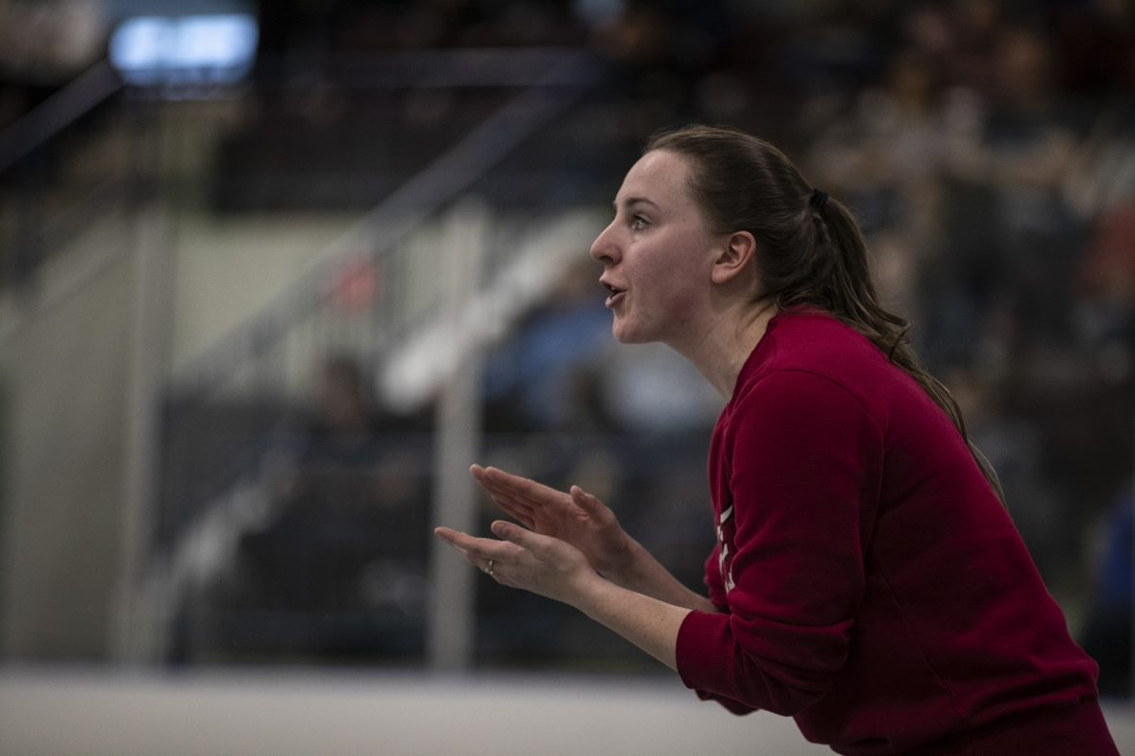
COACH ELIGIBILITY POLICY
Focus on safe and responsible coaching
Easily accessible and available courses
Applies to all coach members
  4v4 modification → If a team splits in 2 rosters for a 4v4 event, there must be a registered Head Coach who meets the eligibility requirements on at least one of the rosters at the event.
  Requirements must be met before registration
    A list of coaches from your Club will be sent to the Club contact by August 31, 2021 that have completed the online Screening requirements
    Once Club Form is complete after September 22nd, an audit will be completed and Club Contacts will be sent a follow up email
No more fines
Additional requirements for VC Nationals. See VC website.
Available in the BECOME A COACH section of the OVA website

Slide 21
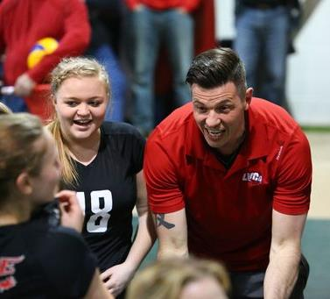
https://bettercoaches.com/ova

Slide 22
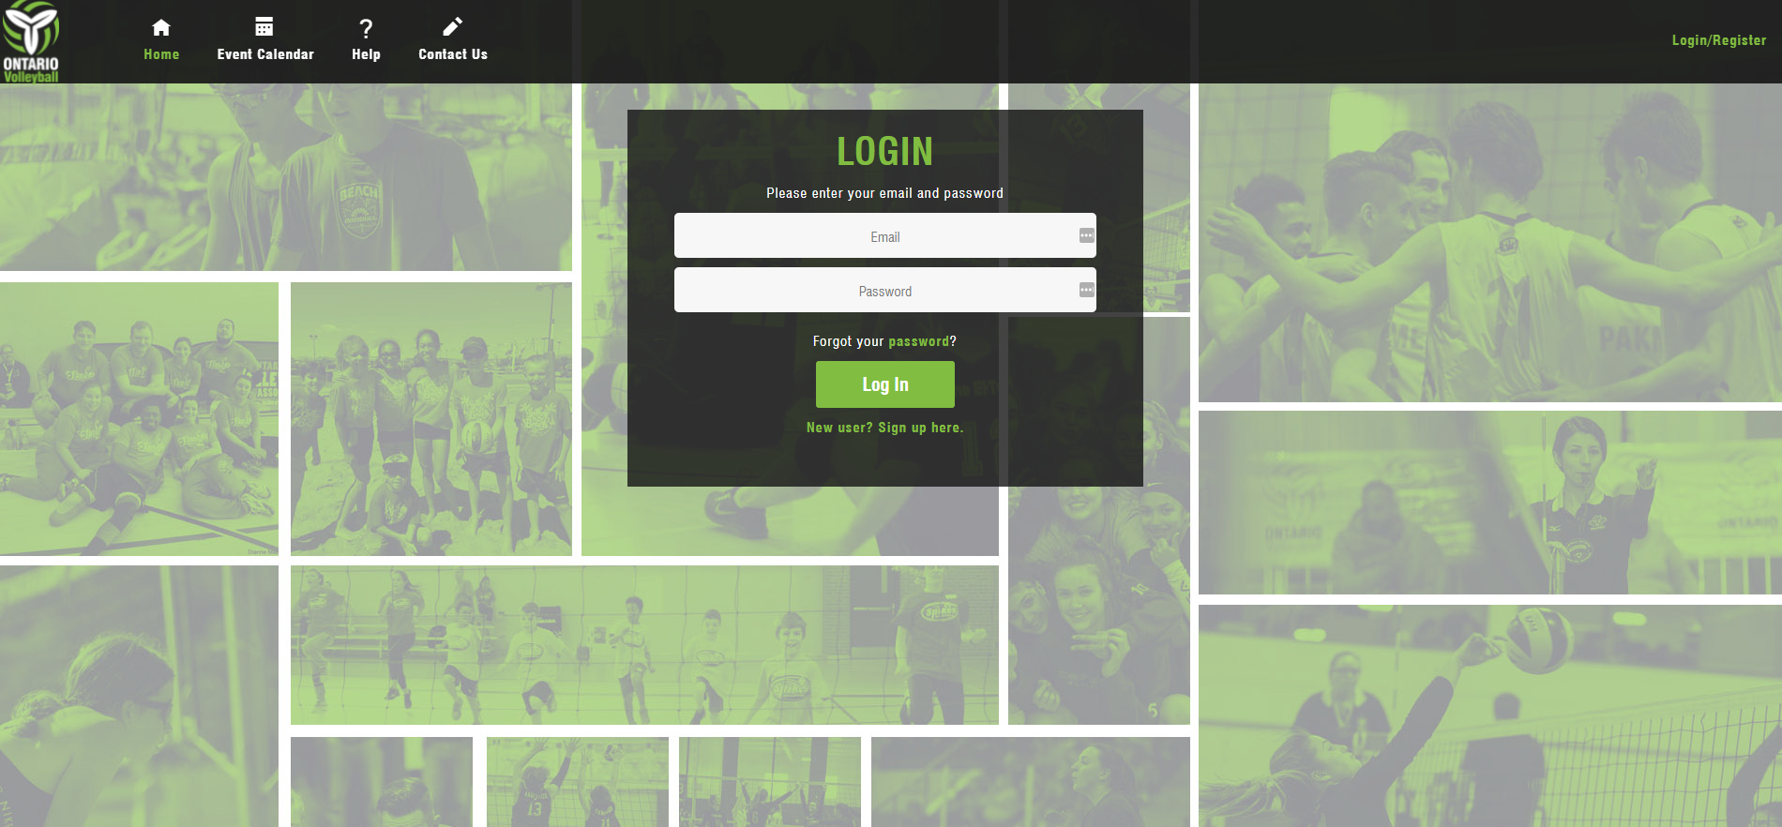
MEMBERSHIP REGISTRATION SYSTEM (MRS)
New season MRS Registration begins September 1st
Username is your email address - You cannot have 5 people in one family with the same email address.
Email addresses – no underscores
  Using underscores in email addresses is a throwback to old legacy email systems (e.g., Hotmail) and they are not allowed in by most new email providers (e.g., Gmail)
  Underscores can apparently cause mail delivery issues and are a tool for fraudsters
  Many new systems won’t accept email address with underscores anymore

Slide 23
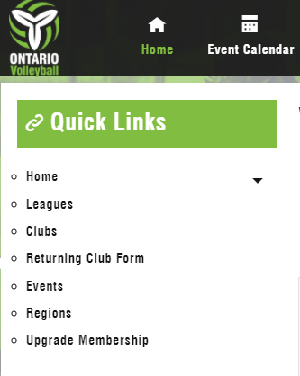
RETURNING CLUB REGISTRATION & CLUB FORM
Club Contacts must pay the full membership fee to create their Club in the MRS system.
First step is to register as a Club Contact
  Then create a “Returning Club” by clicking on link under “Quick Links”
    All data collected electronically vs fillable PDF’s of the past
    All Club data from 2020/21 season will be auto populated for the 2021/22 season – Club Contact only has to update the form. Edits can be made for the duration of the membership season as required.
    Club signs off on all waivers, including COVID-19 acknowledgement form
Club form must be submitted by Sunday September 22nd or certificate of insurance may be revoked.
MRS Club How to Guides: https://www.ontariovolleyball.org/club-resources

Slide 24
MRS ADMINISTRATION
Athletes will be required to register as members in the MRS in one of the following categories prior to participating in any on-court activities:
Activity | Required Membership Level
Tryouts (prior to Sept 1st) | Tryout Player (Brand new members not currently in MRS)
Tryouts (after Sept 1st) | Tryout Player or Recreational Player (Returning members)
Club Practices | Recreational Player or Competitive Player*
OVA Competitive Event | Competitive Player (6v6 Rallyball to 18U) Recreational Player (4v4 Rallyball)
Note: athletes can keep a Recreational membership role until the first competitive event of the season but must be a competitive player on the day of competition.

Slide 25
MRS – ATHLETE REGISTRATION PROCESS
After an athlete makes a team, the individual athlete or club must upgrade their membership to a Recreational player ($7 OVA membership fee + $5 VC membership fee) prior to any on-court activities.
Athletes will be required to purchase a full OVA competitive membership prior to the first OVA competition (aside from 4v4 Rallyball players)
If Clubs pay for athlete fees, they can pay for the full competitive membership when adding the athlete to a team and by selecting the corresponding competitive role
How to Guides are online: https://www.ontariovolleyball.org/player-resources

Slide 26
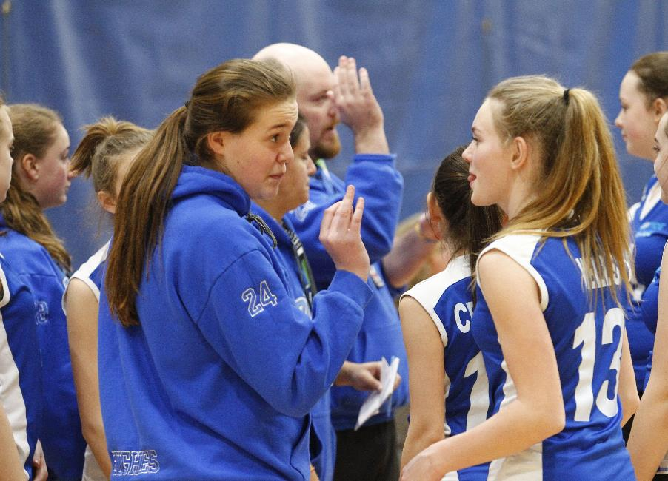
COACH/CLUB STAFF REGISTRATION
Coaches and Club staff must register themselves to comply with Rowan’s Law legislation and sign off on online waivers
  If Club wants to pay for their coaches and Club Executive memberships, the individual can sign up as a “Volunteer” to avoid paying fees
  Then Club contact can pay to upgrade coach/staff to full membership when adding their coach onto the team
  Club Contact can search all members to add them to their teams (like old NRS process)
Full membership is required for coaches and club staff prior to on-court activities - this includes Tryouts

Slide 27
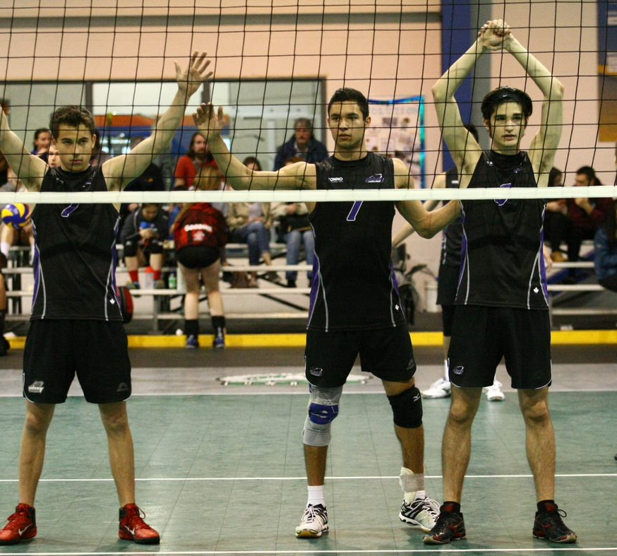
INSURANCE
Mylene Andrade, Membership Services Coordinator will issue Certificates of Insurance (COIs)
Send Certificate of Insurance (COI's) requests to insurance@ontariovolleyball.org
COI's will be issued to the Club for facility bookings for upcoming season.
Once the new policy is in affect after September 1st, permits will be re-issue with the new season dates and automatically emailed to Club Contact
Questions on insurance? Email info@ontariovolleyball.org or jharkness@ontariovolleyball.org

Slide 28
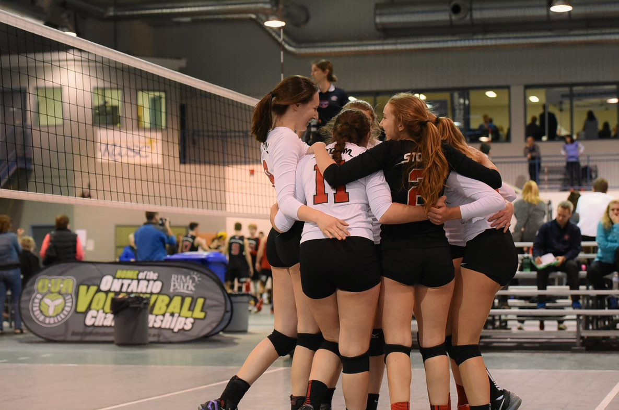

Slide 29
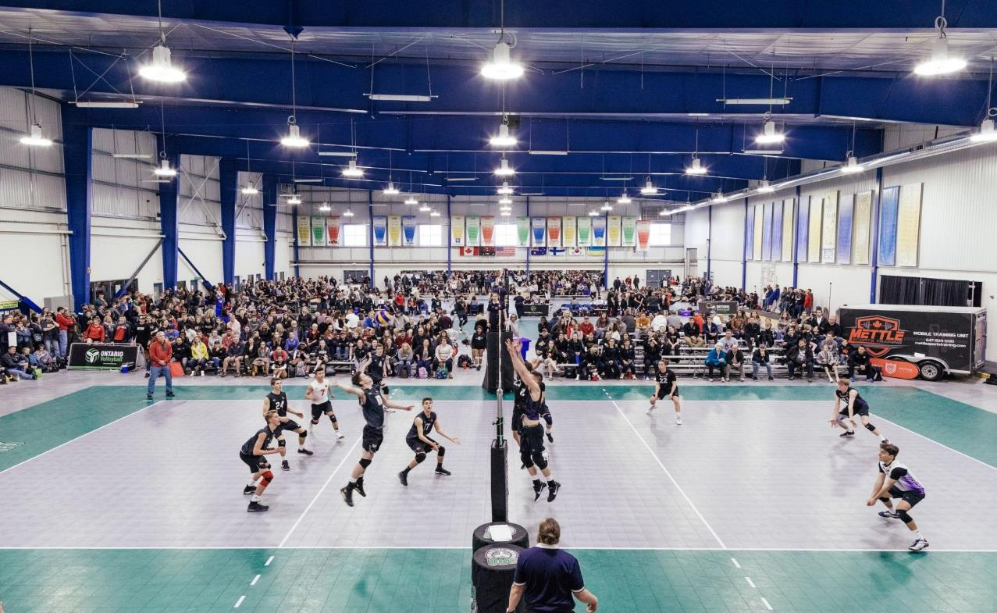

Slide 30
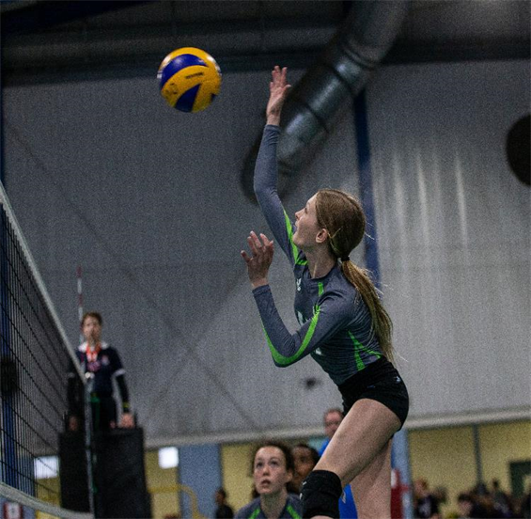
POLICY UPDATE
    Policies Updated/New
        Anti-Doping
        Discipline and Complaints
        Dispute Resolution and Appeal
        Accessibility
        Diversity, Equity and Inclusion
        Trans Inclusion Policy (previous Transgender Athlete Policy)
        Reciprocation
        Privacy
    Rowan’s Law
        January 2022 changes
        OVA Concussion Policy will be updated and resources shared
          Return to Play post concussion mandate

Slide 31
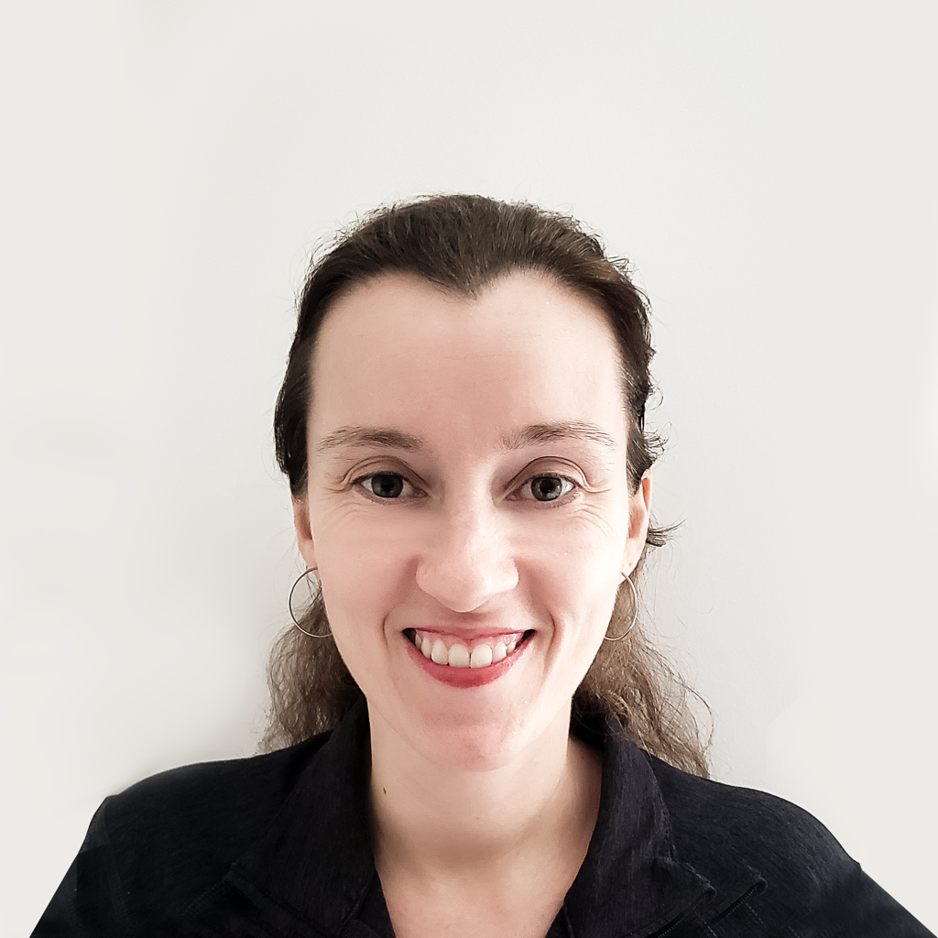
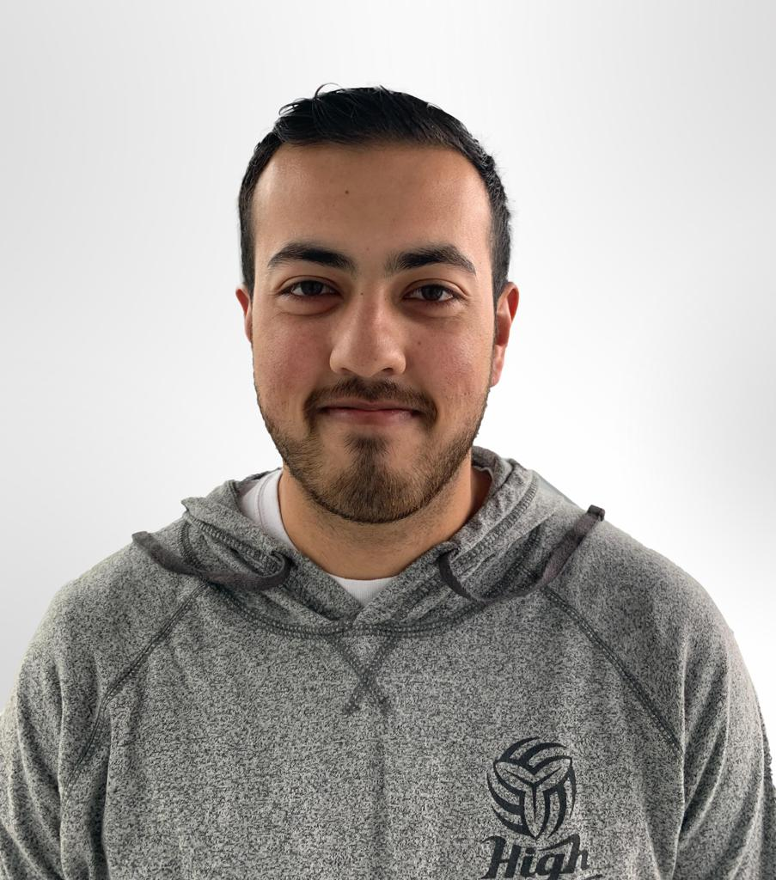
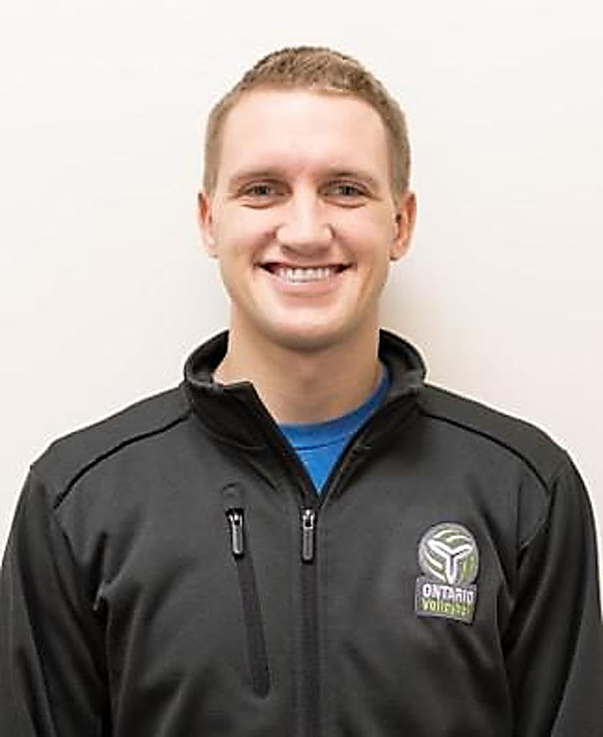
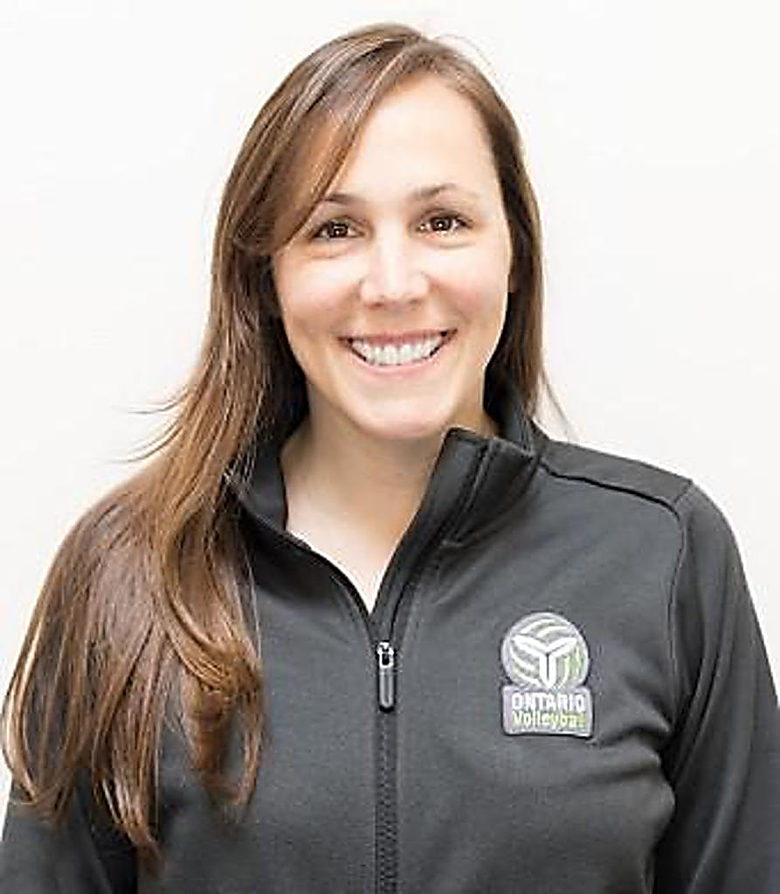
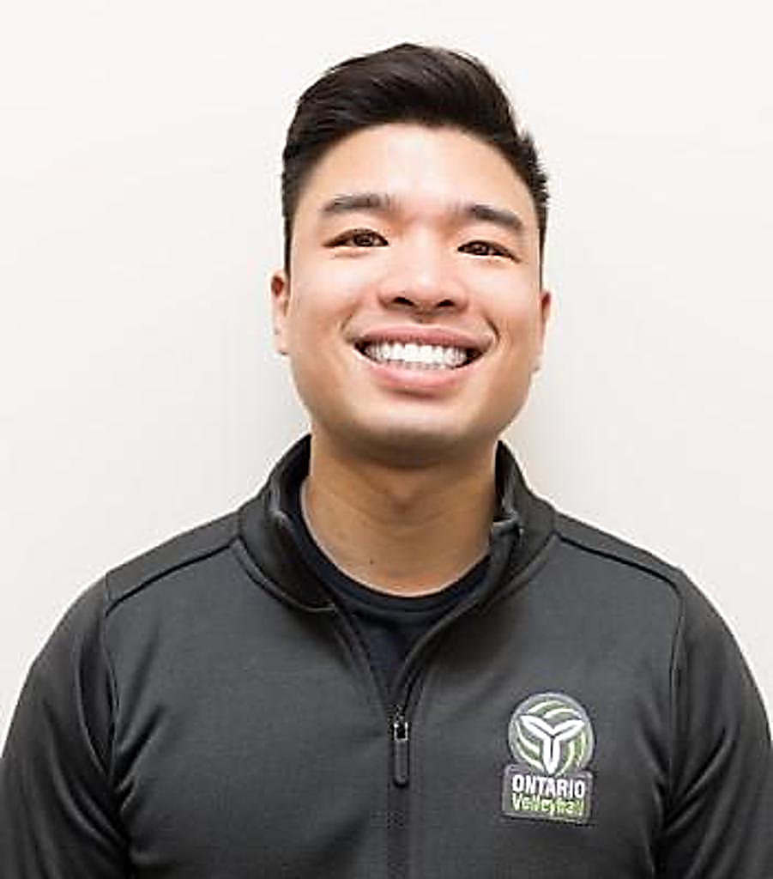
QUESTIONS AFTER TONIGHT?
Contact any of the staff from this call to assist!
Mylene Andrade
Membership Services Coordinator
Insurance, MRS. Event Sanctioning
cbennett@ontariovolleyball.org
Jacob Barker
Indoor Competitions Coordinator
4v4 to 15U Boys and Girls
jbarker@ontariovolleyball.org
Carrie Campbell
Manager of Indoor Competitions
Tryout Window, Major Events
ccampbell@ontariovolleyball.org
Mark Wiersma
Indoor Competitions Lead
16-18U Boys and Girls,
mwiersma@ontariovolleyball.org
Jessie Nairn
Operations Coordinator
Coaching and Referee Courses and Eligibility, Respect in Sport Compliance
jnairn@ontariovolleyball.org
Kelvin Cheng - Operations Lead
Coaching Courses, Referees
kcheng@ontariovolleyball.org

Slide 32
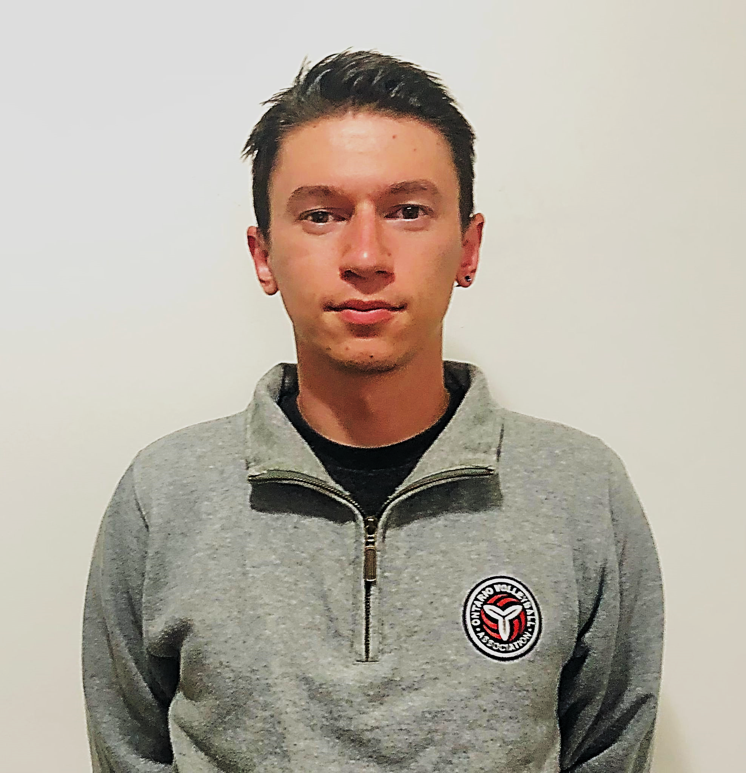
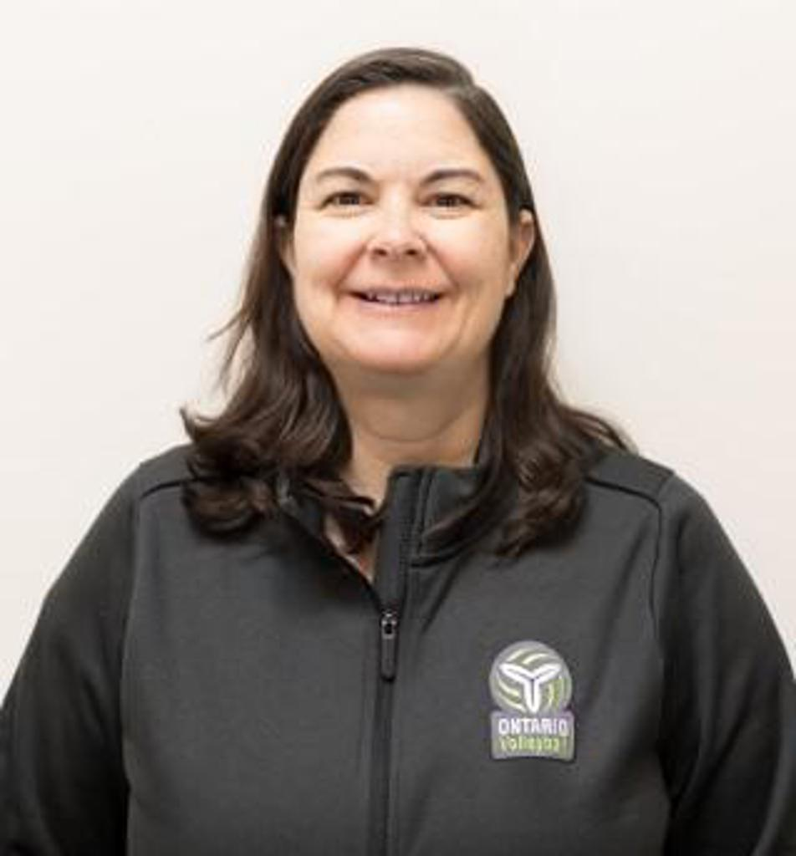
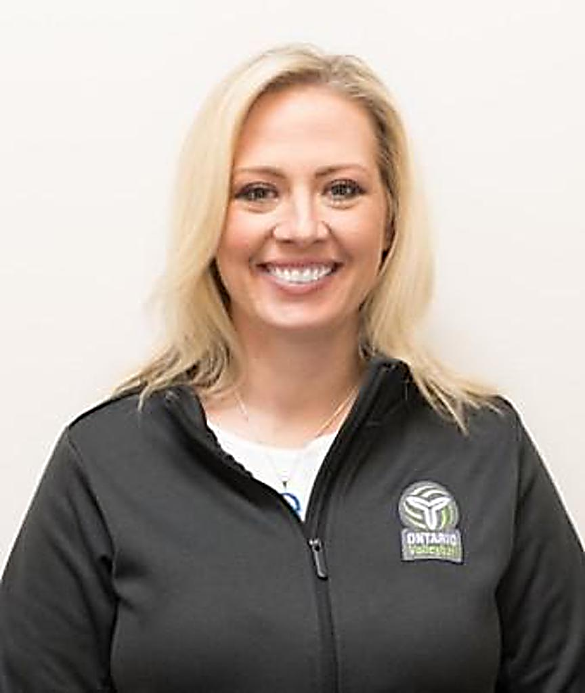
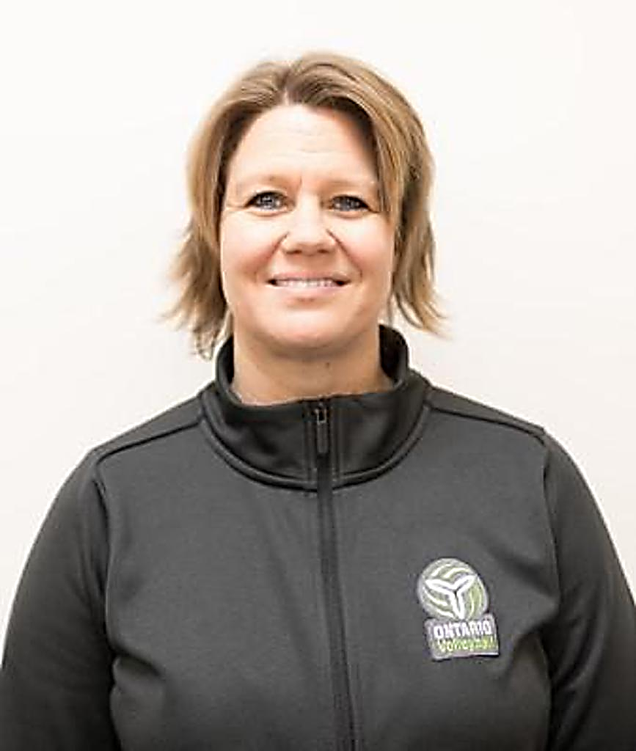
QUESTIONS AFTER TONIGHT?
Contact any of the staff from this call to assist!
Oklend Llakaj
Athlete Development Coordinator
ollakaj@ontariovolleyball.org
  Jennifer Harkness
  Director of Finance and Administration
  Complaints, Finances
  jharkness@ontariovolleyball.org
Alishia Lidums
Director of Volleyball Operations
alidums@ontariovolleyball.org
  Jo-Anne Ljubicic
  Executive Director
  jljubicic@ontariovolleyball.org

Slide 33


Thank-you OVA community!

Slide 34
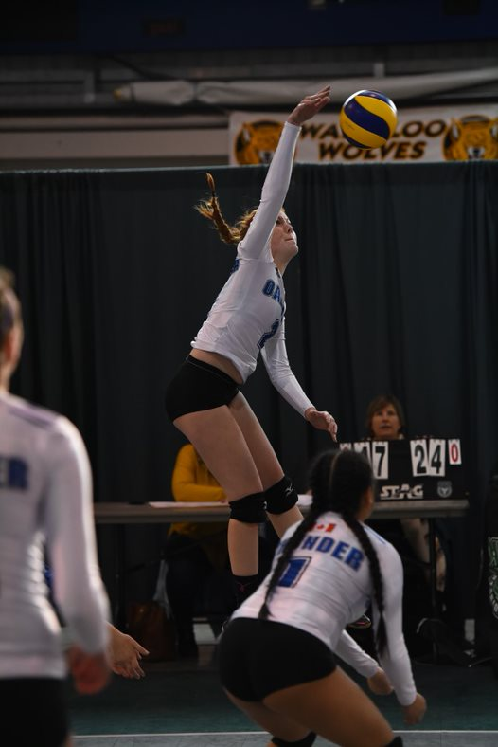
GOVERNANCE REVIEW UPDATE
Governance Committee - In the process of revising OVA ByLaws
Why – Compliance
  Ontario Not-For-Profit Corporations Act (ONCA)
  Canadian Sport Governance Code
Currently
  Legal review
  Regional Presidents and Executive feedback and review
  Board Review
Membership Next Steps
September - Town Hall to share proposed changes and rationale, review questions and feedback
Post on website
Regional AGM Meetings held by October 15, 2021
Special Meeting by November 3, 2021

Slide 35
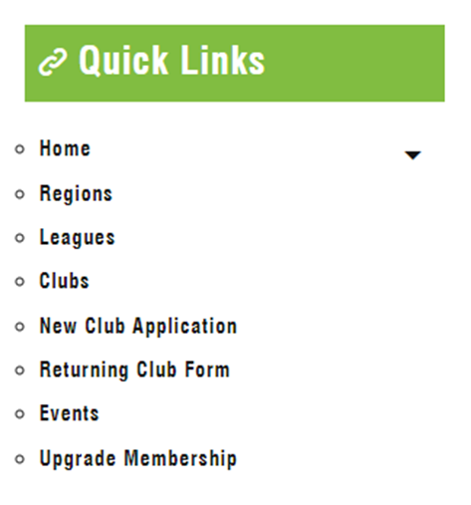
NEW CLUB APPLICATION IN MRS
Club Contacts must pay the full membership fee to create their Club in the MRS system.
First step is to register as a Club Contact
  Then create a “New Club Application” by clicking on link under “Quick Links”
    All data collected electronically vs fillable PDF’s of the past
    After form is submitted, OVA will approve or decline the club application and notify the club contact upon completion via email
    Upon approval, the club contact will login to their profile on MRS and click on 'New Pending Club' under "My Organizations" on the home page
    Once required fields are completed, the club contact will be prompted to pay the club registration fees
MRS Club How to Guides: https://www.ontariovolleyball.org/club-resources

