Slide 1


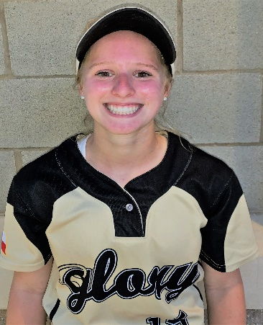
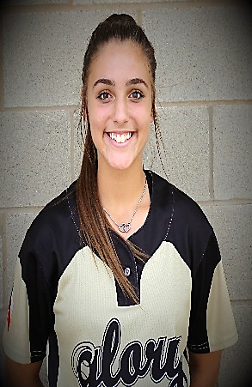
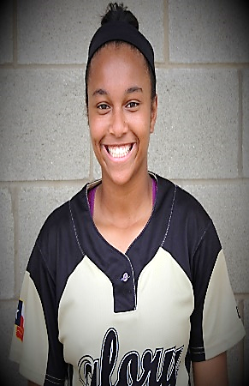
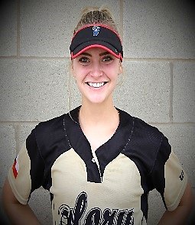
Glory Adkins 18U Gold
Head Coach Keith Allen
214-876-0724 - coachkeithallen@gmail.com
2020 - #15
Cate Bade
SS / 2B / 3B
GPA 4.4 of 4.0
ACT 32 – SAT 1320
__________________
2021 - #27
Tessa Galipeau
1B / OF
GPA 4.0 of 4.0
NJHS / FCA / HOSA
__________________
2020 - #28
Mikaila Kenney
CF / SS / 2B
GPA 3.9 of 4.0
DFW All Metro Team
___________________
2020 - #45
Katie Sadler
RHP
GPA 3.96 of 4.0
Academic All District
___________________
Notes:
_________________________________________________________________________
_________________________________________________________________________
_________________________________________________________________________
_________________________________________________________________________
_________________________________________________________________________
_________________________________________________________________________
_________________________________________________________________________
________________________________________________________________________
_________________________________________________________________________
Summer Schedule:
06/07/2019 - 06/09/2019 TCS Texas State Championships
06/15/2019 - 06/16/2019 Texas Summer Cup Sugar Land
06/20/2019 - 06/23/2019 2019 Summer Shootout
07/01/2019 - 07/08/2019 Colorado Fireworks
07/15/2019 - 07/18/2019 TC/USA Nationals Atlanta
07/22/2019 - 07/27/2019 USA ASA JO Cup South Carolina
Recruiting Contact:
Keith Allen – 214-876-0724
coachkeithallen@gmail.com
Recruiting Contact:
Jack Fultz – 214-557-7722
jsfultz@txglory.com

Slide 2
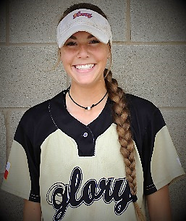
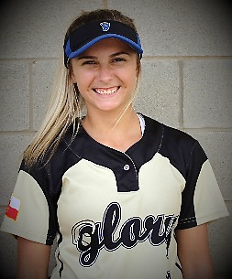
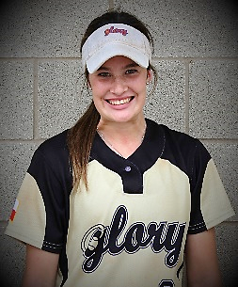
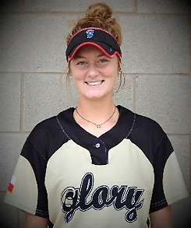
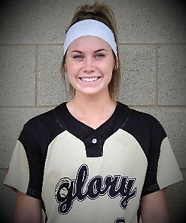
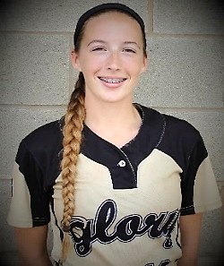
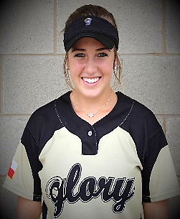







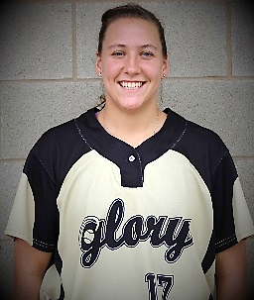
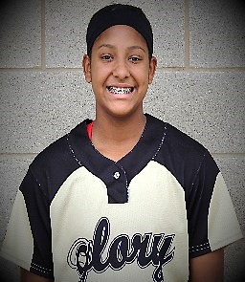
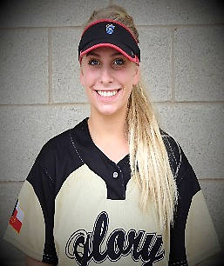
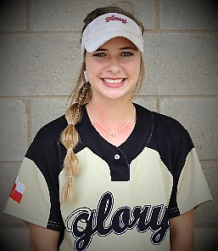
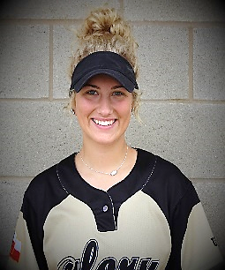
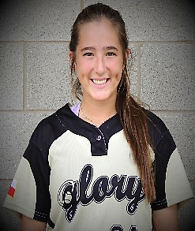
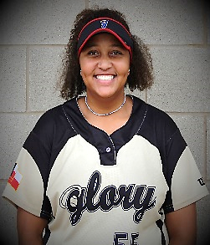





Glory Adkins 18U Gold
Head Coach Keith Allen
214-876-0724 - coachkeithallen@gmail.com
2019 - #1
Morgan
Medford
SS / 2B / OF
GPA 3.5 of 4.0
HT 5’ 8”
2019 - #4
Amanda
Desario
CF / OF
GPA 4.0 of 4.0
HT 5’ 8”
2020 - #8
Lexi
Benson
CF / LHP / 1B
GPA 4.25 of 5.0
HT 5’ 8”
_____________
2020 - #5
Kaitlyn
Gee
SS / 2B / 3B
GPA 3.8 of 4.0
HT 5’ 9”
2019 - #6
Lauren
Ledbetter
Catcher
GPA 3.70 of 4.0
ACT 26
2020 - #10
Alyssa
Bates
RH Pitcher
GPA 4.0 of 4.0
HT 5’ 8”
2019 - #16
Bailey
Brenek
Catcher / 3B
GPA 4.0 of 4.0
HT 5’ 7”
2019 - #17
Reagan
Chism
2021 - #18
Vanessa Hollingsworth
2019 - #25
Hannah
Hasle
RH Pitcher
GPA 4.0 of 4.0
HT 5’6”
2020 - #26
Ashley
Nazar
Outfield / 1B
GPA 3.55 of 4.0
HT 5’ 5”
_____________
2019 - #29
Lexi
Pope
SS / 3B / 2B
GPA 4.0 of 4.0
HT 5’8”
2019 - #34
Gaby
Garcia
C / 3B / OF
ACT 30 HT 5’ 6”
_____________
2019 - #55
Karlie
Charles
RH Pitcher
GPA 4.0 of 4.0
HT 5’ 8”

