Slide 1
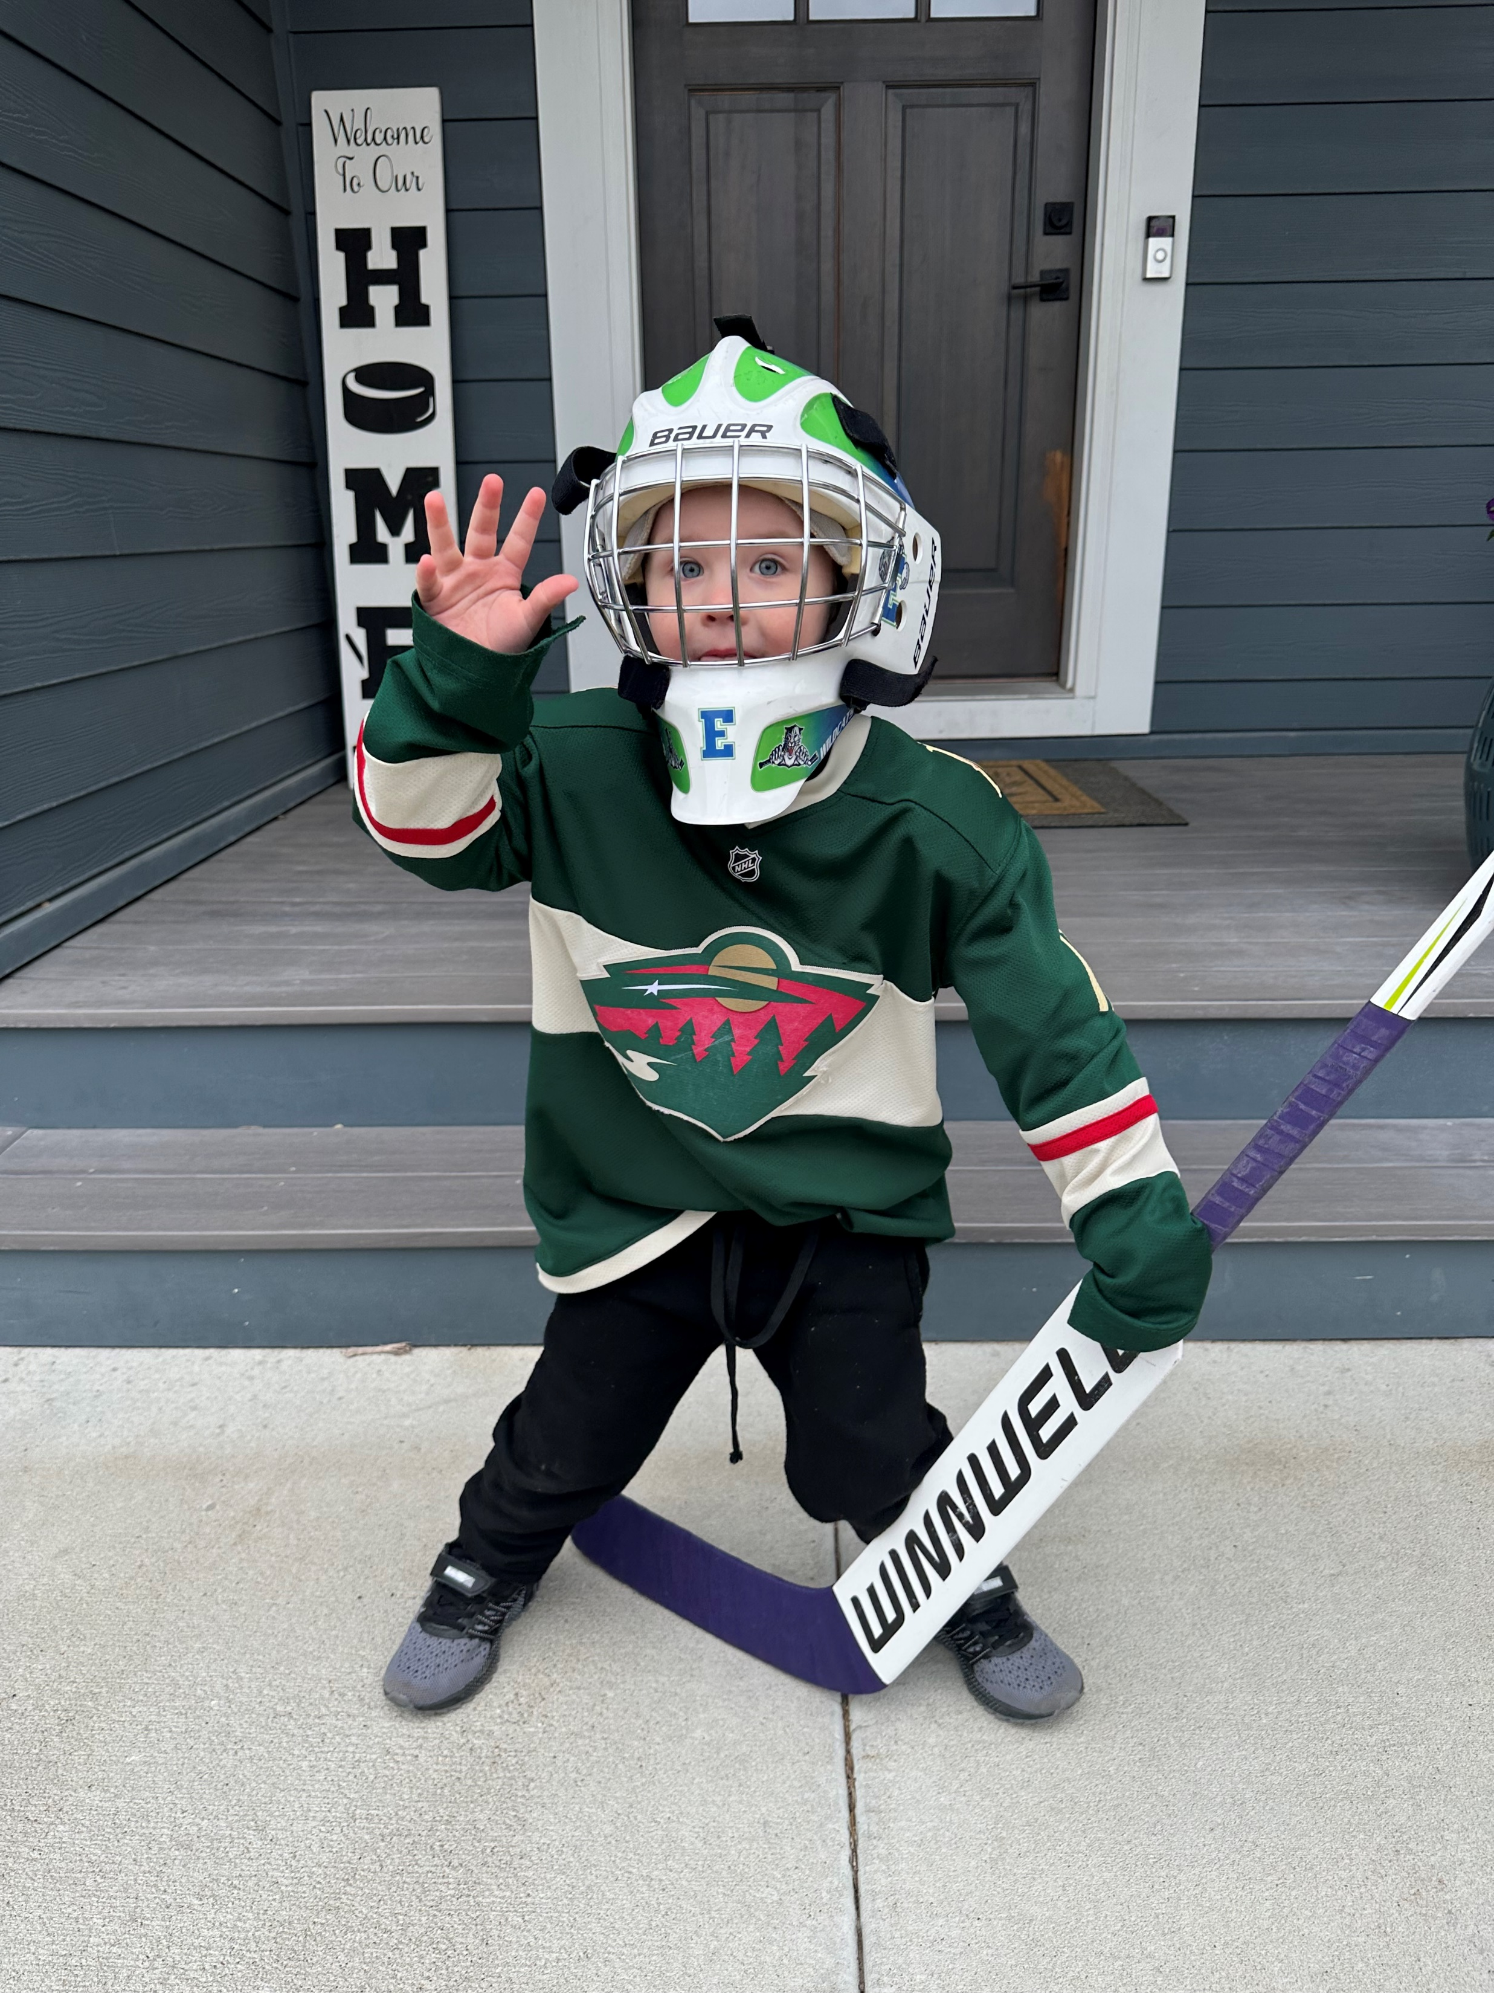
Goalie Coach and Parent Meeting
Eagan Hockey Association
10/24/2024

Slide 2

Introductions
Jon Kerr
EHA Coach In Chief
Chris Rasinen
EHA Goalie Coach In Chief
CEP Goaltending Bronze
Eric Gundersen
CEP Goaltending Silver
Robert Braun
Board Members
Former/Current Parent Goalies

Slide 3
Season Plan
Sunday Goalie Clinics
Monday Skills
Comments on 8U/Mites
Coach the Coach
We will hop on the ice with you!
Robert: Squirt/10U and below
Rasinen/Gundersen Peewee/12U and up
Informal Film Reviews
Squirt/10U & Mite/8U
Devenir Film Reviews
Peewee/12U and up

Slide 4
Who Is a Goalie Coach?

Slide 5
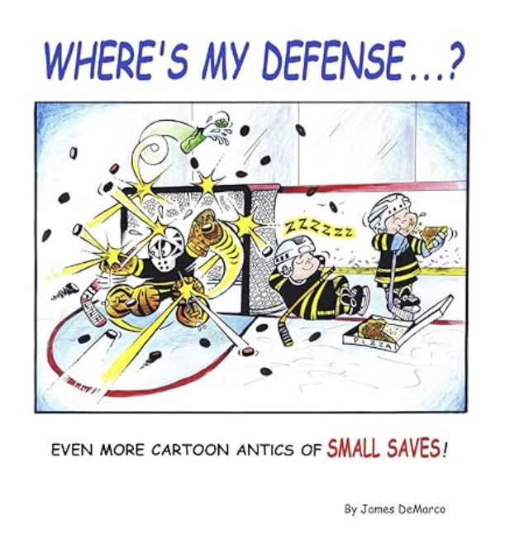

How to Support Your Goalies
Coaches
Communicate with your goaltenders
Give goalies the time, space and resources in practice to work on goalie skills
Seek out drills that are specific for goalies
Look at your plan and ask yourself what the goalie experience will be for that practice
Learn from goalie coaches what your specific goalies need to work on
Help them have fun
Parents
Talk about their whole game not just the goals scored on them
Avoid the blame game with other players
Communicate with coaches absences from practices
Sharing a net is not a competition
Remember that goaltending development is a marathon, not a sprint
Normalize sitting by other parents at games
Seek out opportunities within the greater goalie community
Help them have fun

Slide 6

Gundersen – Review Goaltender Silver Capstone Project

Slide 7
Beginner Goalies
Acronym RADS
Ready
Angle
Depth
Shuffles

Slide 8
FILM REVIEW!

Slide 9
Case Study – Tonio, Are You Ready?
April 2024
View 3:30 and 7:30 marks of film – goalie not ready
Film Review Action Items
Roomba
Get your wiggles out
Ready at Red Line

Slide 10
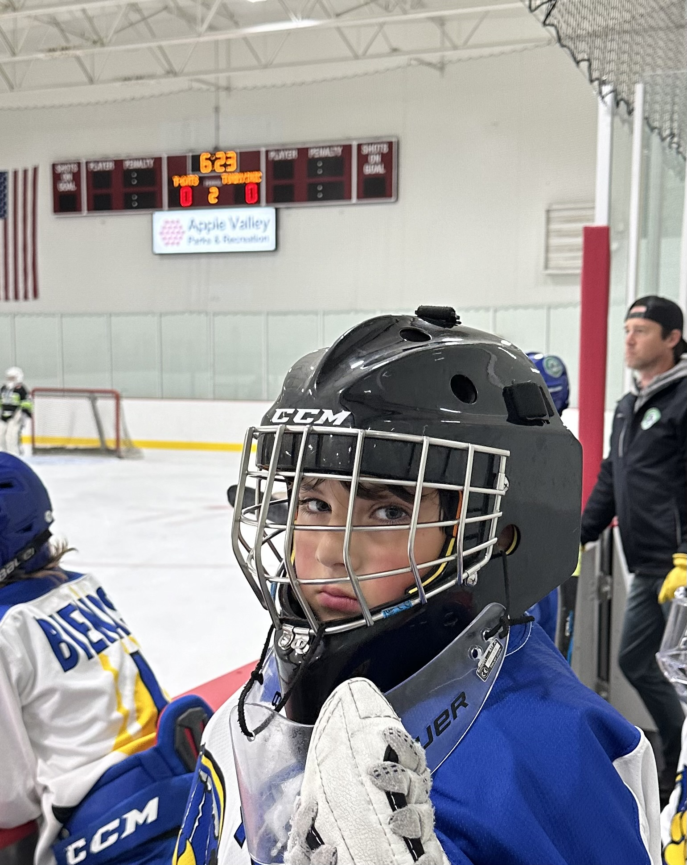
Tonio is Ready!
August 2024
Full Clip

Slide 11
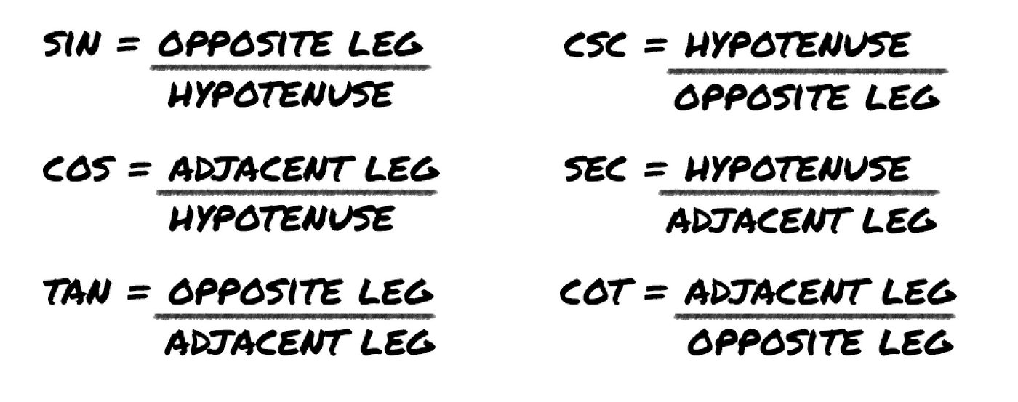
Kevin, are you ready and on angle?
Clip
31:24
Not Ready
Angle on shooter, not on puck

Slide 12

Shuffles
Video Link
View 18:13 and 18:50

Slide 13
Equipment
Tory Dalbec
General Sports – Edina
Booking: generalsportsmn.com
Questions: tdalbec@generalsports.us

Slide 14

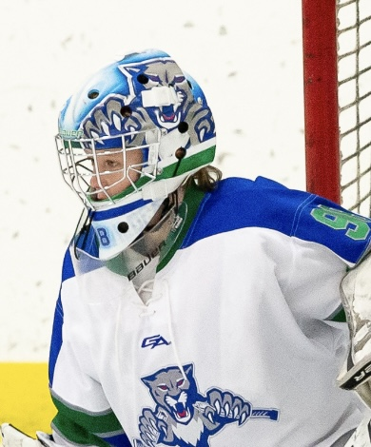


Custom Helmets
Grangrothgraphics.com

Slide 15
Resources
EHA Goalie Page
Gundersen’s Capstone Project
Robert Braun 612-518-5641
Chris Rasinen 612-298-3271
Eric Gundersen 651-334-8685

