Slide 1

APPLE VALLEY BURNSVILLE HOCKEY 2023-24
PARENT MEETING

Slide 2
AVBHA Leadership
Executive Team:
  Andrew Spencer, President
  Joanie Baltes, Vice President
  Luke Korkowski, Treasurer
  Jodi Oster, Secretary
Other:
  Jodi Oster, DIBS Coordinator
  Brian Gibson, Grievance Committee Chair
  Emily Hindal, Tournament Director
  Ginger Lemke, Communications – Recruiting & Retention
Hockey Development:
  Chris Sikich
  Jeremy Pries
Mite Coordinators:
  Luke Korkowski
  Heather Olson
  Ginger Lemke (Intro Coordinator)

Slide 3
Which level is my child?
Mini-mite 1 (MM1)
  Skill level: 1st year skaters
  Grade level: Pre-K and Kindergarten
*Born before 5/31/19*
Mini-mite 2 (MM2)
  Skill level: 2nd year skaters
  Grade level: 1st grade
Mite Minor
  Skill level: 3rd year skaters
  Grade level: 2nd grade
Mite Major
  Skill level: 4th and 5th year skaters
  Grade level: 3rd grade
Don’t know how to skate
  1st time skater
  MM1
Sort of knows how to skate
  player can stand up on the ice, move around, and get back up
  Pre-K through 1st Grade (MM1)
  2nd through 3rd Grade (MM2)
Can skate but has never played hockey
  Pre-K through 2nd Grade (grade level)
  3rd Grade (Mite Minor)

Slide 4
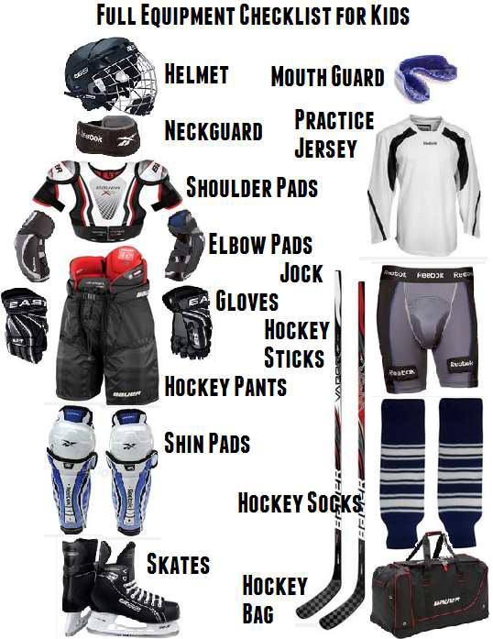
Equipment
Lower
  Moisture Wicking Undergarment
  Supporter/Cup
  Shin Guards
  Hockey Socks
  Breezers/Hockey Pants
  Skates
Upper
  Shoulder Pads
  Elbow Pads
  Hockey Jersey
  Helmet with Full Face Mask
  Mouthguard
  Neckguard
  Gloves
  Stick

Slide 5
Budget Tips
Take advantage of used equipment
Equipment doesn’t make the player
Volunteer!!! Our community depends on volunteers, that way we don’t have to pay the “PROs”
The Power of No
https://www.minnesotahockey.org/page/show/1269347-budget-tips

Slide 6
Our Main Ice Arenas & Training Centers
Burnsville Ice Center “BIC1 & BIC2”
  251 Civic Center Parkway, Burnsville
Apple Valley High School (Sports Arena) “AVSA”
  14452 Hayes Road, Apple Valley
Hayes Ice Arena
  14595 Hayes Road, Apple Valley
Burnsville Training Center
  The Burnsville Training Center is located across the parking lot from the Burnsville Ice Center to the West. It is housed in part of a former city public works building. The door is next to the Skate Park.
Apple Valley training Center
  14760 Pennock Ave Apple Valley

Slide 7
Mite Plus / U8 Girls
For returning players
  Program is in addition to House Mites,
  NOT a replacement
  Expectation is to attend all practices and
  Games for both House Mites and Mites Plus
Levels:
  Boys: Beginner, Intermediate, Advanced,
  Girls U8: Beginner, Intermediate/Advanced
Parent Expectations:
  Please Inform head coach if your child will miss a practice or a game
  Support the coaching staff
  Helping with on and off ice activities during scrimmages (clock and boards)
  Talk to the head coach if you have a comment, compliment, question, concern, or complaint. (24 Hour Rule)

Slide 8
Mite Plus & Girls U8 Evaluations
Format:
  Skill Station Evaluations
  Scrimmage & Game Play
Rosters will be announced after tryouts commence
  Will be posted on avbhockey.com website
Final team roster decisions will be made by a consensus from
  Mite Coordinators and Board Evaluators
Please note:
  What team you think your child should be on is not as important as what team they are evaluated at and placed on. Developing at the appropriate level is
VOLUNTEERS!!!
  If you can skate, please consider volunteering as a
    Mite In-House Assistant Coach
    Mite Plus Assistant Coach
  Not a hockey genius? No problem!
  Not an elite skater? No problem!
  Please reach out and our mite coordinator will get you started today!
Applevalleyhockey.com > resources > coaches corner
  Coaches Resources
  Coaches Application
  Volunteer Registration (avbhockey.com)

Slide 9
Calendar Items SportsEngine
October 16th- Mite Plus Clinic Starts
October 28th- House Mites 1st Practice
November 4th- Try Hockey For Free
November 11th & 12th -Mite Plus Evaluations
December 6th - Picture Day
January 7th- Jamboree
February 4th- Jamboree
March 3rd- Jamboree
March 17th- Mite Fun Day
A platform for communications & team schedules
Once your child is rostered to a team you will be able to use the RSVP and team messaging functions.
It is important to RSVP for practices and games.

Slide 10
Birth Certificates Labeling Gear
All 1st year players must provide a copy of a government issued birth certificate to the Registrar
Email a pdf copy to: registrar@avbhockey.com
Please label your child's gear!
Gloves
Helmet
Breezers
Stick
Water Bottle
Knee pads
Elbow pad
Anything your child may leave in the locker room

Slide 11
District 8 Association / Coaches Information
Cities located in District:
Apple Valley, Cottage Grove, Eagan, Eastview, Farmington, Hastings, Inver Grove Heights, Johnson-Como/N St Paul, Lakeville, Red Wing, Rosemount, Sibley Area, South St. Paul, Woodbury.
www.minnesotahockeydistrict8.com/connect
www.minnesotahockey.org/handbook
Interested in coaching?
Coach Application: https://www.applevalleyhockey.com/coachapp
Volunteer Registration: https://www.avbhockey.com/volunteerregistration
Talk with a mite coordinator about reimbursement of coaching classes
There will be a mandatory coach/manager meeting for any Mite coach who wishes to be on the ice during the 2023-2024 season.
More information will be provided regarding date/time.

Slide 12
Bring a Friend Day
We are encouraging your child to bring a friend to hockey and have them skate with the team. They will need to have skates and a helmet to participate during the practice. If your child brings a friend that day they can fill out a ticket to be entered in a prize drawing happening after practice.
More information will be coming in the weekly email.

Slide 13

DIBS: Volunteering
www.avbhockey.com/dib_sessions
  Families are required to complete 10 DIBS Volunteering Hours
  Can be done in tournaments, try hockey for free, intro to hockey and other events

Slide 14













Our Sponsors - Show support and visit them

