Slide 1

2019 Ontario Soccer
Grassroots Survey

Slide 2
Overview
The 2019 Ontario Soccer Grassroots Survey aims to have a greater understanding of the state of grassroots programs across the Province.
The survey provides an update to the previous grassroots survey conducted in 2014 and measures the impact of the implementation of Long-Term Player Development since 2012.
Players, parents and coaches involved in grassroots programming were included in this survey. The survey took place between February and September 2019 and utilized both online and offline methods for data collection.
Notes:
Bullet points why and how

Slide 3

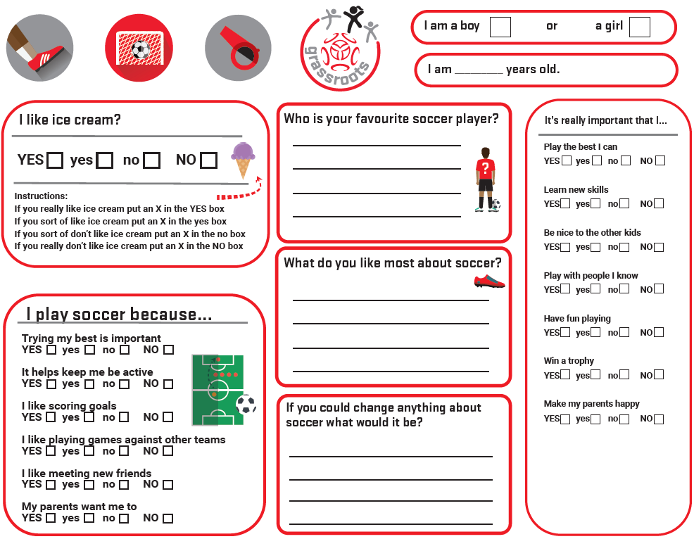
2014
1027 Responses
2019
1788 Responses
Likert scale and open-ended questions
Priority scale and open-ended questions
Conducted in person only
Conducted in person and online
Notes:
Include background information – LTPD evolution, new grassroots standards
Include highlights/findings from 2014
Please include more details on the survey changes changes from 2014 to now
Method for each group (parent/coaches/players)

Slide 4
Player participation in numbers
 | Boy |  | Girl | %
Age | # | % | # | % | Total #
8 | 115 | 64 | 66 | 36 | 181
9 | 120 | 57 | 91 | 43 | 211
10 | 111 | 57 | 83 | 43 | 194
11 | 74 | 70 | 31 | 30 | 105
12 | 98 | 82 | 21 | 18 | 119
 | 518 | 64 | 292 | 36 | 810
Boys Overall
64% of total participation
810
Girls Overall
36% of total participation
Players aged 8 to 12 participated in the survey
518
292

Slide 5
Player participation in numbers
Boys Overall
64% of total participation
810
Girls Overall
64% of total participation
Players aged 8 to 12 participated in the survey
518
292

Slide 6
Players Parent Coaches
837
141
Parents
Coaches
Parents who had kids in multiple ages were allowed to select both within the survey
Coaches who coach kids in multiple ages were allowed to select both within the survey

Slide 7
Player Survey Results

Slide 8
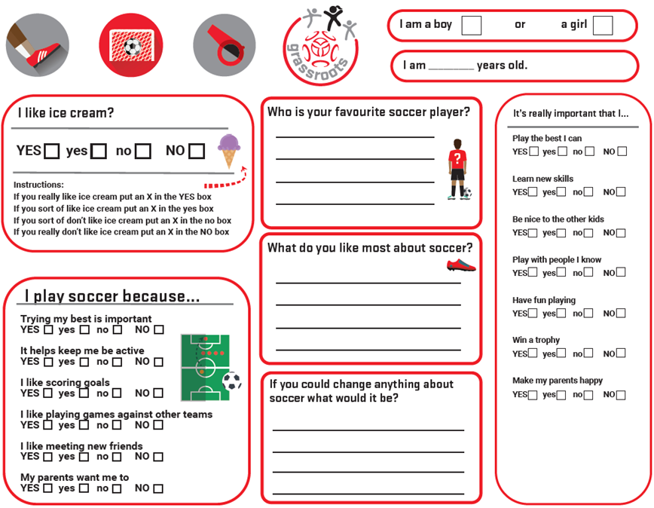
Player
Asked players aged 8 to 12 to complete on site survey.
11 questions – 10 being information gathering and 1 being demo on how to complete the answers (I like ice cream)

Slide 9
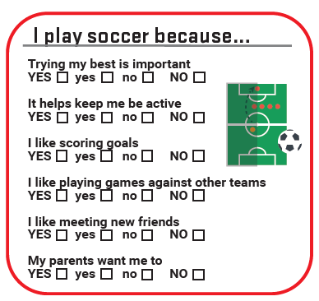
Player
Players were asked “I play soccer because…”
Parents were asked “Why did you put your child in organized soccer?’
Coaches were asked “Why do you coach kids in organized soccer?”
By asking each group the aim is to determine the following:
What are the determining factors associated with participation
Do the determining factors change as players get older?

Slide 10
Player
Notes:
Include a slide that outline the questions “I play soccer because” ( and a short reason why we asked the question)
Questions should be separated
Graphic would be better to highlight these responses
Breakdown by Age/Gender

Slide 11
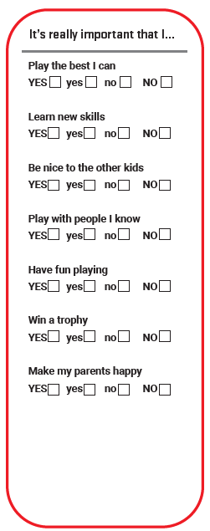

Player
Players were asked “It’s really important that I…”
Parents were asked “What is important for you with your child's experience in soccer?
Coaches were asked “What is important for the children you coach to experience in soccer?”
By asking each group the aim is to determine the following:
What are the key factors in motivation?
Do the determining factors change as players get older?
Notes:
Graphic would be better to highlight these responses
Breakdown by Age/Gender

Slide 12
Player

Slide 13
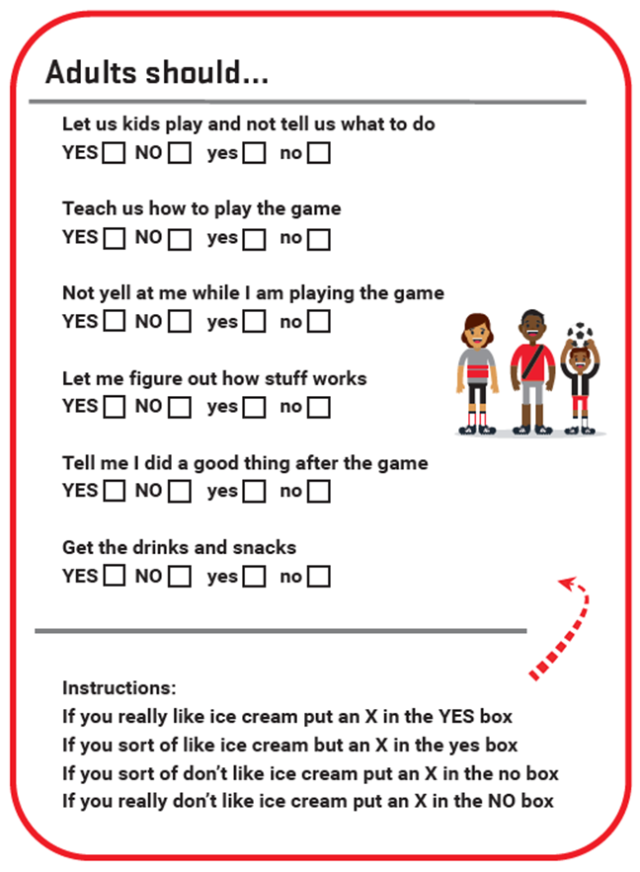
Player
Players were asked “Adults should…”
Parents were asked “Kids should...”
Coaches were asked “Kids should...”
By asking each group the aim is to determine the following:
What is the expectation and perceptions from players of the adults involved in the game?
Does this changes as players get older?

Slide 14
Player

Slide 15
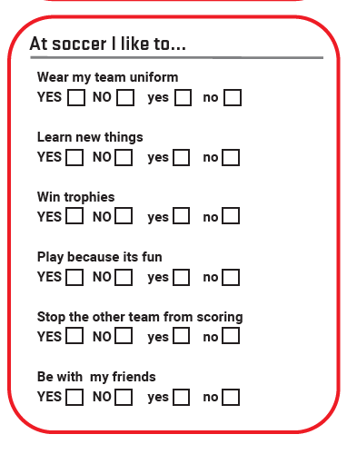
Player
Players were asked “At soccer I like to…”
Parents were asked “Why did you put your child in organized soccer?’
Coaches were asked “Why do you coach kids in organized soccer?”
By asking each group the aim is to determine the following:
Support the findings from previous questions and identify trends between previous questions
Do the determining factors remain consistent and align with the other groups?

Slide 16
Player

Slide 17
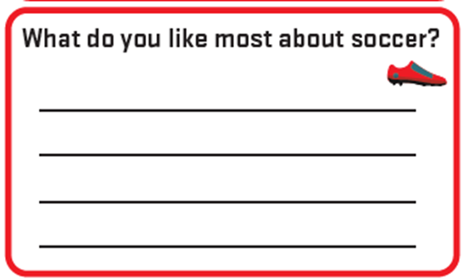
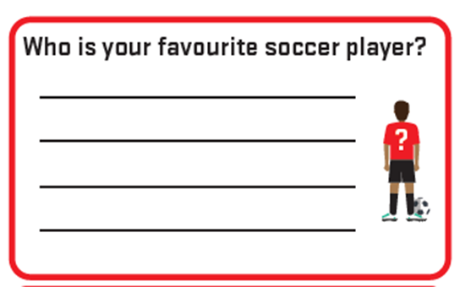
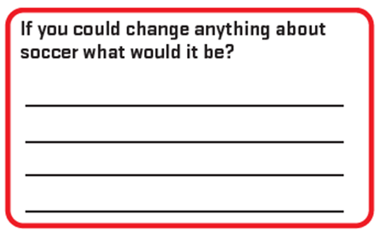
Player
Players were asked Open ended questions
Parents and Coaches were aske similar questions with the same open ended response possible
By asking each group the aim is to determine the following:
Allow all groups to express themselves in their own words
Identify factors that are common within age groups and genders and to support future designing of programming for these age groups.

Slide 18

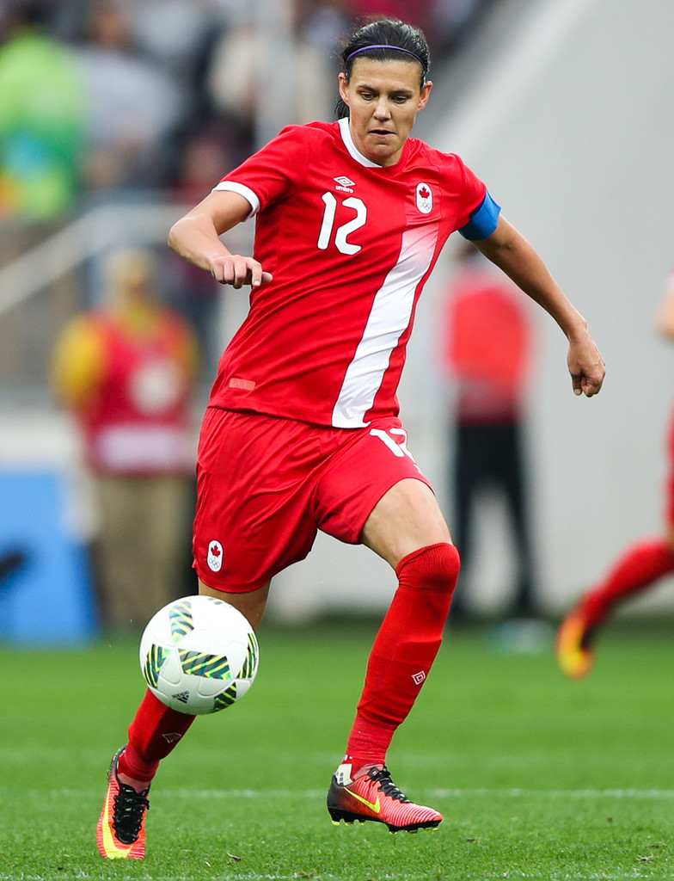
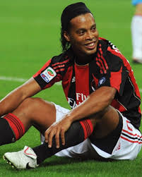
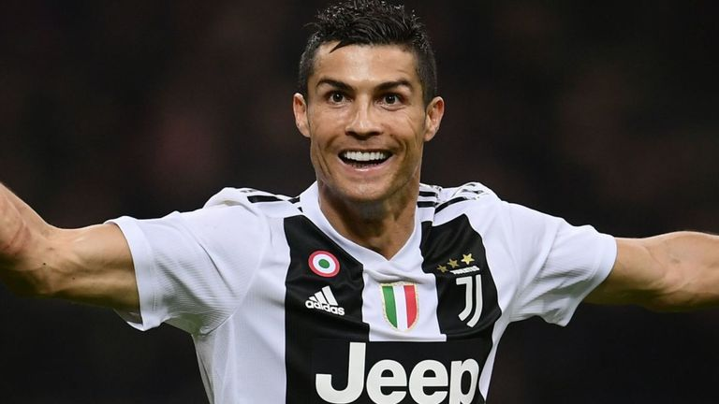
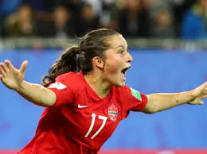
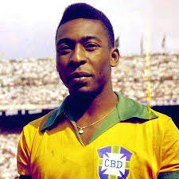
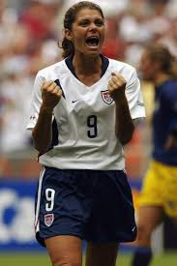
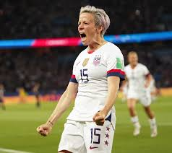
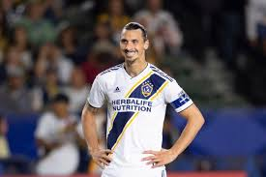
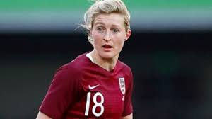
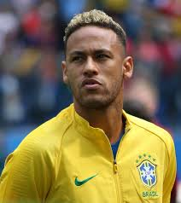

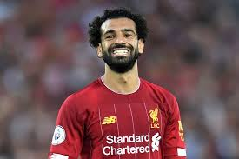
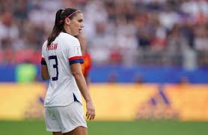
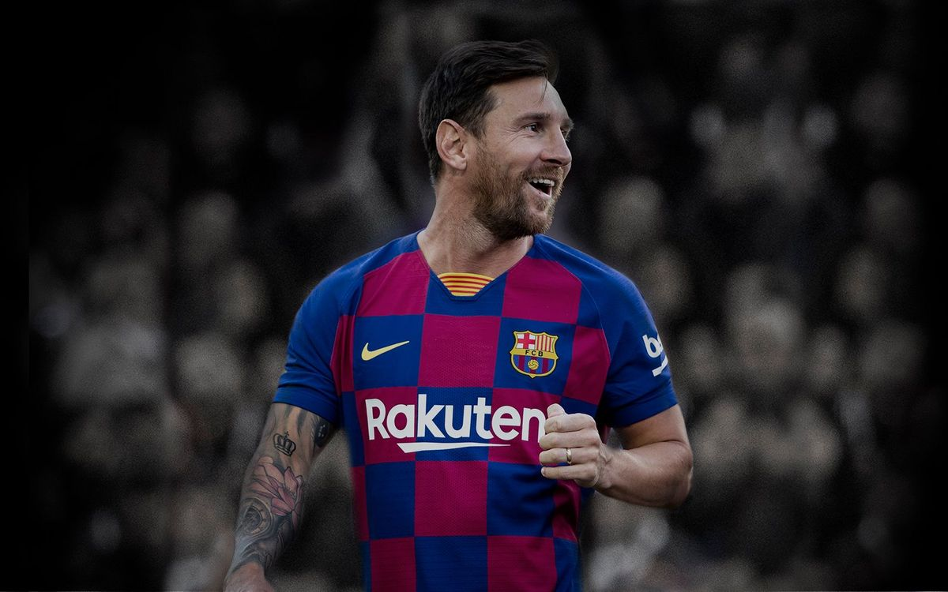
Player

Slide 19
Player
Notable others = Rapone, Lawrence, Hamm, White, coach Jordan, Kovacevic, Matheson
Notable others = Neymar, Mbappe, Pele, #17 Ottawa fury, my dad, Zlatan

Slide 20

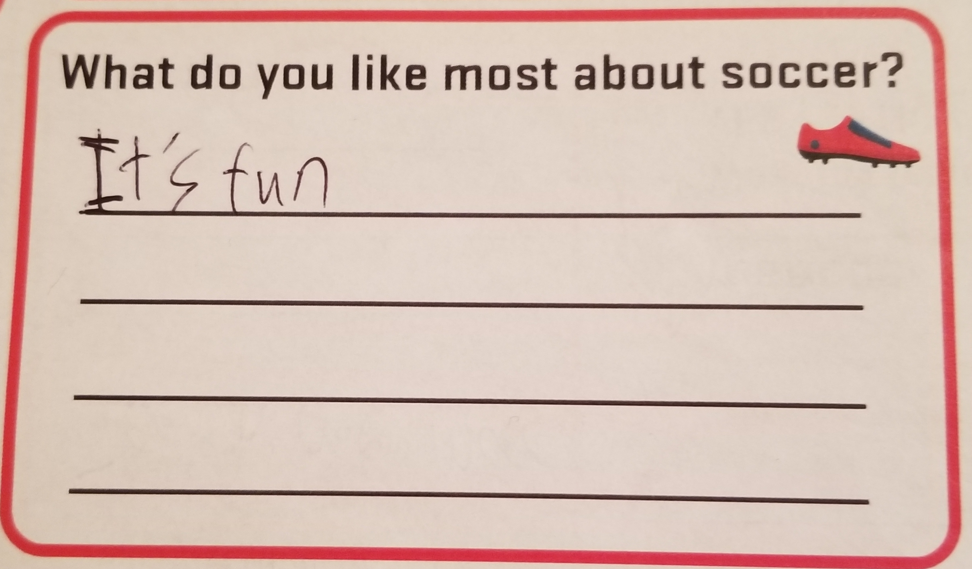
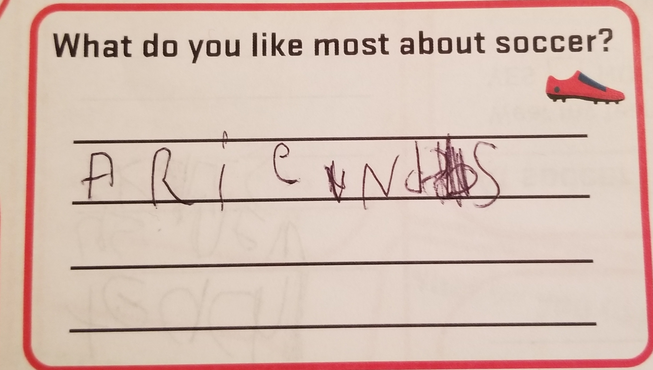
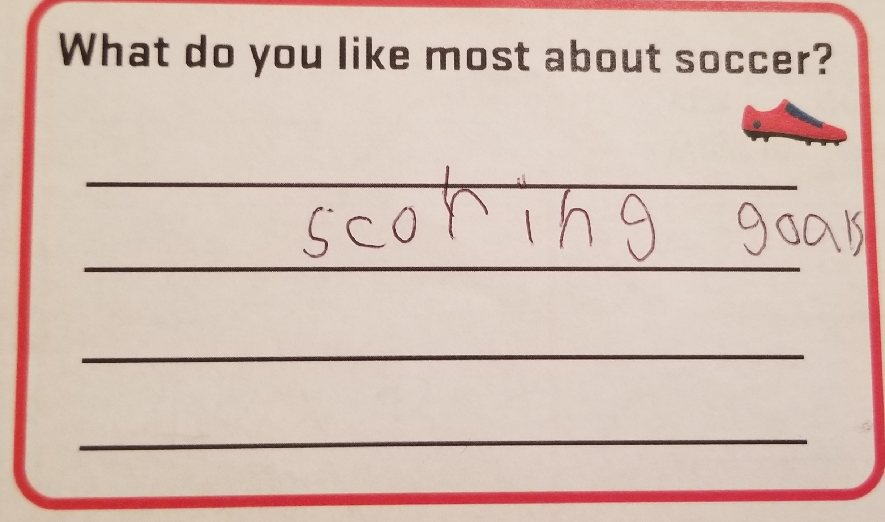
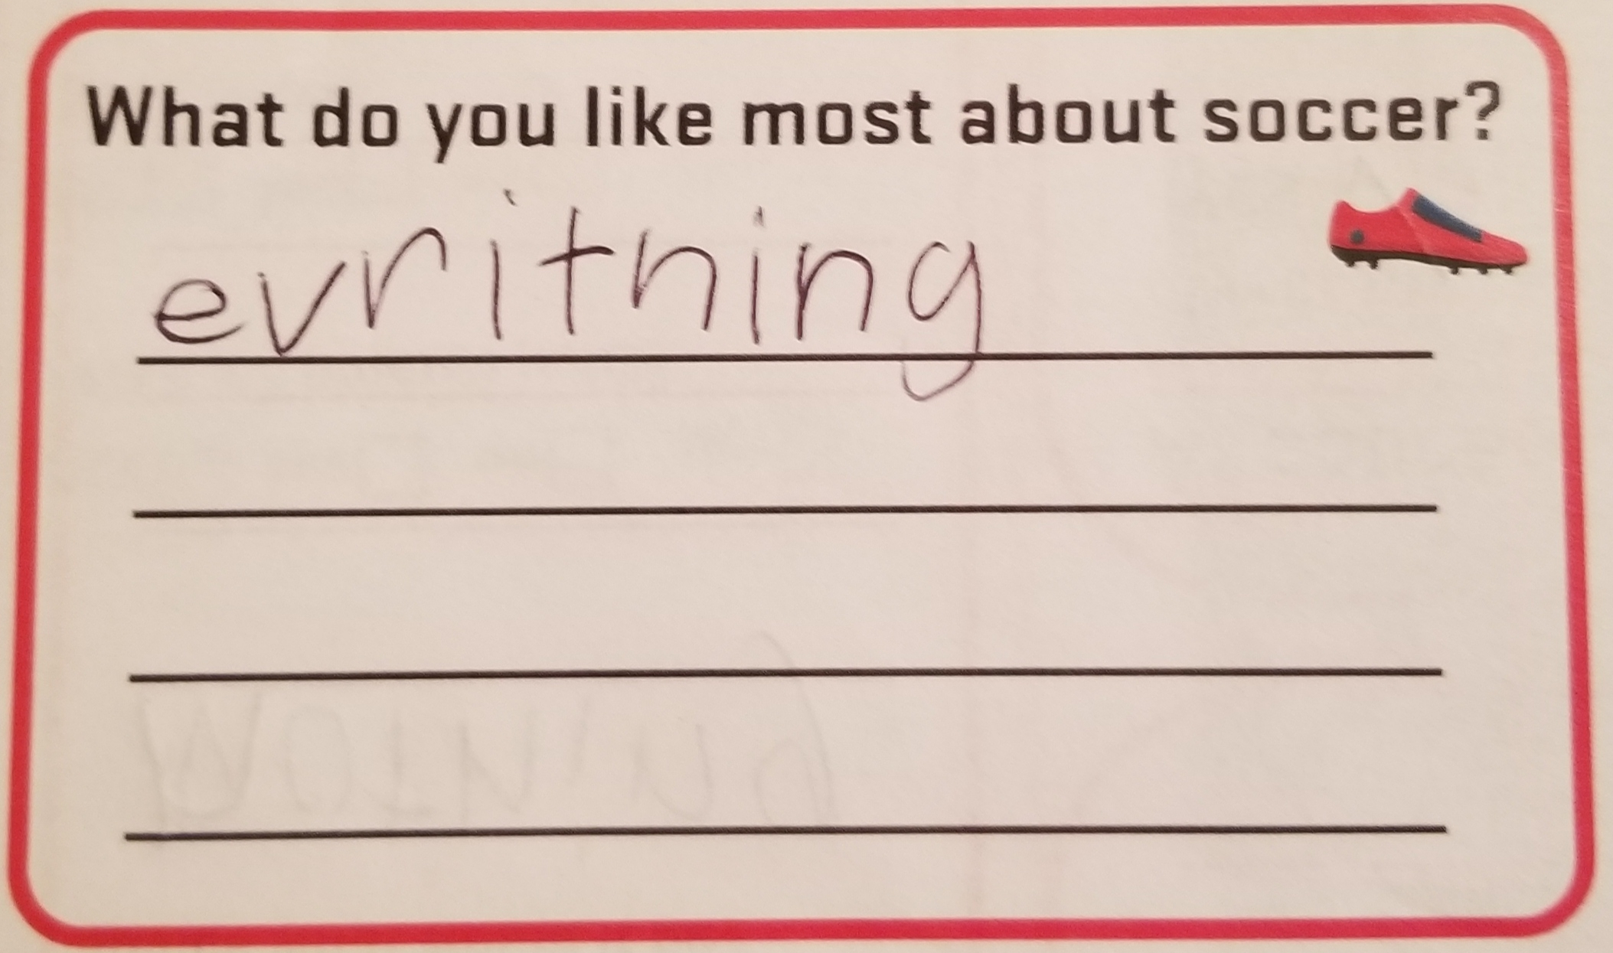
Player
Players were asked open question and responses analyzed as % of players that chose theme.
Ex. Scoring goals 25% players mentioned as liked most about soccer

Slide 21
Player
Notable Other mentions
Stopping goals
Defending
Not sure
Running around
Family watching
Being outside
Nutmegs
Juggling
The ball
Snacks

Slide 22
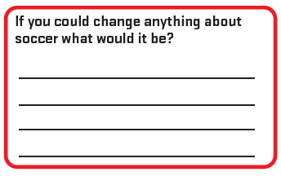
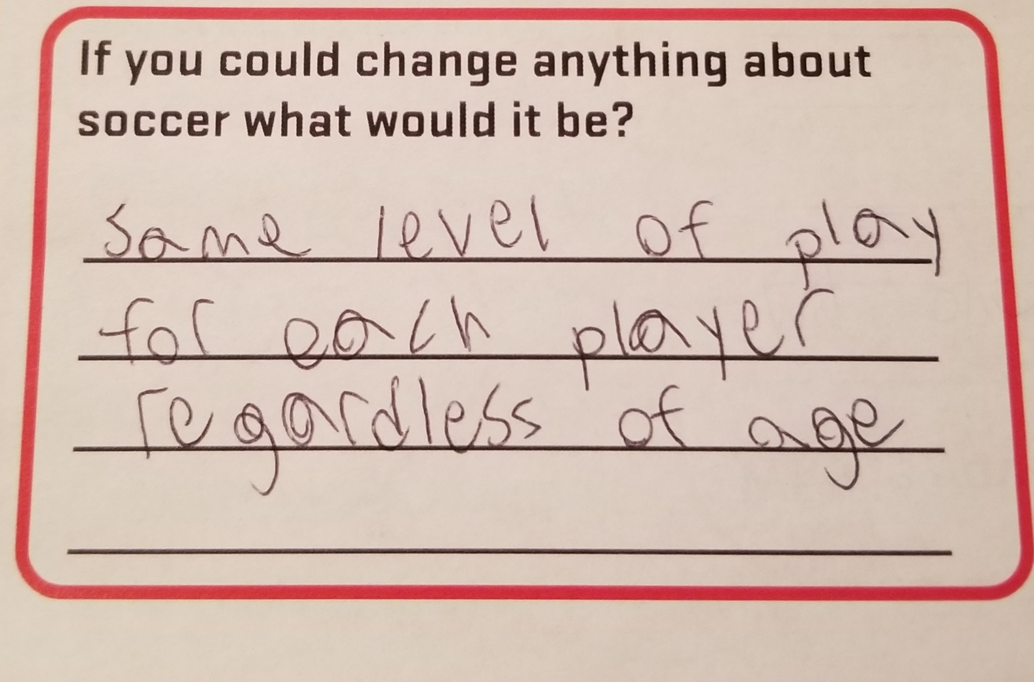
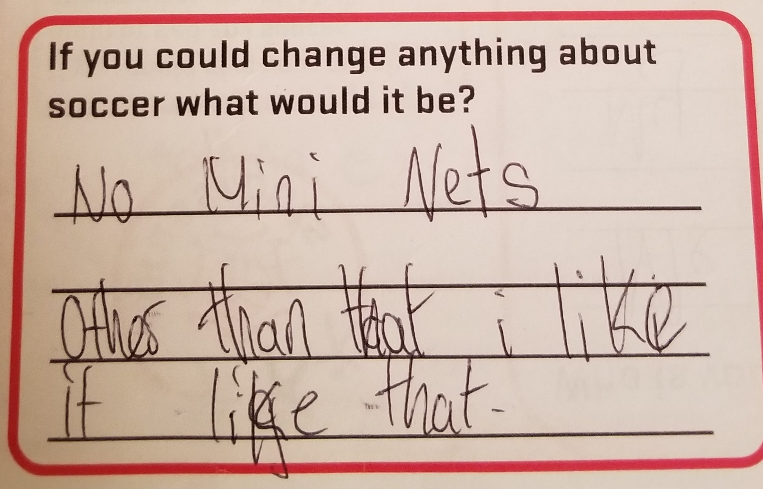
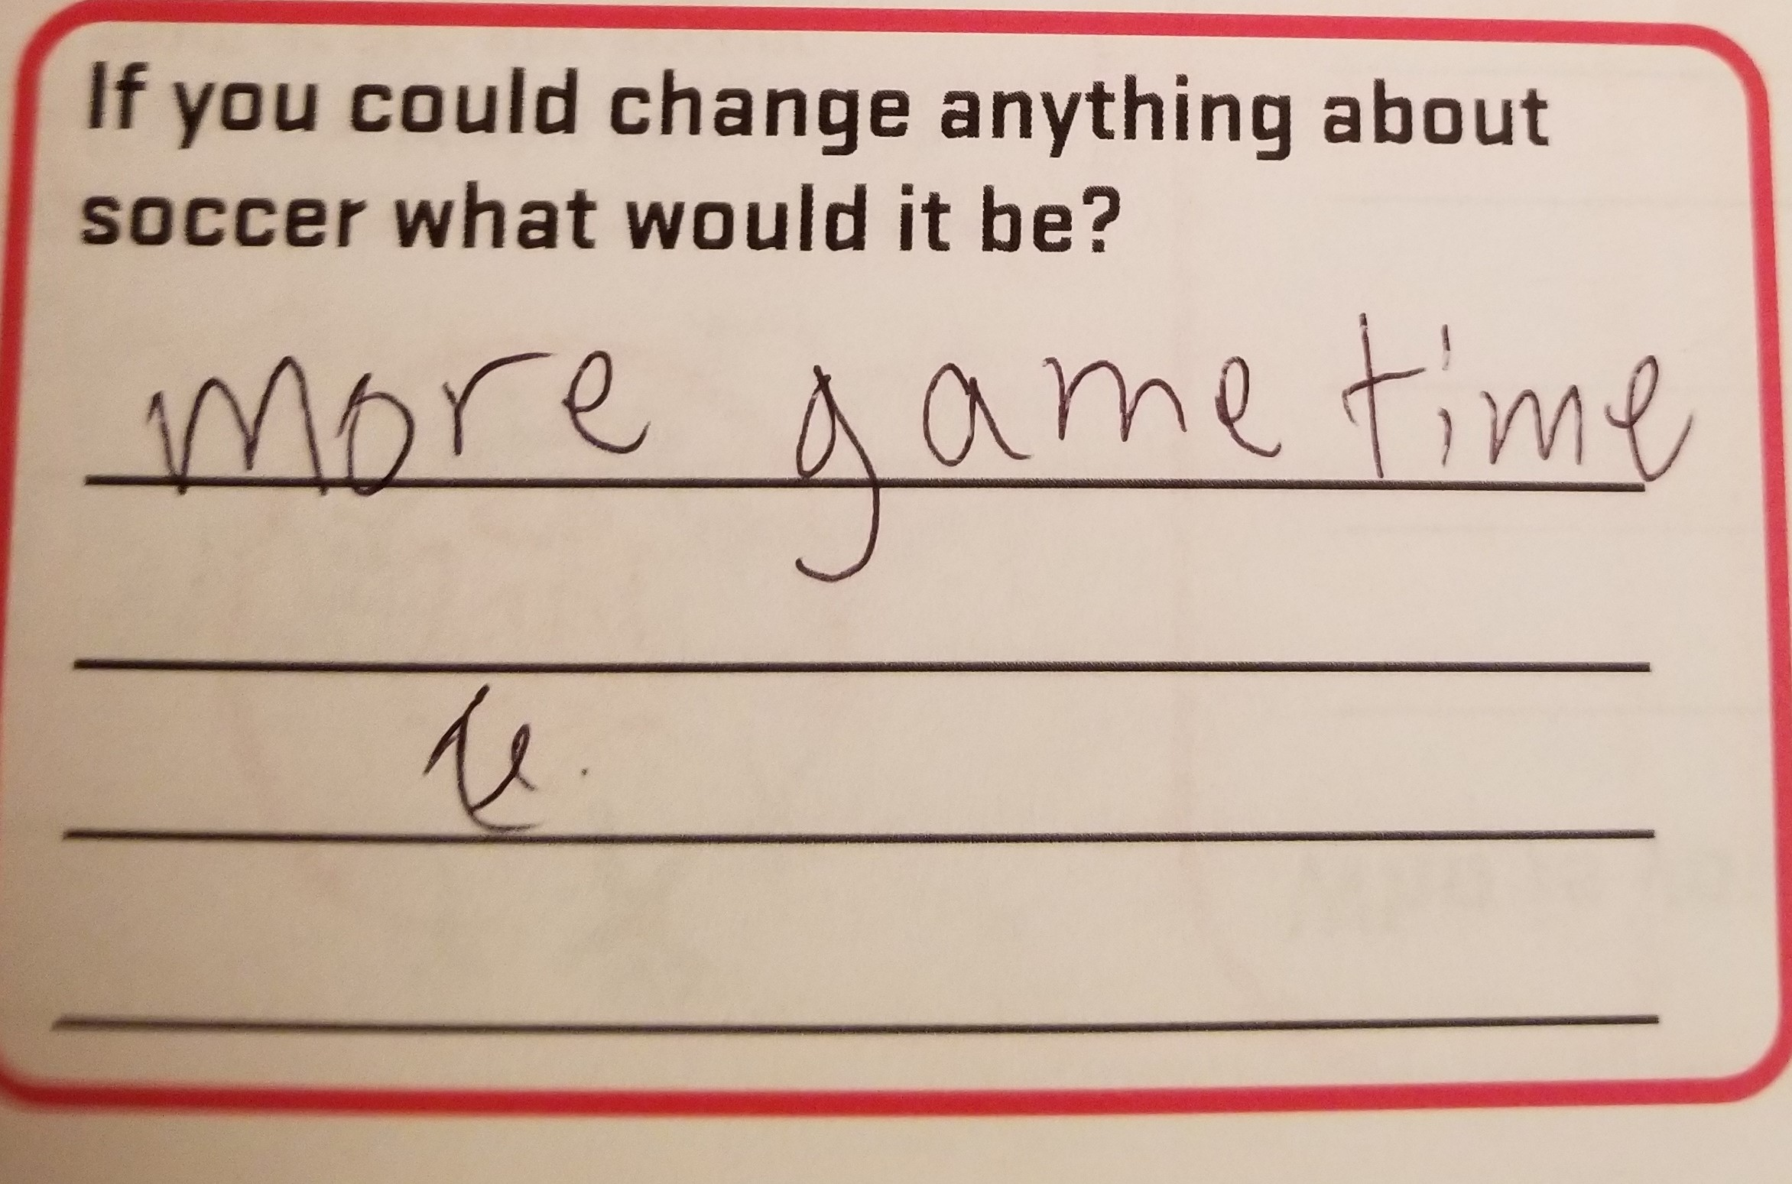
Player
Players were asked open question and responses analyzed as % of players that chose theme.
Ex. Size of nets 4% players mentioned as would change about soccer

Slide 23
Player
Notable Other mentions
Longer games
VAR
It is too early
Bigger field
Boys/girls play together
The refs
Smaller pinnies
More water breaks
No coaches
Retreat line
Throw ins
Everyone make world cup

Slide 24
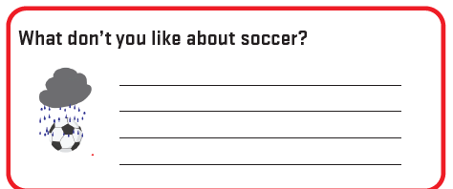
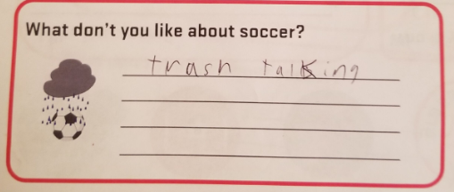
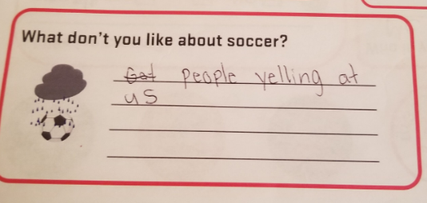
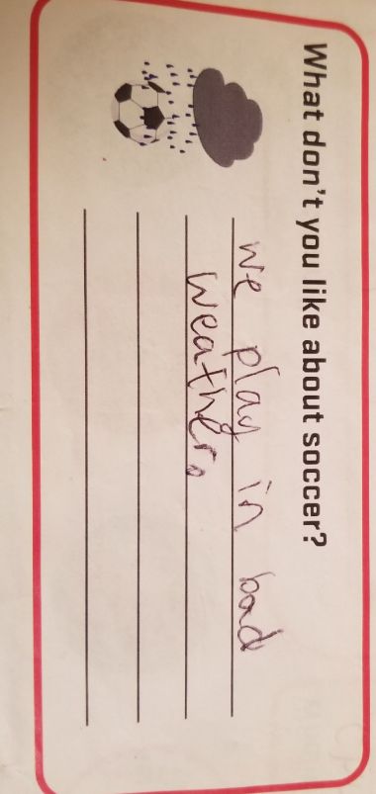
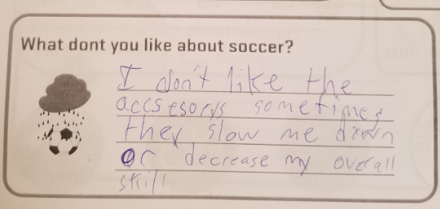
Player
Players were asked open question and responses analyzed as % of players that chose theme.
Ex. Yelling from sidelines 18% players mentioned don’t like about soccer.

Slide 25
Player
Notable Other mentions
Short games
VAR
It is too early
Ball to hard
Big kids vs little kids
The refs
It’s conflicts with hockey
Bad fields
25

Slide 26

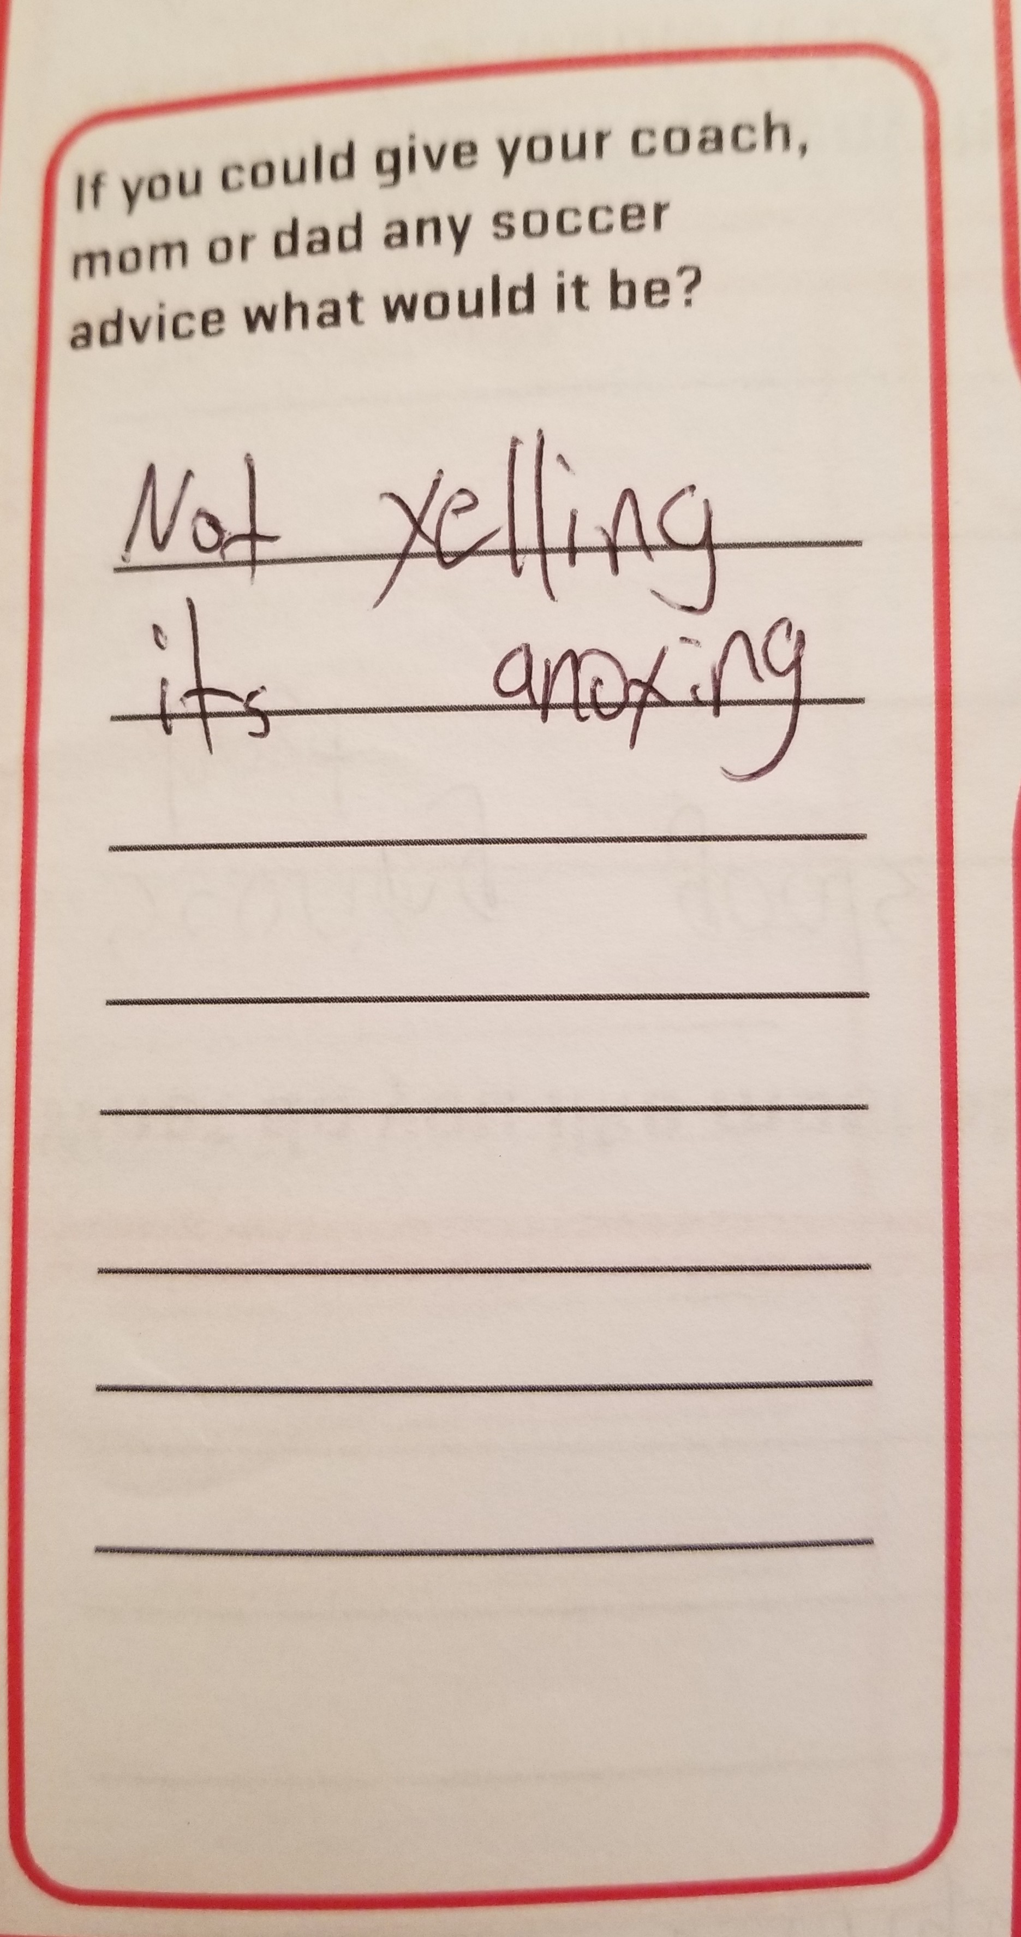
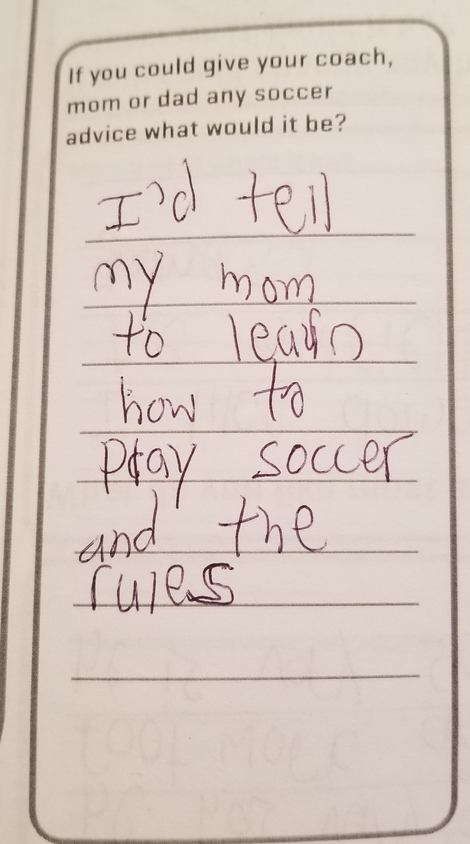
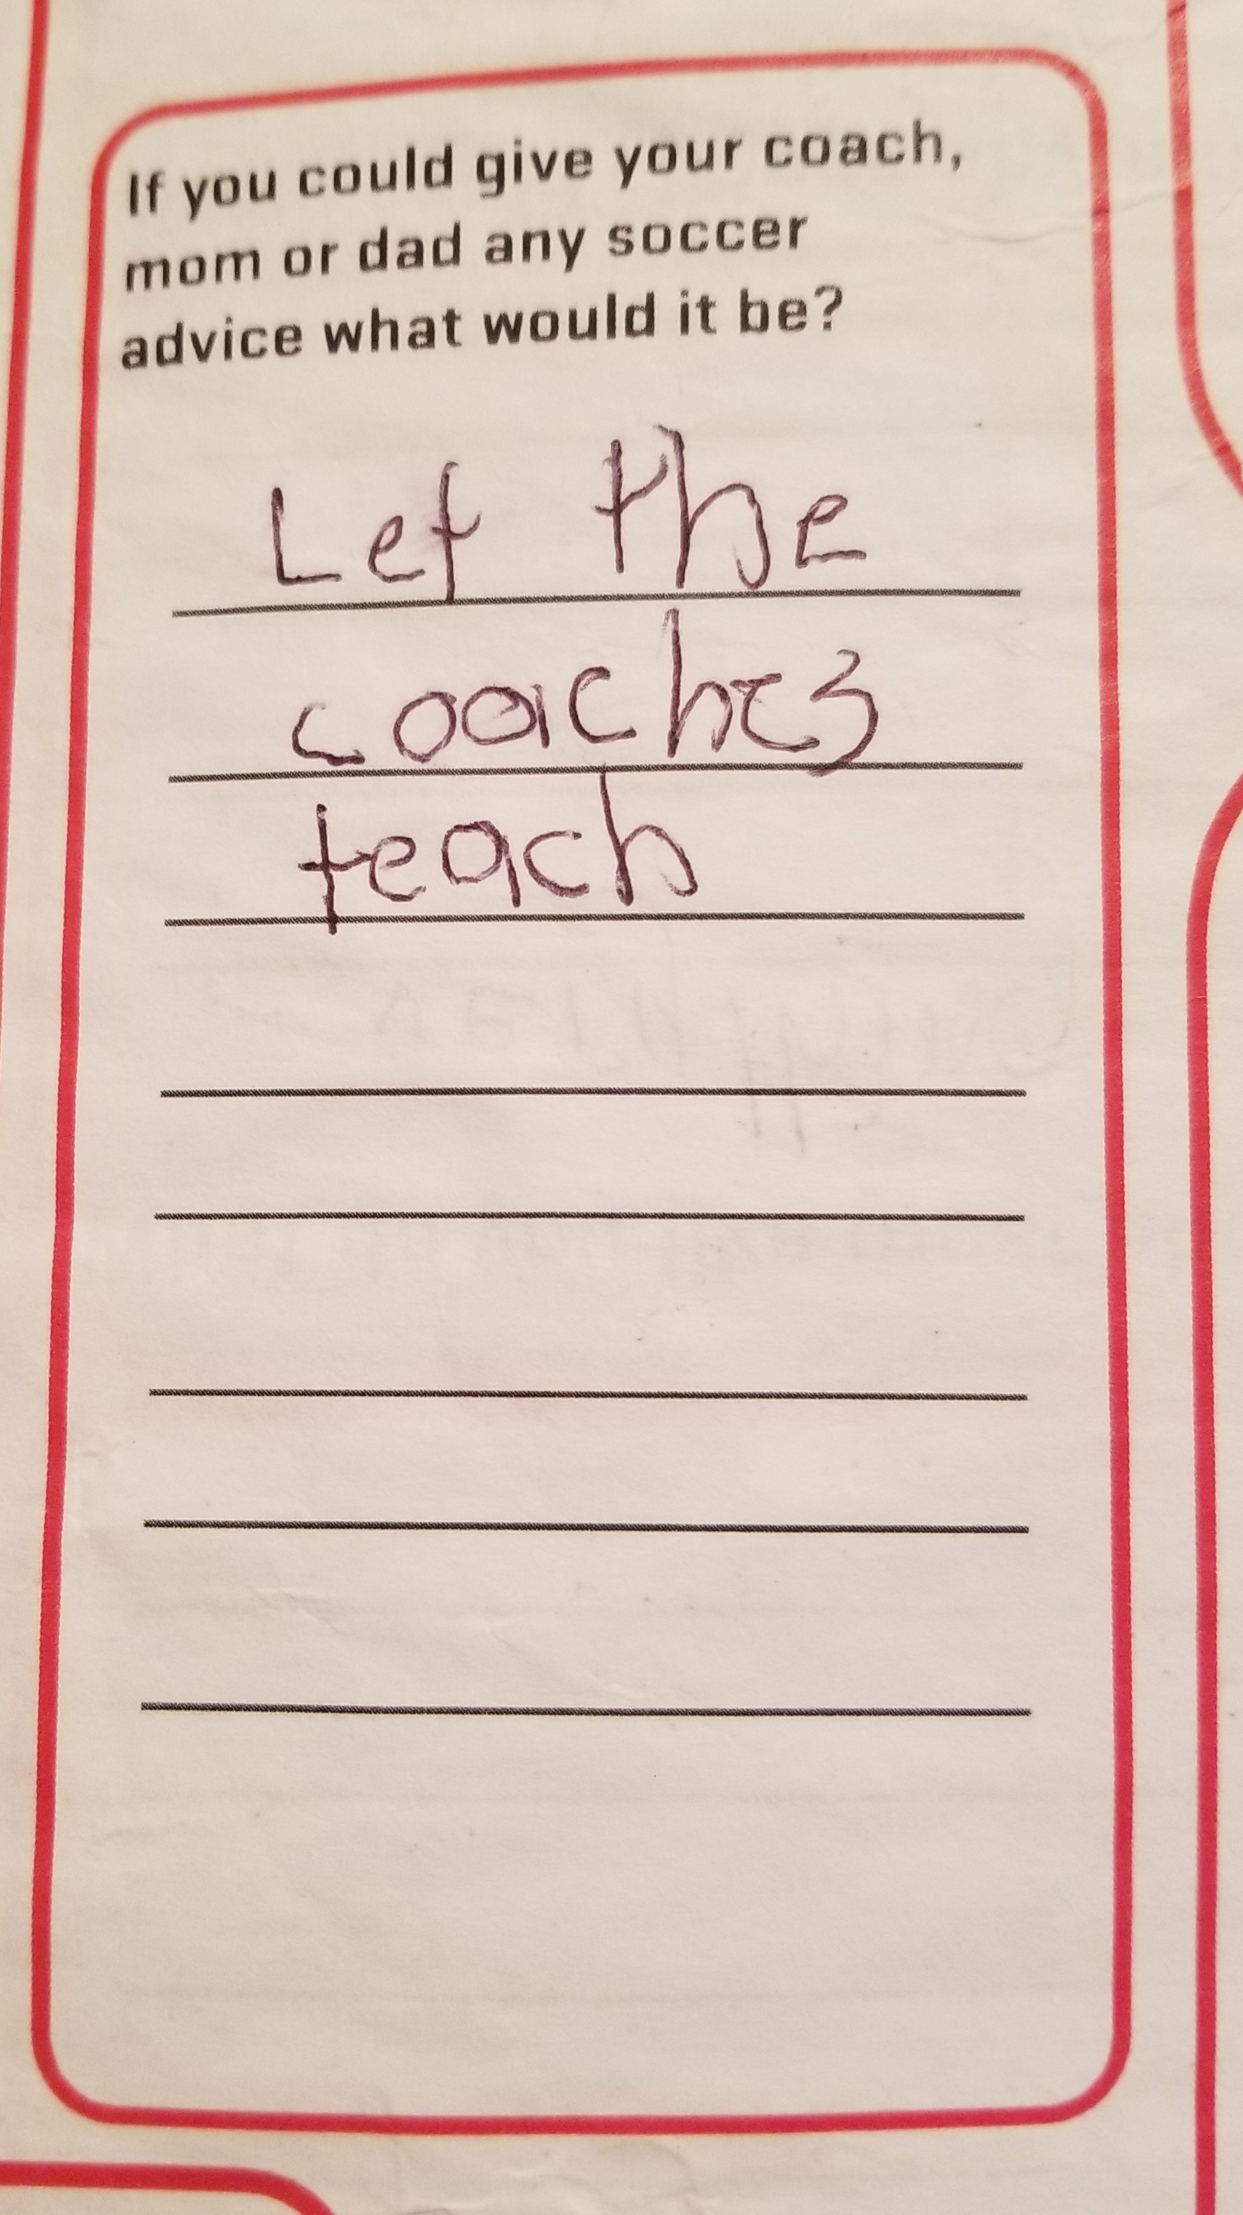
Player
Players were asked open question and responses analyzed as % of players that chose theme.
Ex. Tell me did a good job more, 18% players mentioned as would be advice to coach, mom or dad.

Slide 27
Player
Notable Other mentions
Longer games
No refs
Come to more games
Keep doing what doing
Learn the how to play
Know the rules
Better snacks
Play more
27
27

Slide 28
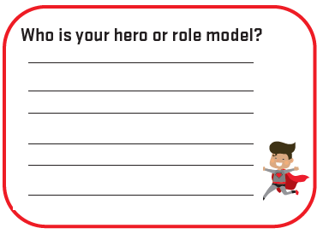
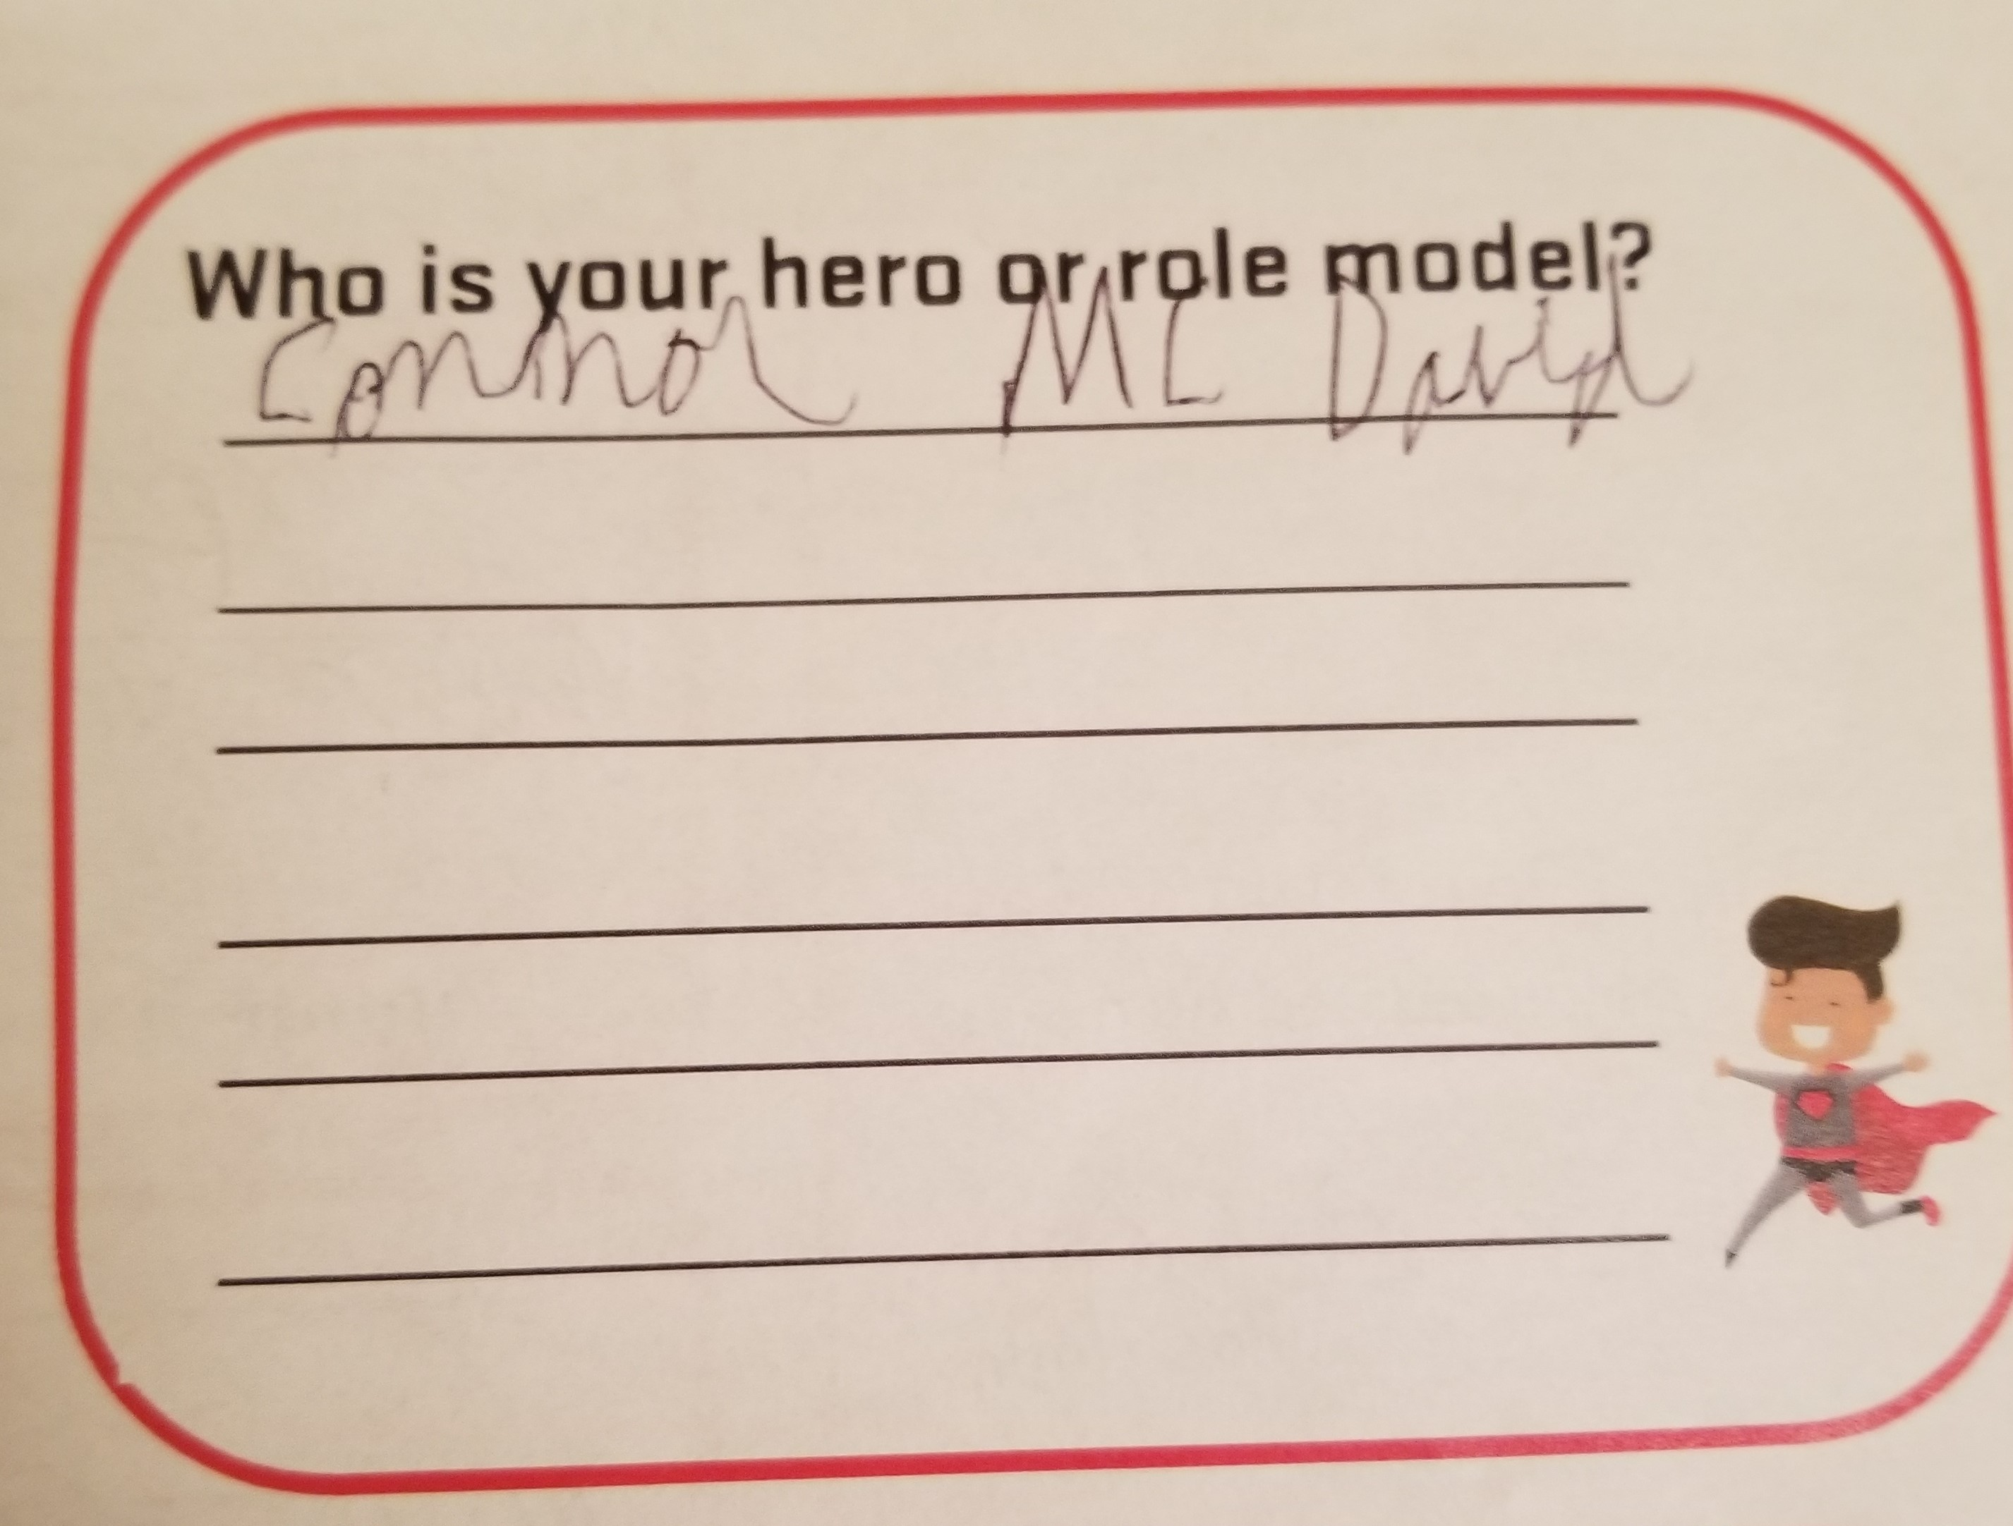
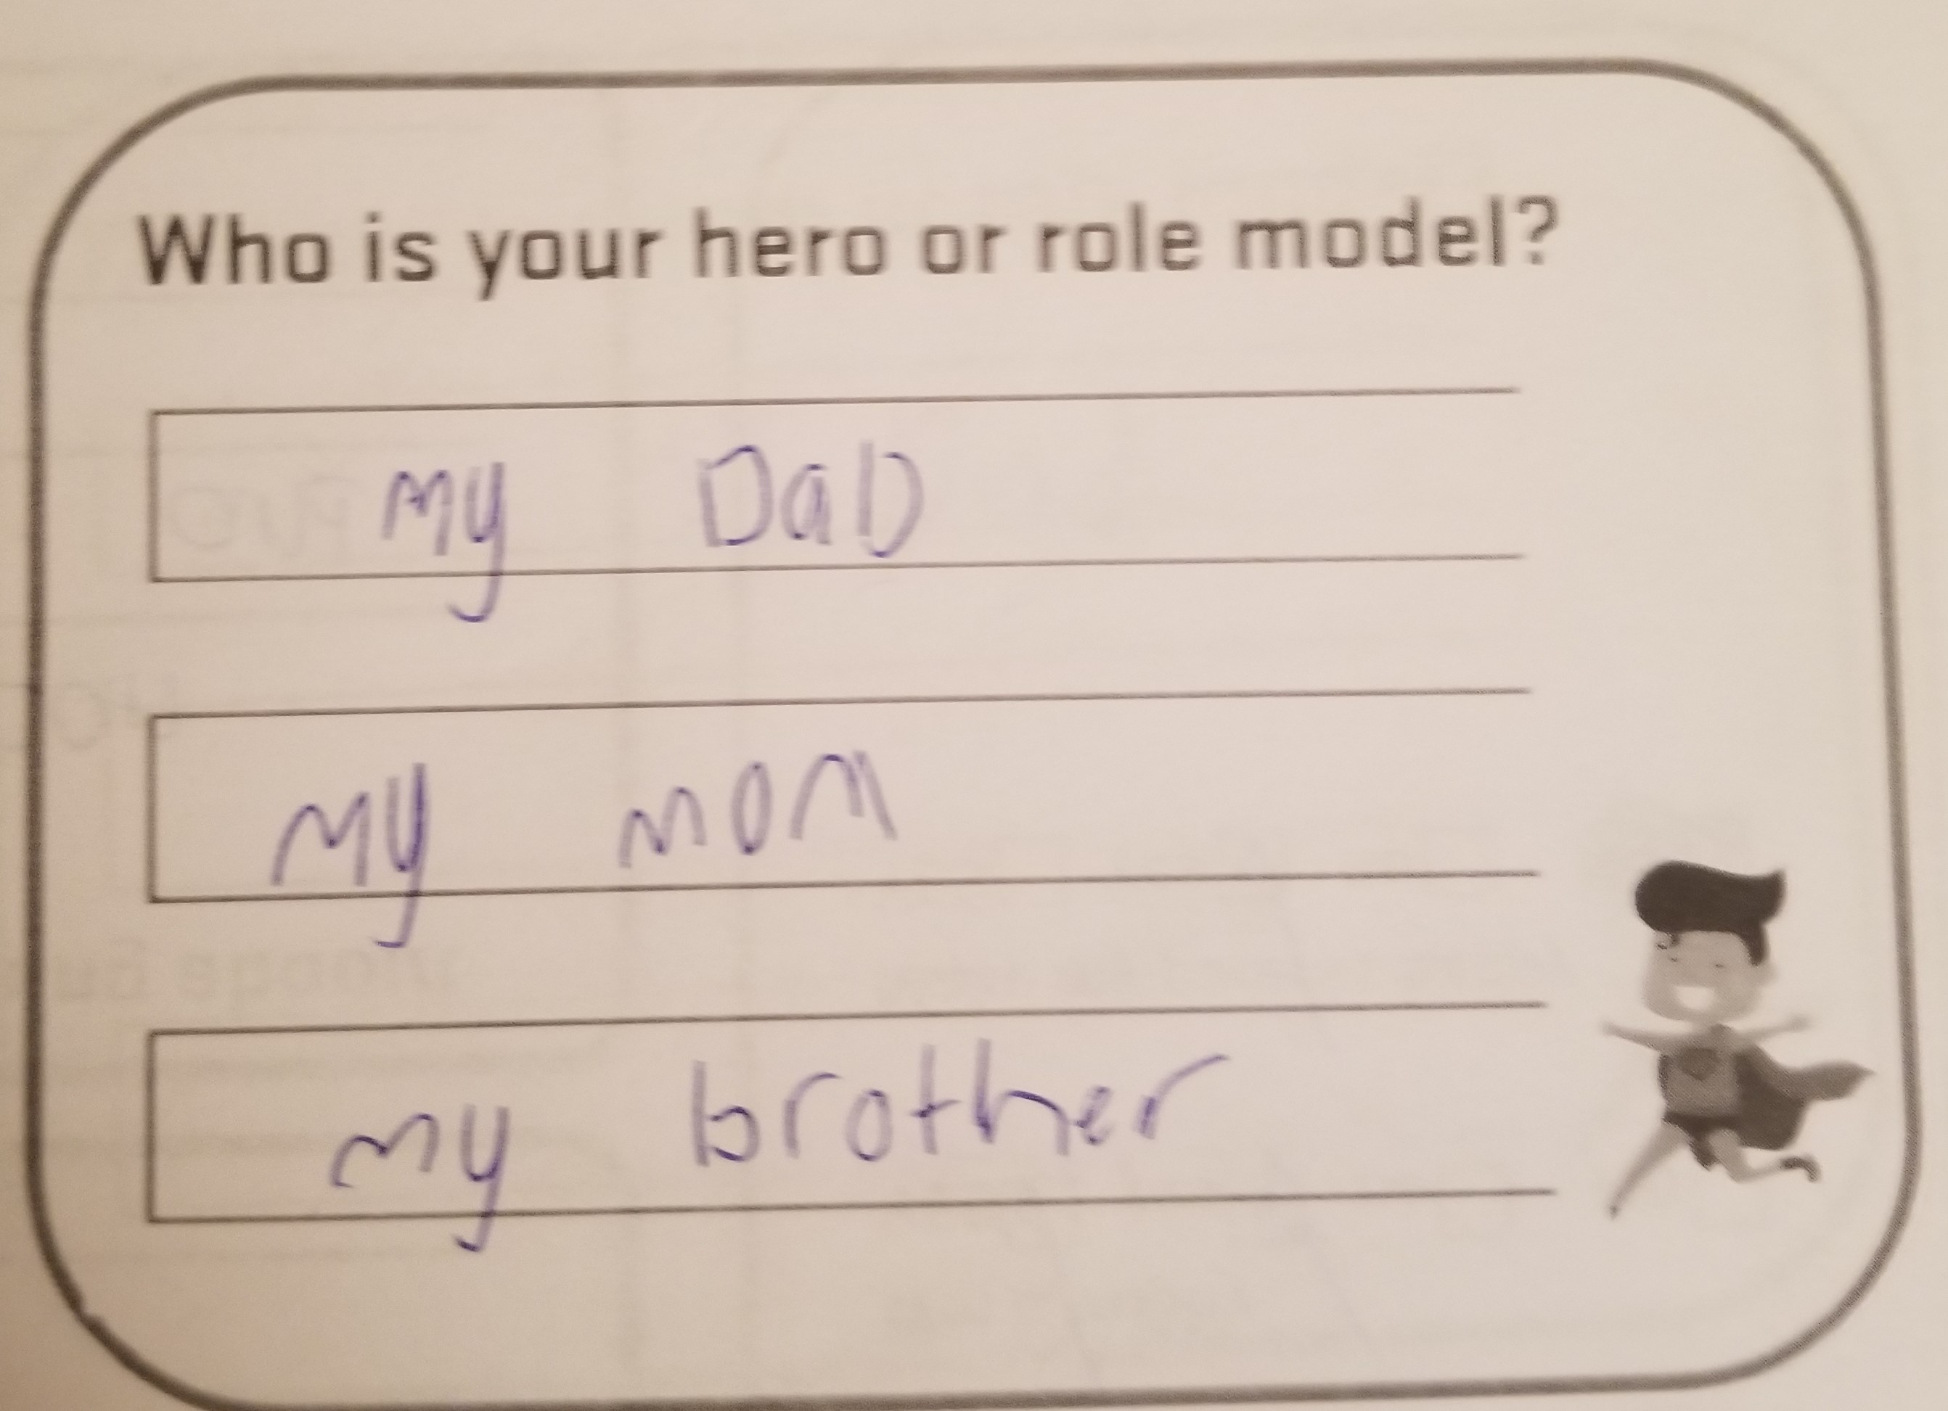
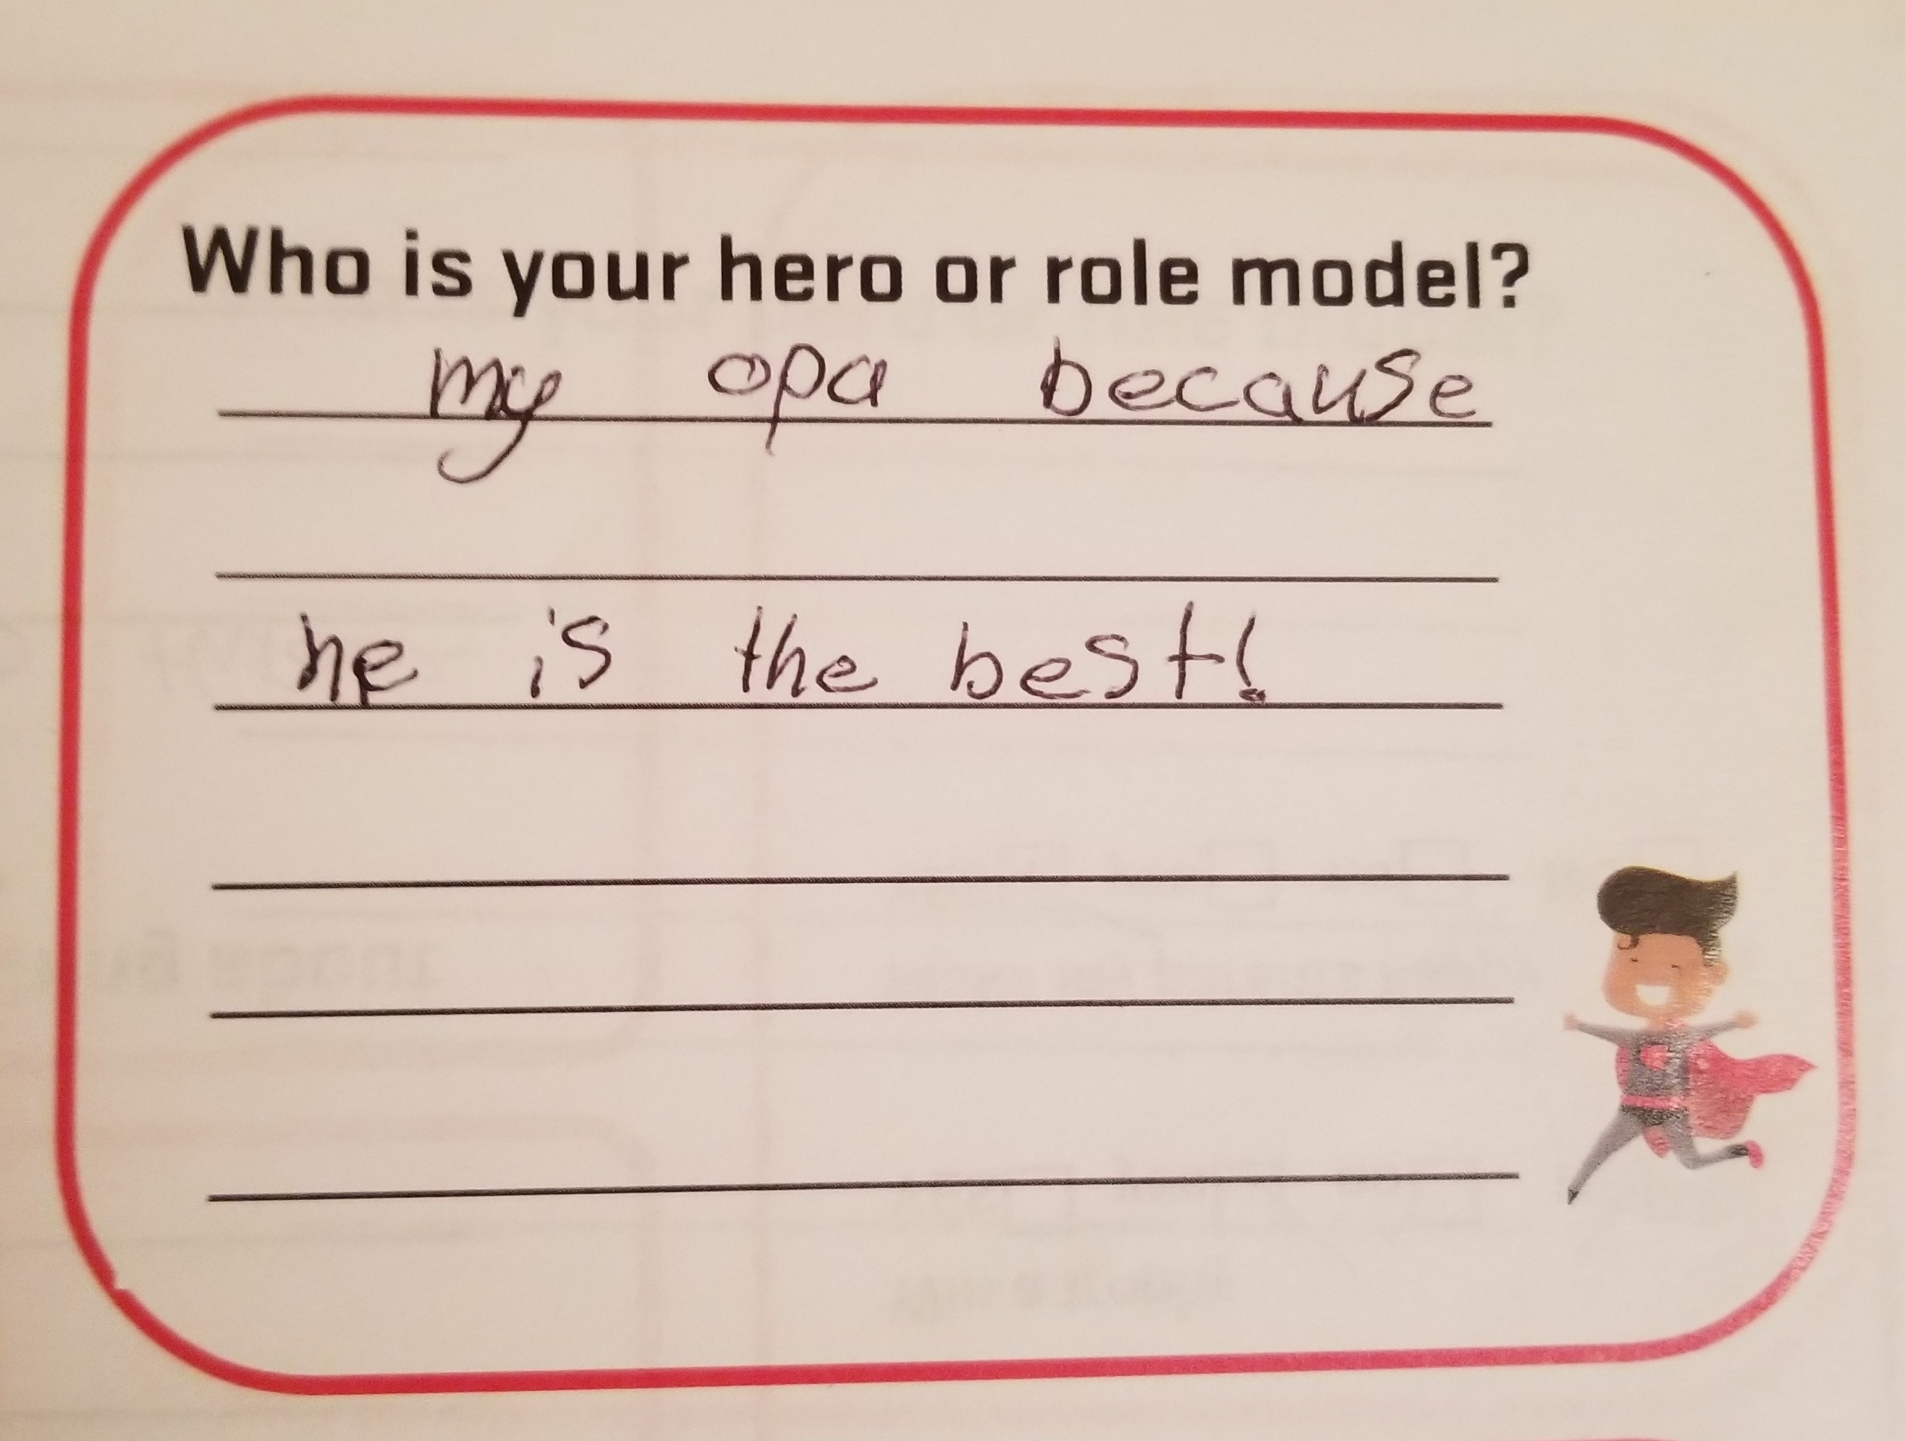
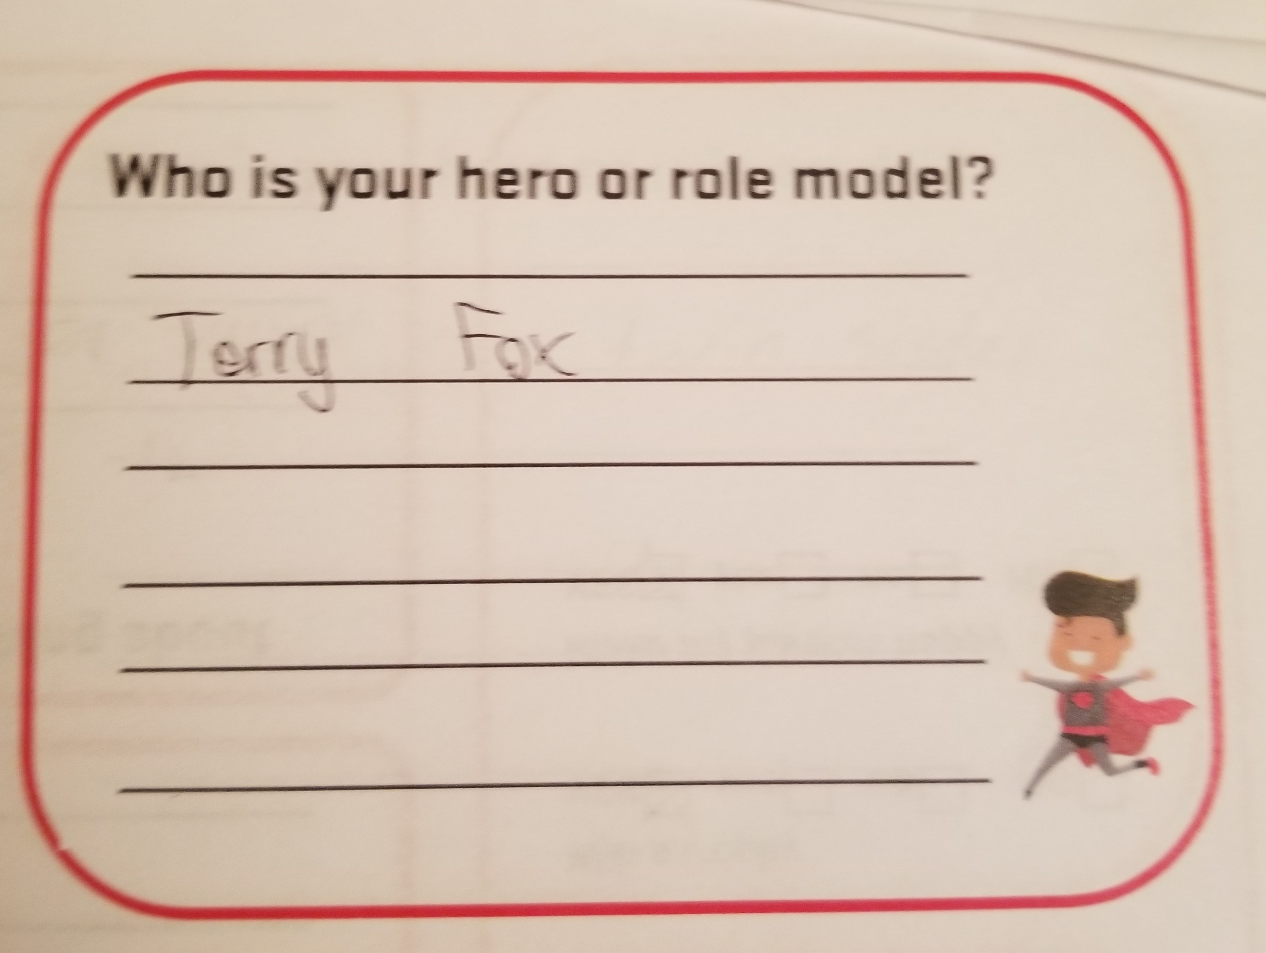
Player
Players were asked open question and responses analyzed as % of players that chose theme.
Ex. Family 63% players mentioned as their role model. Mom, Dad, brother or sister!

Slide 29
Player
Notable Other mentions
Gordon Ramsey
Neighbour
Older kid at park
Myself
Everyone
Comic super hero
29
29

Slide 30
Parent Survey

Slide 31
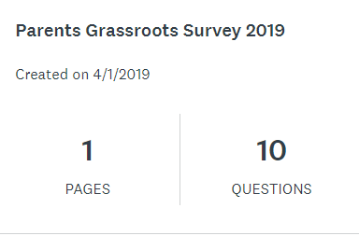
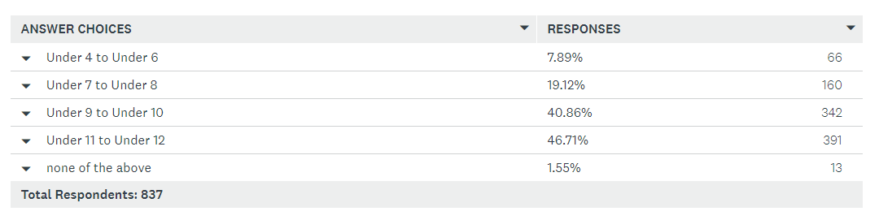
Parent
Parents were asked 10 questions using an online survey.
10 questions – 9 being information gathering about their kids in soccer and 1 being about World Cup 2026.

Slide 32
Parent
Parents with more than one child could select each age group.
Core information was focused on 8 to 12 year olds.
Province wide survey available to all parents from both clubs and academies.

Slide 33
Parent
What is your understanding level of Soccer's Long Term Player Development (LTPD)
Long Term Player Development began to be implemented into soccer in 2012.
Long Term Athlete Development build from Sport for Life evolved into each sport.
2019 has seen the latest introduction Long Term Development in Sport and Physical Activity v3

Slide 34
Parent
What is important for you with your child's experience in soccer?
*rate each option 1 being most important 2 next most important ensuring all have a ranking

Slide 35
Parent – Top and Bottom choices
Learn new skills
2 = 35.72%
1 = 32.39%
8 = 0.96%
7 = 0.48%
What is important for you with your child's experience in soccer?
*rate each option 1 being most important 2 next most important ensuring all have a ranking
Have fun playing
1 = 36.68%
3 = 20.55%
7 = 1.08%
8 = 0.24%
Beat the other team
1 = 0.48%
2 = 1.43%
7 = 20.91%
6 = 53.57%
Play fair
4 = 34.41%
3 = 27.24%
7 = 1.55%
8 = 0.24%
Be with their friends
5 = 49.34%
4 = 20.43%
8 = 2.03%
1 = 0.84%
Win a trophy
1 = 0.60%
2 = 1.31%
8 = 21.62%
7 = 65.83%
They play as well as are able
2 = 27.84%
1 = 24.25%
6 = 0.84%
8 = 0.84%
Please us as a parent
2 = 0%
3/4 = 0.96%
6 = 15.05%
8 = 65.83%

Slide 36
Parent
Notes:
Not sure if we want to break out each response with all or highlight top/bottom as previous slide?

Slide 37
Parent
Why did you put your child in organized soccer?
*rate each option 1 being most important 2 next most important ensuring all have a ranking

Slide 38
Parent – Top and Bottom choices
Why did you put your child in organized soccer?
*rate each option 1 being most important 2 next most important ensuring all have a ranking
I like to see them score or stop goals
7 = 43.23%
6 = 23.47%
2 = 1.8%
1 = 0.72%
Seeing them try their best is important more than winning
1 = 26.63%
2 = 25.27%
7 = 3.11%
8 = 1.56%
It helps keep them fit and healthy
1 = 33.73%
2 = 32.06%
7 = 0.72%
8 = 0.72%
So that they can meet new friends through soccer
4 = 25.33%
5 = 22.69%
1 = 2.25%
8 = 2.16%
To be apart of a team and wear the uniform
5 = 24.79%
6 = 20.48%
1 = 1.92%
8 = 2.99%
To have them compete against other kids
6 = 27.46%
5 = 20.83%
1 = 1.44
8 = 1.56%
So that they can develop new skills
1 = 32.69%
2 = 24.67%
6 = 2.04%
8 = 1.2%
It is important they win trophies
8 = 85.35%
7 = 9%
4 = 0.36%
2 =0 .36%

Slide 39
Parent
Kids should...
*rate each option 1 being most important 2 next most important ensuring all have a ranking

Slide 40
Parent – Top and Bottom choices
Kids should...
*rate each option 1 being most important 2 next most important ensuring all have a ranking
Feel encouraged to do their best
1 = 56.95%
2 = 27.1%
6 = 0.72%
5 = 0.48%
Be able to make decisions on their own
3 = 28.62%
2 = 28.26%
5 = 3.83%
6 = 0.6%
Feel they are able to try different things without punishment
5 = 24.79%
6 = 20.48%
1 = 1.92%
8 = 2.99%
Be taught more in practice
4 = 27.94%
3 = 26.74%
1 = 10.79%
6 = 1.32%
Have great snacks
6 = 78.06%
5 = 15.23%
3 = 0.96%
2 = 0.36%
Not be told what to do from the sidelines while playing
5 = 53.96%
4 = 20.38%
1 = 2.76
2 = 2.64%

Slide 41
Parent
837
Parents
What has been the greatest positive from your child's youth soccer experience?
Notable Other mentions
active
Away from video games
everything
Winning lots
Discipline provided
festivals

Slide 42
Parent
What is your greatest challenge or frustration with the youth soccer experience of your child?
Notable Other mentions
active
Away from video games
everything
Winning lots
Discipline provided
festivals

Slide 43
Parent
If you could change anything in youth soccer, what would it be?
Notable Other mentions
Politics
Be more like hockey
Multi sport opportunities
More games
Finance sharing
More commitment for all
Rank kids
Less clubs – too many to choose

Slide 44
Parent
What resources would you like to have access to?
Notable Other mentions
active
Away from video games
everything
Winning lots
Discipline provided
festivals

Slide 45
Coach Survey

Slide 46
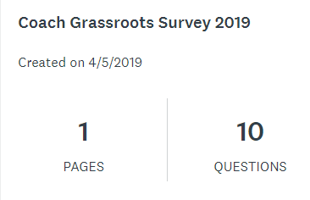
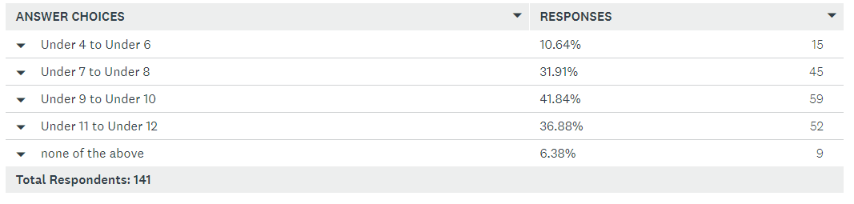
Coach
Coaches were asked 10 questions using an online survey.
10 questions – 9 being information gathering about their kids in soccer and 1 being about World Cup 2026.

Slide 47
Coach
Coaches working with more than one age group could select each age group.
Core information was focused on 8 to 12 year olds.
Province wide survey available to all coaches from both clubs and academies.

Slide 48
Coach
What is your understanding level of Soccer's Long Term Player Development (LTPD)
Long Term Player Development began to be implemented into soccer in 2014.
Long Term Athlete Development build from Sport for Life evolved into each sport.
2019 has seen the latest introduction Long Term Development in Sport and Physical Activity v3

Slide 49
Coach
What is important for the children you coach to experience in soccer?
*rate each option 1 being most important 2 next most important ensuring all have a ranking
Notes:
Some of the o% wont data label?

Slide 50
Coach
What is important for the children you coach to experience in soccer?
*rate each option 1 being most important 2 next most important ensuring all have a ranking
Play fair
4 = 36.17%
3 = 26.95%
8 = 0.7%
7 = 0%
They play as well as are able
3 = 29.08%
4 = 19.86%
7 = 0%
8 = 0%
Learn new skills
2 = 44.68%
3 = 21.99%
6 = 0%
8 = 0%
Win a trophy
7 = 46.81%
8 = 34.04%
1/2/3 = 0.71%
5 = 0%
Have fun playing
1 = 63.12%
2 = 13.48%
5/6/8 = 2.84%
7 = 0.71%
Be with their friends
5 = 48.23%
4 = 21.99%
7 = 2.13%
1 = 1.42%
Beat the other team
6/7 = 37.59%
8 = 13.48%
1/2/4 = 0.71%
3 = 3.55%
Please us as a coach
8 = 46.10%
6 = 34.75%
1/3 = 0.71%
2 = 0%
Notes:
Some of the o% wont data label?

Slide 51
Coach
Why do you coach kids in organized soccer?
*rate each option 1 being most important 2 next most important ensuring all have a ranking

Slide 52
Coach
I like to see them score or stop goals
7 = 44.29%
6 = 21.43%
2 = 0.71%
1 = 0%
Why do you coach kids in organized soccer?
*rate each option 1 being most important 2 next most important ensuring all have a ranking
Seeing them try their best is important more than winning
1 = 45.71%
2 = 30.71%
7 = 1.43%
8 = 0%
So they can meet new friends through soccer
4 = 28.57%
3 = 18.57%
7 = 5.71%
1/8 = 1.43%
It helps keep them fit and healthy
3 = 29.29%
2 = 27.86%
6/7 = 2.14%
8 = 0%
So that they can develop skills
1 = 32.86%
3 = 22.14%
8 = 1.43%
6 = 0.71%
To have them compete against other kids
6 = 30.71%
7 = 21.43%
1 = 0.71%
8 = 0%
It’s important they win trophies
8 = 88.57%
7 = 5.71%
5 = 0.71%
2/3 = 0%
To be a member of a team and wear the uniform
5 = 29.29%
6 = 23.57%
2 = 5%
1 = 1.43%
Notes:
Some of the o% wont data label?

Slide 53
Coach
Kids should...
*rate each option 1 being most important 2 next most important ensuring all have a ranking

Slide 54
Coach
What is important for the children you coach to experience in soccer?
*rate each option 1 being most important 2 next most important ensuring all have a ranking
Feel encouraged to do their best
1 = 55.71%
2 = 28.57%
5 = 0.71%
6 = 0%
Be able to make decisions on their own
2 = 34.53%
1 = 29.50%
5 = 4.32%
6 = 0.72%
Be taught more in practice
4 = 31.91%
5 = 26.24%
6 = 2.84%
1 = 2.13%
Not be told what to do from the sidelines while playing
5 = 39.72%
4 = 31.21%
2 = 2.84%
1 = 0.71%
Have great snacks
6 = 76.60%
5 = 17.02%
3 = 0.71%
1 = 1.42%
Feel they are able to try different things without punishment
3 = 33.33%
2 = 21.28%
1/5 = 11.35%
6 = 2.84%
Notes:
Some of the o% wont data label?

Slide 55
Coach
What has been the greatest positive from your coaching experience in youth soccer experience?

Slide 56
Coach
What is your greatest challenge or frustration with the youth soccer experience as a coach?
Notable Other mentions
Education for coach
Not enough coaches
paperwork
Not enough games
Organizing player pool

Slide 57
Coach
If you could change anything in youth soccer, what would it be?
Notable Other mentions
How tier players
Season length
Cost of everything
Structure of leagues
Referee quality

Slide 58
Coach
What resources would you like to have access to?
Notable Other mentions
Female specific
Interaction with pro’s
Cost breakdown
Video stuff
How to rank players
Club does a good job

Slide 59
Ontario Soccer
Player Development Program Team

