Slide 1


HASTINGS
RAIDERS BASKETBALL
Player/Parent Meeting
2025-2026

Slide 2


AGENDA & TOPICS
Introductions & Contact Info
Purpose & HHS Parent/Athlete Video
Player & Parent Expectations
Communication
Levels of Play & Team Goals & Purpose
Season Details & Schedules
Reminders (to do items)

Slide 3


INTRODUCTIONS & CONTACT INFO
WE BELIEVE IN:
Being academically responsible
Having fun
Team first mentality
Sportsmanship
Relationship building
Personal growth
Skill development
Developing intangible life skills
Competing & winning
Mike Giesen
C-Squad Head Coach & Varsity Assistant
michaelgiesen@yahoo.com
Eric Mace
JV Head Coach & Varsity Assistant
emace@isd200.org
Rick Tavernier
Varsity Head Coach
tavernierr@isd199.org
651-306-7906 (w)
We coach help student-athletes become responsible and caring individuals who will use their work ethic and determination to make positive contributions in their community.

Slide 4

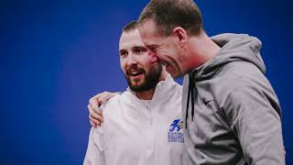
HHS PARENT ATHLETE VIDEO

Slide 5

PLAYER & PARENT EXPECTATIONS
Players:
Follow all MSHSL & HHS rules
Be academically responsible
Be accountable
Attendance matters (school & practice)
Be coachable
Good sportsmanship
Team first mentality
Take care of your mental and physical health
Parents:
Above all else, support your daughter in a positive manner
Model good sportsmanship from the stands
Attend as many games as possible
Help with communication when necessary
Have fun!

Slide 6

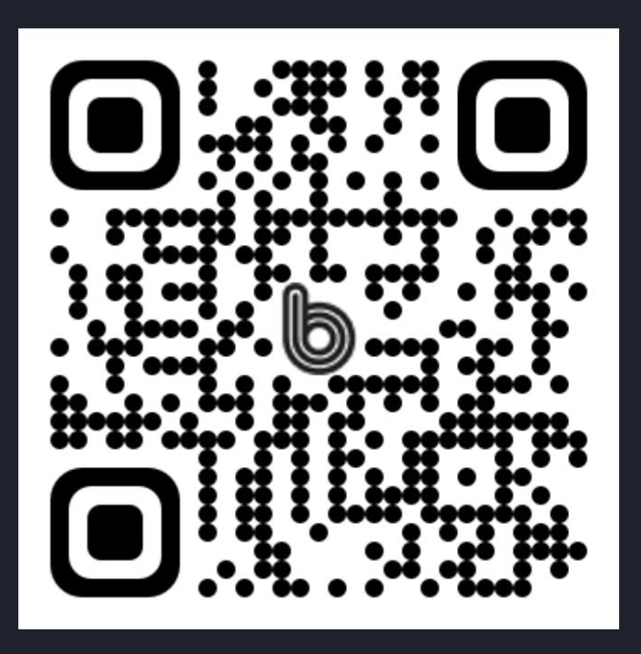

COMMUNICATION
Communicating with players:
Band App
Parents & Coach Communication:
Biweekly email
Recap & upcoming items
Need to speak with a coach?
In person or email is ideal
24 hour rule (if it’s an emotional topic)
Encourage your daughter to self-advocate
QR code for players to join the new 2025-26 group.

Slide 7
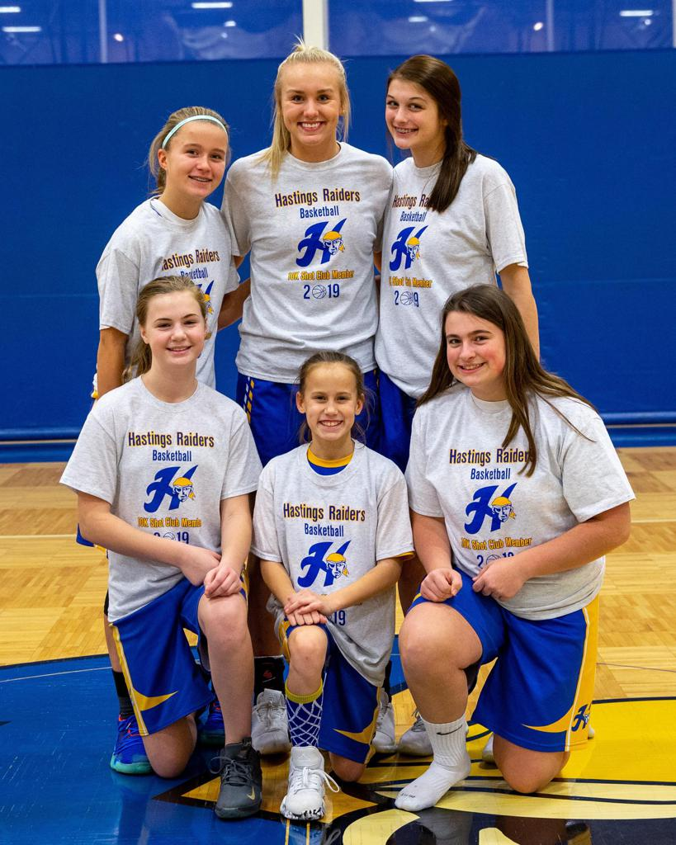
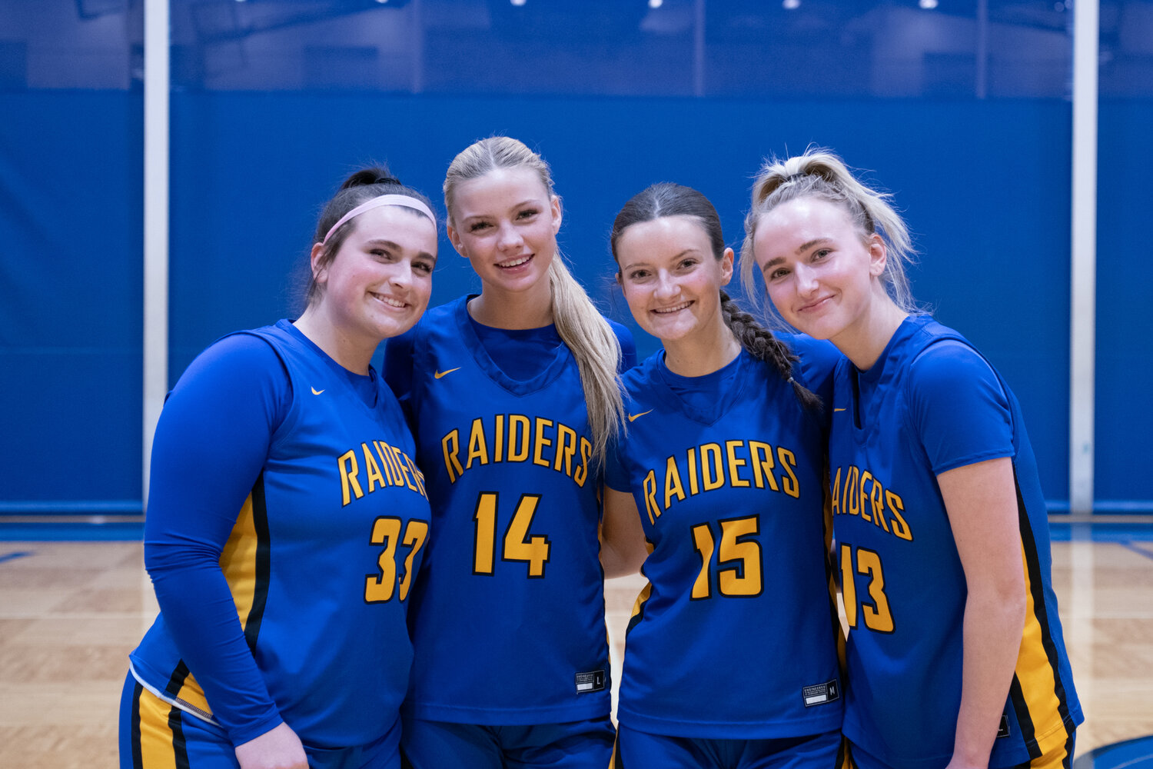
LEVELS OF PLAY
Team Placement and Purpose
C-Squad
8th & most 9th graders
Winning is secondary
High focus on skill development, learning concepts, and building confidence
Nearly all the same schemes & concepts as JV & Varsity
This group will practice with JV/Varsity at times - New This Year!
JV
Playing time is earned; not equal
Identical concepts & schemes
Increased emphasis on productivity & efficiency
Developmental and a proving ground for varsity (JV players might play some varsity minutes)
Varsity
Playing time is earned; not equal
The pinnacle of high school competition.
Where high skills and intangibles meet!
There is shift - winning is one of our primary goals!

Slide 8
SEASON DETAILS & SCHEDULES
Start Date
Monday, November 10th/main gym (3:45-6pm)
Tryouts/Evaluations Dates
The first 3 Days (Nov. 10-12th)
Everyone will practice from (3:45-6pm)
The coaching staff will meet with players after tryouts
No cuts! Team placement (not fixed; this is fluid)
Practice Schedule - NEW THIS YEAR!
All teams (C/JV/Varsity) will practice from 3:45-6pm @ HHS

Slide 9
SEASON DETAILS & SCHEDULES
Important Dates:
Nov. 15 - C/JV/Varsity Scrimmage @ HHS - NEW THIS YEAR!
Everyone is welcome to attend!
Nov. 17 - Team/Player Photos & Blue/Gold Night
Also team picture day!
Nov. 20 - Vertical Raise Fundraiser (5:30 - 6:30pm)
Nov. 25 - First Game @ Burnsville (4:15, 5:30 & 7pm)
Nov. 27 - Volunteering at Gobble Gait (need to verify)
*Dec. 12-13 - Out of Town Trip (next slide) - NEW THIS YEAR!
Dec. 29-30 - Holiday Tournament @ HHS (Monday & Tuesday)
Just a Reminder
All non-conference & conference home games are @ 4:45 & 6:30pm
There are a few away games @ 4:00, 5:30 & 7:00pm

Slide 10
SEASON DETAILS & SCHEDULES
*Overnight Trip Details*
When: Friday, Dec. 12 - Saturday, Dec. 13
Where: Pine City (Friday) and Cloquet (Saturday)
Transportation
The bus will leave around 3:15pm from HHS
To help cover the cost we cancelled busing to Park HS & Simley HS (saving $900).
Hotel
All hotel costs are covered for the team.
Super 8 by Wyndham in Cloquet (the team is staying here)
AmericInn by Wyndham in Cloquet (right next to the Super 8)
Discount pricing link on GBB website

Slide 11
SEASON DETAILS & SCHEDULES
Specific to the C Team - NEW THIS YEAR!
There is a modified schedule with some MEC schools:
Saturday, January 10:
10:00am - Hastings vs Two Rivers, Tartan vs Mahtomedi
11:00am - Hastings vs Mahtomedi, Two Rivers vs Tartan
Friday, January 23:
4:30pm - Hastings vs Tartan, Mahtomedi vs Two Rivers
5:30pm - Hastings vs Two Rivers, Tartan vs Mahtomedi

Slide 12
REMINDERS
Don’t forget to Registration!
Go to hastingsathletics.org - Click on Registration tab
Emails from registration will be used for communication.
All levels practice from 3:45-6pm starting on Nov.10
Be ready & warming up by 3:45!
Practice jerseys will be distributed on Nov. 10
All players need the BAND app
If you need the invite scan the QR code and/or talk with a coach before you leave.
Hotel reservations (link to discounted pricing on Hastings Girls Basketball website)
Super 8 by Wyndham in Cloquet
AmericInn by Wyndham in Cloquet

Slide 13

THANK YOU!
Go Raiders!

