Slide 1

Welcome!
2025-2026 Welcome Meeting
September 16, 2025

Slide 2
Agenda
Welcome
About Booster Club
Reports & Updates
Fundraisers
Calendar/Website
Questions
Thank you for coming!

Slide 3
Welcome!
The purpose of the Osseo Orchestra Boosters(OOB) is to see to the needs of the Osseo Senior High School Orchestras which will enhance the growth of the Orchestra in experiences and learning in a music-oriented setting. All decisions shall be made based on the betterment of the overall program of the Osseo Senior High School Orchestras and its students.
Items supported by the boosters include:
Senior scholarship, music supplies (rosin, music, strings, etc.), special concert accompaniments, student gatherings, Senior gifts, small ensemble registration fees and more!
We welcome all parents and guardians of the Osseo High School Orchestra students to participate.
Meetings are held on the second Tuesday of each month. Watch calendar to confirm times and location.

Slide 4
Meet the Board
President– MK Thao
Vice President—position open
Secretary—Katie
Treasurer—Lisa Skov
Orchestra Director—Dr. Dean

Slide 5
Reports & Updates
Director’s Update—Dr. Dean
Treasurer’s Report—Lisa Skov

Slide 6
Fundraising
Fundraising is an important function of the OOB, as this is how we are able to support and enhance each students experience!
Last Season’s Highlights:
Steak Fry Fundraiser
Suites & Sweets Raffle and Concessions
Dine & Donate—Zupas, Freddy’s, Culver's, Canes and more
Lynde Nursery & Nothing But Bundt Cakes Fundraisers
Music Awards Night
What is up for 2025/2026—glad you asked!!

Slide 7
Fundraising for 2025-2026
We have many great fundraisers planned, but we are always open to new and fun ideas!!
SnapRaise Booster Fundraiser
Steak Fry at the Osseo Legion, Sunday, October 26th from 5:30-8:30pm
Suites & Sweets Concert—silent auction & concessions
Nothin’ Bundt Cakes Valentines Sale
Lynde Greenhouse Poinsettia Sale
Coupon Fundraiser
Pancake Breakfast at Osseo Legion
Multiple Dine to Donate Events
If you have ideas or would like to volunteer to coordinate or help out, please email the OOB at : osseoorchestraboosters@gmail.com

Slide 8
How do I know when things are?
Not sure where to find information—there are lots of options!!
Website: https://www.oshorioles.org/orchestra
There is a tab for each orchestra and the boosters. This will have all the information you need and then some! Currently under construction, but more coming soon!
Facebook: Osseo Orchestra Boosters and Osseo Senior High Orchestras
Email: osseoorchestraboosters@gmail.com
Make sure you are getting Dr. Dean’s notifications

Slide 9
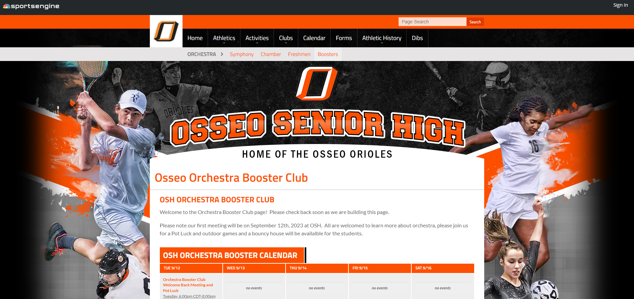

Slide 10
Important Upcoming Dates:
SnapRaise Fundraiser—September
Steak Fry at Osseo Legion, October 26th
Suites & Sweets Concert—

Slide 11
Upcoming Events
SnapRaise—look for links to share with family & friends. Social media, texts, email, letters are a few of the great ways to share!
Pasta Bar, 10/26—will need lots of volunteers to make this happen. Look for a sign-up link coming soon. Will also need baked good donations, so get those ovens warmed up! Tickets will be passed out 9/30 and due on 10/18.
Fall Concert, November 7th—will need help with passing out programs and more.
Let us know if you’d like to help!

Slide 12
Questions?
What would you like to know, or know more about?

Slide 13
Thank you for coming!
Looking forward to a great year!!

