Slide 1

PALMETTO REGION
Officials Information

Slide 2
USAV Officials Uniform
USA Volleyball polo-style shirt that is one of the three approved colors:
  The white shirt is the default, so all referees must own a white shirt.
  http://vbofficialsgear.com/
  Optional: approved outerwear that may be worn while officiating a match
Dark navy blue slacks that are pressed and in good repair (not faded).
Black or dark navy blue leather belt (if slacks are made for a belt).
Shoes and socks that meet the following specifications:
  Clean, white athletic shoes
  Non-marking rubber soles
  No exposed “coils” (for example, the “Z-Coil” style)
All white socks, at least crew length
Solid color mask and electronic whistles are a requirement for this season.

Slide 3
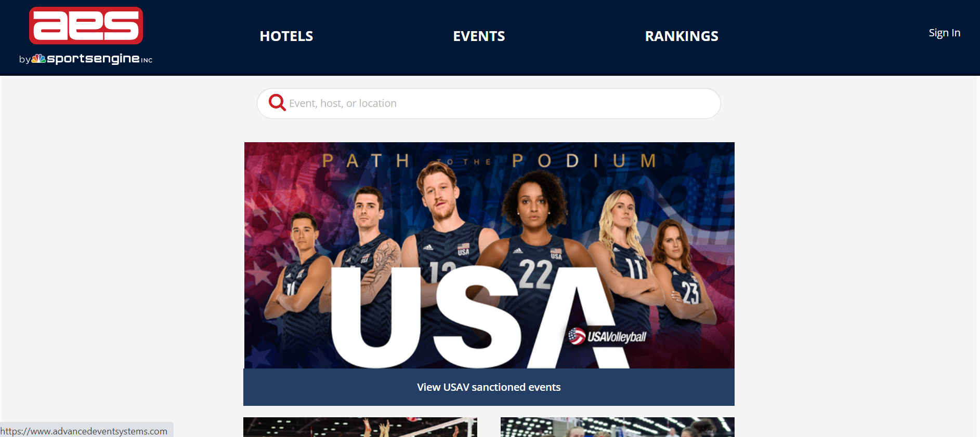
Registration for Palmetto Region events
Go to https://www.advancedeventsystems.com
Create an account or sign in

Slide 4
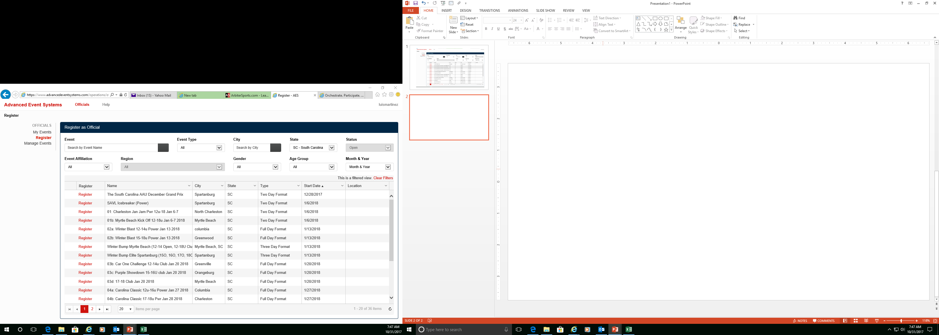
Registration for Palmetto Region events
Choose SC from the State dropdown arrow
Be sure to pay attention to dates for each event (full day, two day, etc)
When you find an event that you would like to attend…
Click on Register and click confirm.
NOTE: If your screen looks different when you first sign in, click on your name on the top right hand side and click dashboard. This will bring you to this screen.

Slide 5
Registration for Palmetto Region events
Please remember it is not first come first serve. Once you are registered for an event you will wait to see if the assigner has hired you for this event.
Palmetto Region events will have a PVA designation.
As an Independent Contractor you can work any USAV events in the USA and his territories.
You have to complete all the region pre-requirements in order to work a tournament.
When you have been accepted for an event you will receive an email from info@advancedeventsystems.com with “Official Status Change”.
You will want to log into advancedeventsystems.com every once in a while to check out your status because sometimes an email notification is not sent.
*You will want to coordinate with Luis Martinez to schedule an on court evaluation. Professional Officials Program please contact Luis Martinez at officials@palmettovb.com

Slide 6
Region requirements
In order to be in good standing with the Region, you have to complete all the pre-requirements below.
a. Pay USAV dues.
b. Pass background check.
c. Complete online training and test (Not available yet)
d. Complete Safe Sport training.
e. Attend the virtual advancement/National Clinic (dates TBD)

Slide 7
Register for ArbiterPay account
Visit https://www.refpay.com/ and click SIGN UP
Choose Sports Official/ Event Worker
Enter personal information (skip Federal TCC#)
Enter bank account information
Email Richard Holstead holsteadr@msn.com and include your name, ArbiterPay account username, and ArbiterPay account number.
Note: If you have an arbiter account, you don’t have to register for an arbiterpay account.

