Slide 1

All Aboard: A Parent’s
Introduction to Crew
ADMIT ONE
All Aboard
2nd Thursday each month
7:30-8:30 pm
DEPARTURE:
2nd Thursday each month
SEAT ASSIGNMENT:
meet.google.com/yix-nfqb-hib
SEAT CLASS: Parent
Langley Crew Booster Club
Notes:
Thank you for taking time out of your evening to join us
We won’t be recording this evening, but we will post the slide deck, including the Q&A on the website’s All Aboard page
As a side note, we’ve added a Website Directory, with links to subpages, to make it easier to find the information you’re looking for
Just like last month, if you have a question, please type it in the Chat.
All the questions are being noted and we’ll add them to the slide deck before we post it on the website.
Please mute yourself during the presentation, but feel free to unmute once we go to Q&A
This evening, we’ll be talking about:
Our busy end of season schedule
Summer rowing options

Slide 2
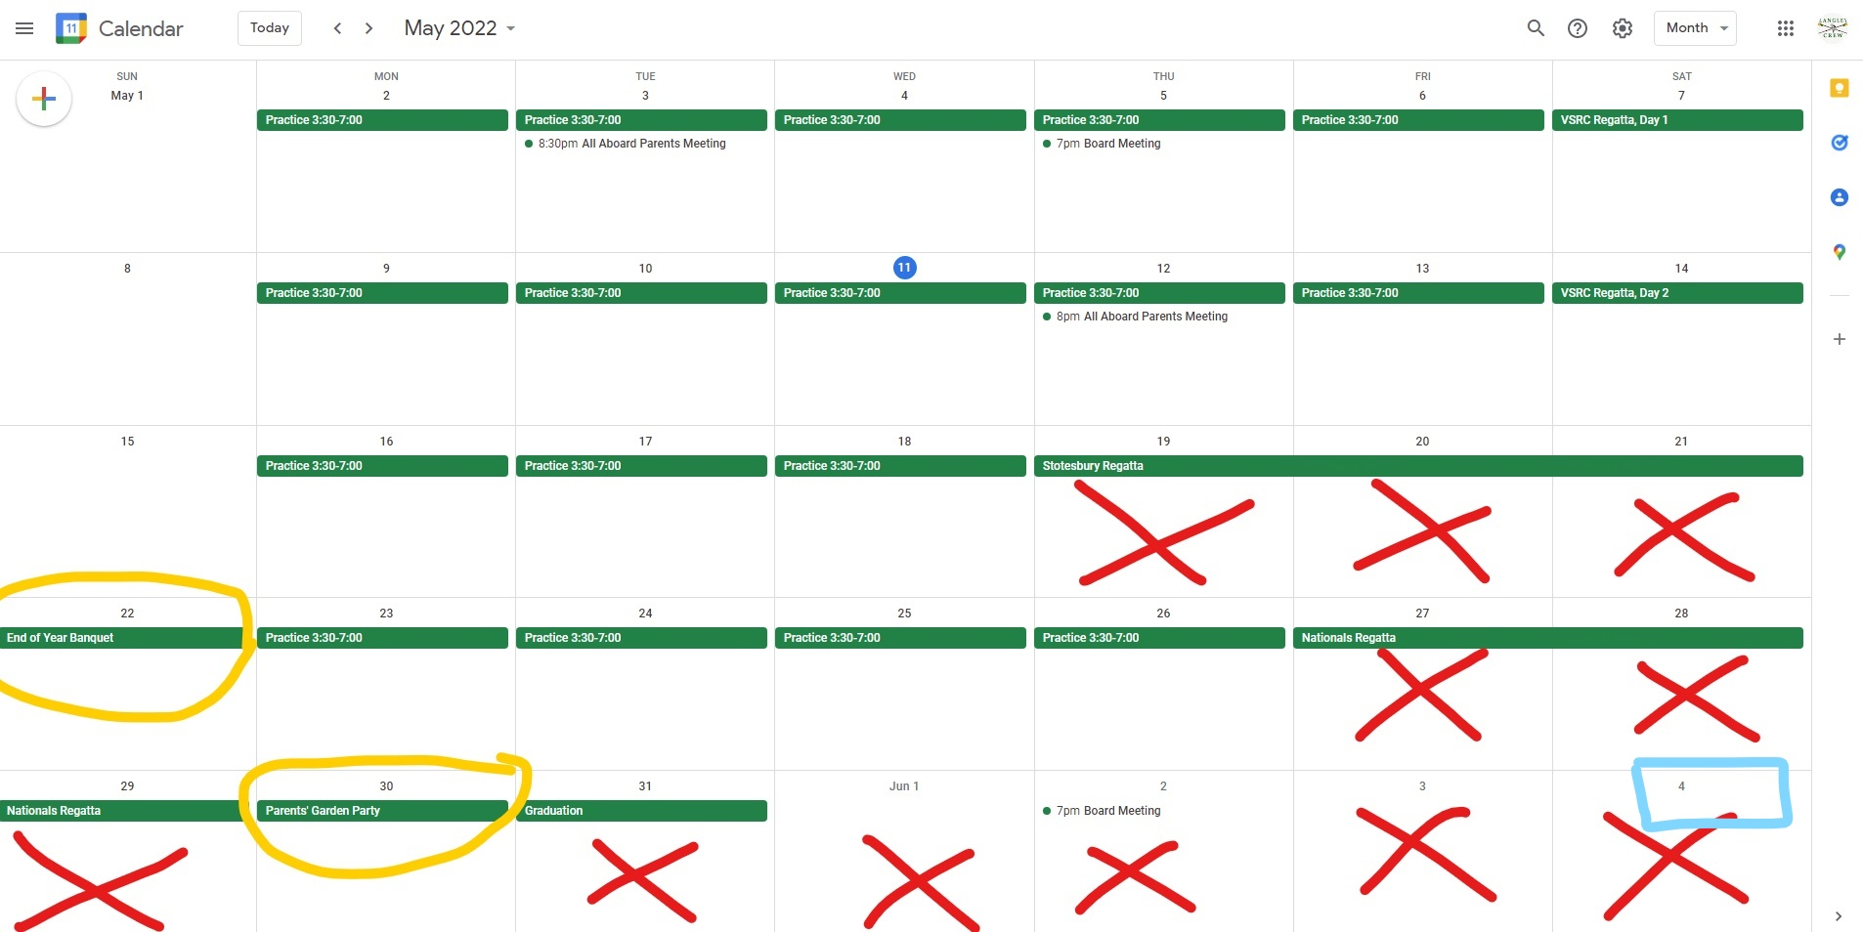

Busy, Busy, Busy
Notes:
As you can see, our calendar runneth over.
Every year, we do an End of Year Banquet, usually held on the first weekend in June, the first weekend after Nationals (see the blue).
This year, graduation doesn’t allow that. If we wait until that first weekend in June, we lose our Seniors. We also can’t do it on Memorial Day weekend, because hopefully several of our kids are competing in Nationals
The only reasonable date for the banquet is May 22 – everyone who went to Stotesbury is back and has had several hours of R&R
In pre-Covid years, we held a parents-only garden party to celebrate the season. We’re also reviving that and squeezing it in on Memorial Day itself – the season is over and everyone is back from Nationals
So, let’s go over these events in more detail

Slide 3
Away Trips
Stotesbury Cup Regatta – Philly 5/19-21
For those going, we’ve sent out an email with tons of information on transportation, what to bring, schedule of activities, etc. If you have any questions, please let us know.
National Championship – Camden, NJ 5/28
Nationals is only for those boats that placed in a state championship. Because fewer boats go, we don’t book rooms, meals or transportation – we really don’t have any idea how many kids are going until too late to do any of those things.
Notes:
Nationals
Memorial Day weekend in Camden
Only the boats that place at States will go
We won’t know until 5/7 or 5/14 who goes
Providing tent or snacks depends on how many boats go
We’ll provide more information to the parents whose kids are going as we know more

Slide 4

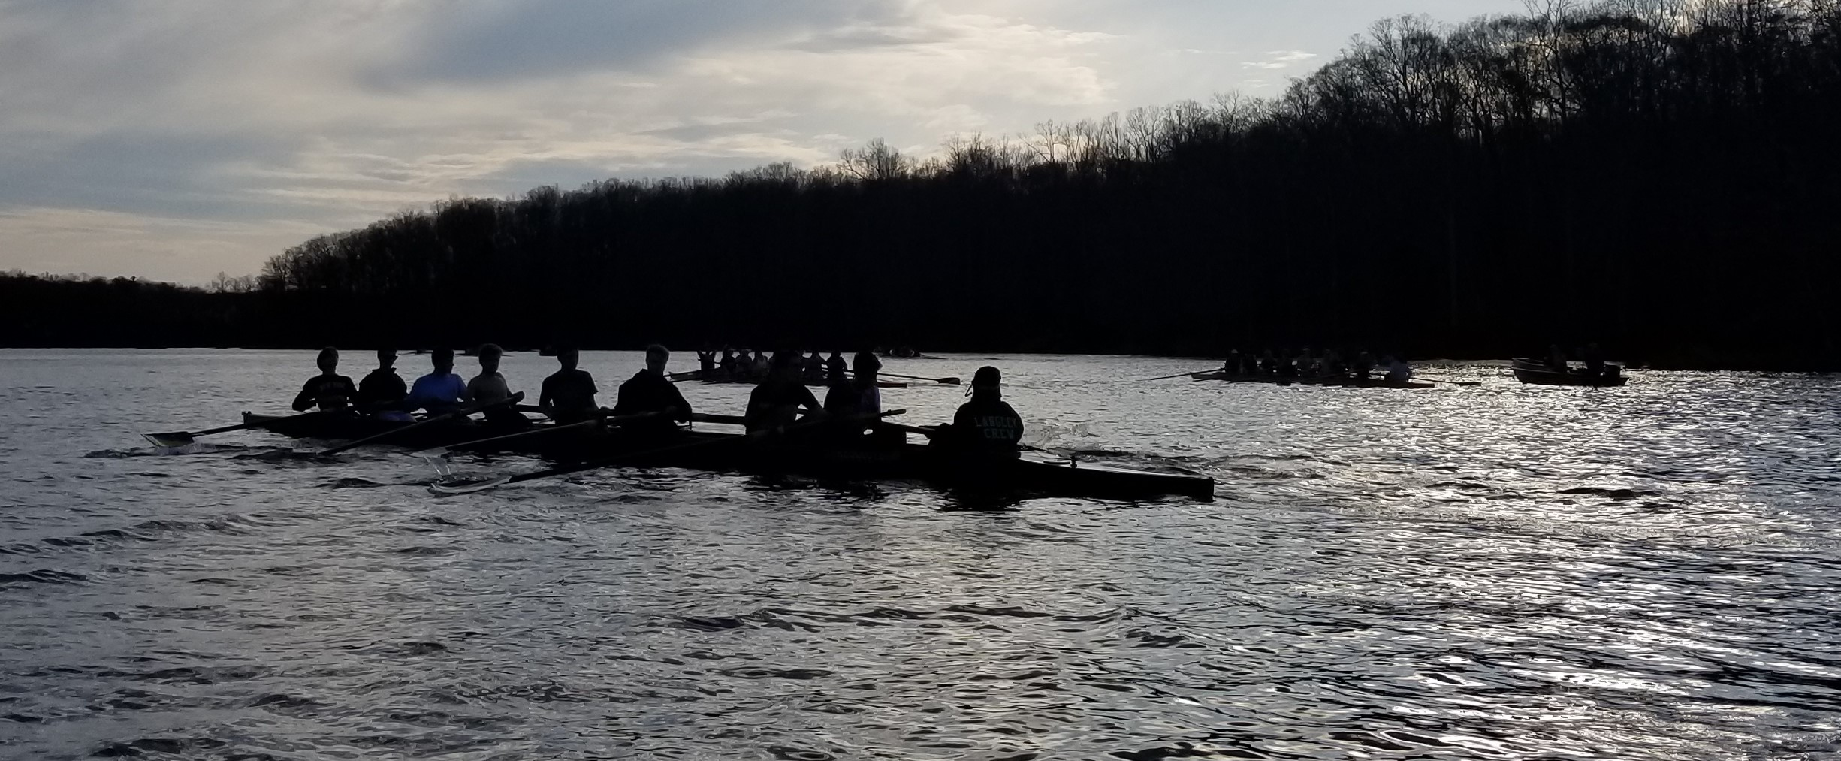
Last Day of Practice
May 18 is the last practice for most of the team
Those going to Nationals will practice until May 26.
  Practice is at normal times
  One bus will be provided
Coaches do want the kids at practice until May 18, regardless of Stotesbury or Nationals attendance. Any time on the water is good time, and they are planning technique training rather than race prep for most of the kids.
Notes:
The last day of practice is May 18 for most of the team
They do want to see everybody until May 18
Those going to Nationals will practice until May 26

Slide 5
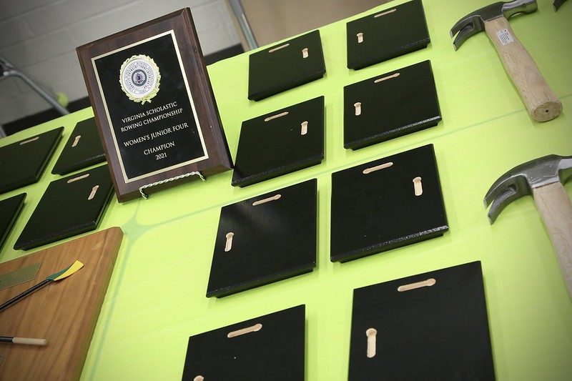
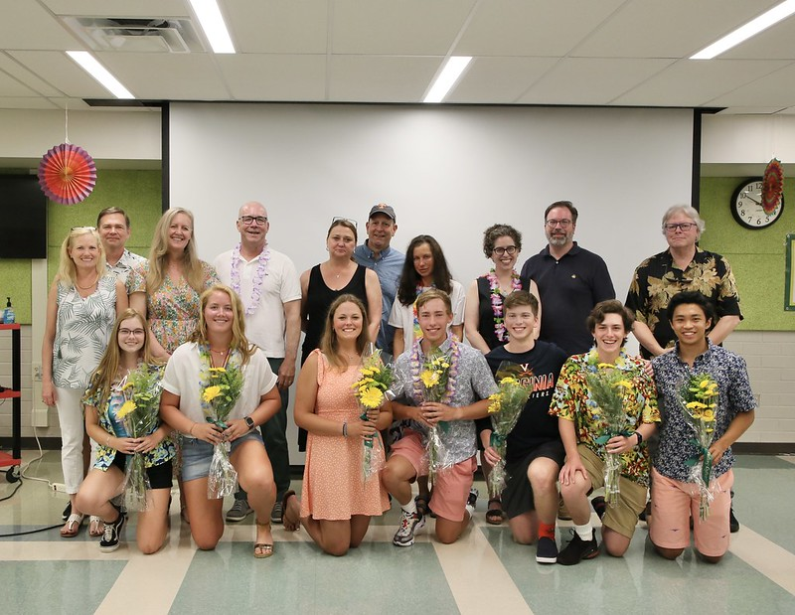
End of Year Banquet
Sunday, May 22, 4:30-7:30, Cafeteria
Dinner
Season Recap
Annual Meeting/Captain’s Awards
Awards presentation
Senior video
Parent’s Garden Party
Memorial Day, May 30, 3-6 pm
1101 Waverly Way
Elizabeth Davis’s home
Parking at LHS (across the street, ¼ mile)
Sign up for what food to bring: https://www.signupgenius.com/go/70A084CACA629A4FF2-parents
BYO everything else (lawn chair, drinks, etc.)
Notes:
End of Year Banquet
Lots of fun, especially for the kids
After dinner, the kids break off
The adults have a quick full Membership meeting, mostly to vote in next year’s Board applicants
The captains present their paper plate awards to each team member.
When the kids come back, we present awards and honor the seniors and their parents
Parent’s Garden Party
Has been on hiatus for a couple of years
Very informal
Chance to socialize with other crew parents, talk about something besides how clueless VASRA is
Hosted by Elizabeth Davis – Finn’s mom
Signup Genius for what type of food to bring
Bring your own everything else

Slide 6
Offseason Training
  Where to look:
  Google
  Row2k.com
  Langley Crew website
  What to look for:
  U19 – all participants are under 19 (focused on high school-aged students
  Developmental vs competition programs
    Developmental programs are focused on skill-building and technique improvement, with no participation in regattas. Generally more basic programs, more skill building
    Competition programs also do skill-building and technique improvement, but the focus is on regatta competitions. Generally more advanced programs, more skill refining
Notes:
A Google search will get you an overwhelming list of options
A Row2k.com search will get you fewer options, but only those who have paid to advertise there
Our website has the most common regional options, if you don’t want to travel far
Developmental programs are more focused on building new skills and improving the basic skills
Competition programs are focused on refining those skills and will compete most weeks. Think of it like the little league travel team

Slide 7
Regional Classes
Resilient Rowing Club
Resilient Rowing Club practices at Sandy Run during the summer months and offers both competitive and developmental programs
Thompson Boat Center
TBC rows out of the Thompson Boathouse in Georgetown and offers classes in sculling, which will improve the rowing technique. This is where McLean trains.
Sandy Run Scullers
Sandy Run Scullers provides training and recreational sculling opportunities. Their program is geared towards those with little or no sculling experience but with at least one year of sweep rowing experience, and includes the elements of the technical sculling stroke, equipment care, and plenty of time on the water.
Penn AC Gold
Penn AC Gold is a competitive and intensive summer rowing program for high school athletes that operates out of Penn AC Boat Club in Philadelphia, PA. Their goal is to instruct athletes on all aspects of rowing necessary to prepare for collegiate and national level competition.
Notes:
Langley Crew Boosters Club does not endorse any of the following programs. This is for information purposes only, to let you know of the local programs we know about.
Conor did the Resilient developmental last year, and they did all sculling. Helped his stroke and balance, but he didn’t practice in sweep boats
Thompson and Sandy Run Scullers is all sculling as well. No sweep rowing, but you will see improvement in strength, stroke, and balance
Penn is in Philly, and is a competitive-only program

Slide 8
Summer Camps
University of Virginia
Boys: UVA Wahoo Rowing Camp for Boys - Charlottesville
Girls: Cavalier Rowing Camp for Girls - Charlottesville
US Naval Academy Camps
Boys: https://www.navycrewcamp.org/camps.html - Annapolis
Girls: http://www.navycamps.co/ - Annapolis
Providence Rowing Camp @ Brown – Providence, RI
Princeton Rowing Camp – Princeton, NJ
Coxswain-Specific Training
Princeton Rowing Camp – Princeton, NJ
Sparks – various locations
Notes:
Again, we don’t officially endorse these, but several of the kids this year are attending either the UVA or Navy camps.

Slide 9
Langley Opportunities
Langley Crew Summer Camp
Two weeks – August 1-12
One two-week session
Monday-Friday mornings
Exact times TBD
Transportation to and from Langley provided
Fee TBD
Rowers must have 1 year rowing experience
Fall Rowing
Saturday mornings in September and October
Approximately 1 hour before Learn to Row sessions
Returning/experienced rowers only
Informal
No transportation provided

Slide 10
QUESTIONS???

Slide 11
Langley Summer Camp
Q: Does Langley camp require the physical to be done before hand?
A: No. This is done outside the FCPS requirements, so we are not requiring the physical.
Q: My child would LOVE to attend, but we will be out of town the first week. Can we "timeshare" a slot?
A: We had not considered that. Give us a chance to discuss it and get back to you.
Q: Maybe for camp we should allow people to sign up for 1 or 2 weeks in case they can’t do both weeks.
A: We can look into it. Logistics will be tricky, as we need to book the buses and determine coaching schedules well in advance. We need to know how many are signed up to determine what size bus and how many coaches are needed, and that drives the price.
Q: Will you need parent volunteers for the camp?
A: We will need 10 certified chaperones for the buses, one each day.

Slide 12
Volunteering
Q: When will the kids be offered the opportunity to volunteer for learn to row?
A: Not until during Learn to Row. How many kids we need will depend on the size of the LTR class. All of the captains will volunteer, but the need for other volunteers depends on how many LTR kids show up each week. It’s very informal. What generally happens is that some of the returning rowers will stay back after their practice row to see what help is needed. If they aren’t needed, they go home.
Q: Could you make the PR position as a volunteer position to provide community credits for student position? They know social media wayyyyy more than we do
A: No, it can’t be a student – it’s a Board position and must be an adult.
Q: Could the PR position be an adult who supervises a student, like an intern?
A: Had not considered that – let us get back to you.
Board Positions
Q: Do you have a list of the positions you need (a list of what you just went over)?
A: There is a list of board positions on the website, under Contact Us, and the slides from last month have a list of what’s needed as well as short descriptions – they’re posted under All Aboard on the website
Q: If we are interested in positions, should we just email you?
A: Yes, please do. If you’re not sure about fit, or time demands, just ask us and we can help you find what will work for you.

