Slide 1

All Aboard: A Parent’s
Introduction to Crew
ADMIT ONE
All Aboard
2nd Thursday each month
7:30-8:30 pm
DEPARTURE:
2nd Thursday each month
SEAT ASSIGNMENT:
meet.google.com/yix-nfqb-hib
SEAT CLASS: Parent
Langley Crew Booster Club
Notes:
Thank you for taking time out of your evening to join us
We won’t be recording this evening, but we will post the slide deck, including the Q&A on the All Aboard page, which you can find on the dropdown menu under the Parents tab and under the Info tab
Just like last month, if you have a question, please type it in the Chat.
We’re going to do this a little differently this time. We’re going to be going over several new and important things, so I’m going to break for questions after each topic rather than save it all til the end.
Once we finish the presentation, we’ll spend the rest of our time on additional questions
All the questions are being noted and we’ll add them to the slide deck before we post it on the website.
Please mute yourself during the presentation, but feel free to unmute once we go to Q&A
This evening, we’ll be talking about:
Ergathon, Spring Break & the Jan 24 Meeting
Spring Training
Volunteering
Navigating the website

Slide 2

Ergathon
Q: What is the schedule?
A: The full schedule is posted on the website’s home page, but races are from 9 am til noon
Q: When do we need to be there?
A: Freshmen need to be there to weigh in at 8:00, everyone else should get there at 8:30
Q: How long does it last?
A: We expect to be done around 1 pm, after medal presentations
Q: Does everyone have to go?
A: Coaches and captains are expecting everyone to attend
Spring Break Reminder
Spring Break is April 3-7, in the middle of regatta season. We practice every weekday that week. We also have regattas on April 1st and 8th. The kids row for a couple of hours, break for an hour, then row for another couple of hours. Lunch and transportation are NOT provided. We don’t have exact times yet but will keep you posted.
Notes:
Ergathon
your athlete has to be there either 8 or 8:30
The event will be over around 1 pm
This is a team bonding thing, so they want everyone there
Directions are on the mail page of the website and on the GroupMe chat
Spring Break
No transportation, no lunch provided, and we don’t know exact times yet, but we’ll let you know as soon as it’s determined

Slide 3
What Did I Miss from the Season Kickoff Meeting Jan 24?
Important Dates: (website page – Calendar, rolling month on Home page)
  February 11 – Ergathon
  February 18 – First day on the water
  February 20 – Practice on the water at 3 pm, no buses
  March 11 – Regatta Season Kickoff Roundtable
  March 18 – Regatta season starts
Travel to the Occoquan (“the Quan”) (website page– Training Logistics, Volunteering)
We’ll go over logistics in more detail tonight than we did on the 24th
Each bus must have a chaperone – if a volunteer does not show, an entire bus is cancelled and $600 wasted
Volunteering: (website page–Volunteering)
4 volunteer activities per year required for each Crew family
  Chaperone the bus – 1x required
  VASRA role – 1x required
  Team Support
Donating food does not count

Slide 4
What Did I Miss from the Season Kickoff Meeting Jan 24?
Water Training Schedule: (website page– Training Logistics, Volunteering)
Weekdays (All days Monday - Friday)
  Bus loads: 3:15pm
  Bus departs LHS: 3:30pm
  Practice starts: 4:30pm
  Practice ends Sunset
  Bus returns to LHS approx. 7:15 pm - 8:15pm
Saturday Practice
  Practice time TBD (approx. 2 hrs long)
  No buses – parent carpools are required
Bus Rules: (website page– Training Logistics, Volunteering)
We’ll go over them in detail tonight
Attendance:
We’ll get into this later
Spring Break practice – attendance is expected for all rowers – new and returning
2023 Regatta Schedule: (website page– Home page)

Slide 5
Spring Training
What you need to know:
We bus the kids to the Occoquan on school days.
We do not bus the kids on weekdays with no school or an early release.
They will still practice on early release days, so transportation will be up to you.
We load the buses at 3:30, in front of the school, and leave for the park at 3:45.
We will leave the park at around sunset. In February and early March, that’s usually around 6:30, so they will be back to Langley around 7:00-7:15. In April and May, we leave around 7:30, so they’re back around 8:00-8:15
What does this mean for you?
They are going to come home even more tired and hungry than during winter conditioning
Saturday mornings are going to be long if you’re driving both ways. It’s an excellent opportunity to bond with other crew parents also stuck in Lorton for a couple of hours
Notes:
General guidance on whether they have practice – if they go to school, they have practice.
General guidance on bussing – if they go to school for the full day, we bus them
The chaperone will post on GroupMe when they leave the Occoquan, so you will have an idea when they will arrive at Langley
The trip generally takes 40 minutes each way
If you went to Learn to Row, you’ve probably explored all the cultural and meaningful attractions in the Lorton area, so get to know some of your fellow sufferers, make some new friends on Saturdays.

Slide 6
What does this mean for your kid?
They no longer have the break between school and practice, but they have time on the bus. Some of them even actually discuss their homework.
The intensity of the training will ramp up –moving the boat is harder than erging.
They’re not going to have a lot of time for other stuff.
What do you need to do?
Send them to school with lots of snacks
Make a plan for dinner. They’re getting home later than usual and starving
Work with your carpools to make a plan for Saturdays.
What does your kid need to do?
Dress appropriately:
  Slides or crocs
  Tight shorts or long pants Layers, especially for the cooler days
  Lots and lots of socks – they’re going through at least 2 pair a day, if not 3
Bring extra clothes
Bring snacks for both before and after practice
Bring water, but no metal water bottles
Notes:
The kids will need to maximize those new time management skills they learned during winter conditioning.
They are going to be a little sore at first – it’s harder than erging, and uses the muscles a little differently
We’ve found that it’s just as beneficial, if not more so, for the kids NOT to do their homework on the bus but to use that time instead as down time to relax, socialize, and unwind between activities.
The same goes for the ride back – if they sleep, read, listen to their music or socialize instead of doing homework, they are more ready physically, emotionally, and mentally to do homework after they get home eat than if they tried to do it on the bus.
They need snacks for before and after practice – they’re having very long days. Check out the nutrition pages on the website for ideas
They need to dress properly and bring extra clothes, especially socks
They are going to get wet no matter what, and it’s a long ride home in wet pants and soggy socks
They will need a full water bottle to take down to the park – the park doesn’t turn the water fountains on until it gets warm

Slide 7
Buses
Schedule:
Buses load at 3:15 at the front of the school, by Door 1, and depart promptly at 3:30
Buses do not wait for late rowers
Buses leave Sandy Run within 15 minutes of all equipment being put away
Buses return to the front of the school, by Door 1
Buses depart as soon as everyone has left the bus upon return to the school
Behavior:
FCPS bus behavior rules apply
There is a trash bag at the front of the bus, by the driver. Use it as you depart the bus
Stay seated at all times the bus is in motion
Clean up after yourself
Carpooling with a friend:
There is no rule against the kids carpooling to practice with a teammate who drives
The driver must fill out a driver authorization form and return it to the Athletics Office
We cannot police whether or not your child is in a carpool or the bus
Notes:
We have a great relationship with our bus company, Chariots for Hire. They’ve been very helpful for us, accommodating as much as they can, and they give us a very, very good rate. We do not want to jeopardize that.
Last year was not a good one in terms of bus-related behavior by the kids or the parents so we are taking steps to correct that this year.
The timing on the buses is critical. We reserve the buses for a certain time frame. If we go past that time frame, we are charged $70 per bus.
The bus will leave on time at 3:30. If your child is not on the bus by then, it will leave without them. Getting to practice or explaining to the coach why they missed the bus is then their responsibility.
If your child leaves something on the bus in the evening, there is less than 5% chance you will ever see it again. Once that bus has left in the evening, it’s just gone.
The behavior rules seem self-evident, but experience tells us it is not. Your child must behave like a reasonable, rational, non-toddler human on the bus. Like they’re a guest at someone’s house, not at a restaurant where there is a wait staff and a janitor.
We frown upon the kids carpooling among themselves, but it happens. Gas prices permitting, some of those who drive prefer to drive themselves.
We cannot monitor if your child is getting a ride from another student. Rules about that are up to you to set and enforce.
If your child is the driver, they must have filled out the FCPS authorization form and turned it in to Langley.

Slide 8
Bus - Return Procedures
Students:
Students will wait in their seats until released by the chaperone
The chaperone will inspect each seat area row by row, front to back, for trash or abandoned items
Once the seat area is checked and approved by the chaperone, the student will be released
Parents:
The chaperone will post on GroupMe when the buses leave the park and when they get on 495 to allow parents to get to the school on time to pick up their child
Do NOT wait for your child along the curb at the front of the school. You MUST park in a parking space. If there are no parking spaces in front of the school by the time you get there, park around the side
Parents parking along the curb must move before students are released from the buses
Suspension
Not following the safety rules may lead to your child’s suspension from the bus
Repeatedly not cleaning up their snack mess may lead to their suspension from the bus
Parents repeatedly waiting along the curb may result in their child’s suspension from the bus
Notes:
We have changed how we get off the bus this year to eliminate the complaints the bus company had last year.
We will be dismissing the kids row by row, working from front to back, as the chaperone inspects the bus for stuff in danger of being left behind and for trash and snack debris.
Once the child’s seat is cleaned and all items retrieved, they can go
Parents MAY NOT wait along the curb. We have 3 buses. That’s where they go.
You must park in a parking space. If you want one of the few in the front, you will need to get there early.
If you park along the side, either text your kid where you are or walk to the front of the school to get them.
If you are parked along the curb, you will be told to move and buses will not release a single child until you do.
Repeated failure to follow the rules may lead to your child’s suspension from the bus. That will mean they need to find an alternate way to practice.

Slide 9
Attendance
The single most important factor in your child’s success at crew is their attendance at practice.
We practice as boats, not as individuals. One person missing practice changes the dynamics of the boat’s training, which affects the dynamics of how the boat performs in the regatta.
The coaches have shared an attendance form with your children. They are expected to note any absences as soon as they are known. This allows the coaches to plan practices based on who will be there, and it allows the Transportation Committee to cancel a third bus if it is not needed, saving us $500.
If your child must miss practice:
  Pre-planned: Log on attendance sheet ASAP, but at least the Saturday before. Try to schedule pre-planned absences for Mondays
  Last minute: Log on attendance sheet the night before
  Emergency: Notify coach ASAP
It is okay for your child to take the bus down to the park but get a ride back home from someone else. AS LONG AS they notify the captain and the chaperone.
Notes:
Each week, the coaches put the people who they intend to race together in the boat together for practice. It improves their timing and allows the coach to identify and correct any issues that has them out of sync. If your child isn’t there, their absence impedes that.
We are realistic in the expectations on attendance – no one has ever had perfect attendance throughout the season and we have never had a day where everyone on the team attends. We know they will be absent at times, we just want them to do it as little as possible and to follow the rules about it when they are absent.
The number one thing they need to do when they are going to be absent is to notify the coaches as far in advance as possible by filling out the Attendance Form
Parents do not and will not have access to the attendance form. The kids are responsible for their managing their attendance
It is okay for your child to take the bus down to the park but get a ride back home from someone else. AS LONG AS they notify the captain and the chaperone.

Slide 10
Weather
We row in the rain
We row in the cold, as long as the air temperature is over 45°
We row when it is moderately windy
We row if storms are predicted
Weather Cancellations
Sandy Run has a sophisticated weather monitoring system which measures several conditions including exact wind conditions on the water and storm conditions in the direct area of the park. It is far more detailed and precise than the online weather predictions. We use this information to determine weather cancellations
  If the winds are strong enough to make the boats unstable, we do not row
  If there is thunder or lightning, we do not row
If we cancel water practice before the buses roll, we will hold practice at the school as if it were winter conditioning all over again, with the schedule the same as during winter conditioning.
If we cancel water practice after the buses have left – if we’re on the water or on the way – we get the kids back in the buses and take them back to the school. Practice will be cancelled for the day, and we will notify you when to get your kids.
Notes:
Crew is a water sport. They are going to get wet. There is splashback from the oars hitting the water. Their pants, and often their shirts, will get wet from that, as will their feet.
Storms predicted is a very different thing from storms happening
We do not rely on weather reports from weather.com, accuweather, WTOP, or any of the online weather apps you have access to. We rely on the detailed information from the Sandy Run weather system that reports the actual conditions at the park, not general conditions measured at Reagan National or Dulles. It’s highly localized and specific to conditions that will affect rowing.
The main weather concerns are lightning and strong winds. If there is lightning spotted, the boats are called back to the dock. If the wind is strong enough to make the boats unstable, we call them back to the dock. If the wind is moderate, we will practice in an area called the cove, which is more protected from the wind than the more open parts of the reservoir.
If we are aware of these conditions before the buses leave Langley, we cancel water practice and do a winter conditioning practice at the school. If we have already left Langley, we get them back on the buses and head back to school, no further practice for that day.

Slide 11
Questions??

Slide 12
Volunteering
What you need to know:
Crew season for your kids is volunteer season for you. This is where crew becomes a family activity. The season does not happen without a lot of volunteers. The schools’ crew teams – and the regattas – are managed by parent volunteers.
What does this mean for you?
Each crew family is required to volunteer for four events:
One chaperone turn (you’ll get instructions)
One VASRA volunteer duty (you’ll get instructions)
Two “elective” duties
What does this mean for your kid?
They can have a season. It’s just that simple.
What do you need to do?
Meet your volunteer obligations
Watch the newsletter for volunteer requests
Check the Volunteer options on the website to see what you might like to do
What does your kid need to do?
Nothing. This is on you.
Notes:
This is what we mean by “crew is not a drop-off sport.” It’s not like the PTA where it will happen anyway if you don’t help out, because other people will step up. There are no other people. There is just us, and we all have to do our share to make the magic happen for our kids. There is a finite pool of volunteers, and it’s relatively small for all the tasks that need to get done.
We do track which families have signed up for what volunteer roles, and we track which families have completed their obligations, which have done some of their volunteer obligations, and which have done none of their obligations
Donating food does not count as a volunteer role fulfillment
The Volunteer pages on the website have tons of information, and instructions, on all the volunteer opportunities available to you. You’re pretty much guaranteed to find something you’ll enjoy.

Slide 13
Questions??

Slide 14
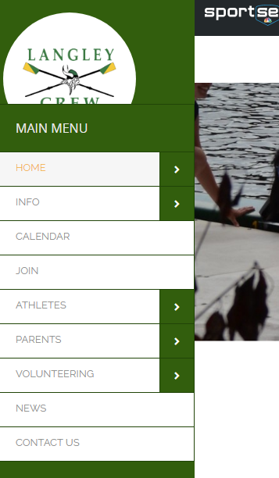

Navigating the Website
Langleycrew.com has nine main topic pages, most of which have subpages, accessible through dropdowns.
Home – the main page and the most urgent information
Support – information on how to support the team financially
New Rower FAQs – Answers to the most common questions asked by new rowers
Parent FAQs – Answers to the most common questions asked by parents
Notes:
You’ll notice that I’ve mentioned the information on the website a lot tonight. As the spring season begins and we get closer to regattas, there will be a lot of things happening. A lot of you are doing this for the first time, and you’ll have a lot of questions. We’re happy to tell you what you need to know, but you will find most of your questions answered on the website.
We’re going to look at what’s on each topic page one by one. Feel free to log in on a separate window and follow along if you’d like.
You’ll notice some subpages are in red – those are the pages that can be accessed through more than one main topic dropdown menu.
The website platform we use is a little clunky, and the designs available are a little outdated, but we try to make it as user-friendly as possible.

Slide 15
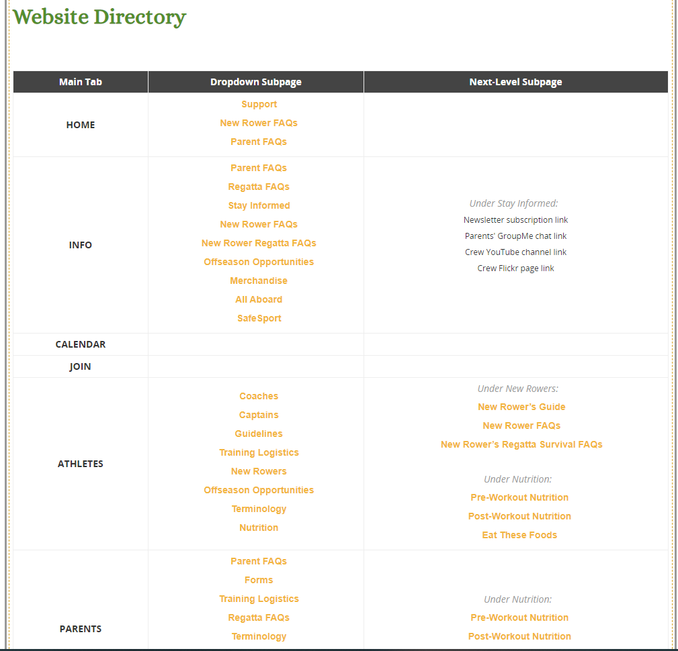
Website Directory
Langleycrew.com has nine main topic pages, most of which have subpages, accessible through dropdowns.
Notes:
You’ll notice that I’ve mentioned the information on the website a lot tonight. As the spring season begins and we get closer to regattas, there will be a lot of things happening. A lot of you are doing this for the first time, and you’ll have a lot of questions. We’re happy to tell you what you need to know, but you will find most of your questions answered on the website.
We’re going to look at what’s on each topic page one by one. Feel free to log in on a separate window and follow along if you’d like.
You’ll notice some subpages are in red – those are the pages that can be accessed through more than one main topic dropdown menu.
The website platform we use is a little clunky, and the designs available are a little outdated, but we try to make it as user-friendly as possible.

Slide 16
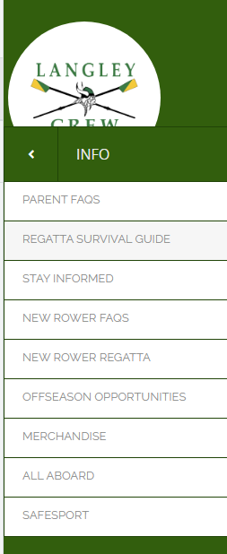
Info – basic information about the crew program
Parent FAQs – Answers to the most common questions asked by parents
Regatta FAQs – Regatta survival guide for parents
Stay Informed – Information on Crew’s social media platforms and messaging forms
New Rower FAQs – Answers to the most common questions from potential and new rowers
New Rower Regatta FAQs – Answers to the most common regatta questions, geared towards rowers
Offseason Opportunities – Information and links about off-season development and competition
Merchandise – information on ordering uniforms and crew merchandise
All Aboard – slide decks from the parent information program are posted here
SafeSport – Information on the abuse prevention program Langley Crew adheres to, including who needs to get fully certified, and how to get the training.
Notes:
The Info tab has information that doesn’t really fit anywhere else.
We are limited to 9 tabs, so it’s sort of the website’s junk drawer. We need to put it somewhere and there’s only so many drawers

Slide 17
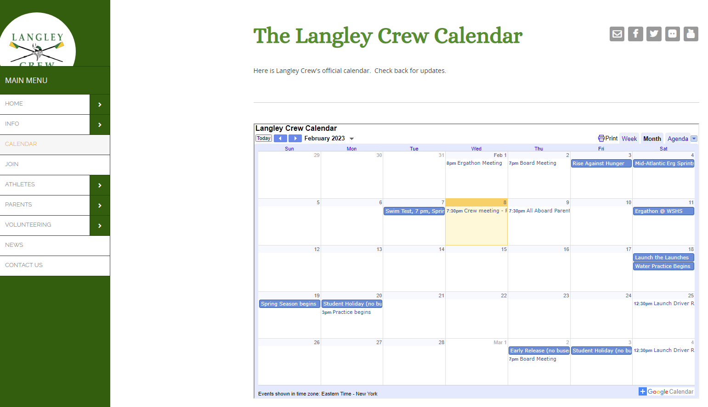
Calendar – the crew calendar, with all events and non-standard practices listed.
Notes:
The calendar is kept updated and includes regattas, meetings, fun events, and days when the buses are not used

Slide 18
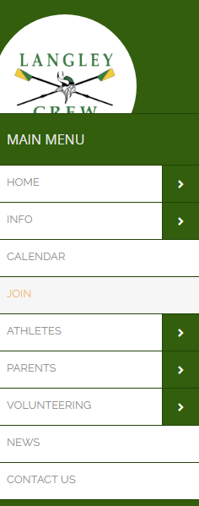
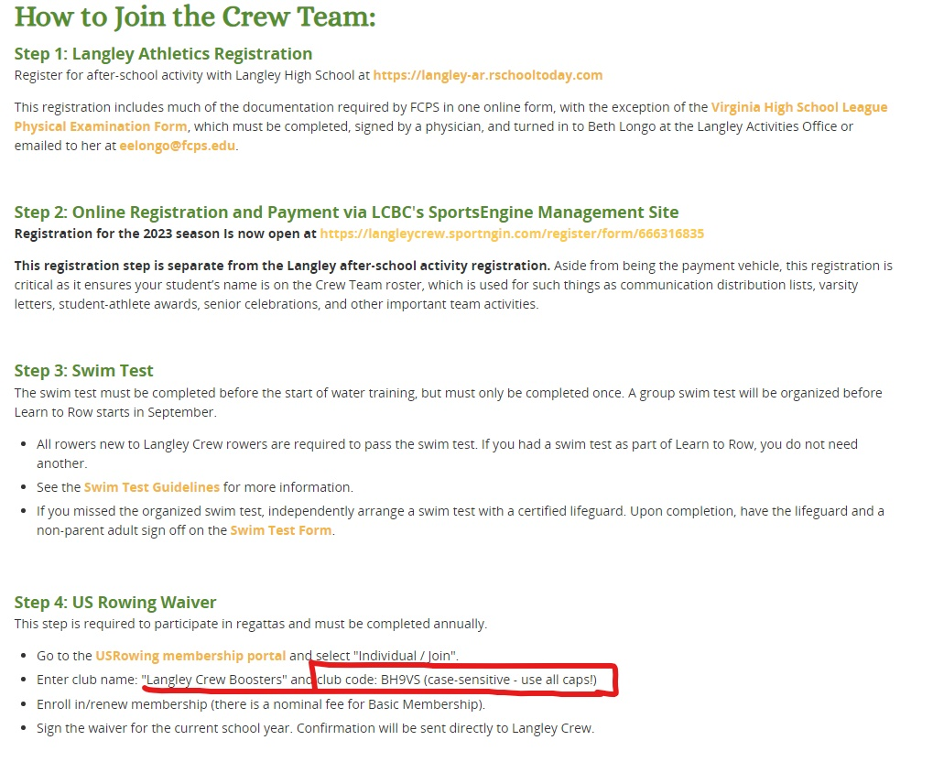
Join – information about the program, instructions on how to join the crew team
Notes:
The Join page has links to the various registration sites and what goes where.
It also has the all-important USRowing club code required to affiliate your rower with Langley Crew, which is required to participate in the regattas.

Slide 19
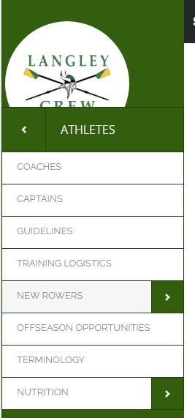
Athletes – Information geared to the student athletes
Coaches – bios
Captains – bios
Guidelines – expectations for the athletes regarding behavior, attendance, etc.
Training Logistics – logistical information for winter and spring training
New Rowers – information targeted to the new rower
New Rower’s Guide
New Rower’s FAQs
New Rower’s Regatta Survival FAQs
Offseason Opportunities – Information and links about off-season development and competition
Terminology – glossary of rowing terms
Nutrition – guidance on proper ways to fuel your body during the season
Pre-Workout
Post-Workout
Eat These Foods
Notes:
All the information under the Athletes tab is directed to the student athlete – new and returning
The New Rower’s Guide is a compilation of the relevant website information geared towards newbies, in one handy location

Slide 20
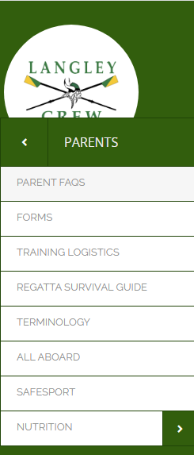
Parents – information geared to crew parents, including the Parent’s Guide to Crew (Crew 101)
Parent FAQs – answers to the most common questions asked by parents
Forms – links to forms and downloadable resources
Training Logistics – logistical information for winter and spring training
Regatta FAQs – Regatta survival guide for parents
Terminology – glossary of rowing terms
All Aboard – slide decks from the parent information program are posted here after the meeting
SafeSport – Information on the abuse prevention program Langley Crew adheres to, including who needs to get fully certified, and how to get the training
Nutrition – guidance on proper ways to fuel your body during the season
Pre-Workout
Post-Workout
Eat These Foods
Notes:
The Parent’s tab is where you’ll spend most of your time, most likely
The Parent’s Guide to Crew (Crew 101) is a downloadable PDF with the information parents need about crew. We’ve consolidated the parent information from the website into one PDF document and posted it on the main Parents page for downloading

Slide 21
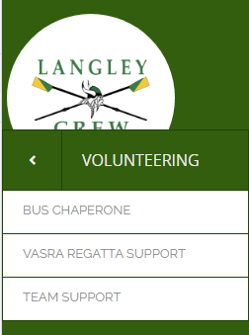

Volunteering – information on the volunteer requirements for each crew family
Bus Chaperone – information on the chaperone duties
VASRA Regatta Support – information on VASRA and brief descriptions of the volunteer roles
Team Support – information on the many ways you can volunteer to support the team
Notes:
Volunteering is how things get done. Here you’ll find descriptions of what is needed to run the program, both for us and for VASRA
VASRA’s full staff is maybe half a dozen people. Everything that happens, happens because the parents make it happen.

Slide 22
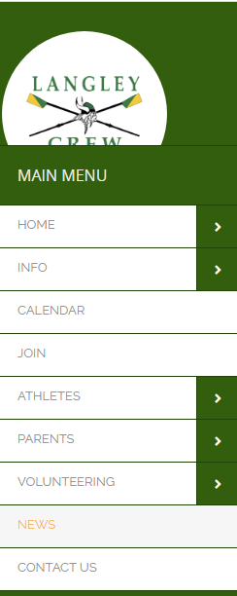
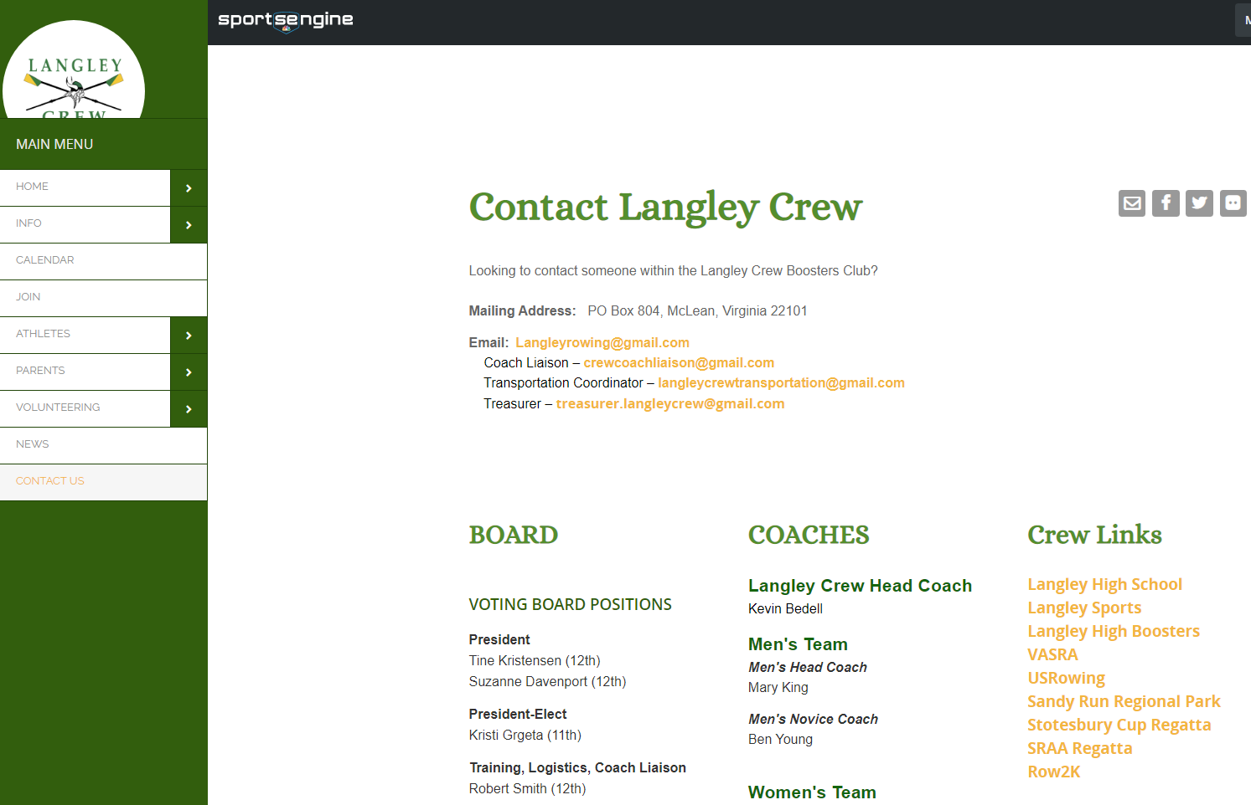
News – Latest news on the crew team’s activities and successes
Contact Us –
list of Board members,
coaches and captains; LCBC contact information;
links to relevant sites, map to Sandy Run

Slide 23
Questions??

Slide 24
Water Practice:
Q: How many times a week are they expected to do water practice?
A: Six days a week, the same as winter conditioning. The only day we don’t practice is Sunday.
Q: Is there a reason why Monday is a good day to schedule possible conflicts?
A: There are a couple, both related to maximizing practice results. First, the coaches spend the first day working on technique drills rather than timing, and watching to see where the timing and synchronization needs to be tweaked. Secondly, it’s the furthest practice from the next regatta, so getting everything synced is less important. Thirdly, if most of the absences are on the same day, the coaches can adjust their plans based on that.

Slide 25
Buses:
Q: If a student is taking the bus to practice but getting a ride home, should they take their stuff off the bus when they get off for practice?
A: Yes. The buses are not required to stay at the park during practice; they just have to be back by 6:45. They usually stay at the park, but not always, and the drivers don’t always stay with the bus. The kids can put their stuff in the workroom or in our area of the boathouse
Q: Are buses assigned or is it first come first served?
A: The large buses are broken out by gender – one for the men’s team, one for the women’s team. If we have more than 110 kids going to practice, the third bus will be the “overflow” bus

Slide 26
Misc:
Q: Is the regatta kick off meeting at school or at the Quan?
A: It will be in the school cafeteria
Q: When and where do we sign up for VASRA volunteering?
A: You can sign up for the regatta support right now by logging in to your SUG account. We’ll post the VASRA workday link on the newsletter and the website this weekend
Q: Is there a link for SafeSport certification on the website?
A: Yes. There is an entire page devoted to SafeSport, including a link to the training.
Q: How do we get on the GroupMe chat?
A: You need to download the app. Once you’ve done that, go to the Stay Informed page and click the link to request to join. Fill in your child’s information and we will approve your request. We do this to make sure the members are all actually crew parents.

