Slide 1

Coaching the 110/100 Meter Hurdles
Building Hurdlers When You Can’t Even See the Track

Slide 2
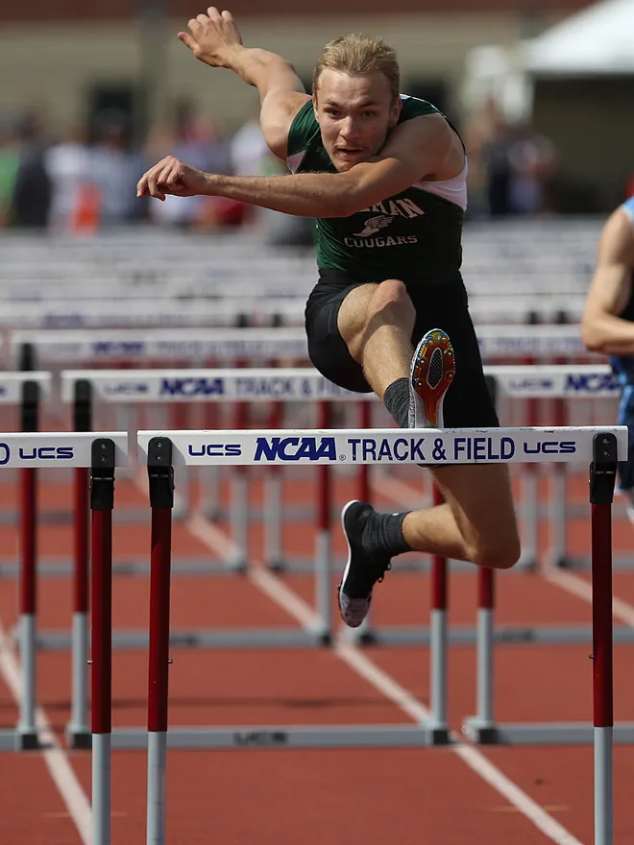
Background
Coleman HS graduate (2017)
9x State place winner
4x Individual State Champion
2x Team State Champion
2016 WISTCA Male Athlete of the Year
Competed at University of North Dakota and Ripon College
Entering 3rd year as Head Coach at Coleman

Slide 3
Who This Is For?
High school hurdlers
Indoor / early outdoor reality
Limited time, big groups

Slide 4
Clinic Roadmap
Early season development
Seasonal programming
Coaching individuals in a group

Slide 5
Early Season Reality & What Matters
Indoor spaces, limited runway, weather conditions
No full hurdles- but real development still happens
Early-season priorities
General conditioning (strength, mobility, coordination)
Rhythm
Mechanics
Ground contact
Height and speed come later

Slide 6
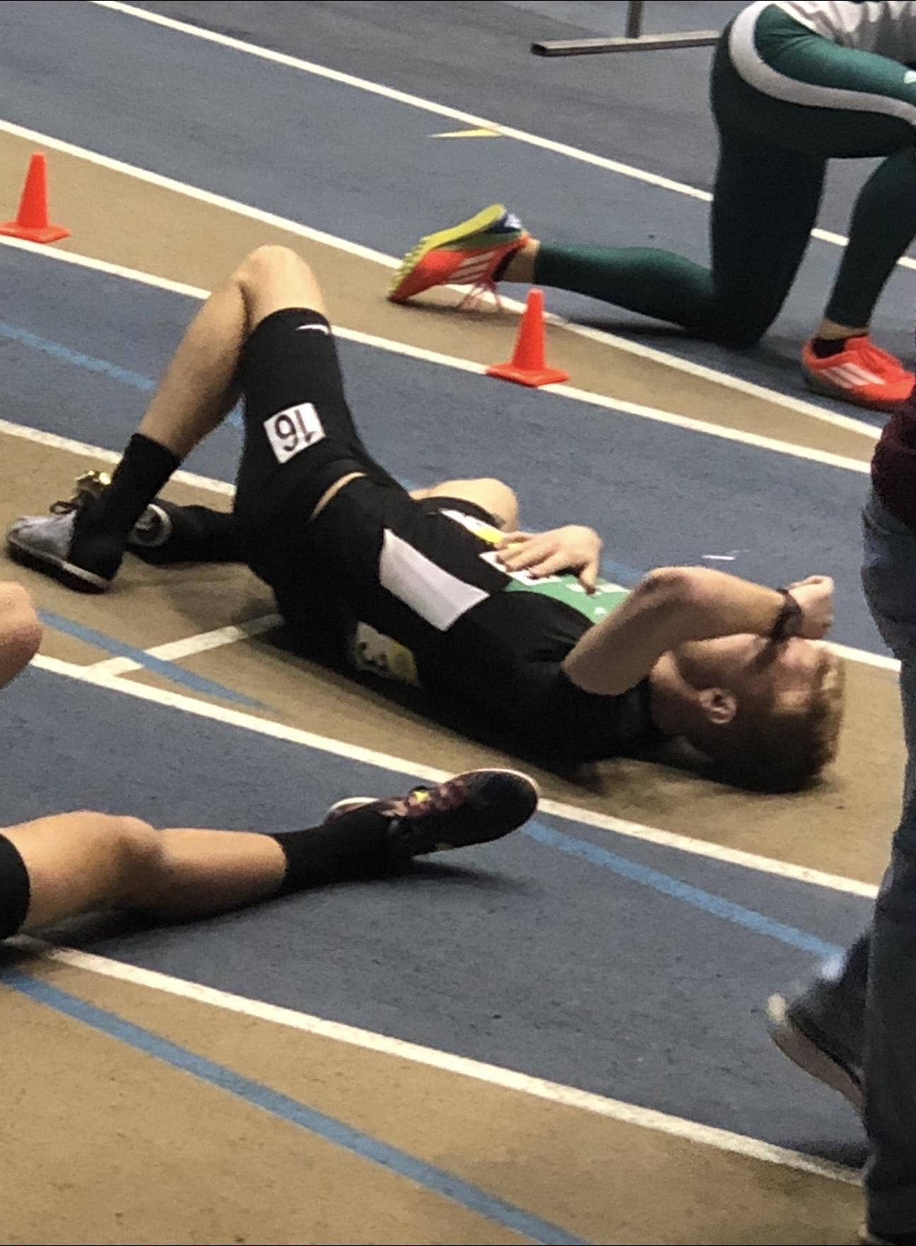
General Conditioning
Strength: body weight and core exercises
Mobility: Hips
Coordination and agility
2-3 sessions per week

Slide 7
Rhythm Before Speed
3- Step rhythm is more important than perfect positions
Teach cadence indoors before adding speed
Focus on feeling the motion, not rushing it

Slide 8
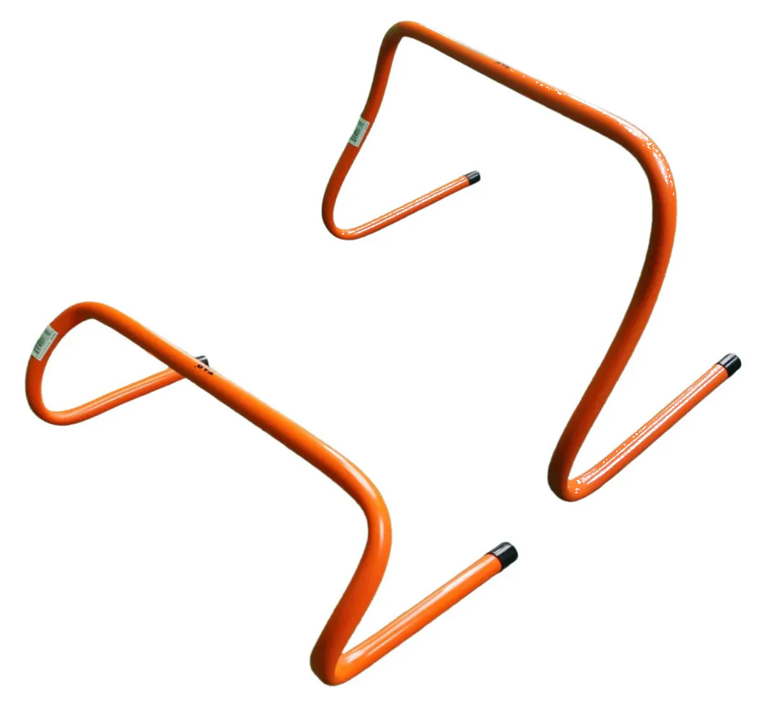
Rhythm Before Speed
Mini hurdles or tape marks for timing
Spacing 3-4 steps for most athletes; adjust per athlete
Focus on feeling the rhythm, not speed
Repeat 4-6 time, emphasize consistent cadence

Slide 9
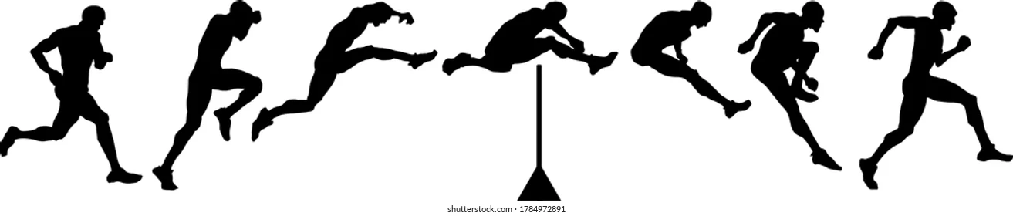
Mechanics Overview / Goals
Lead leg: attack efficiently, foot under hips
Trail leg: quick, narrow recovery
Proper mechanics = smooth, efficient hurdling
Technique first, speed later

Slide 10
Lead Leg
Attacking the hurdle efficiently
Foot lands under hips
Knee drive
Arms
Upright posture

Slide 11
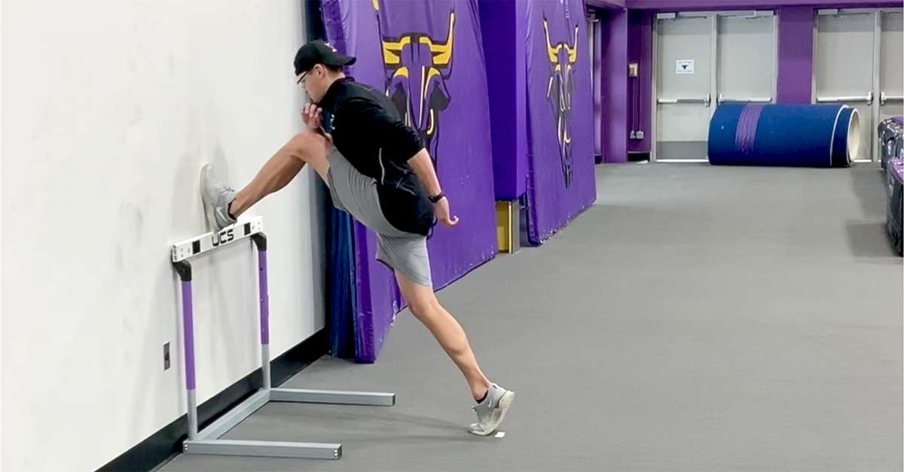
Lead Leg drills
Wall drill
Side drill

Slide 12
Trail Leg
quick , narrow recovery
Hip-driven motion, not knee-led
Maintain rhythm with lead leg / arms
Smooth, controlled motion

Slide 13
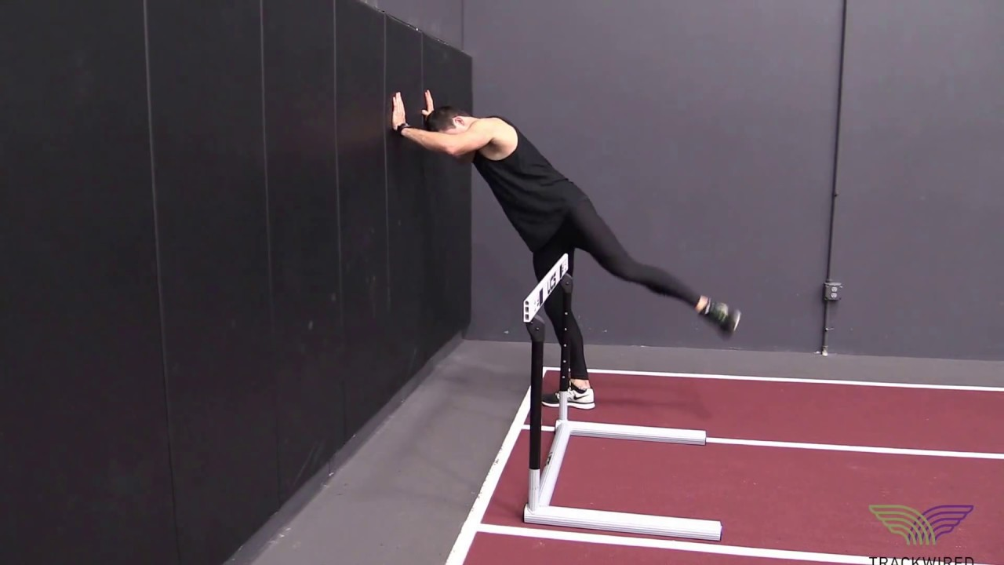
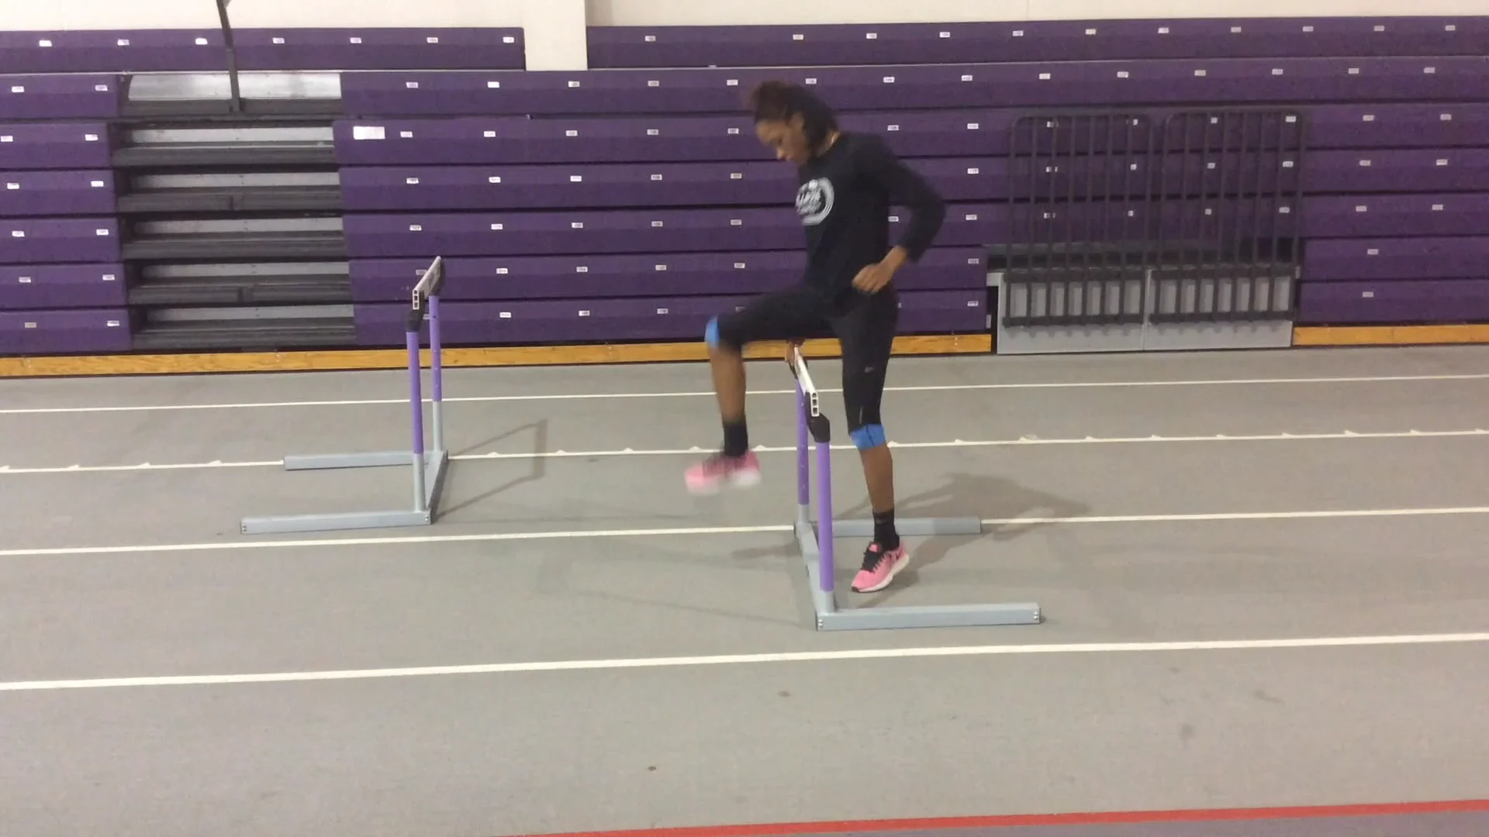
Trail Leg Drills
Wall drill
Side drill
Over the top rocking drill

Slide 14
Ground Contact
Minimize time on the ground going into and after the hurdle
Strong, quick push off for lead leg
Efficient landing and recovery for trail leg
Maintain rhythm and balance

