Slide 1


Rick Daniel
CAHA President
Graham Bundy
CAHA Vice President
& Discipline Chair
Matt Hurley
CAHA Board Member
& SafeSport Coordinator
Brad Hoffman
Executive Director, CAHA

Slide 2
USA Hockey & You
Coaching Certification
Rules & Discipline
SafeSport
Modern Practice Planning Concepts & Examples

Slide 3



H
O
C
K
E
Y
S
T
R
U
C
T
U
R
E
National Governing Body with US Olympic Committee oversight
Districts – Coordination of National Strategies & Policies (12 districts)
Affiliate – Enforcement of National Goals, Rules and Priorities (34 affiliates) and supporting Associations with programs and funding
Your Association – Who you play with and for (Polar)
Your Association

Slide 4




Invests in Safety for Players
USA Officials & Coaching Hockey Certification
USA Hockey SafeSport
Certification, Locker Room Monitors
USA Hockey/Affiliate Background Screening
USA Hockey Supplemental Insurance
Neck Guards, Mouth Guards, Helmets, Body Checking, Rules & Policies

Slide 5

Certifies & invests in your Coaches
USA Hockey Coaching Education Program
Levels 1-5 – certified every year
USA Hockey Age Specific Modules
8U – 18U
USA Hockey SafeSport Certification
Initial Class with recertification every year
Affiliate Background Screening by reputable third party
Required to renew every other year
Positive Coaching Workshops
Recommended

Slide 6

Invests in your Officials
USA Hockey Certification
Level 1 – 4
USA Hockey SafeSport Certification
USA Hockey/Affiliate Background Screening
NO OFFICIALS = NO GAMES
Very high turnover of youth hockey officials due to abuse from parents & coaches

Slide 7

Coaching Requirements
USA Hockey Certification
Level 1 – 4
USA Hockey SafeSport Certification
USA Hockey/Affiliate Background Screening
USA Hockey/Affiliate Background Screening
Age Module

Slide 8
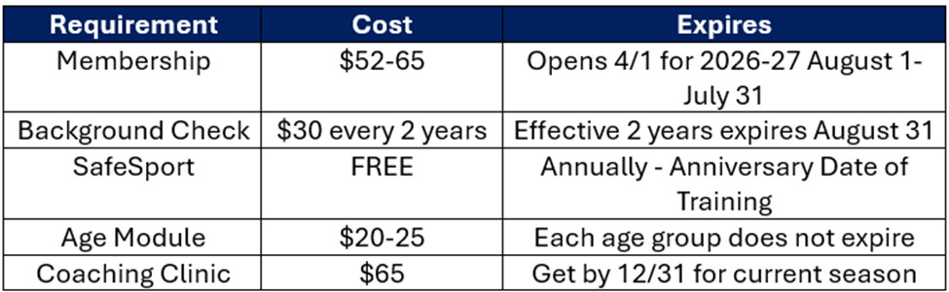
Coaching Requirements

Slide 9
Insurance Coverage for Coaches
Excess Accident Coverage
Catastrophic Coverage
Liability Coverage

Slide 10
What risk if coach isn’t certified?
No Coaching Education
No age-appropriate training
No background check
No Safesport Training on bullying, sexual abuse, hazing, etc.
Not subject to USAH Discipline
Player USAH insurance coverage at risk

Slide 11



Discipline Updates
“GAME MISCONDUCT”
suspension of a player or Team Official for the balance of the game with immediate substitution taking place on ice. A player or Team Official incurring a game misconduct penalty shall also be suspended for the team’s next game….the game the penalty occurred in does not count.
“MATCH” penalty involves the immediate removal of a player or Team Official for the balance of the game and a five-minute time penalty, or the designated match penalty time, shall be assessed. A player or Team Official incurring a match penalty shall be suspended from participating in all USA Hockey activities until their case has been heard.

Slide 12
Discipline Updates
Suspensions for Fighting (Rule 615) - player is assessed a major and game misconduct penalty for Fighting (Rule 615), they are subject to the following progressive discipline:
First Offense: 2 game suspension,
Second Offense: 6 game suspension
Abuse of Officials (Rule 601d) - should the Abusive Conduct occur in a game where any of the assigned game officials are 17 or younger, the stated penalties (game misconduct, suspensions) shall double, regardless of whether the abusive conduct is directed at any official 17 or younger. This applies to coaches, players, and spectators.

Slide 13
Discipline Updates
Twelve (12) or More Penalties in a Game (Rule 401 (b)) Automatic CAHA Discipline - whereas a team is assessed twelve (12) or more penalties during one game, they are subject to the following progressive discipline:
First Offense - Head Coach will serve the one (1) game suspension mandated by USA Hockey.
Second Offense - Head Coach will serve the one (1) game suspension
Any Match Penalties assessed under Rule 601(e.1) (Physical Assault of Official) and Rule 601(e.3) Uses language that is hateful or discriminatory in nature: Any hearing resulting from a match penalty assessed under either of these rules shall reside with the Affiliate

Slide 14
Discipline Updates
Locker Room Monitor Automatic CAHA Discipline - for no locker room monitors in any USA Hockey event (game, practice, off-ice):
First Offence: Automatic $500 fine payable by the Association to CAHA and automatic 2-game suspension of head coach
Second Offence within the same season: Automatic $1000 fine payable by the Association to CAHA and a mandatory discipline hearing that may include discipline up to and including permanent suspension from all USA Hockey events for the Head Coach and the President of the Association

Slide 15
Discipline Updates
Spectator Policy: Any participant attending a sanctioned USA Hockey event removed from the venue by a USA Hockey official, security personnel, facility personnel, or Association personnel over a period of two consecutive seasons will be subject to mandatory suspension from ALL USA Hockey events for the following periods:
1st offense automatic 30-day suspension from all events involving the Association and may be subject to additional supplemental discipline review as determined by the association/CAHA based on the event.
2nd offense, automatic 60-day suspension from all events involving the Association and required hearing with the CAHA Discipline committee subject to additional supplemental discipline up to and including permanent lifetime suspension from all USA Hockey events.
Note: If an Official 17 years old or younger is officiating the game where the incident occurred, the fines and suspensions will be doubled. This is regardless of whether the behavior was directed at the Official 17 years old or younger or not.

Slide 16
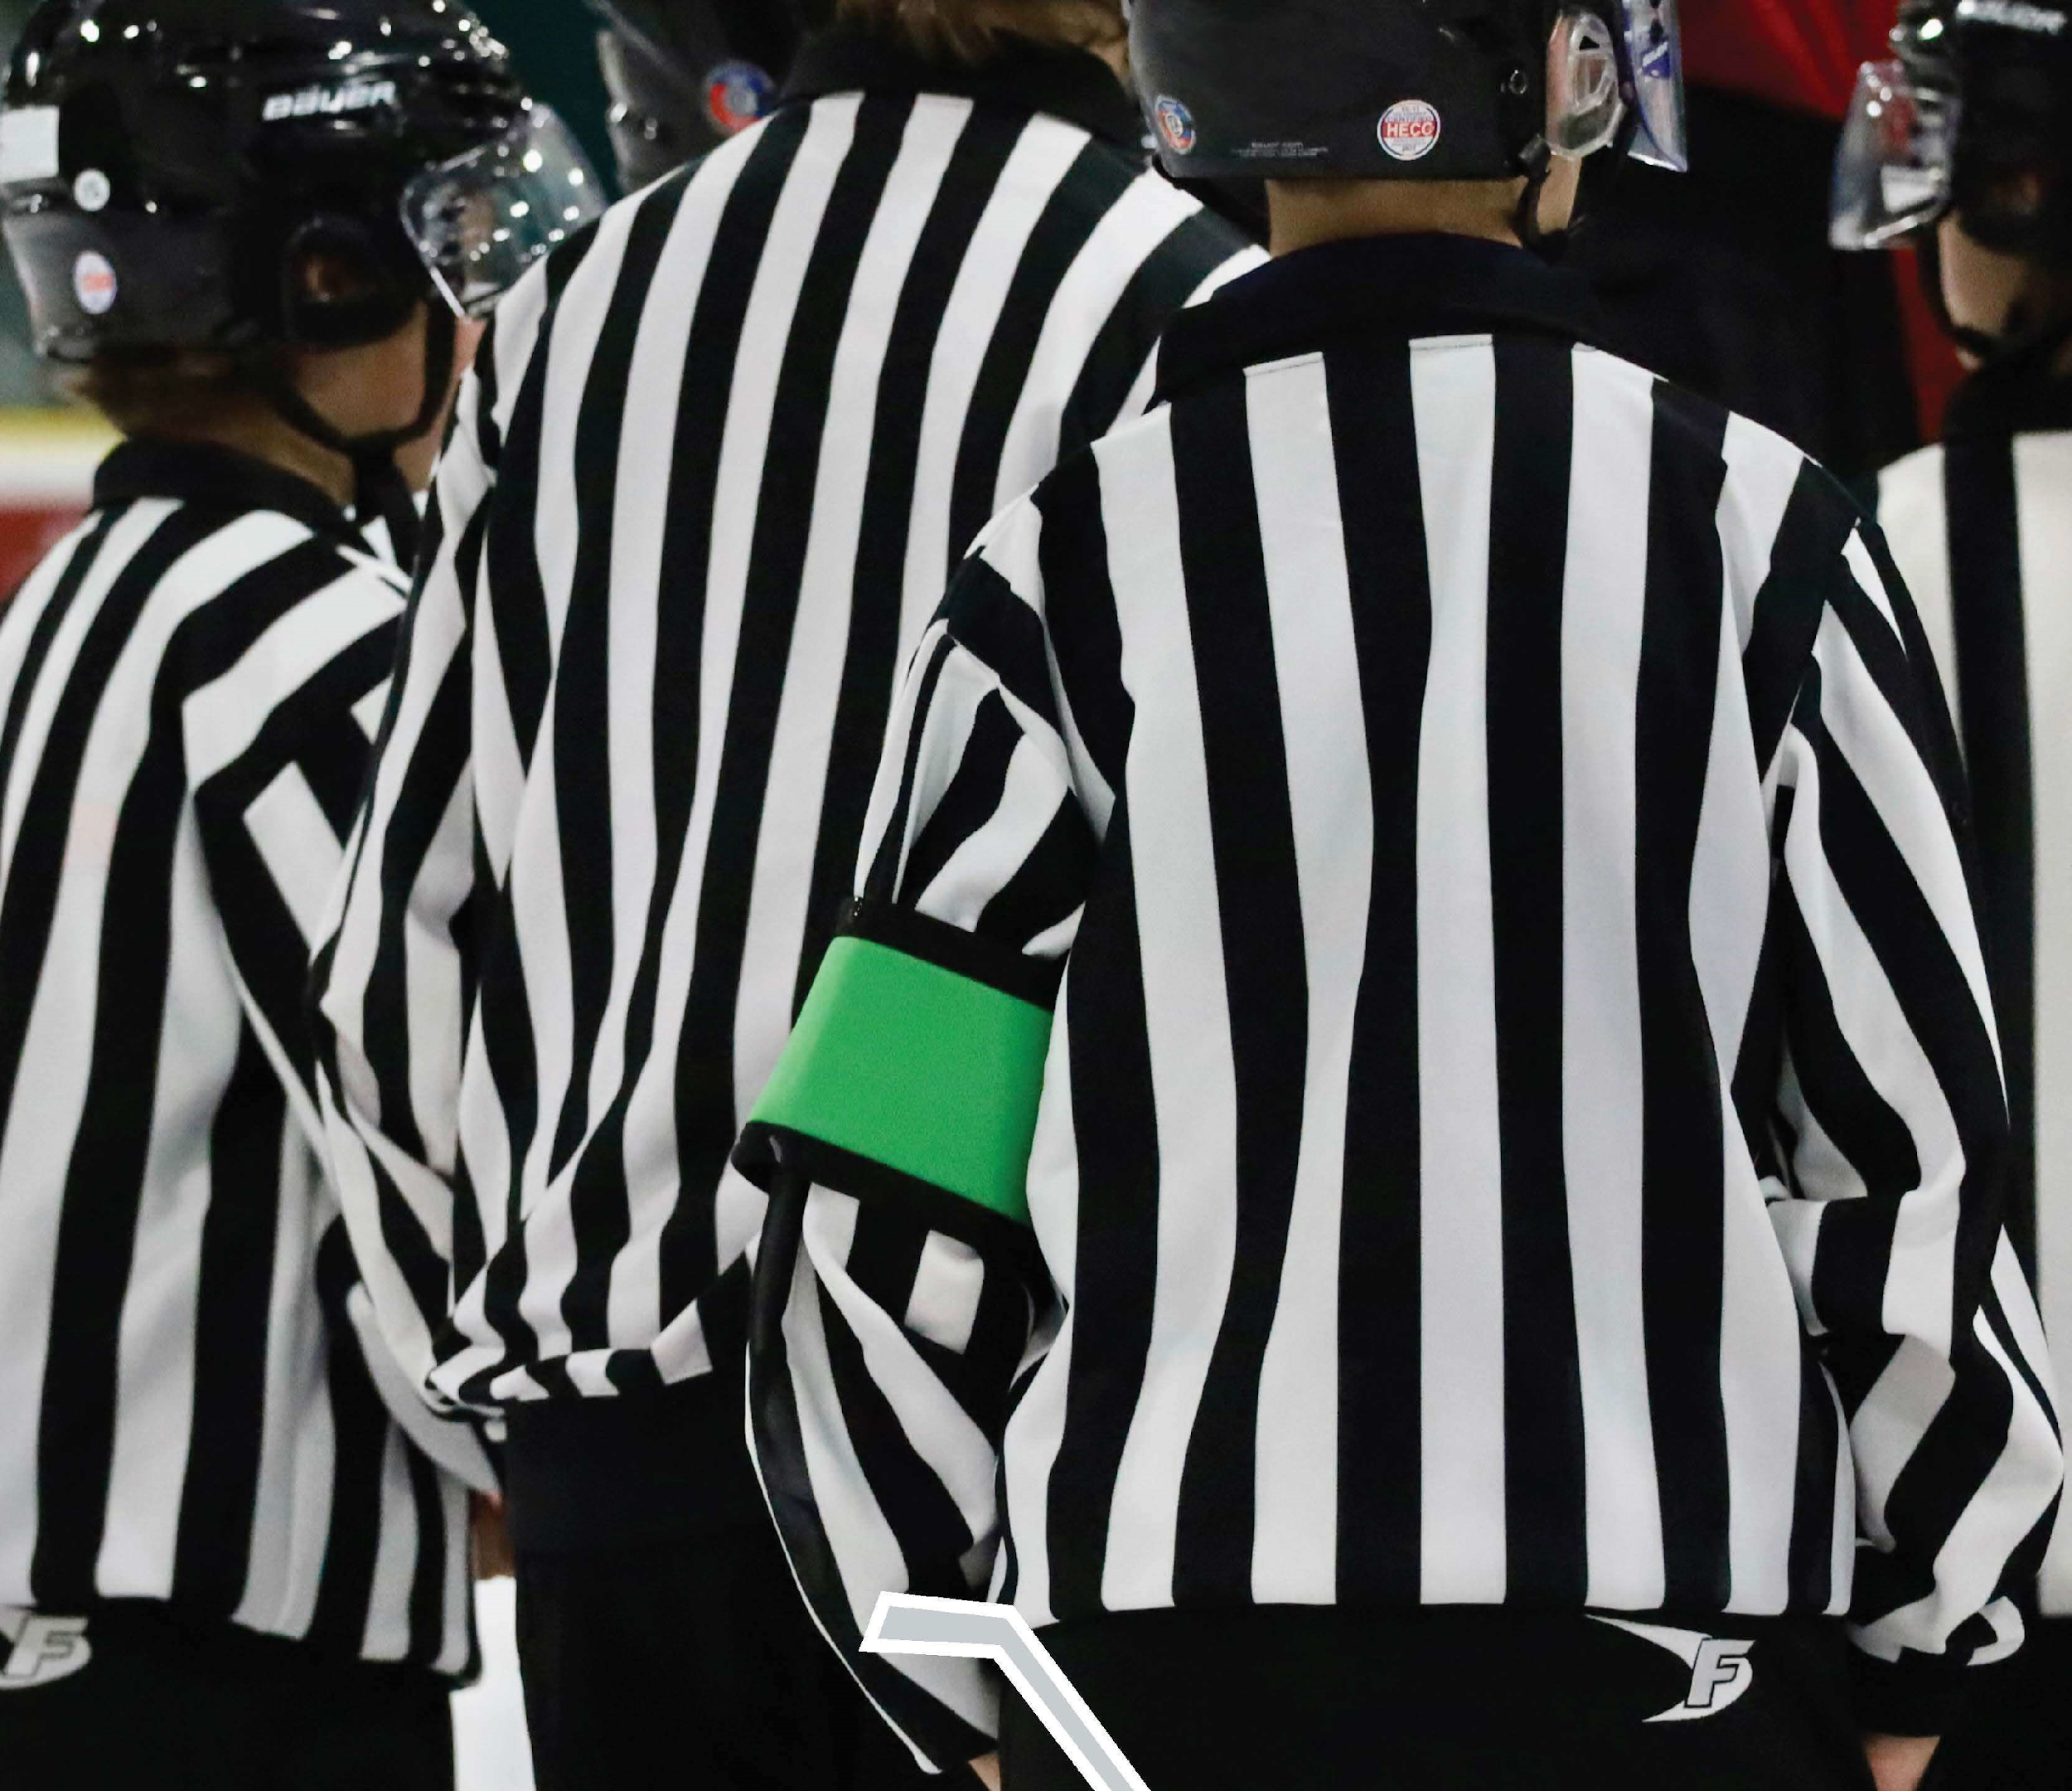
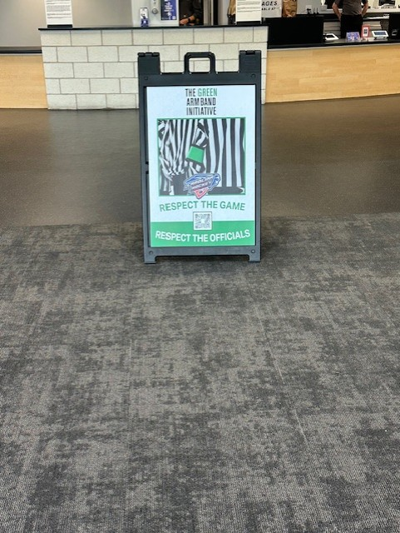
Green Armband Initiative
The Green Arm Band Initiative aims to enhance the safety and development of young (17 and under) ice hockey officials by clearly identifying them on the ice. Increase awareness that certain officials are minors. Not a reflection of experience, only of age.
Encourage respect and appropriate behavior from players, coaches, and spectators.
Reduce verbal abuse and intimidation of young officials.
Create a safer and more supportive officiating environment to improve retention.
Provide a visual cue for coaches, players, and spectators to exercise greater patience and understanding.

Slide 17

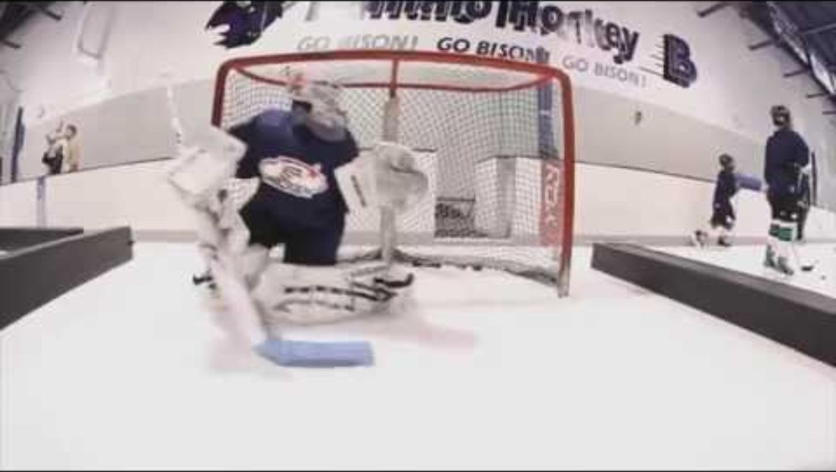

Slide 18
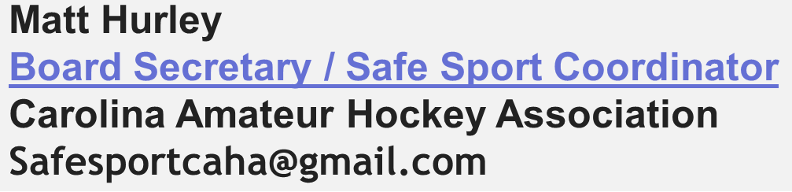
The USA Hockey SafeSport program was developed to give all participants (and their parents) confidence that they are playing our sport in the safest possible environment, both on and off the ice.
USA Hockey has implemented policies addressing certain types of abuse and misconduct, and certain policies intended to reduce, monitor and govern the areas where potential abuse and misconduct can occur.

Slide 19
What Topics Does SafeSport Address?
YES NO
Sexual, Physical and Emotional Abuse
Bullying, Threats and Harassment
Hazing
Locker room, social media, and travel guidelines
Coaching Style
Structure/Plan of Game Play
Distribution of Playing Time
Player Position Assignments
Disputes between parent/player expectations and coaches' expectations
Incidents that occur outside the realm of USA Hockey activities (i.e. neighborhood, school, etc.)

Slide 20
KEY POINTS
Safe Sport applies to ALL participants: parents, players, coaches and community members.
Players should not enter a locker room until a coach/locker room supervisor is present.
NO electronic devices are allowed in locker rooms (i.e. ipads, phones, cameras, etc.).
NO one-on-one contact.
NO text messages, snapchat etc messages from a coach to a player. Parents or Guardians must be included in the messages.
Any misconduct on the part of a participant/s that violates these guidelines will be reported immediately and investigated.
Misconduct that allegedly violates any legal statute (i.e. sexual abuse) will immediately be referred to local law enforcement agencies and the Department of Social Services which would have primary jurisdiction. Safe Sport involvement will be suspended pending the outcome of the local law enforcement’s investigation.
A report made in “bad faith” may result in disciplinary action for the participant filing the allegation. Abuse of Process is strictly prohibited.

Slide 21
REMEMBER!!
Abuse or misconduct is not limited to interactions between coaches and their players.
Watch for abuse or misconduct among players and ensure that participants are being safe and respectful of one another at all times (locker room, parking lot, lobby, etc.).
Guidelines apply to all participants within the association, even those who are not directly involved in the coaching or playing of the game. CAHA has a spectator policy.

Slide 22
WHO MUST BE SAFESPORT TRAINED?
Coaches
Volunteers
Managers
Locker Room Monitors
Players turning 17 years old during the playing season

Slide 23
POTENTIAL CONSEQUENCES
Temporary Suspension
Permanent Suspension
Removal from all USA Hockey events
Referral to law enforcement authorities
Legal charges
Permanent criminal record

Slide 24
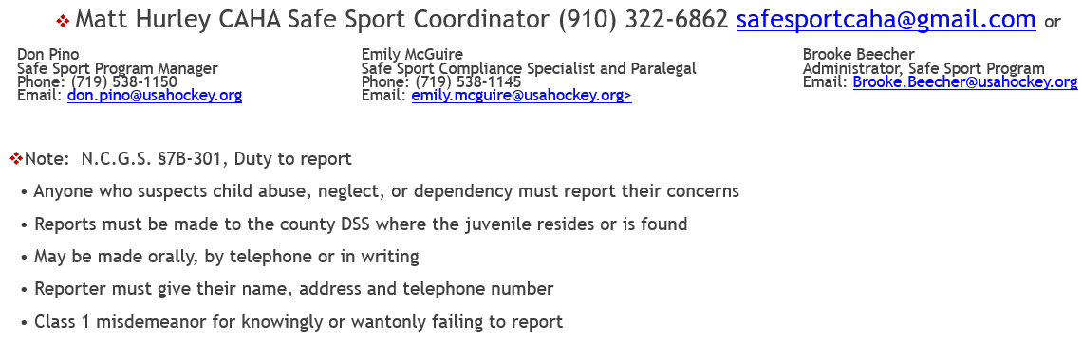
CONTACTS

Slide 25
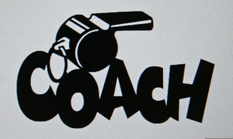
I’m a coach….
what now?!?

Slide 26
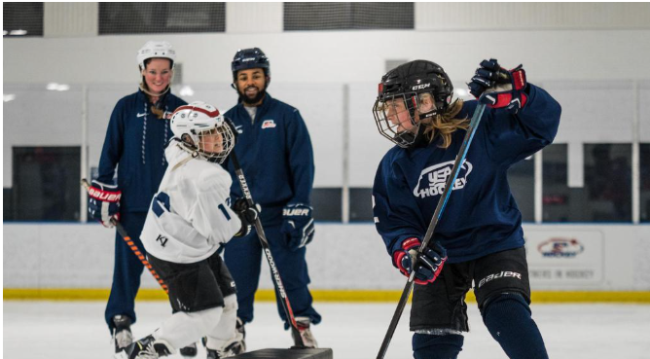
Why Do You Coach?

Slide 27

What’s important?
RESPECT
RULES
OFFICIALS
OPPONENTS
TEAMMATES
SELF
It’s how much you CARE not how much you KNOW that counts to the kids

Slide 28
If you SHOW you care, you
are already a great coach
You ARE a role model
Learn their names
Enthusiasm - fake it until you make it
Engage with each one every practice and game
EVERY kid has value as a person – look for it
Learn about them – pre-season questionnaire
Play ALL the kids ALL the time
Safe environment
Winning is 10% of the goal
Understand your biases

Slide 29
PLAYER SAFETY:
you owe it to them
Equipment fits
Neck Guards – no exceptions
Locker Room Monitors – Be there
Safe from bullying, emotional & physical abuse
Fulfill Coaching Requirements

Slide 30
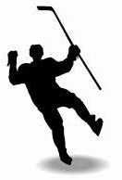
Let’s talk about developing hockey players
Notes:
Looking at hockey players, what is the average age they reach their peak? Ask the group for their ideas. OK….lets look….

Slide 31
What is the age that a hockey player reaches their peak?
Notes:
Looking at hockey players, what is the average age they reach their peak? Ask the group for their ideas. OK….lets look….

Slide 32
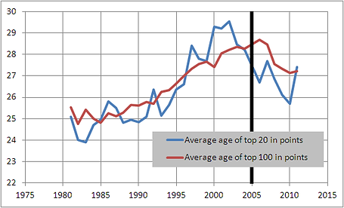

28
Source: sbnation.com
It takes a LONG time to reach your peak
Notes:
26 is the average age for peak development. This is one chart that shows this but there are many more. Its about 25-27 or average of 26. So what does this mean for you and your child?

Slide 33
28
How many years
until the group
you are coaching
reaches their peak?
Source: sbnation.com
It’s a long process…
Notes:
26 is the average age for peak development. This is one chart that shows this but there are many more. Its about 25-27 or average of 26. So what does this mean for you and your child?

Slide 34
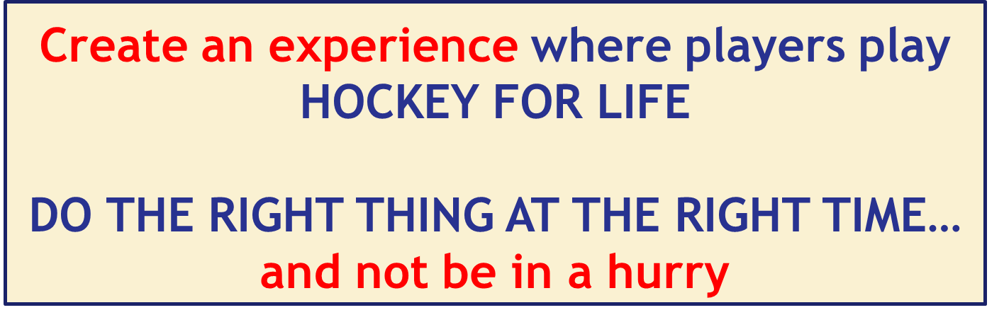
Long-Term Athlete Development is the foundation of learning & development
The Long-Term Athlete Development (LTAD) model is an athlete-centered framework that uses training, competition, and recovery depending on the participants stage in their athletic development. Age-specific stages of development.
Notes:
So what is LTAD and how might you think about it as a parent?
It is an athlete-centered framework that uses practice/training, competition, and recovery depending on where the child is in their stage of development.
Defines 7 stages and this helps to develop athletes to their individual potential and it helps to improve sports programs.
KEY POINTS include gradual improvement, individual focus, programs for individual, and helps coaches.
2 takeaways – Create the experience so they develop and keep playing, do the right thing at the right time and not be in a hurry. Details…

Slide 35
AGE-APPROPRIATE
Kids Are NOT Little Adults
Kids don’t make the NHL at 8U or 10U but
they can quit the sport entirely

Slide 36
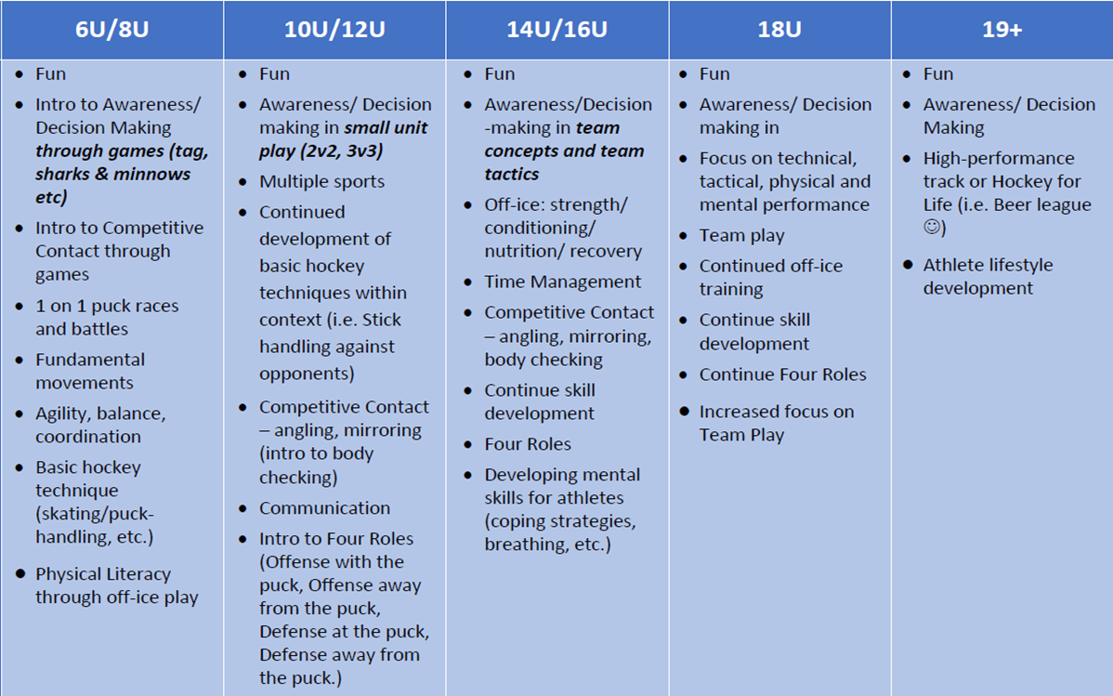











Right Thing at the Right Time: Concepts not Systems
TOO SOON
F
U
N
D
A
M
E
N
T
A
L
S
Once a player has some skill competency, introduce game complexity and learning
skills in context

Slide 37

How to Create the Best Learning Environment for
your Players
Developing players as hockey GAME players

Slide 38
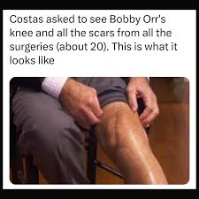
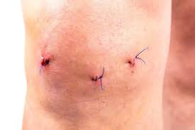
Modern Coaching Concepts
“Always done it this way”
vs adopting new methods
WHICH DOCTOR WOULD YOU HAVE OPERATE ON YOUR KNEE TODAY?

Slide 39
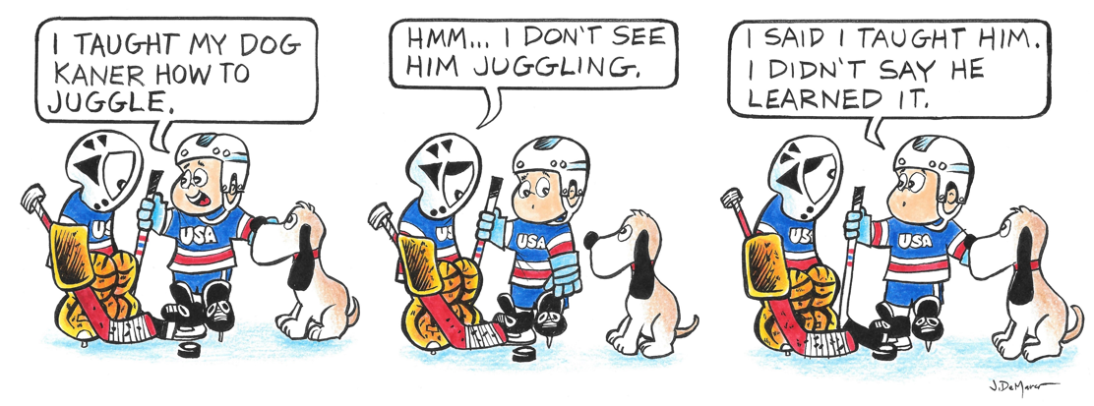

What is Learning?
PRACTICE
GAME

Slide 40
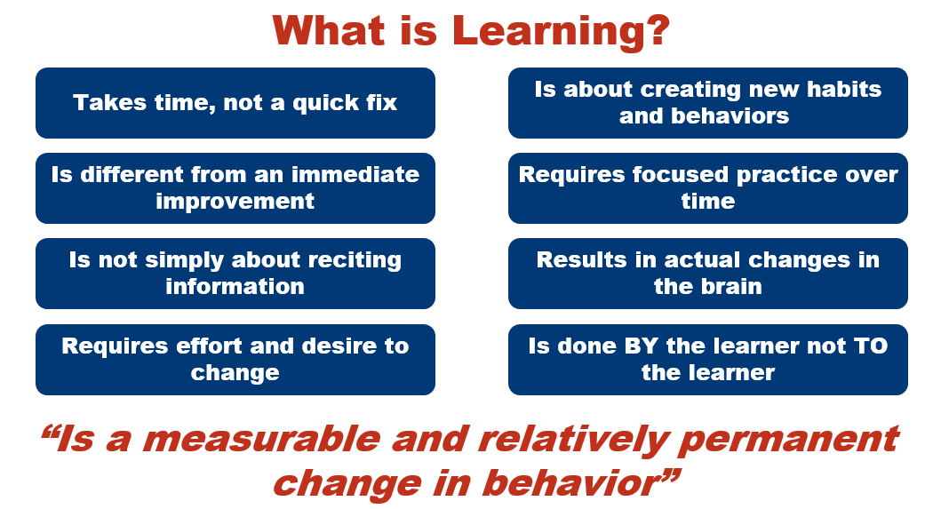

Slide 41
HOW KIDS LEARN
THE ENVIRONMENT IS
ALWAYS THE BEST TEACHER
Triggers and Cues in the game determine what decisions are made to take action to solve game problems.
Coaches create the environment where the kids can experience and learn
“All great players are great jugglers of the ball,
but all great jugglers of the ball are not great players”

Slide 42
5 Steps to create the best learning environment

Slide 43
Be Intentional with Practice & Activity Design
Start with the end in mind – set specific learning objectives for practice & each activity
Identify the game problem or what you want players to learn
Analyze the underlying issues
Design practice environment/activity to address the underlying issues
Reflect on what went well and what needs to improve

Slide 44
Specific Learning Objectives: goal of each practice and activity > Is it age-appropriate? > does it apply to the game? > What do we want them to learn?
1
Begin with the end in mind

Slide 45
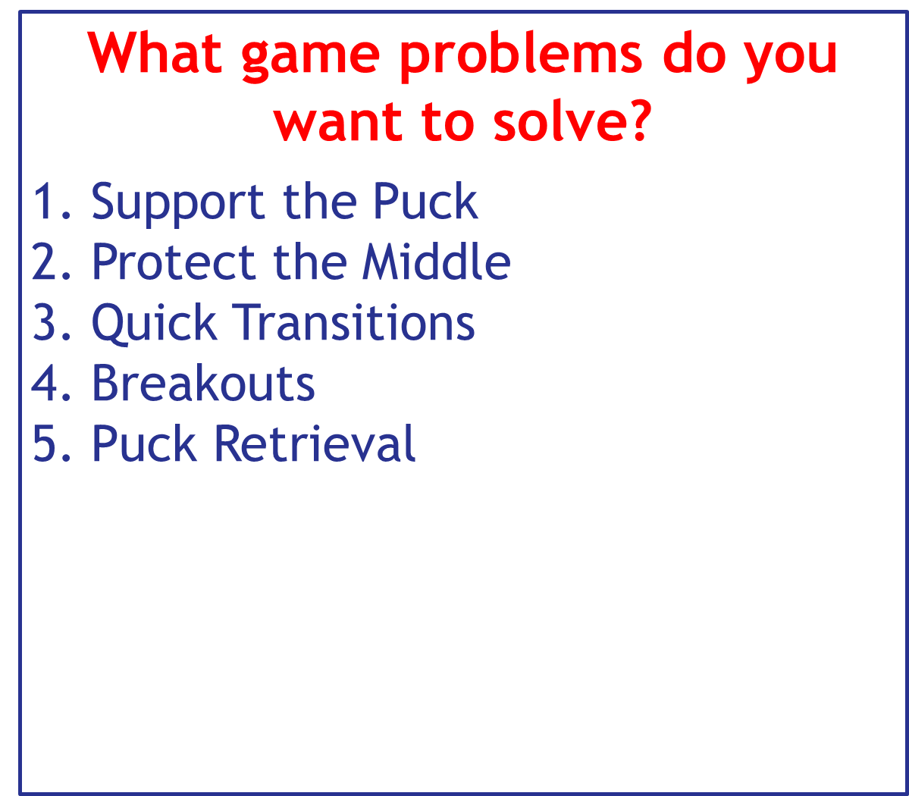
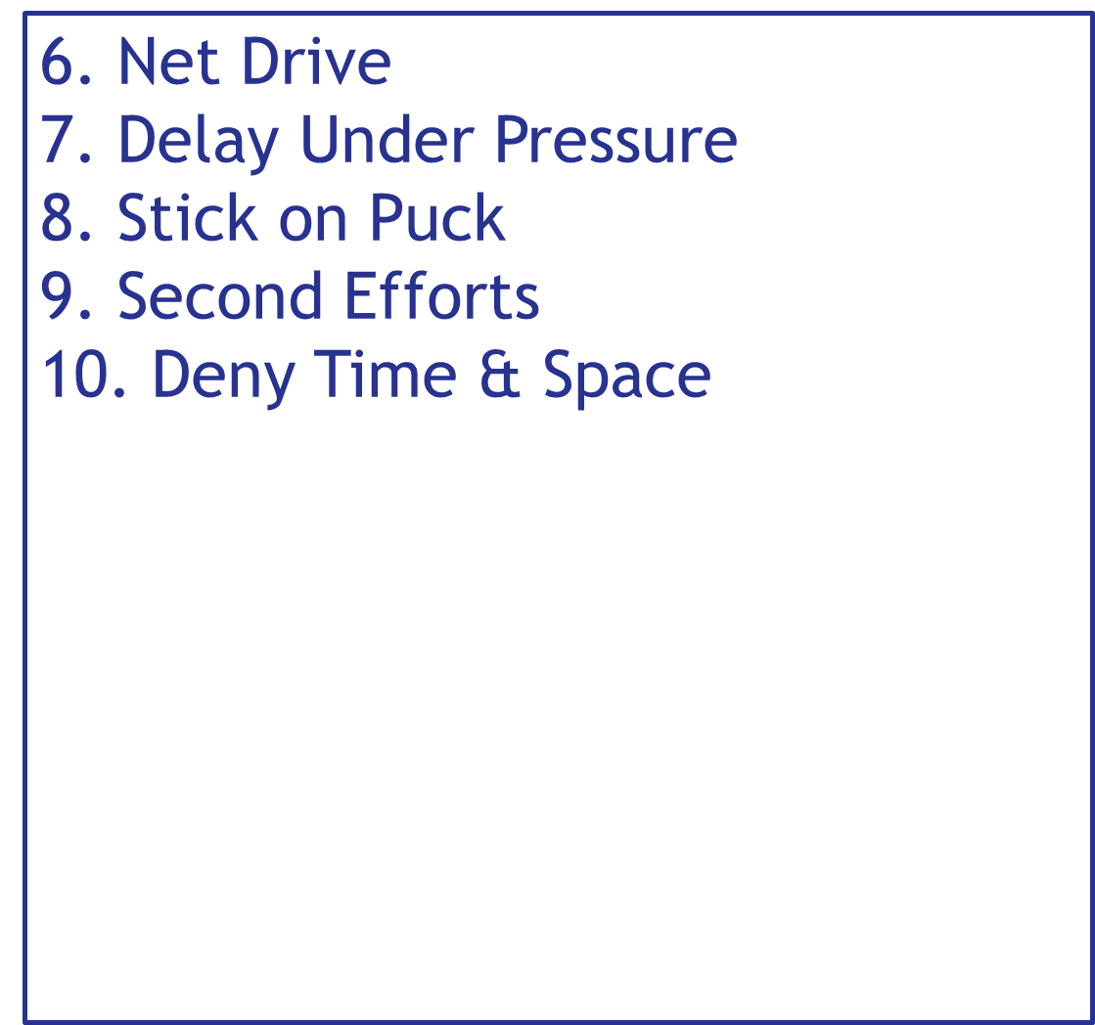
2
What Game problem are
we trying to solve?

Slide 46
3
What are the Underlying issues?
What is the game telling us?
What cues are we responding to successfully or not?
Examples
Supporting the Puck – players are standing still after passing, players too tight together or too far apart, F1-F2-F3 concepts
Getting beat to pucks – awareness, scanning, transitioning quickly, skating, body position
Not passing to open players – can’t stickhandle with head up, awareness, scanning, confidence, going to open space
Can’t breakout – getting to open space, body position, skating, passing, catching a pass, puck protection

Slide 47
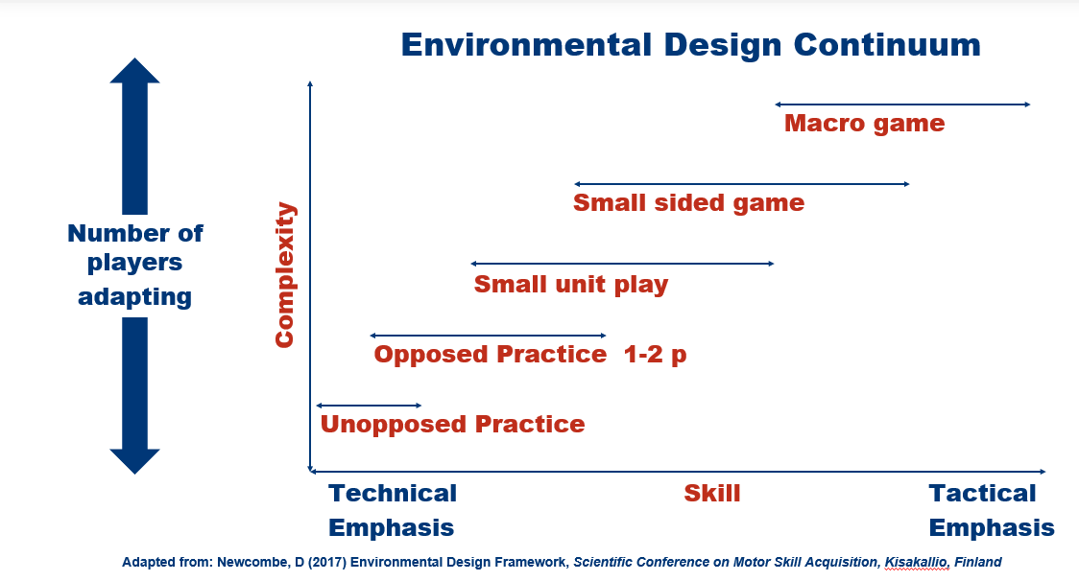
Select Activities Select the type of activity to maximize the learning
4
What drill type you use depends on desired outcome:
Unopposed (blocked) drills are best for early technical skill acquisition (ie skating, passing)
Increasing complexity results in greater skill acquisition – drill with opposition (ie edgework while evading opponent in a drill)
Moving up to small unit play (ie 2v2 in tight spaces) increases skill acquisition
Next level is small game (ie 3v3 in small game w/focus on evasion and puck protection)
The game is final step
REGRESS PROGRESS

Slide 48
BEST LEARNING ENVIRONMENT
BLOCKED vs RANDOM DRILLS
Blocked drills are repetitive, have pre-determined paths and outcomes, very little decision making and a narrow focus of awareness (meaning they don’t have to scan and read the environment).
Random drills mean not doing the same thing twice - an unpredictable environment for kids where they are not aware of the solution or decision that needs to be made before they perform the technique.
IN A GAME: DO CONES DEFEND?
ARE THERE OPPONENTS ON THE ICE?

Slide 49
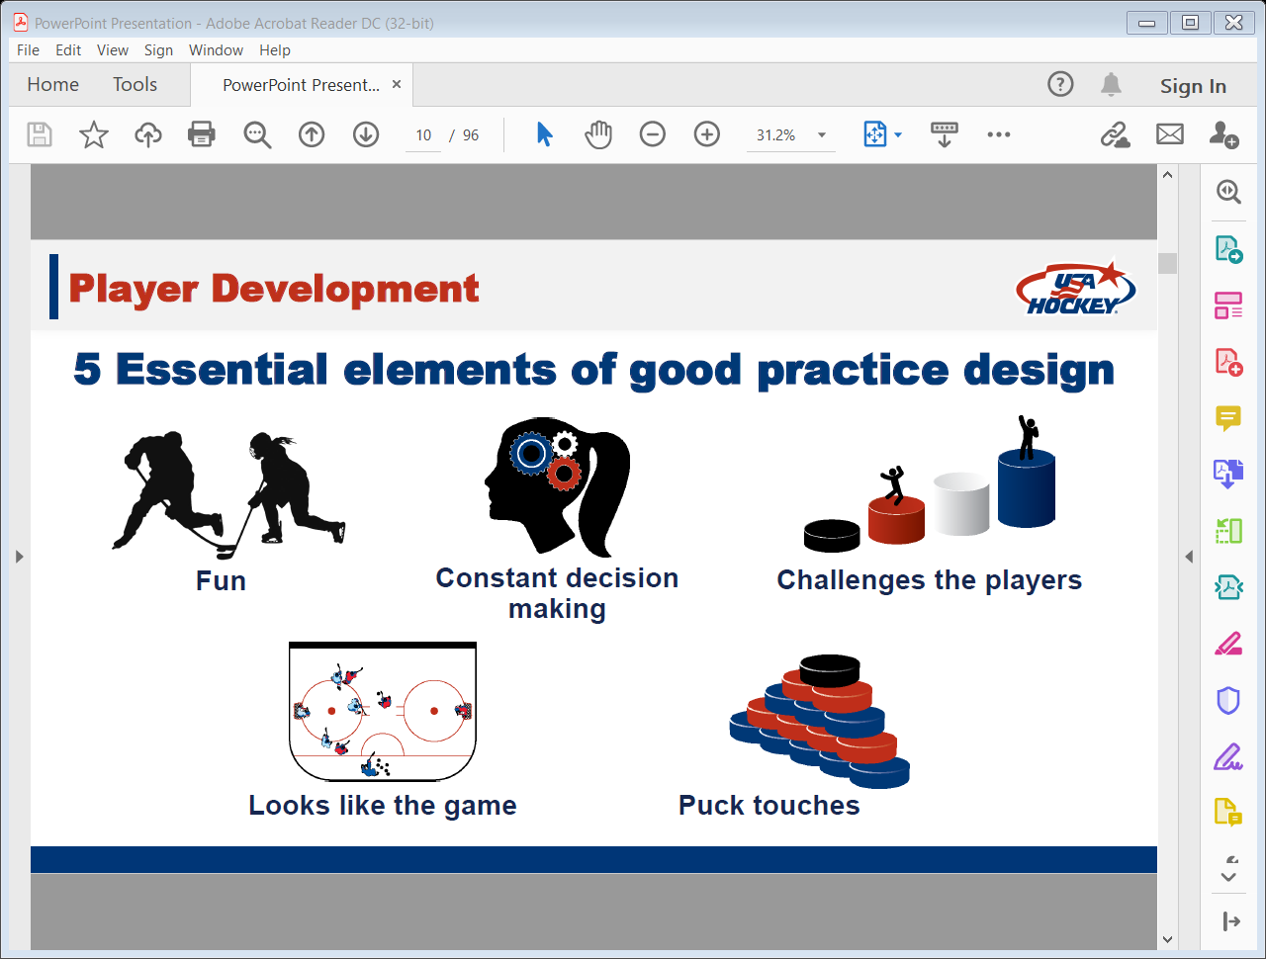
5
Check if activities include 5 Elements
of Good Drill & Practice Design

Slide 50
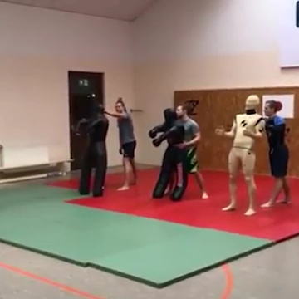
Environment matters

Slide 51
What do the 5 Elements
Look Like?

Slide 52
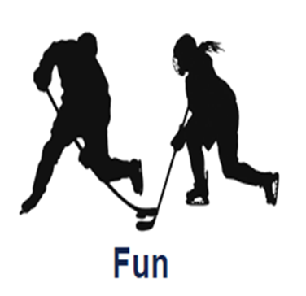
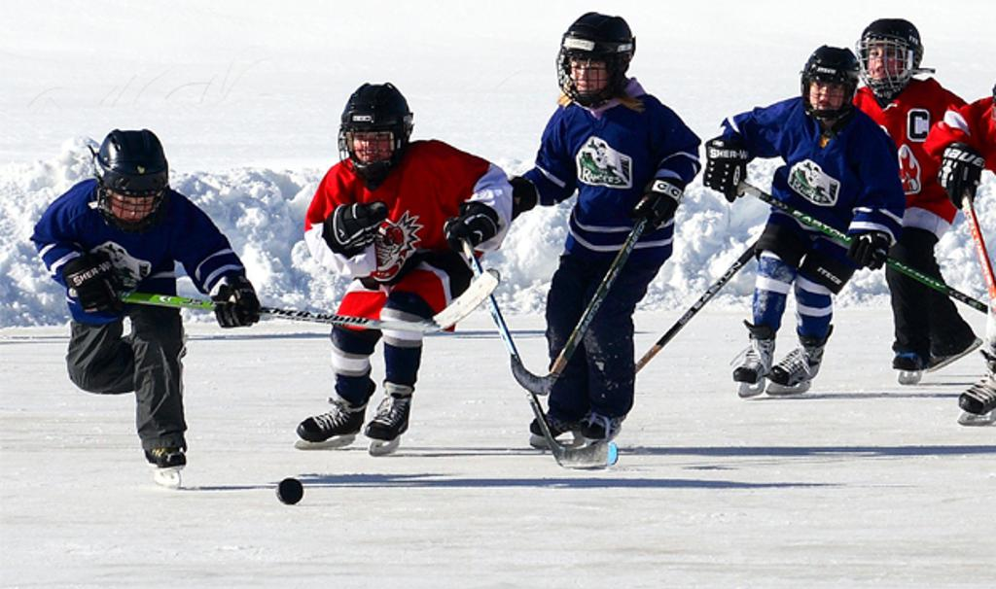
Always Remember What
FUN Looks like to ALL ages
FUN = Playing the Game!

Slide 53

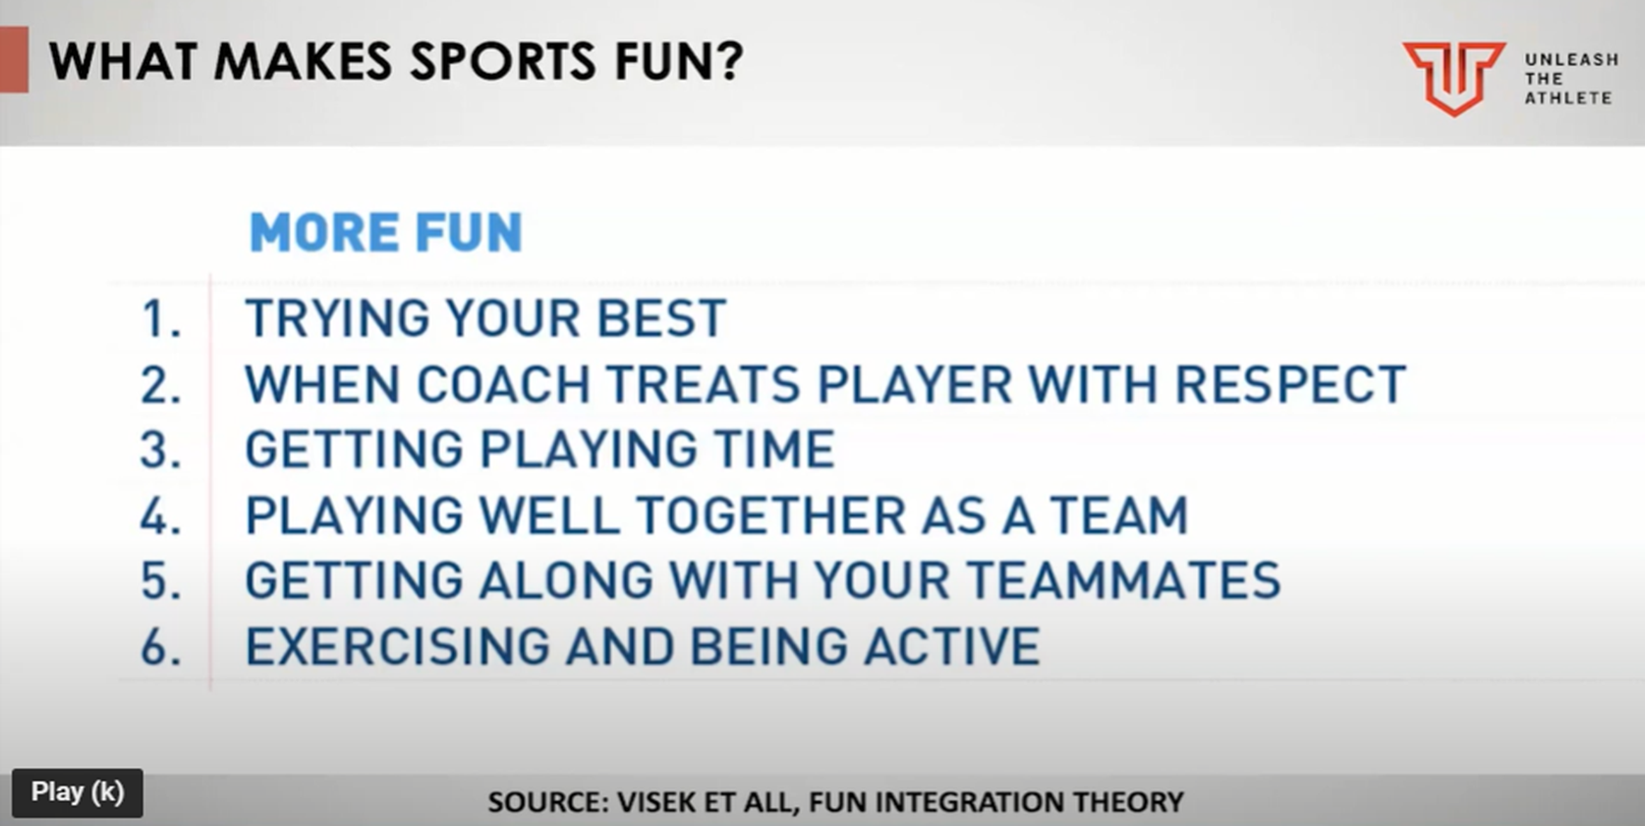

FUN HOW DO KIDS DEFINE “FUN”?

Slide 54
Designing Practices that have game situations means better skill acquisition & game results.
Use players not cones
Ensure there are decisions in every situation
Let the kids figure it out
Use constraints – change size of area, use scoring to incentivize behaviors, add players
Start players facing away from the play and dump the puck in – must find the puck (game-like), race for it (game-like), and battle for it (game-like)
Add players, create chaos, make it unfair, unpredictable, make sure there are cues coming from environment
“What did you see?”

Slide 55
SMALL GAMES ”Slice of the game” with a purpose
What’s the goal?
15 kids? 4v4 mean 8 playing and 8 waiting – 1:1 work to rest ratio (good)
1 goalie – have 2 nets and when team gains possession they need to go behind the empty net and come back out
DON’T put 2 lines in the corners and have them go 1-2 at a time

Slide 56
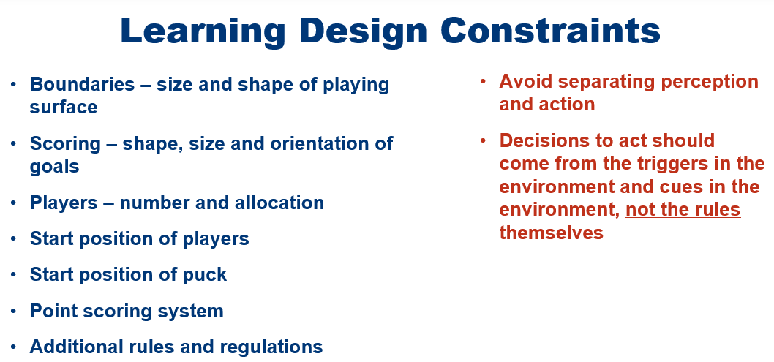

Slide 57
On-Ice Adjustments to enhance learning
Make space smaller or bigger
Add players
Add decision points
Opposition & pressure
Change net location
Start players in different locations
All the players doing something at the same time vs taking turns

Slide 58
Some examples: Activities (drills)

Slide 59
Keep asking yourself…
“What is the activity asking
of the players?”
Does this happen in a game?
Are decisions required?
Is it fun and engaging?
Are we maximizing random repetitions for each player?
Are there players standing around?
Is there some struggling?
Don’t forget
your goalies!

Slide 60
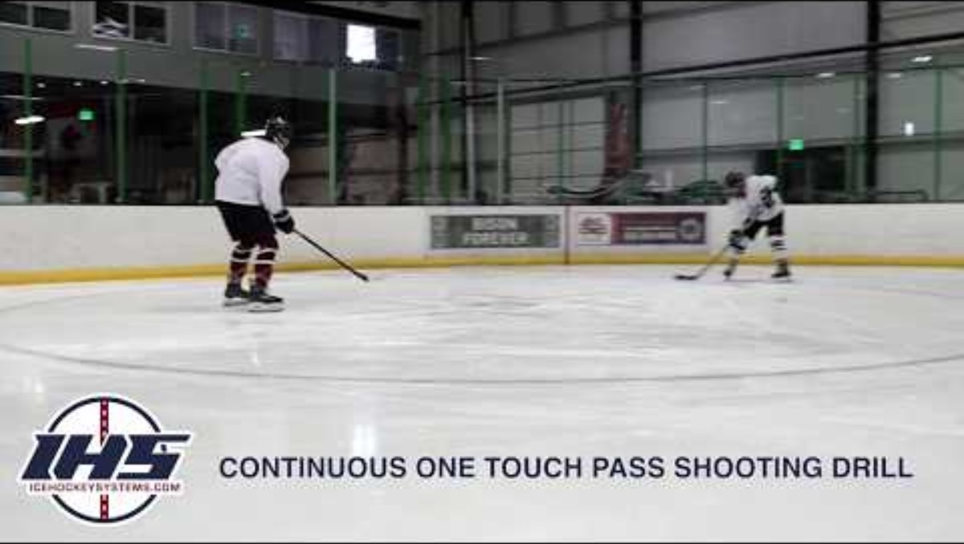
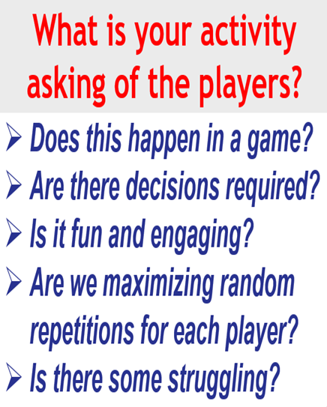
Decision-Making & Looks Like The Game:
HOW COULD WE ADD DECISIONS & MAKE MORE GAME-LIKE WHILE DEVELOPING ONE-TOUCH PASSING SKILLS?

Slide 61
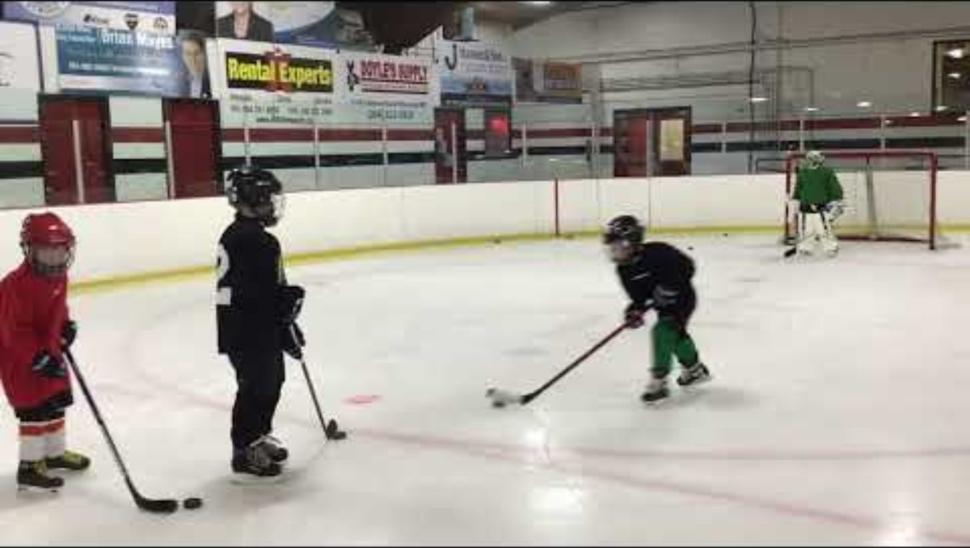
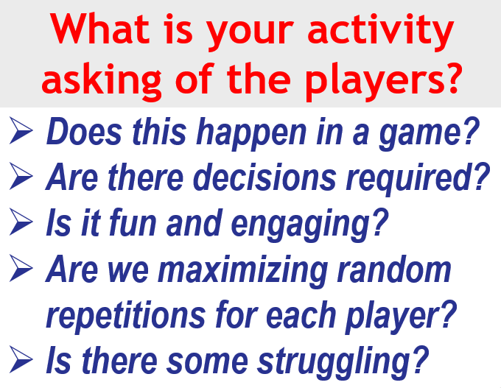

Slide 62
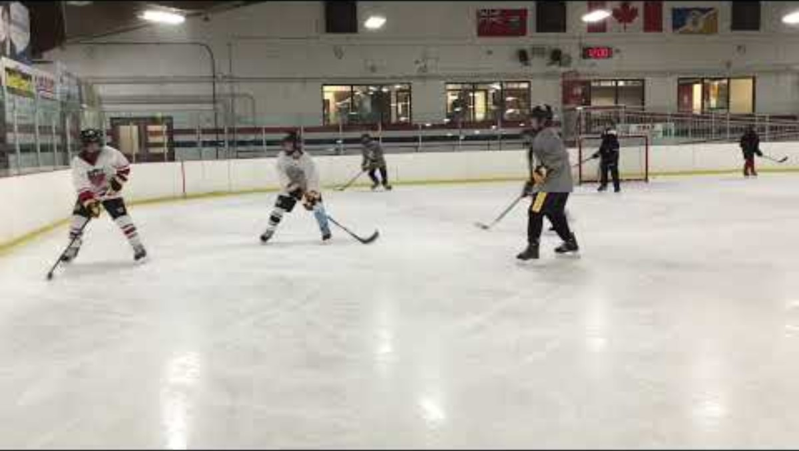


Slide 63
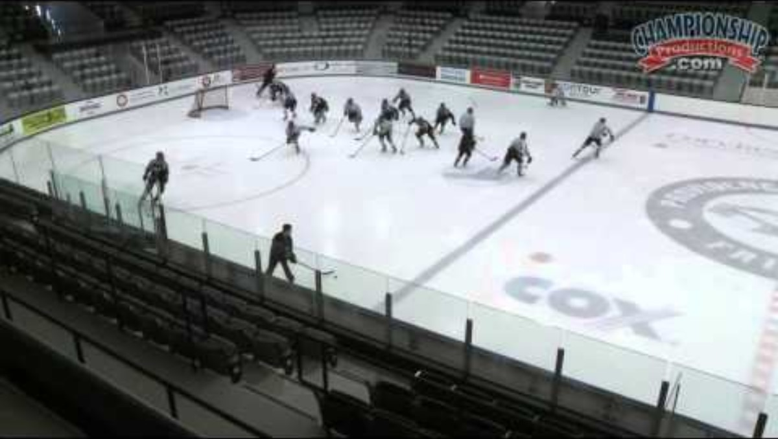

Slide 64
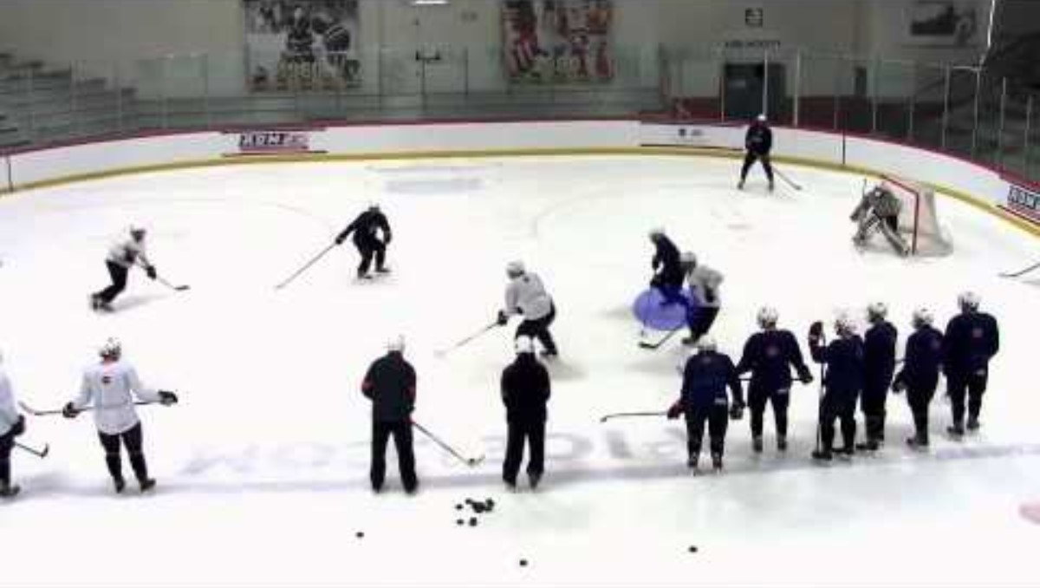
Small game 3v3 – breakouts, regroup

Slide 65
Don’t Forget the Goalies!

Slide 66
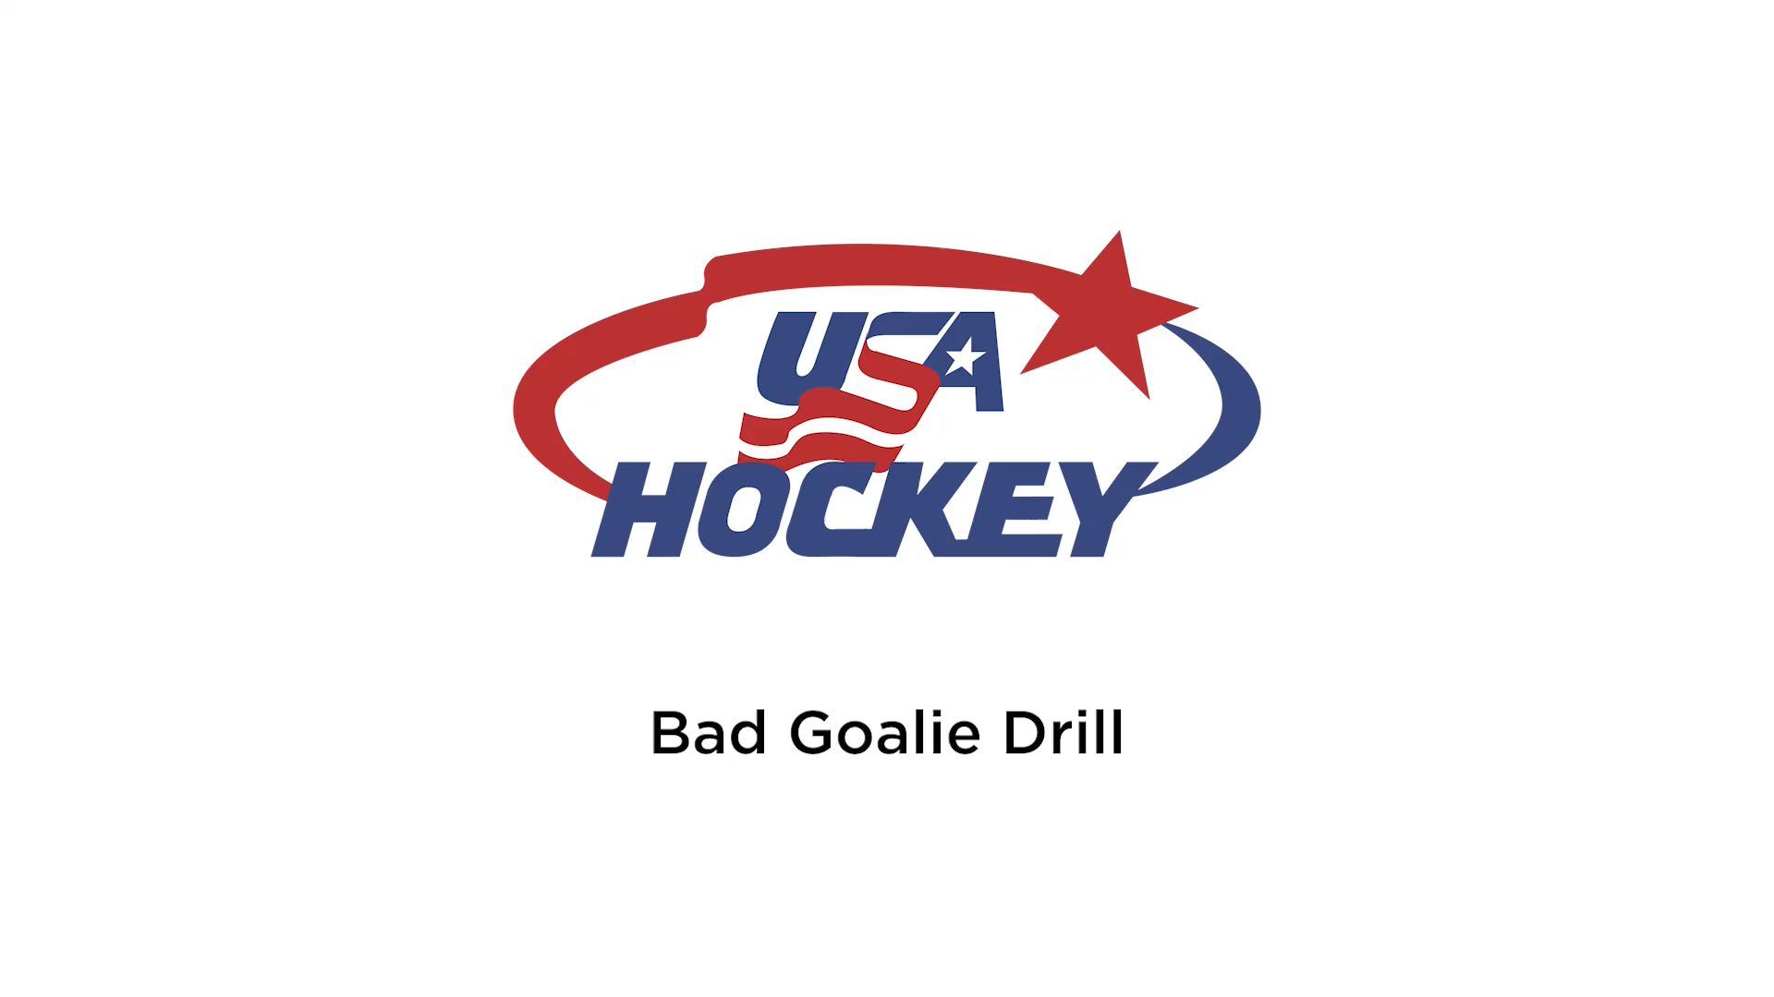

Slide 67
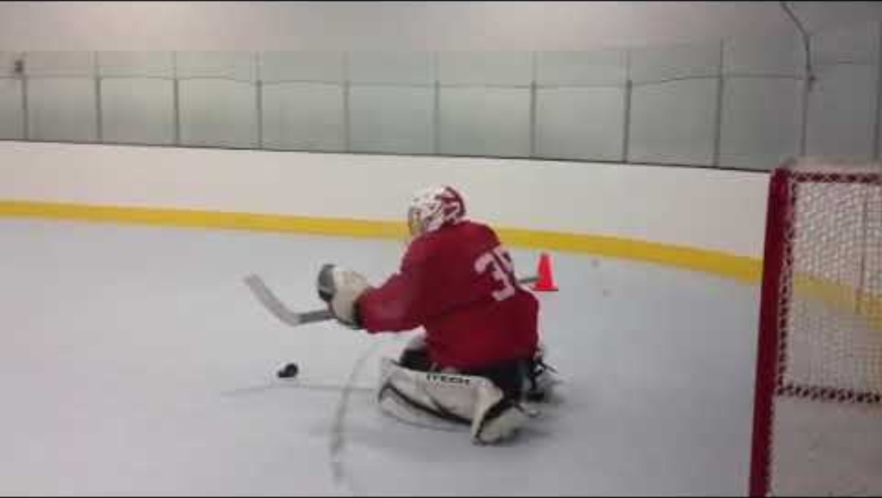

Slide 68
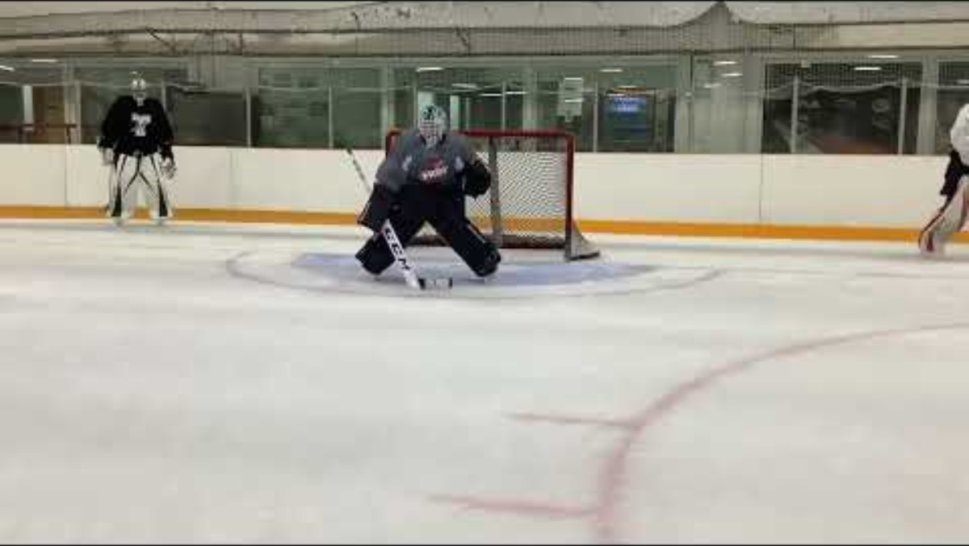

Slide 69
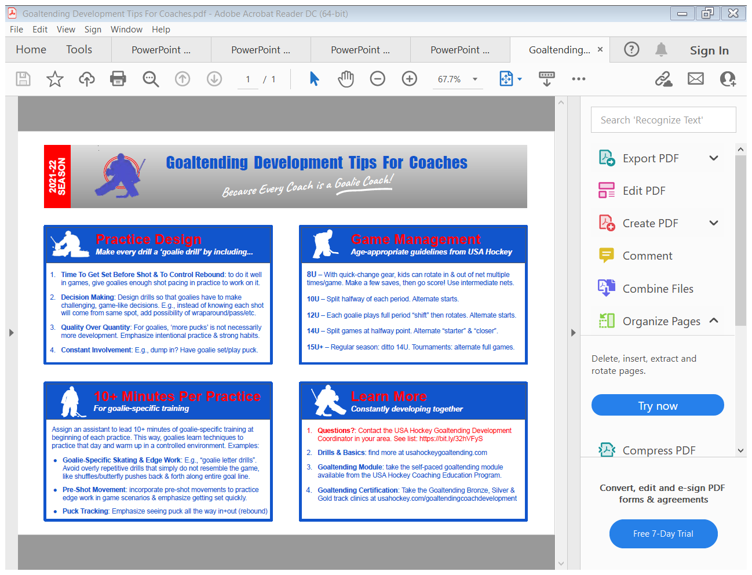
Don’t Forget Your Goalies!

Slide 70
Key Takeaways
Trust that a new emphasis on setting up a learning environment will make you a better coach and add to your toolbox
Do the right thing at the right time
Skills are learned quicker and “stick” with game context
Environment (cues, reads) is the first teacher
5 Elements: fun, add decisions (cues), chaos, challenge, game-like
Look for lines, players standing around, no fun, bored, not going hard, experiment, change
Find opportunities for all the players doing something at the same time vs taking turns

Slide 71
RESOURCES
LTAD by Age Group
Tips for “stickier” Learning
USA Hockey Coaching Webinar Series
E-Learning USAH
Practice Plan & Drill Libraries
Brad Hoffman: Brad.Hoffman@carolinahockey.org

Slide 72
RESOURCES
https://www.carolinahockey.org/coachingcorner

Slide 73
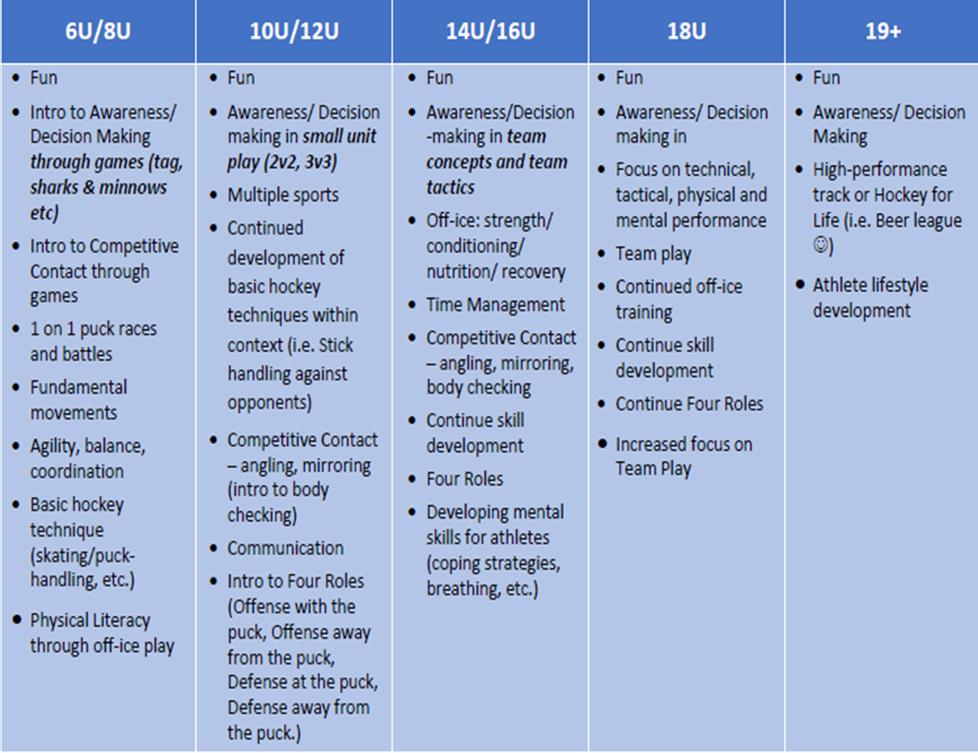
The Right Thing at the Right Time

Slide 74
Tips for “Stickier” Learning
What game problem do you want them to solve?
Does this happen in a game? 2-0 occurs 1 time/game
Cones don’t defend - use players & small games
Ensure there are decisions in every situation
Let the kids figure it out – let them play, ask “what did you see?”
Use constraints to create multiple game-like situations – small games to force specific decisions, change size of area, scoring system, add players, rules

Slide 75
Tips for “Stickier” Learning
Start players facing away from the play and dump the puck in – must find the puck (game-like), race for it (game-like), and battle for it (game-like)
make sure cues come from the environment - add players, create chaos, make it unfair, problems to solve, unpredictable
Recall – structure practices so that players must recall what they learned previously (earlier in the practice or in a previous practice)

Slide 76
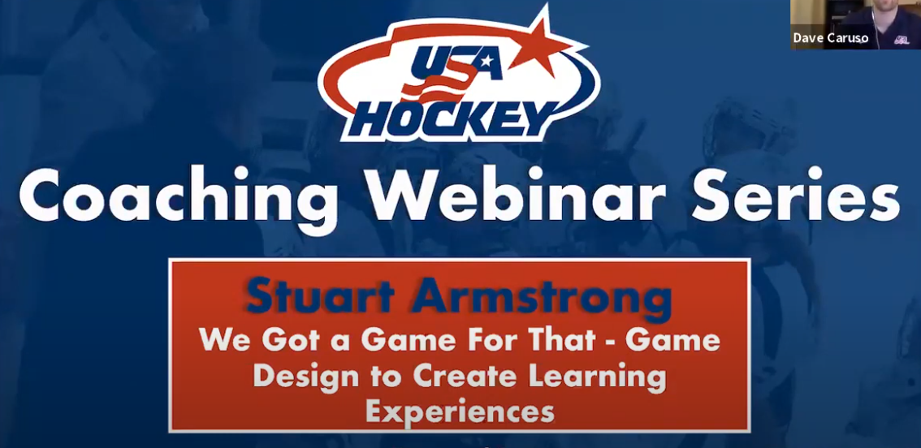
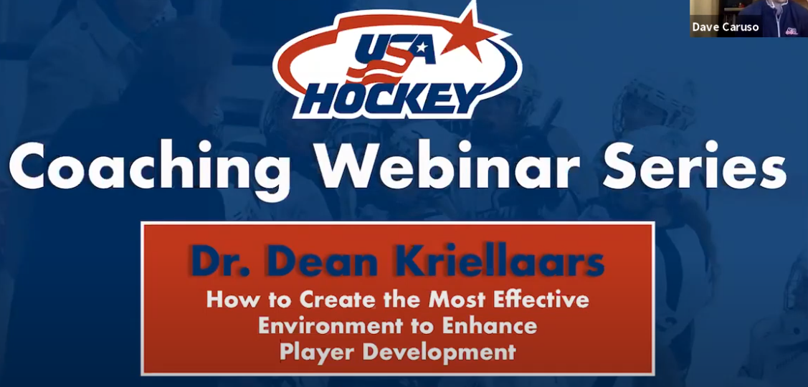
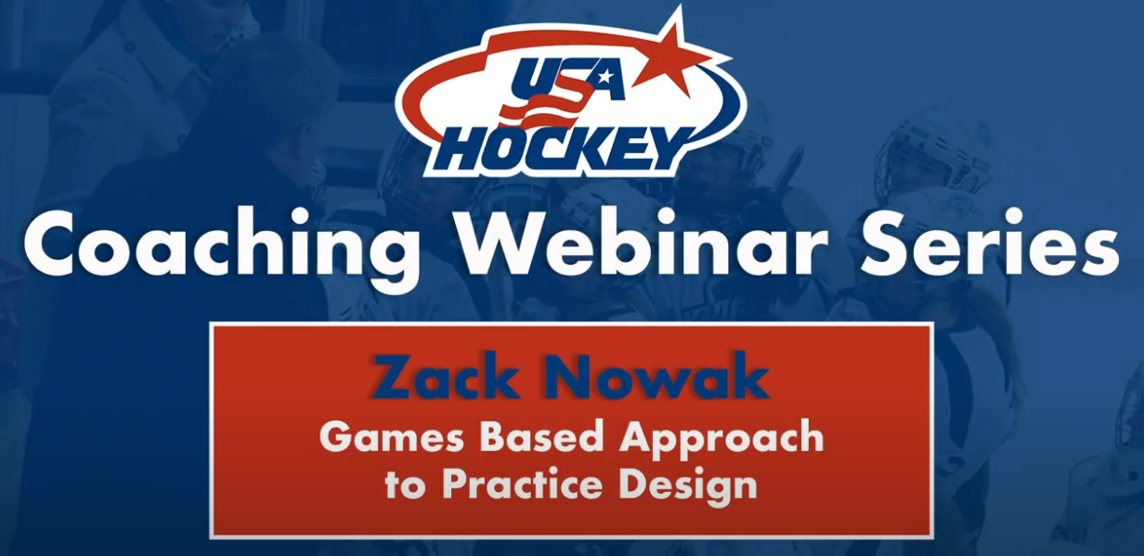
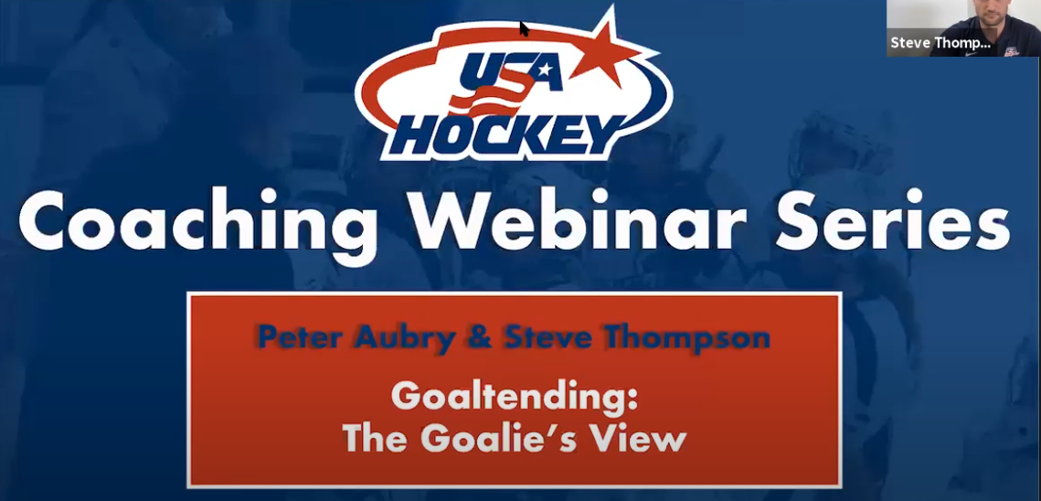

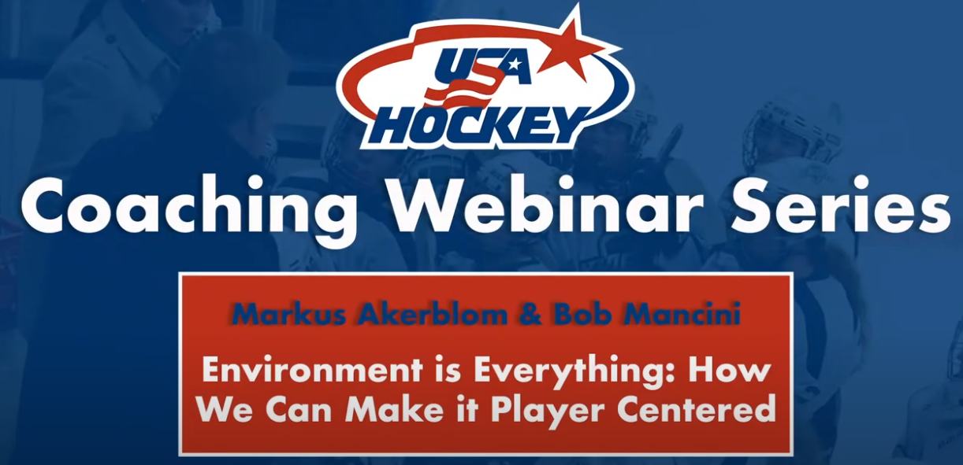
Coaching Webinar Series

Slide 77
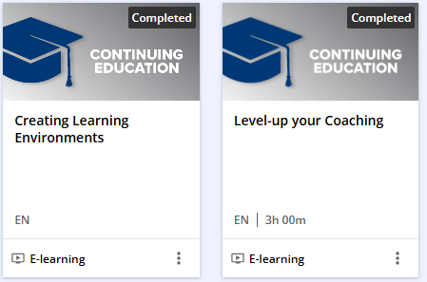
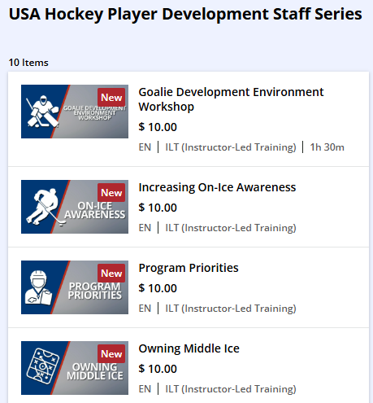
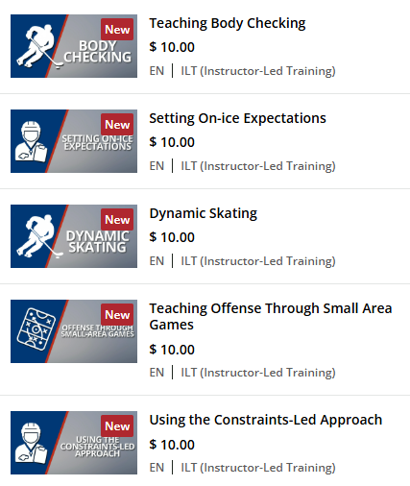
E-Learning
https://lms.usahockeylearningcenter.com/

Slide 78
RESOURCES – practice plans, small games, ideas, how to coach
https://www.carolinahockey.org/coachingcorner
https://www.youtube.com/@usahockey
https://www.usahockey.com/smallareagames
www.positivecoach.org
www.usahockey.org
https://www.usahockey.com/smallareagames
https://www.youtube.com/usahockey
https://www.usahockey.com/learningcenter
CALL, TEXT, EMAIL me
704-497-5641, BDHATHPG@aol.com

Slide 79
LTAD: Specific Ages

Slide 80
8U Hockey – Fundamentals Build the Foundation
Fun/Activity/Movement/Play
Introduction to athleticism and suppleness
Introduction to the ABCs
(Agility, Balance, Coordination, Speed)
Speed/quickness window
Simple Small Area Games for concepts
Body Contact
Cross ice competition – Competing is not necessarily playing to win a game
Play to learn!
Notes:
ABCs: Agility, Balance, Coordination, Speed/Suppleness

Slide 81
10U/12U—Learning to Train
FUN!
Golden age of Skill Development
Small Area Games with a purpose
Body Contact
Begin decision-making skills
Becoming aware – develop spatial awareness
Notes:
Key Coaching Points—10U/12U
Quality skill demonstrations create proper mental picture
Under-speed training
High volume of reps at reduced intensity increase success
Teach
Encourage fun!

Slide 82
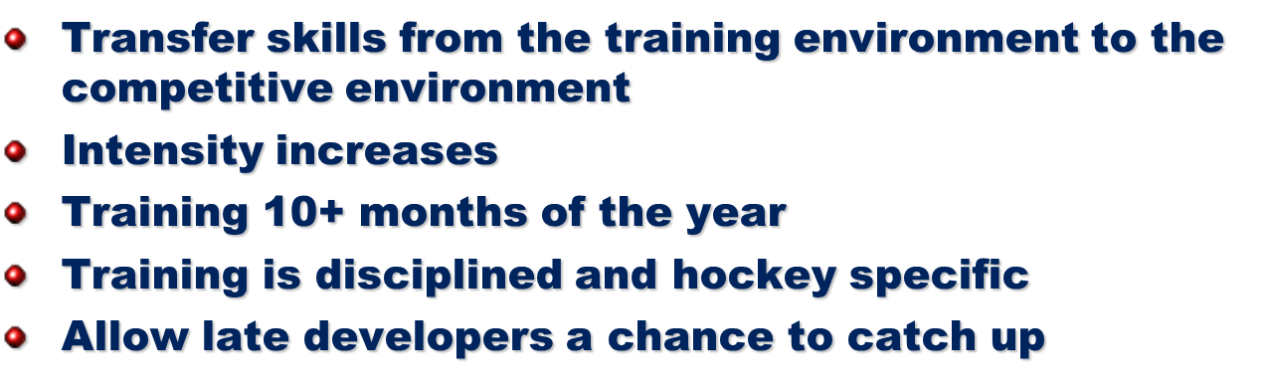
14U/16U Training to Train
FUN!
Build aerobic and strength bases
Further develop hockey skills
Increase competitiveness through the use of Small Area Games
Start to Specialize
16U/18U Learn to Compete
Notes:
14U/16U Key Coaching Points
Emphasize small area games & competitive drills
Continue to teach body checking
On-ice
Dry land training
Don’t abandon station-based practices
Create progressions
Emphasize smart skills
Over speed skills
Under speed skills
Don’t waste time on conditioning alone
Practice should still be fun
Points

